Slide 1
Notes:
First, I like to thank the organizers, in particular Hong-Joo Kim, and the International Advisory Committee for inviting me to deliver this opening lecture for this conference. I feel honored. On Thursday before the banquet we have a brainstorming on the future of scintillation research, and I felt that in order to discuss about the future one should know about the past. This explains the title of my presentation The history of scintillation discovery and the challenges that lie ahead. I will also go into the history of our community.

Slide 2
Outline
History of scintillator discovery
  Tl activated scintillators
  BGO, BaF₂, LSO, garnets
  Ce³⁺ activated scintillators
Enablers and drivers of discovery and development
  Technological enablers
    PMT, PD, Si-PM
    Availability of purified rare earths
  User demands (HEP, medical diagnostics, safeguarding)
  Fundamental knowledge, new theory, curiosity
Challenges that lie ahead
Notes:
What I want to do is to walk you through the history of scintillator discovery. When was what invented and why? What were the drivers of a discovery.
Along my presentation I will show pictures of key players in scintillation research. Many are still around here at this conference. I will show photo’s at an age when they made their discovery or when they provided their important contribution. You may reckognize yourself or your colleague

Slide 3
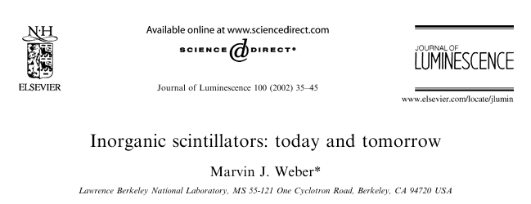
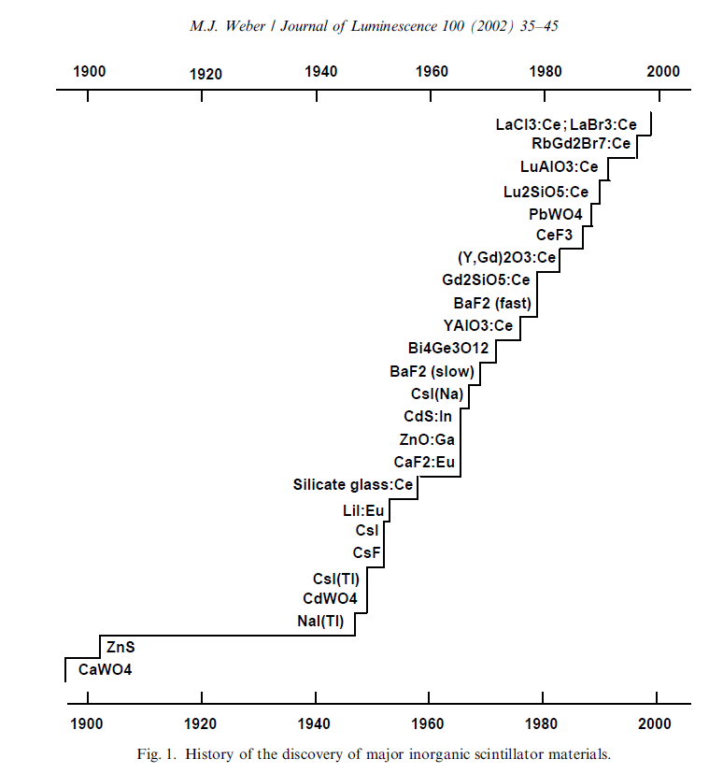
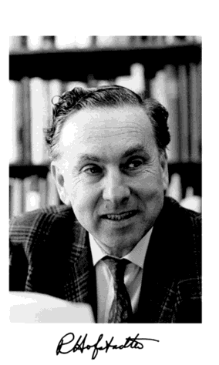
Discovery of NaI:Tl in 1948
Notes:
Weber distinguished 3 phases in scintillator discovery. 1) visual scintillation counting discovery of radioactivity, X-rays, alpha particles. 2) after invention/availability of the PMT 1946-1980. During this phase BGO was discovered

Slide 4
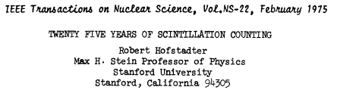
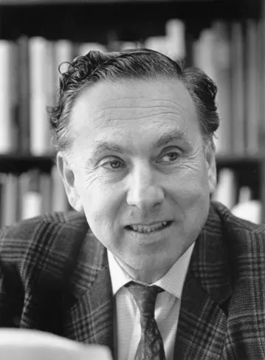
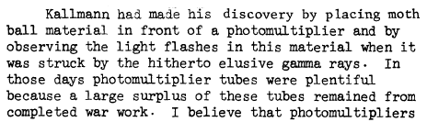
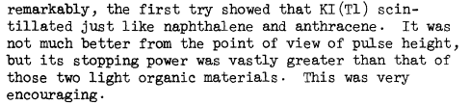
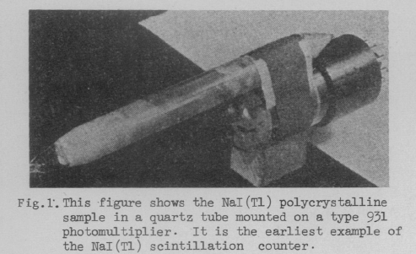

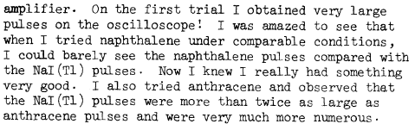
NaI:Tl and CsI:Tl

Slide 5

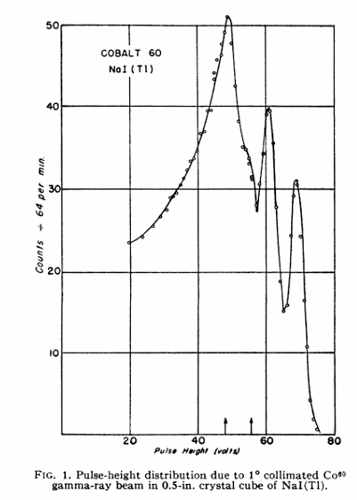
First pulse height spectrum in 1950
Enabler: availability of PMTs after WWII
Driver: the need to detect the elusive gamma rays
Notes:
Weber distinguished 3 phases in scintillator discovery. 1) visual scintillation counting discovery of radioactivity, X-rays, alpha particles. 2) after invention/availability of the PMT 1946-1980. During this phase BGO was discovered

Slide 6
Discovery of Y₃Al₅O₁₂:Ce by G. Blasse in 1967
Enabler: chemical purification of the rare earths in the 1960ties
Notes:
YAG;Ce represents an entire class of materials. The garnets. Many variants are important as scintillator.

Slide 7
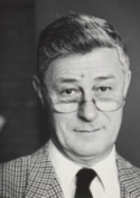
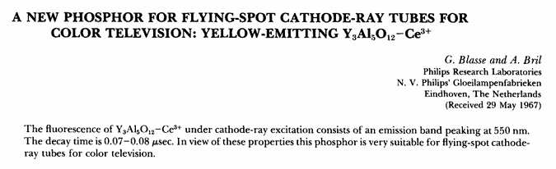
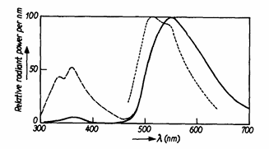

patented by company Philips in 1974 as phosphor for tube lighting
Knowledge from inspiring scientists in phosphor research as an enabler and driver of scintillator development
Notes:
In 1967 Blasse still a young scientist. 20 years later when I entered the field he inspired me a lot. I collected all his published papers.

Slide 8
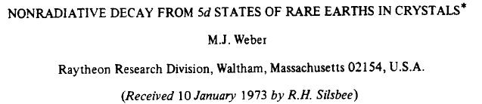
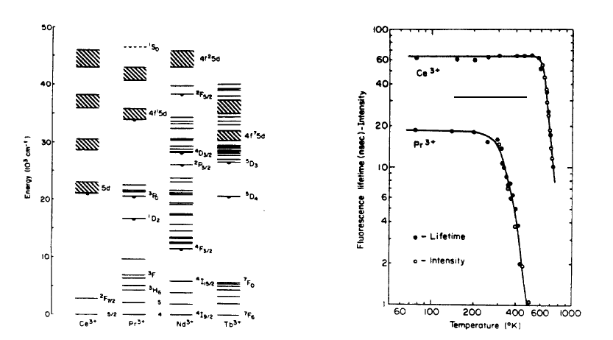
Y₃Al₅O₁₂

Slide 9
Discovery of Bi₄Ge₃O₁₂ (BGO) 1973-1975
Notes:
Weber distinguished 3 phases in scintillator discovery. 1) visual scintillation counting discovery of radioactivity, X-rays, alpha particles. 2) after invention/availability of the PMT 1946-1980. During this phase BGO was discovered

Slide 10
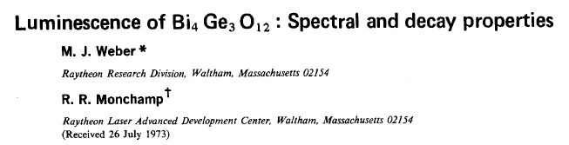
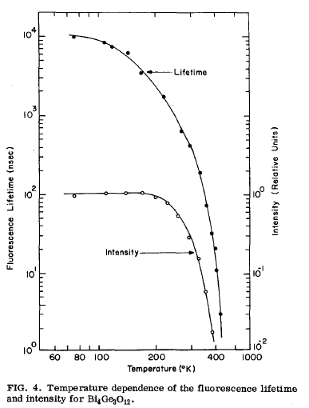
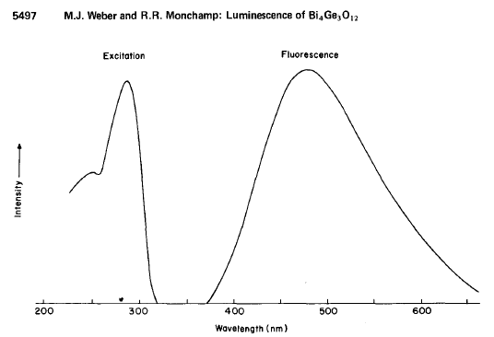

Notes:
Weber realized the potential as scintillator

Slide 11
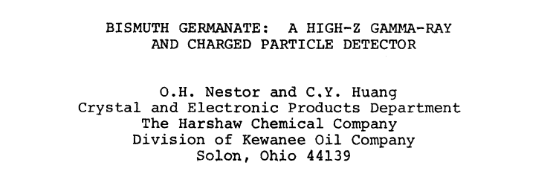
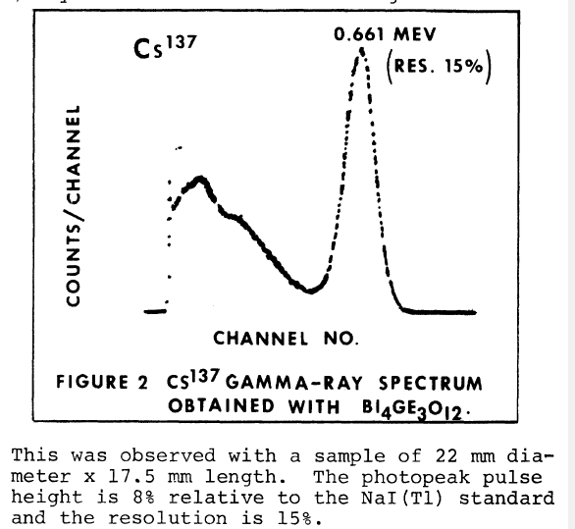
The pulse height spectrum is the birth certificate of a new scintillator

Slide 12
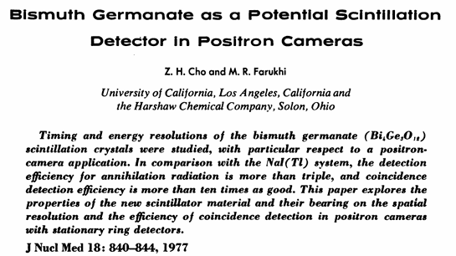
Medical diagnostics and high energy physics were the drivers for the further development of BGO
BGO became standard scintillator for most commercial PET scanners in 1980s-1990s
User demands (medical diagnostics) as a driver of scintillator development
Notes:
Cho and Farukhi realized potential application
Discovery is one thing, development is another

Slide 13
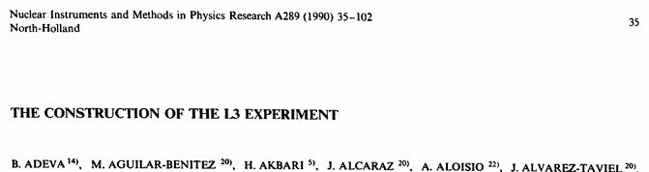

User demands (HEP) as a driver of scintillator development
BGO calorimeter for L3 at CERN 1989 using 12 tons of BGO (SIC)
CsI calorimeter for CLEOII detector at Cornell University 1989
Notes:
BGO became also the crystal of choice for the L3 experiment at CERN

Slide 14
Discovery of the fast component in BaF₂ (1982)
First the slow component and couple of years later the fast component

Slide 15
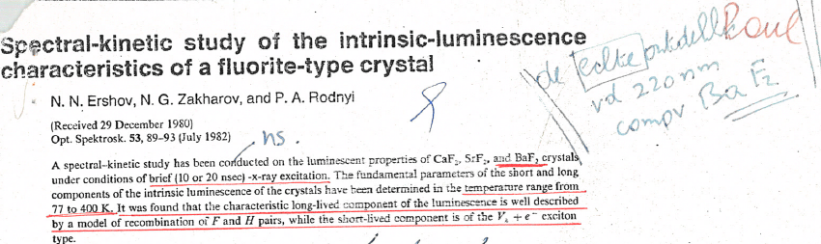
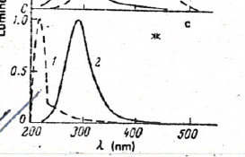
Discovery fast component in BaF₂ in 1982
BaF₂ - fast UV luminescence
First observation of fast 220nm component (decay time <10ns)
Residual impurities were suggested to be responsible
Notes:
The fast component is at 220nm in the UV and you need UV sensitive PMTs hence it later discovery then the slow component

Slide 16
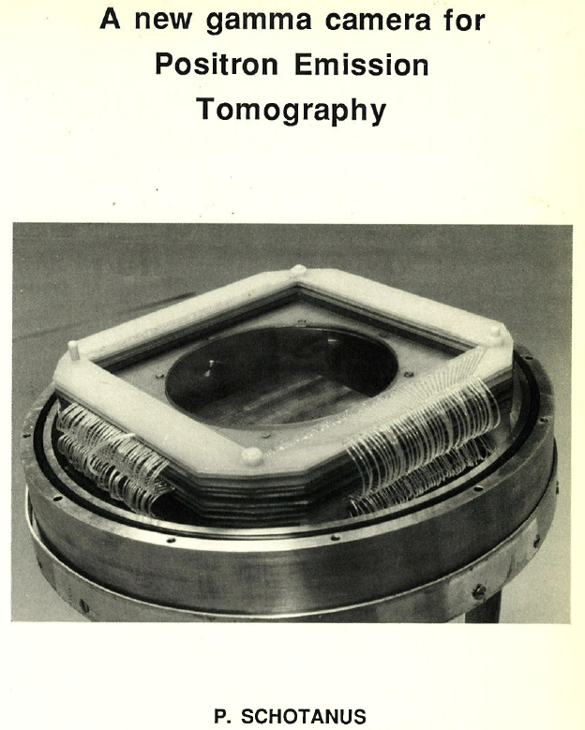
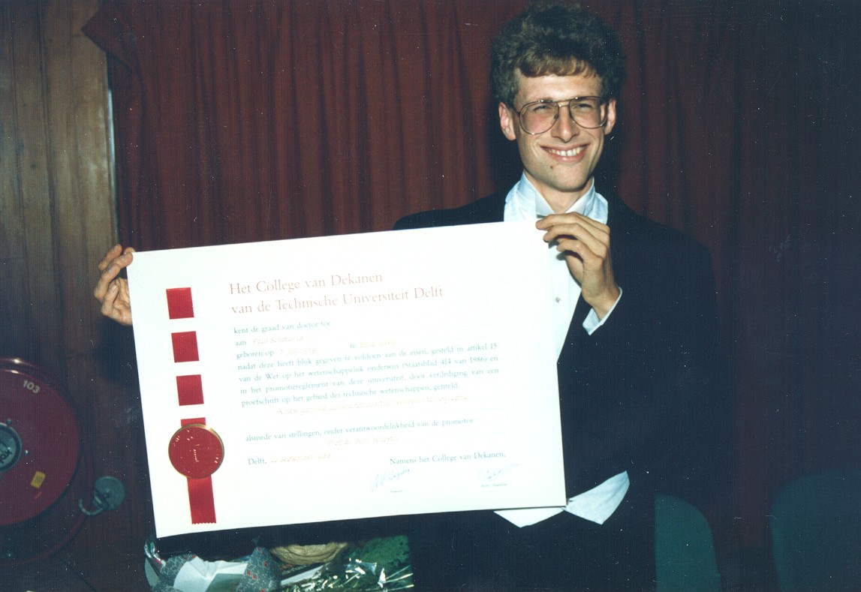
Medical imaging as driver of BaF₂ development
High energy Physics as driver of BaF₂ development
BaF₂ for the detector system TAPS
Notes:
At this time, I entered as a young scientist in the field of scintillation research in the group of Carel van Eijk. Paul Schotanus was stil around as a postdoc and taught me the tricks of scintillators characterization.
Now CEO of his company Scionix in The Netherlands

Slide 17
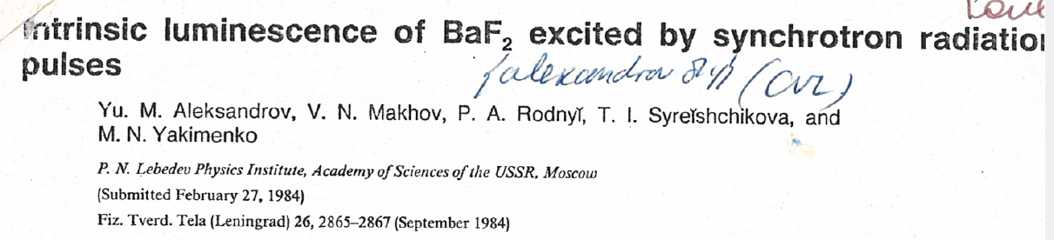
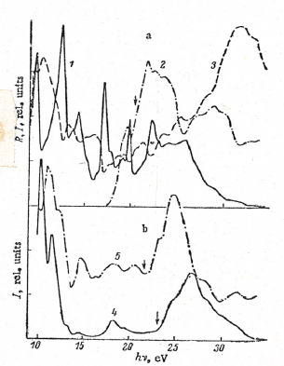
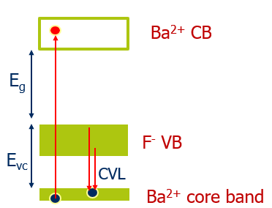
Explanation fast component in BaF₂ in 1984
Excitation onset at 18 eV
Evidence of core-valence emission
Decay time <7ns
Notes:
The fast component is at 220nm in the UV and you need UV sensitive PMTs hence it later discovery then the slow component

Slide 18
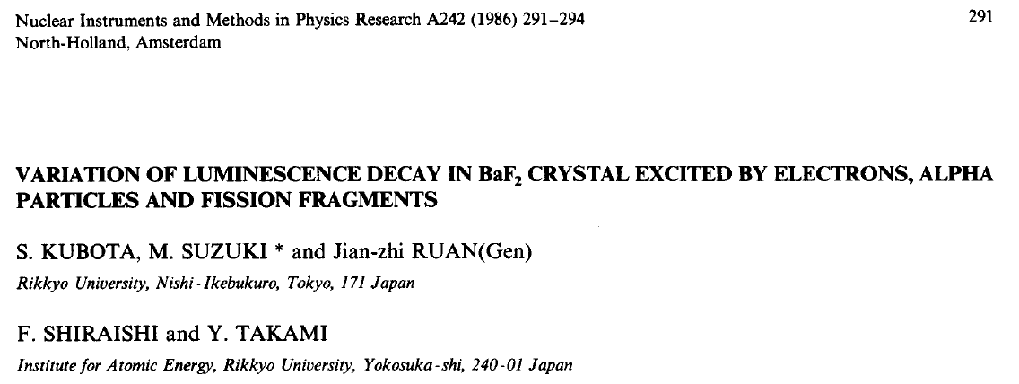
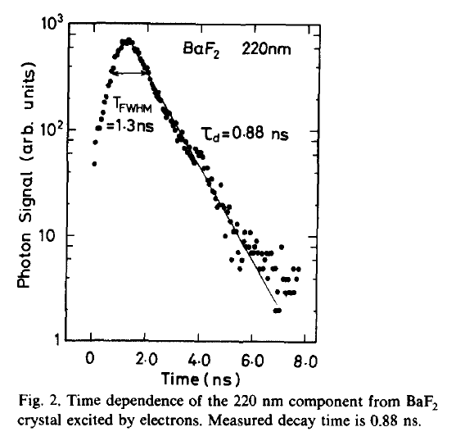
Measuring fast component in BaF₂ (1986)
BaF₂ - fast UV luminescence
Notes:
Verify if this is indeed Kubota

Slide 19
The Ce³⁺ doped scintillators
Speed is important
Ce³⁺ 5d-4f emission is fast (17-60 ns)
Notes:
Weber distinguished 3 phases in scintillator discovery. 1) visual scintillation counting discovery of radioactivity, X-rays, alpha particles. 2) after invention/availability of the PMT 1946-1980. During this phase BGO was discovered

Slide 20
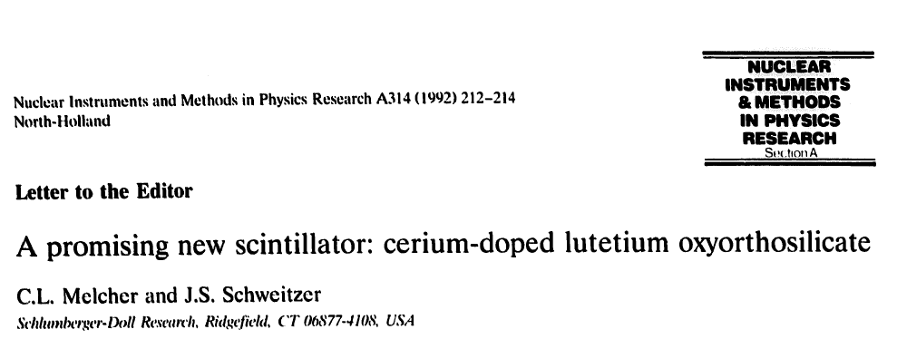
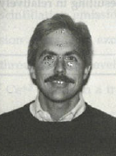
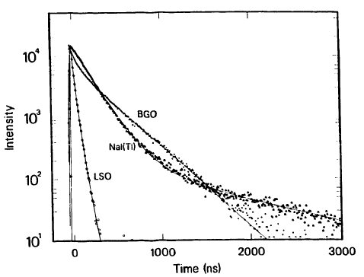
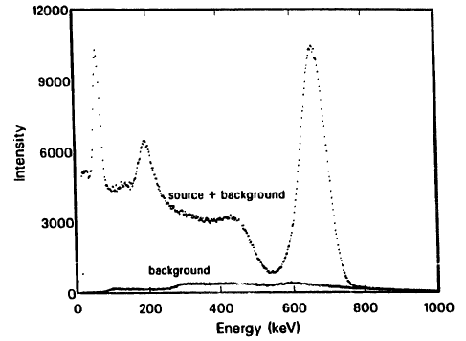
The discovery of Lu₂SiO₅:Ce³⁺ in 1992
Oil-well logging as driver for LSO discovery and development
Notes:
Yiu see that LSO is much faster than NaI:Tl and BGO. Eventually it replaced BGO in PET-scanners.

Slide 21
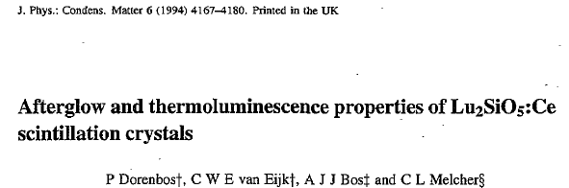
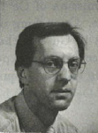
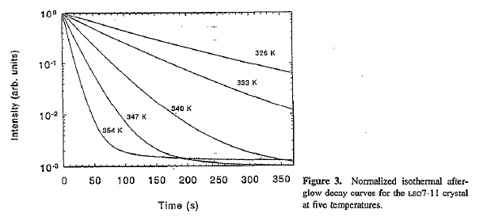
Strong afterglow with more than 1 hour 1/e decay time at room temperature
Notes:
I will come back on the afterglow problem later

Slide 22
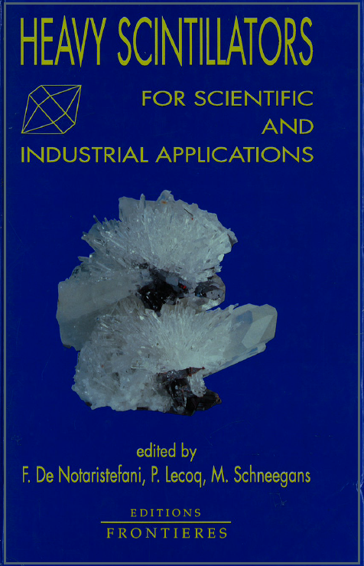
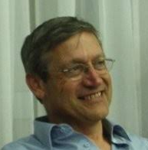
Crystal2000 Chamonix, France, September 22-26, 1992
The SCINT conference series as drivers of scintillating material discovery
Paul Lecoq
PbWO₄ calorimeter for CMS at CERN
Notes:
In the meantime the first scintillator conference was organized by Paul Lecoq, the founding father of this conference series that bring us here together today.

Slide 23
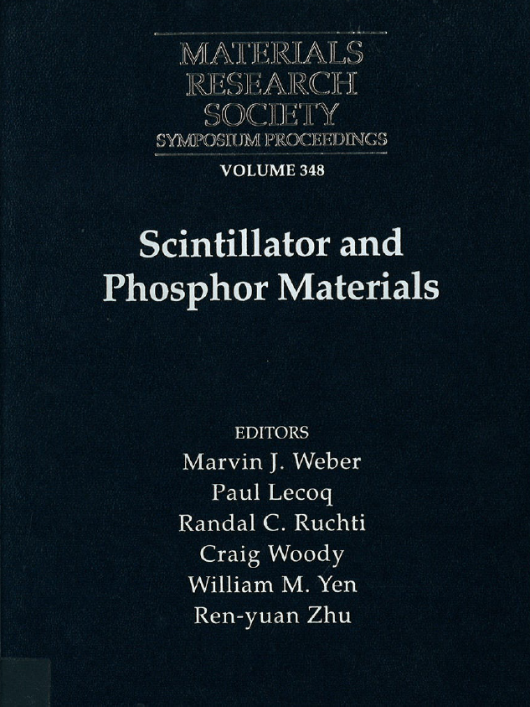
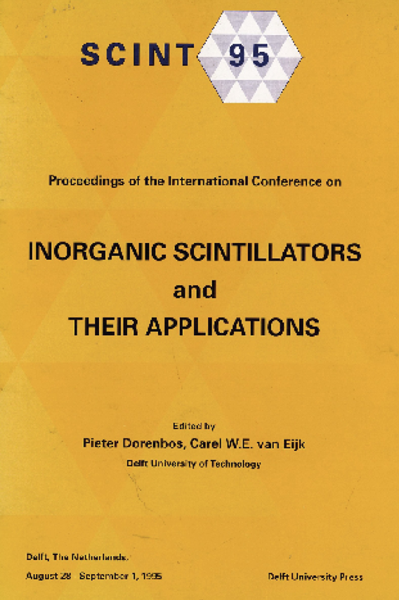
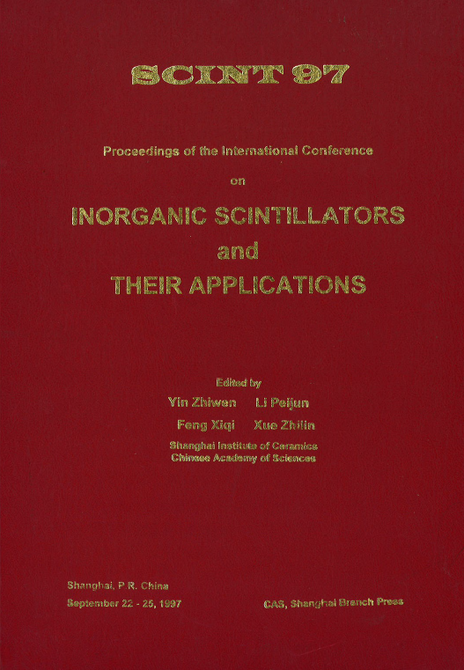
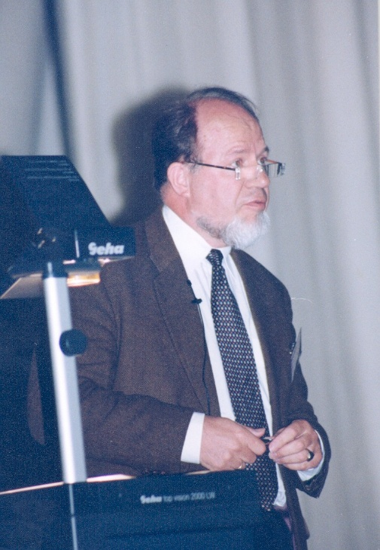
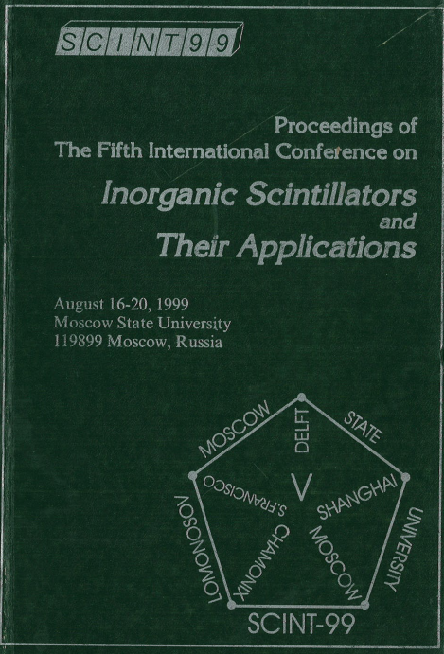
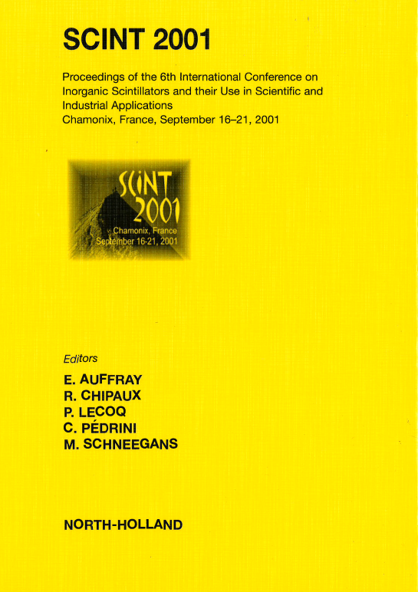
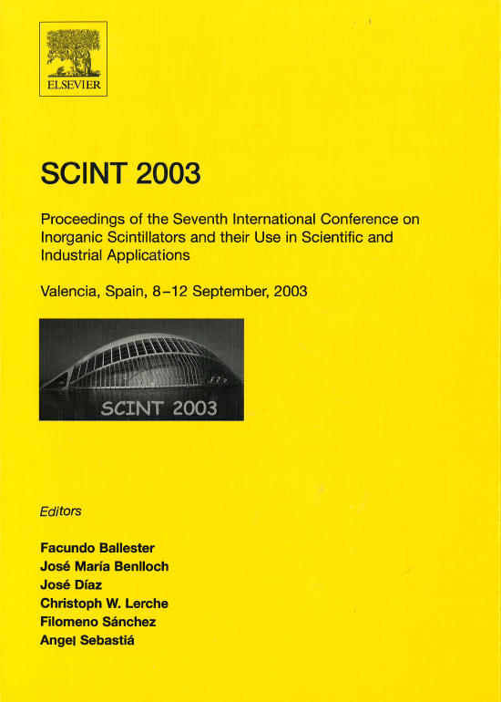
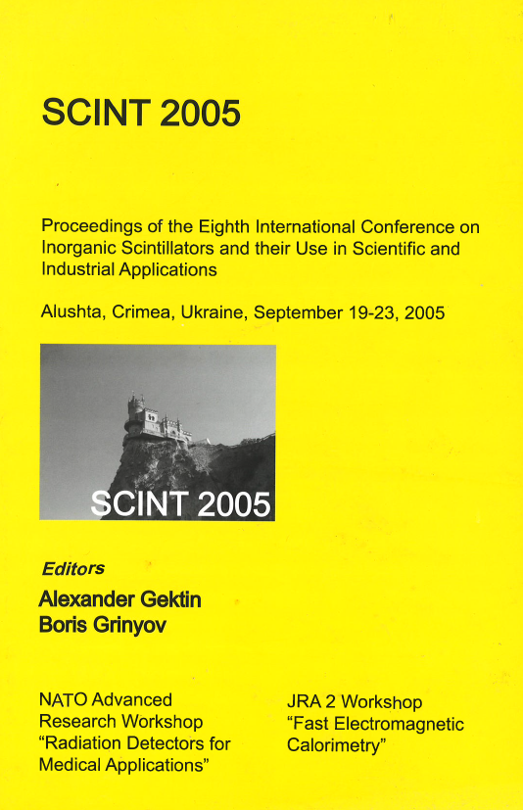
1992
1994
1995

Slide 24
Scintillator studies/development at TU-Delft 1988-2005
Lu₂SiO₅:Ce (LSO)
K₂LaCl₅:Ce (first Ce doped halide)
Cs₂LiYCl₆:Ce (CLYC neutron scintillator)
LuCl₃:Ce
LuBr₃:Ce
LaCl₃:Ce³⁺
LaBr₃:Ce³⁺
Notes:
LSO:Ce was already mentioned. We performed studies in collaboration with Charles Melcher.
Initially we started with BaF2 (together with Paul Schotanus). Suppression of slow component with la doping
Pr and Nd doping LuAG:Pr
Collaboration with Bern University and Saint-Gobain Research

Slide 25
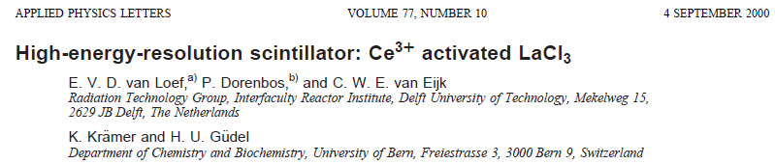
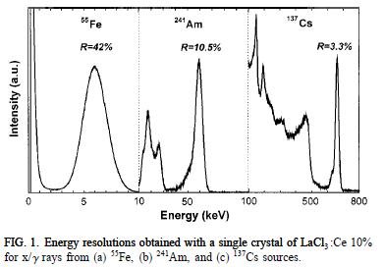

The discovery of LaCl₃:Ce³⁺ in 2000
Now we knew we really had something very good!

Slide 26



The discovery of LaBr₃:Ce³⁺ in 2001
Now we knew we really had something even better!

Slide 27



Slide 28





Karl Krämer, expert halide crystal grower, was an enabler of scintillator discovery in Delft

Slide 29

Notes:
9-11 terrorist attack on twin towers became a driver scintillator discovery (in US). Ceramic Gd3Al3ga2O12:Ce and Cs2LiLaBr6:Ce are commercially available, but for the rest no new discoveries that led to a successful commercial product.

Slide 30


Notes:
We see that co-doping is a rising research trend

Slide 31


How engineering and co-doping is driving scintillator development
Lu₂SiO₅:Ce³⁺ invented by Melcher and Schweitzer in 1992
(Lu,Y)₂SiO₅:Ce³⁺ improvement patented by Bruce Chai et al. 2003
High melting point 2700C lowered by 100C due to Y
→economic issue, i.e., cost reduction, as a driver of innovation
Afterglow problem (not solved by Y-co-doping/solid-solution)
Notes:
Bruce Chai generous sponsor of the Banquet of Scint conferences
President of Crystal Photonics

Slide 32
oxygen vacancy electron traps
Notes:
I will come back on the afterglow problem later

Slide 33



Improving LSO:Ce by means Ca²⁺ of co-doping
First patented in 2005
1%Ca
0.5%Ca
Notes:
The initial idea was that electron trapping in oxygen vacancies was responsible for the afterglow. The idea was by means of c-doping to alter oxygen defect structure.

Slide 34


In the luminescence phosphors field, it was always believed that Ce⁴⁺ kills the Ce³⁺ emission
Ce³⁺ 4f-5d absorption bands

Slide 35
VRBE scheme
Ce³⁺ + hole → Ce⁴⁺
Ce⁴⁺ + electron→(Ce³⁺)*→scintillation photon
Ce⁴⁺ + electron→(Ce³⁺)*→scintillation photon
Ce³⁺ + hole →Ce⁴⁺
Strong afterglow reduction
Increase of light yield
Shorter rise time
  Better timing

Slide 36
VRBE scheme
Ce³⁺ + hole → Ce⁴⁺
Ce⁴⁺ + electron→(Ce³⁺)*→scintillation photon
Ce⁴⁺ + electron→(Ce³⁺)*→scintillation photon
Ce³⁺ + hole →Ce⁴⁺
Strong afterglow reduction
Increase of light yield
Shorter rise time
  Better timing

Slide 37
VRBE scheme
Ce³⁺ + hole → Ce⁴⁺
Ce⁴⁺ + electron→(Ce³⁺)*→scintillation photon
Ce⁴⁺ + electron→(Ce³⁺)*→scintillation photon
Ce³⁺ + hole →Ce⁴⁺
Strong afterglow reduction
Increase of light yield
Shorter rise time
  Better timing

Slide 38




Mg²⁺ co-doping→30% higher light yield and less slow component
Notes:
Shanghai Institute of Ceramics in collaboration with Martin Nikl

Slide 39

Engineering of the garnet phosphors and scintillators
P. Dorenbos
The color of 5d-4f emission can be tuned→LED-phosphor
Temperature of thermal quenching can be optimized
Density by admixing Lu or Gd can be optimized
Optimization by co-dopants (like Mg²⁺)

Slide 40

Scintillator non-proportional response to energetic electrons
NaI:Tl. LSO:Ce
Strongly
Non-proportional
Cherepy et al. IEEE Trans. Nucl. Sci. 56(3) (2009) 873
LaBr₃:Ce
LaCl₃:Ce
YAlO₃:Ce
proportional
Notes:
The light yield of a scintillator is expressed in photons/MeV. Ideally that number should be independent on the gamma ray energy. In that case we speak of a perfect proportional response. In the figure above the light yield is normalized to unity at 500 keV. For the ideal response one expects a constant. In reality, the response depends on the energy of the electron that creates the ionization track. LSO (Lu2SiO5) and NaI:Tl have a strong non-proportionality. LaBr3:Ce shgow must more constant response.

Slide 41




Non-proportionality is not a given property
Notes:
Non-proportionality is not an unchangeable property of scintillators. It depends on concentration and on temperature.

Slide 42

LaBr₃:Ce³⁺;50ppm Sr²⁺
Synchrotron X-ray energy
50 ppm of Sr²⁺ improves performance dramatically

Slide 43
Challenges that lie ahead
It seems (to me) that traditional new scintillator discovery does not lead easily to new commercial products. It is hard to beat the existing products, and the traditional research fields have been largely explored.
By means of co-doping and/or engineering strategies, properties can still be improved
  Improving crystal growth properties LYSO
  Engineering the proportionality LaBr3:Ce 50ppm Sr2+
  Shortening the rise time LYSO:Ce;Ca
  Improving thermal stability
What I learned is that 0.1 eV change in electronic level locations (valence band, conduction band, luminescence center), may alter performance dramatically
Notes:
Perhaps a theme at the brainstorming session of Thursday

Slide 44
Challenges that lie ahead
Should we explore entirely new research fields
  Direct bandgap emission (Pb-perovskite halides)
  Semi-conducting compounds
  Hybrid materials, nano materials, plastics
scintillation materials discovery by means of
  machine learning
  computational simulation
But!
  50 ppm of co-dopant may improve scintillator performance strongly (we don’t know why)
  0.1 eV change in Ce³⁺ 5d-level relative to CB-bottom→100K change in quenching temperature
My guess: for the time being at best one may predict what will not work but not what will work

Slide 45

Challenges that lie ahead
More information from the same data
Wolszczak NIM A886 (2018) 30
if the arrival time of each individual photon from each scintillation event can be detected, almost full information can be used
Waveform digitizers, fast photon detectors and artifical intelligence for data management and analysis

Slide 46






Slide 47
(BM)₂PbBr₄ and dielectric engineering
BM=benzimidazole
Mengling Xia et al. Adv. Mater. 35 (2023) 2211769
195 meV
360 meV
Exciton binding energy enhanced to 360 meV by
confinement 3D→2D
by a small dielectric constant of organic spacer layer
Decay time changes with 1/E_{eh}→reduced decay time

Slide 48
(BM)₂PbBr₄ and dielectric engineering
BM=benzimidazole
Mengling Xia et al. Adv. Mater. 35 (2023) 2211769
light yield of 3190 ph/MeV at 662 keV
decay of 0.97 ns

Slide 49
Take away message
Usually, Ce³⁺ is a poor emitter or not at all on large La-sites
  e.g. La₂O₃, LaAlO₃
  before 2000 we focused on Ce³⁺ doping on small Y or Lu sites
  however, LaCl₃ and LaBr₃ turned out to be the best
Usually, the presence of Ce⁴⁺ kills Ce³⁺ emission
  and always reducing synthesis conditions were applied
  however, Ce⁴⁺ due to Ca²⁺ or Mg²⁺ co-doping can improve scintillator performance
  only when the CT-absorption band at higher energy than 5d-4f emission band!
Take away message: do not mislead yourself by trends. Nature is much more versatile.

Slide 50


Additional fast components in BaF₂ (1985)
BaF₂ - fast UV luminescence
195nm and 175nm band
Decay time <3ns
220nm
195nm
175nm

