Slide 1
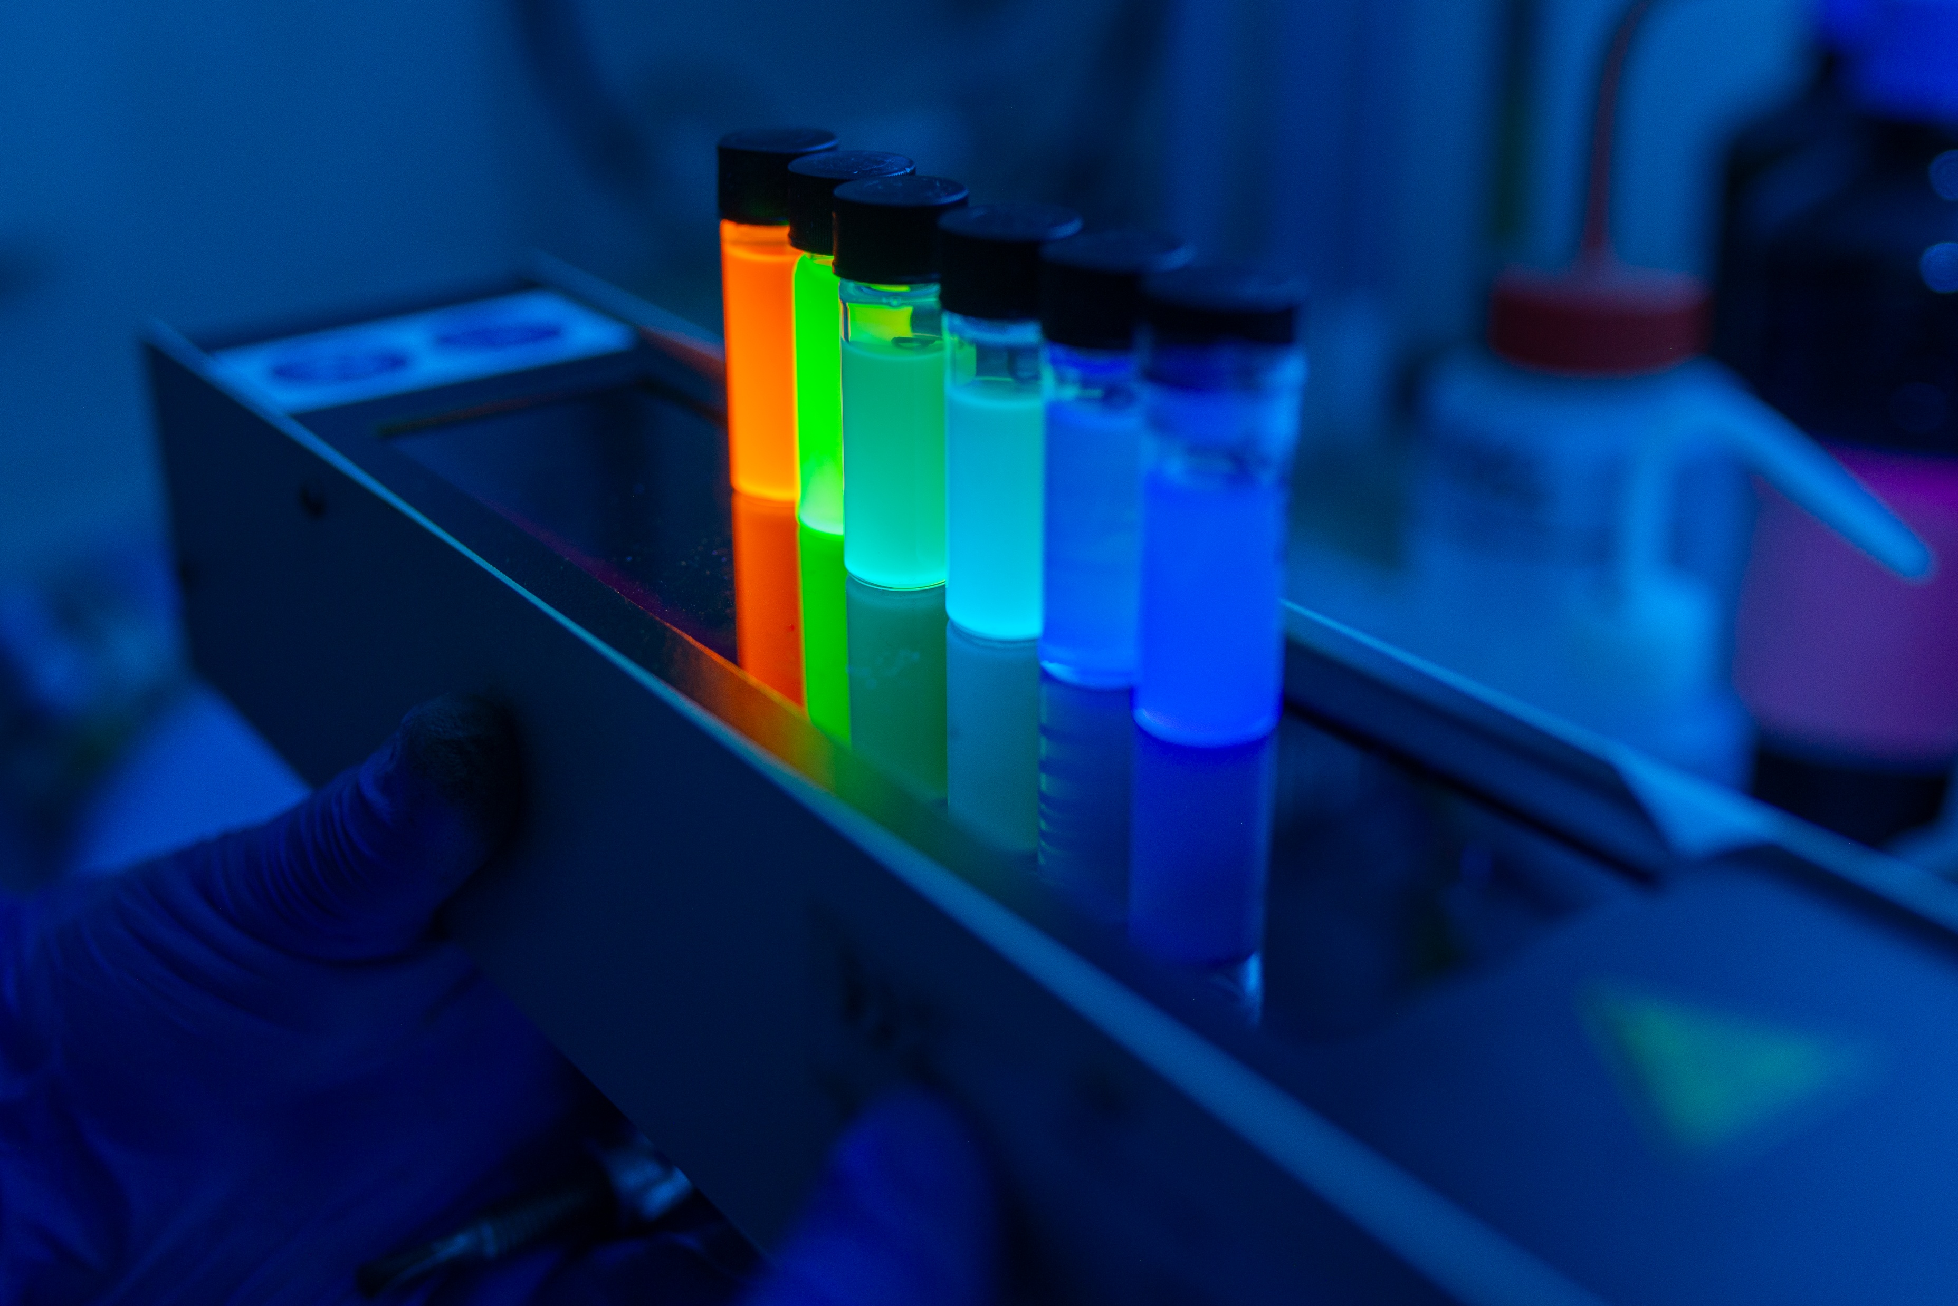





Development of cesium lead halide nanocomposite scintillators for high energy physics
Jan Král^{1,2}, Vojtěch Zabloudil^{1,3}, Vladimír Mašek¹, Petr Liška^{4,5}, Solangel Rojas¹, Vladimir Babin², Jan Valenta⁶, Václav Čuba¹, Eva Mihóková^{1,2}, Kateřina Děcká^{1,2}, Etiennette Auffray³
¹ Faculty of Nuclear Sciences and Physical Engineering, Czech Technical University in Prague, Prague, Czech Republic
² Institute of Physics of the Czech Academy of Sciences, Prague, Czech Republic
³European Organization for Nuclear Research (CERN), Meyrin, Switzerland
⁴ CEITEC, Brno University of Technology, Brno, Czech Republic
⁵ Institute of Physical Engineering, Faculty of Mechanical Engineering, Brno University of Technology, Brno, Czech Republic
⁶ Faculty of Mathematics and Physics, Charles University, Prague, Czech Republic
SCINT 2026, Gyeongju, Korea, 28.5.2026

Slide 2
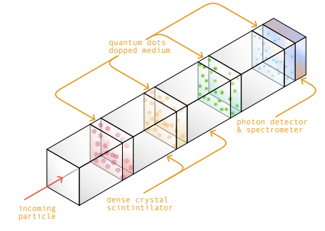
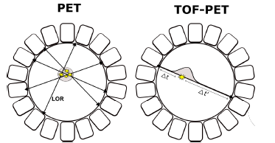
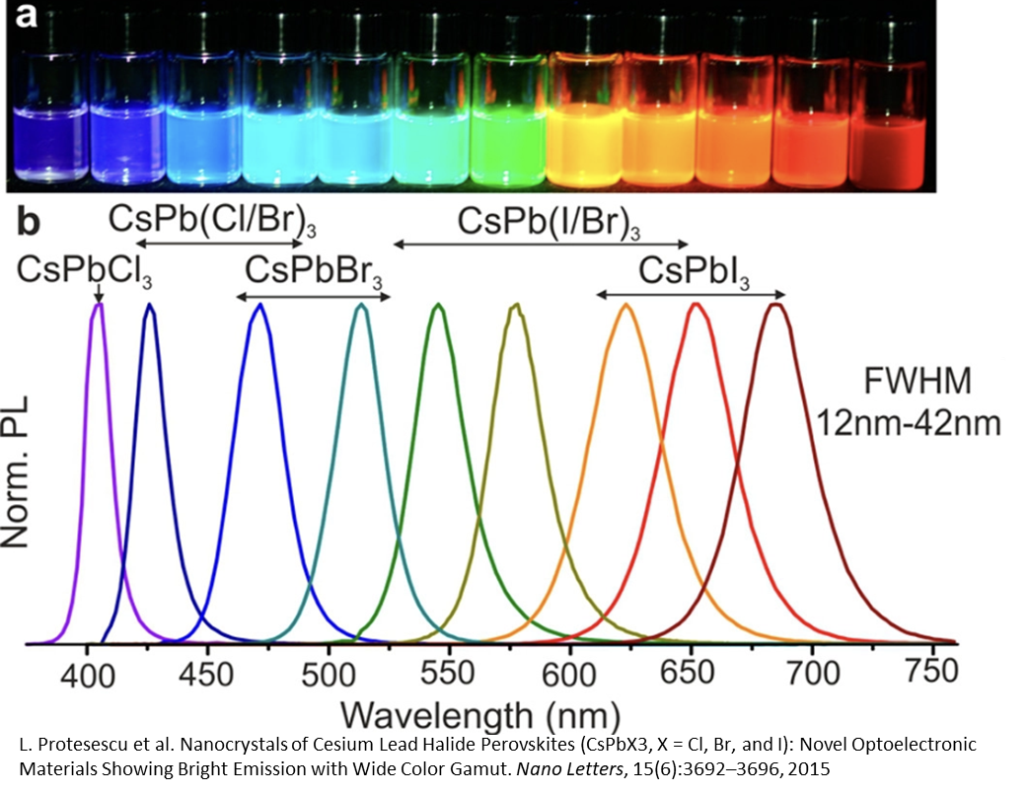
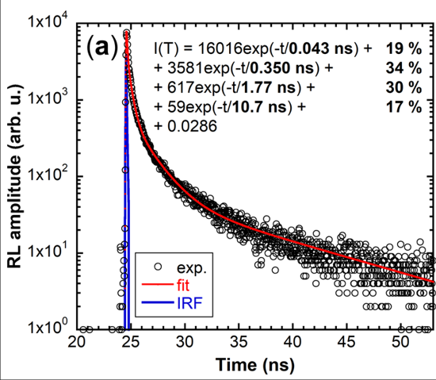
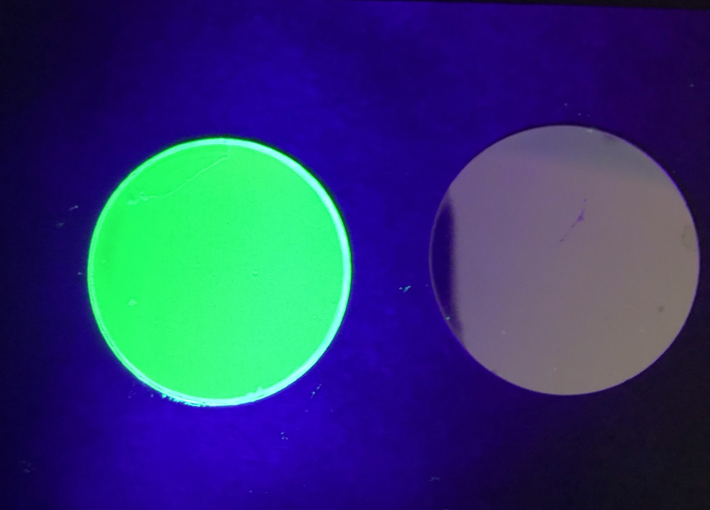
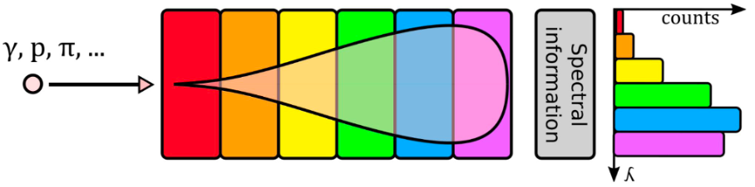

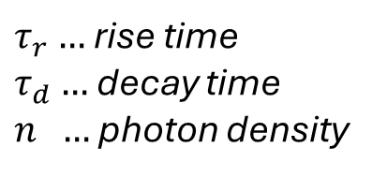
Cesium lead halide nanocrystals
ABX₃ (A=Cs⁺, MA⁺; B=Pb²⁺ ; X=Cl⁻, Br⁻, I⁻)
narrow tunable emission peak
excitonic ultrafast luminescence
coincidence time resolution
$$CTR∝\sqrt{\frac{τ_{r}∙τ_{d}}{n}}$$
$τ_{r}…$rise time
$τ_{d}…$ decay time
$n …$ photon density
Nano Lett. 2015, 15, 6, 3692–3696
K. Děcká, et al. Nanomaterials 2022, 12, 14.
  Chromatic calorimetry
  Time-of-Flight PET
2
Notes:
Dát obrázek toho calolimetru a heterostruktury

Slide 3
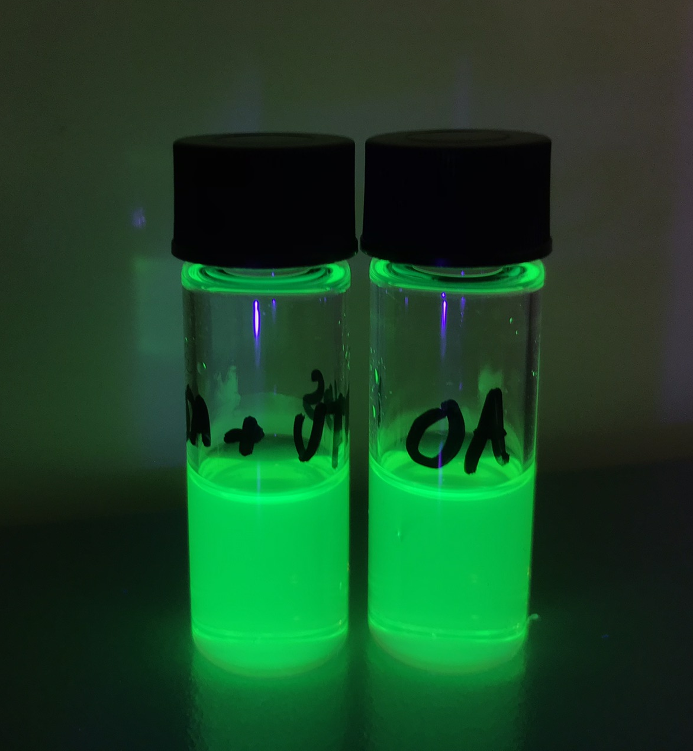
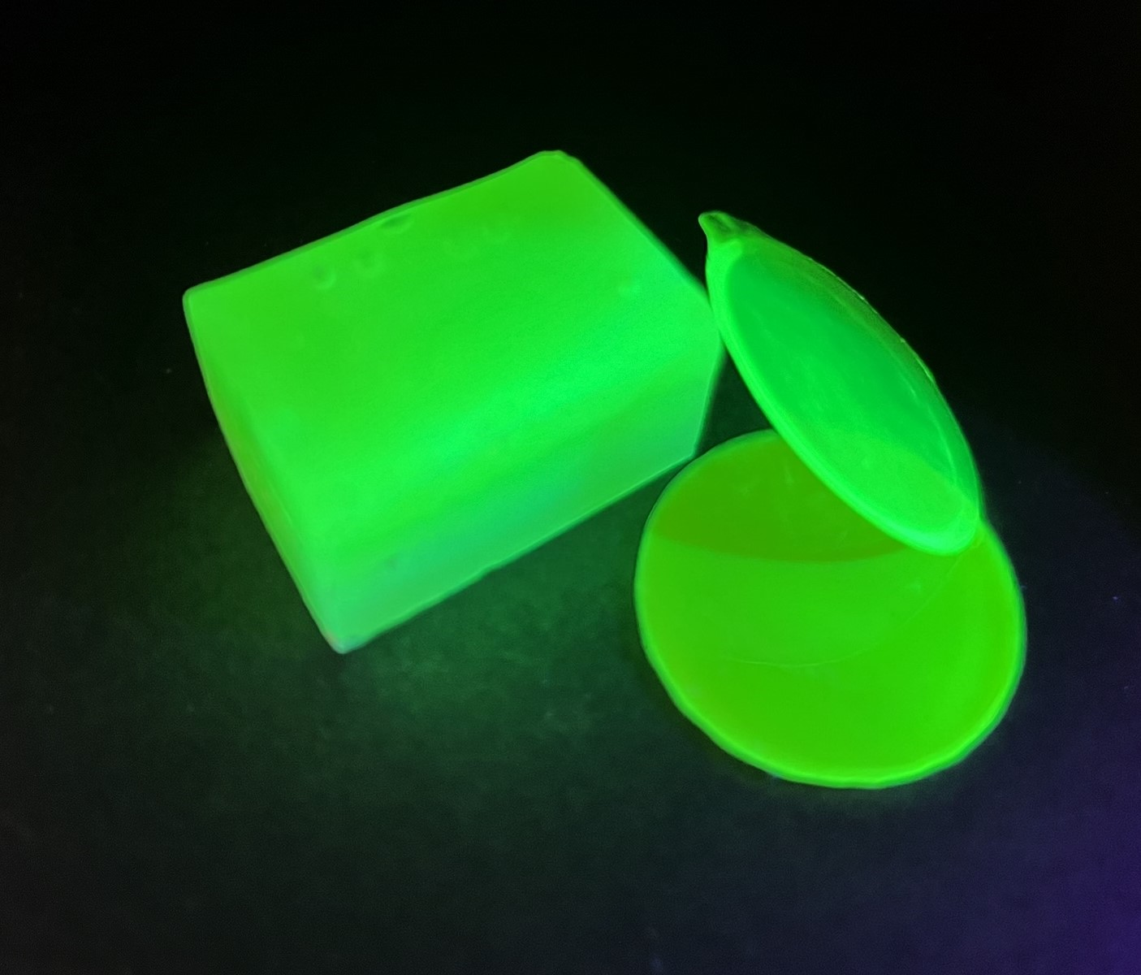
Embedding nanocrystals into a polymer matrix
moving from bare nanocrystals or colloidal solutions to solid nanocomposite scintillators
embedding procedure
polystyrene (PS)
polyvinyl toluene (PVT)
epoxy resin (ER)
tailoring nanocomposites for various application requirements
exploration of radiation hardness study of different nanocomposite
polyurethane (PU)
polydimethylsiloxane (PDMS)
poly(methyl methacrylate) (PMMA)
3

Slide 4
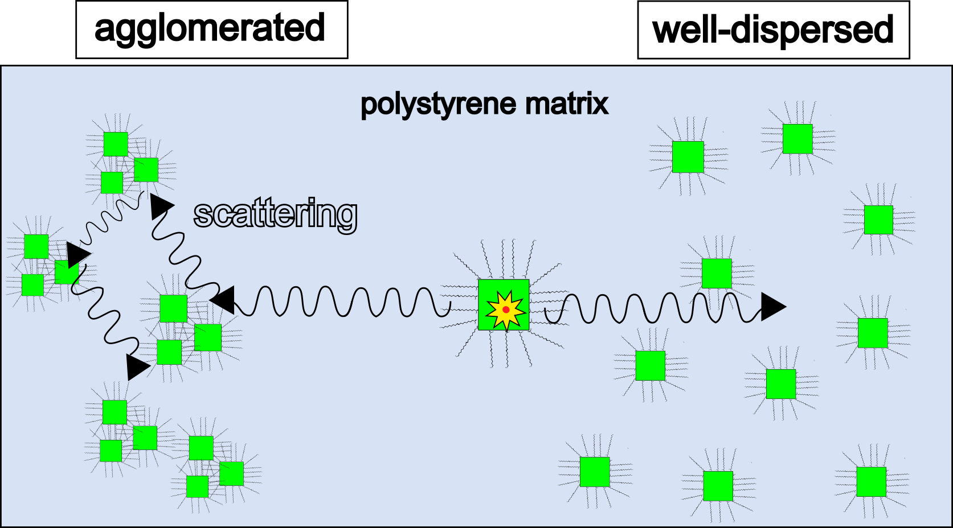
Embedding nanocrystals into a polymer matrix
moving from bare nanocrystals or colloidal solutions to solid nanocomposite scintillators
embedding procedure
polystyrene (PS)
polyvinyl toluene (PVT)
Challenges:
suppression of thermal damage due to ligand desorption
protection from more polar polymer precursors
perform functionalization for copolymerization
epoxy resin (ER)
tailoring nanocomposites for various application requirements
exploration of radiation hardness study of different nanocomposite
polyurethane (PU)
polydimethylsiloxane (PDMS)
poly(methyl methacrylate) (PMMA)
3

Slide 5
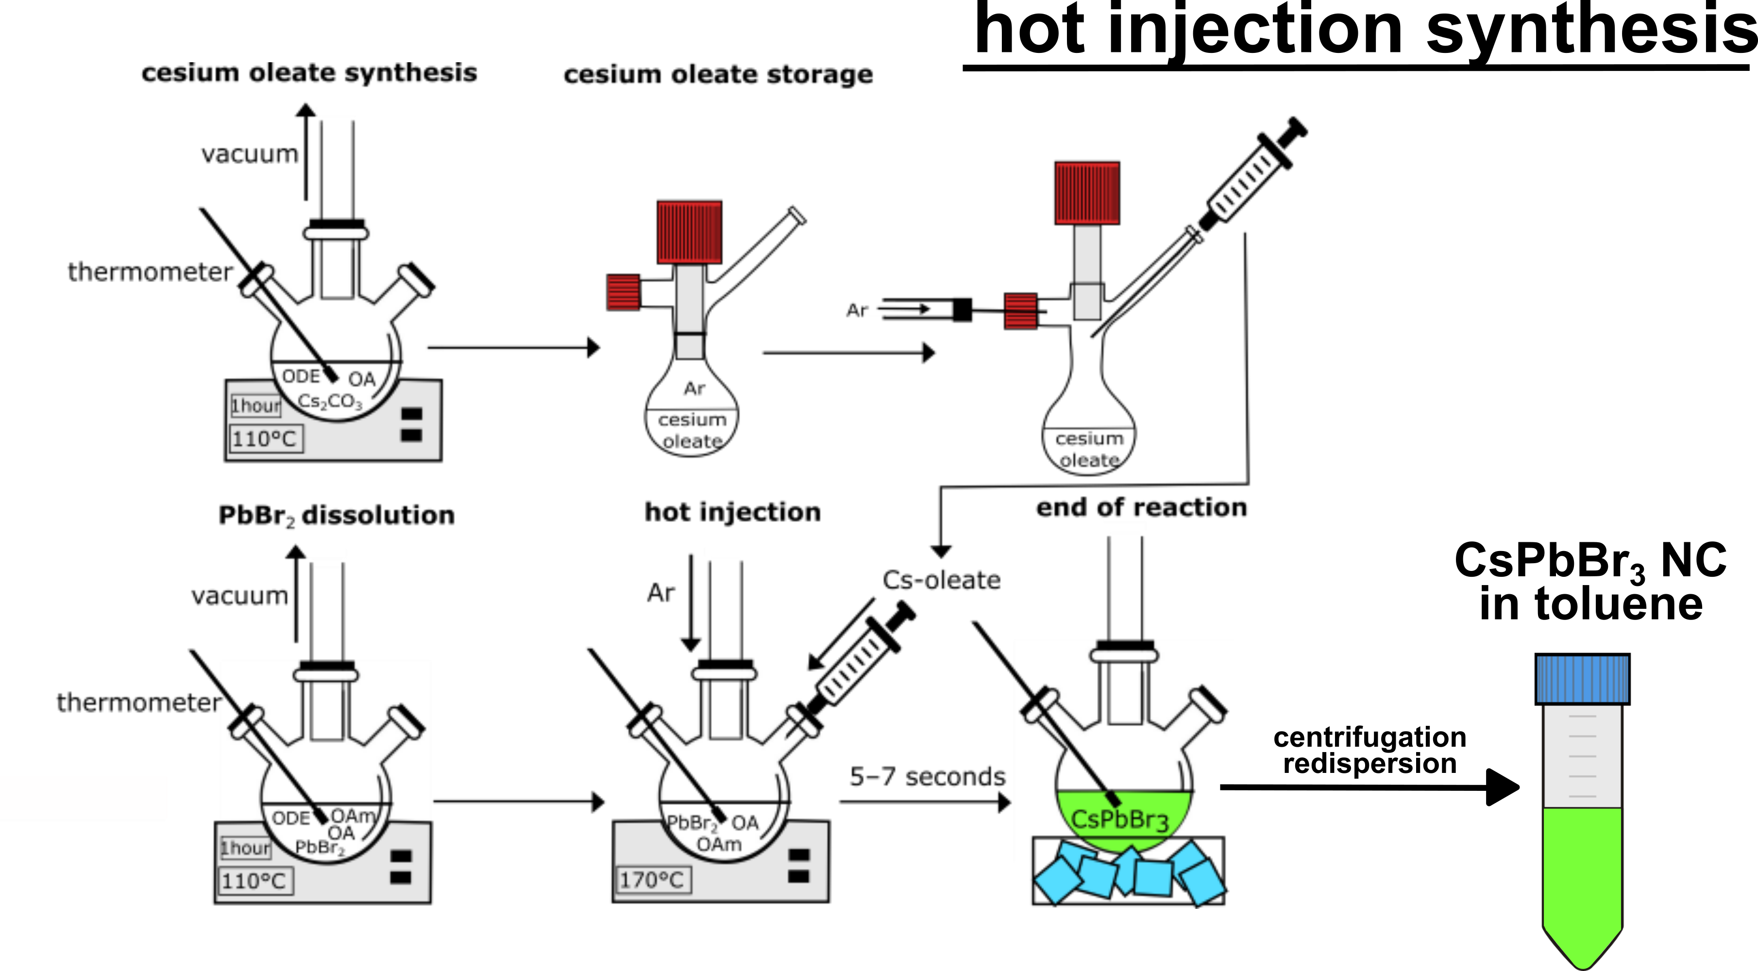
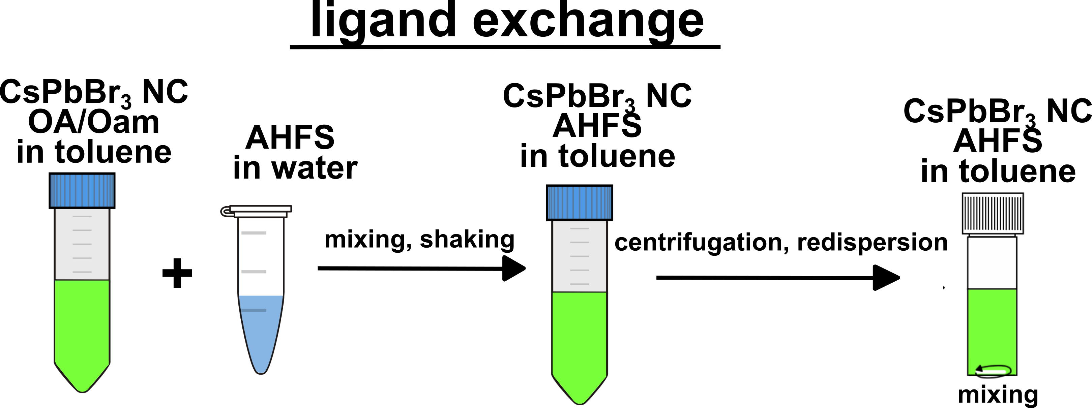
Embedding nanocrystals into a matrix
nanocrystal synthesis
nanocrystal surface modification
ligand exchange
4

Slide 6
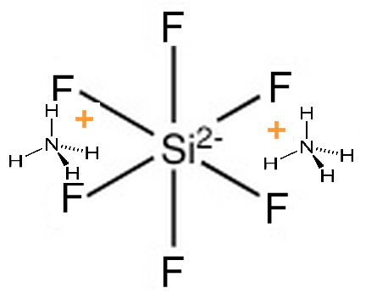
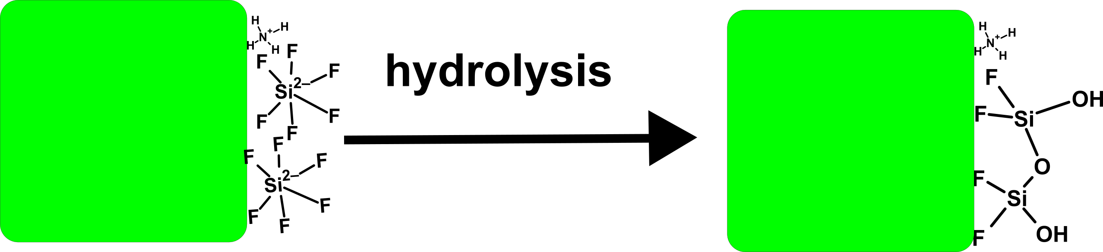
Nanocrystal surface modification
nanocrystal synthesis
nanocrystal surface modification
talk on Limiting exciton diffusion enhances the photoluminescence of CsPbBr₃ nanocrystal films at high excitation densities by Simon Jessen (Aarhus University)
Thursday 28.5.2026 at 16:10
ligand exchange
Challenges:
suppression of thermal damage due to ligand desorption
protection from more polar polymer precursors
perform functionalization for copolymerization
  ammonium hexaflurosilicate (AHFS)
CsPbBr₃
CsPbBr₃
fluoride surface treatment
formation of Si-O-Si network
platform for further functionalization by organosilanes to tune the nanocrystals for various matrices
4

Slide 7
Nanocrystal surface modification
nanocrystal synthesis
nanocrystal surface modification
ligand exchange
Challenges:
suppression of thermal damage due to ligand desorption
protection from more polar polymer precursors
perform functionalization for copolymerization
5

Slide 8
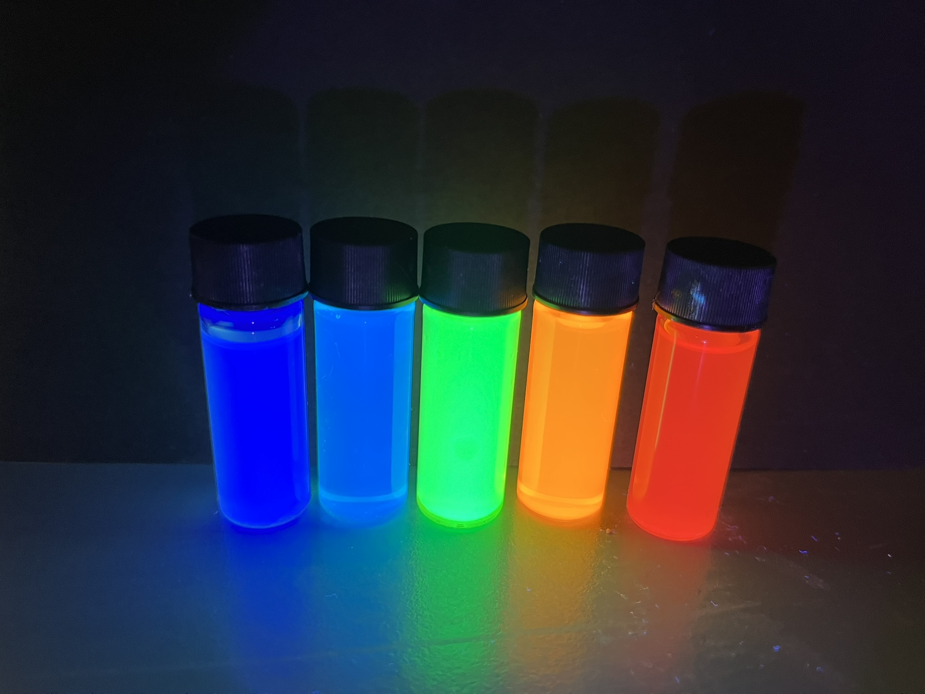
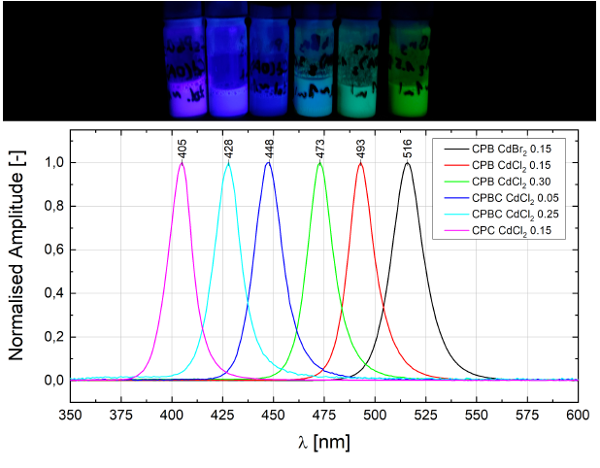
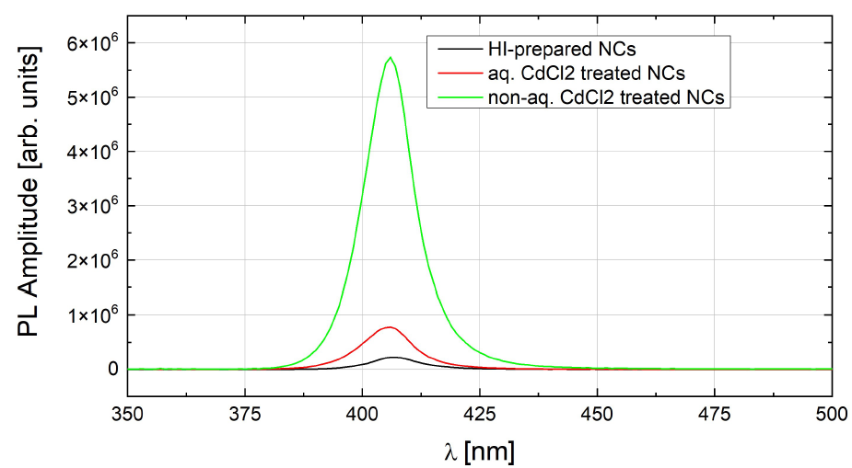
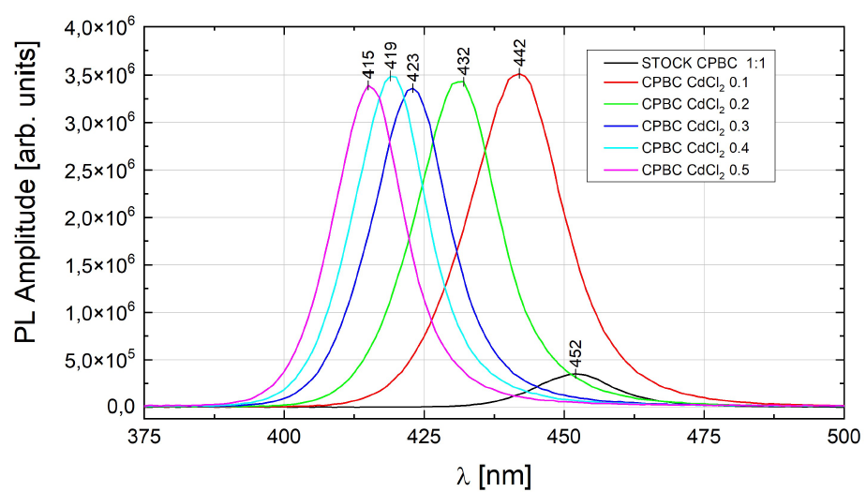
Nanocrystal spectral tuning
nanocrystal synthesis
nanocrystal surface modification
anion exchange
AHFS ligand exchange
CsPbBr₃ = CPB
CsPbCl₃ = CPC
CsPb(Br_{1-x}Cl_{x})₃ = CPBC
org. Cd²⁺
org. Cd²⁺
spectral emission tuning
org. Cd²⁺ treatment for CPC and CPBC PLQY enhancement
6

Slide 9
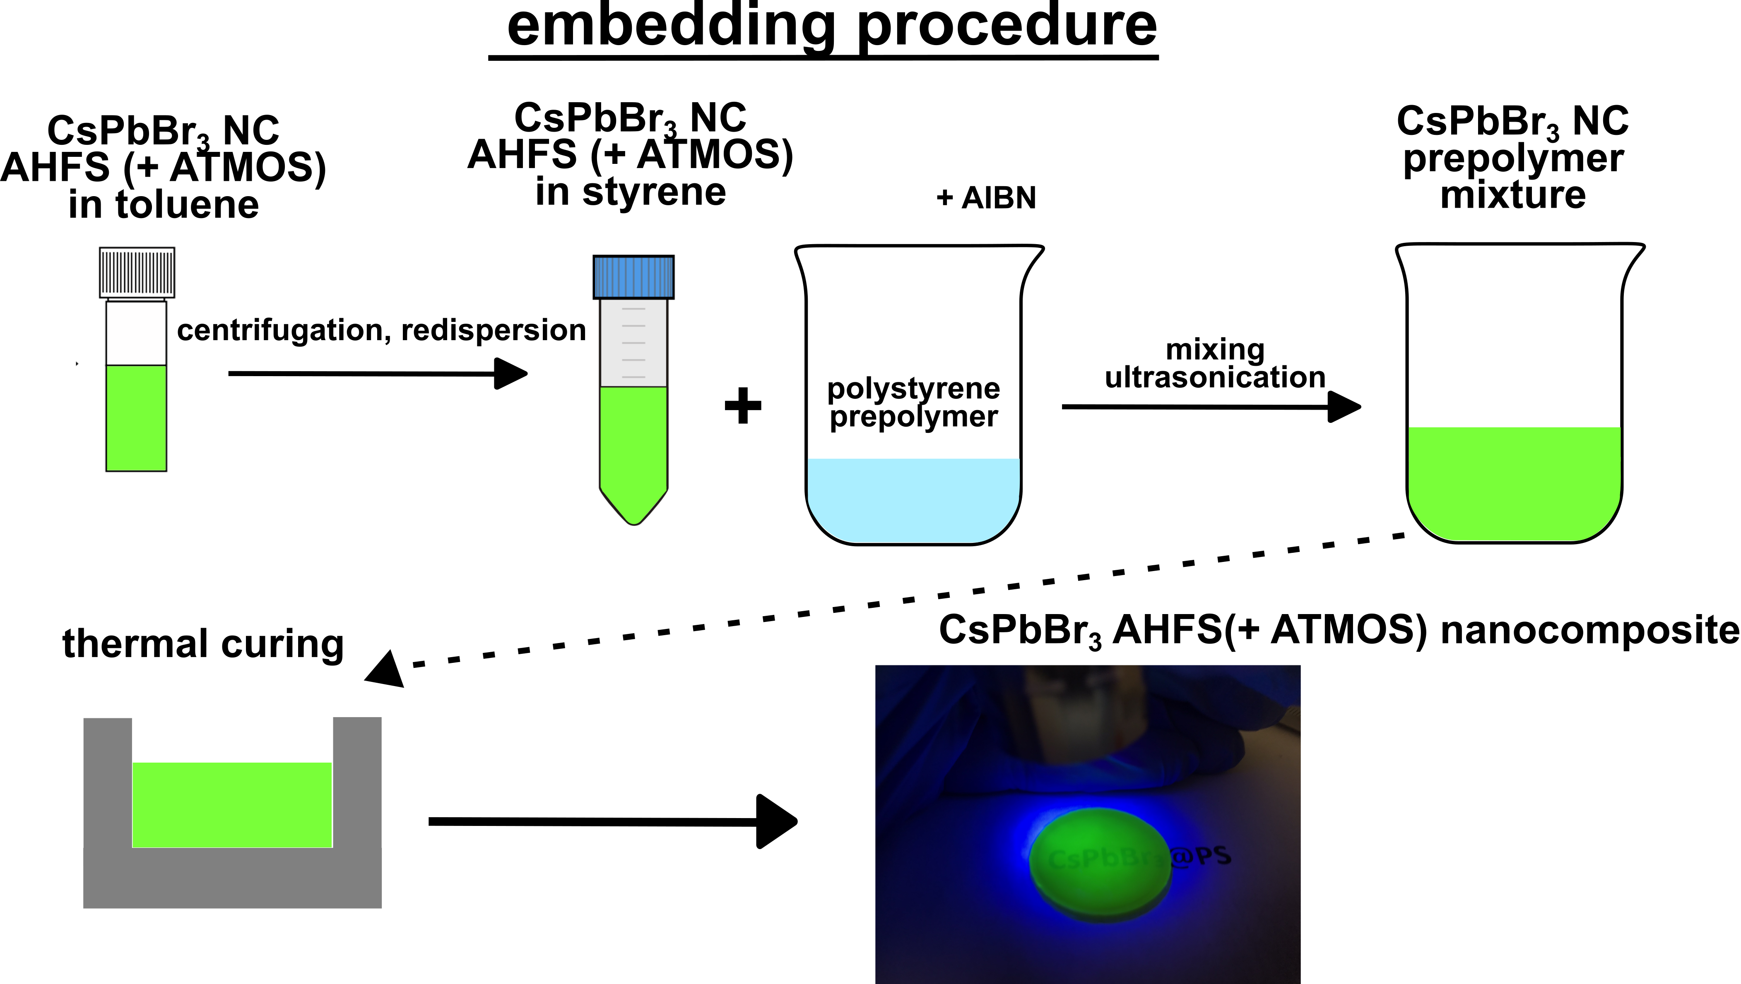
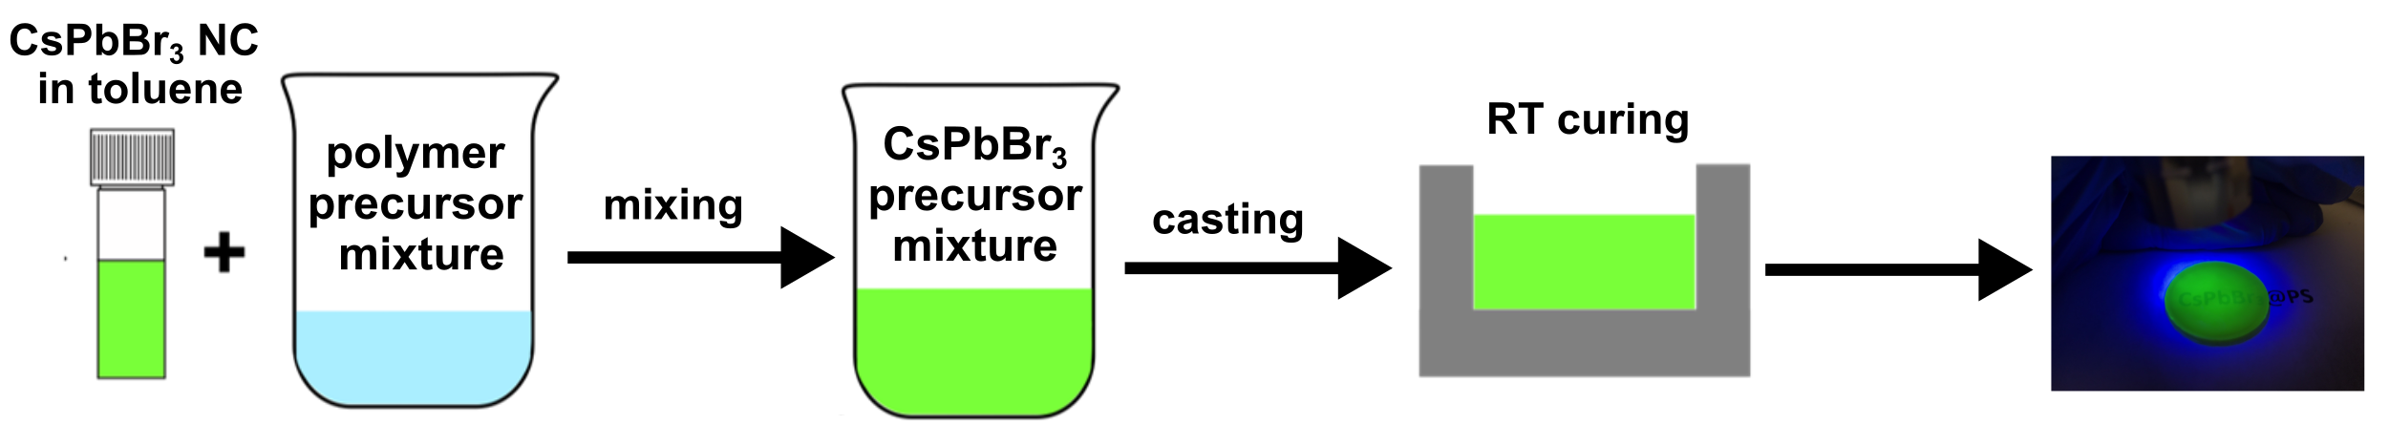
Embedding nanocrystals into a matrix
nanocrystal synthesis
nanocrystal surface modification
AHFS ligand exchange
embedding procedure
thermal embedding procedure
RT embedding procedure
7

Slide 10
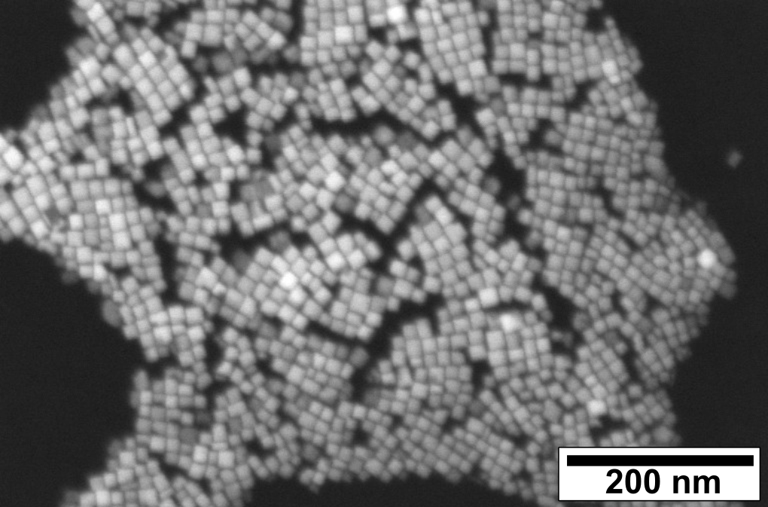
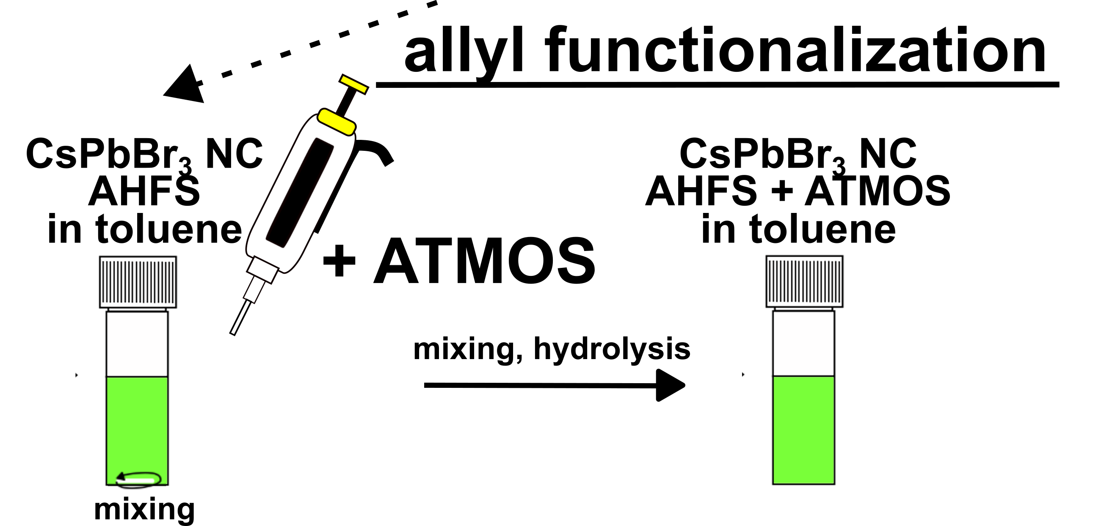
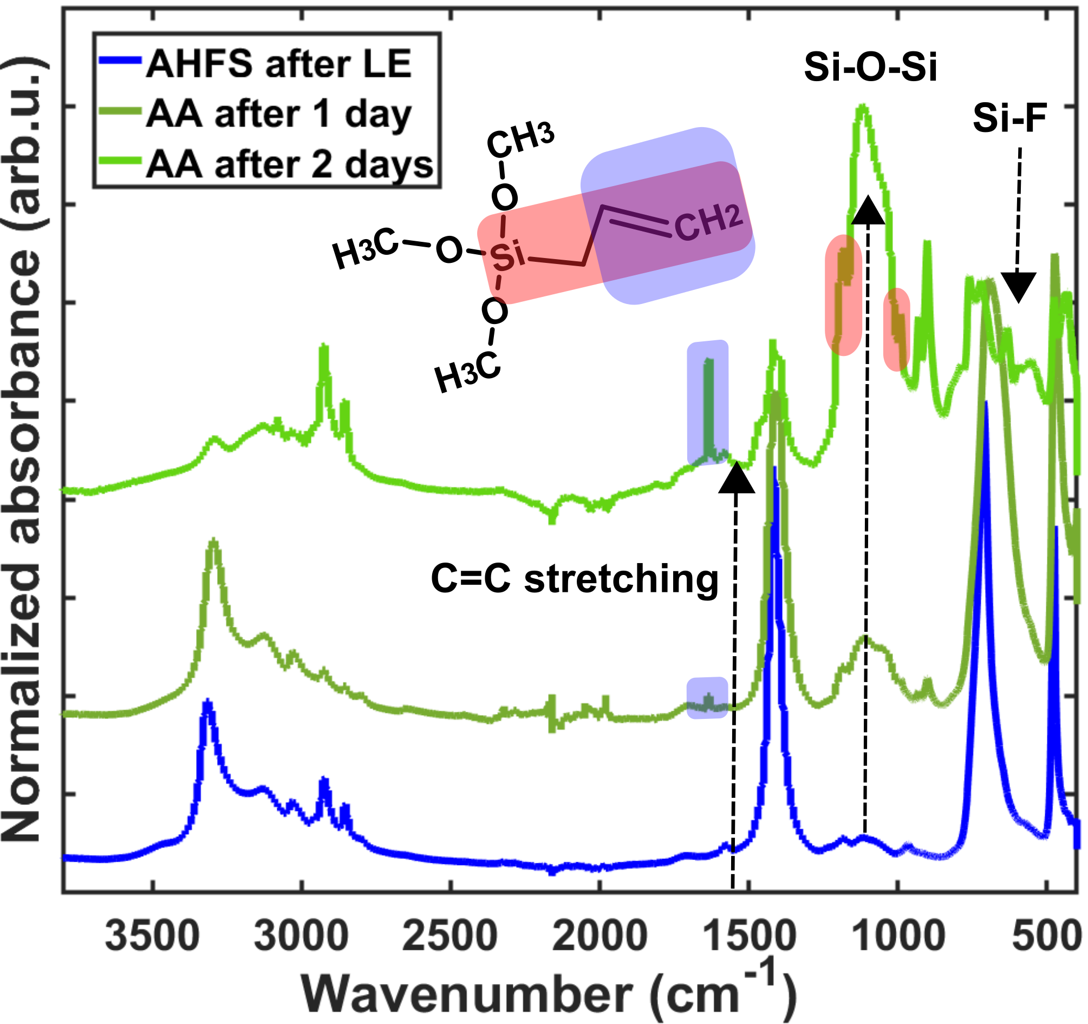
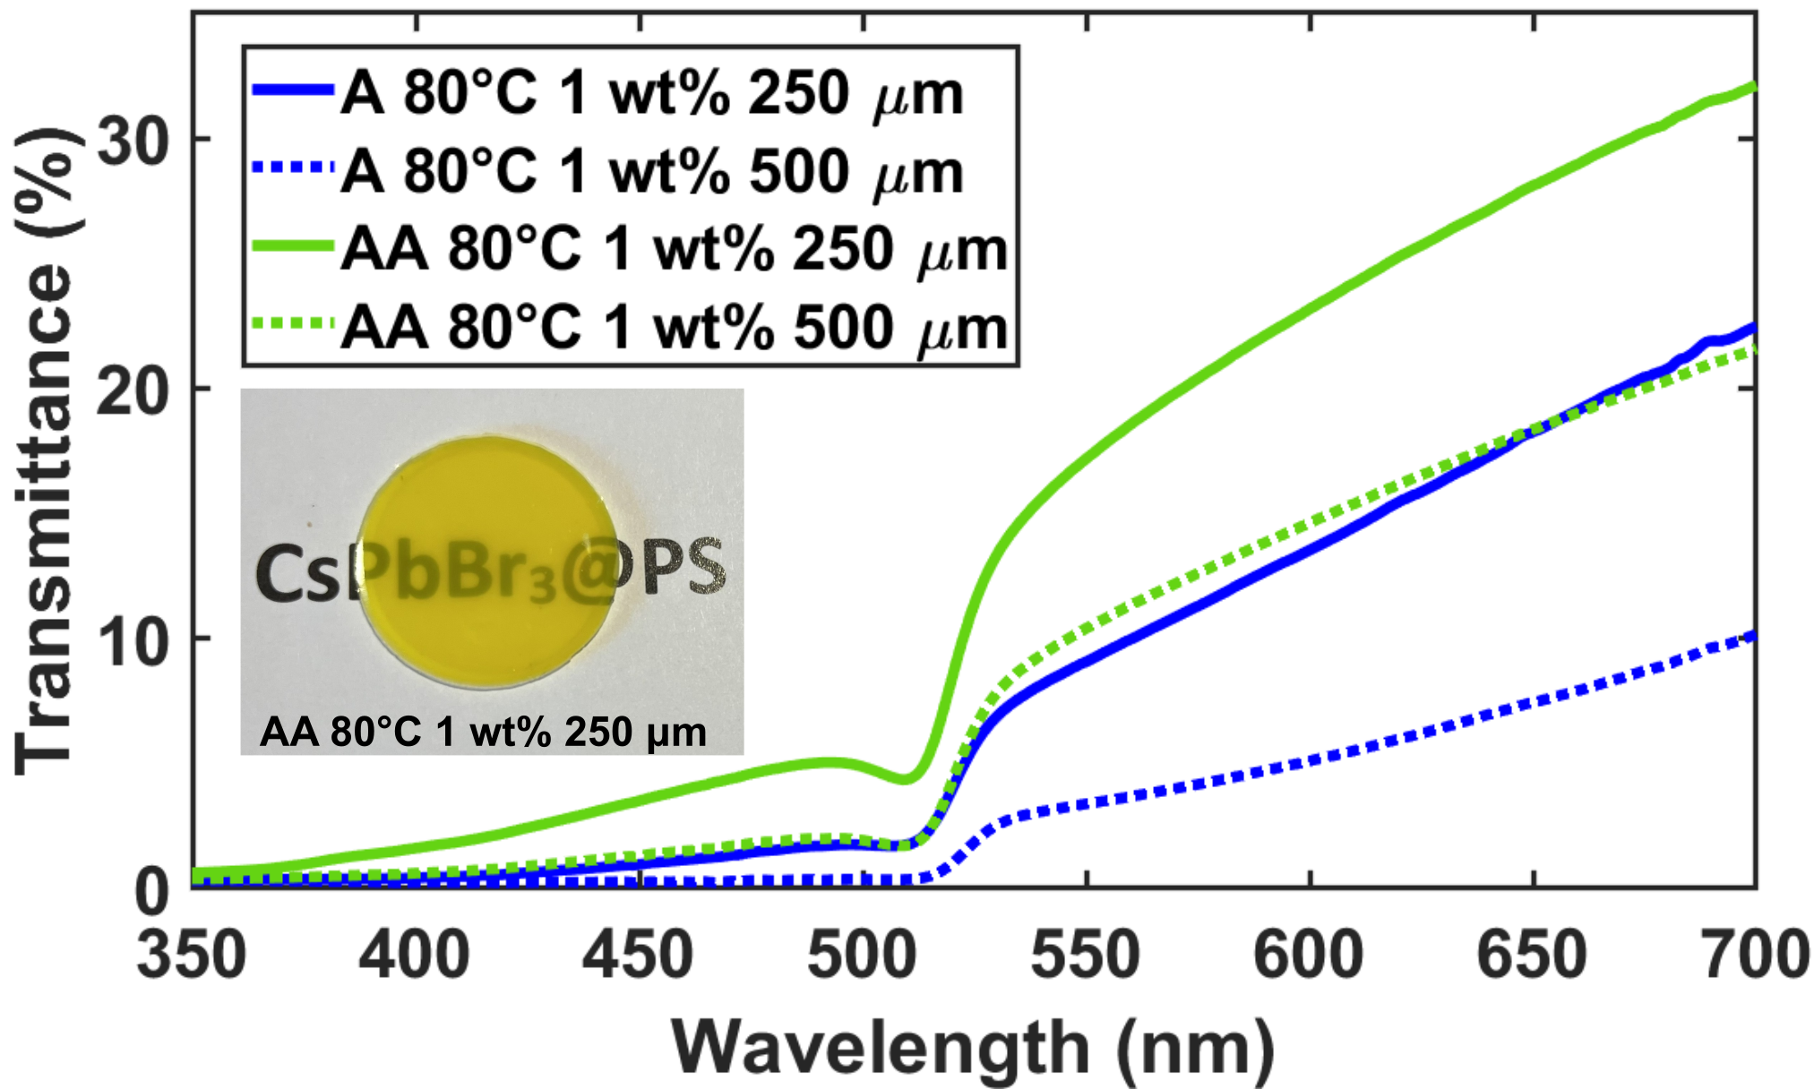
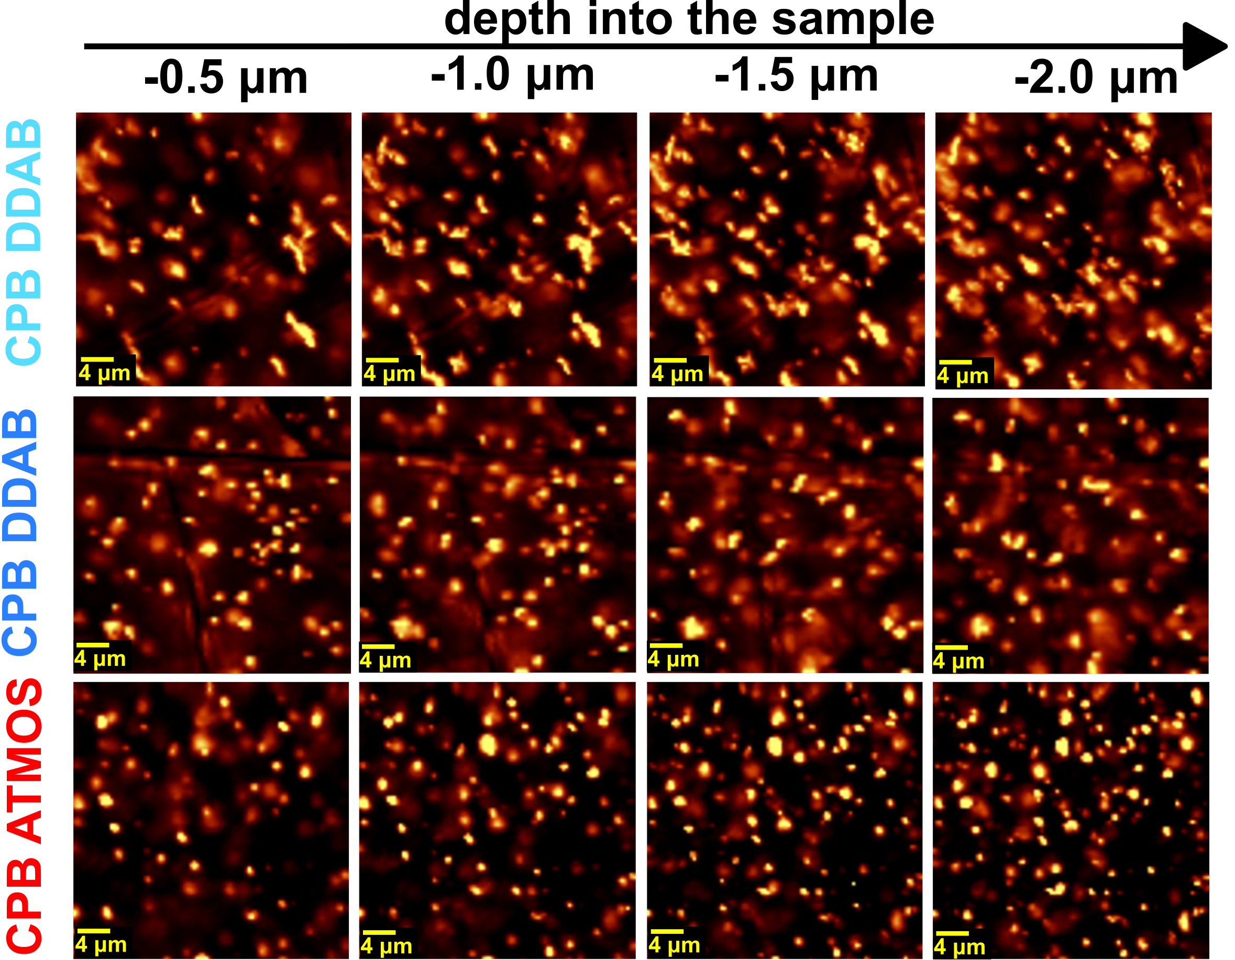
AHFS +ATMOS functionalization
AHFS = A samples
AHFS + ATMOS = AA samples
45% PLQY
95% PLQY
60% PLQY
Decreasing NC cluster size
transparency improvement with allyl-functionalization
reduced agglomeration
Jan Král et al. 2025 J. Phys. Mater. 8 015007
8

Slide 11
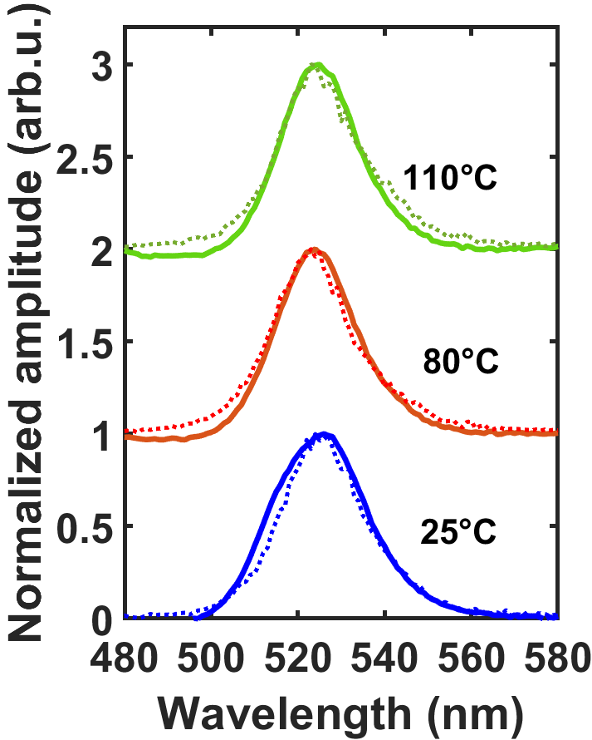
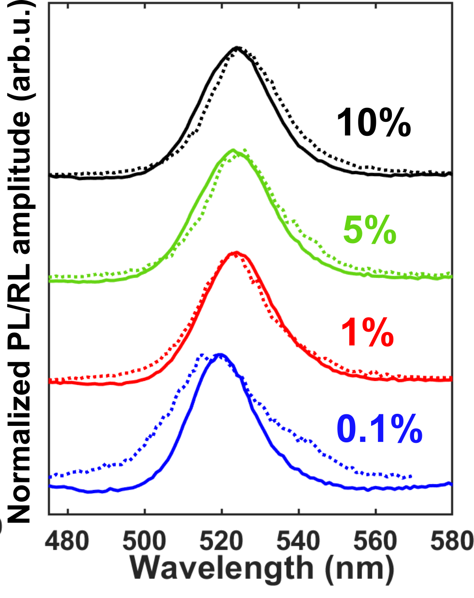
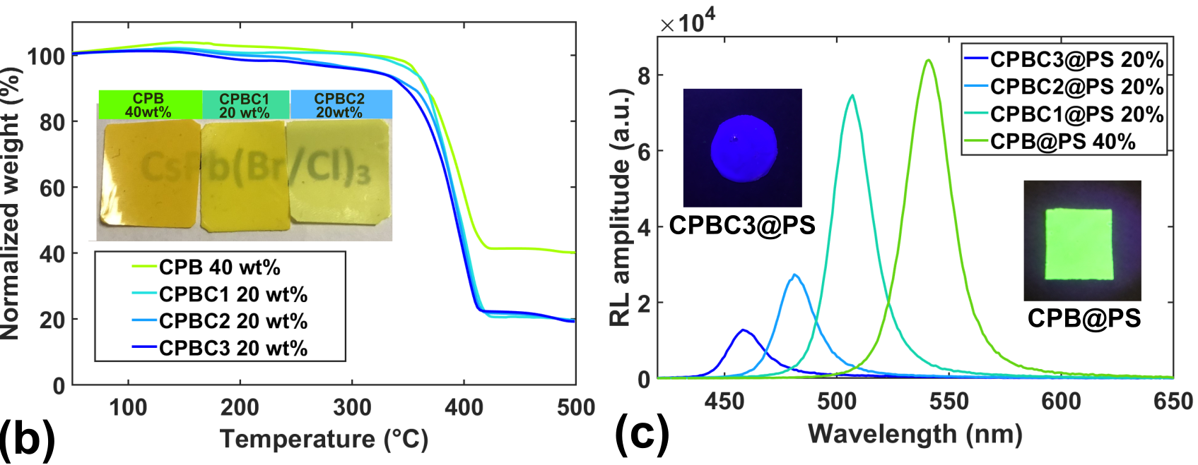
PL and RL properties
J. Mater. Chem. C, 2026,14, 4440-4450
PL and RL spectra preservation across range of NC loading and with polymerization temperatures up to 110°C
nanocrystal loading pushed up to 40 wt%
9

Slide 12
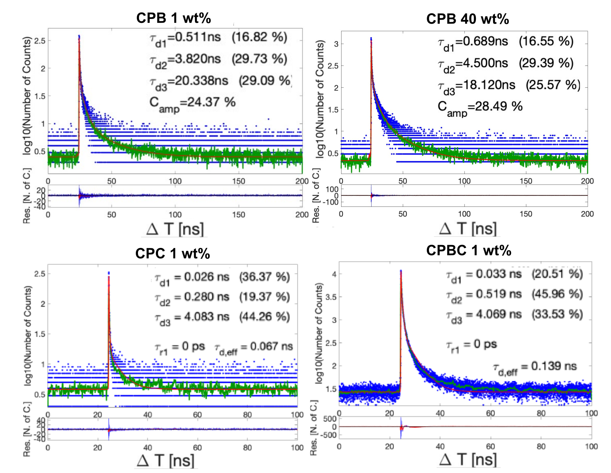
RL decay kinetics
ultra-fast multi-excitonic decay preserved to high loadings
significant acceleration of kinetics with chloride content
9

Slide 13
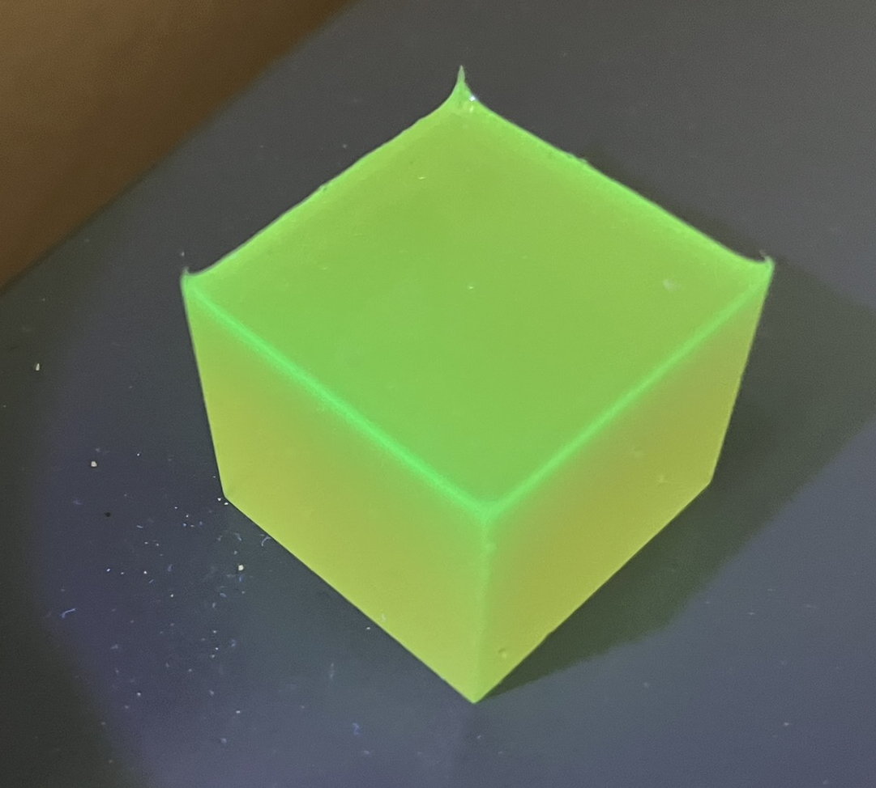
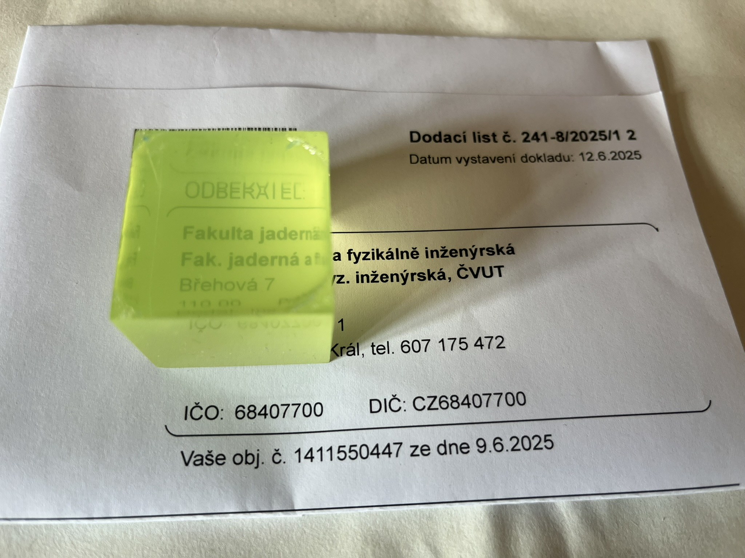
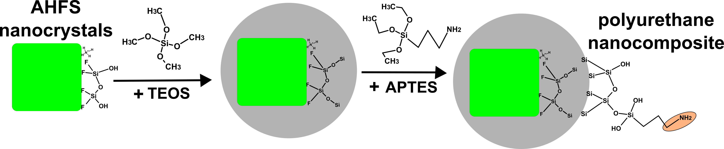
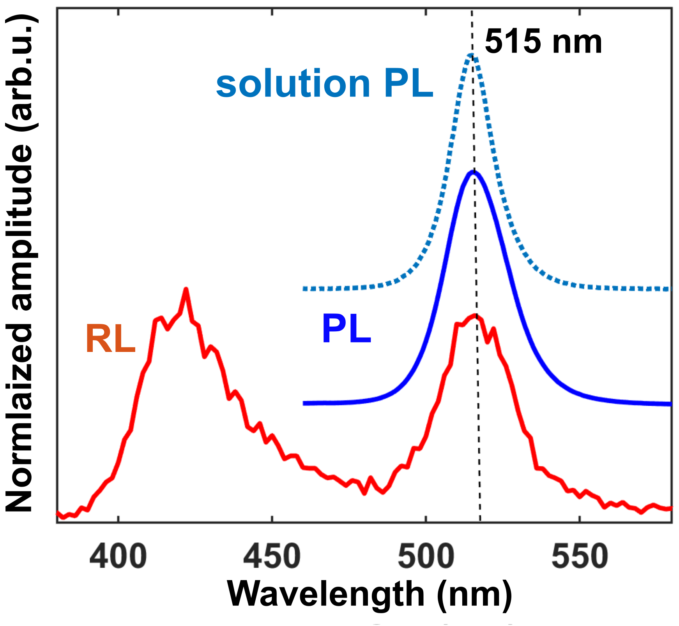
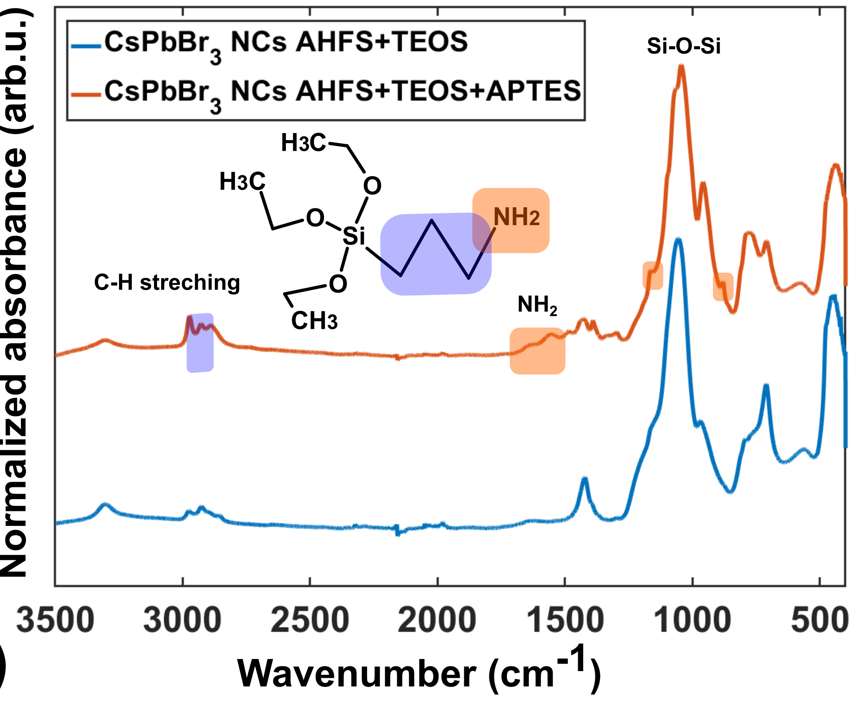
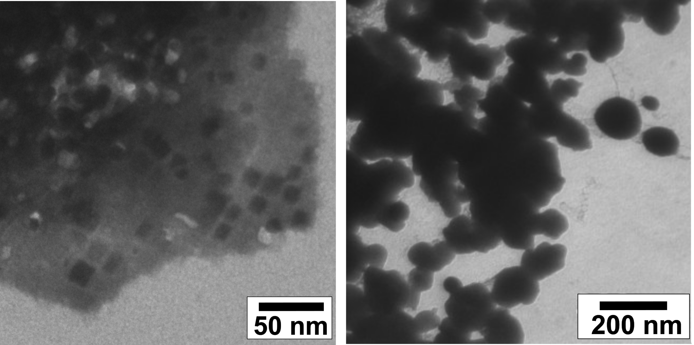
CPB@SiO₂ polyurethane nanocomposites
(3-Aminopropyl)triethoxysilane
Adapting the procedure for compatibilization with different polymer matrices
(3-Aminopropyl)triethoxysilane
for polyurethane matrix
  SiO₂ shell for protection
  APTES for amino-functionalization
preserved PL/RL emission position
10

Slide 14
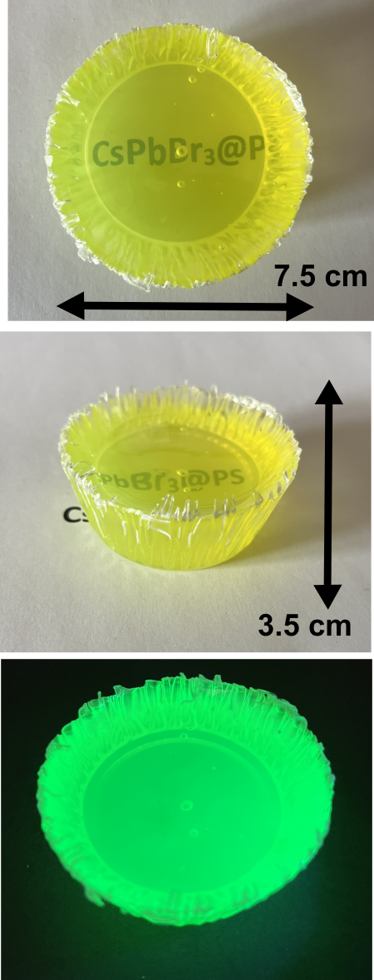
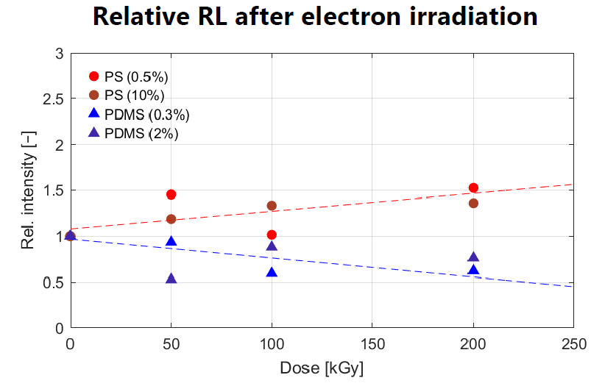
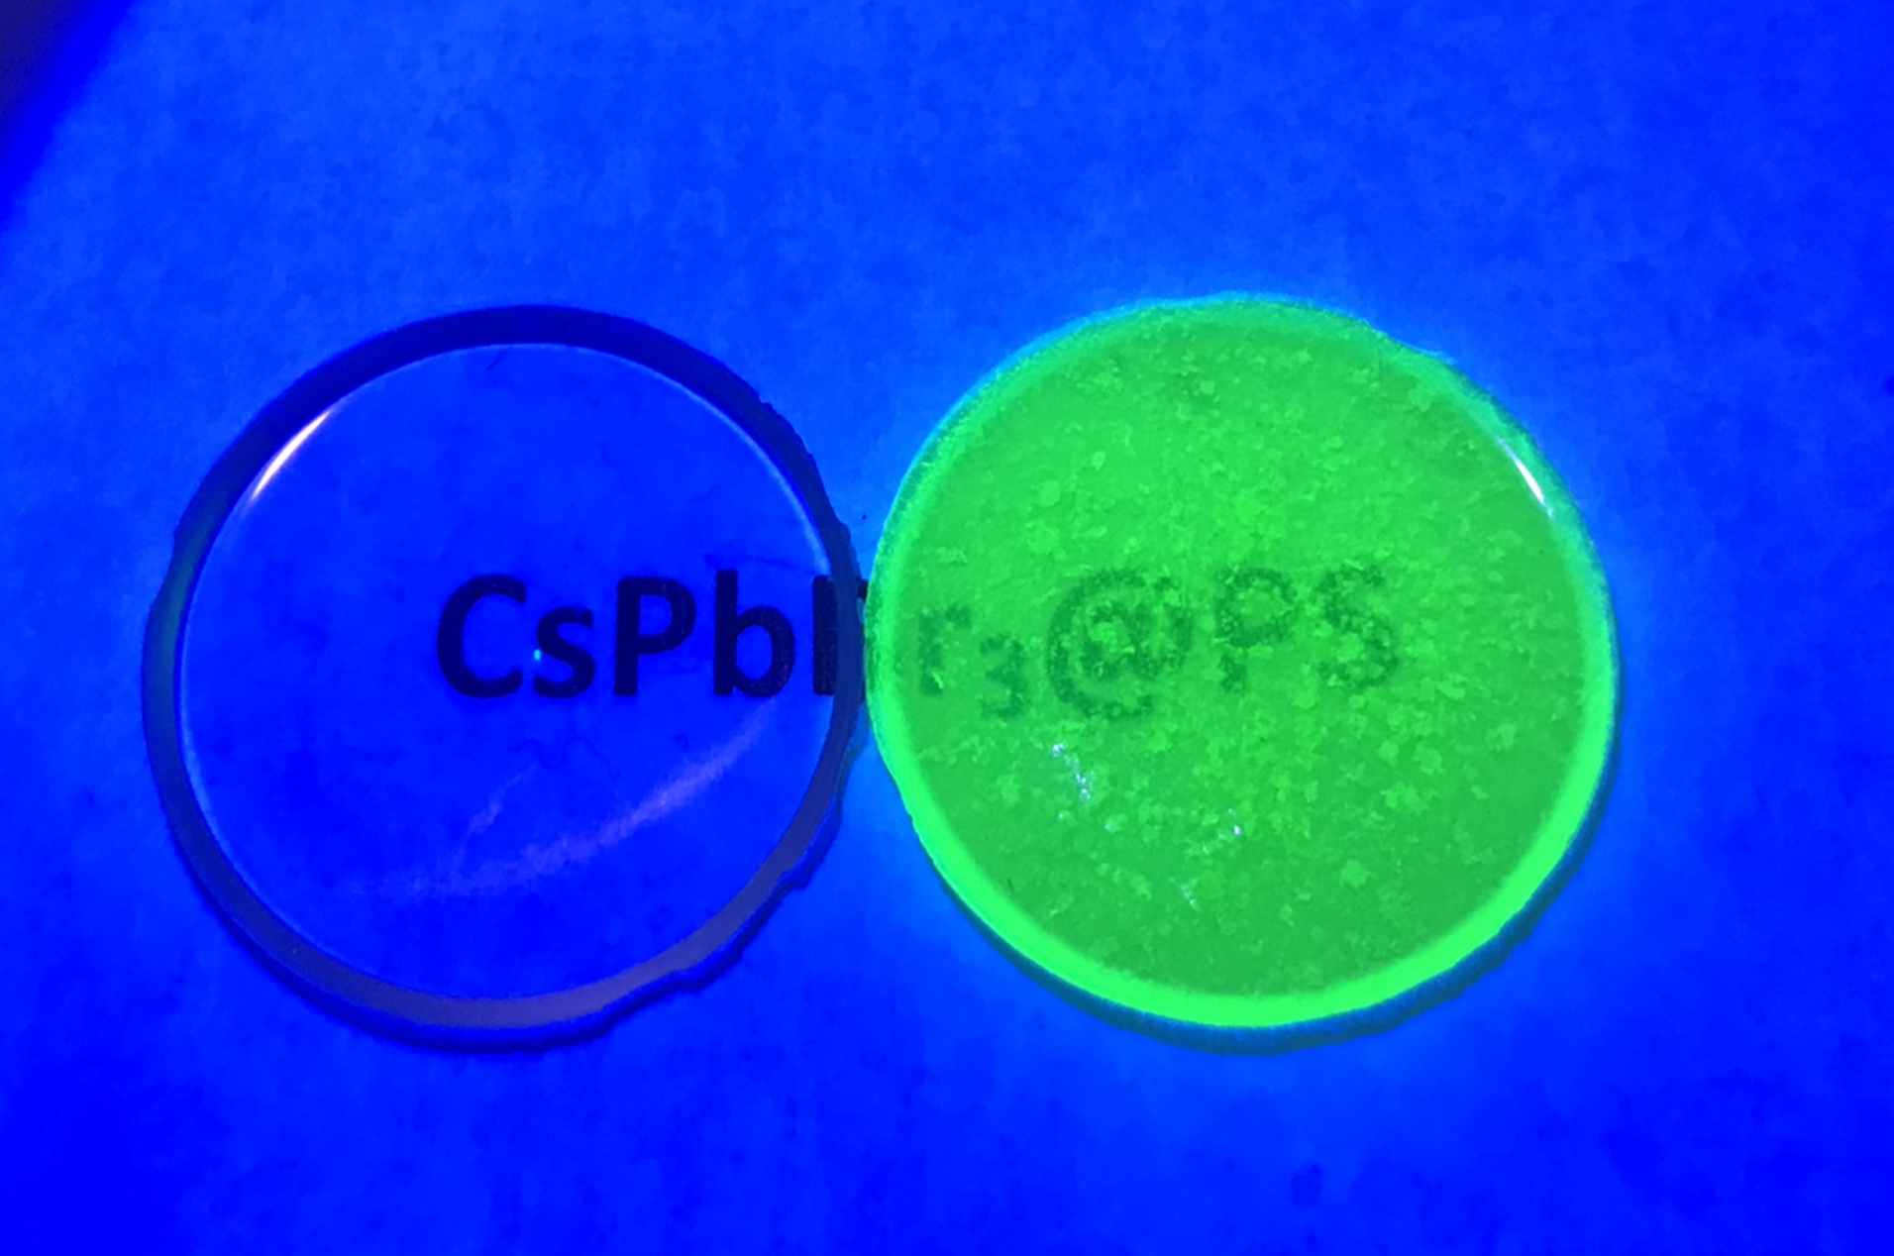
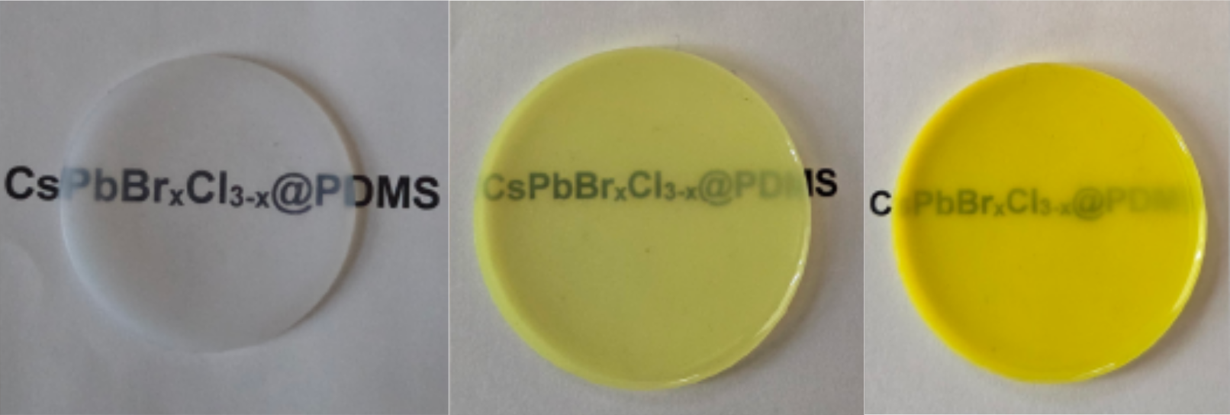
CPX₃ nanocomposites in various matrices
Sample fabrication scaled to large volumes
and tailored for various matrices
polyurethane nanocomposites
SiO₂ encapsulation
allyl-functionalization
polystyrene nanocomposites
+
amino-functionalization
subjected to radiation hardness study:
talk on Radiation stability of plastic and nanocomposite scintillators by Václav Čuba (CTU)
Monday 25.5.2026 at 11:54
SiO₂ encapsulation
epoxy nanocomposites
PDMS nanocomposites
11

Slide 15
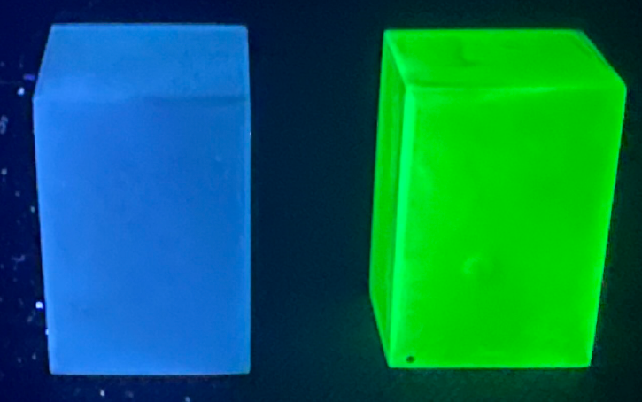
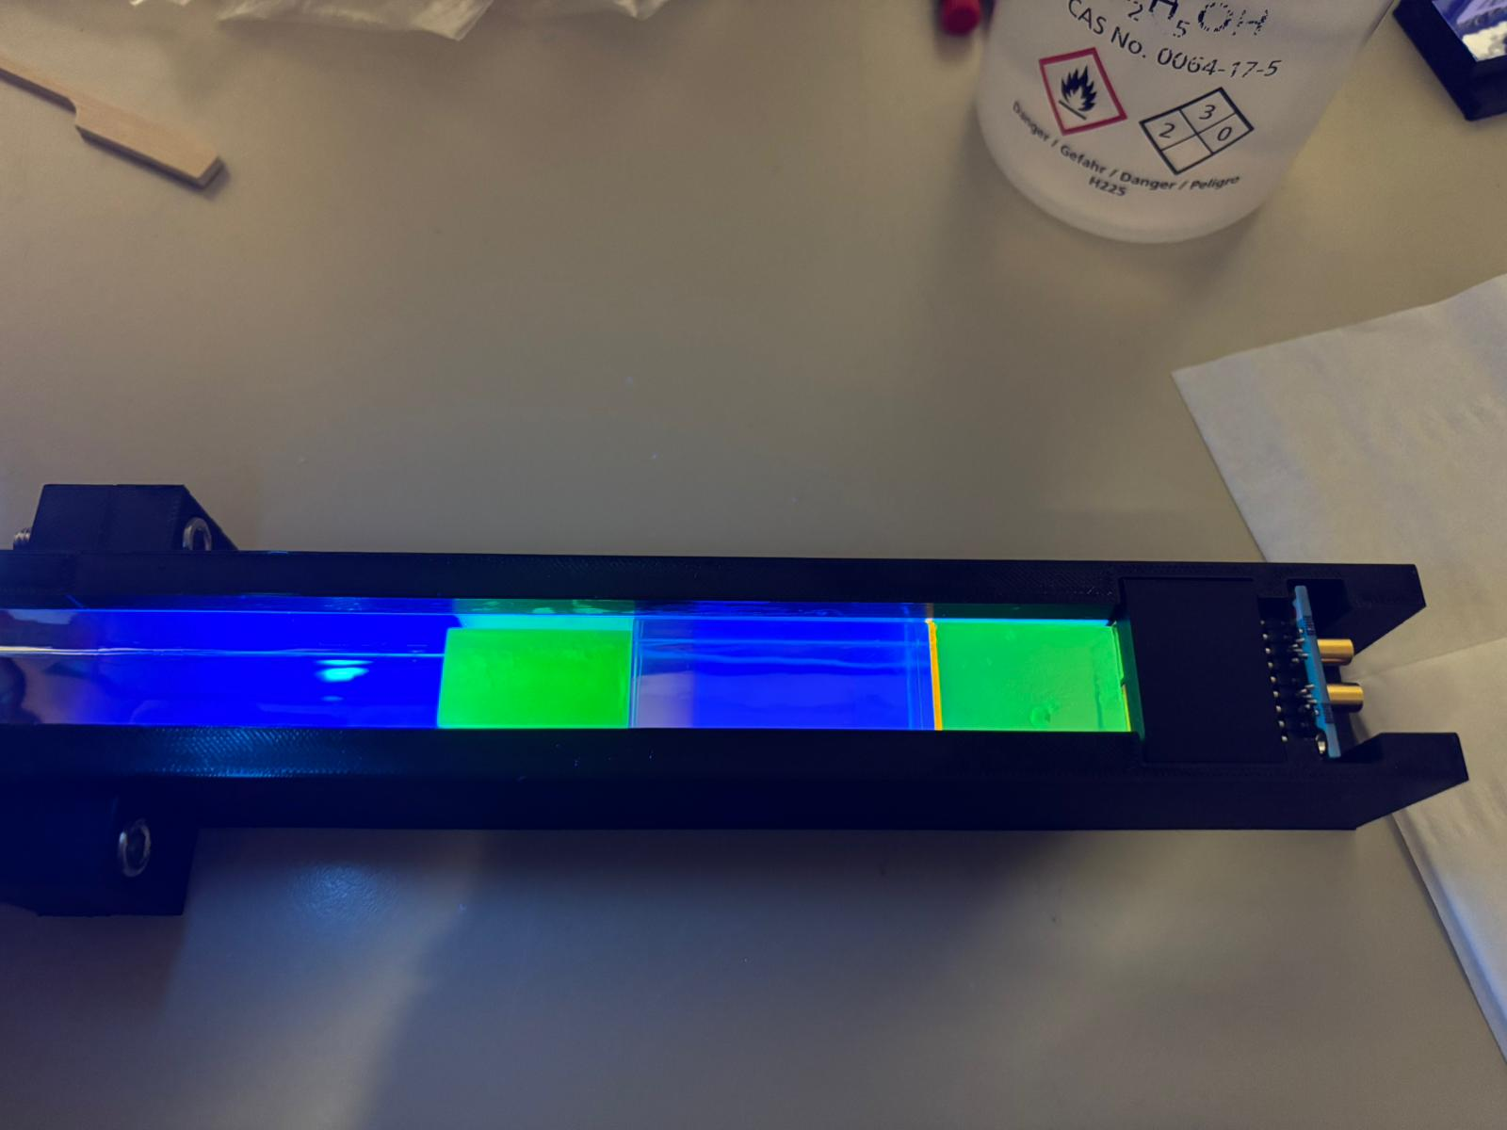
Samples for Chromatic calorimetry
polystyrene nanocomposites
3×2×2 cm³ samples for chromatic calorimetry experiments
scintillation prototype
August 2025 test beam at SPS facility
talk on Towards chromatic calorimetry using nanocomposite scintillators by Vojtěch Zabloudil (CERN, CTU)
Monday 25.5.2026 at 9:57
12

Slide 16
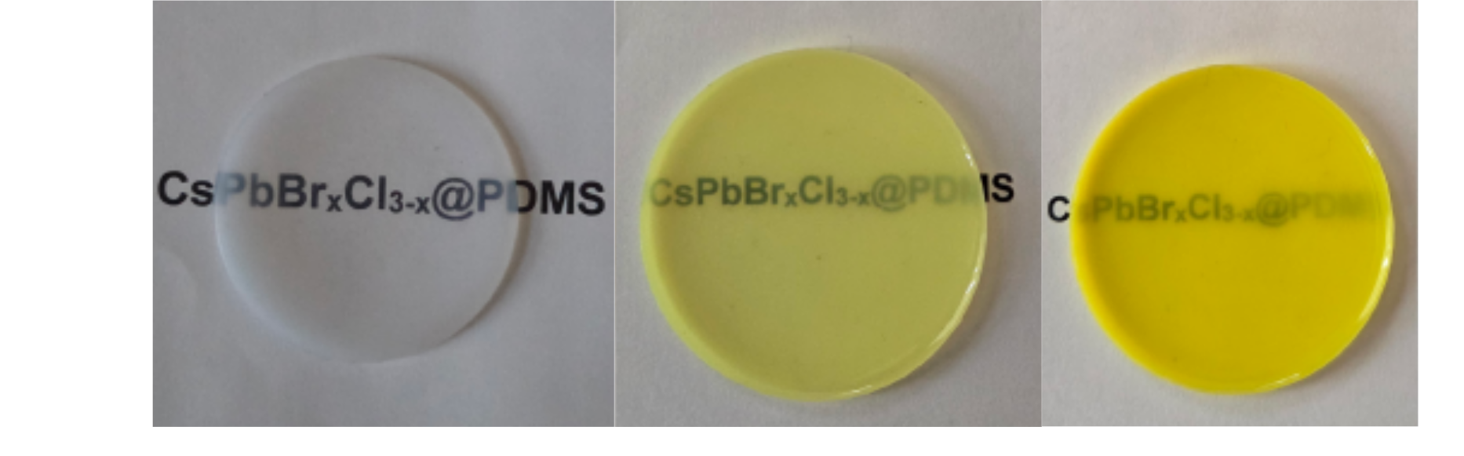
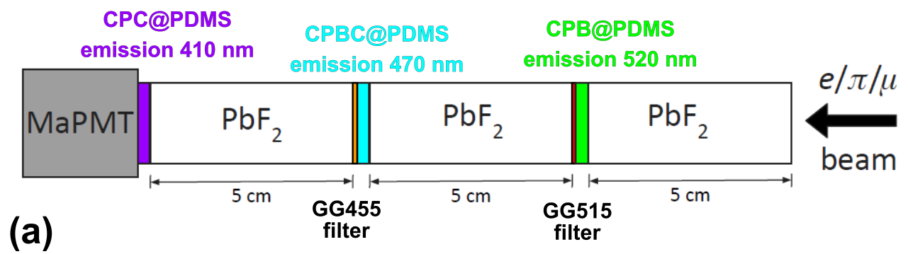
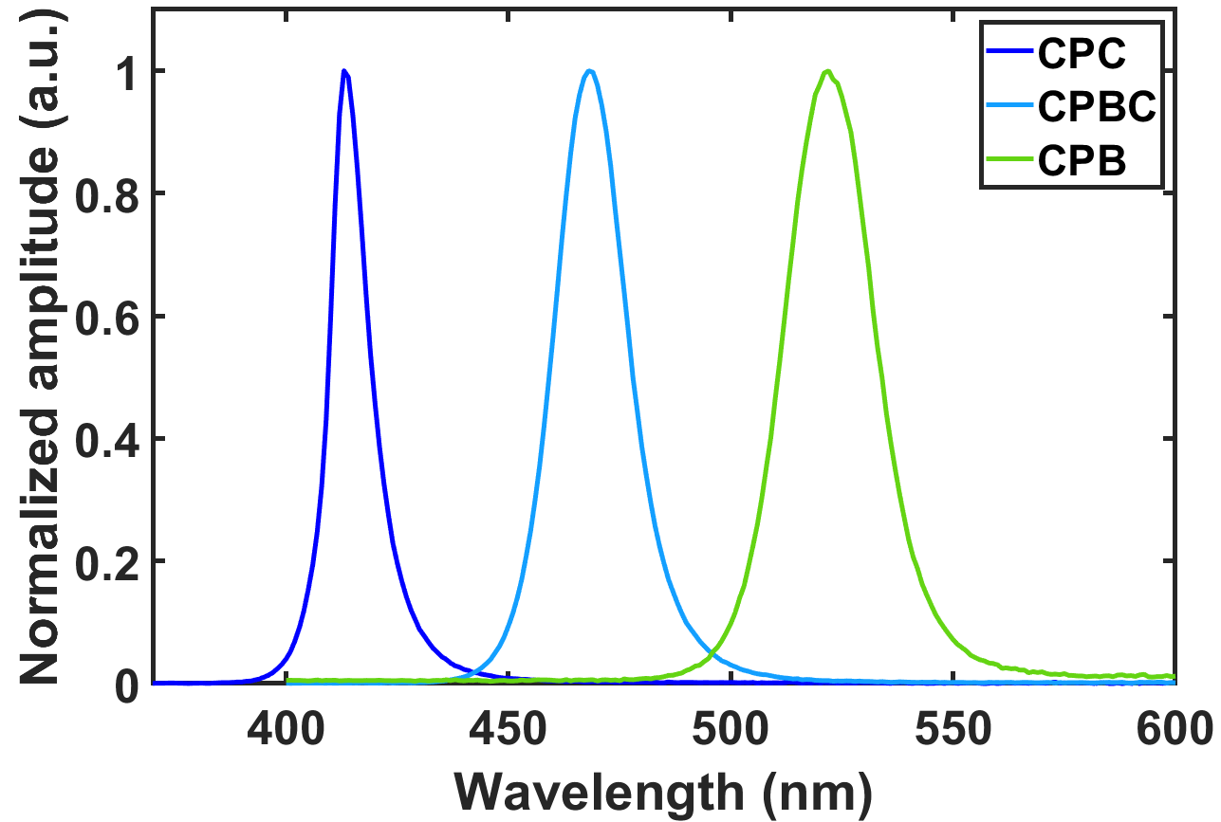
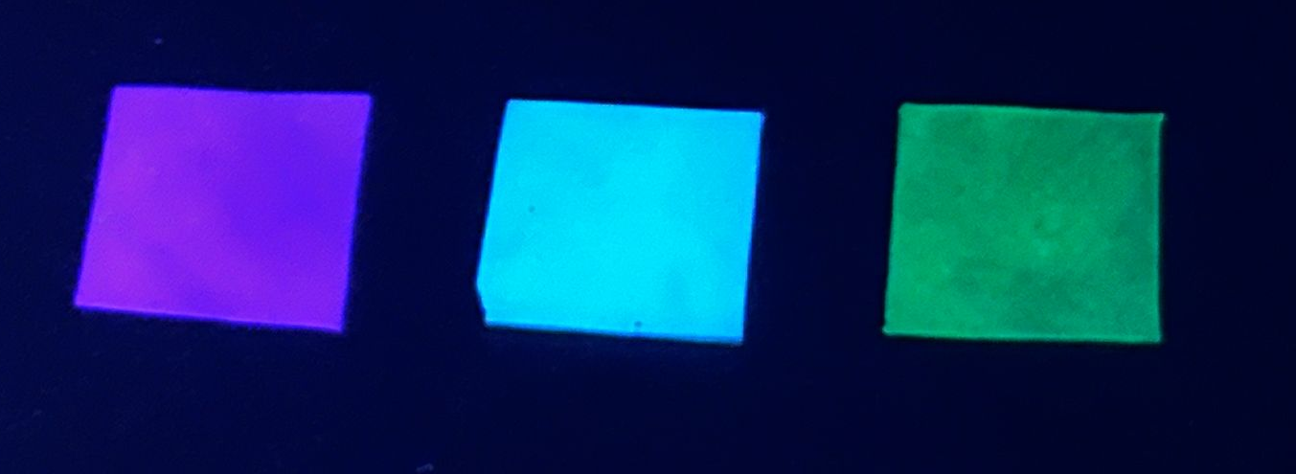
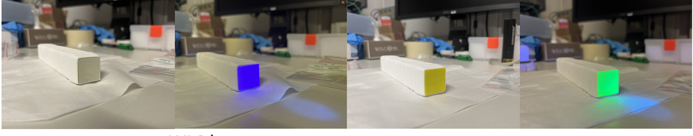
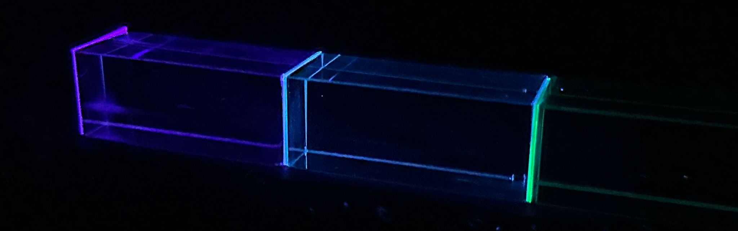
Samples for Chromatic calorimetry
polystyrene nanocomposites
3×2×2 cm³ samples for chromatic calorimetry experiments
scintillation prototype
September 2025 test beam at CERN SPS facility
PDMS nanocomposites
wavelength-shifting prototype
WLS layers with superior optical coupling
April 2026 test beam at CERN SPS facility
13

Slide 17
Conclusions and summary
developed AHFS functionalization enabling tailoring the NC surface for various polymer matrices
enhanced thermal polymerization resistance for bright CsPbBr₃ polystyrene nanocomposite fabrication
improved transparency thanks to copolymerizable groups
radiation hardness under high-energy electron and proton radiation of various nanocomposites explored
CPX₃ nanocomposites scaled and measured during test beam in CERN in chromatic calorimetry concept
14

Slide 18

Acknowledgements
This work was carried out in the frame of the Crystal Clear Collaboration.
Supervisor: Etiennette Auffray (CERN)
Supervisor-specialists: Eva Mihóková (FZU) and Kateřina Děcká (CTU)
Collaborators: Ildefonso León Monzón (UAS), František Hájek (FZU), Michal Horák (CEITEC), Yacine Haddad (CERN), Anne-Mazarine Lyon (CERN), Matteo Salomoni (CERN), Michal Horák (CEITEC), Jean-Louis Faure (CERN)
The project received support from EIC pathfinder UNICORN project (GA 101098649).
15

