Slide 1

Dysprosium-Doped Lithium Borate Glass for Dosimetry Applications
Presented by: Felix, Anastazia Tarimo
Advisor: Prof. Hong Joo Kim
Anastazia Tarimo Felix ¹, Nguyen Duc Ton ¹ Jaeyoung Cho¹, Nguyen Thanh Luan², D. Joseph Daniel¹
Faizan Anjum¹, Syed Azaz Ali¹ and Hong Joo Kim ^{1,2*}
¹Department of Physics, Kyungpook National University, Daegu 41566, Republic of Korea
²The Center for High Energy Physics, Kyungpook National University, Daegu 41566, Korea
Email*: hongjooknu@knu.ac.kr

Slide 2
OUTLINES
Introduction
Materials and Methods
Results and Discussion
Conclusion

Slide 3
1.INTRODUCTION
Properties of Glass
Optical properties application
Luminescence properties application
Why Dysprosium lithium borate glass used for dosimetry application
Objectives

Slide 4
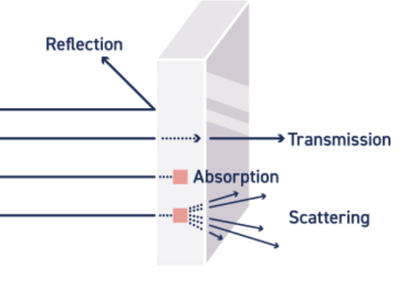
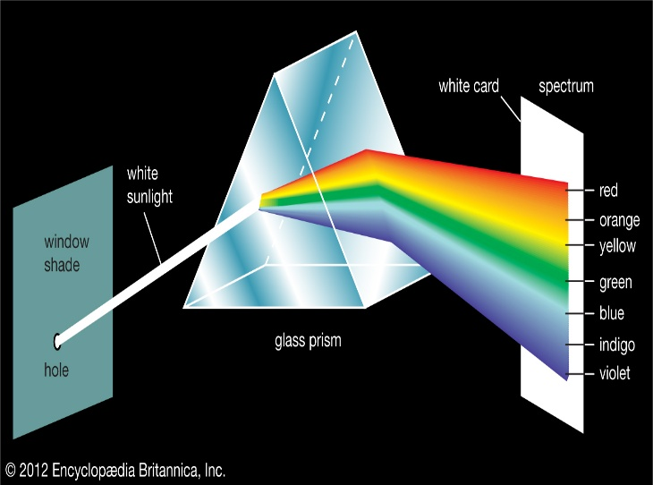
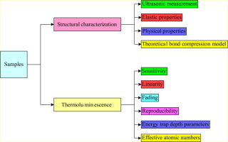
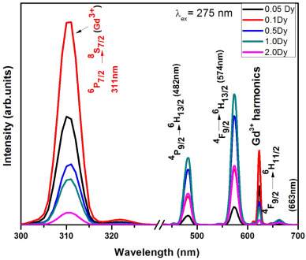
PROPERTIES OF GLASSES
Optical properties
i) Transmission
ii) Absorption
iii) Reflection
iv) Scattering
v) Refracted
Luminescence Properties
i) Photoluminescence
ii)Thermoluminescence
iii) X ray luminescence
Optical properties of glass
The white light gets split into the rainbow of colors, and it also gets bent (refracted),
Luminescence properties of dysprosium phosphate glass

Slide 5
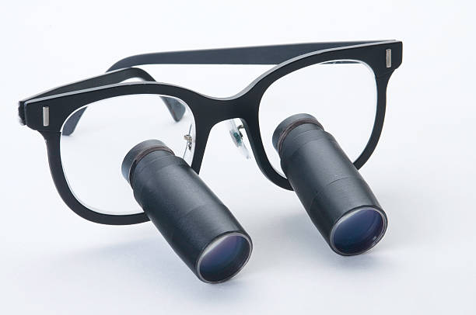
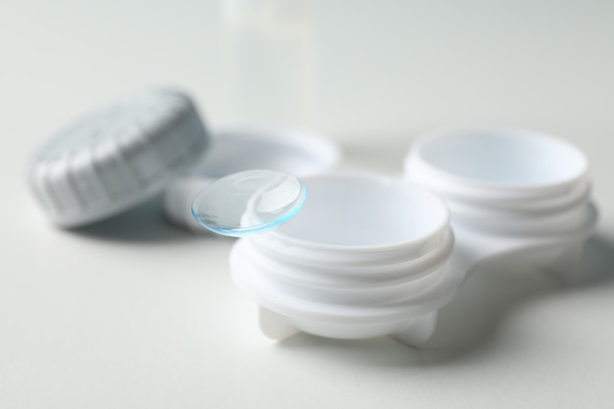

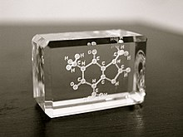

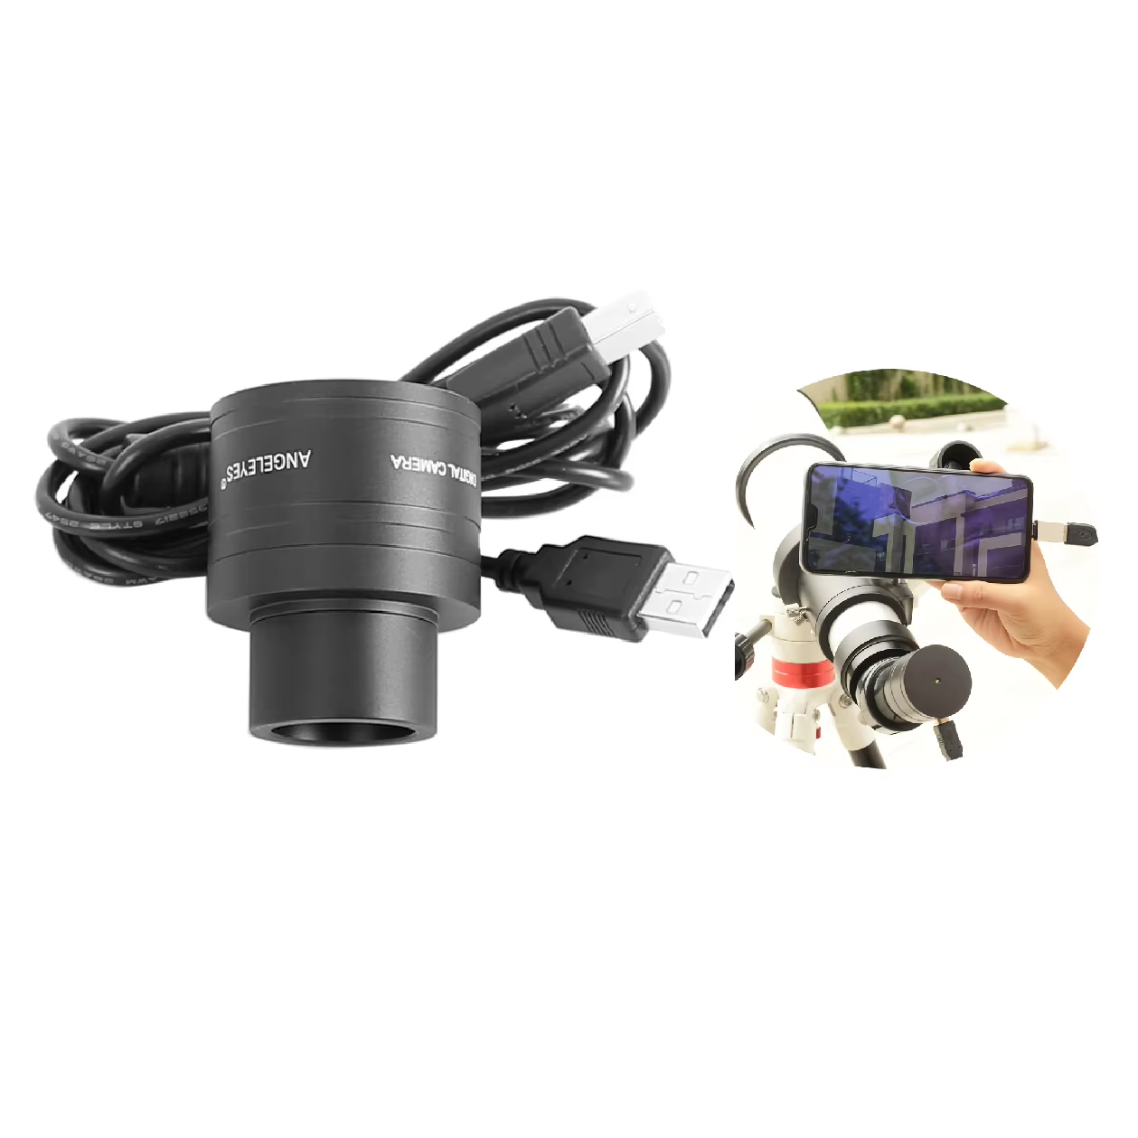
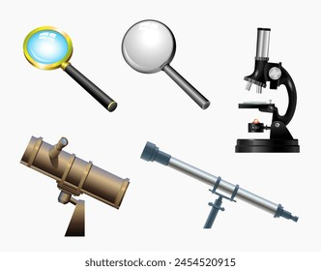
OPTICAL PROPERTIES APPLICATIONS
Medical eye wear
Medical eye Lense
Window
A laser glass sculpture of a caffeine molecule
Optical properties applications
Lenses
Windows
Cameras and Telescopes
Optical instruments
Laser
Telescope Camera
Wine Glass
Microscope Telescope

Slide 6
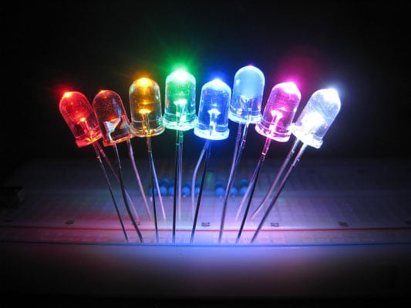
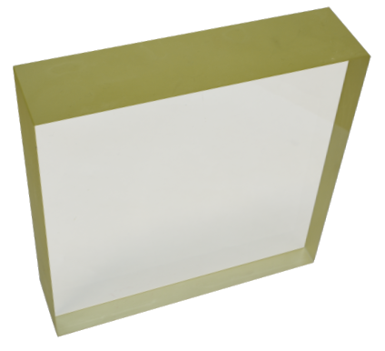
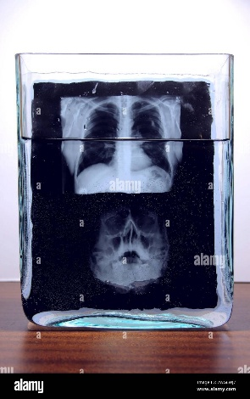
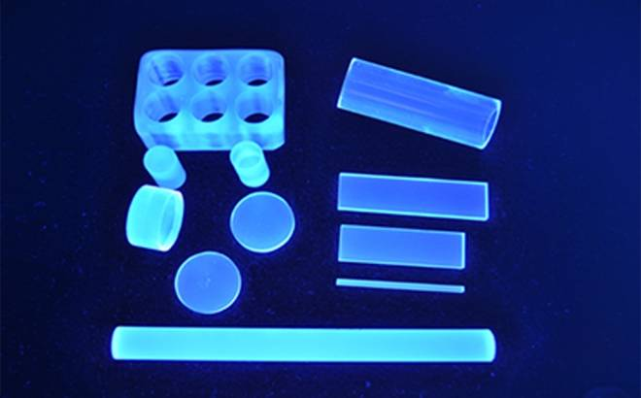
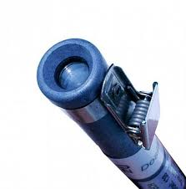
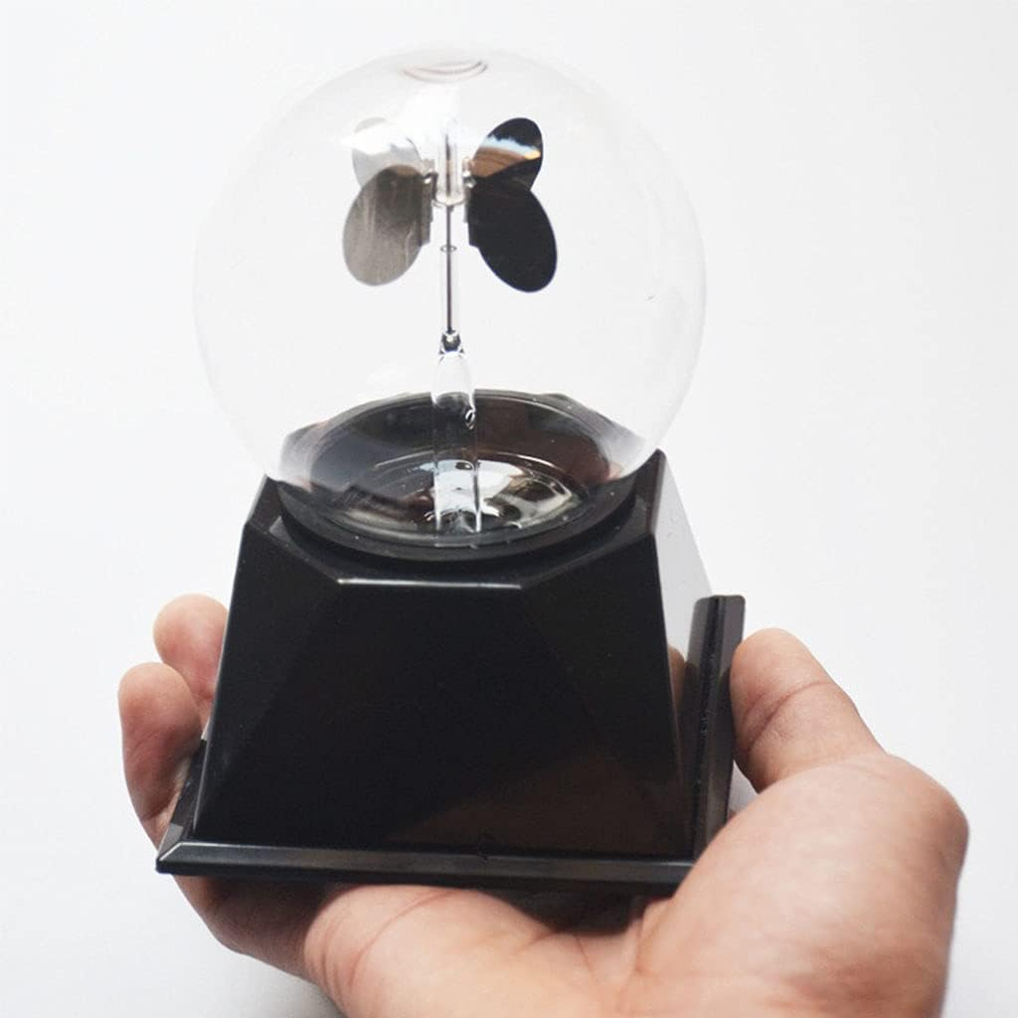
LUMINESCENCE PROPERTIES APPLICATIONS
Light emitting Diode
Guardian Glass neutron detection technology
Lead Glass Radiation shielding
Radiography results film of human skull x-ray scanning in glass laboratory vessel with liquid
luminescence properties application
Light emitting diode
X ray imaging
Radiation detection
Dosimetry application
For Energy Radiation Dosimeter Clear Solar Power Glass Science Education
Pen direct reading radiation dosimetry

Slide 7
Why Dysprosium Lithium Borate Glass for Dosimetry
Lithium Borate glasses are tissue equivalent material for radiation dosimetry due to their atomic number, similar to human tissue (Zeff = 7.42).
Alkali is added to glass materials to improve thermal stability, reduce viscosity, and boost color center formation under ionizing radiation.
Dy³⁺ ions are noted for light emission properties and their use in solid-state lasers

Slide 8
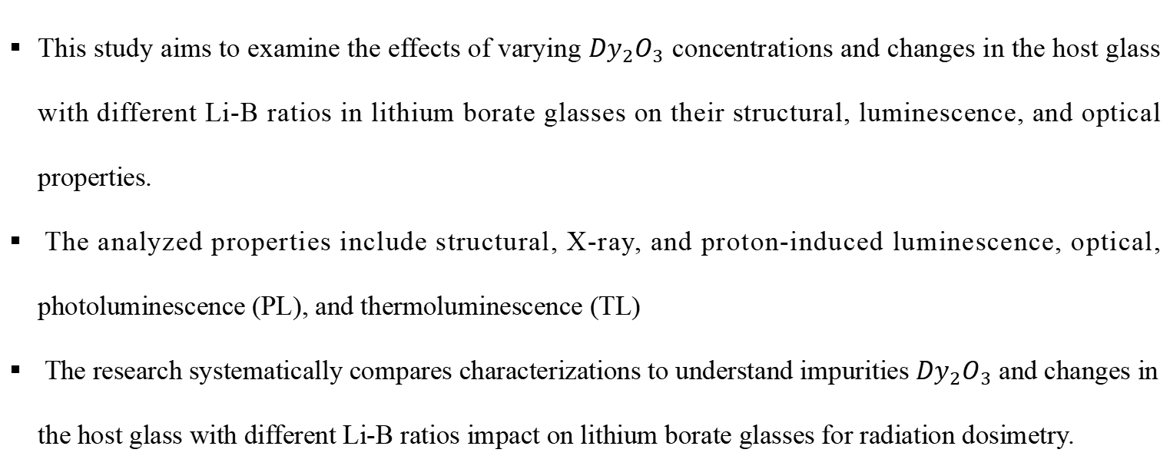
OBJECTIVES
This study aims to examine the effects of varying ${Dy}_{2}O_{3}$ concentrations and changes in the host glass with different Li-B ratios in lithium borate glasses on their structural, luminescence, and optical properties.
The analyzed properties include structural, X-ray, and proton-induced luminescence, optical, photoluminescence (PL), and thermoluminescence (TL)
The research systematically compares characterizations to understand impurities ${Dy}_{2}O_{3}$ and changes in the host glass with different Li-B ratios impact on lithium borate glasses for radiation dosimetry.

Slide 9
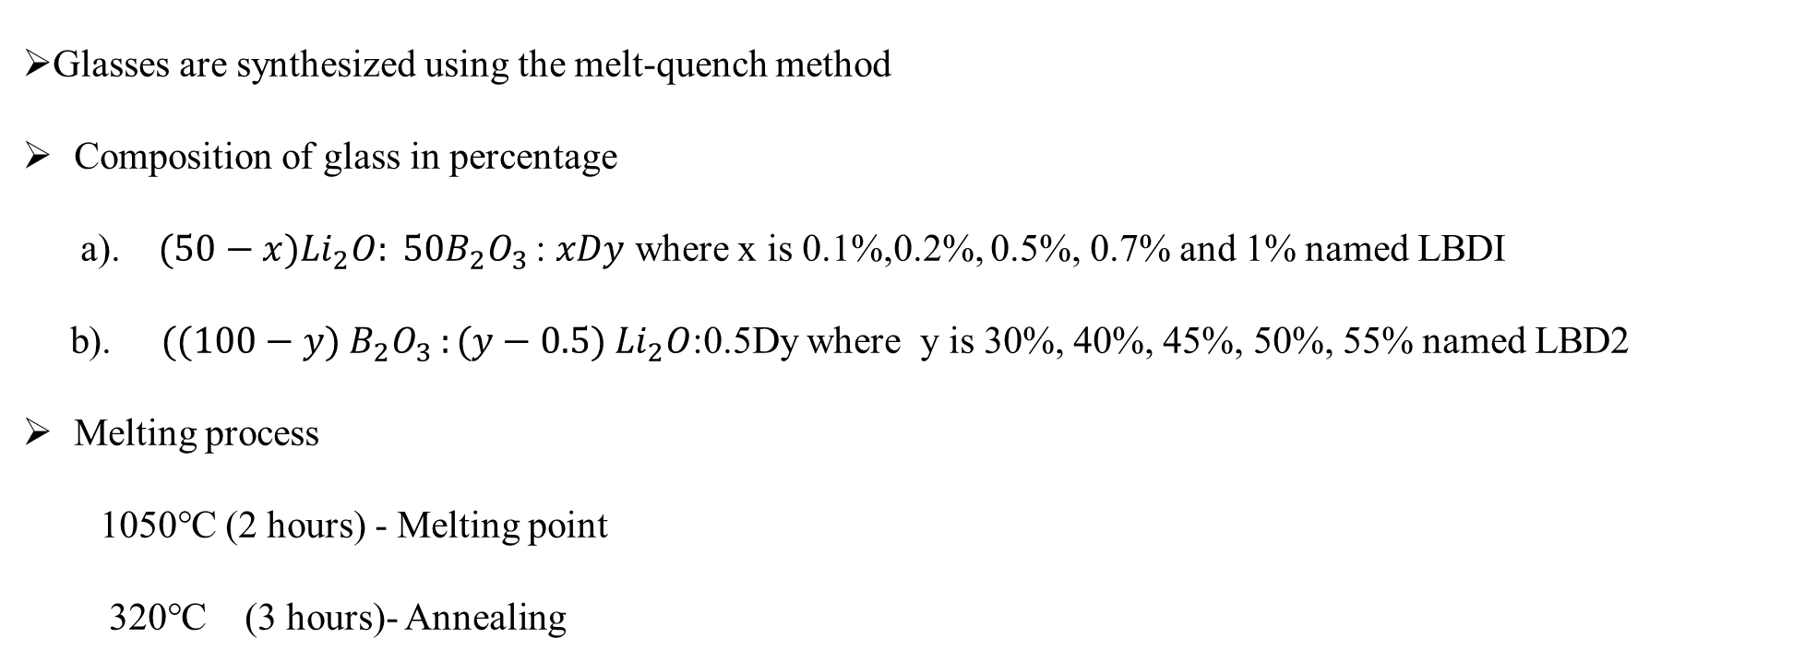
2. MATERIALS AND METHODS
Glasses are synthesized using the melt-quench method
Composition of glass in percentage
a). $(50−x{)Li}_{2}O: 50B_{2}O_{3 }$: $xDy$ where x is 0.1%,0.2%, 0.5%, 0.7% and 1% named LBDI
b). $((100−y) B_{2}O_{3 }:(y−0.5) {Li}_{2}O$:0.5Dy where y is 30%, 40%, 45%, 50%, 55% named LBD2
Melting process
1050℃ (2 hours) - Melting point
320℃ (3 hours)- Annealing

Slide 10
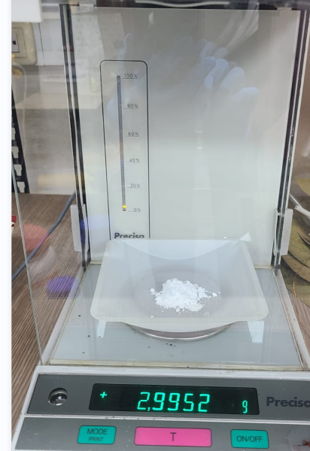
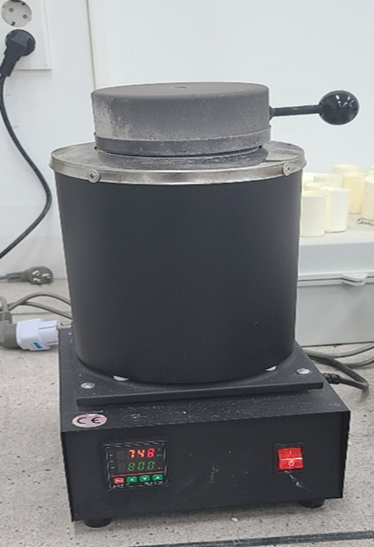
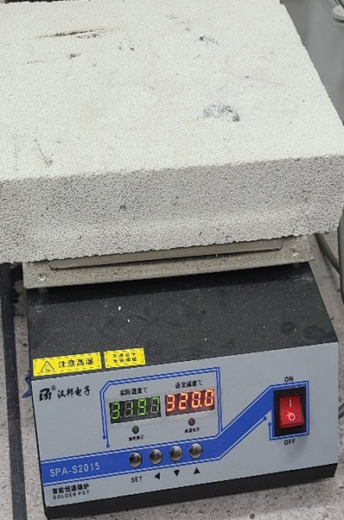
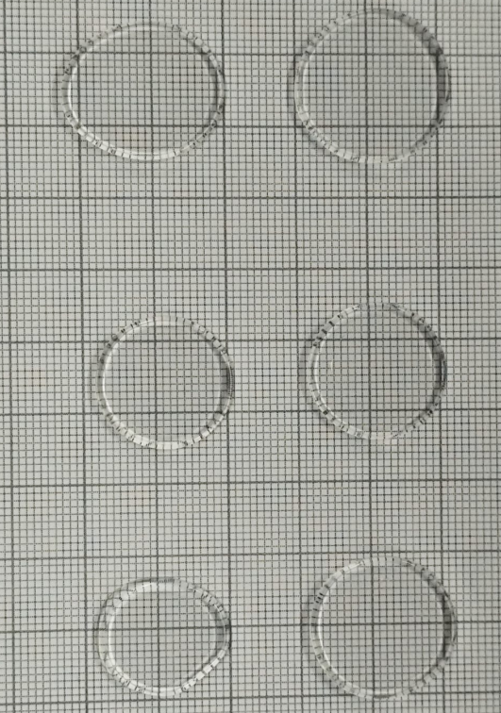
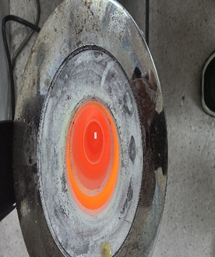
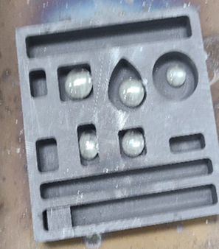
Experiment and Instrumentation
Glass Fabrication process
Annealing
Glass
Weighting
Melting
Instrumentation and Measurement process
XRD for Glass structure
Fluorescence spectrophotometer for PL Measurements
UV-visible spectrophotometer for Transmission properties
X ray Generator for X ray luminescence
TL spectroscopy for TL Measurement

Slide 11
3.RESULTS AND DISCUSSION
Structural, X-ray induced, and proton induced luminescence
Photoluminescence
Optical and Effective atomic number (Zeff)
Thermoluminescence

Slide 12
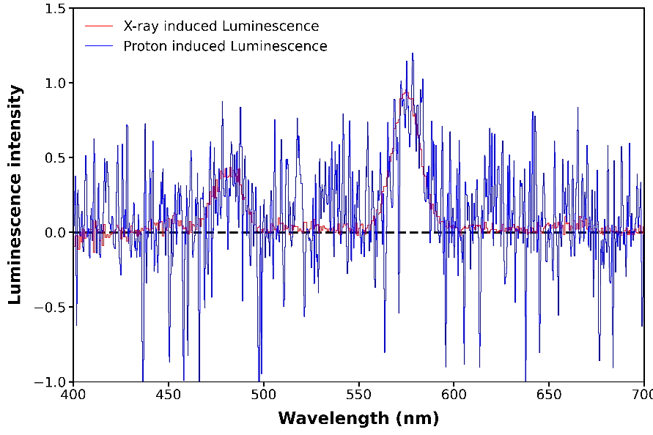
Structural, X-ray, and Proton Induced Luminescence
(i)
(ii)
(iii)
(i)shows XRD Spectra , (ii) shows x ray spectra, and proton induced luminescence
The XRD spectra display broad humps without any sharp crystallization peaks, indicating that the glass samples are amorphous in nature.
X ray and Proton induced luminescence shows strong peak at 575nm is because of ⁴F_{9/2} → ⁶H_{13/2} transition. While second most intense peak at 484nm is due to transitions ⁴F_{9/2} → ⁶H₁₅

Slide 13
Photoluminescence
PL decay time for prepared glass samples (a) LBD1 and (b) LBD2
Excitation spectra shows seven sharp peaks due to 4f - 4f transition of Dy³⁺ ions
The PL emission spectra exhibit two strong bands centered at 484 nm (blue) and 575 nm (yellow)
Average decay time decrease as increase concentration of Dy ion
(a) PL excitation spectra and (b-d) PL emission spectra for glass samples where a, c and d for LBD1 and b for LBD2 glass sample.

Slide 14
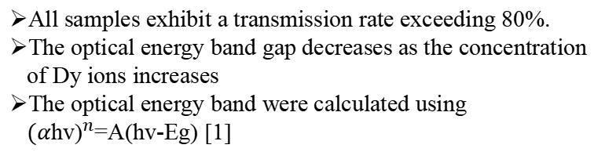
Optical and Effective atomic number (Zeff)
Z_{eff} of undoped and doped LBD2 composition
All samples exhibit a transmission rate exceeding 80%.
The optical energy band gap decreases as the concentration of Dy ions increases
The optical energy band were calculated using ${(α\text{hv}\text{)}}^{n}$=A(hv-Eg) [1]
(a) and (b) show the transmission spectra of the glass samples, while (c) and (d) present the linear absorption spectra and optical band gap of the glass samples, respectively. (a) for LBD2 and (b-d) for LBD1 glass sample.

Slide 15
Thermoluminescence
Tl glow curve for (a) undoped 30LI glass sample and (b) LBD2 glass sample
Tl glow curve for (a) LBD2 sample measured 48hrs after x ray irradiation and (b) the 30LI glass sample measured at different time intervals after X-ray irradiation
The undoped glass sample exhibits a TL intensity peak at approximately 123 °C, while the doped glass sample shows highest intensity peaks ranging from approximately 137 °C to 187 °C, as measured 10 minutes to 48 hours post irradiation
The analysis has indicated that the glow curves glass samples consist of three overlapping thermoluminescence (TL) peaks
Glow curve analysis for 30LI using deconvolution (a) measurements taken 10 minutes after X-ray irradiation and (b) measurements taken 48 hours after X-ray irradiation

Slide 16
4.CONCLUSION
Our findings emphasize the distinctive properties of Dysprosium-doped lithium borate glasses, making them valuable for various applications, particularly in radiation detection and dosimetry.
This research enhances the understanding of the behavior of Dysprosium-doped lithium borate glass under various excitation sources, emphasizing its potential applications in fields like radiation detection and dosimetry.

