Slide 1
Fluorozirconate compounds synthesised by a facile hydrothermal method for radiation detection application
D J Daniel
CHEP, KNU
CHEP Joint International Workshop: Detector Development for High Energy Physics and Various Applications & 7th Luminescence Materials Workshop
(Date: February 11 to 14, 2025 Place: High-1 Resort, Jeongseon)

Slide 2
Advantages of Fluoride Crystals
Fluoride crystals are popular scintillation materials which could be used in the various applications of fundamental and applied research. Laser application, Ionic conductors, Optical window materials vacuum ultraviolet (0.12 µm) to mid IR range (12 µm).
Moreover, these Fluorides possess the additional advantages of low refractive index, good thermal and mechanical stability.
These fluorides are not hygroscopic, if we compare them with other typical halides (Cl⁻,Br⁻,I⁻).
However,
There is no research going on Tl-based fluorides for scintillators.
Therefore, replacing the Fluorine anion will be the new direction and the possibility of finding new non-hygroscopic potential scintillator crystals.

Slide 3
Challenges in High temperature melt methods
Though fluoride crystals have many good features and applications, the major disadvantage is the crystal growth part.
Usually, fluorides are grown by two major high-temperature melt growth methods, namely, Bridgman-Stockbarger and Czochralski. However, in the traditional melt methods, there are some disadvantages such as:
high thermal strains during the cooling time,
sticking to the walls of the crucibles and ampoules.
difficulty in growing incongruent melting behaviour materials .
Corrosive nature: reacts with quartz, (whereas Cl⁻,Br⁻,I⁻ can be easily grown by quartz).

Slide 4
Challenges in Fluorides
The aggressive behavior of fluoride melts and vapors set forth specific requirements for construction materials, such as heaters, crucibles, thermo-insulators, and other materials used in crystal growth devices.
Fluorine is one of the most reactive elements.
Fluorine easily reacts with Oxygen and forms complexes such as OH⁻ hydroxyl radicals, which efficiently substitute for the F⁻ ions in the crystalline structure.
Requires very specific procedures.
Corrosive nature: reacts with quartz, (whereas Cl⁻,Br⁻,I⁻ can be easily grown by quartz).

Slide 5
Hydrothermal Method
A possible method alternative to the traditional melt methods, the hydrothermal technique, is the best choice for the synthesis of complex fluorides . This hydrothermal method has several advantages such as :
Safe reaction conditions (low growth temperature ˂= 200℃).
cost-effectiveness (certainly lower cost compared to high-temperature melt methods).
Easy handling process.

Slide 6
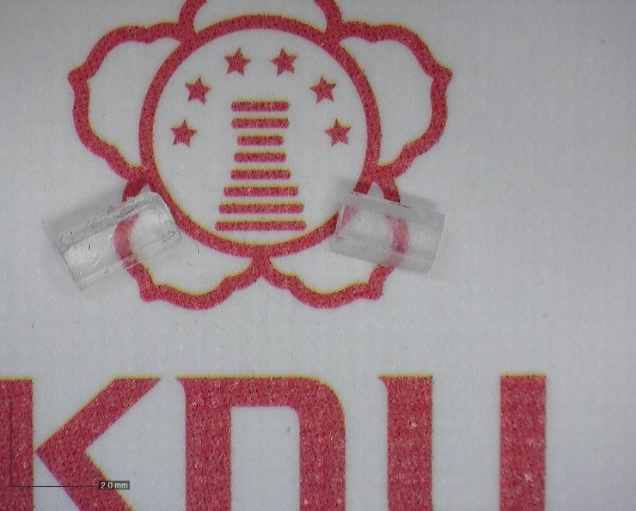
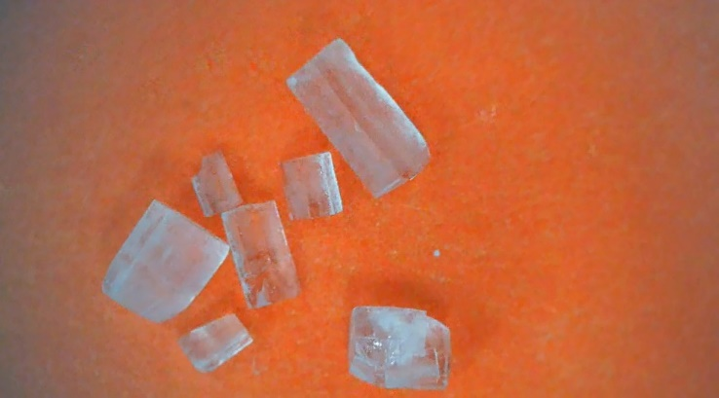
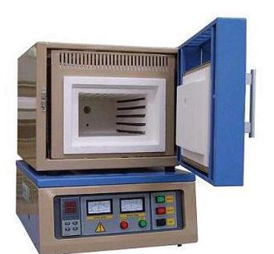
Hydrothermal Method
Hydrothermal synthesis is a wet-chemistry technique that produces complex inorganic powders in a supercritical state and/or sub-critical state.
By changing the reaction variables such as reaction temperature, reaction pressure, mineralizer concentration and additive concentration, nucleation and/or crystal growth rates can be controlled easily in the hydrothermal process.
PTFE Teflon
Solution preparation
Stainless steel Autoclave
Digital photograph of as-grown Li₄ZrF₈ single crystals (microscopic view)
180 degree C for 24 hrs

Slide 7
Fluorozirconates
The family of fluorozirconates denotes a wide range of compounds with various stoichiometric compositions such as AxBF_{y} (A = monovalent, divalent, or trivalent metal ion or inorganic/organic cation; B = Zr/Hf; x=1,2,3; y= 5,6,7).
these fluorozirconates are of great interest in investigating the physical and chemical properties due to their potential applications in several fields.
The high atomic coordination number of zirconium fluoride (ZrF₄) is 6, 7, or 8 and the coordination polyhedra can be linked to each other by vertices, edges, and faces leading to the formation of various crystal structures .
In recent decades, fluorozirconates and fluorohafnates have been investigated for their potential use as:
solid electrolytes for high ionic mobility, luminescence and ferroelectrics materials.

Slide 8
Thallium Based (high-density) Scintillators
Thallium (Tl) is one of the largest and heaviest chemical elements in the group 13 elements.
It has the following physico-chemical properties such as:
Tl has the electronic configuration of s²p¹ outer electron configuration.
Heavy metal ions with an ns² electron configuration are commonly producing luminescence bands at ambient conditions.
Tl⁺ ion is well known as an efficient luminescence activator and used widely in commercial scintillators such as NaI: Tl⁺, and CsI: Tl⁺
Not only, an efficient activator, but as a host member the heavy Tl⁺ ion gives rise to a high density and effective number of host compounds significantly.
The high Z_{eff} material can produce high photoelectric conversion efficiencies of high-energy photons, since the probability of interaction by the photoelectric effect is proportional to the density and Z_{eff} of material.
atomic weight (204.4) | melting point (303.5°C)
atomic number (81) | boiling point, 1457°C and
density (ρ, 11.9 g/cm³) | two oxidation states Tl⁺, and Tl³⁺

Slide 9
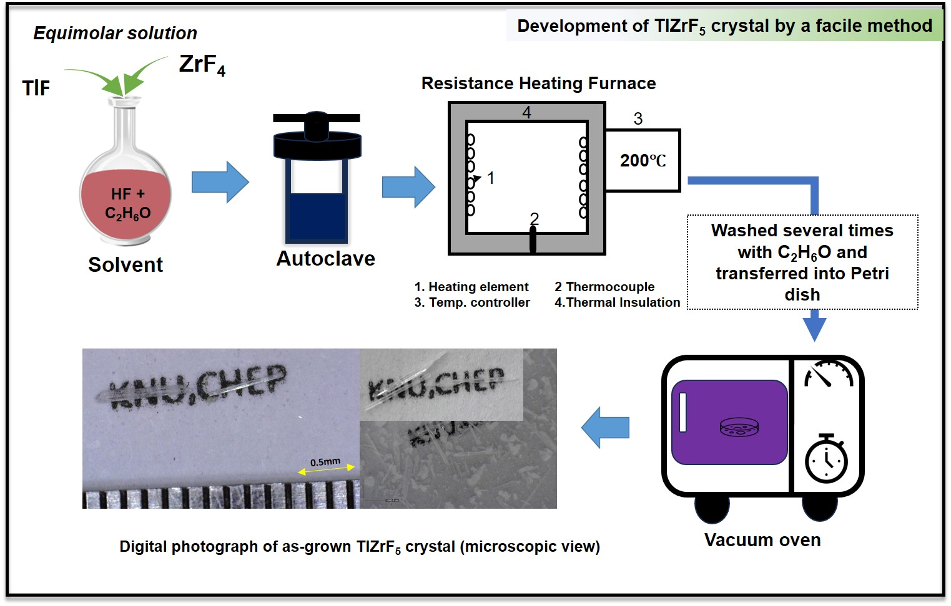
A fluorozirconate compound: TlZrF₅

Slide 10
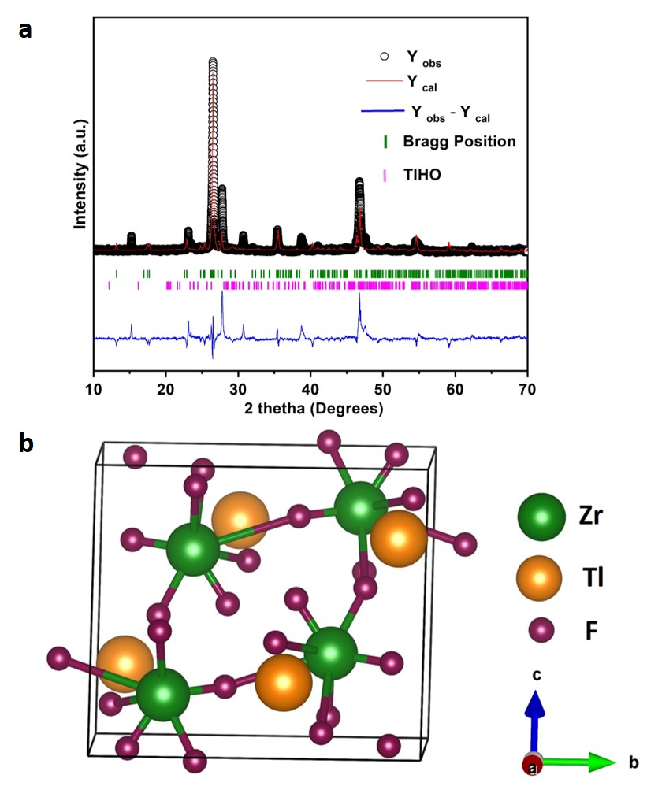
Structural phase confirmation
The crystal structure and phase formation of the grown crystal were confirmed through the PXRD analysis.
Table. Refined crystallographic parameters of TlZrF₅
a) Experimentally observed diffraction data (solid circles) and calculated diffraction peaks (red line) of a TlZrF5 sample. b) Typical unit cell packing diagram.
 | TlZrF₅
Crystal System | Monoclinic
Space Group | P 2₁/c
Lattice Parameters | a = 8.1005(4) Å b = 7.8646(4) Å c = 7.9570(7) Å α = γ = 90° β = 123.812(4)°,
Unit Cell Volume | V = 421.18(5) Å³
R_{p} % R_{wp} % χ² | 7.4 10.3 1.28

Slide 11
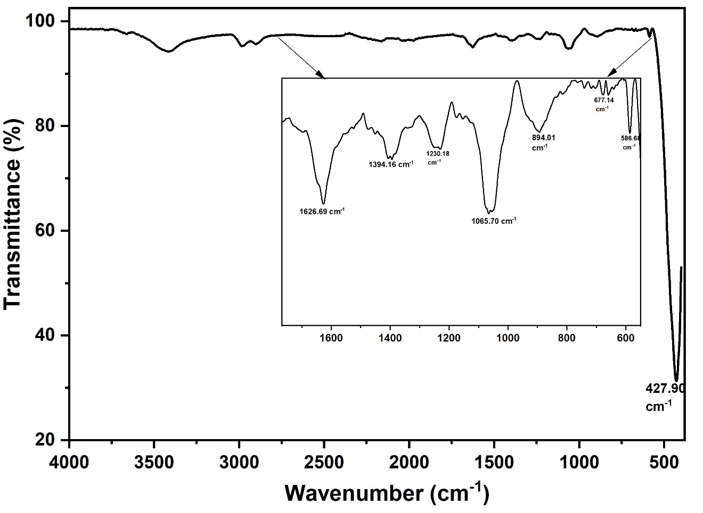
FT-IR spectral analysis
The presence of the peak at 3416 cm⁻¹ depicts the surface adsorbed OH- moiety.
The peak at 586.68 cm-1 is related to the in-phase stretching vibrations (νs) of ZrF₈, which closely agree with other fluorozirconate compounds β-BaZrF₆.
The bands in the region of 500 - 675.73 cm⁻¹ correspond to the metal-fluorine stretching modes. Similar bands were observed for other tetrafluorides at 650 cm-¹.

Slide 12
XPS and EDAX analysis
The Zr 3d spectrum was deconvoluted into three significant peaks corresponding to Zr 3d_{5/2}, Zr 3d_{3/2}, and Zr-F, with binding energies of 184.2 eV, 186.5 eV, and 188.4 eV, respectively. The energy difference between the 3d_{5/2} and 3d_{3/2} peaks was measured at 2.3 eV, which is consistent with the characteristics of zirconium metal.
The F 1s spectrum was also deconvoluted into three primary peaks at binding energies of 684.5 eV, 685.9 eV, and 687.8 eV, corresponding to F 1s, metal-fluoride, and Tl-F, respectively.
The presence of thallium, zirconium, and fluorine was confirmed in the highlighted area. The ratios obtained from the XPS analysis were strongly corroborated by the EDX analysis.
XPS spectra for TlZrF5 sample: a) wide scan spectrum, b) Zr 3d, c) F 1s, d) Tl 4f. e) A recorded electron image and an EDAX spectrum

Slide 13
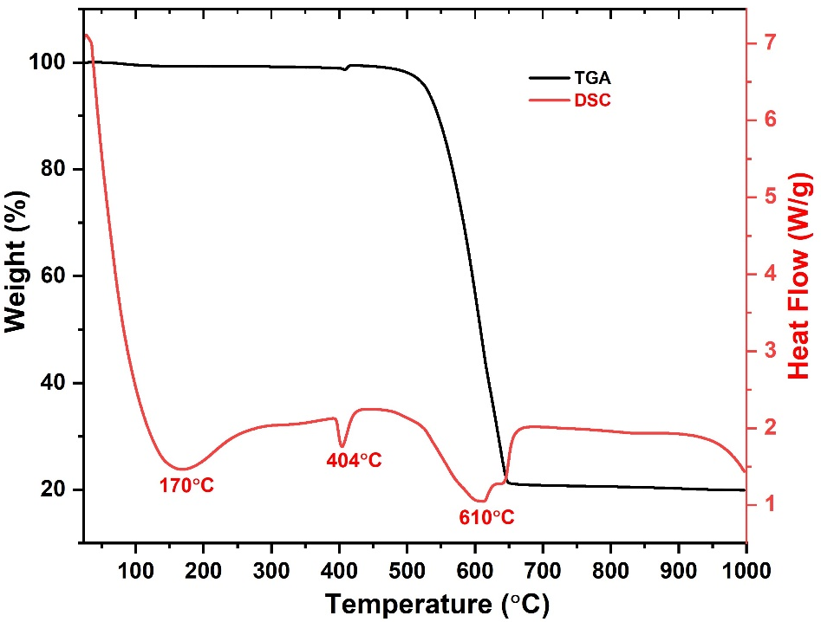
TGA/DSC analysis
Three endothermic extrema were noticed. The first one, a broad endothermic peak maximum of around 170℃, is the result of the impurity phase (TlHO, which is confirmed in the refinement process of PXRD analysis) in the trace amount.
The second sharp endothermic peak at 404℃ corresponds to the melting point of the crystal sample.
Afterwards, weight loss begins, and a third endothermic peak is observed at a maximum of 610℃ corresponding to the decomposition of the compound.
The measured TGA/DSC curves for the TlZrF5 sample.

Slide 14
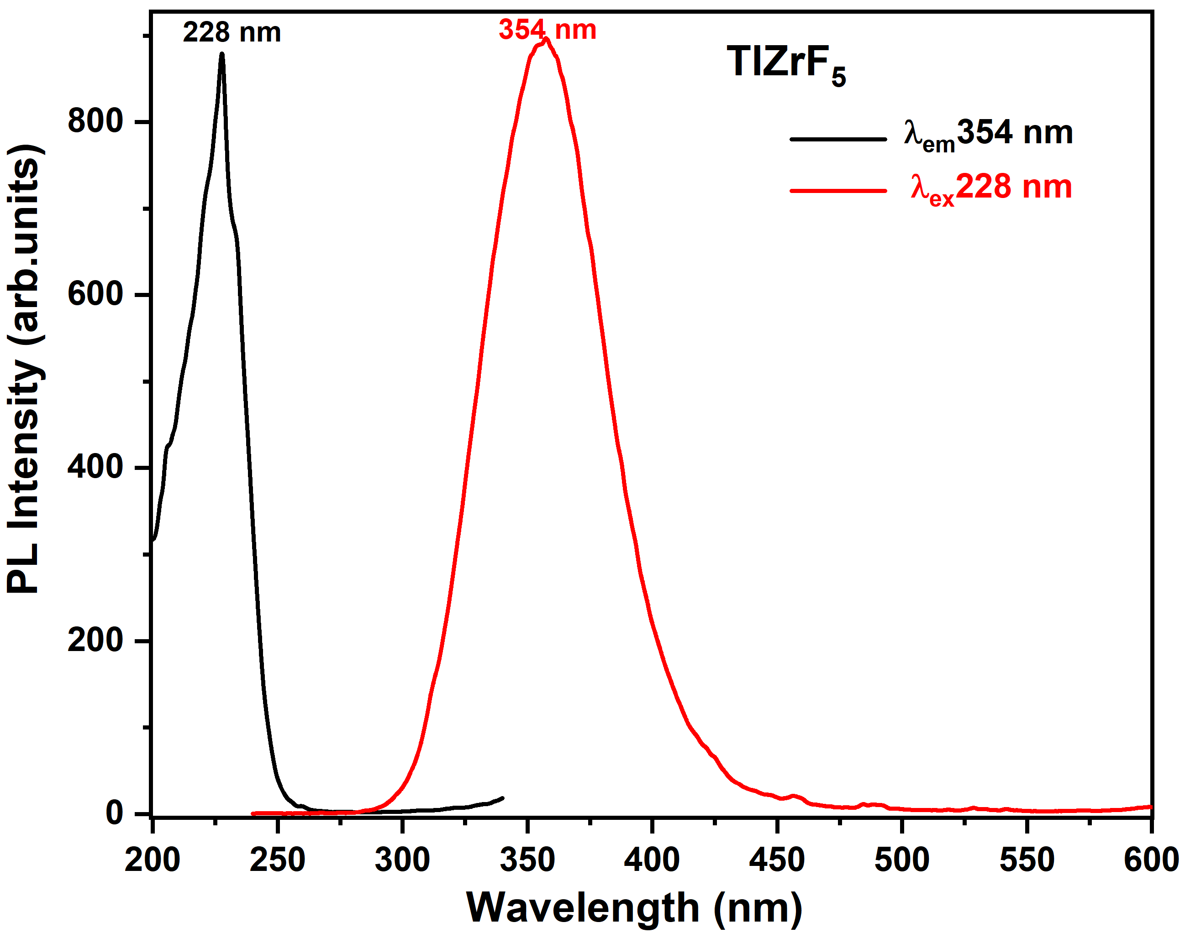
PL analysis
The observed emission band at 354 nm is caused by the electronic transition of Tl⁺ ion. The maximum peak excitation band at 228 nm is related to the ¹S₀ → ³P₁ transition, which is generally denoted as the A band. In the case of emission, excitation in all bands yields the same emission peak at 354 nm, which corresponds to the spin-orbital-allowed transition ³P₁ → ¹S₀.

Slide 15
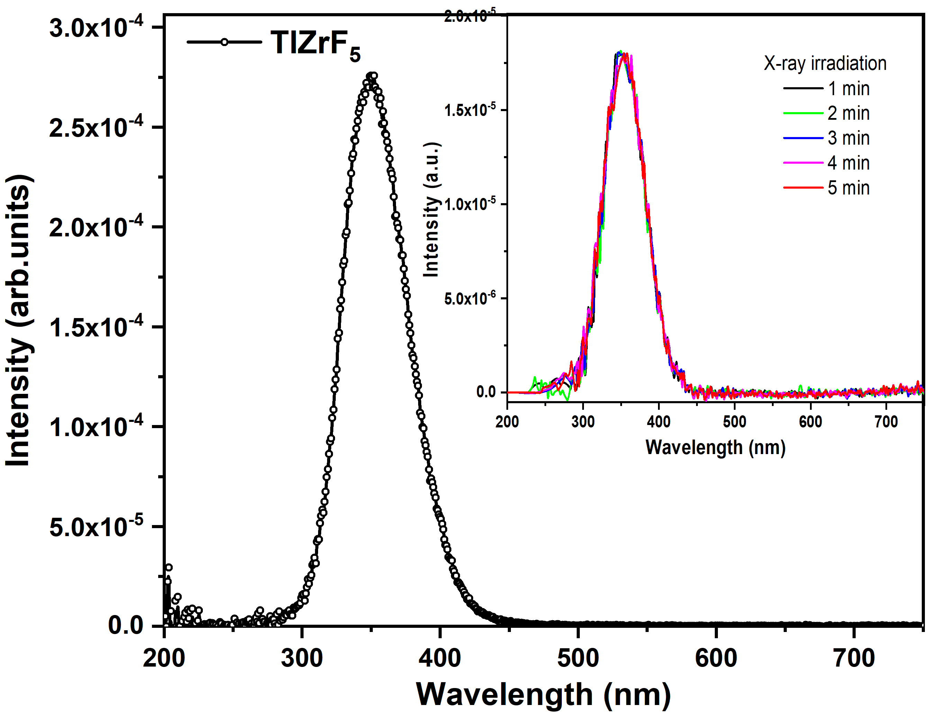
X-ray induced luminescence
In TlZrF₅ compound, the observed emission is intrinsic, and it is due to the transition between the upper split levels of the ³P₂ term and the ¹S₀ state of the Tl⁺ ion.
The observed emission wavelength region at 350 nm is consistent with the observation of a previous report by Godneva et al [30] for various fluorozirconates such as KZrF₅, RbZrF₅·H₂O, and β-CsZrF₅·H₂O.
The initial intensity is not changed after irradiation, which confirms that this material possesses good radiation hardness and there is no change in color of the sample after irradiation
X-ray excited luminescence of TlZrF₅ compound. The inset shows the X-ray emission intensity with 5 min of continuous X-ray irradiation. (HV 100 kV and 2 mA, which is equivalent to 86 rad).

Slide 16
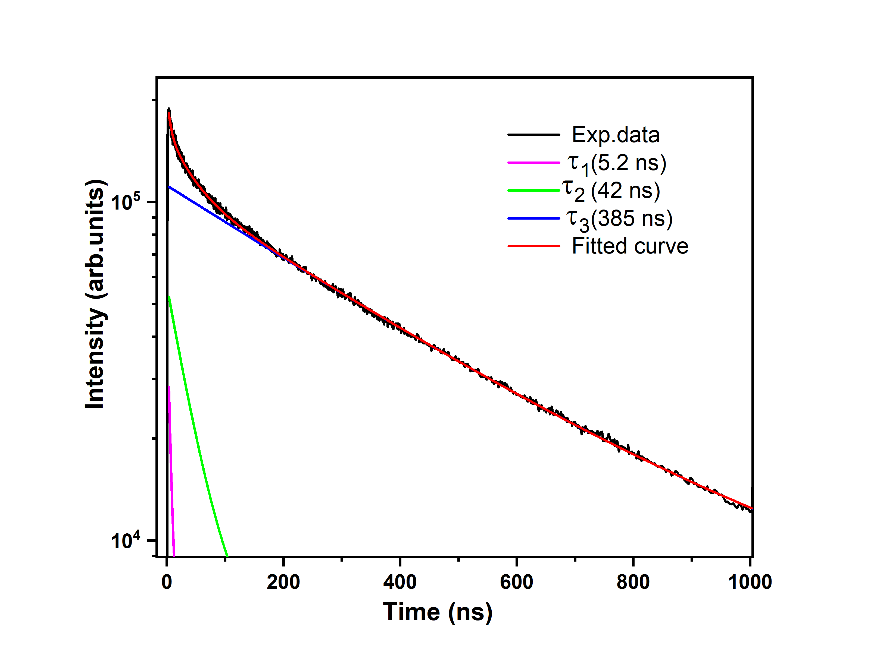
Decay time
The decay time for the 353-nm emission of the sample, measured under the pulsed 110-keV electron beam excitation at room temperature.
The fitting parameters are as follows: a fast component with τ1=5.2 ns (9%), a medium component with τ2=42 ns (12%), and a slow component with τ3=385 ns (79%), where the numbers in brackets show relative initial amplitudes.
Decay curve of TlZrF₅ emission measured under 110 keV excitation at room temperature.

Slide 17
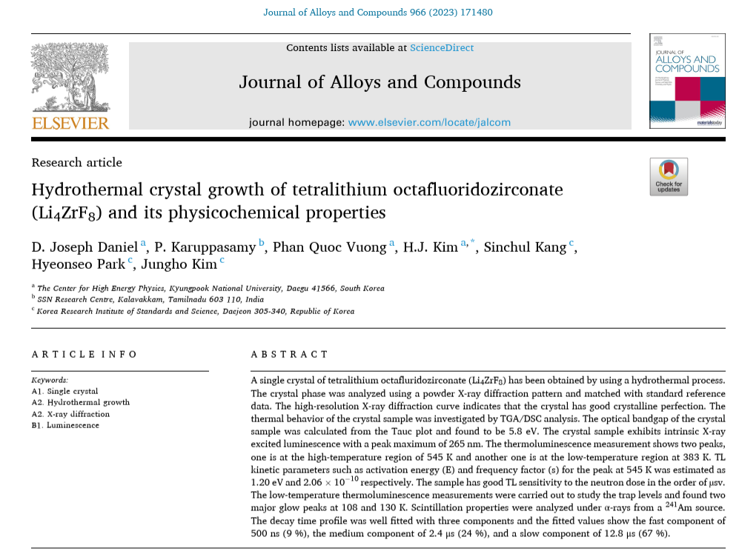
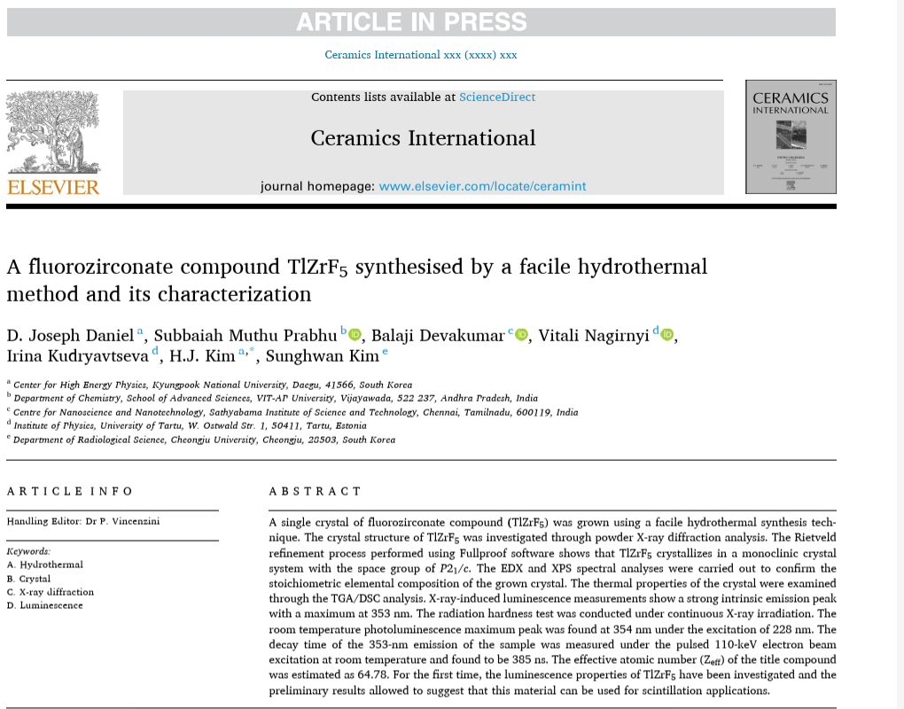
Recent publications on fluorozirconates

Slide 18
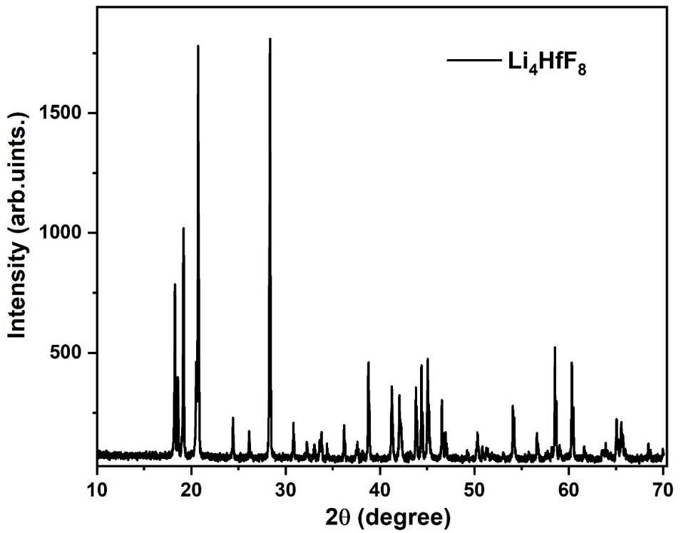
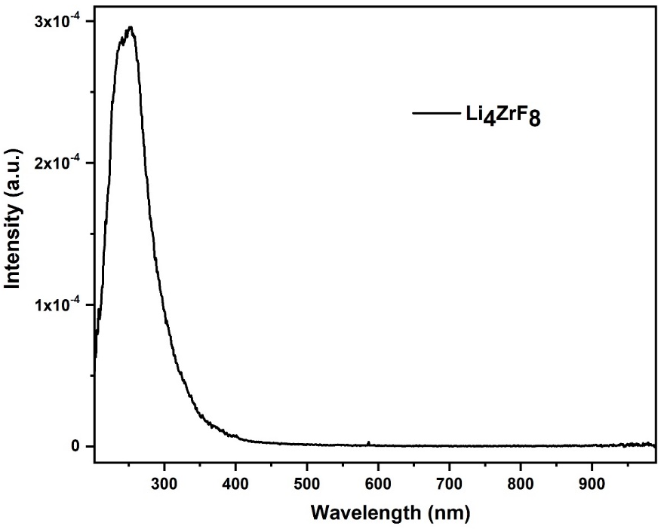
Other ongoing fluorozirconates

Slide 19
Summary
A possible method alternative to the traditional melt methods, the hydrothermal technique, is the best choice for the synthesis of complex fluorides.
TlZrF₅ has been successfully synthesized using hydrothermal method.
The strong intrinsic X-ray luminescence, high density and high Zeff are desirable properties for scintillation applications.
The synthesis process of other fluorozirconates and fluorohafnate compounds are ongoing.

Slide 20
Acknowledgement
This research was supported by the National Research Foundation of Korea (NRF No-2018R1A6A1A06024970) RS-2023-00248006-0-1 funded by the Ministry of Education, Korea.

Slide 21
Thank you for your kind attention

