Slide 1

Role of Gluons:
Gravitational form factors and
Spin-Orbit Correlations
Hyun-Chul Kim
Department of Physics, Inha University
Incheon, Korea
APCTP Workshop, June 25-28@Incheon

Slide 2


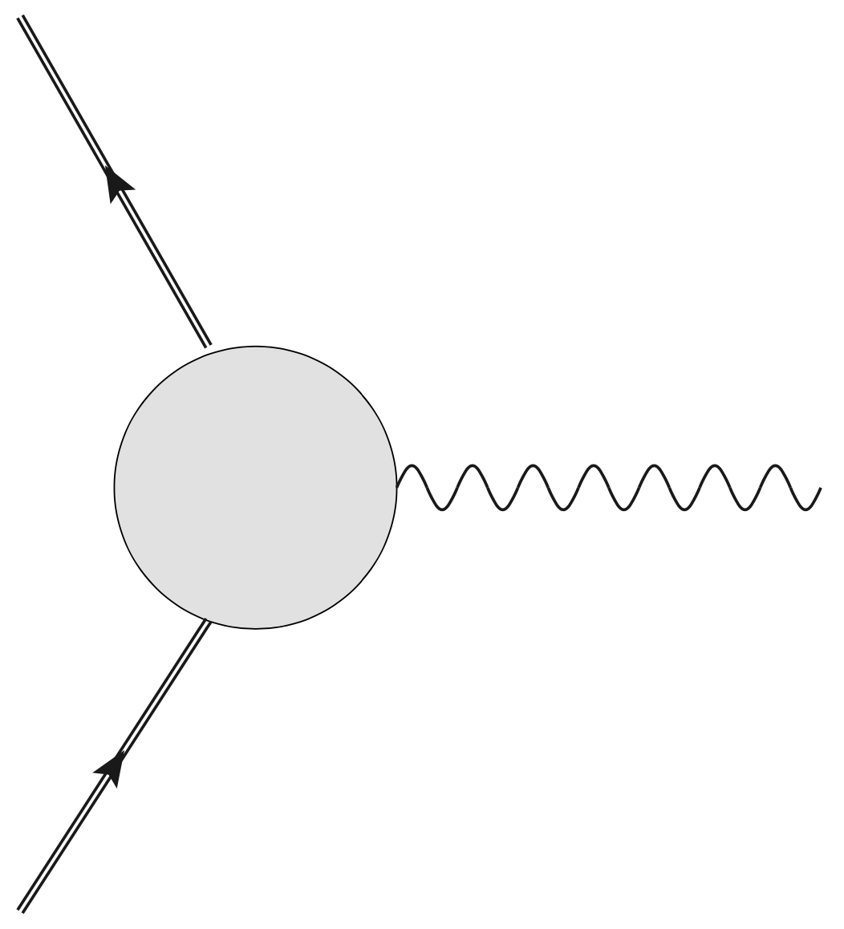
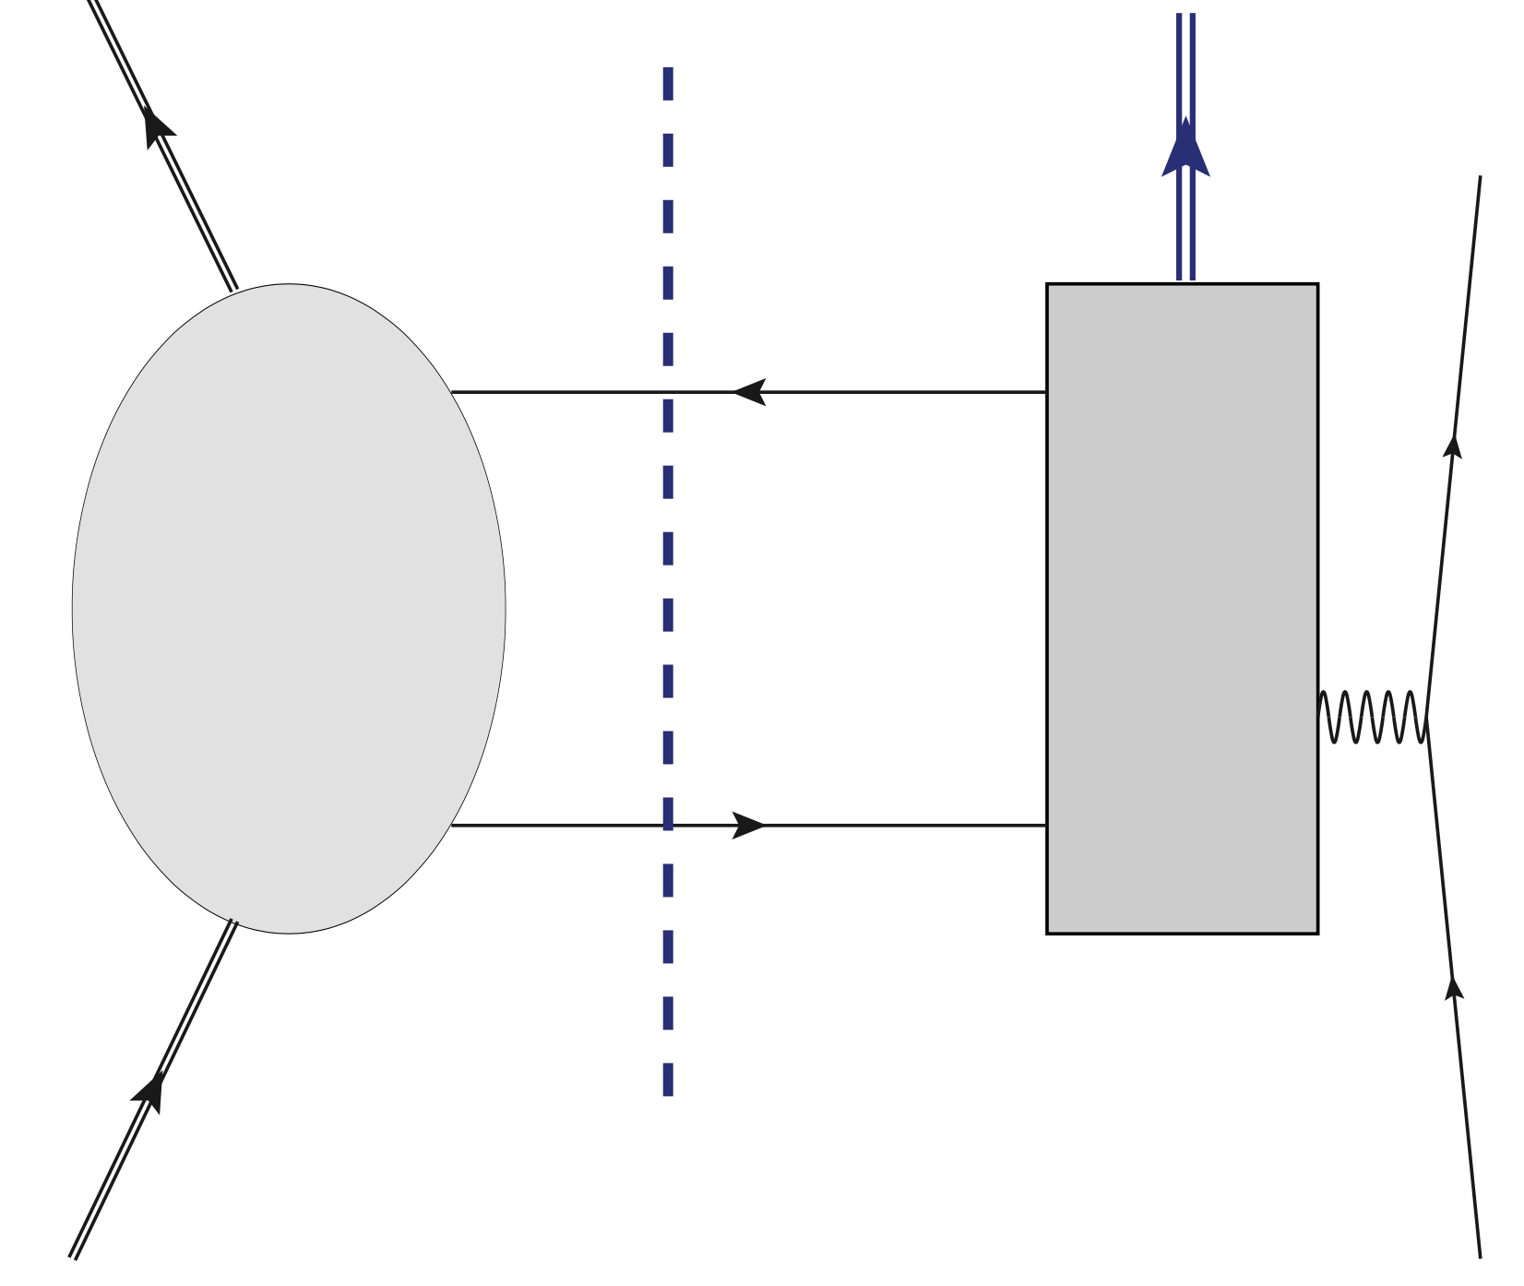








Introduction: Hadron Structure in QCD
Noether current as a probe
QCD operators
Scale invariance
Soft part (npQCD)
Hard part (pQCD)
EM form factors
Electroweak form factors
Gravitational form factors
Scale-dependent
Gluons enter!
Hadronic matrix
elements
governed by symmetries

Slide 3





Effective QCD operators
QCD
Low-energy Effective
quark-gluon dynamics
(Essential physics: SBXB)
QCD operators
Effective QCD operators
Twist-2 effective operators
are determined by dynamics.
Twist-2

Slide 4
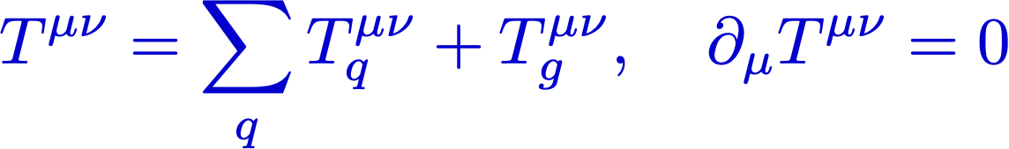
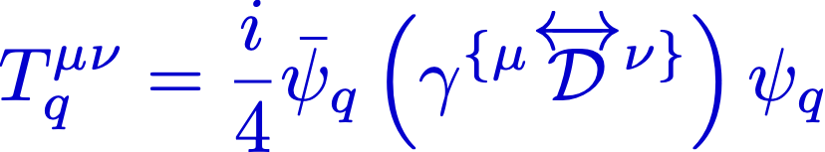
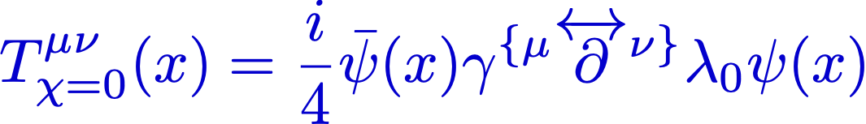
Example: Flavor-decomposition of EMT operators
Energy-momentum tensor operators:
M.V. Polyakov and P. Schweitzer, IJMP. A 33 (2018)
QCD operators
Effective QCD operators
(Gluons integrated out)
However…
Flavor decomposition of GFFs require both twist-2 & twist-4 EMT operators.
But we don’t know how to derive the flavor-nonsinglet EMT currents
without ambiguity.
H-Y. Won, HChK, J.-Y. Kim, JHEP 05 (2024)

Slide 5
Gravitational form factors
of
the proton

Slide 6
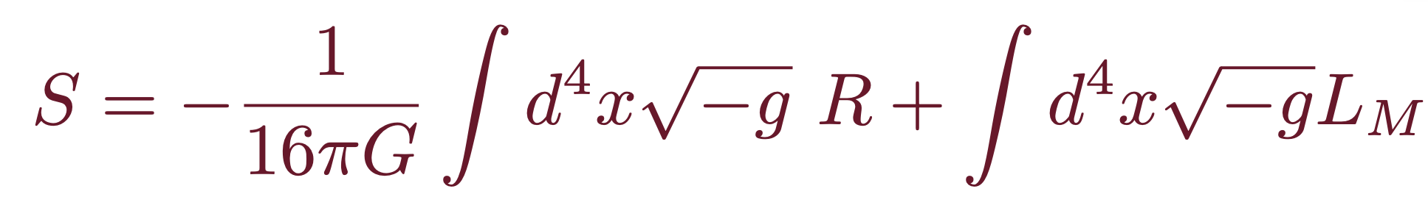


Energy-Momentum Tensor operators
Hilbert-Einstein Action
Changing the metric in the long-wave approximation,
we find the Energy-Momentum tensor that characterizes the response of
the nucleon to the static variation of the space-time metric:
Bellifante-Rosen type QCD EMT Current
Quark part
Gluon part

Slide 7




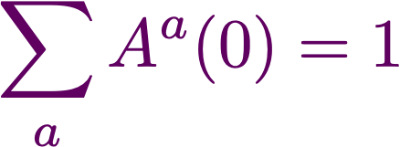
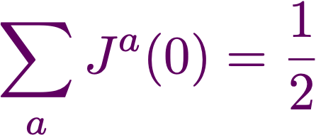
Gravitational (EMT) form factors
Gravitational form factors of the nucleon in QCD
D(Druck)-term
Weiss & Polyakov, 1999
Non-conservation
of EMT pieces
(cosmological constant)
Mass
Spin
O. V. Teryaev, Front. Phys. 11 (2016)
K.-F. Liu, PRD 104 (2021)
Deformation of space
= mechanical properties of the nucleon
Pressure & Shear-force distributions (pressure anisotropy)
Pressure & Shear-force distributions (pressure anisotropy)
Kobzarev et al. 1962; Pagels, 1966

Slide 8
Twist-projected EMT currents
H-Y. Won, HChK, J.-Y. Kim, JHEP 05 (2024)
Twist-4 EMT current:
Twist-2 EMT current:
Twist-2 baryon matrix elements
Twist-4 baryon matrix elements
cbar form factor comes from
the twist-4 operator!

Slide 9
Flavor decomposition of GFFs
To decompose the GFFs, we need to compute the generalized EMT
form factors for the flavor triplet & octet.
From the current conservation
The effective EMT currents
Extracting cbar form factors are the most challenging one!
H. Y. Won, HChK, and J.-Y. Kim, PRD 108 (2023)
H-Y. Won, HChK, J.-Y. Kim, JHEP 05 (2024)

Slide 10
3-D Distributions

Slide 11
3D distributions
2D EMT distributions are unambiguously defined in the 2D IMF or LF
(Abel transform).
However, in the large Nc limit, it is natural and sufficient to focus on the 3D distributions (static soliton).
The large Nc approximation yields the equivalence between the light-front helicity state and the canonical spin state at rest (C. Lorce et al. PRD 106 (2022)).
This allows one to perform matching between the 3D components of the EMT and the 2D LF ones (J.Y Kim et al. PLB 884 (2023)).
In the Breit frame
H. Y. Won, HChK, and J.-Y. Kim, PRD 108 (2023)
H-Y. Won, HChK, J.-Y. Kim, JHEP 05 (2024)

Slide 12
Mass distribution
Temporal component of the EMT
Mass monople form factors
In the forward limit
Twist-4 contributions
H-Y. Won, HChK, J.-Y. Kim, JHEP 05 (2024)

Slide 13
Mass distribution
Baryon masses
Mass radii
H-Y. Won, HChK, J.-Y. Kim, JHEP 05 (2024)

Slide 14
Angular momentum distribution
0i component of the EMT
The angular momentum of a baryon
The decomposition of the angular momentum into the OAM and the quark spin requires the twist-3 component of the EMT (the antisymmetric part of the EMT current): Spin-Orbit correlation
H-Y. Won, HChK, J.-Y. Kim, JHEP 05 (2024)

Slide 15
Mechanical Properties
ij component of the EMT
Pressure densities
Shear-force densities
Pressure form factors
In the forward limit,
The unambiguous definition of the 3D pressure distribution is not possible without the twist-4 form factors considered.
H-Y. Won, HChK, J.-Y. Kim, JHEP 05 (2024)

Slide 16
Stability conditions (Equilibrium eqs)
Conservation of the EMT
Internal force fields
M. V. Polyakov & P. Schweitzer, IJMPA33 (2018)
Equilibrium Equation
H-Y. Won, HChK, J.-Y. Kim, JHEP 05 (2024)
H. Y. Won, HChK, and J.-Y. Kim, PRD 108 (2023)

Slide 17
Stability conditions (Equilibrium eqs)
Von Laue condition
Pressure density must have at least one nodal point.
Local stability condition
IA Perevalova, MV Polyako, P Schweitzer, PRD 94 (2016).
See also Lorce et al. EPJC 79 (2019) for other
stability conditions.
Mechanical radius
H-Y. Won, HChK, J.-Y. Kim, JHEP 05 (2024)
H. Y. Won, HChK, and J.-Y. Kim, PRD 108 (2023)

Slide 18
Effective EMT operators

Slide 19
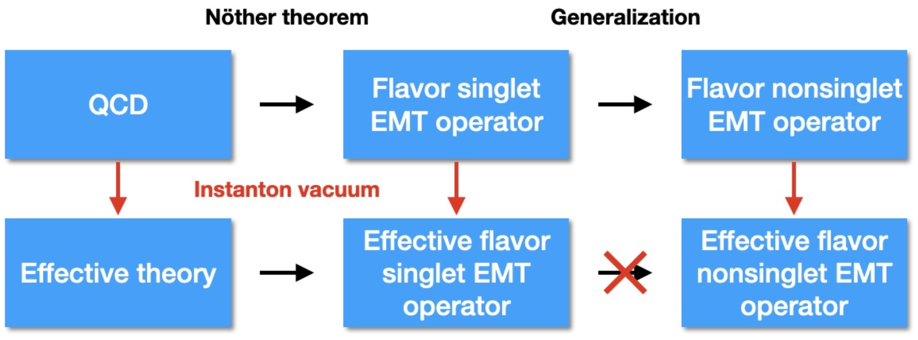
Effective EMT Operator
H-Y. Won, HChK, J.-Y. Kim, JHEP 05 (2024)
Effective operators:
?
Flavor nonsinglet operators require careful derivation!

Slide 20
Effective EMT Operator
Sum rules in QCD
Sum rules in the effective theory
Gluons are integrated out.
H-Y. Won, HChK, J.-Y. Kim, JHEP 05 (2024)

Slide 21
EMT Operator from the instanton vacuum
Effective quark operators
Pion mean fields
D. Diakonov et al. NPB 461 (1996)
J. Balla et al. NPB 510 (1998)
Dilute instanton medium
Bosonization
All low-energy theorems are satisfied (chiral anomaly, trace anomaly, etc).
The chiral-even twist-2 local operator is generated by expanding the non-local vector
current, which measures the vector GPDs, with respect to the space-time distance:
Twist-2 gluon operators are suppressed with respect to the packing fraction.
H-Y. Won, HChK, J.-Y. Kim, JHEP 05 (2024)

Slide 22
EMT Operator from the instanton vacuum
Twist-3 gluon operators
The contributions from these operators have been found to be crucial for satisfying the QCD equation of motion.
Essential role in the decomposition of the nucleon spin
Spin-orbit correlations are also related to them.
Twist-4 gluon operators should be also replaced by
flavor-dependent quark operators.
Gluons should be considered when the flavor decomposition
is considered, in particular, for the cbar form factors.
We will restrict ourselves to the twist-2 case for the GFFs.
H-Y. Won, HChK, J.-Y. Kim, JHEP 05 (2024)

Slide 23
Pion Mean-field approach

Slide 24

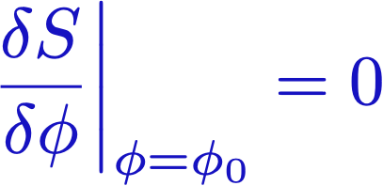



Mean fields
Given action ,
: Solution of this saddle-point equation
This classical solution is regarded as a mean field.
Mean-field potential that is produced by
all other particles.
Nuclear shell models
Ginzburg-Landau theory for superconductivity
Quark potential models for baryons

Slide 25
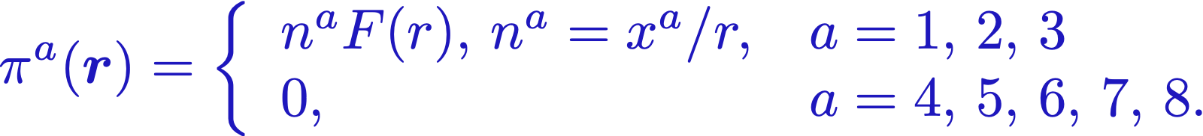
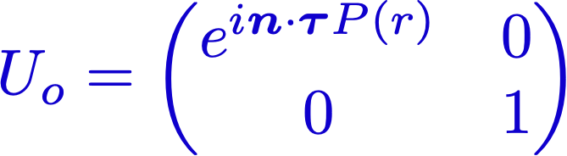

Pion mean-field approach (Chiral Quark-Soliton model)
Baryons as a state of Nc quarks bound by mesonic mean fields.
Effective chiral action:
E. Witten (1979)
D. Diakonov & V. Petrov (1986)
Key point: Hedgehog Ansatz
D. Diakonov, V. Petrov, P. Pobylitsa (1988)
It breaks spontaneously
Witten’s trivial embedding
Ch. Christov, HChK, K. Goeke et al. PPNP (1996)
D. Diakonov hep-ph/9802298

Slide 26
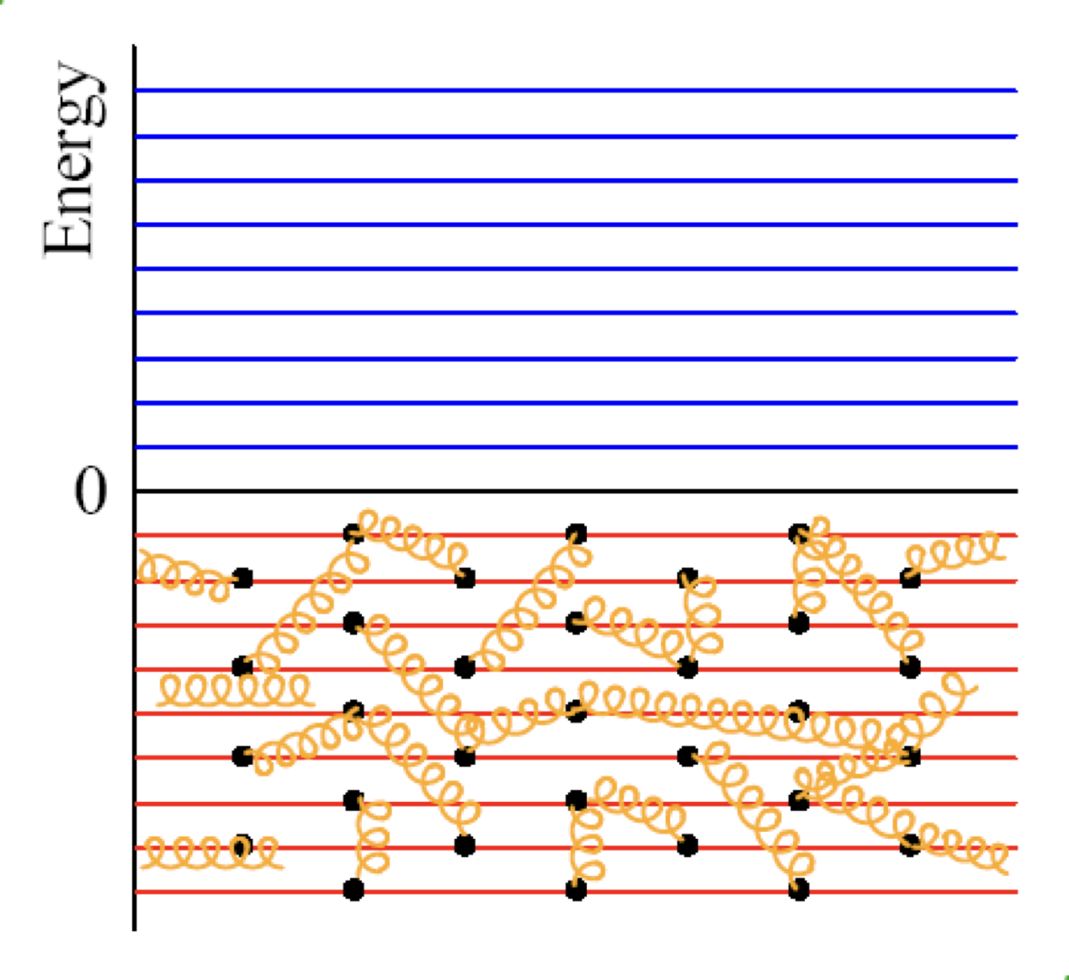
Schematic view on the XQSM
Interacting vacuum

Slide 27
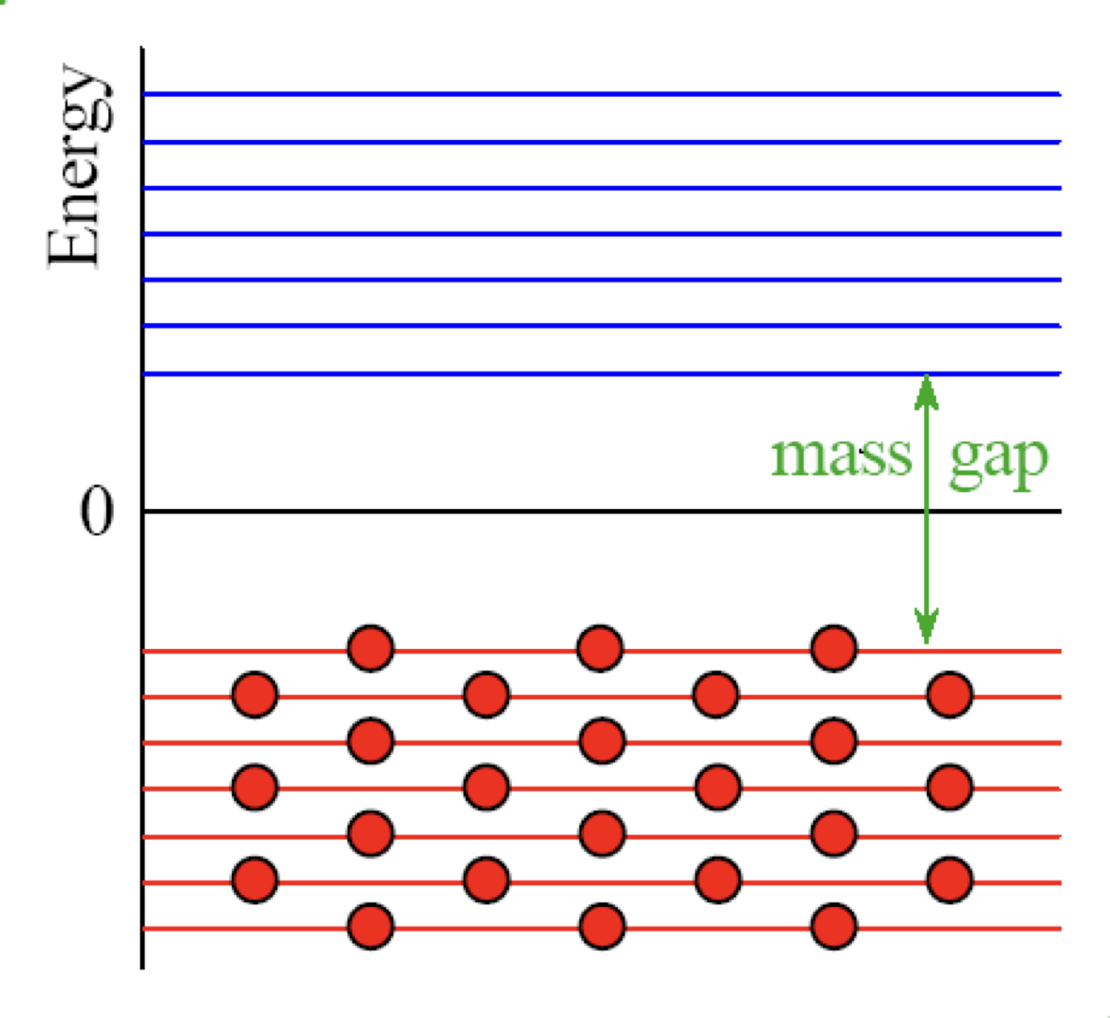
Schematic view on the XQSM
Spontaneous breakdown of chiral symmetry

Slide 28
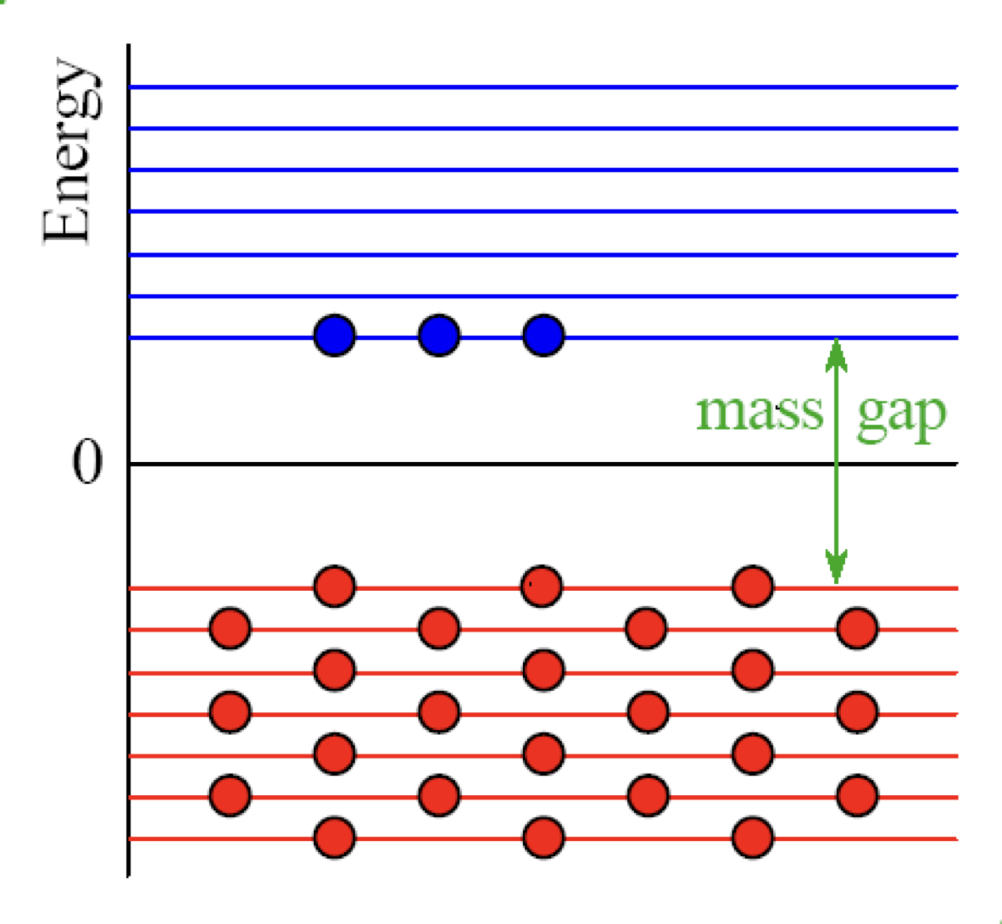



Schematic view on the XQSM
Interaction between quarks and pion background fields

Slide 29
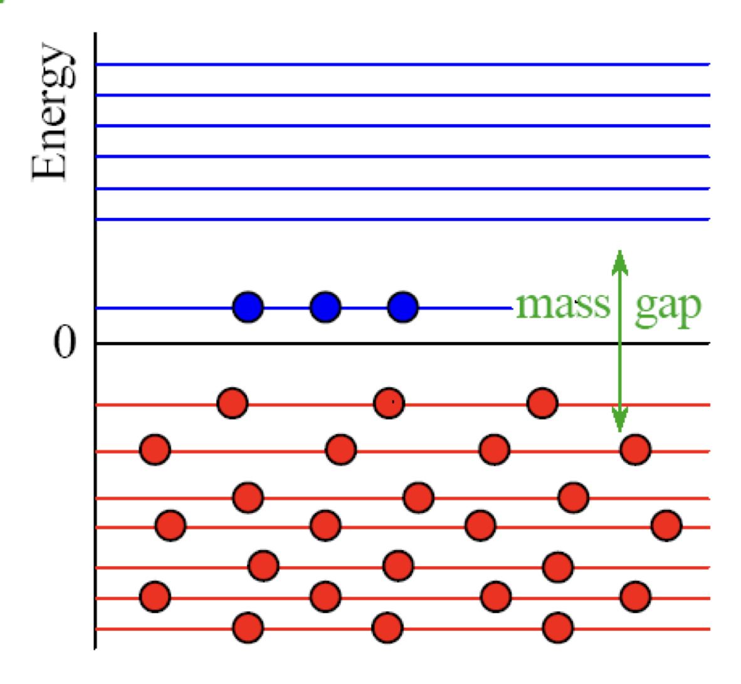
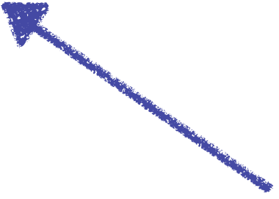
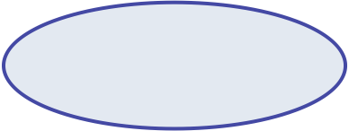

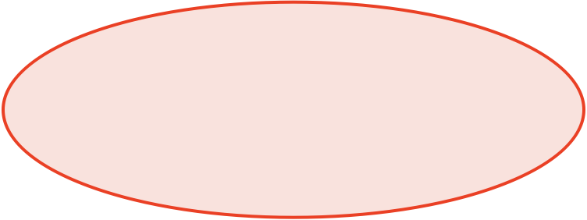
Schematic view on the XQSM
Nc quarks are bounded by the pion mean fields self-consistently.
Valance level:
Energy decreases
Sea level:
Energy increase
The system is stabilized!

Slide 30



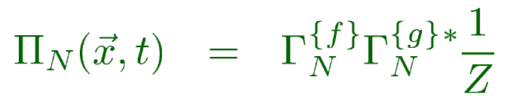
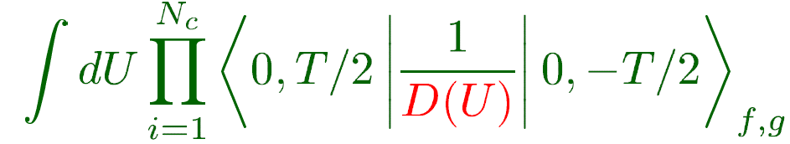

Baryon correlation function
Baryon as Nc valence quarks bound by pion mean fields
Presence of Nc quarks will polarize the vacuum or create mean fields.
Nc valence quarks
Vacuum polarization or meson mean fields
Ch. Christov, HChK, K. Goeke et al. PPNP (1996)
D. Diakonov hep-ph/9802298

Slide 31
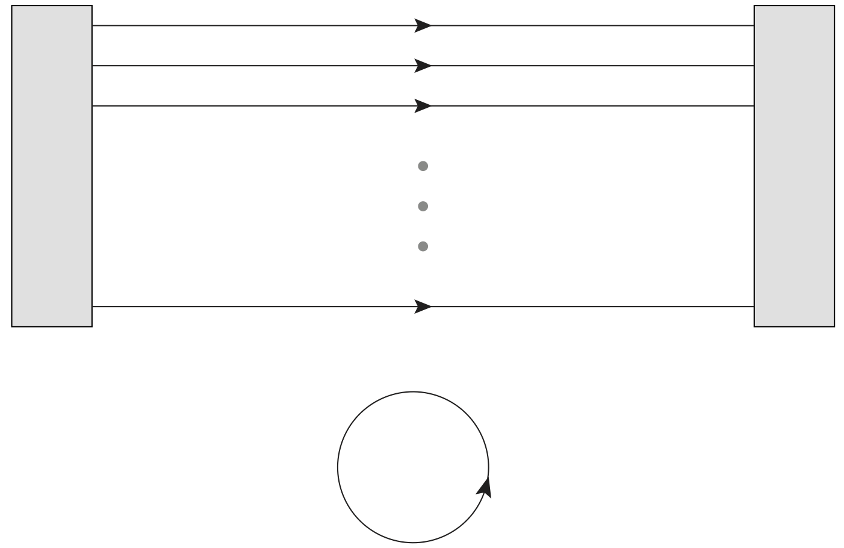


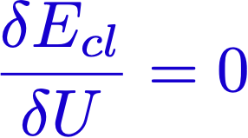


Baryon correlation function
Baryon as Nc valence quarks bound by pion mean fields
Classical Nucleon mass is described by the Nc valence-quark energy
and sea-quark energy.
Ch. Christov, HChK, K. Goeke et al. PPNP (1996)
P(r): Soliton profile function
or Soliton field

Slide 32
Zero-mode(collective) quantization
Rotational & Translational zero modes
Collective Hamiltonian & Wavefunctions in flavor SU(3) symmetry
Ch. Christov, HChK, K. Goeke et al. PPNP (1996)
D. Diakonov hep-ph/9802298

Slide 33
GFFs from the XQSM
Rotational & Translational zero modes
For detailed results, see the refs. H. Y. Won, HChK, J.-Y. Kim JHEP (2024) & PRD 108 (2023)

Slide 34
Results & Discussion

Slide 35
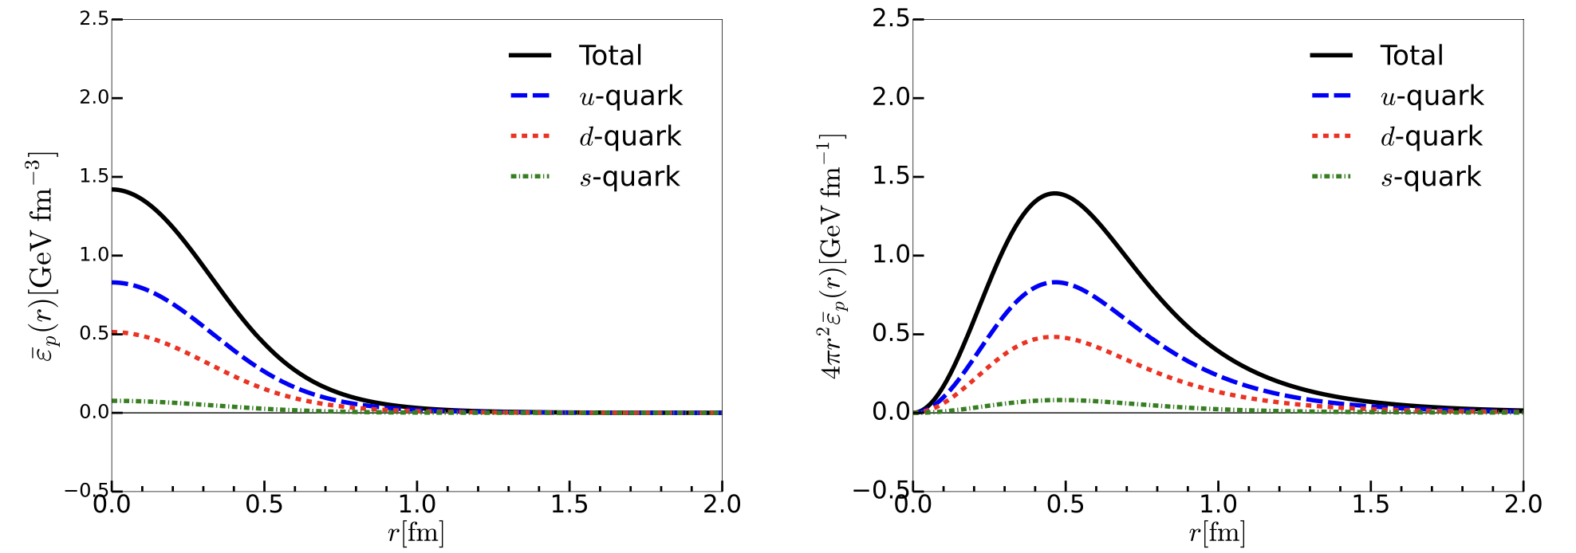
Mass distributions
Contribution from the s quark is negligible.
H-Y. Won, HChK, J.-Y. Kim, JHEP 05 (2024)

Slide 36
Mass distributions
The gluon contributions to the leading-twist operators are parametrically
suppressed with respect to the instanton packing fraction.
J. Balla et al. NPB 510 (1998)
M. Polyakov &. H. Son, JHEP 09 (2018)
In the neutron,
u for d and d for u.
H-Y. Won, HChK, J.-Y. Kim, JHEP 05 (2024)

Slide 37
Mass distributions
These numbers can be understood as the second Mellin moments of the PDFs.
We list the predictions of the proton momentum fraction carried
by the u-, d-, and s-quarks:
H-Y. Won, HChK, J.-Y. Kim, JHEP 05 (2024)

Slide 38
Angular momentum distribution
Strange quark contribution is negligible.
: Ji’s relation
X. Ji, PRL 78 (1997)
Suppressed by the instanton packing fraction.
H-Y. Won, HChK, J.-Y. Kim, JHEP 05 (2024)

Slide 39
Problem of the naïve decomposition
Decomposition of the isotriplet J
M. Wakamatsu & H. Nakakoji, PRD 71 (2005)
Violation of Ji’s sum rule (X.D. Ji, PRL 78 (1997))
Origin of : role of gluons
The second moment of the chiral-odd twist-3 quark distribution
P. Schweitzer, PRD 67 (2005)
Ohnishi & M. Wakamatsu, PRD 69 (2004)
This makes the second moment deviate from QCD.
Indication: If the covariant derivatives had been used,
these discrepancies would have been resolved.
Spin-orbit correlations are also very important to consider.
H.W. Won, J.-Y. Kim, HChK, PRD 108 (2023)

Slide 40
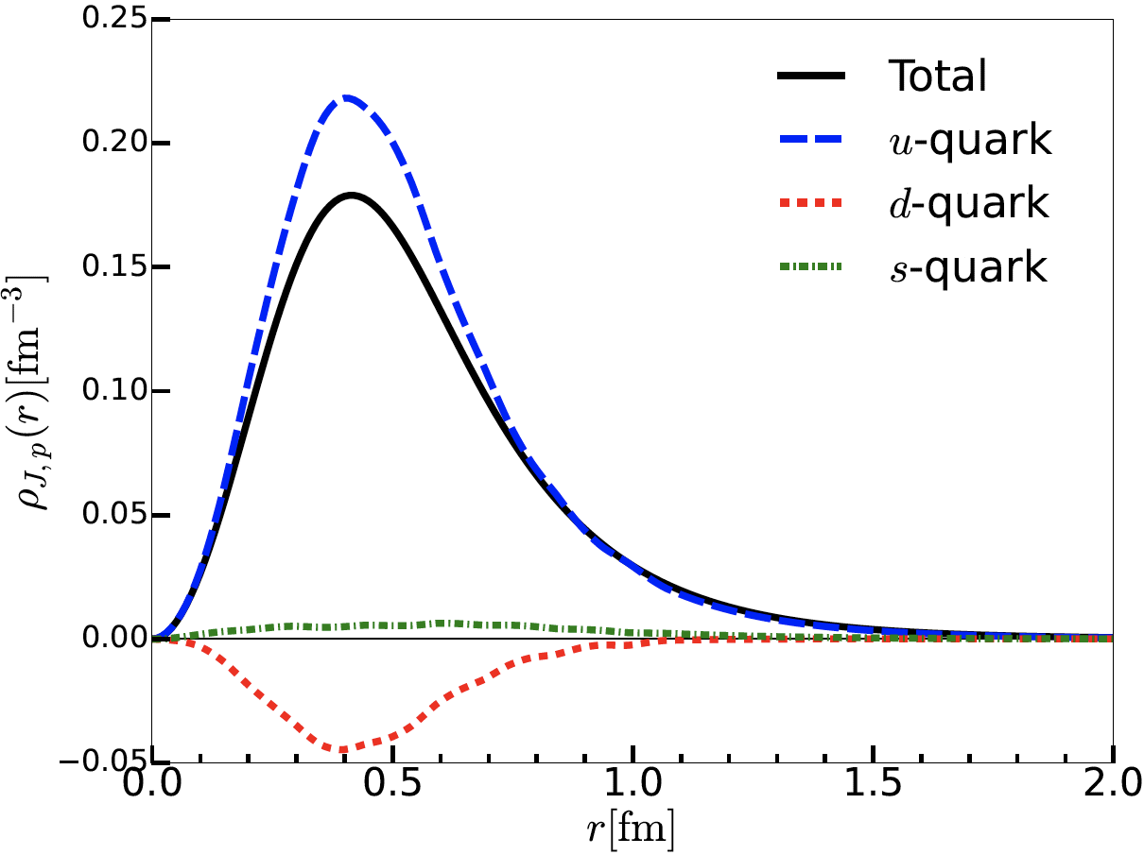
Angular momentum distribution
Strange quark contribution is negligible.
H-Y. Won, HChK, J.-Y. Kim, JHEP 05 (2024)

Slide 41
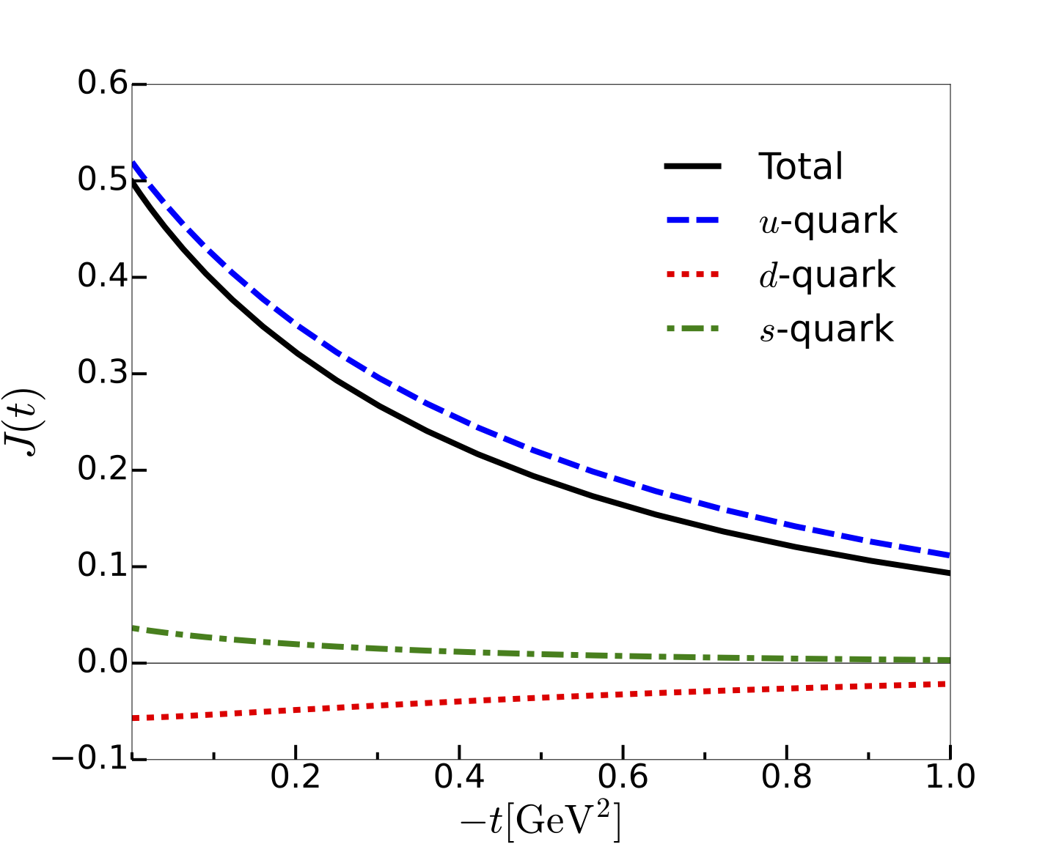
Flavor-decomposed J form factors
Strange quark contribution is negligible.
H.W. Won, J.-Y. Kim, HChK, PRD 108 (2023)

Slide 42
Mechanical properties: Twist-2 case
Stability condition in SU(3)
However, there is no proper way of constructing the effective flavor-triplet
and -octet EMT currents by a global symmetry.
Our strategy
: It contains both twist-2 & twist-4 operators.
We first consider the twist-2 EMT operator
H-Y. Won, HChK, J.-Y. Kim, JHEP 05 (2024)

Slide 43
Mechanical properties: Twist-2 case
Stability condition in SU(3)
Twist-2 case
Twist-4 contribution
Both quark and gluon contribution should
be considered.
The derivation of the twist-4 EMT operators is under way.
H-Y. Won, HChK, J.-Y. Kim, JHEP 05 (2024)

Slide 44
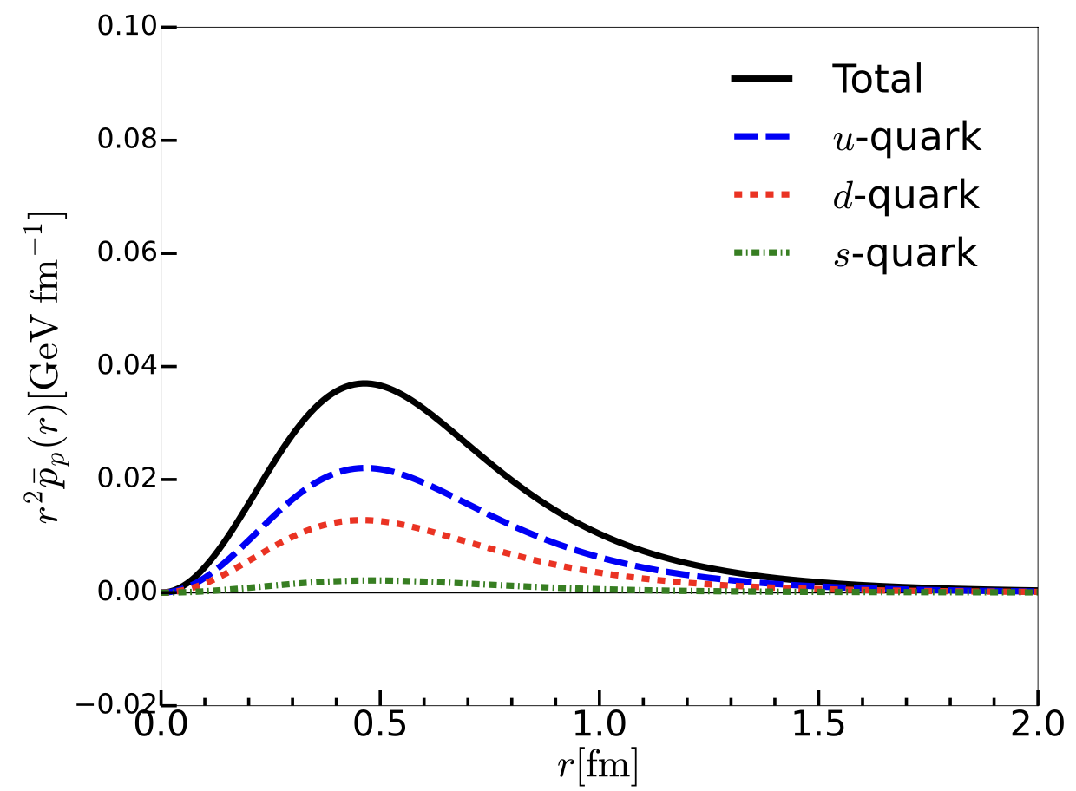
Mechanical properties: Twist-2 case
H-Y. Won, HChK, J.-Y. Kim, JHEP 05 (2024)
Twist-2 part of the pressure density.
No nodal point.
H.W. Won, J.-Y. Kim, HChK, PRD 108 (2023)

Slide 45




Color blindness in SU(3)
in SU(2)
in SU(3)
The flavor blindness is only valid
in SU(3)!
The strange quarks should essentially be
considered in the proton!
Burkert et al. assumed the flavor blindness.
Lattice QCD arrives at a similar conclusion.
(D. Hackett et al. 2310.08484)
H.W. Won, J.-Y. Kim, HChK, PRD 108 (2023)

Slide 46
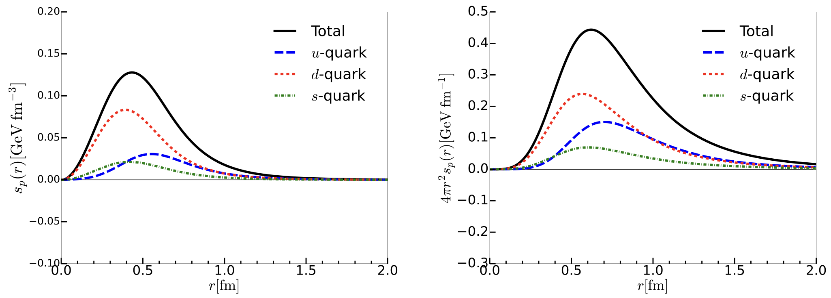
Shear force densities
ij off-diagonal component of the EMT: No twist-4 contribution
Local equilibrium condition
H-Y. Won, HChK, J.-Y. Kim, JHEP 05 (2024)

Slide 47
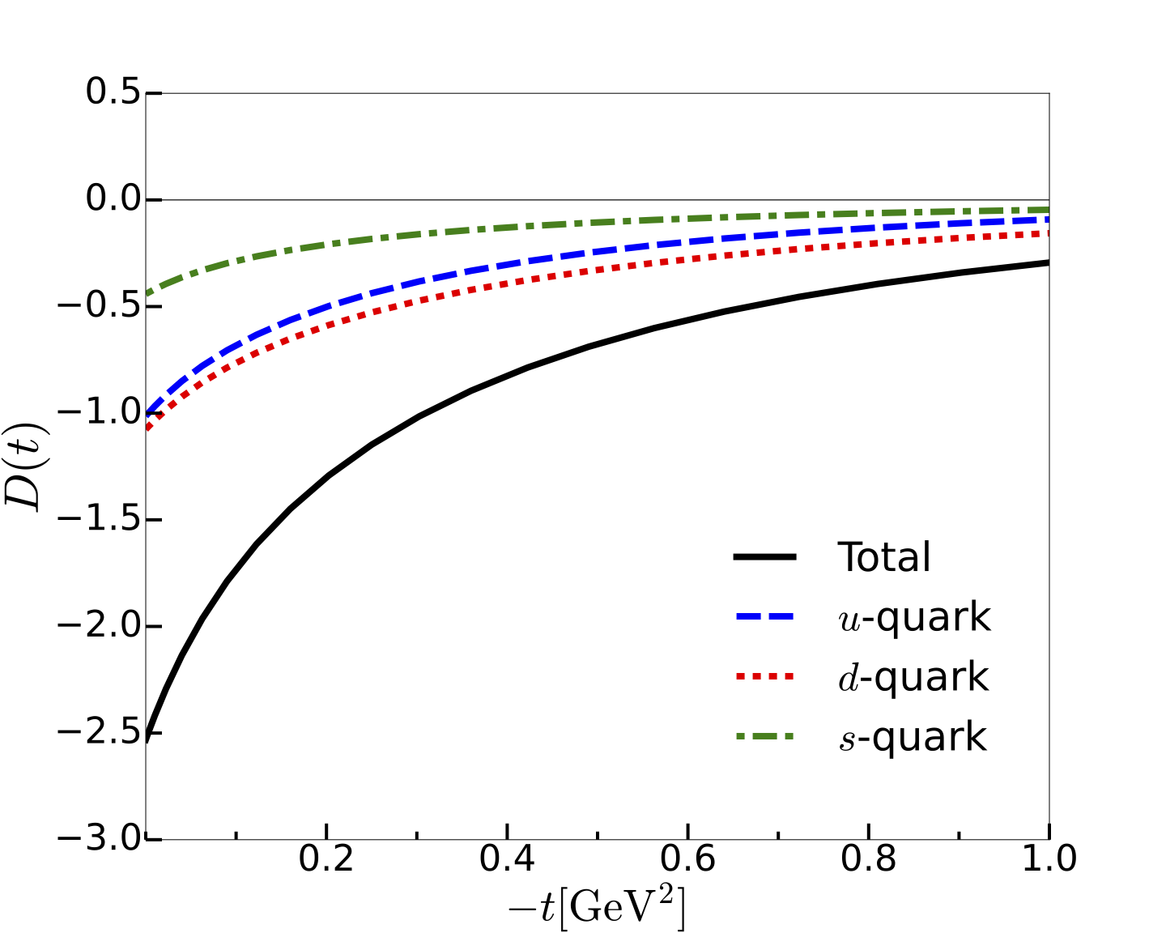
Flavor-decomposed D-term form factors
D-term can be evaluated at
the twist-2 level.
Similar situation in the EM transitions of the delta isobar
Sea quarks (Dirac continuum)
play a significant role.
The strange-quark contributions are essential for flavor blindness!
H.W. Won, J.-Y. Kim, HChK, PRD 108 (2023)

Slide 48



Estimation of mechanical Radius
V. Burkert et al. (2022)
in SU(3)
Mechanical radius
Charge radius
H.W. Won, J.-Y. Kim, HChK, PRD 108 (2023)

Slide 49
Estimation of mechanical radius
Mechanical radius
Charge radius
Mass radius
H.W. Won, J.-Y. Kim, HChK, PRD 108 (2023)

Slide 50
Spin-Orbit Correlations

Slide 51
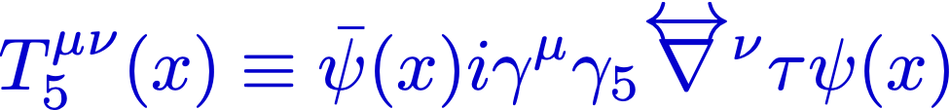
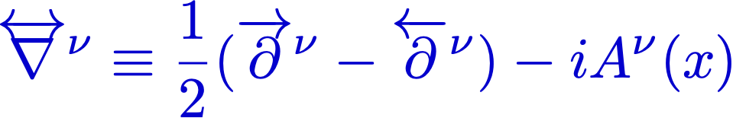
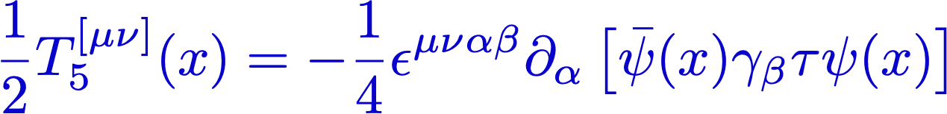
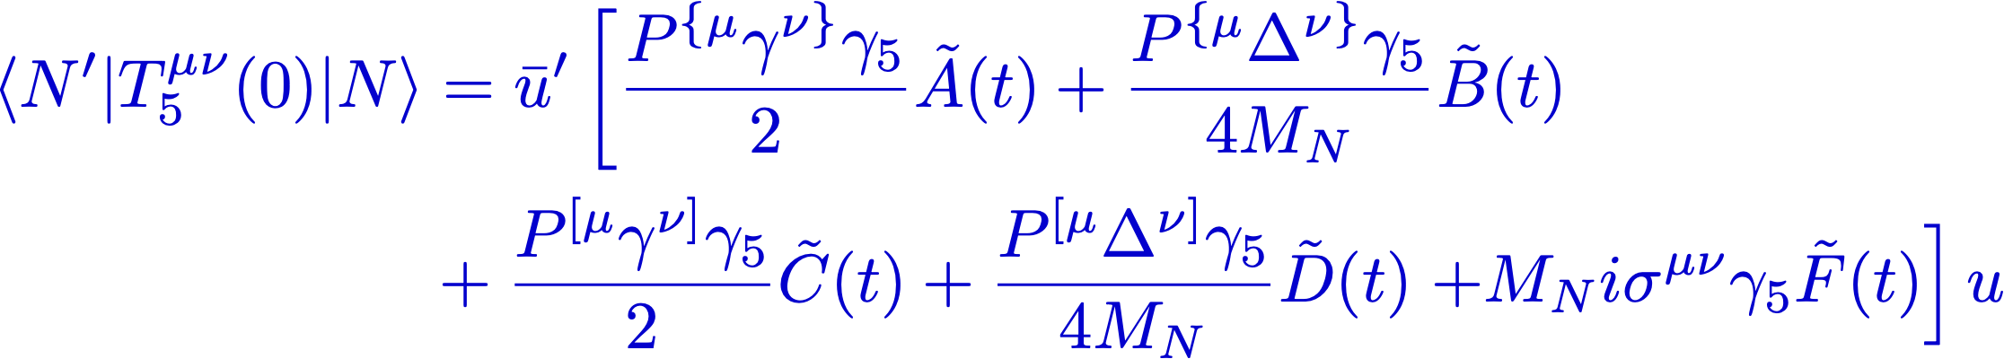
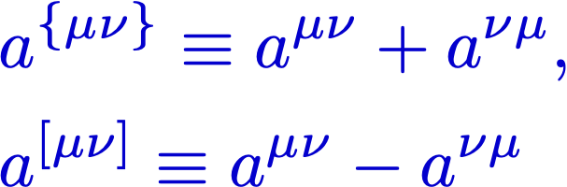
Spin-orbit correlation: Twist-3 operator
QCD operators
C. Lorce, PLB 735, 344 (2014)
QCD EOM & the instanton vacuum
EOM of Effective theory
Effective QCD operators
J.-Y. Kim and C. Weiss, PLB 848, 138387 (2024)
(Twist-3 projection)
Kinetic term
Potential term
Parity-odd form factors

Slide 52
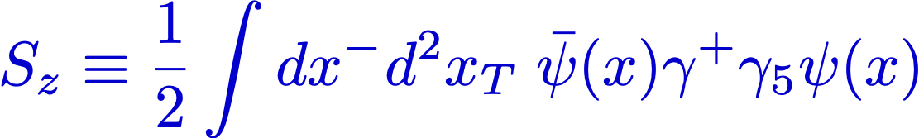
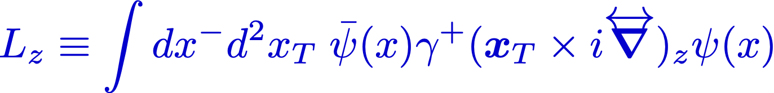
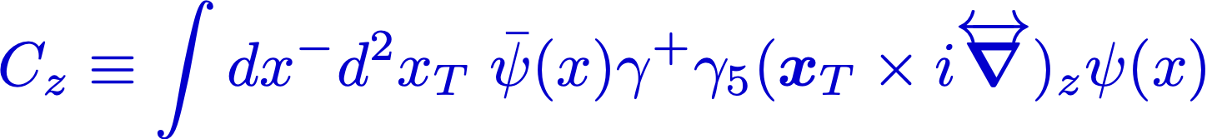
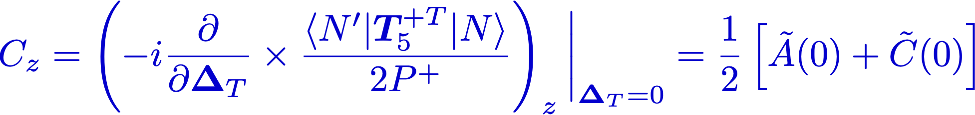
Interpretation of the SOC operator
In the context of light-front quantization
Difference of # of quarks with
positive and negative spin projection
along the z axis.
OAM projection along the z axis
regardless of the spin.
Spin-orbit correlation of quarks
Difference of the OAM projection of quarks with positive and negative spin
projection.
J.-Y. Kim, H.-Y. Won, HChK, Ch. Weiss 2403.07186 [hep-ph]

Slide 53
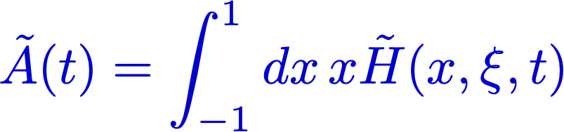
Parity-odd Form factors
Axial-vector GPDs
The second moment of H
J.-Y. Kim, H.-Y. Won, HChK, Ch. Weiss 2403.07186 [hep-ph]

Slide 54
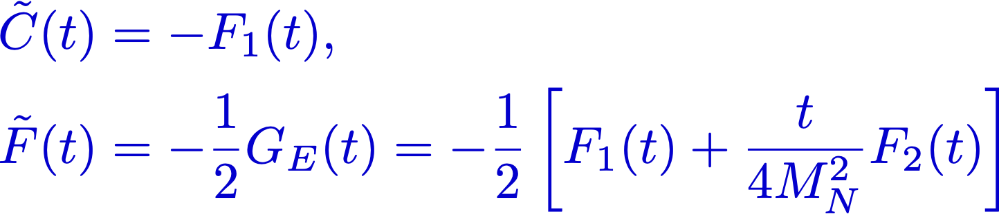
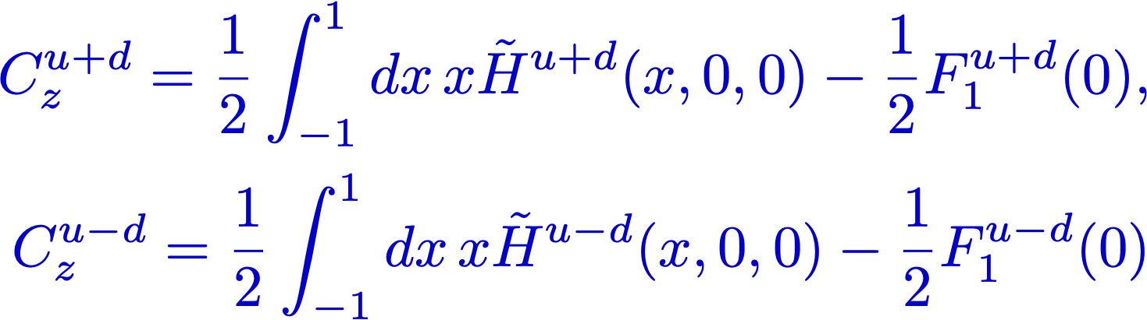
Parity-odd Form factors
C & F form factors are related to the EM form factors.
Spin-orbit correlation
J.-Y. Kim, H.-Y. Won, HChK, Ch. Weiss 2403.07186 [hep-ph]

Slide 55
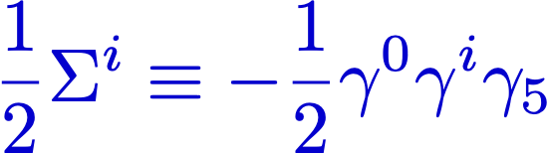
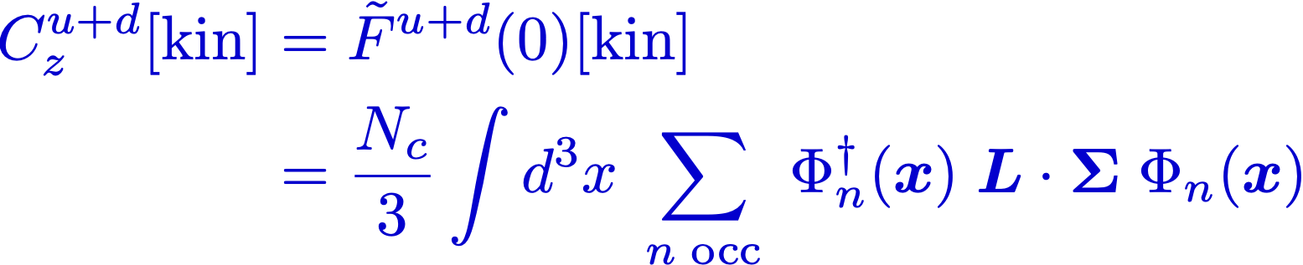
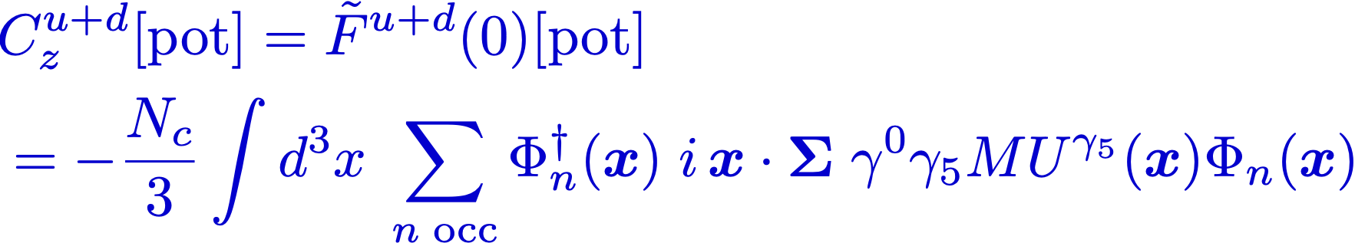

Spin-orbit correlation in an effective chiral theory
Expressions in the theory
: the correlation of the quark spin and OAM.
: The correlation between the radius vector and the spin of the quarks
bilinear form provides the pseudoscalar density that allows
the radius vector to couple to the spin (Fully relativistic effect).
J.-Y. Kim, H.-Y. Won, HChK, Ch. Weiss 2403.07186 [hep-ph]

Slide 56


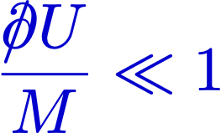

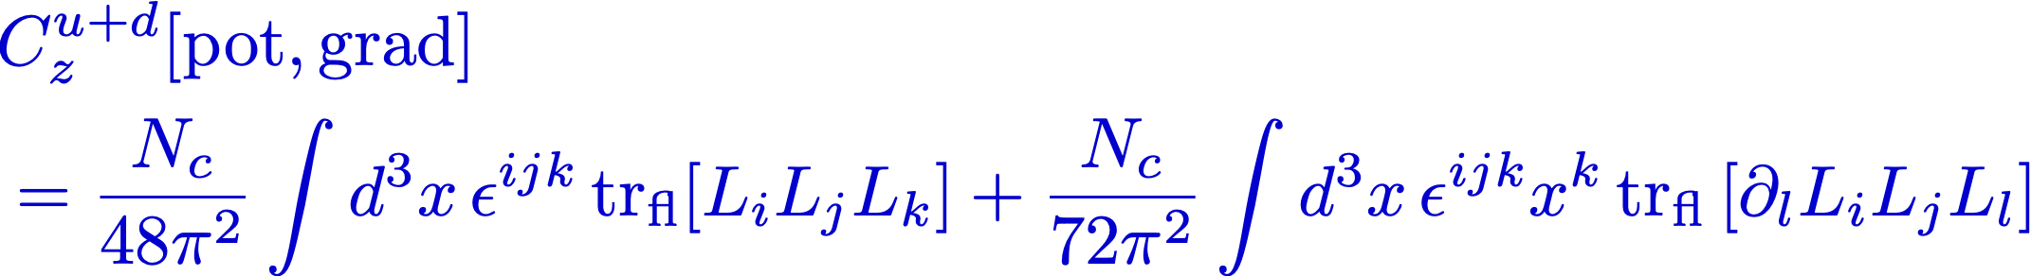
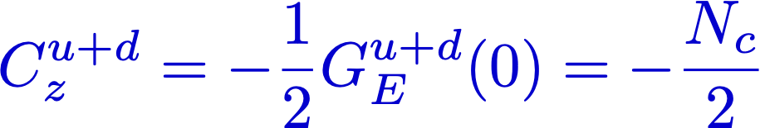
Gradient Expansion
Chiral effective theory of the nucleon interpolates between the NRQM
and the Skyrme model.
: NRQM limit
: Skyrmion limit
Finite # of the effective
chiral Lagrangian
J.-Y. Kim, H.-Y. Won, HChK, Ch. Weiss 2403.07186 [hep-ph]

Slide 57
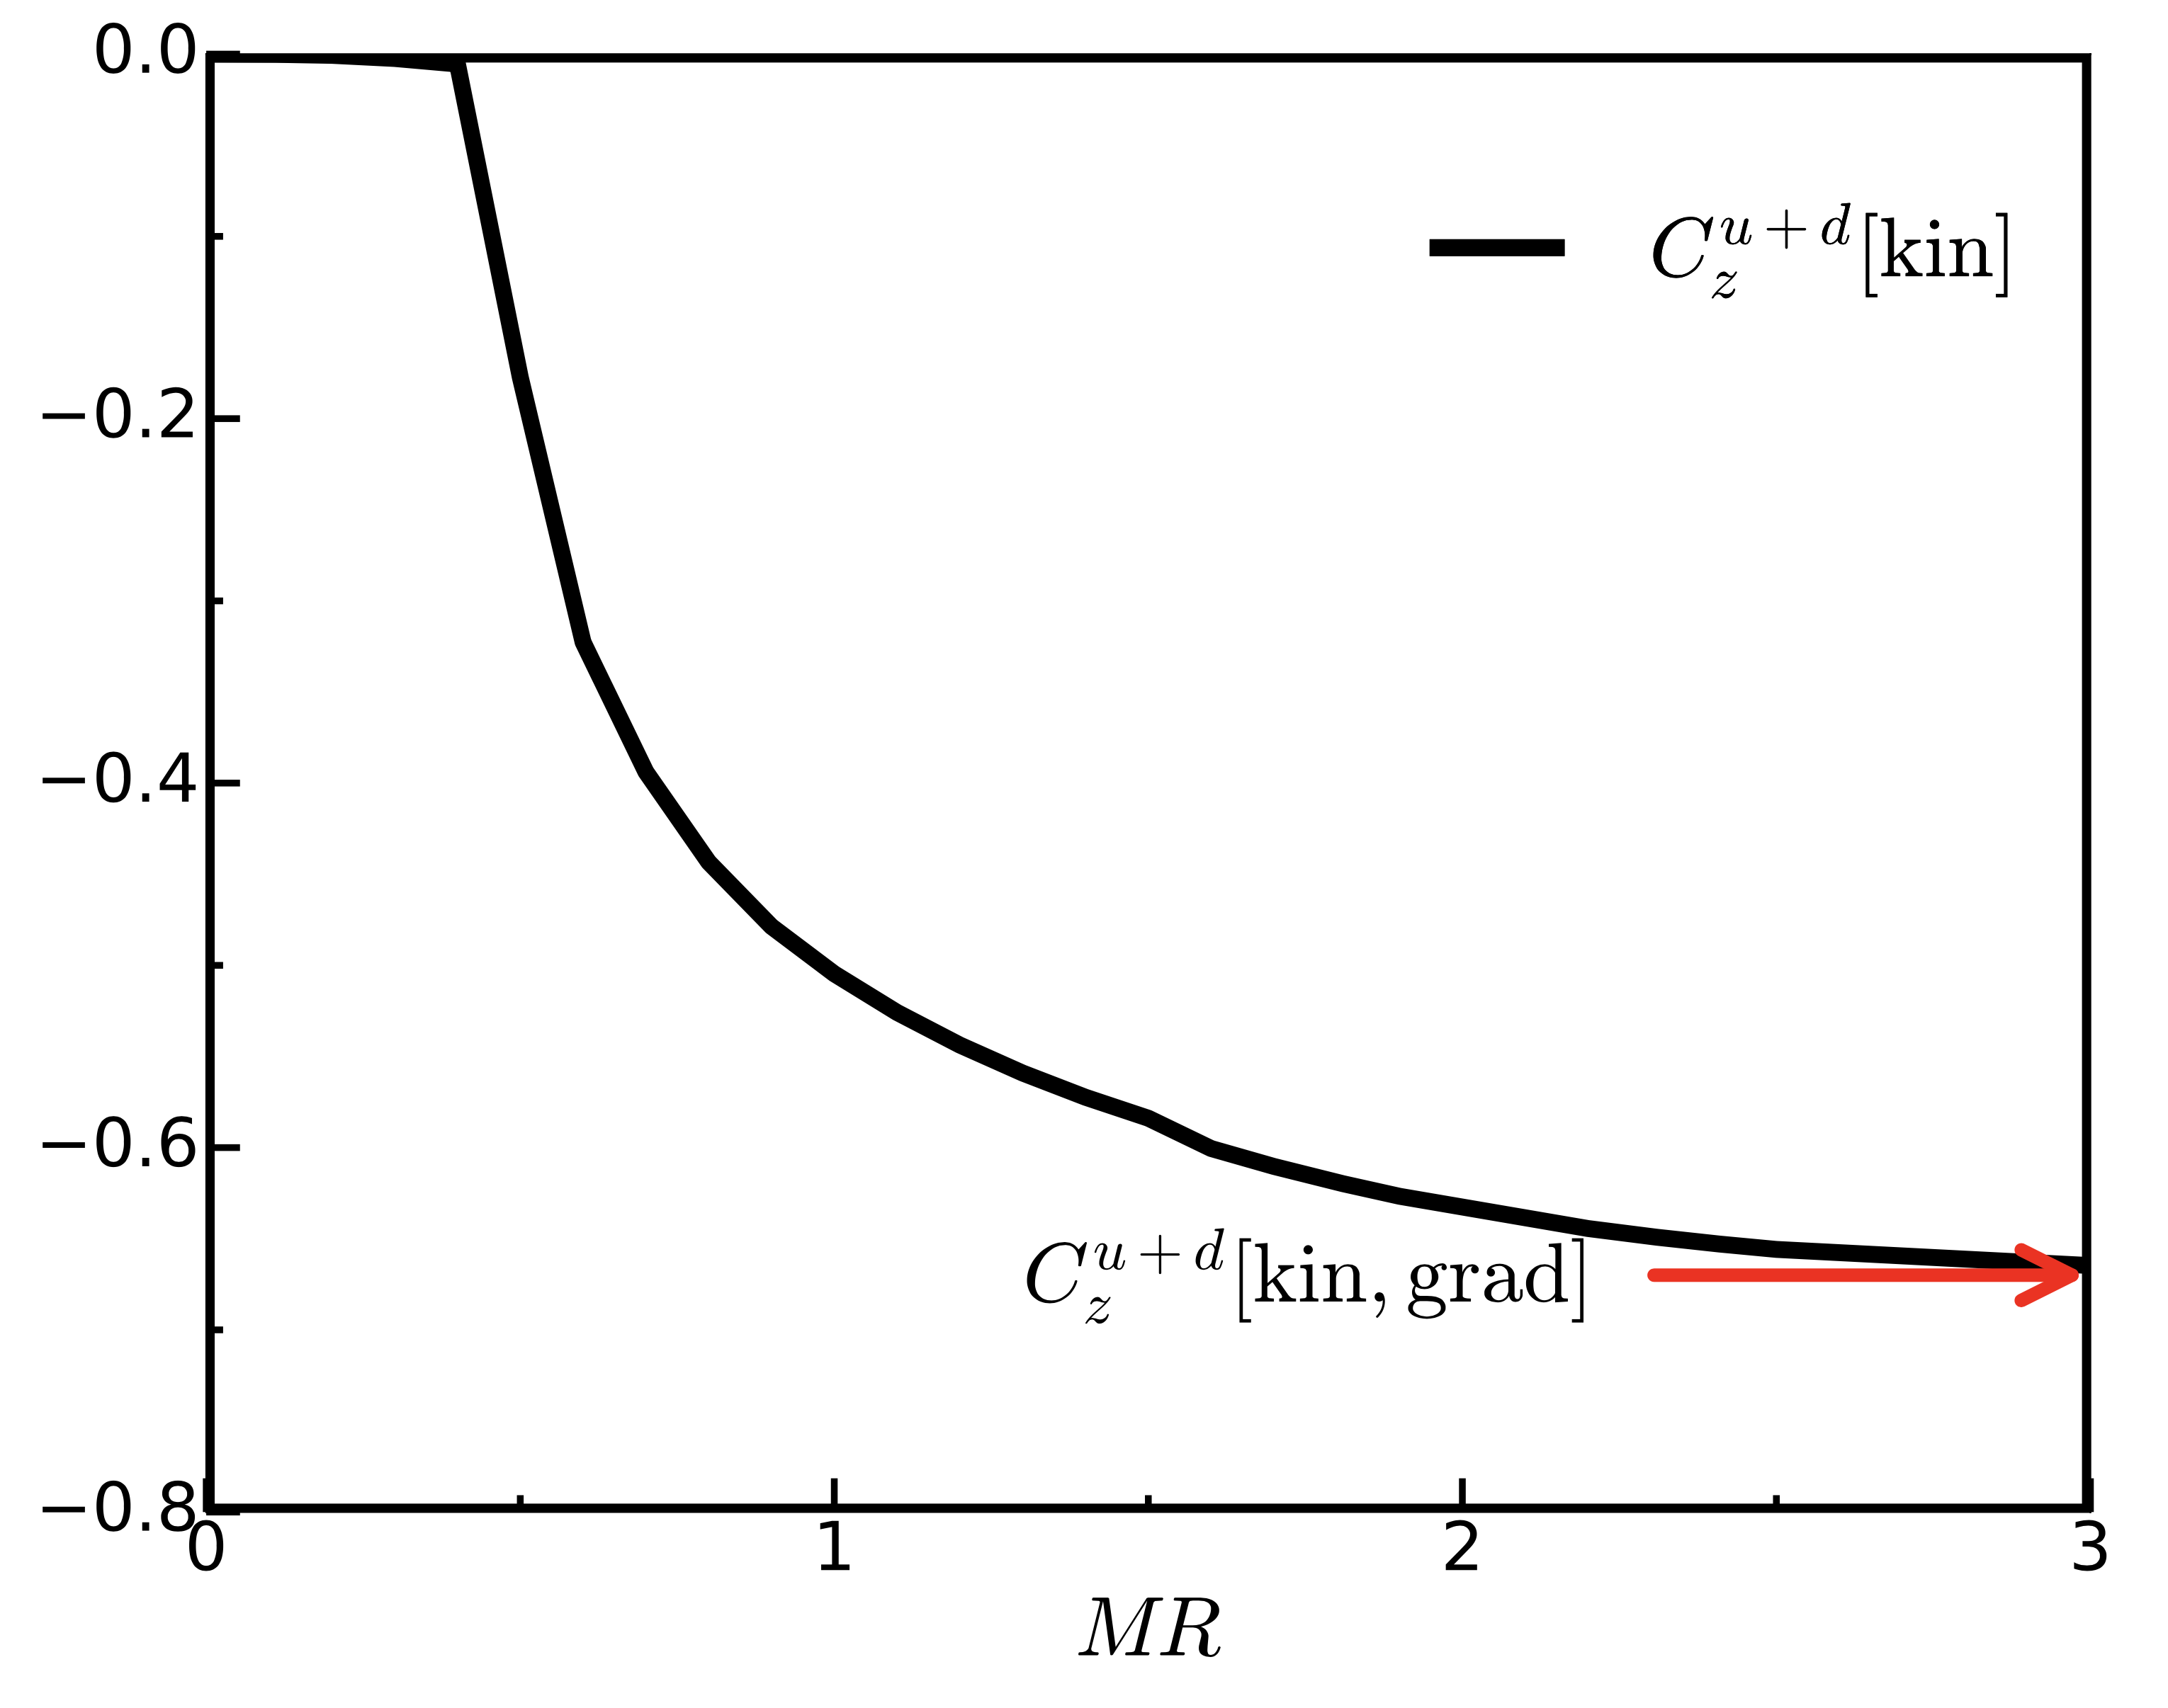
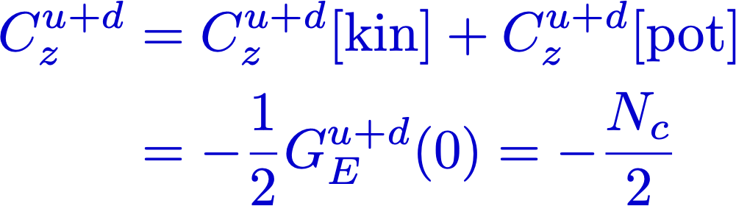

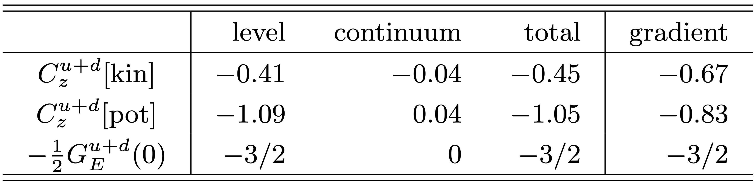
Results
NRQM limit
Physical mean-field
Skyrmion limit
J.-Y. Kim, H.-Y. Won, HChK, Ch. Weiss 2403.07186 [hep-ph]

Slide 58



Summary
In this talk, we focused on the twist-2 part of the proton GFFs.
Flavor decomposition of GFFs requires the flavor nonsinglet EMT operators that cannot be constructed without any ambiguity.
Twist-4 operator also contribute to the GFFs, in particular cbar one.
The nucleon mass and pressure require information on cbar form factors:
Both the twist-2 and twist-4 EMT operators should be considered.
Gluons come into essential play in describing the GFFs even with effective theory.
For the isoscalar SOC, the EOM relation is satisfied independently in each quark single-particle level in the nucleon.
SOC - Kinetic term takes the form of
: quark spin and OAM correlation
SOC - Potential term
Coupling of the quarks to the chiral
field of the nucleon
Against the simple quark model

Slide 59
Though this be madness,
yet there is method in it.
Hamlet Act 2, Scene 2
by Shakespeare
Many thanks to J-Y. Kim, H-Y. Won, and Ch. Weiss
for wonderful collaborations!
Thank you very much for the attention!

