Slide 1

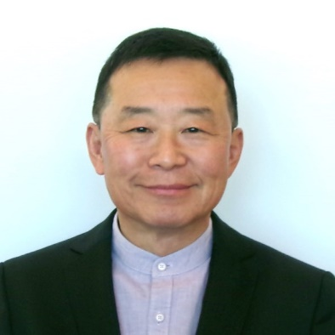


KNU PHYSICS
SEMINAR
Search for Dark Sector Particles/ Dark Matter at Fermilab Accelerator Facility
https://indico.knu.ac.kr/event/687/
유재훈 교수
University of Texas at Arlington
The neutrino oscillation needs parameters to be measured precisely to provide essential information for a modification of the Standard Model. Accomplishing this novel goal in future neutrino experiments, such as the Deep Underground Neutrino Experiment (DUNE) at Fermilab, requires high flux neutrino beams and powerful combination of near and far detectors. The Long Baseline Neutrino Facility (LBNF) is under construction to provide high intensity proton beams fed by the new PIP-II high intensity LINAC and therefore high flux neutrino beams to the experiment and the near and far detector sites, while the DUNE collaboration is working on finalizing the design and prototyping its detectors. This powerful facility being prepared for the oscillation measurements makes it possible to access physics Beyond the Standard Model, which was inconceivable at a neutrino experiment in the past. In this talk, I will discuss DUNE experiment itself, its beams and detectors and discuss the prospects of searching for dark matter and dark sector particles, along with their sensitivity reaches. In addition, the new conceptual experiment, called DAMSA that searches for DSP’s using the high intensity PIP-II LINAC and its expected sensitivity reach will be discussed.
22 May, 2023
Monday
4:00 – 5:00 PM
219동 205호
학생들의 많은 참여 바랍니다.
경북대학교 물리학과
Notes:
1

