Slide 1
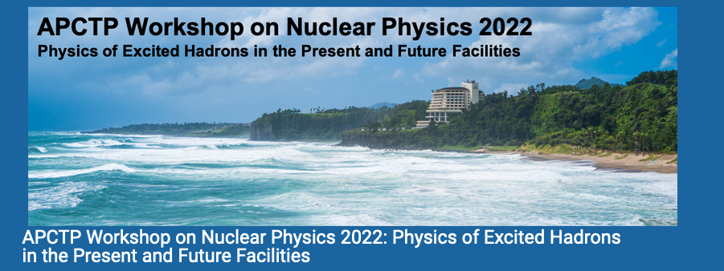

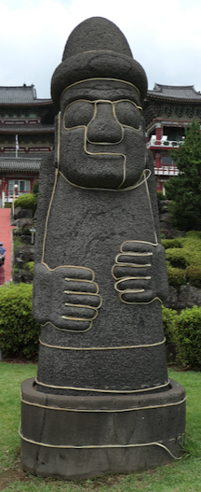

Exploring the production of N*s
with pion and electron beams
PHY-1615146
PHY-2012826
Philip Cole
Lamar University
July 16, 2022

Slide 2
Outline
Why
Who
Where
What
How
Not necessarily in this order…

Slide 3
Why
Why N*s are important. (quoted from Nathan Isgur^{1,2})
  The first is that nucleons are the stuff of which our world is made.
  My second reason is that they are the simplest system in which the quintessentially nonabelian character of QCD is manifest.
  The third reason is that history has taught us that, while relatively simple, baryons are sufficiently complex to reveal physics hidden from us in the mesons”
¹Workshop on Excited Nucleons and Hadronic Structure (2000).
²Baryon Spectroscopy, E. Klempt and J.-M. Richard, arXiv:0901.2055v1[hep-ph]1 4 Jan 2009
We need to spread the word to lay and expert audiences alike that
excited baryon research is indeed exciting and crucial to science.

Slide 4
Coupled-channels picture of resonance excitation [Motivation (Whys and Wherefores and How)]
πN
ππN
→ N* → ηN
KΛ KΣ
The same N* resonance must be found in different reaction channels in a consistent way!
e⁻N
πN
T
πΝ→πΝ
T
ηΝ→πΝ
T
γΝ→πΝ
T
ρΝ→πΝ
T
σΝ→πΝ
T
ΚΛ→πΝ
T
ΚΣ→πΝ
T
πΝ→ηΝ
T
ηΝ→ηΝ
T
γΝ−>ηΝ
T
ρΝ→ηΝ
T
σΝ→ηΝ
T
ΚΛ→ηΝ
T
ΚΣ→ηΝ
T
πΝ→γΝ
T
ηΝ→γΝ
T
γΝ→γΝ
T
ρΝ→γΝ
T
σΝ→γΝ
T
ΚΛ→γΝ
T
ΚΣ−>γΝ
T=
T
πΝ→ρΝ
T
ηΝ→ρΝ
T
γΝ→ρΝ
T
ρΝ→ρΝ
T
σΝ→ρΝ
T
ΚΛ→ρΝ
T
ΚΣ→ρΝ
T
πΝ→σΝ
T
ηΝ→σΝ
T
γΝ→σΝ
T
ρΝ→σΝ
T
σΝ→σΝ
T
ΚΛ→σΝ
T
ΚΣ→σΝ
T
πΝ→ΚΛ
T
ηΝ→ΚΛ
T
γΝ→ΚΛ
T
ρΝ→ΚΛ
T
σΝ→ΚΛ
T
ΚΛ→ΚΛ
T
ΚΣ→ΚΛ
T
πΝ→ΚΣ
T
ηΝ→ΚΣ
T
γΝ→ΚΣ
T
ρΝ→ΚΣ
T
σΝ→ΚΣ
T
ΚΛ→ΚΣ
T
ΚΣ→ΚΣ
See Yannick Wunderlich’s talk

Slide 5
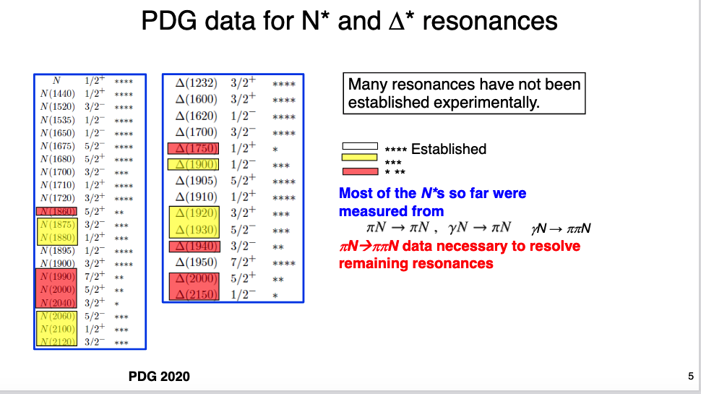
Why
From Hiroyuki Sako’s Talk

Slide 6
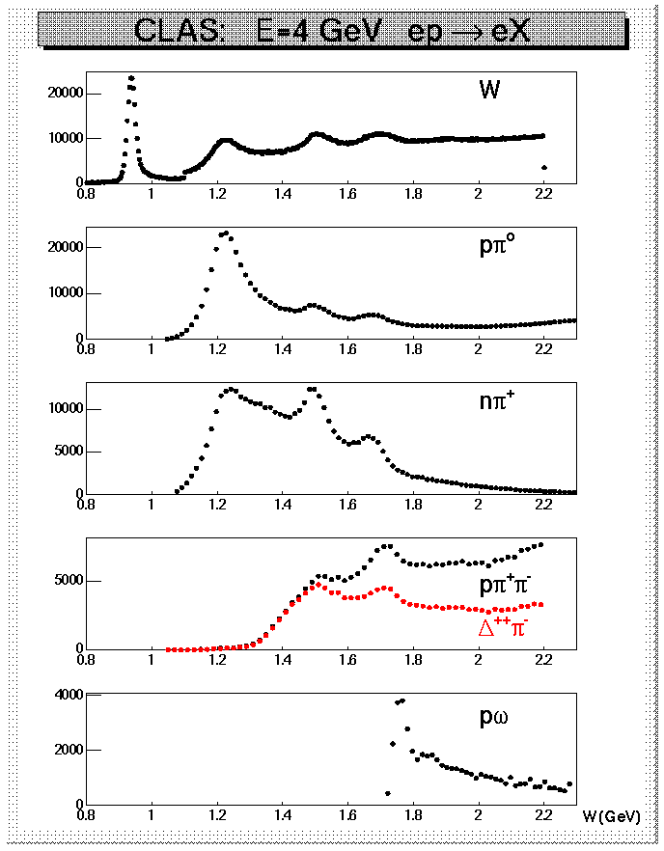
Why Nπ/Nππ electroproduction channels are important
CLAS data on meson electroproduction at Q² < 4.0 GeV²
  Nπ/Nππ channels are the two major contributors in N* excitation region;
  these two channels combined are sensitive to almost all excited proton states;
  they are strongly coupled by πN→ππN final state interaction;
  may substantially affect exclusive channels having smaller cross sections, such as ηp, KΛ, and KΣ.
Therefore, knowledge on Νπ/Νππ electroproduction and pion-beam mechanisms is key for the entire N* Program

Slide 7
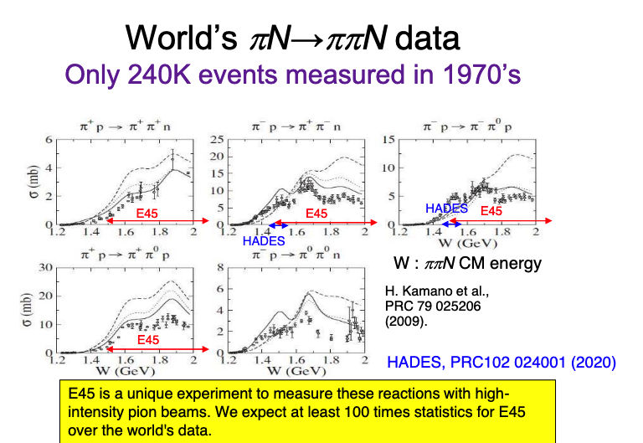
Why
From Hiroyuki Sako’s Talk

Slide 8
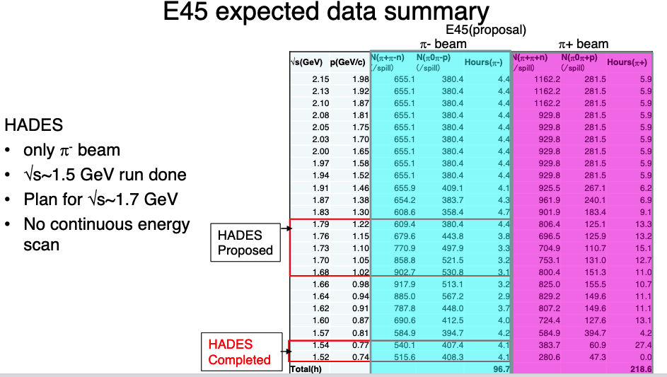
From Hiroyuki Sako’s Talk

Slide 9
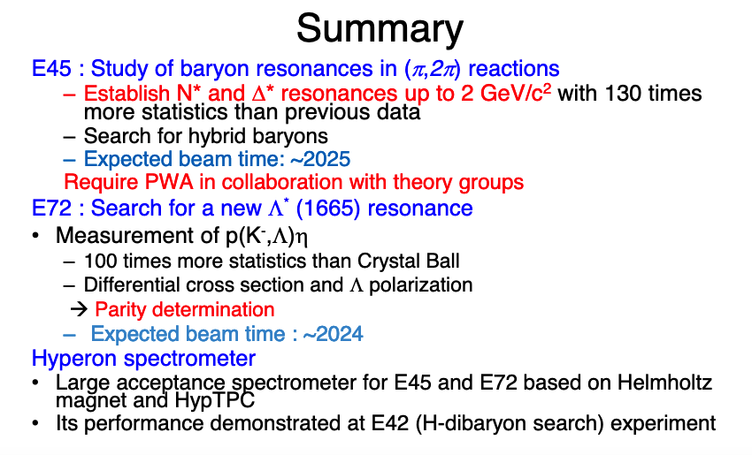
E45 – Big Statistics in the 2nd & 3rd Resonance Regimes
From Hiroyuki Sako’s Talk

Slide 10
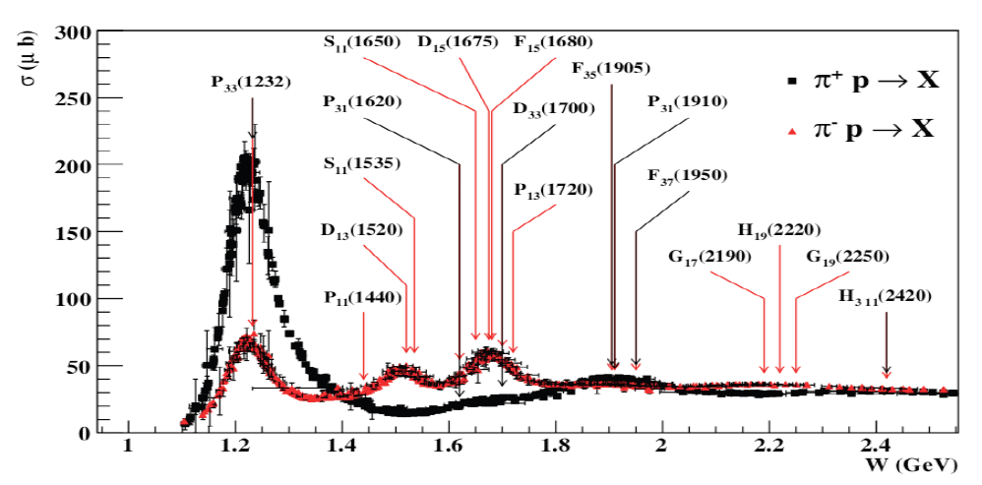
Baryon resonances (N*s and Δ*s)
σ (mb)
N*s are broadly overlapping
Notes:
Delta++/Delta0 cross section ratio is 3. Mention CR-coefs + Qual Prob.

Slide 11
Space-like q² < 0
Time-like q² > 0
And let’s not forget E45
Teresa Peña ECT* 2017

Slide 12
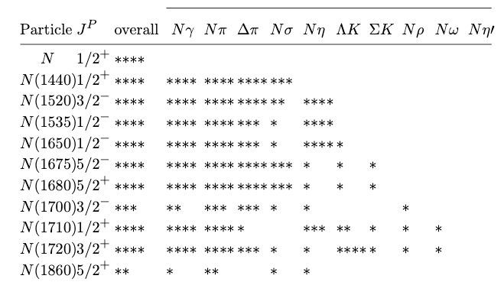
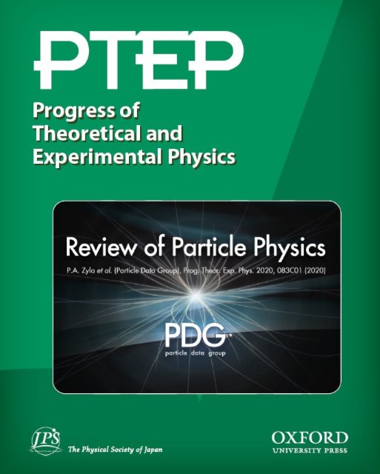
No
Data?

Slide 13


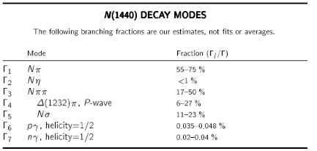
Decay Modes

Slide 14

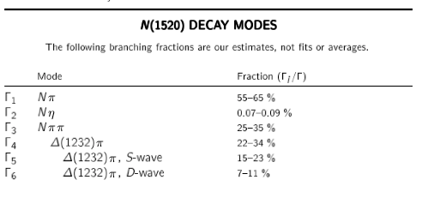
Decay Modes

Slide 15

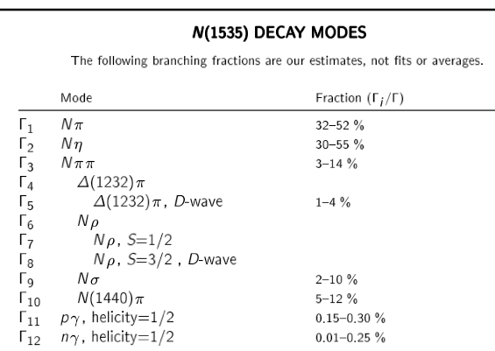
Decay Modes

Slide 16
The Puzzle of the Proton
ECT* Workshops are a start (May 2017 + Sept. 2019)
Special topic session (for NSTAR 2017, 2019, 2022) is a start
GSI Workshop on Electromagnetic Structure of Strange Baryons (Oct. 2018) is a start
The US-Japan Collaboration (JPARC/JLab) White Paper is a start.
The workshop on Baryon Production at BESIII (Sept 2019, Hefei, PRC) is a start.
This workshop is a start.
At some point, we must go beyond the starting point.
unraveling the puzzle of the proton.

Slide 17
White Paper

Slide 18
LOI: NSF PIRE Submitted: Sept 8, 2016

Slide 19
LOI: NSF PIRE Submitted: Sept 8, 2016
Ahead of our time

Slide 20
HOW
Meeting Ground between
Theory and Experiment
cf. Harry Lee’s Opening Remarks.

Slide 21
Experimental/Theory/Phenomenology for q² < 0, q² = 0, q² > 0 (space-like/photon/time-like)

Slide 22
Experimental/Theory/Phenomenology for q² < 0, q² = 0, q² > 0 (space-like/photon/time-like)

Slide 23
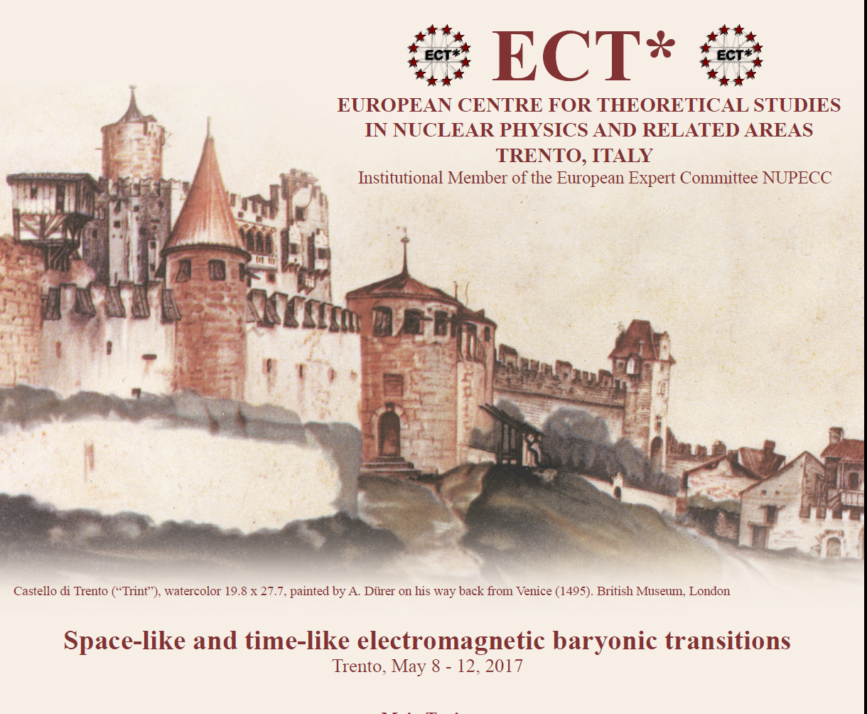
Report on the ECT* Workshop:
Space-like and time-like electromagnetic baryonic transitions
https://indico.in2p3.fr/event/14330/overview

Slide 24
Reason for the Workshop
This ECT* workshop brought together several different experimental and theoretical communities, whose research
spans the kinematical regimes in q² between the space-like and time-like regions
  q² = 0 [anchor point] photon-beam (unpolarized & linearly- and circularly polarized experiments (ELSA, JLab, LEPS, & MAMI)
  q² > 0 [time-like] meson-beam experiments (GSI and J-PARC) proton-antiproton beam experiments (FAIR)
  q² < 0 [space-like] electron-beam experiments (JLab)

Slide 25
Our Research Vision
  We sought to bring together a representative sample of experimental, phenomenology, and theory groups, who are working on the nucleon resonance problem.
    Discuss the direction on the study of understanding the underlying structure of nucleons in terms of the time-like and space-like electromagnetic baryonic form factors and transitions;
    Delineate the spectrum of excited baryon states;
    Describe and detail how quarks are confined and acquire mass through the mechanism of dynamical chiral symmetry breaking.

Slide 26
Confirmed Speakers at ECT* (SL/TL)
Daniele Binosi (ECT* Trento)
Vladimir Braun (University of Regensburg)
William Briscoe (George Washington University)
Susanna Costanza (University of Pavia)
Annalisa D’Angelo (University of Rome)
Michael Döring (George Washington University)
Christian Fischer (University of Giessen)
Bengt Friman (TU Darmstadt)
Tetyana Galatyuk (TU Darmstadt)
Leonid Glozman (University of Graz)
Ralf Gothe (University of South Carolina)
Kyungseon Joo (University of Connecticut)
Helmut Haberzettl (George Washington University)
Hiroyuki Kamano (Osaka University)
Eberhard Klempt (University of Bonn)
Stefan Leupold (Uppsula University)
Victor Nikonov (University of Bonn and PNPI, Gatchina)
Teresa Peña (IST Lisbon)
Ralph Rapp (Texas A&M University)
Hiroyuki Sako (JAEA)
Piotr Salabura (Jagiellonian University in Krakow)
Hartmut Schmieden (University of Bonn)
Karin Schönning (Uppsula University)
Federico Scozzi (IPN Orsay and TU Darmstadt)
Kirill Semenov-Tyan-Shanskiy (PNPI, Gatchina)
Igor Strakovsky (George Washington University)
Joachim Stroth (Goethe University Frankfurt)
Annika Thiel (University of Bonn)
Lothar Tiator (University of Mainz)
Ralf-Arno Tripolt (ECT* Trento)
Jochen Wambach (TU Darmstadt and ECT* Trento)
+ The SL/TL ECT* Organizers: Philip Cole, Béatrice Ramstein, and Andrey Sarantsev

Slide 27
Following topics were covered
  Electromagnetic baryon excitations through meson electroproduction
  Theoretical approaches for baryon transition form factors in the space-like region
  Baryon spectroscopy from photoproduction and meson beam experiments
  Amplitude analysis and extraction of baryonic resonances properties
  Electromagnetic transitions through dilepton production
  Unified description of space-like and time-like baryon electromagnetic transitions
  Vector mesons in medium
  Prospects for future experimental studies

Slide 28
Physics Opportunities with Meson Beams
William J. Briscoe (GW), Michael Döring (GW), Helmut Haberzettl (GW), D. Mark Manley (KSU), Megumi Naruki (Kyoto Univ.), Igor I. Strakovsky (GW), Eric S. Swanson (Univ. of Pittsburgh)
(Submitted on 26 Mar 2015)
Over the past two decades, meson photo- and electro-production data of unprecedented quality and quantity have been measured at electromagnetic facilities worldwide. By contrast, the meson-beam data for the same hadronic final states are mostly outdated and largely of poor quality, or even nonexistent, and thus provide inadequate input to help interpret, analyze, and exploit the full potential of the new electromagnetic data. To reap the full benefit of the high-precision electromagnetic data, new high-statistics data from measurements with meson beams, with good angle and energy coverage for a wide range of reactions, are critically needed to advance our knowledge in baryon and meson spectroscopy and other related areas of hadron physics. To address this situation, a state of-the-art meson-beam facility needs to be constructed. The present paper summarizes unresolved issues in hadron physics and outlines the vast opportunities and advances that only become possible with such a facility.
Bill Briscoe ECT* 2017

Slide 29
Structure of excited baryons
  effective degrees of freedom
  transition charge densities
  running quark mass
  => nature of states
N(1680)5/2⁺
[56,2⁺]₂
2
L_{3q}
[70,1⁻]₁
N(1675)5/2⁻
N(1520)3/2⁻
N(1535)1/2⁻
e’
π, η, ππ, K
e
γ_{v}
1
N*,△*
Q
N
N, Y
[56,0⁺]₀
A_{1/2}, A_{3/2}, S_{1/2}
E₁₊, M₁₊, S₁₊
Δ(1232)3/2⁺
N(940)1/2⁺
N(1440)1/2⁺
N(1710)1/2⁺
[70,0⁺]₀
0
0
1
N [ħω]
2
I.G. Aznauryan et al., Analysis of p(e,e’Nπ); V.I. Mokeev et al., Analysis of p(e,e’pπ⁺π⁻)
Annalisa D’Angelo ECT* 2017
Notes:
The N* spectrum teaches us about the underlying symmetries, to access the internal structure we need to probe the nucleon with virtual photons that measure the resonance strength versus the time-distance scale. What one measures are the helicity amplitudes A1/2, A3/2, and S1/2 or equivalent electromagnetic multipoles. I will focus on 3 states highlighted here.

Slide 30
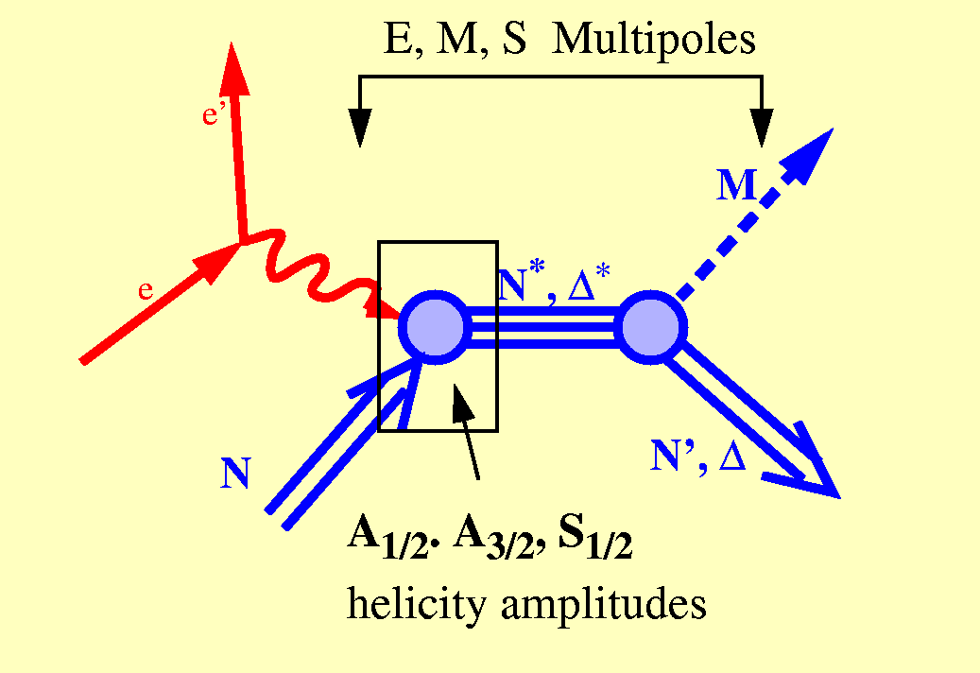
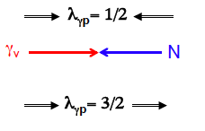
Electroproduction
The helicity amplitudes are related to the matrix elements of the electromagnetic current via:
Transverse
  A_{1/2}
  A_{3/2}
Longitudinal
  S_{1/2}
A_{½}: <N*,S_{z}*=+½|ε_{μ}⁽⁺⁾J^{μ}_{em}|N,S_{z}=−½>
A_{3/2}: <N*,S_{z}*=+3/2|ε_{μ}⁽⁺⁾J^{μ}_{em}|N,S_{z}=+½>
S_{½}: <N*,S_{z}*=+½|ε_{μ}⁽⁰⁾J^{μ}_{em}|N,S_{z}=+½>
cf. Victor Mokeev’s talk
Notes:
EBAC: dynamical coupled channel analysis is based on the world data set on piN. gammaN, and gamma*N and constrained by unitarity. (to Npi, Neta, N2pi)
This allows the extraction of the meson-baryon contributions under minimal model assumptions

Slide 31
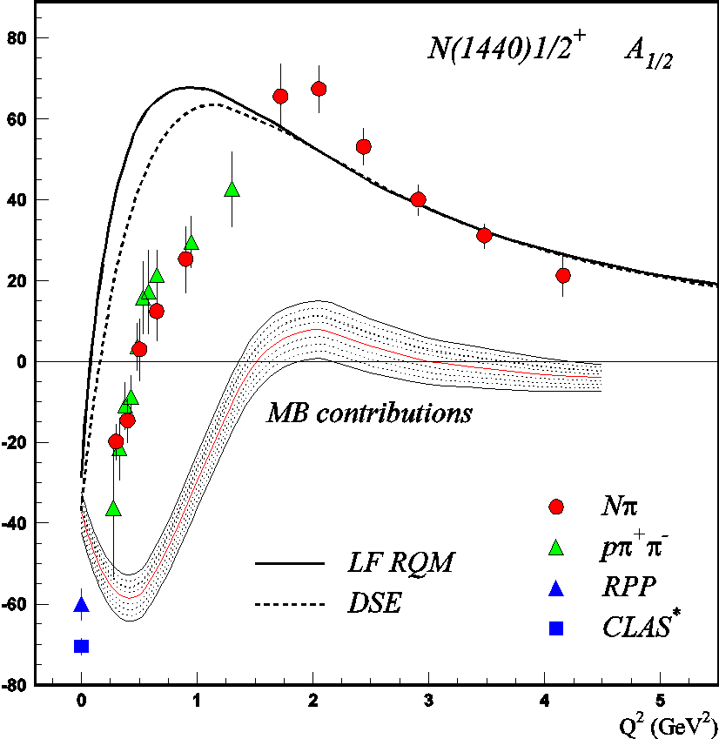
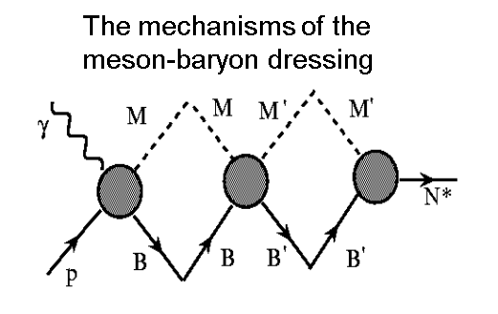
V. D. Burkert, Baryons 2016
DSE describe successfully the nucleon elastic and the transition
N→Δ(1232)3/2⁺, N→N(1535)1/2⁻ form factors with the same dressed
quark mass function (J.Segovia, et al., PRL 115, 171801 (2015)).

Slide 32
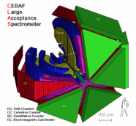
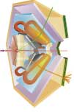
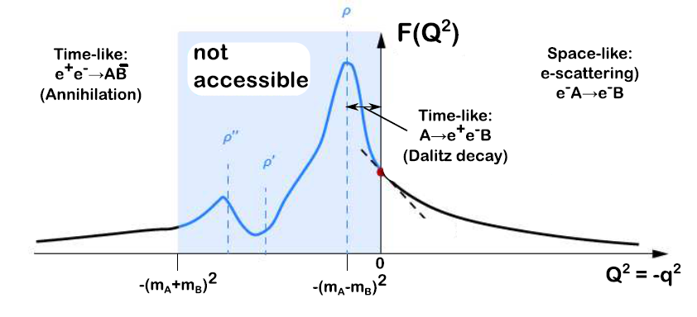
Electromagnetic baryonic transitions in time-like and space-like regions: towards a global picture?
Time-Like electromagnetic form factors
Space-Like electromagnetic form factors
preliminary studies with HADES/GSI
Precise data from JLab/CLAS up to -q²=4 GeV²
F(q²)
n
Inverse pion electroproduction
e⁺
q² <0 fixed
π ⁻
R
γ*
p
γ*
R
e⁻
p
e⁻⁻
e⁻
F(q²)
π⁻
q² =(M _{ee} )²> 0
variable
p
e⁻⁻
Theoretical tools: Dispersion Relations, Dyson-Schwinger, Vector Dominance, Constituent Quarks ?
Béatrice Ramstein ECT* 2017

Slide 33
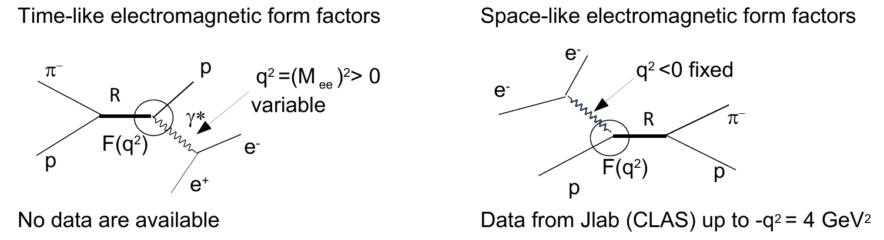
Electromagnetic form factors
n
4m_{ee}² <q² <(M_{R}-M_{n})²
Limit at q²=0 given by real photon decay
Exploration of higher q² with CLAS12
Role of quark core and meson cloud in the TL region ?
Béatrice Ramstein – NSTAR 2019
Notes:
Small q2 region can be explored, Influence of vector mesons at finite q2

Slide 34
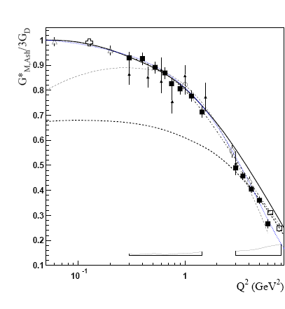

Electromagnetic structure of baryons
Dalitz decays
Δ₃₃ (J=3/2) → N (J=1/2)γ
space-like
N*→Ne+e-
e+e-→NN^{(*)}
e-N→e-N*
„pion cloud”
„quark core”
N
I. G. Aznauryan and V. D. Burkert,
Prog. Part. Nucl. Phys. 67, 1 (2012)
R→ Nγ* : em. Transition Form Factors
R (J≥3/2) : (3) G_{M} (q²), G_{E} (q²) , G_{C} (q²)
R (J=1/2) : (2) G_{M/E} (q² ), G_{C} (q² )
.. or covariant eTFF
for example for J=1/2
„QED”
M. I. Krivoruchenko, et. al
Annals Phys. 296, 299 (2002)
Piotr Salabura ECT* 2017

Slide 35
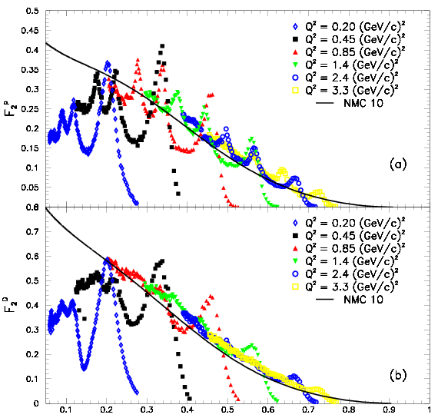
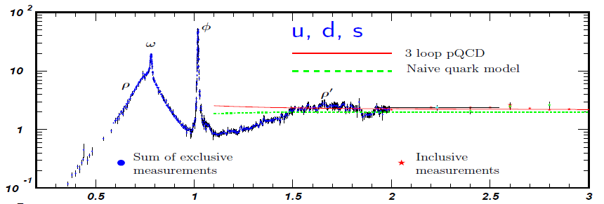
Change in Degrees of Freedom
As function of q²
Spacelike: F₂-Structure Funct.
JLAB
Data
Timelike: e⁺e⁻ → hadrons
p
Im Π_{em}(M) / M²
M [GeV]
d
● Q² _{dual} ~ 2.5-3 GeV²
● depends on channel?
ξ ≈ x
average → Quark-Hadron Duality
lower onset-Q² in nuclei?
Ralf Rapp ECT* 2017

Slide 36
Some Questions to Ponder
How to compare Helicity Amplitudes between SL and TL?
Can the data in the SL region afford constraints for those in the TL regime? (e.g. Covariant Spectator Theory, Teresa Peña and Gilberto Ramalho).
What is the relationship between the density matrix elements for SL → TL? Again, do they offer any constraints on the Helicity Amplitudes between the SL and TL regimes?
Will there be scaling in q² > 0 and q² < 0 (i.e. Q² > 0)?
Amplitude Analysis
Coupled Channel Approach
What role does the MB Cloud play?
What are the relevant d.o.f. as a function of q² for the SL and TL regimes?

Slide 37
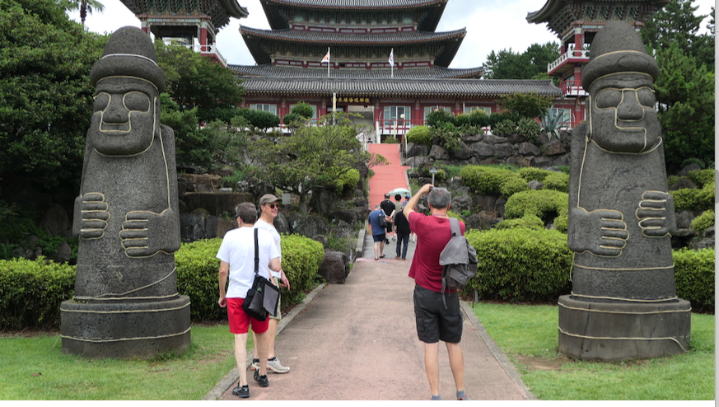
Let’s not forget the fun…

Slide 38

Let’s not forget the fun…

Slide 39

Let’s not forget the fun…
This is not Volker Burkert’s Gravitational Form Factors Talk on the original gravity upon the nucleon

Slide 40
A Campaign – across continents and NP subfields
Meeting Ground between
Theory and Experiment
cf. Harry Lee’s Opening Remarks.

Slide 41


