Slide 1
Instanton effects on charmonium spectrum and electromagnetic transitions
Ki-Hoon Hong
In collaboration with Hyun-Chul Kim, Ulugbek Yakhshiev (Inha University)
Department of Physics, Inha University, Incheon, South Korea
kihoon7065@naver.com

Slide 2
Outline
Introduction
Heavy-Quark Potential&Instanton
Heavy-quark potential in the instanton vacuum
Instanton-induced heay-quark potential
Spin-dependent parts of the $Q\overline{Q}$ potential
Results
Charmonium energy spectrum
Decay rate of the E1 & M1 Radiative Transition
Summary

Slide 3
Heavy-quark potential
&
Instanton

Slide 4
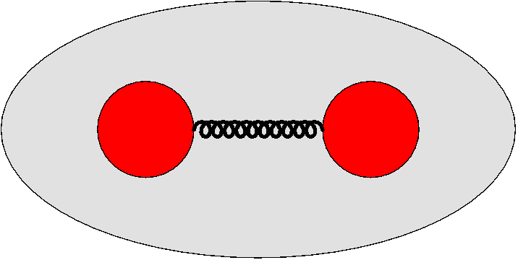
Heavy-quark Potential
Quark
Antiquark
Light mesons
$E_{B}≫m_{q} , E_{B}$: Bound state energy
Light quarks inside of a meson are relativistic
(quite complicated)
Quarkonia
$E_{B}<m_{Q}$
Relativistic effects are sufficiently small.
$1/m_{Q}$is taken to be a small parameter.
A non-relativistic potential approach is theoretically valid.
Strong interaction
Usual heavy-quark potential : $V\left(r\right)=−\frac{α}{r}+kr$
: Asymptotic freedom
one-gluon exchange perturbative potential
Phenomenological confining potential
: confinement

Slide 5
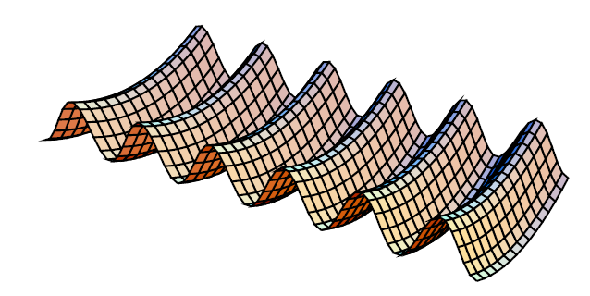
Instanton
In the Chern-Simon coordinate, the instanton is a large fluctuation of the gluon field corresponding to quantum tunneling from one vacuum(minimum of the potential energy) to the neighboring one:
: Instanton
(anti)instanton
: Antiinstanton
Potential energy of the gluon field
Classical trajectory in Euclidean space
To find the best tunneling trajectory having the largest amplitude one has thus to minimize the YM action, which becomes
: self-duality condition
The singular gauge field satisfying the self-duality equation can be written as:
$ρ$ : Average instanton size =1/3 fm
$z_{I}$ : A position of instanton

Slide 6
Instanton in the light-quark system
The Instanton is known to contribute to the interaction between light quarks more than that between heavy quarks.
The dynamical light quark mass is generated from the instanton vacuum (spontaneous breakdown of chiral symmetry):
Quarks hopping from instantons ($I$) to anti-instantons ($\overline{I}$) and vice versa flip helicity.
An infinite number of such jumps generates the dynamical mass $M\left(k\right)=MF^{2}(k)$.
L
R
L
R
L
: quark

Slide 7
Instanton in the heavy-quark system
The gauge field of the instanton medium can be represented by linear superposition of separate instantons and anti-instantons $A_{I}$:
Each instanton field is characterized by its centre $z_{I}$, size $ρ_{I}$, and the color-orientation matrix $U_{I}$.
Averaging over the quark propagator in the instanton vacuum[1]:
The instanton ensemble$⟨⟨⟩⟩$ is composed of the instanton positions and the color-orientation.
From the instanton ensemble one obtains
: is a Yang-Mills field tangent
$\left\langle t\left|θ\right|t^{′}\right\rangle =θ(t−t^{′})$ gives the Heaviside function
[1] Diakonov et al, Phys. Lett. B 226, 372 (1989)

Slide 8
Instanton in the heavy-quark system
To use the perturbation theory, we can choose a small parameter $\frac{{\overline{ρ}}^{4}N}{VN_{c}}≃0.004$ with the instanton density $\frac{N}{V}={\left(1 fm\right)}^{−4}$ and the averaged instanton size $\overline{ρ}=1/3 fm$.
Here the operator $w_{I}$ is a one-instanton operator:
After the Fourier transformation, we can use the definition [1]
The instanton effects on quarkonia are small but still important because they allow one to use physical values of the parameters in the heavy-quark potential.
[1] Diakonov et al, Phys. Lett. B 226, 372 (1989)

Slide 9
Heavy-quark potential in the instanton vacuum

Slide 10
Instanton-induced heavy-quark potential
In the static state, we can use a rectangular Wilson loop along a contour $T×r$ with $T→∞$:
The instanton-induced heavy-quark potential can be expressed in the leading order of $N/VN_{c}$:
In this limit, we can neglect the short sides of the rectangle then we can write

Slide 11
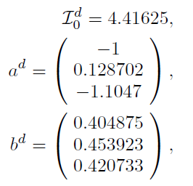
Instanton-induced heavy-quark potential
$→$ Instanton does not describe the quark
confinement.
$→$This is reason for why we need to add the
confining potential.

Slide 12
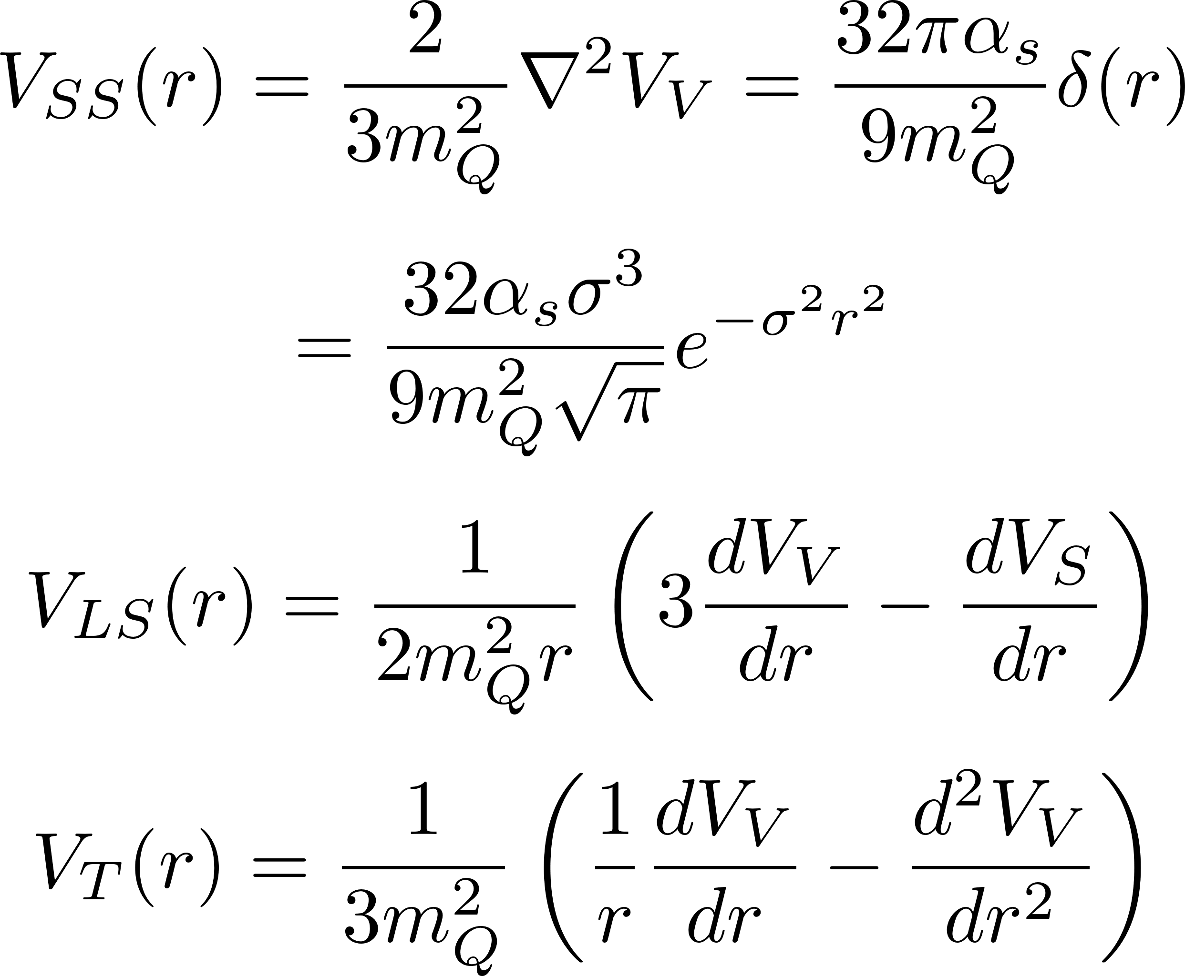
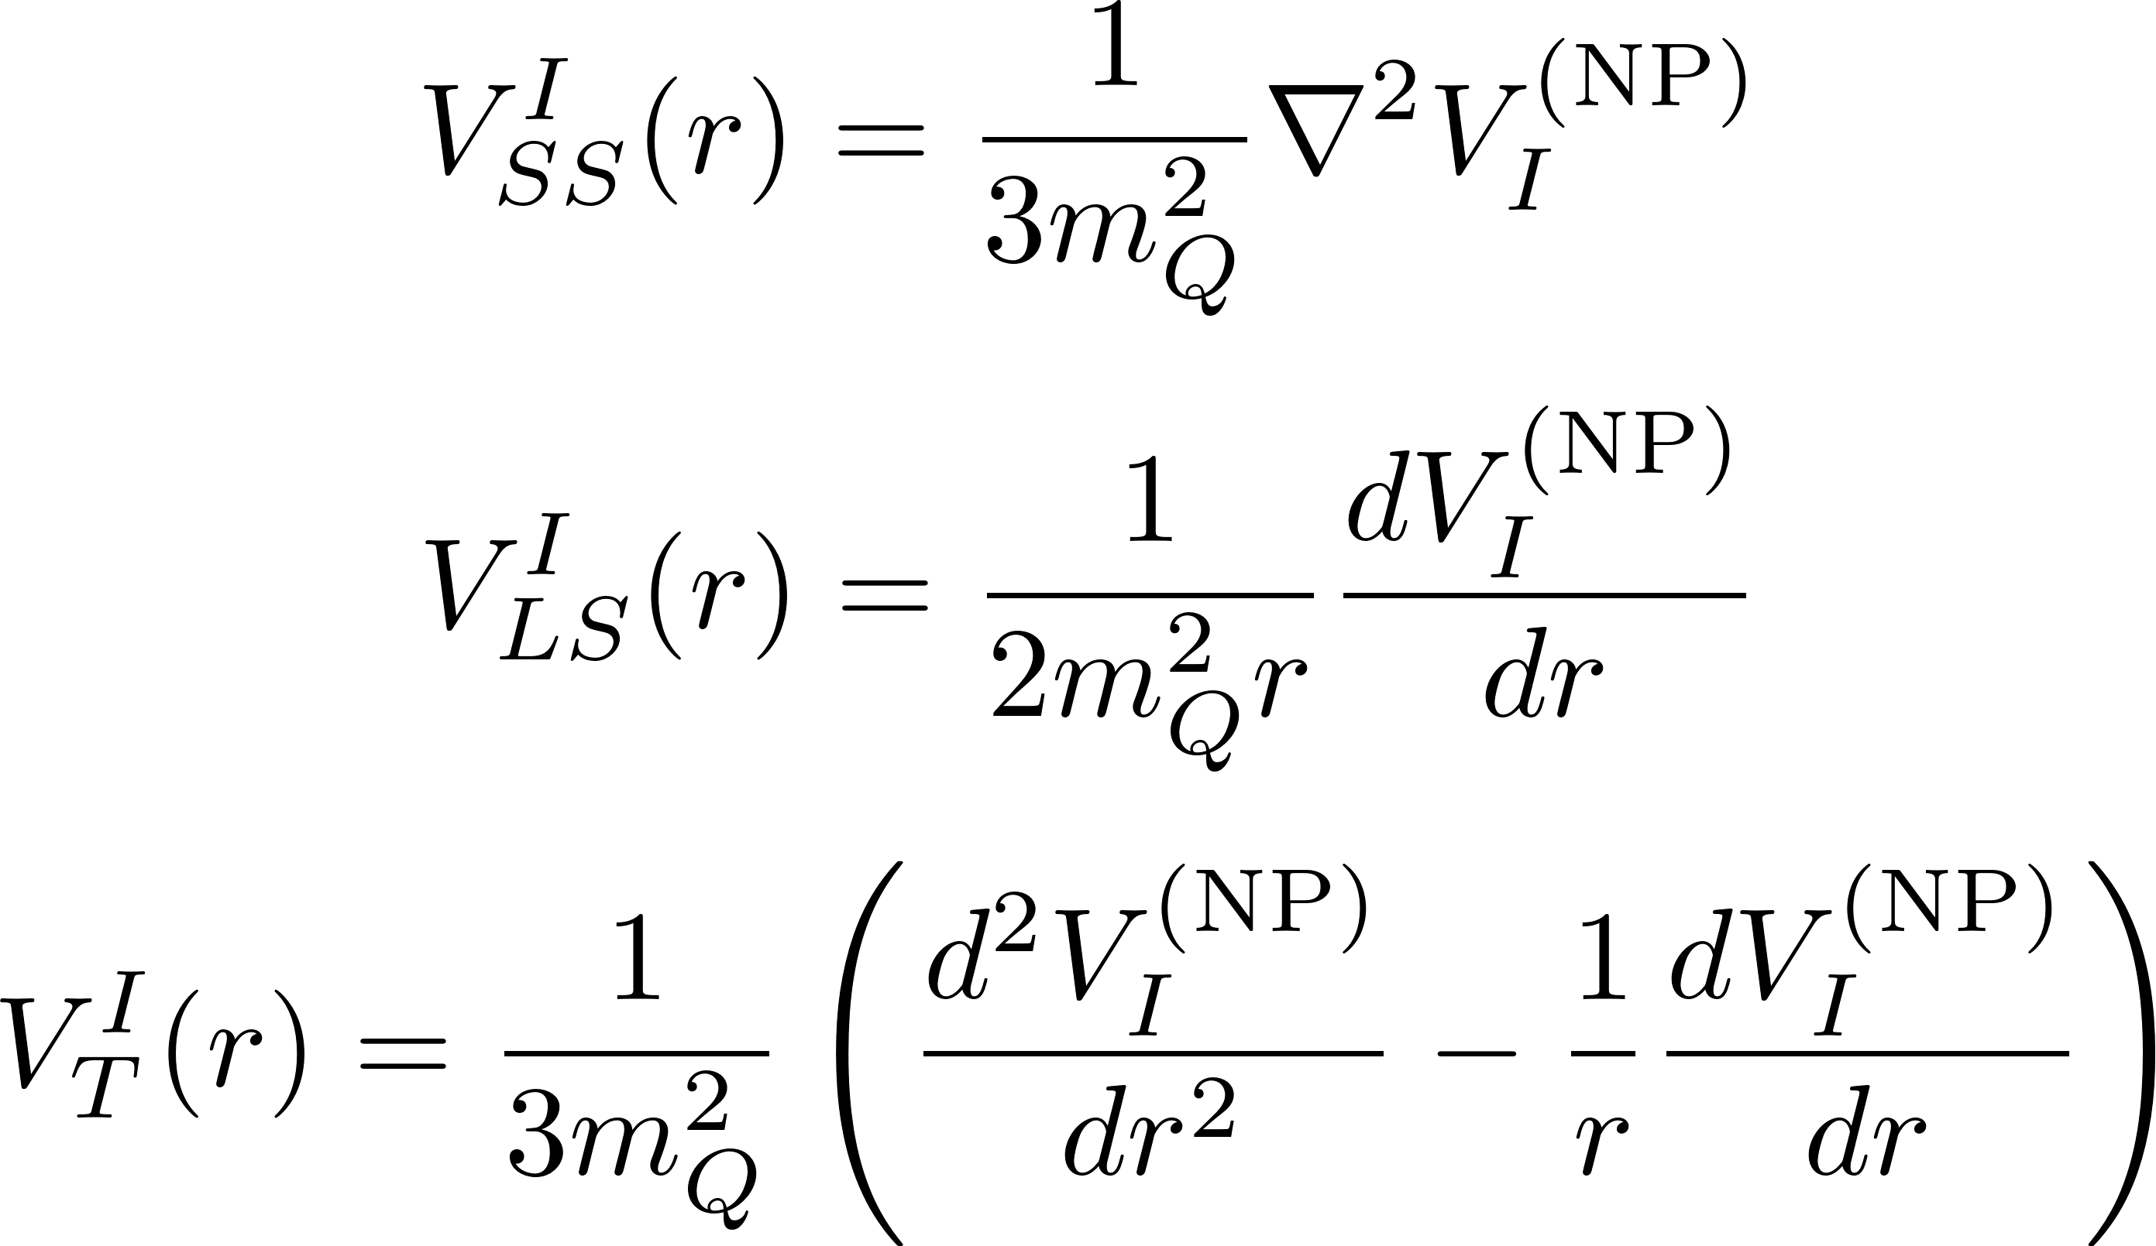
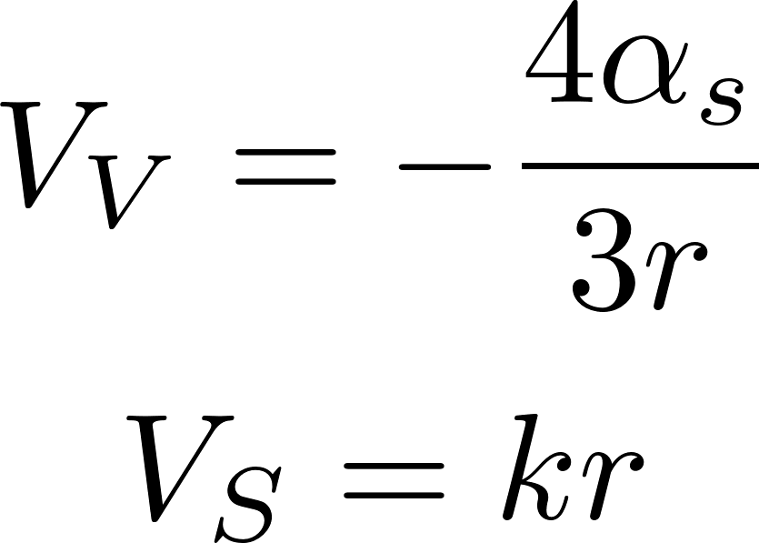
Spin-dependent parts of the $Q\overline{Q}$ potential
The spin-dependent parts of the heavy-quark potential are represented by the Breit-Fermi equation [3, 4]:
The spin-dependent parts of the instanton case are derived in Ref. [3]:
[3] E. Eichten and F. Feinberg, Phys. Rev. D173090 (1981)
[4] M. B. Voloshin, Progress in Particle and Nucl Phys. 61 (2008) 455-511

Slide 13
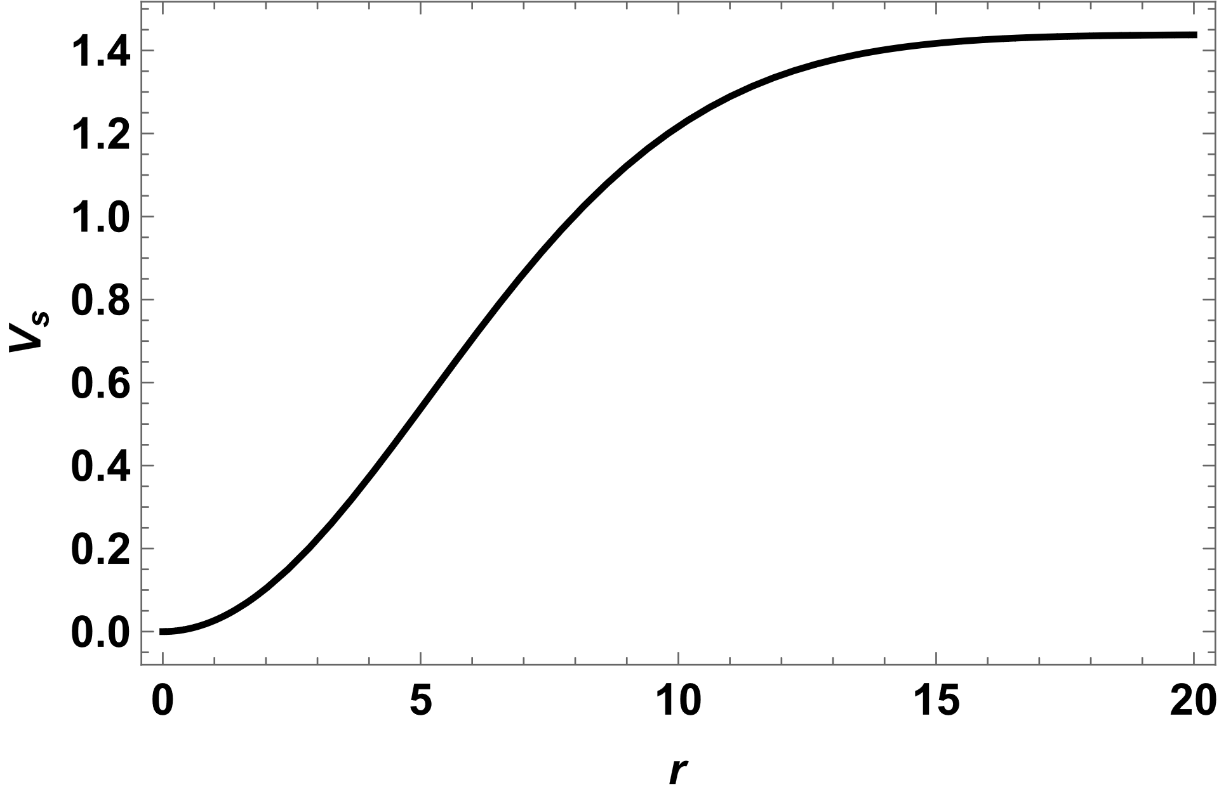
Eigenvalues of the Hamiltonian
To obtain the bound state energy of the quarkonia, we solved the non-relativistic Schrödinger equation
We have 5 fitting parameters: $α_{s}, σ, k, b, m_{c}$
$m_{Q\overline{Q}}$: mass of the quarkonia
$E_{B}$: Bound state energy (eigenvalue of the Hamiltonian)
creation

Slide 14
Results: Charmonium spectrum

Slide 15
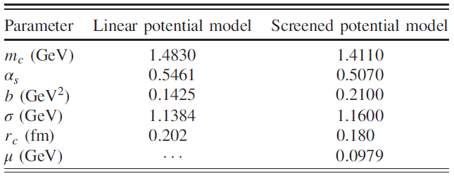
Results: Fitting parameters
We made the modified screened potential to include the induced heavy-quark potential.
Model I is not including the instanton effects
Model II is including the instanton effects
$α_{s}$ in Model II approaches the results of the pQCD:
Linear (LP) and screened (SP) potential models [4]
SP model has the advantage that it gives the smaller running coupling constant and the heavy quark mass than LP.
However, SP model is not easy to optimize in the instanton model because of the additional dynamical mass from the instanton vacuum.
: Linear Potential (LP)
: Screened potential (SP)
[4] Wei-Jun Deng et al, Phys. Rev. D 95. 034026 (2017)

Slide 16
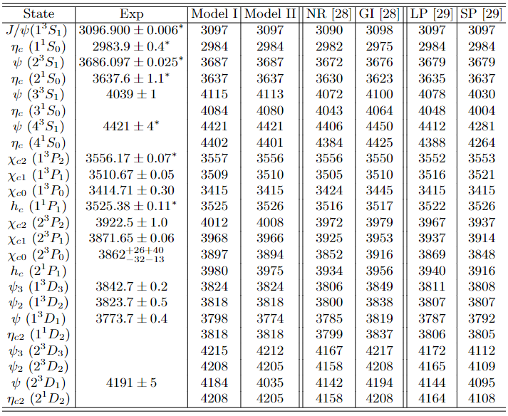
Results: Charmonium spectrum
NR and GI models are nonrelativistic model and Godfrey-Isgur (relativized quark) model.
Nonrelativistic model: Model I(II), NR, LP, SP
Number of input data
This work: 7
Ref. [28]: 11
Ref. [29]: 12
Our model requires relatively less data than another models.
[28] T. Barnes and S. Godfrey, Phys. Rev. D 69, 054008 (2004)
[29] Wei-Jun Deng et al, Phys. Rev. D 95. 034026 (2017)

Slide 17
Results: Charmonium spectrum
The modified screened potential model well describes each ground state.
Model II (instanton model) is the best prediction model.
However, it still cannot describe the excited states of P and D wave because the modified screened potential cannot explain the confinement completely.
The ground state of each wave
Most accurate prediction
[28] T. Barnes and S. Godfrey, Phys. Rev. D 69, 054008 (2004)
[29] Wei-Jun Deng et al, Phys. Rev. D 95. 034026 (2017)

Slide 18
Results: Decay width of the E1 and M1 radiative transitions

Slide 19
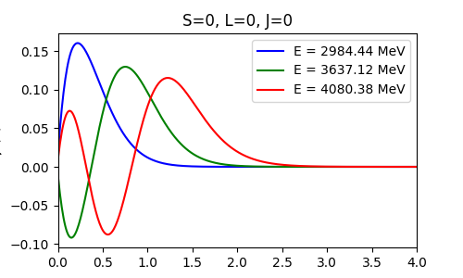
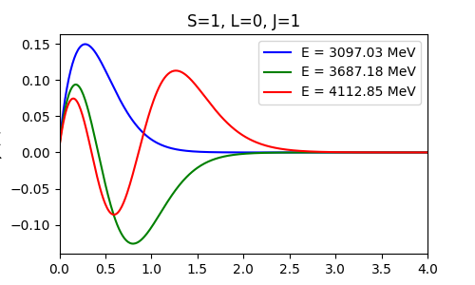
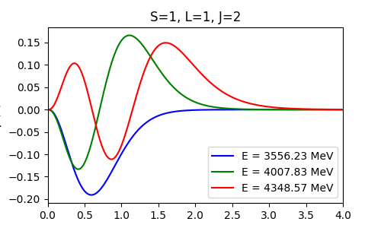
Decay width of the electromagnetic transitions
To see the electromagnetic transitions, we need to know the initial and final state because we have to calculate the matrix element of the EM hamiltonian.
From the previous results, we get also each wavefunction of state.
The wavefunctions ($χ\left(r\right)=rψ(r)$) are obtained by the eigenvalue problem.
Example:

Slide 20
Decay width of the electromagnetic transitions
The interaction Hamiltonian of the quark-photon EM coupling at the tree level is given by
It gives the electric and magnetic dipole interaction:
The initial and final Fock states are represented by
: charge of the charm quark

Slide 21
Decay width of the electromagnetic transitions
Using these states, we get the E1 and M1 decay width[28]
$E_{γ}$ is a final photon energy, $E_{f}^{\overline{c}c}$denotes a total energy of the final $c\overline{c}$ state, $M_{i}^{c\overline{c}}$ stands for a mass of the initial $c\overline{c}$ state and $α=4π{\left|e\right|}^{2}$ is known as the fine-structure constant.
[28] T. Barnes and S. Godfrey, Phys. Rev. D 69, 054008 (2004)

Slide 22
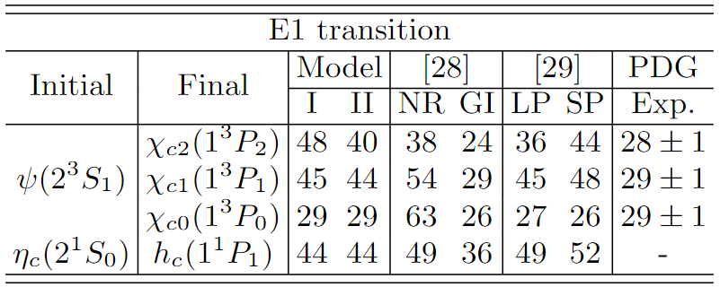
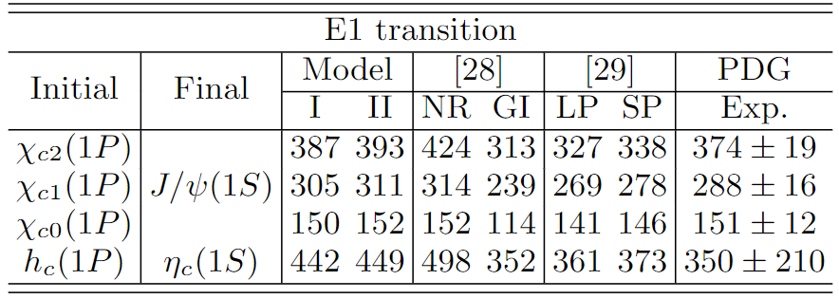
Results: E1 & M1 Radiative Transitions
2S$→$1P transitions (keV)
1$P→$1S transitions (keV)
The instanton effects tend to correct the mass spectrum from Model I.
$ψ→χ_{c1}$ and $ψ→χ_{c2}$ are still big, which are a common problem of the nonrelativistic models.
The confinement potentials of these models are not enough to reproduce the excited states.
Nevertheless, the instanton effects offer the smaller values than the no instanton models.
Overall, the modified screened potential model gives excellent results in this transition compared to other models.
However, $χ_{c1}→J/ψ$ (may be $χ_{c2}$ also) littile big.
We are guessing that is from the overestimated excited states(2P).
[28] T. Barnes and S. Godfrey, Phys. Rev. D 69, 054008 (2004)
[29] Wei-Jun Deng et al, Phys. Rev. D 95. 034026 (2017)

Slide 23
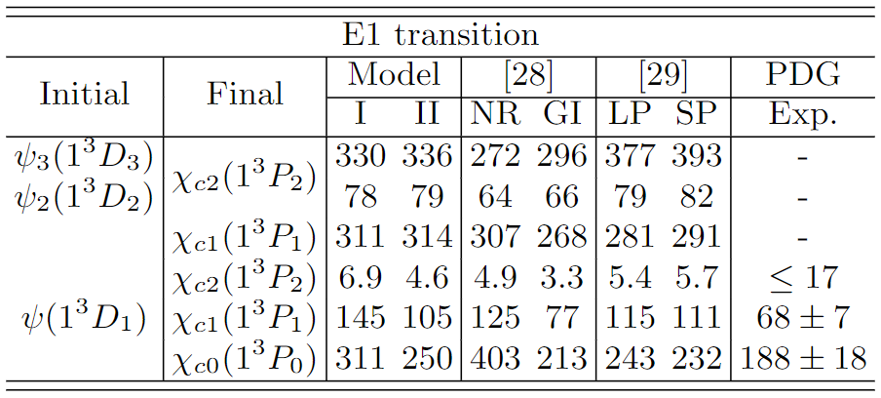
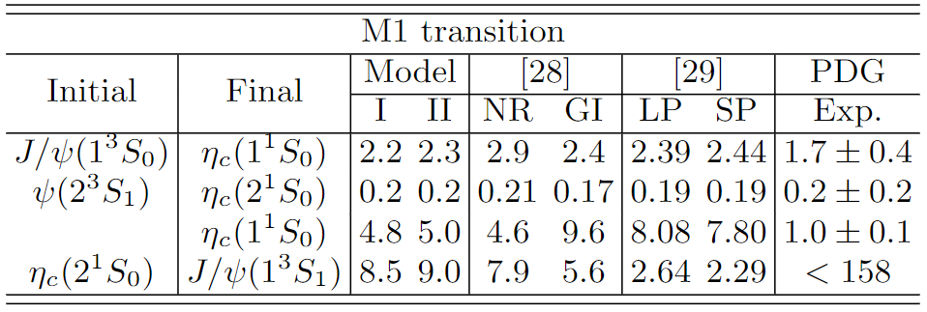
Results: E1 & M1 Radiative Transitions
1$D→$1P transitions (keV)
(keV)
The modified screened potential models predict the first two transitions very well.
On the other hands, we cannot explain the last two transitions. (Homework!)
One can see the problems of the nonrelativistic models.
In the higher states, they cannot well describe the transitions.
However, the instanton effects give better results than Model I.
Especially, $ψ→χ_{c1}$ is remarkable for the best result of the nonrelativistic models.
[28] T. Barnes and S. Godfrey, Phys. Rev. D 69, 054008 (2004)
[29] Wei-Jun Deng et al, Phys. Rev. D 95. 034026 (2017)

Slide 24
Summary
We make the modified screened potential to include the instanton effects on SP model.
We obtained the charmonium spectrum from the heavy-quark potential with the instanton effects.
We got the smaller running coupling constant from MSP ($α_{s}$=0.49) than that of SP ($α_{s}=0.51)$ model.
The instanton model (Model II) gives revised results of each ground state than the others.
We also evaluated the radiative transition width of E1 and M1 transitions.
Although the instanton effect in the heavy-quark system is known to have little contribution, it gives remarkable results from E1 and M1 transitions.
So, we can say that the instanton is still meaningful in the heavy-quark system.

Slide 25
Thank you for your attention

Slide 26
Back Up

Slide 27
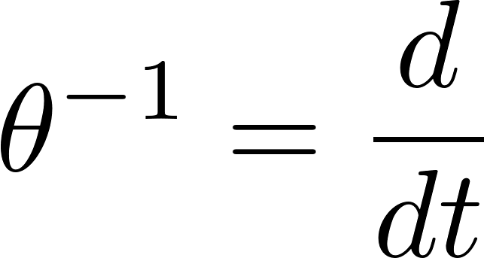
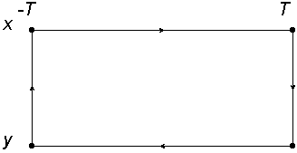
Heavy-quark potential in the instanton vacuum (Including perturbative corrections) [2]
In Ref. [2], they considered the one-gluon exchange(OGE) perturbation part.
They used the instanton packing parameter $λ=\frac{ρ^{4}}{R^{4}}\sim 0.01$ as the running coupling constant $α_{s}\sim λ^{\frac{1}{2}}$.
Averaged Wilson loop($Q\overline{Q}$ correlator) can be written as
Using the Fourier transform of $W^{−1}$: $W^{−1}\left(ω\right)=iω+f\left(ω\right)+g\left(ω\right)$
(1)
(2)
order of
Correlation function from the Fourier transformation :
[1] Diakonov et al, Phys. Lett. B 226, 372 (1989)
[2] M.Musakhanov et al, PhysRevD.102.076022

Slide 28
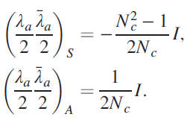
Heavy-quark potential in the instanton vacuum (Including perturbative corrections) [2]
$M_{g}\left(q\right)=\frac{2π}{ρ}{\left(\frac{6λ}{N_{c}^{2}−1}\right)}^{1/2}qρK_{1}\left(qρ\right)$ : Momentum dependent gluon mass
$K_{1}$ : Modified Bessel function of the second type
$ρ=1/3$ fm
$R=1$fm
In the color-singlet state

Slide 29
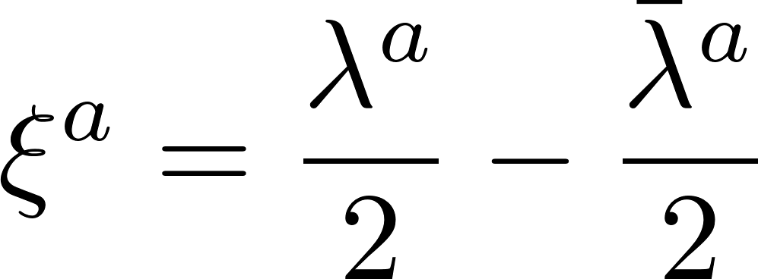
Outlooks
For the case of the hadronic transition amplitude [5] of the two-pion transition between $n^{3}S_{1}$states:
The $ψ^{′}→J/ψ$ transition in the chromo-electric field is described by the effective Hamiltonian
with the chromo-polarizability given by
where $G$ is the Green’s function of the heavy quark pair in the color octet state.
[5] M. B. Voloshin, Progress in Particle and Nucl Phys. 61 (2008) 455-511

Slide 30
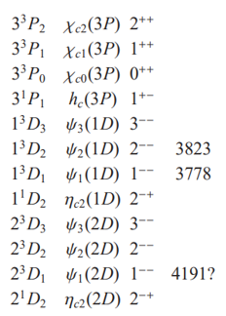
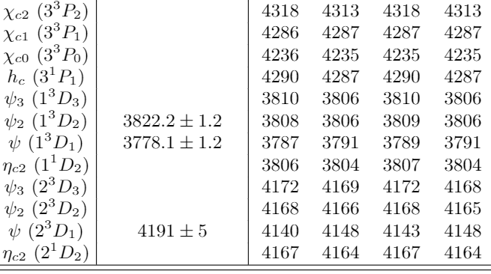
Results: Charmonium spectrum
Fitting parameters
[4]
: LP
: SP
[4] Wei-Jun Deng et al, Phys. Rev. D 95. 034026 (2017)

Slide 31
Potential from Wilson Loop
The $Q\overline{Q}$ state evaluates in time $T$ and can be represented as
: Wilson line
We assume that the heavy quark and antiquark masses $m_{Q,\overline{Q}}→∞$ and they are in static state during $T→∞$.
Heavy quark potential from the correlation function:
$$T≫r (=x−y)$$
$$W\left(C\right)=U\left(\vec{x},−T;\vec{x} ,T\right)U(\vec{y},T;\vec{x},−T)$$
$$V=−\lim_{T→∞}{\frac{1}{T}\ln\left\langle W\left(C\right)\right\rangle }$$

Slide 32
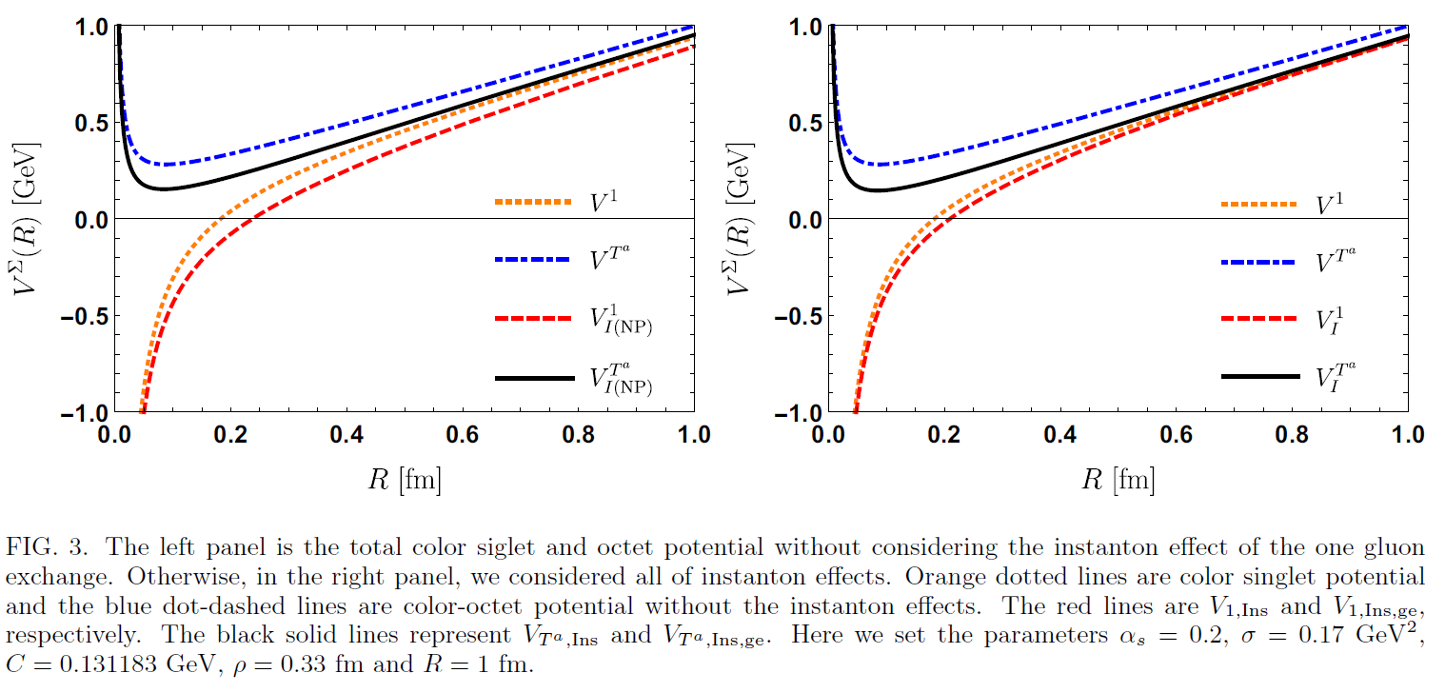
Results
Results

Slide 33
Color-octet heavy-quark potential (NP correction)
Color-octet Wilson loop $W_{T^{a}}$ can be represented by inserting the color exchange operator $T_{a}$
$$T_{a}$$
$$T_{a}$$
Using identity
:cluster decomposition for one-instanton calculation

Slide 34
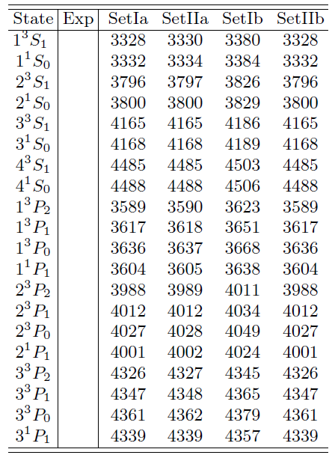
Eigenvalues of the Color-octet Hamiltonian
Bound state energy ($E_{B}$)
Unobservable quantities.
Physical implications are yet unknown.

Slide 35
Why we use the instanton?
In the pQCD, the running coupling constant $α_{s}$ at the one loop level is given by the expression [3-6]:
Table 1 [8]. The result using Cornell potential gives a 51% difference from one of pQCD. On the other hand, the instanton effects as in M-I and M-Iib give the difference 17% and 14%, respectively.
[3] M. Peter, Phys. Rev. Lett. 78, 602 (1997).
[4]M. Peter, Nucl. Phys. B501, 471 (1997).
[5] Y. Schroder, Phys. Lett. B 447, 321 (1999).
[6] A. V. Smirnov, V. A. Smirnov, and M. Steinhauser, Phys. Rev. Lett. 104, 112002 (2010).
[7] C. Anzai, Y. Kiyo, and Y. Sumino, Phys. Rev. Lett. 104, 112003 (2010).
[8] Yakhshiev et al, PhysRevD.98.114036

Slide 36
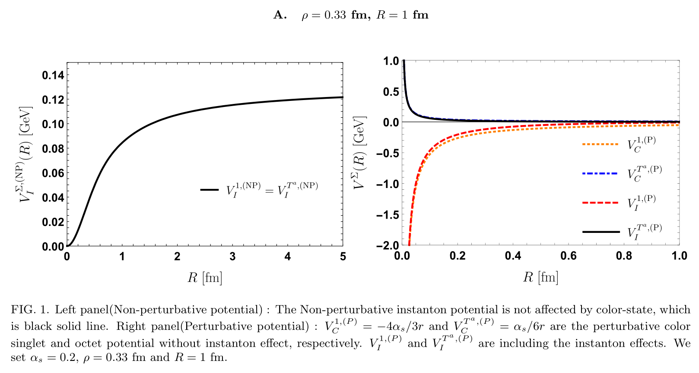
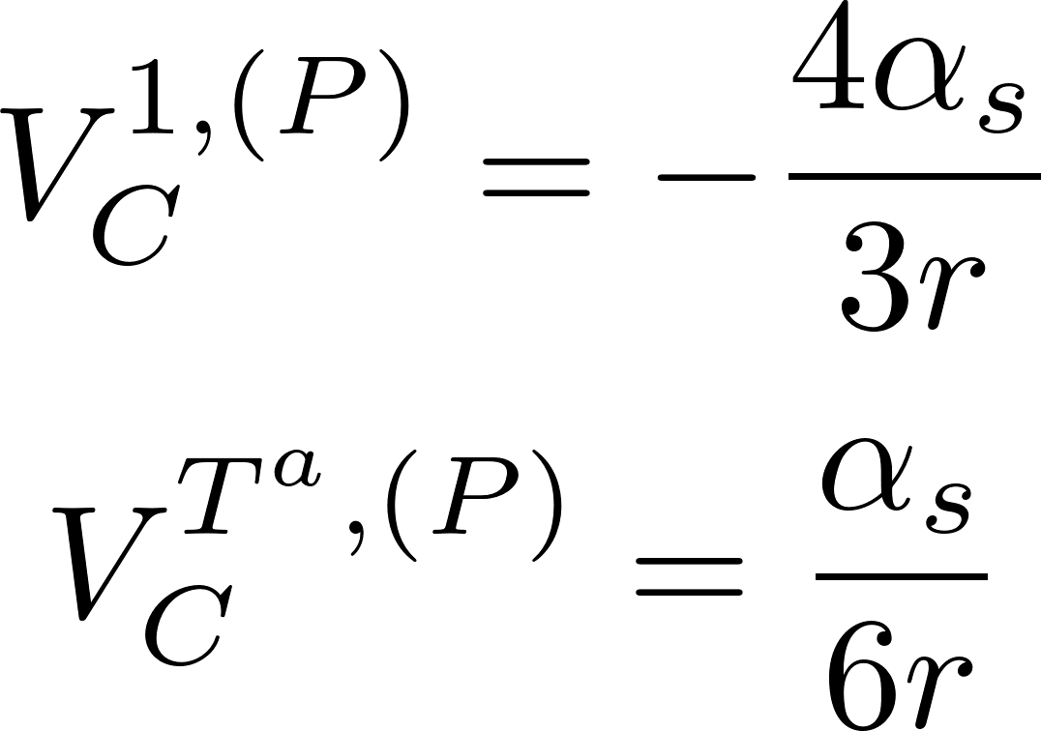
Color-singlet & octet $Q\overline{Q}$ potential

Slide 37
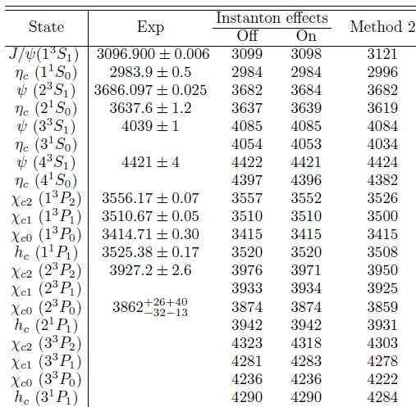
Results: Charmonium spectrum
fitting parameters
The running coupling constant at the one-loop level:
For the case of the instanton effects off: $V_{I}=0, V_{SD}^{I}=0$
We used the instanton parameters $ρ=1/3$ fm and $R=1$ fm

Slide 38
Summary & Outlook
We showed the non-perturbative color-octet heavy quark potential in the instanton vacuum:
The perturbative one gluon exchange instanton effects make the color-singlet(octet) heavy quark potential a little weaker Instanton makes the screening effects.
We obtained the charmonium spectrum and the bound energies in the color-octet states.
Using the color-octet potential derived in the present work, we are going to calculate chromo-polarizabilities of quarkonia.
From this chromo-polarizability, we will show hadronic transition between charmonium resonances.

