Slide 1


Structure of Singly Heavy Baryons
in a Pion Mean Approach
Hyun-Chul Kim
Department of Physics,
Inha University

Slide 2

What we have studied so far:
Mass spectra of singly heavy baryons
Electromagnetic form factors
EM transition form factors
Magnetic moments
Transition magnetic moments
Strong decays of heavy baryons
Isospin mass splittings
Excited Omega_c’s as pentaquarks
Heavy baryon masses in medium
Gravitational form factors: Mechanical structure of heavy baryons
Axial-vector transitions (Jung-Min Suh, Friday)
Axial-vector constants & quark spin content
Light quark PDFs for the singly heavy baryons
(For details, a talk will be given by H.-D. Son in Pohang)

Slide 3
Chiral symmetry from
the instanton vacuum

Slide 4
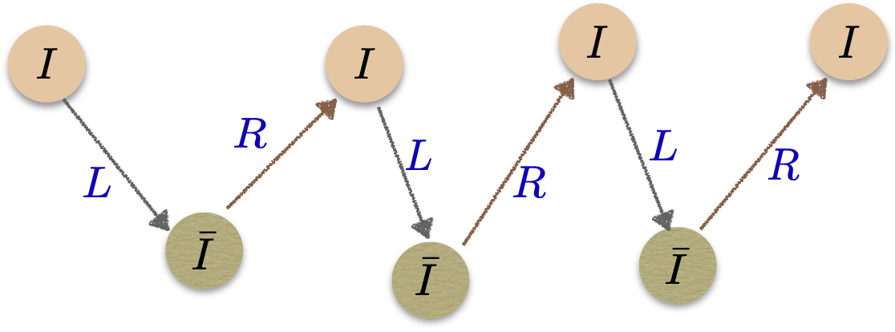
Instanton vacuum and SBXS
Diakonov & Petrov,
NPB 272 (1986) 457
Diakonov
hep-ph/0212026
Shuryak & Schäfer
RMP 70 (1998) 323
A light quark acquires the mass by propagating
through the instanton medium with the helicity of
quarks changed.
Banks-Casher theorem
Quark condensate
Pion decay constant

Slide 5
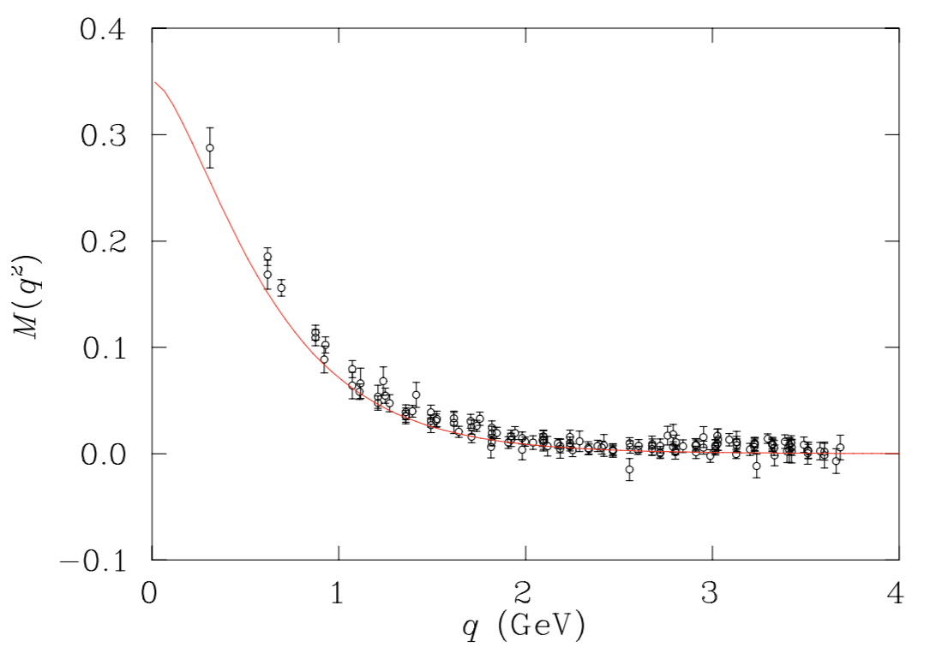
Diakonov & Petrov,
NPB 272 (1986) 457
: Dynamical quark mass from
the Fourier transform of the quark
zero mode in the instanton background

Slide 6
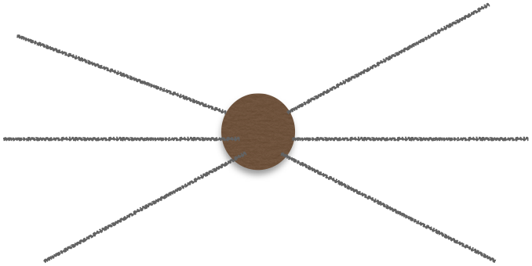
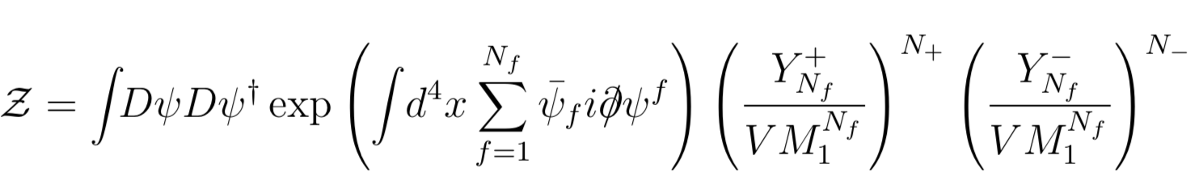
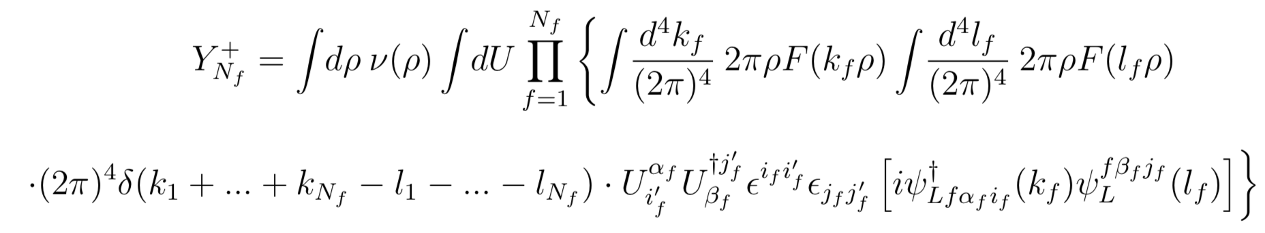
Low-energy QCD parttion function
Diakonov & Petrov,
NPB 272 (1986) 457
Effective quark interactions
After bosonization, we have the effective chiral action.

Slide 7
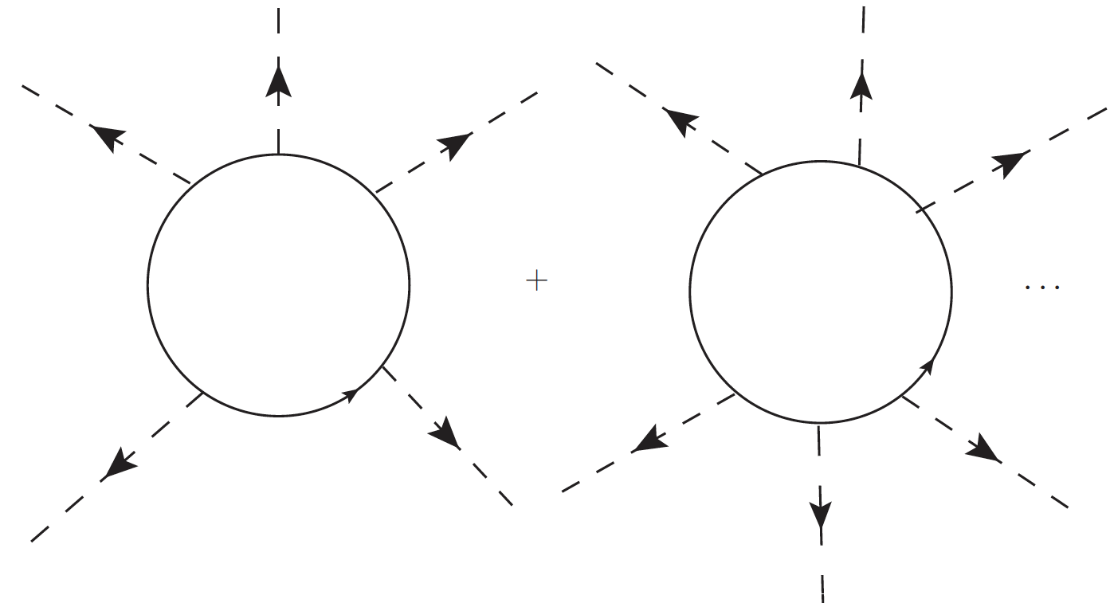
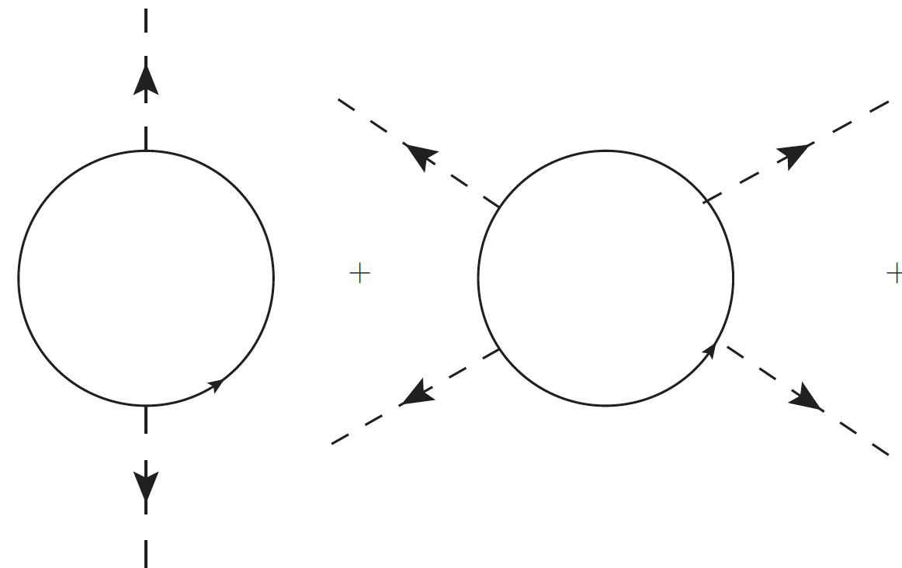
Mesons and baryons
can be described on an
equal footing.
Effective chiral action as the starting point:
Constant M requires regularizations for quark loops.

Slide 8


Witten’s seminal idea: Baryon in the large Nc
NPB, 149(1979)285
Problem in low-energy QCD: Large value of the strong coupling constant
The number of color as an implicit expansion parameter
A baryon can be viewed as a state of Nc quarks bound
by mesonic mean fields.
Its mass is proportional to Nc, while its width is of order O(1).
Mesons are weakly interacting
(Quantum fluctuations are suppressed by 1/Nc: O(1/Nc)).
Extension
A singly heavy baryon can be viewed as a state of
Nc-1 quarks bound by mesonic mean fields.

Slide 9

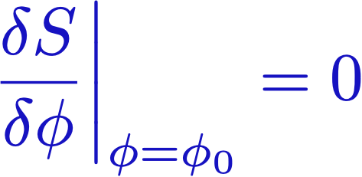


Given action ,
: Solution of this saddle-point equation
This classical solution is regarded as a mean field.
Mean-field potential that is produced by
all other particles.
Nuclear shell models
Ginzburg-Landau theory for superconductivity
Quark potential models for baryons

Slide 10
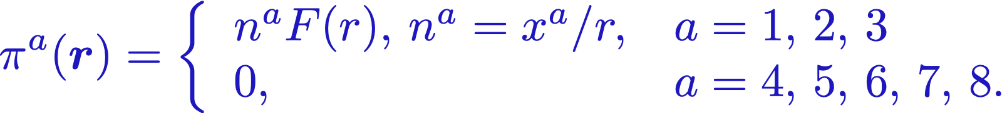
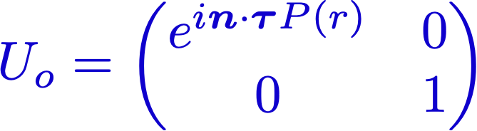
Baryons as a state of Nc quarks bound by mesonic mean fields.
Blotz, HChK, Goeke et al. PPNP 37 (1996) 91
Effective chiral action:
Diakonov, hep-ph/9802298
Key point: Hedgehog Ansatz
It breaks spontaneously
Witten’s trivial embedding

Slide 11
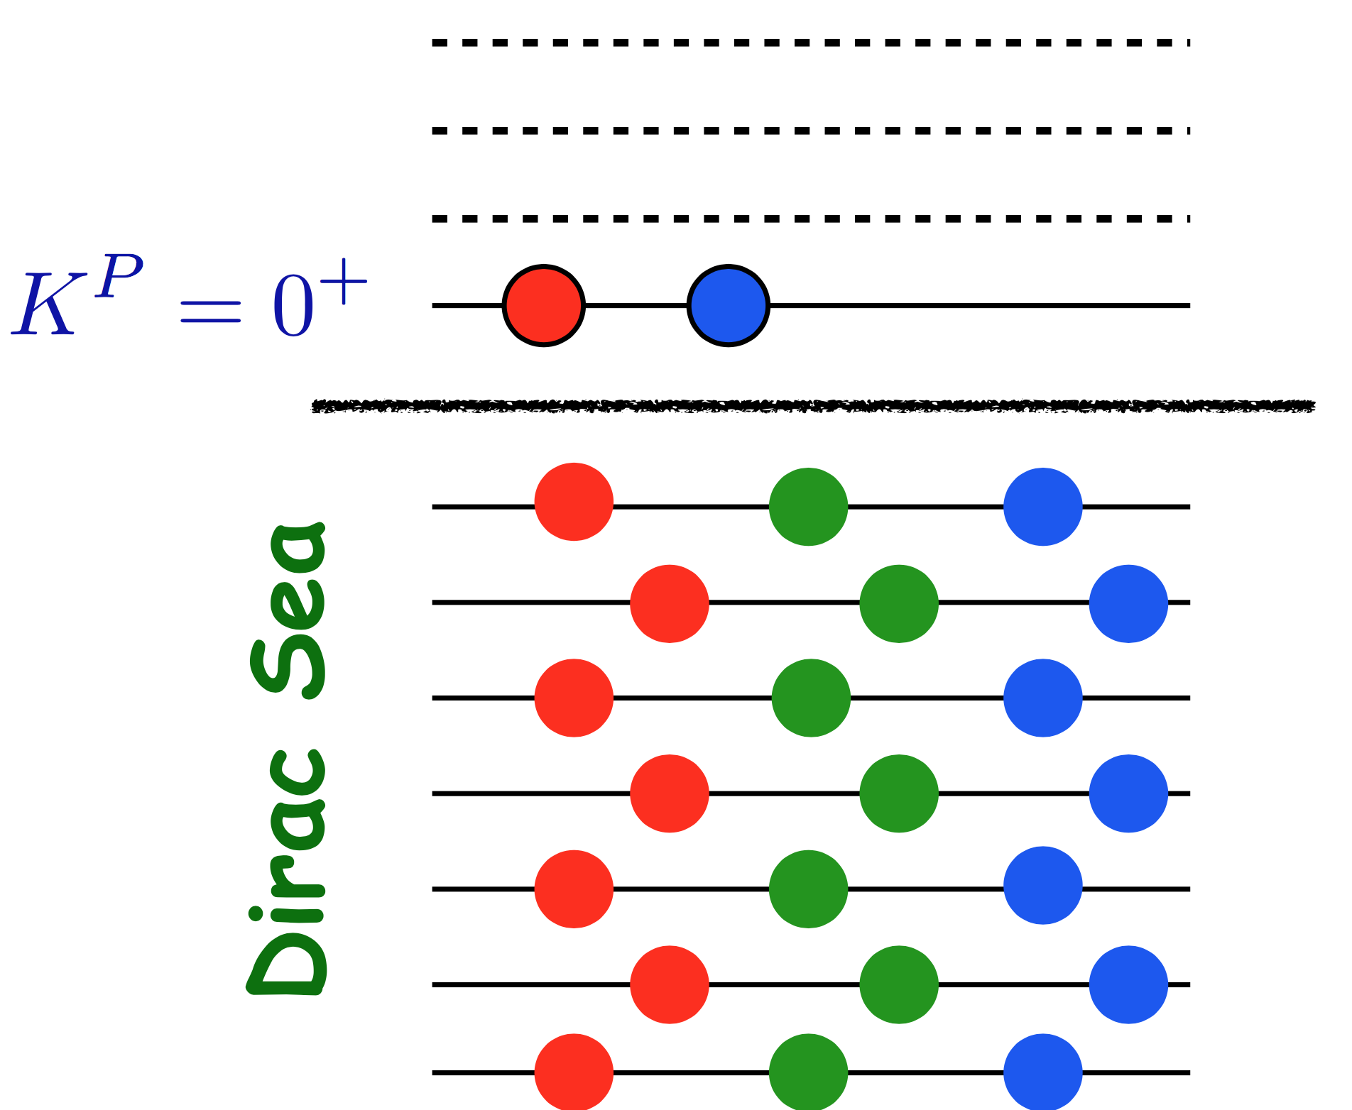

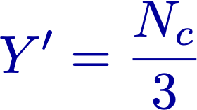
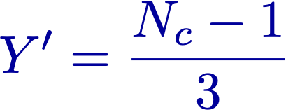

Light Baryons
Singly heavy Baryons
Dirac Sea
Heavy quark
as a static
color source

Slide 12
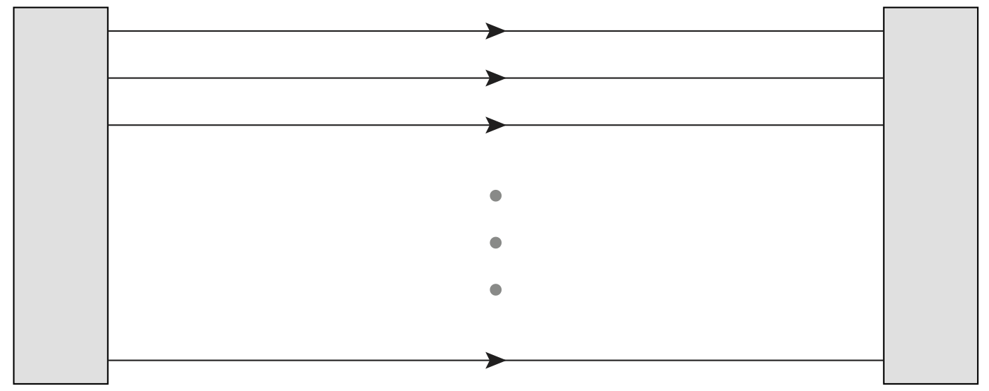


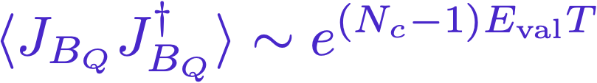

HChK et al. PPNP 37 (1996) 91
Light baryon correlation function
Single heavy baryon correlation function
Presence of Nc (Nc-1) quarks will polarize the vacuum or create mean fields.
Nc (Nc-1) valence quarks
Vacuum polarization or meson mean fields

Slide 13
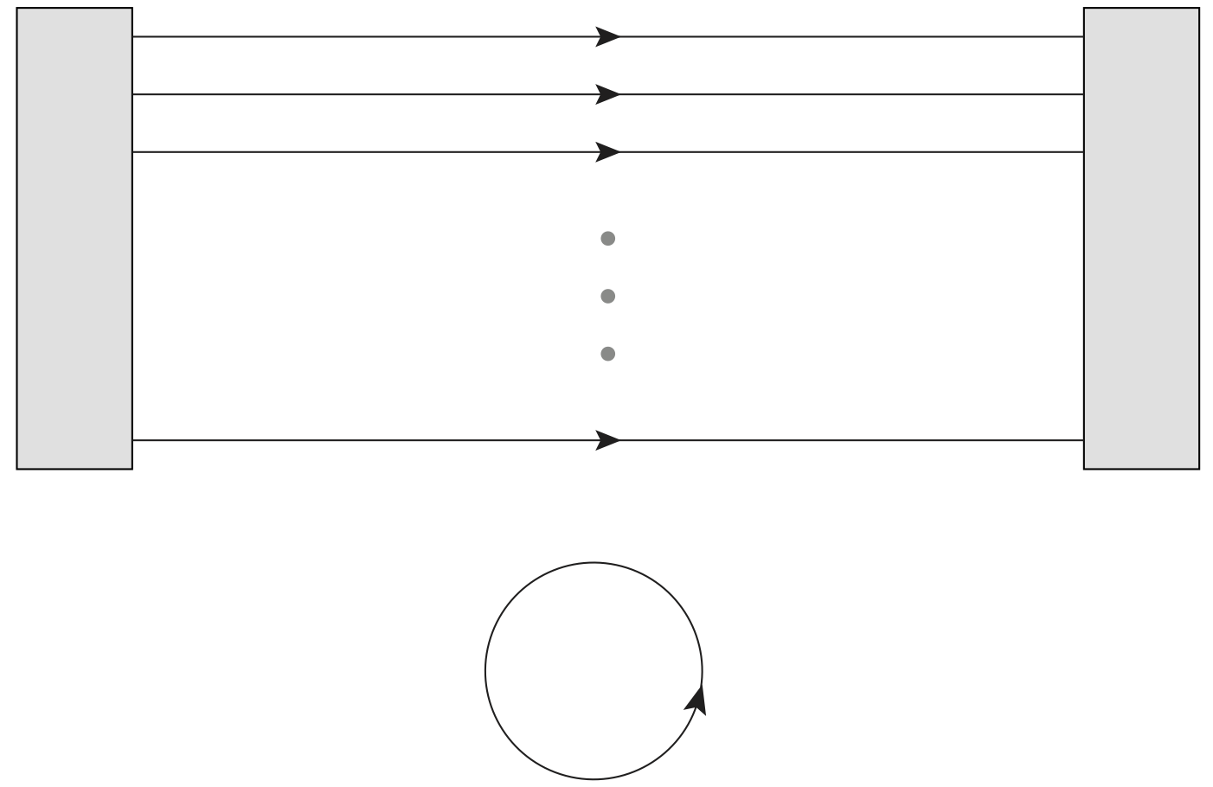

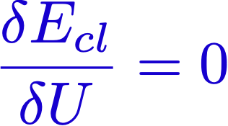


HChK et al. PPNP 37 (1996) 91
Yang, HChK, Praszalowicz, Polyakov,
PRD 94 (2016) R071502
Light baryon classical mass
Single heavy baryon classical mass
P(r): Soliton profile function
or Soliton field

Slide 14
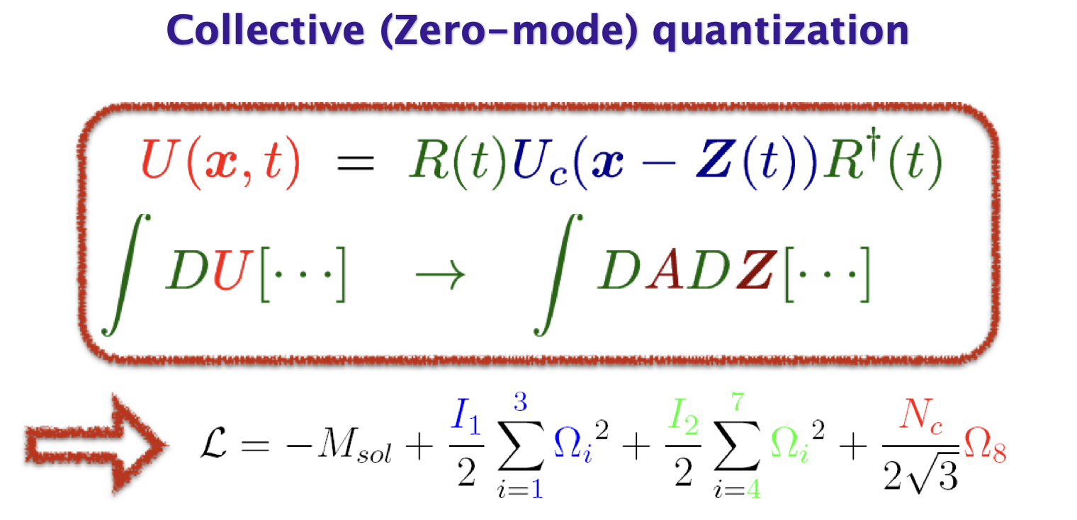

Slide 15
Heavy Quark Symmetry

Slide 16


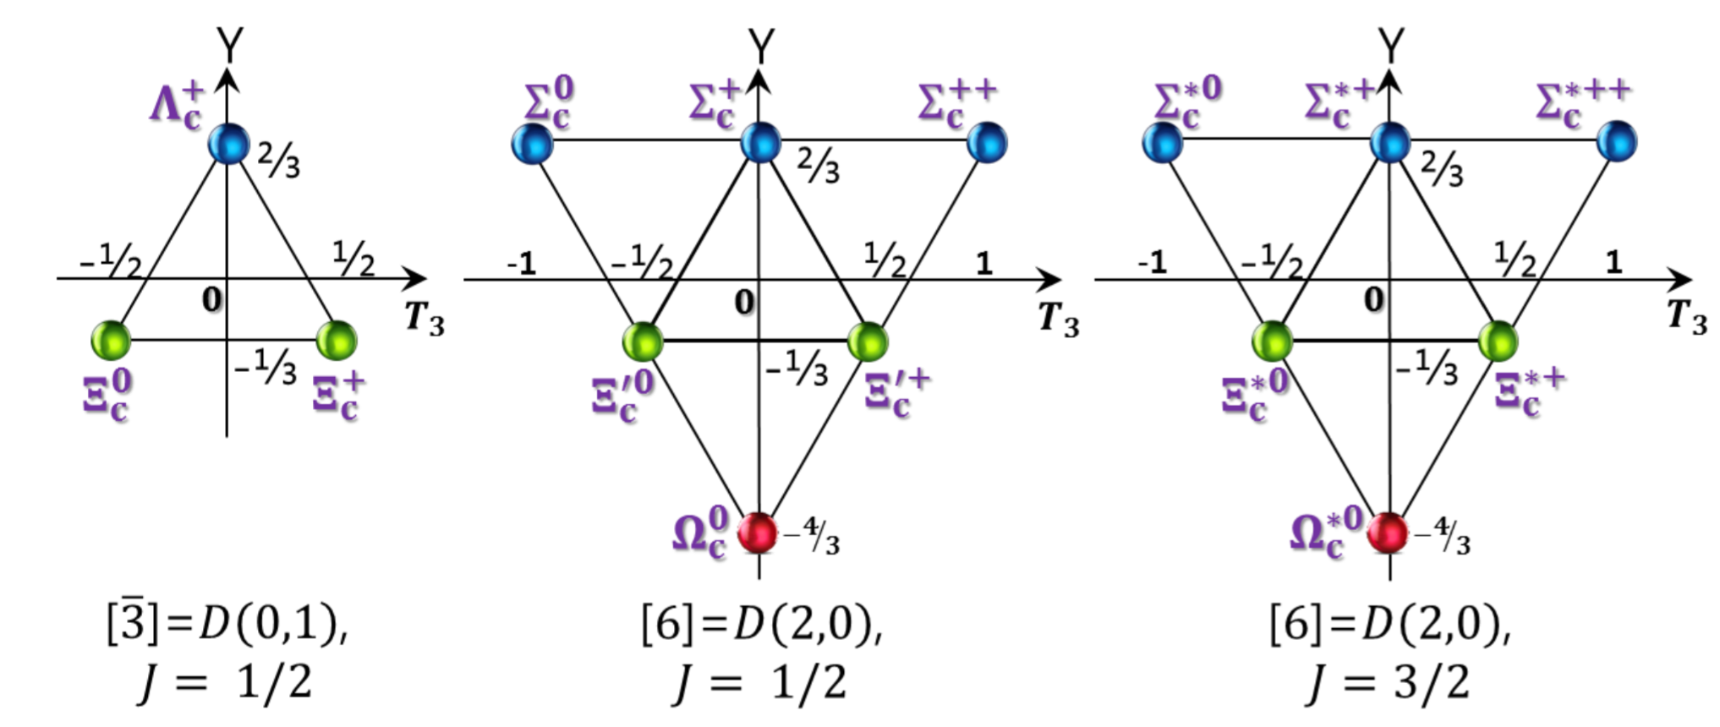


In the heavy quark mass limit, a heavy quark spin is conserved, so light-quark spin is also conserved: Heavy-quark spin symmetry
In this limit, heavy baryons are independent of heavy-quark flavors:
Heavy-quark flavor symmetry
In this limit, a heavy quark can be considered as a static color source.
Dynamics is governed by light quarks.

Slide 17
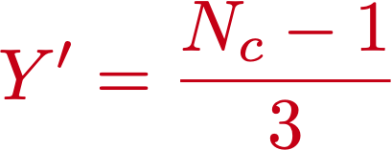




Nc-1 quarks represent heavy-baryon spectra.
Yang, HChK, Praszalowicz, Polyakov,
PRD 94 (2016) R071502
Grand spin:
The lowest rotationally excited states
T=0 for a anti-triplet: J=0 for it. Combining a charm quark with spin 1/2,
we have one anti-triplet.
T=1 for a sextet: J=1. We have two sextets with a charm quark.
(1/2, 3/2).

Slide 18

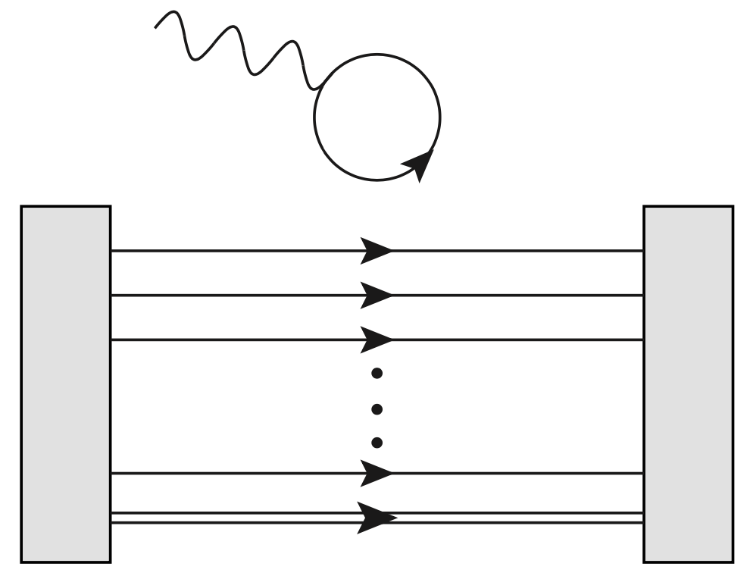
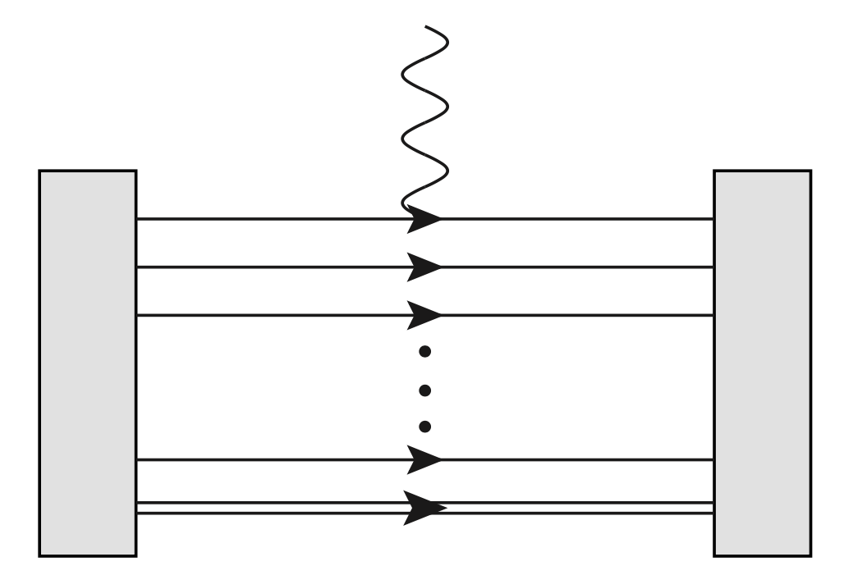

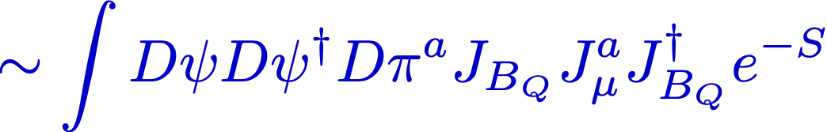
Observables for singly heavy baryons
JY Kim, HChK, PRD.103 (2021) 074025

Slide 19
Quark spin content
of
Singly heavy baryons

Slide 20
Spin of a baryon
X. Ji, PRL 78 (1997) 610
Understanding the spin structure of the nucleon is one of the EIC missions.

Slide 21


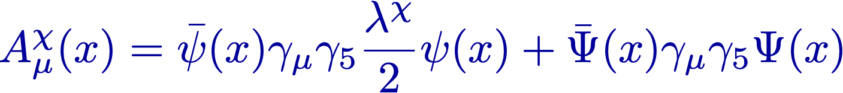

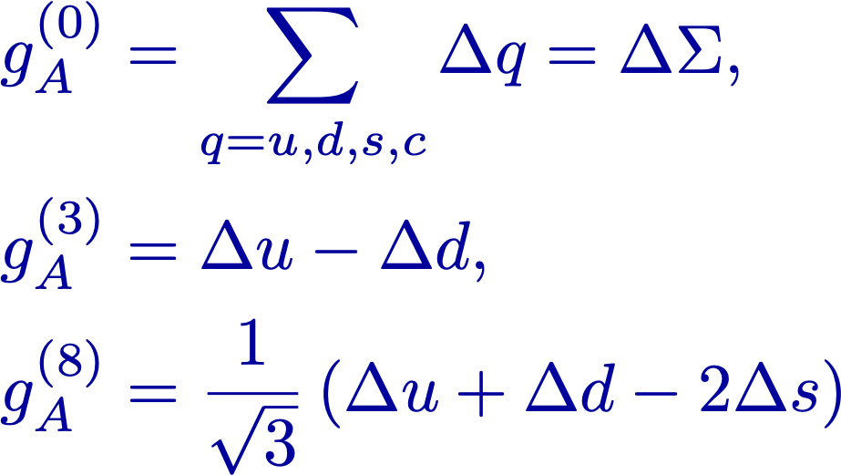
Axial-vector current
Light-quark part
Heavy-quark part
Flavor decomposition of the axial-vector constants
(No gluons in the XQSM)

Slide 22
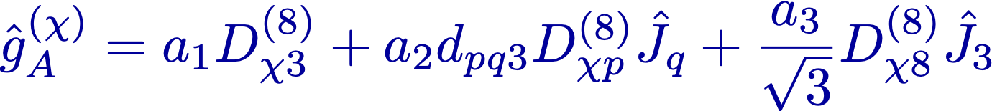
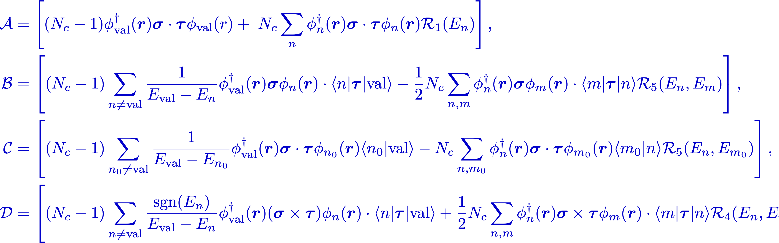
Collective operators

Slide 23


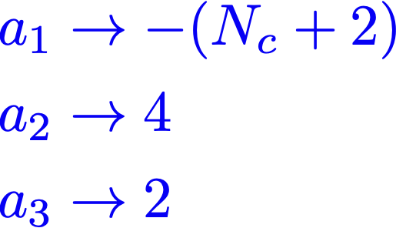


Limit to the Nonrelativistic Quark Model (NRQM)
( : Soliton Size)
Dirac Sea

Slide 24

XQSM
( : Soliton Size)
Bound by the pion
mean field
Dirac Sea

Slide 25


Limit to the Skyrme Model
( : Soliton Size)
As R further increases,
the quarks cross the border
M=0 and the soliton acquires
a winding number =1 and
then dives into the Dirac sea.
Dirac Sea

Slide 26
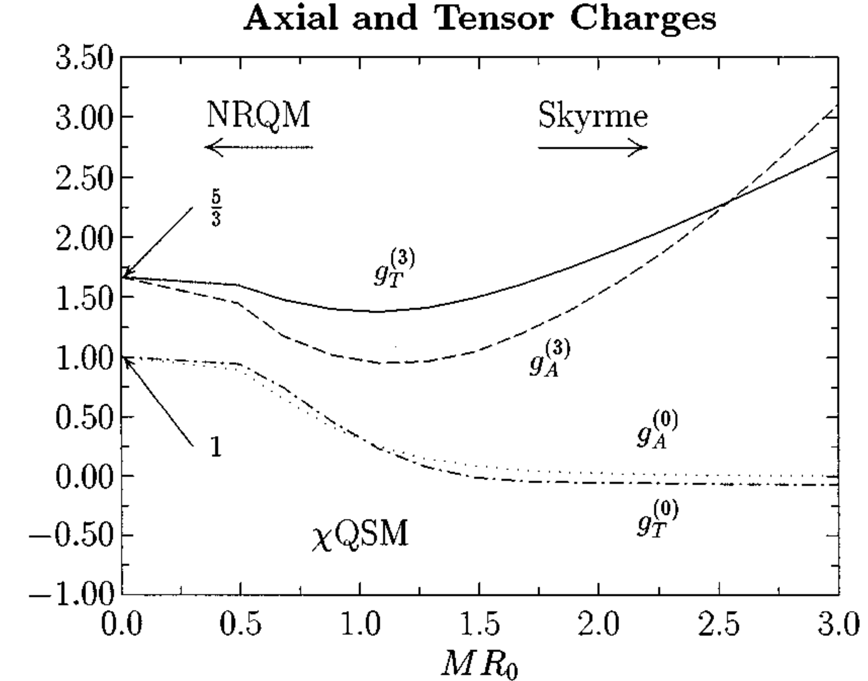
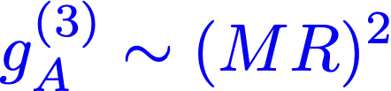
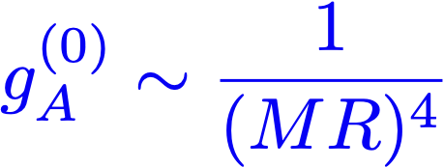
Interpolation
Interpolation between the NRQM and the Skyrme model
HChK, M.V. Polyakov, PRD 53 (1996) 4715

Slide 27
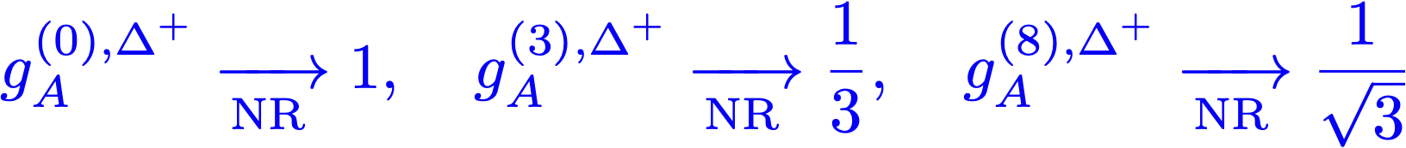
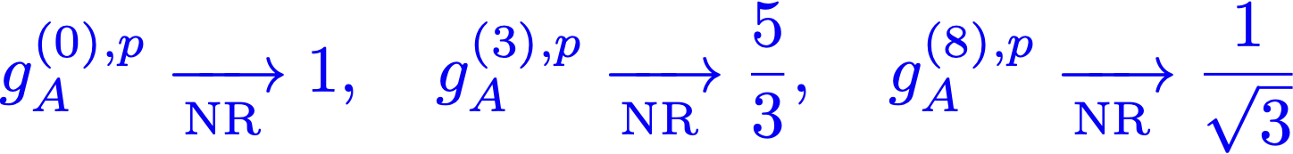
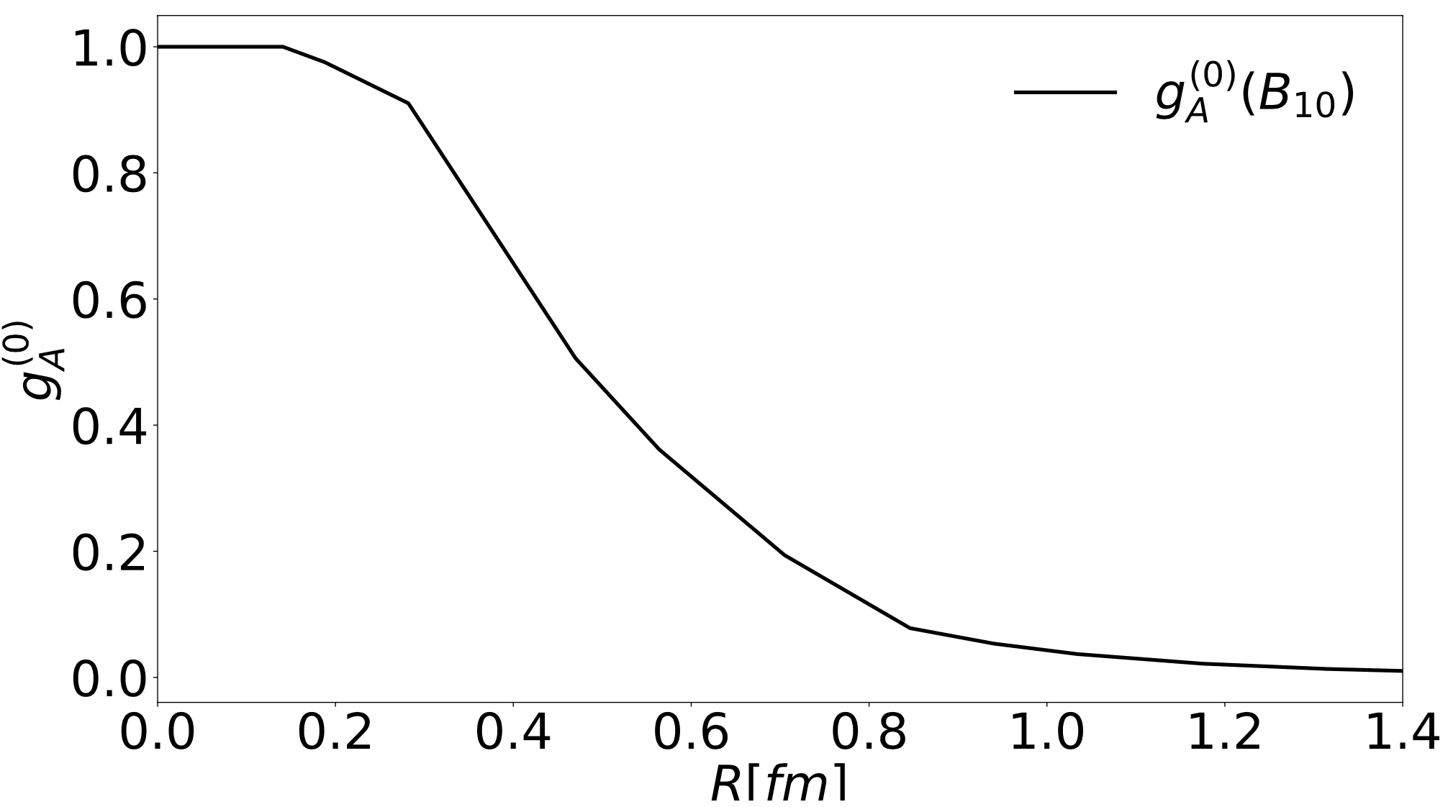


NRQM Limit
Skyrme Limit

Slide 28
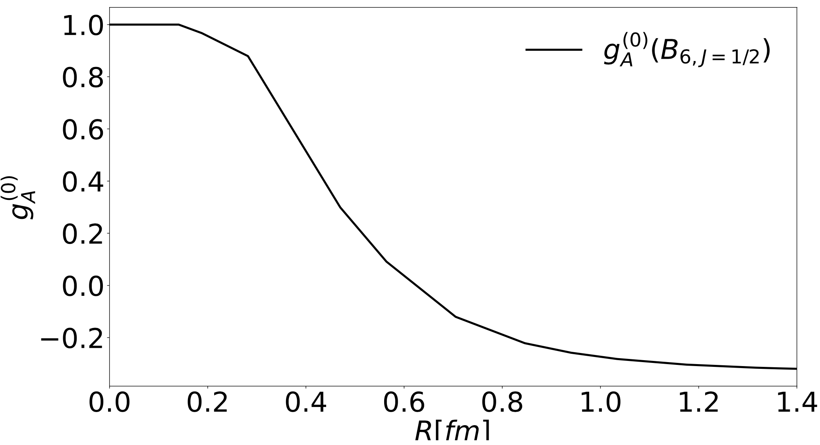
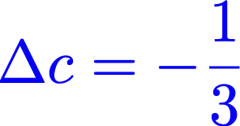
Interpolation
NRQM Limit
Skyrme Limit

Slide 29


Results
The quark spin content of the baryon octet
(Flavor SU(3) symmetry)
J. M. Suh, J.Y. Kim, G.S. Yang, HChK,
In preparation (2022)

Slide 30
The quark spin content of the baryon octet
J. M. Suh, J.Y. Kim, G.S. Yang, HChK,
In preparation (2022)

Slide 31
The quark spin content of the baryon octet
[1] COMPASS Coll., PLB 753 (2016) 18.
[2] XQCD, PRD 98 (2018) 074505.
[3] Green et al., PRD 95 (2017) 114502.
[4] Alexandrou et al., PRL 119 (2017) 142002.
[5] de Florian et al., PRD 80 (2009) 034030.
J. M. Suh, J.Y. Kim, G.S. Yang, HChK,
In preparation (2022)

Slide 32
The quark spin content of the baryon decuplet
J. M. Suh, J.Y. Kim, G.S. Yang, HChK,
In preparation (2022)

Slide 33
The quark spin content of the baryon sextet with J=1/2
[38] Alexandrou et al., PRL 119 (2017) 142002
J. M. Suh, J.Y. Kim, G.S. Yang, HChK,
In preparation (2022)

Slide 34
The quark spin content of the baryon sextet with J=1/2
J. M. Suh, J.Y. Kim, G.S. Yang, HChK,
In preparation (2022)

Slide 35
The quark spin content of the baryon sextet with J=3/2
( )/3
( )/3
( )/3
( )/3
( )/3
( )/3
( )/3
( )/3
( )/3
( )/3
[38] Alexandrou et al., PRL 119 (2017) 142002
J. M. Suh, J.Y. Kim, G.S. Yang, HChK,
In preparation (2022)

Slide 36
The quark spin content of the baryon sextet with J=3/2
All positively polarized!
J. M. Suh, J.Y. Kim, G.S. Yang, HChK,
In preparation (2022)

Slide 37
Teaser Ad:
Parton distribution functions
in a
Singly heavy baryon

Slide 38
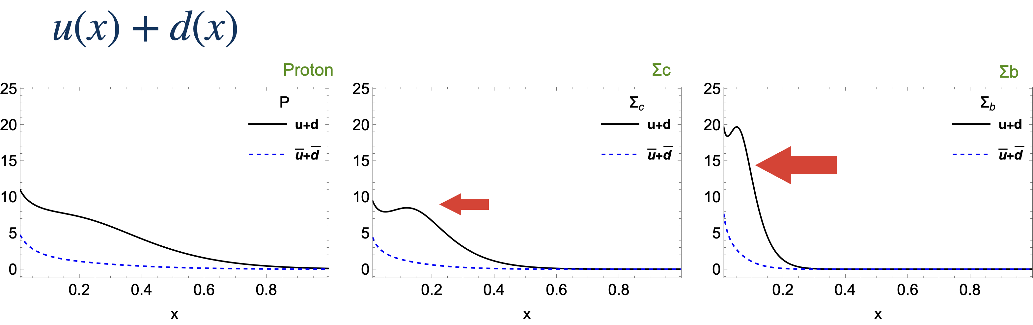
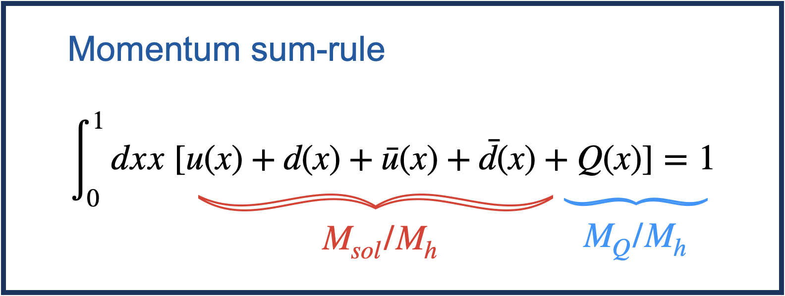
H.D. Son and HChK,
In preparation (2022)

Slide 39
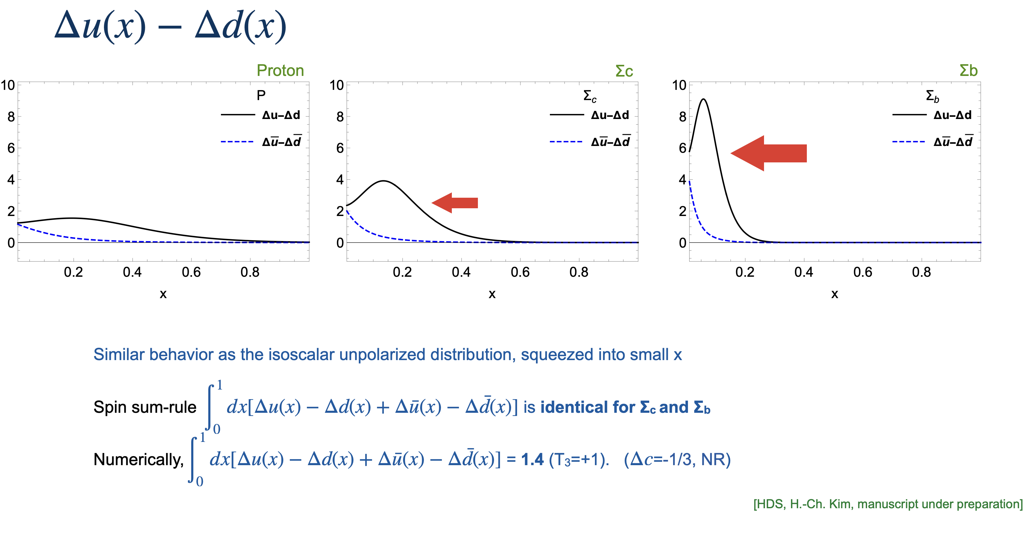

Slide 40
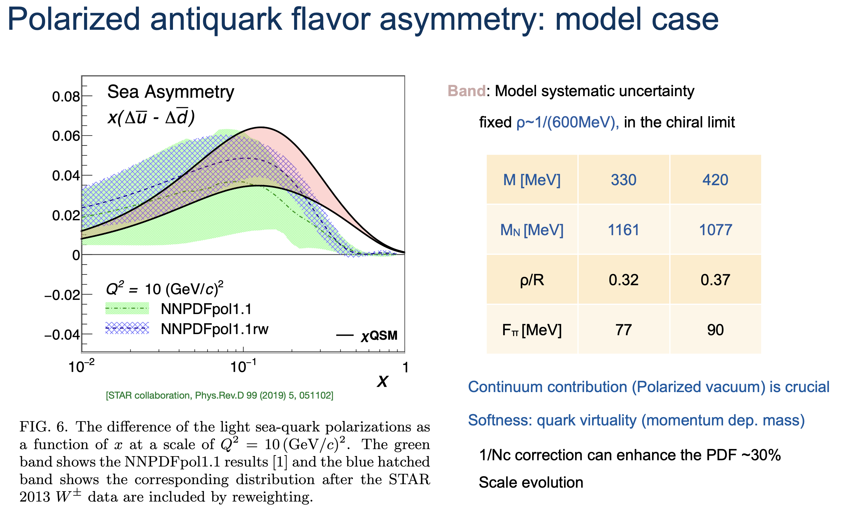

Slide 41
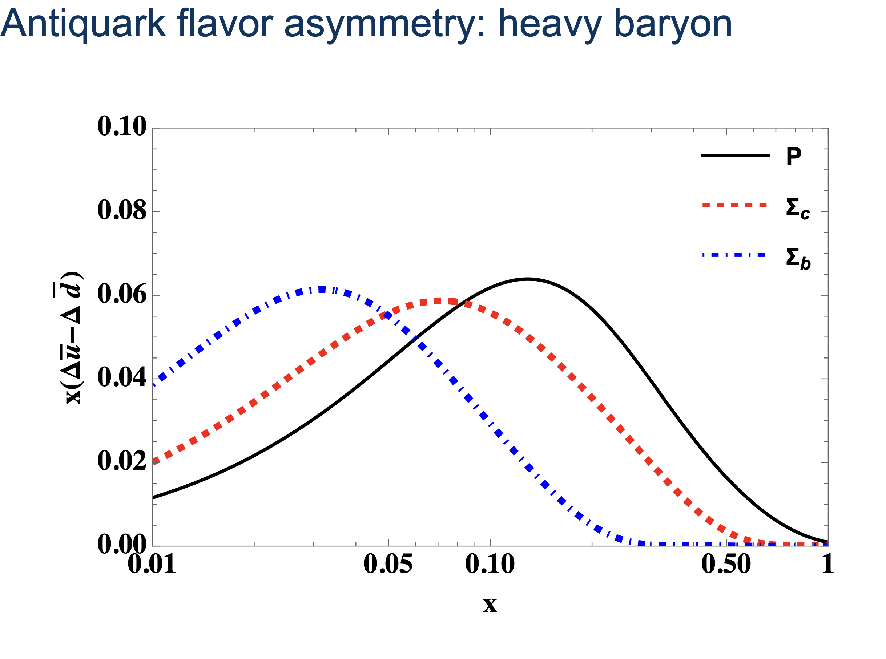
H.D. Son and HChK,
In preparation (2022)

Slide 42
Summary

Slide 43


We introduced a pion mean-field approach, which describe both light and singly heavy baryons on an equal footing.
The quark spin content of the light and singly heavy baryons (low-lying states) were discussed.
Notable finding: All the light quarks inside a singly heavy baryon with spin 3/2 are positively polarized.
We briefly mentioned the light-quark PDFs in a singly heavy baryon.

Slide 44
Though this be madness,
yet there is method in it.
Hamlet Act 2, Scene 2
by Shakespeare
Thanks to my Collaborators!
J.-Y. Kim, H.-D. Son, J.-M. Suh, Gh.-S. Yang
Thank you very much for the attention!

