Slide 1

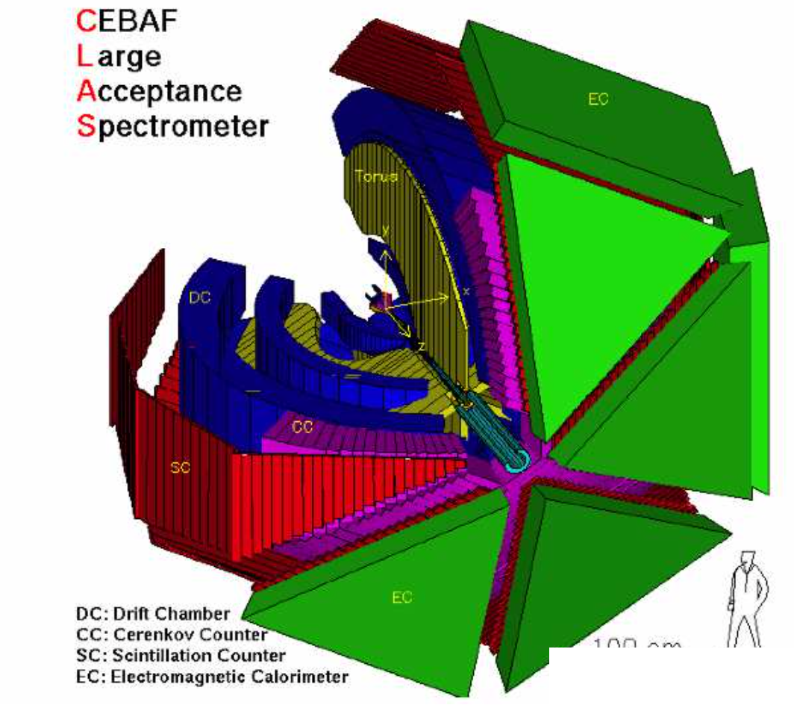



Nucleon Resonance Electrocouplings and Emergence of Hadron Mass
Δ(1600)3/2⁺ electrocouplings:
CLAS preliminary results vs. CSM predictions
Concept on emergence of hadron mass (EHM) from QCD within continuum Schwinger function method (CSM)
EHM manifestation in the structure of the pion and the ground/excited states of the proton
Insight into EHM from the results on γ_{v}pN* electrocouplings determined at Q² < 5 GeV² from CLAS data
Extending insight into EHM from the γ_{v}pN* electrocouplings for Q² up to ~8-10 GeV²
V.I. Mokeev
Jefferson Lab
(CLAS Collaboration)
APCTP Workshop on Nuclear Physics 2022

Slide 2
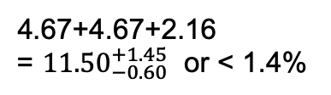
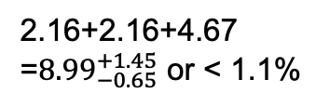
How do the Ground/Excited State Nucleon Masses Emerge?
Composition of the Nucleon Mass:
proton
neutron
M_{p}, MeV (PDG20)
M_{n}, MeV (PDG20)
938.2720813
±0.0000058
939.5654133
±0.0000058
Sum of bare quark
masses, MeV
Sum of bare quark
masses, MeV
2.16+2.16+4.67
=${8.99}_{−0.65}^{+1.45}$ or < 1.1%
4.67+4.67+2.16
= ${11.50}_{−0.60}^{+1.45}$ or < 1.4%
Higgs mechanism generates the masses of bare quarks
Dominant part of nucleon mass is generated in processes other than the Higgs mechanism
The Continuum Schwinger method (CSM) has conclusively demonstrated that the dominant part of hadron mass is generated by the strong interaction in the regime where the QCD running coupling becomes comparable with unity - the so-called strong QCD regime
2

Slide 3
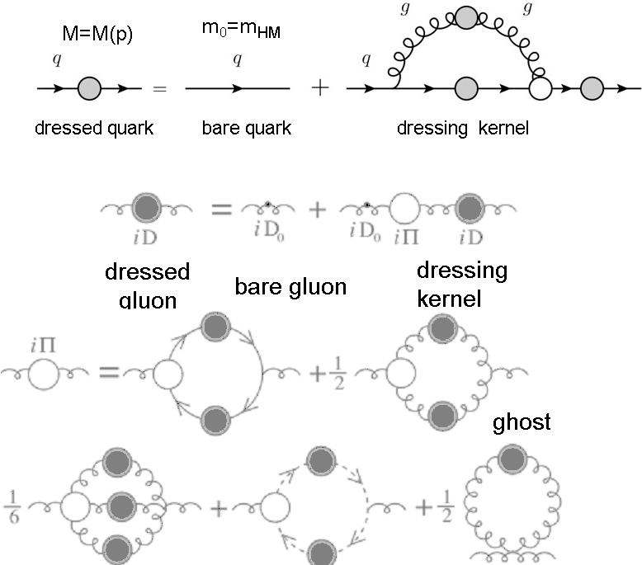
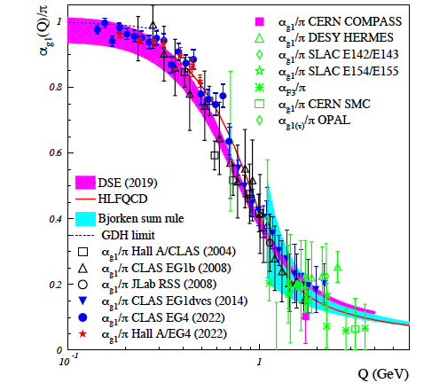
Basics for Insight into EHM: CSM and Lattice QCD Synergy
Emergence of Dressed Quarks and Gluons
D. Binosi et al., Phys. Rev. D 95, 031501 (2017)
QCD Running Coupling α(k)
Zh-F. Cui et al., Chin. Phys. C44, 083102 (2020)
A. Deur et al., Particles 5, 171 (2022)
In the regime of the QCD running coupling comparable with unity, dressed quarks and gluons with distance (momentum) dependent masses emerge from QCD, as follows from the equations of the motion for the QCD fields.

Slide 4
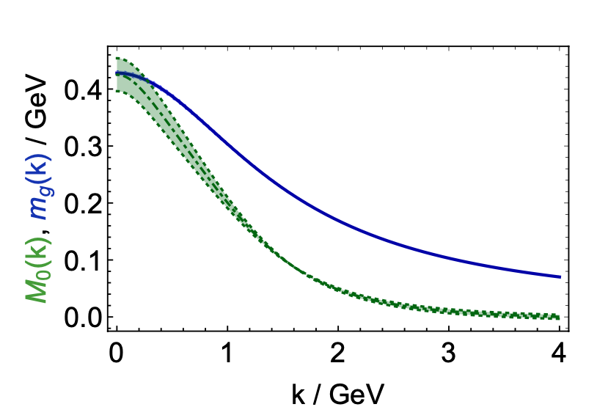
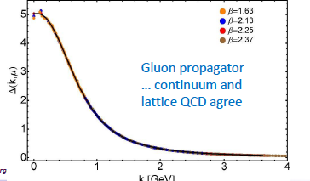
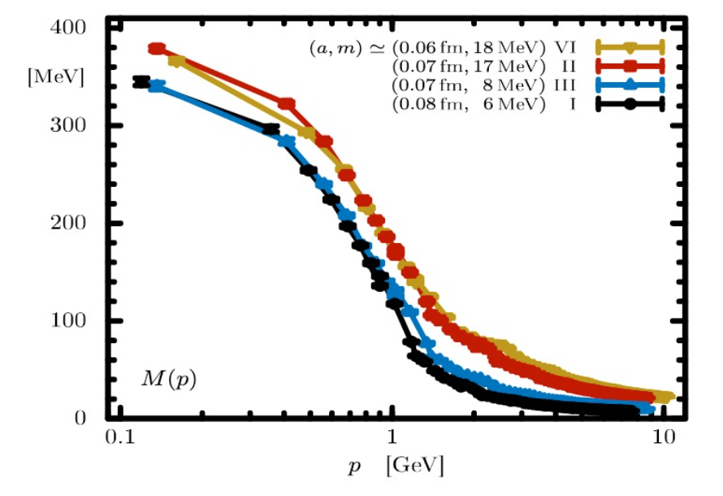
Basics for Insight into EHM: Continuum and Lattice QCD Synergy
Express fundamental feature: emergence of the quark and gluon masses even in the case of massless quarks in the chiral limit and massless QCD gluons
Continuum QCD results are confirmed by LQCD
Insight into EHM from data on hadron structure represents a challenge for experimental hadron physics
Dressed Quark/Gluon Masses (Continuum QCD)
C.D. Roberts, Symmetry 12, 1468 (2020)
Dressed
gluons
Dressed
quarks
Inferred from QCD Lagrangian with only Λ_{QCD} parameter
Dressed Quark Mass (Lattice QCD)
O. Olivera et al., Phys. Rev. D 99, 094506 (2019)
k [GeV]

Slide 5
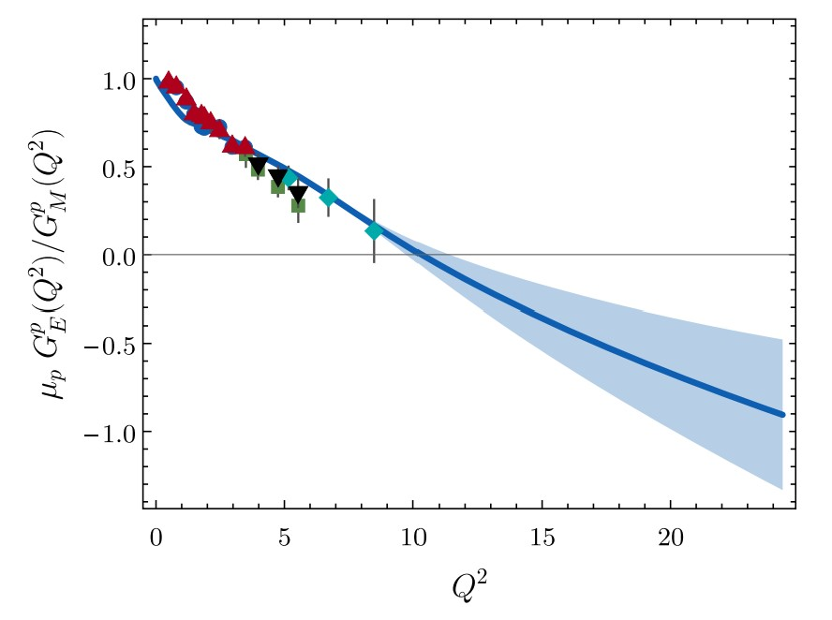
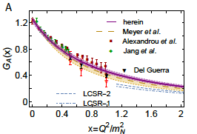
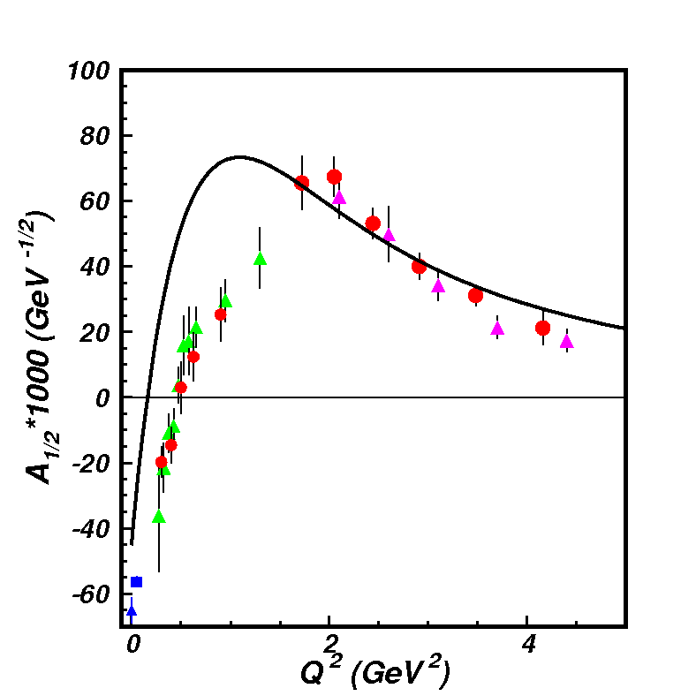
EHM from Global Hadron Structure Analysis
All observables will be extended by the future data from JLab in the 12 GeV era, AMBER@CERN, EIC, EicC
Nucleon Elastic FF
Nucleon Axial FF
γ_{v}pN* Electrocouplings
N(1440)1/2⁺
μ_{p}G_{E}/G_{M} (Q²)
in DSEQCD
Dressed Quark/Gluon
Running Masses
Pion Elastic FF
Pion PDF
Dressed
gluons
Dressed
quarks
CSM has provided predictions on observables that describe the structure of mesons and the ground/excited states of the nucleon by employing the same dressed quark mass function

Slide 6
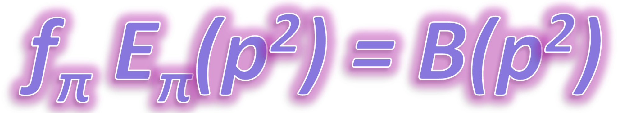
Insight into EHM from Data on Pion/Kaon Structure
The model and renormalization scheme/scale independent Goldberger-Treiman relations connect the momentum dependence of the dressed quark mass to the pion/kaon Bethe-Salpeter amplitudes, making the studies of pion and kaon structure a promising way to map out the momentum dependence of the dressed quark mass.
Pions and kaons are simultaneously q$\overline{\text{q}}$ bound states and Goldstone bosons in chiral symmetry breaking. Their masses should be reduced to zero in the chiral limit and, in the real world, down to small values in comparison with the hadron mass scale owing to DCSB.

Slide 7
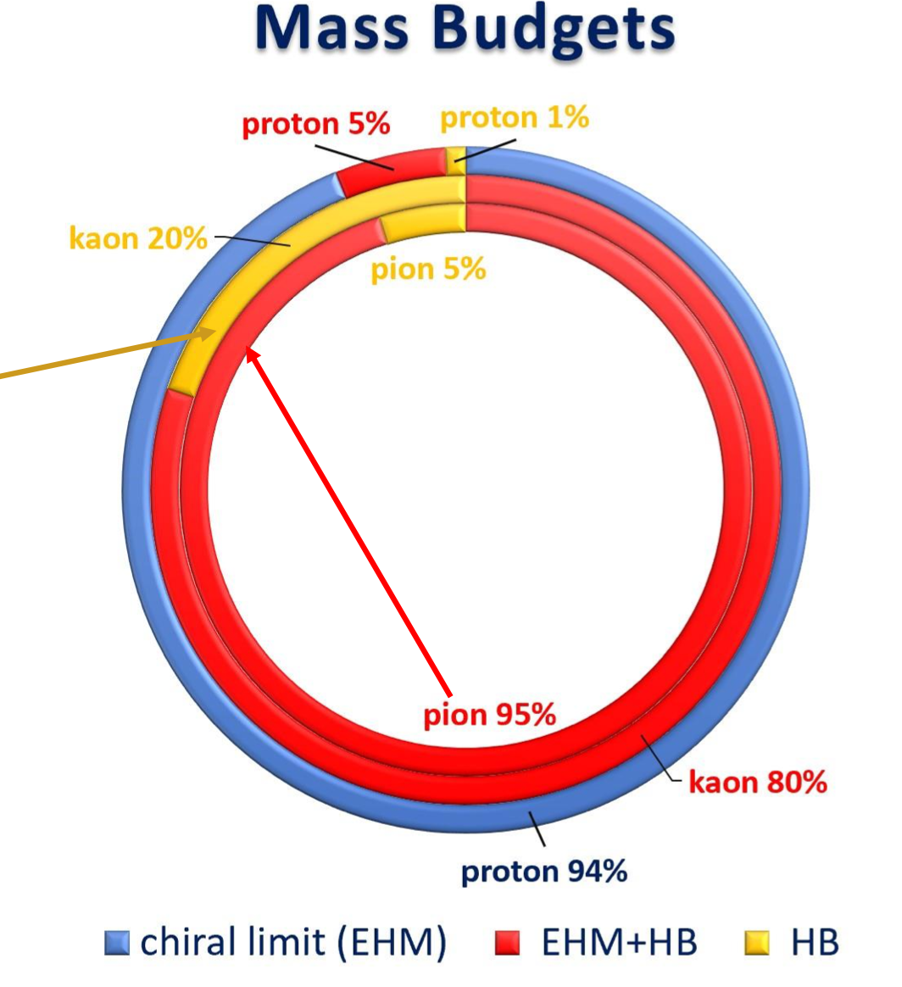
Insight into EHM from the Data on N/N* Structure
Studies of π/K structure elucidate the interference between emergent and Higgs mechanisms in EHM
Studies of ground/excited state nucleon structure allow us to explore the dressed quark mass function in a different environment where the sum of dressed quark masses is the dominant contribution to the physical masses of these states, offering insight into emergent mechanisms
Successful description of the π/K elastic FF and PDF, nucleon elastic/axial FFs, and the γ_{v}pN* electrocouplings of prominent nucleon resonances of different structure achieved with the same dressed quark mass function is of particular importance to validate insight into the momentum dependence of the masses of dressed quarks

Slide 8
N* Photo-/Electroexcitation Amplitudes (γ_{r,v}pN* Photo-/Electrocouplings)
and their Extraction from Exclusive Photo-/Electroproduction Data
Resonant amplitudes
Non-resonant amplitudes
e’
π, η, ππ, KY,…
π, η, ππ, KY,…
γ_{v}
e
*
N*,△
+
N
N’
N
N’
Definition of N* photo-/electrocouplings
employed in CLAS data analyses:
Real A_{1/2}(Q²), A_{3/2}(Q²), S_{1/2}(Q²)
I.G. Aznauryan and V.D. Burkert, Prog. Part. Nucl. Phys. 67, 1 (2012)
  Consistent results on the γ_{r,v}pN* photo-/electrocouplings from different meson photo-/electroproduction channels allow us to validate reliable extraction of these quantities.

Slide 9
Summary of Published CLAS Data on Exclusive Meson Electroproduction off Protons in N* Excitation Region
Hadronic final state | Covered W-range, GeV | Covered Q²-range, GeV² | Measured observables
π⁺n | 1.1-1.38 1.1-1.55 1.1-1.70 1.6-2.00 | 0.16-0.36 0.3-0.6 1.7-4.5 1.8-4.5 | dσ/dΩ dσ/dΩ dσ/dΩ, A_{b} dσ/dΩ
π⁰p | 1.1-1.38 1.1-1.68 1.1-1.39 1.1-1.80 | 0.16-0.36 0.4-1.8 3.0-6.0 0.4-1.0 | dσ/dΩ dσ/dΩ, A_{b}, A_{t}, A_{bt} dσ/dΩ dσ/dΩ
ηp | 1.5-2.3 | 0.2-3.1 | dσ/dΩ
K⁺Λ | thresh-2.6 | 1.40-3.90 0.70-5.40 | dσ/dΩ P⁰, P′
K⁺Σ⁰ | thresh-2.6 | 1.40-3.90 0.70-5.4 | dσ/dΩ P′
π⁺π⁻p | 1.3-1.6 1.4-2.1 1.4-2.0 | 0.2-0.6 0.5-1.5 2.0-5.0 | Nine 1-fold differential cross sections
dσ/dΩ − CM angular distributions
A_{b}, A_{t}, A_{bt} − beam, target, and beam-target spin asymmetries
P⁰, P′ – recoil and transferred polarization of strange baryon
Around 150,000
data points!
Almost full coverage
of the final state hadron phase space
The measured observables from CLAS are stored in the
CLAS Physics Data Base http://clas.sinp.msu.ru/cgi-bin/jlab/db.cgi
Notes:
Исследования процессов электровозбуждения N* во всех эксклюзивных каналах электророждения мезонов в резонансной области стало возможным в экспериментах на детекторе CLAS , где была получена доминирующая чеать результатов по реакциям эксклюзивного электророждения мезонов на нуклонах.

Slide 10
Nucleon Resonance Electrocouplings from Data On Exclusive Meson Electroproduction with CLAS
Exclusive meson electroproduction channels | Excited proton states | Q²-ranges for extracted γ_{v}pN* electrocouplings, GeV²
π⁰p, π⁺n | Δ(1232)3/2⁺ N(1440)1/2⁺,N(1520)3/2⁻, N(1535)1/2⁻ | 0.16-6.0 0.30-4.16
π⁺n | N(1675)5/2⁻, N(1680)5/2⁺ N(1710)1/2⁺ | 1.6-4.5
ηp | N(1535)1/2⁻ | 0.2-2.9
π⁺π⁻p | N(1440)1/2⁺, N(1520)3/2⁻ Δ(1620)1/2⁻, N(1650)1/2⁻, N(1680)5/2⁺, Δ(1700)3/2⁻, N(1720)3/2⁺, N’(1720)3/2⁺ | 0.25-1.50 2.0-5.0 (preliminary) 0.5-1.5
The N* electroexcitation amplitudes (γ_{v}pN* electrocouplings) have become available in a broad range of Q² < 5 GeV²
In the mass range W < 1.6 GeV, the γ_{v}pN* electrocoupling were obtained from independent studies of πN, ηp, and π⁺π⁻p electroproduction
Most recent results can be found in: A.N. Hiller Blin et al, PRC100, 035201 (2019)

Slide 11
Electrocouplings of N(1440)1/2⁺ and N(1520)3/2⁻ Resonances from πN and π⁺π⁻p Electroproduction off Proton Data
pπ⁺π⁻ CLAS
preliminary 2022
A_{1/2}
A_{1/2}
N(1440)1/2⁺
N(1520)3/2⁻
Consistent results on the N(1440)1/2⁺ and N(1520)3/2⁻ electrocouplings from independent studies of the two major πN and π⁺π⁻p electroproduction channels with different non-resonant contributions allow us to evaluate the systematic uncertainties of these quantities in a nearly model-independent way.

Slide 12
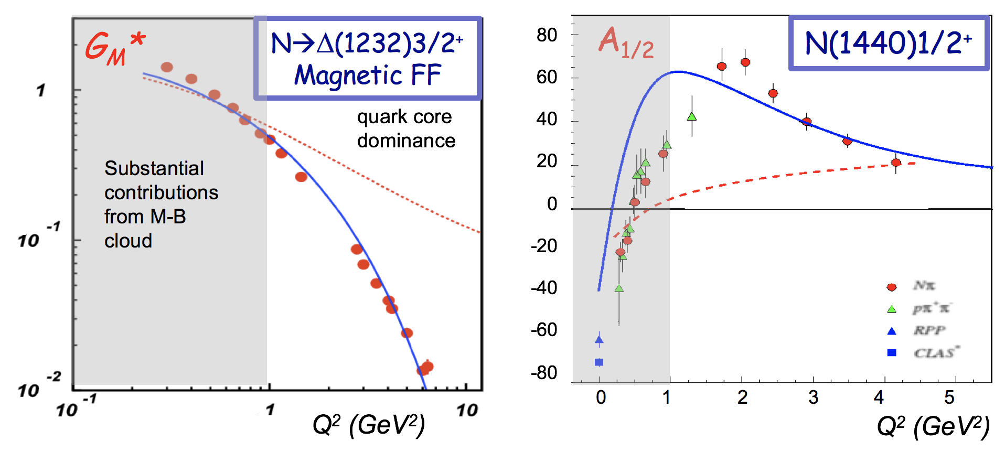
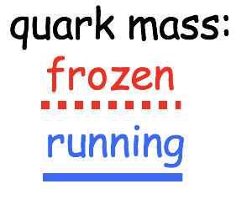
Emergence of Hadron Mass: Concept from CSM vs. Available Experimental Results
CLAS results vs. CSM expectations with running quark mass
J. Segovia, PRL 115, 171801 (2015)
Successful description of the pion and nucleon elastic FFs, and the electrocouplings of the Δ(1232)3/2⁺ and N(1440)1/2⁺ resonances has been achieved with the same dressed quark/gluon mass functions
CSM calculations
confinement regime:
- constituent quark mass
Pion Elastic FF
Nucleon Elastic FF
mass composition
<2% Higgs mechanism
>98% non-perturbative
strong interaction
Q² F_{π} / GeV²
μ_{p}G_{E}^{p}(Q²)/G_{M}^{p}(Q²)
Q² (GeV²)
Q² (GeV²)
Dressed quarks with dynamically generated masses represent active degrees of freedom in the structure of the pion, nucleon, and the Δ(1232)3/2⁺, N(1440)1/2⁺ resonances
Strong evidence for insight into EHM
approaching bare quark Higgs mass
Dressed Quark/Gluon Masses from CSM
C.D. Roberts, Symmetry 12, 1468 (2020)
12
Notes:
- The picture of a quark inside of a hadron is a dynamical picture - what we effectively see depends on the quark momentum - review the picture and the importance of scale
- Model calculations of form factors and electrocouplings are sensitive to the evolution of the dressed quark mass function.
- Review the model calculations
- The data from CLAS12 will cover for the first time the range of Q2 where the dominant part of the hadron mass is generated addressing the key open problems of what is the nature of confinement and how is more than 98% of the visible mass in the Universe generated?

Slide 13
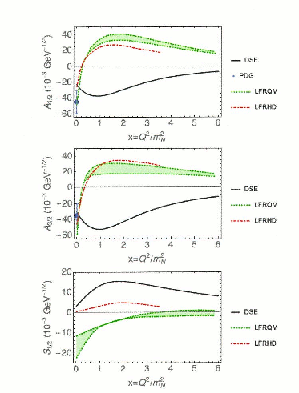
Electrocouplings of the Δ(1600)3/2⁺: CSM Prediction vs. Data Determination
Extraction of Δ(1600)3/2⁺ electrocouplings from the CLAS π⁺π⁻p electroproduction data at 2.0 GeV²<Q²<5.0 GeV² within the JM reaction model, January-March, 2022
Parameter-free CSM predictions for Δ(1600)3/2⁺ electrocouplings
Ya Lu et al., Phys. Rev. D 100, 034001 (2019)
Notes:
Continnum QCD approaches provided parameter free prediction on D(1600)3/2+ electrocopuplings. The CLAS p+p-p electroproduction data at 2.0 < Q < 5.0 GeV2 (current and next slides) are comsistent with the contribution of D(1600)3/2+ resonance with electrocouplings predicted within continuum QCD approach. The extraction of these electrocouplings from the data without any model bias is in progress. If expectations from continuum QCD on electrocouplings of this state will be confirmed, the access to dressed quark mass function from the data on resonance electrocouplings will be fully validated.

Slide 14
Electrocouplings of the Δ(1600)3/2⁺: CSM prediction vs. Data Determination
Preliminary
CSM predictions, Ya Lu et al., Phys. Rev. D 100, 034001 (2019)
Electrocouplings from independent analyses of π+π⁻p differential cross sections within three W-intervals, 1.46<W<1.56 GeV, 1.51<W<1.61 GeV, and 1.56<W<1.66 GeV for 2.0<Q²<5.0 GeV²
CLAS results on Δ(1600)3/2⁺ electrocouplings confirmed the CSM prediction, solidifying evidence for gaining insight into the dressed quark mass function and, consequently, into EHM from the studies of the γ_{v}pN* electrocouplings
14

Slide 15
Toward Exploration of EHM from Orbital Nucleon Excitations
Continuum QCD Breakthrough: N(1535)1/2⁻ electrocouplings computed under a traceable connection to the QCD Lagrangian (green area).
C.D Roberts et al, private communication
The first preliminary continuum QCD evaluation of electro-excitation amplitudes of the [70,1⁻] supermultiplet resonances (L_{3q}=1) with the same dressed quark mass function as used for resonances with L_{3q}=0
lQCD+LCSR
V. Braun et al.
Studies of electroexcitation amplitudes for the resonances in the second region suggest the universality of the dressed quark mass function for the ground and different excited states of the nucleon, including the first spin-isospin flip, the first radial, and the first orbital (L_{3q}=1) excitations.

Slide 16
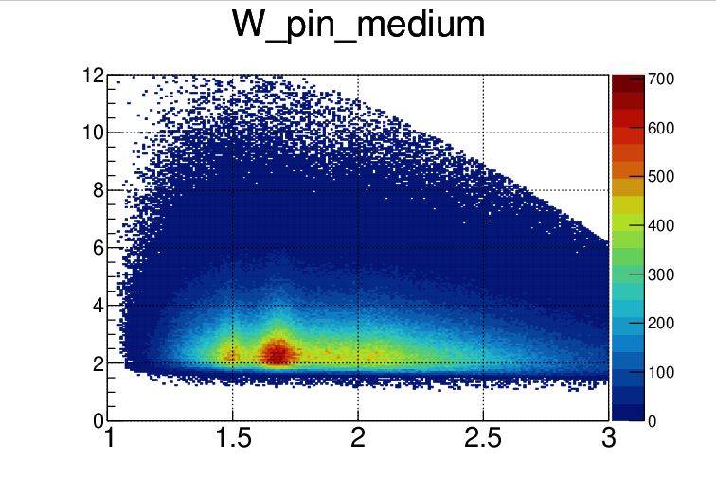
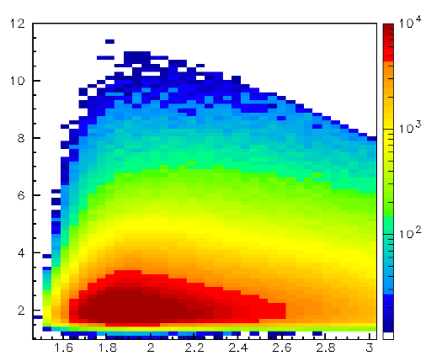
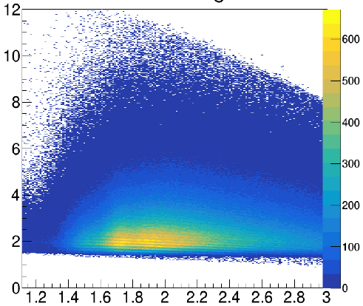
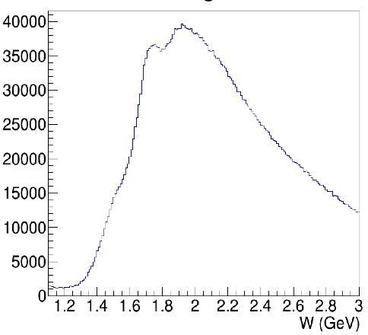
N* Electroexcitation to High Q² with CLAS12
Expected outcome: The first results on the γ_{v}pN* electrocouplings of most N* states from data in the range W < 2.5 GeV and Q² > 5 GeV² for exclusive reaction channels: πN, ππN, KY, K*Y, KY*
kinematic coverage for RG-A data @ 10.6 GeV
π⁺n
K⁺Y
π⁺π⁻p
π⁺π⁻p
Q² (GeV²)
Q² (GeV²)
Q² (GeV²)
resonances?
3rd
resonance
regions
2nd
W (GeV)
W (GeV)
W (GeV)
W (GeV)
Expected events per Q²/W bin for full RG-A dataset
Collecting the remainder of the approved RG-A beam time will give a factor of two more statistics
This will extend the Q² range of the γ_{v}pN* electrocouplings to 8-10 GeV² for each of these channels – the data collected so far will limit us to 6-8 GeV²
π⁺n |  |  | K⁺Λ & K⁺Σ⁰ |  |  |  |  | π⁺π⁻p
Q² [GeV²] | W [GeV] 1.5-1.55 | W [GeV] 1.7-1.75 | Q² [GeV²] | W_{Λ} [GeV] 1.7-1.75 | W_{Σ} [GeV] 1.7-1.75 | W_{Λ} [GeV] 1.9-1.95 | W_{Σ} [GeV] 1.9-1.95 | Q² [GeV²] | W [GeV] 1.7-1.75 | W [GeV] 1.9-1.95
 |  |  | 1.4-2.2 | 63417 | 6012 | 66564 | 33170
 |  |  | 2.2-3.0 | 72144 | 5364 | 77443 | 28720
5.2-5.8 | 15272 | 4175 | 3.0-4.0 | 52358 | 3945 | 51991 | 18936 | 5.2-5.8 | 2813 | 2808
5.8-6.5 | 10737 | 2637 | 4.0-5.0 | 24833 | 3103 | 26690 | 5925 | 5.8-6.5 | 1822 | 1969
6.5-7.2 | 7367 | 1684 | 5.0-6.0 | 11203 | 1598 | 11160 | 2642 | 6.5-7.2 | 1159 | 1294
7.2-8.1 | 4567 | 1290 | 6.0-7.0 | 5566 | 648 | 6300 | 943 | 7.2-8.1 | 661 | 924
8.1-9.1 | 2742 | 540 | 7.0-8.0 | 2606 | 338 | 3276 | 633 | 8.1-9.1 | 364 | 414
9.1-10.5 | 1453 | 194 | 8.0-9.0 | 1440 | 244 | 936 | 86 | 9.1-10.5 | 118 | 179
16

Slide 17
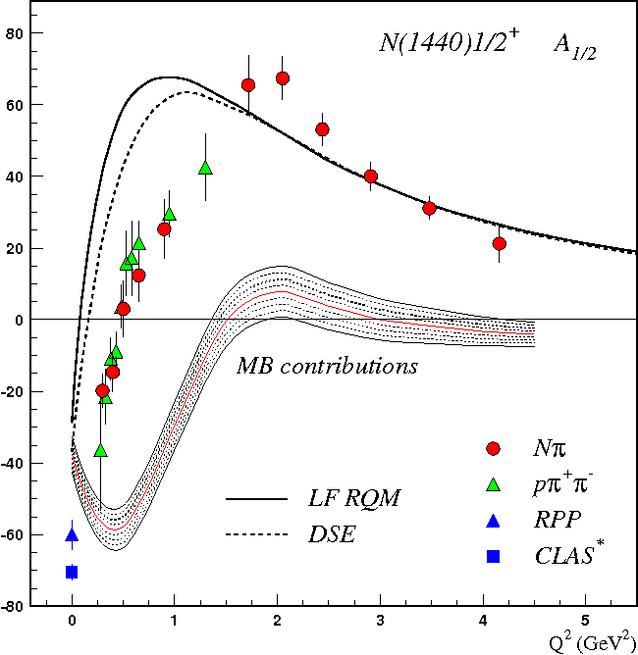
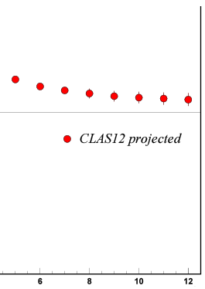
Emergence of Hadron Mass from N* Studies with the CLAS12
N* electroexcitation studies at JLab during 12 GeV era will address the critical questions:
How is >98% of visible mass generated?
How EHM is related to Dynamical Chiral Symmetry Breaking?
(S.J, Brodsky et al., Int. J. Mod. Phys. Rev. E29, 2030006 (2020))
Mapping-out the dressed quark mass function from the γ_{v}pN* electrocouplings of different spin-isospin flip, radial, and orbital excited nucleon states at 5<Q²<12 GeV² will increase knowledge on EHM and motivate efforts to extend these studies for Q² up to 35 GeV² to explore the full range of distances (quark momenta) where the dominant part of hadron mass is expected to be generated
//
N(1440)1/2⁺
Continuum Schwinger Method
A_{1/2} (GeV^{-1/2}) *1000
Mass (GeV)
Dressed quarks
Dressed gluons
CLAS24
CLAS12
CLAS
//
Q² (GeV²)
Momentum, p (GeV)
CLAS results vs. theory expectations with running quark mass
17

Slide 18
Conclusions and Outlook
CSM paradigm for EHM makes a broad array of predictions. Those for N* structure in terms of the Q²-evolution of the γ_{v}pN* electrocouplings are worth testing by confronting the CSM predictions against the experimental results determined from exclusive meson electroproduction data.
CLAS has provided the dominant part of the world data on most exclusive meson electroproduction channels in the resonance region, allowing us to determine the electrocouplings of most resonances in the mass range up to 1.8 GeV for Q² < 5 GeV².
A good description of the Δ(1232)3/2⁺ and N(1440)1/2⁺ electroexcitation amplitudes achieved within CSM approach starting from the QCD Lagrangian with the same dressed quark mass function as used in the successful evaluations of the ground state nucleon EM/axial and pion form factors, and the pion PDF, has demonstrated the capability for gaining insight into EHM.
The CSM parameter-free predictions on the Δ(1600)3/2⁺ have been confirmed by the first (and still preliminary) results on the electrocouplings of this state obtained from π⁺π⁻p electroproduction data, solidifying evidence for gaining insight into the dressed quark mass function within the range of quark momenta up to 0.7 GeV, where ~15% of hadron masses emerges from QCD.
CLAS12 is the only world facility capable of obtaining the electrocouplings of all prominent N* states in the range of Q² up to 10 GeV², allowing us to explore the dressed quark mass function in the range of quark momenta up to 1.3 GeV, where ~50% of hadron mass emerges from QCD.
Confirmation of the CSM predictions on the Q²-evolution of the γ_{v}pN* electrocouplings of nucleon resonances of different structure obtained with the same dressed quark mass function by the results determined from CLAS/CLAS12 experimental data within the range of Q² up to 10 GeV² will allow us to address the most challenging problems of the Standard Model on the nature of hadron mass and the emergence of the N* structure from QCD.
18

Slide 19
Back up

Slide 20
Basics for Insight into EHM: Continuum and Lattice QCD Synergy
Dressed Quark/Gluon Masses (continuum QCD)
C.D. Roberts, Symmetry 12, 1468 (2020)
Dressed quark/gluon masses converge at the complete QCD mass scale of 0.43(1) GeV - value impacted by Higgs mechanism
Express the fundamental feature: emergence of the quark and gluon masses even in the case of massless quarks in the chiral limit and massless QCD gluons
Continuum QCD results get support from LQCD
Insight into dressed quark mass function from data on hadron structure represents a challenge for experimental hadron physics
Dressed
gluons
Dressed
quarks
Inferred from QCD Lagrangian with only Λ_{QCD} parameter
Dressed Quark Mass (lattice QCD)
O. Olivera et al., Phys. Rev. D 99, 094506 (2019)

Slide 21
Insight into EHM from the Data on N/N* Structure
Studies of the ground and excited state nucleon structure allow us to explore the dressed quark mass function in a different environment where the sum of dressed quark masses is the dominant contribution into the physical masses of the ground and excited states of the nucleon
Consistent results on the momentum dependence of the dressed quark mass function from independent studies of the pseudo-scalar mesons and the ground and excited state nucleon structure are of particular importance for the validation of insight into EHM.

Slide 22


Insight to EHM From Resonance Electrocouplings
Dyson-Schwinger Equations (DSE):
J. Segovia et al., PRL 115, 171801 (2015)
J. Segovia et al., Few Body Syst. 55, 1185 (2014)
N→Δ(1232)3/2⁺ magnetic from factor
Jones-Scadron convention
Substantial
contributions
from meson-
baryon cloud
Quark core
dominance
Substantial
contributions
from meson-
baryon cloud
quark mass:
frozen
running
Good data description at Q²>2.0 GeV² achieved with the same dressed quark mass function for the ground pion/nucleon and two excited nucleon states of distinctively different structure validates the continuum QCD results on the momentum dependence of the dressed quark mass. γ_{v}pN* electrocoupling data shed light on the strong QCD dynamics underlying hadron mass generation.
One of the most important achievements in hadron physics of the last decade in synergistic efforts between experimentalists, phenomenologists, and theorists.
Notes:
The experimental results from CLAS on electrocouplings of low-lying resonances have a profound impact on the development of the continuum QCD approaches which are capable to relate the phenomenological information on Q2-evolution of the resonance electrocouplings to the momentum dependence of dressed quark mass M(p). For the first time elecrocouplings of D(1323)3/2+ amd N(1440)1/2+ resonances were successfully described at Q2>2.0 GeV2 within continuum QCD approaches under a traceble connection to the QCD Lagrangian. Studies of the nucleon resonances with CLAS demonstrated that their structure is coming from a complex interplay between inner core of three constituent quarks and the external meson-baryon cloud. Currently, the continuum QCD approaches account for the contributions from quark core only. Therefore they can be directly confronted to the data only at higher enough Q2 where the contributions from quark core become the biggest.
The leading p→D megnetic transition form factor (left plot) was computed within continuum QCD within two ansatz for qq-interaction. In the first exploratory evaluations the simplifies contact qq-interaction was used. This interaction results in frozen momentum independent dressed quark mass, however account for the generation of 360 MeV quark mass in the dressing processes. The transition N-→D magnetic form factors computed with frozen quark mass is shown in magenta on the left plot. The computation overestimate the data at Q2>1.0 GeV2. The discrepancies between the data and computations increases with Q2. Eventually, contact ansatz for qq interaction has been replaced by the most advances ansatz inferred from the QCD Lagrangian within the continuum QCD approach. This advanced ansatz results in the momentum dependent mass of dressed quark. The N-→D magnetic form factor computed with running quark mass is shown in the left plot in blue. Use of running quark mass allow us to reproduce the CLAS data in entire range of Q2>0.8 GeV2. Analysis of the CLAS results wqithin the continuum QCD approaches conclusively demonstrated that dressed quark mass function is in fact running.
Remarkably, a successful description of Roper resonance electrocouplings (right part) has been achieved with exactly the same dressed quark mass function M(p) as used previously for a successful description of the pion, nucleon elastic form factor and D(1322)3/2+ electroexcitation amplitude. The structure of D(1323)3/2+ and N(1440)1/2+ resonances are completely different. The D(1232)3/2+ state represents the spin-isospin fl;ip for three quarks in the ground nucleons, while N(1440)1/2+ state is the first radial excitation of three dressed quarks. Consistent results on the dressed quark mass function from independent studies of pion/nucleon elastic amplitudes and from the electroexcitation amplitudes for the resonances of distinctively different structure strongly suggest the relevance of dressed quark with running mass computed within comtinuus QCD approaches as active degrees of freeom in the structure of pion, ground, and excited nucleon states. This success also demonstrated the capability to map out the momentum dependence of dressed qirak mass from the experimental resultson nucleon elastic form factors and the nucleon resonance electroexcitation amplitudes

Slide 23
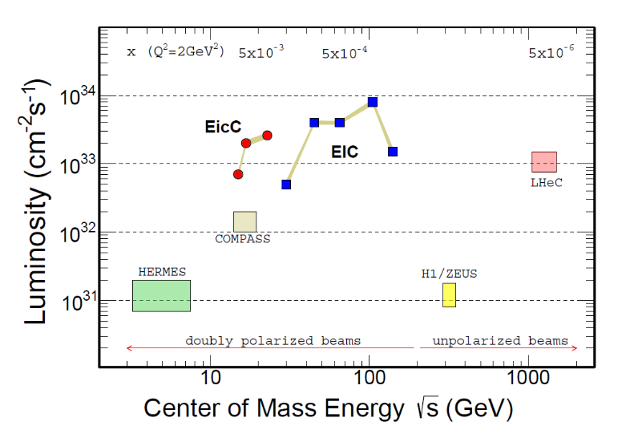
Studies of γ_{v}pN* Electrocouplings at Q² > 10 GeV²
Energy and luminosity increase up to >10³⁶ cm⁻²s⁻¹ are needed in order to obtain information on the γ_{v}pN* electrocouplings at Q²>10 GeV², allowing us to map out the momentum dependence of the dressed quark mass within the entire range of distances where the dominant part of hadron mass is generated
Both EicC and EIC would need much higher, unlikely feasible luminosity
The exclusive electroproduction
measurements foreseen at JLab after
completion of the 12 GeV program:
Beam energy at fixed target: 24 GeV
Nearly 4π coverage
High luminosity
Offer maximal achievable luminosity for extraction of γ_{v}pN* electrocouplings at Q²>10 GeV²
24

