Slide 1
Nucleon Resonances/ Pentaquark States in J/ψ Photo-production
T.-S. Harry Lee
Argonne National Laboratory

Slide 2
To understand the N*/Pentaquark states (P_{c}) of LHCb ,
it is necessary to :
confirm it by other reactions
determine J/ψ-nucleon interactions to know
the structure of P_{c}
Simplest way: Investigate ϒ + N → J/ψ +N
Determined J/ψ-N potential is needed to
c
Test J/ψ-N potential extracted from LQCD
Predict nuclei with hidden charms
Investigate gluonic distributions in nuclei
Investigate the structure of P_{c} of LHCb

Slide 3
Models of J/ψ photo-production on the nucleon
Pomeron-exchange (Donnachie and Landshoff)
Pomeron-exchange + J/ψ-N potential from LQCD
Dynamical Model:
Pomeron-exchange , J/ψ-N potential from LQCD,
Constituent Quark Model, N* excitation
4. Models based on Perturbative QCD
a. Two- and three-gluon exchange model
b. Two-gluon exchange and GPD
5. Holographic model

Slide 4
Pomeron-exchange Model
Leading gluon-exchange mechanism in QCD
Regge Phenomenology
Pomeron-photon analogy
VMD (Vector Meson Dominance)
Pomeron-exchange Model
of Donnachie and Landshoff

Slide 5
Pomeron-exchange Model
3β F (t)
u/d
1
VMD
ϒ
e.m. form factor
J/ψ
J/ψ
Pomeron
Factorization approximation
p
p
β
Pomeron-photon analogy:
u/d
ϒ
μ

Slide 6
pom
Factorization approximation
Define s- and t-dependence
Donnachie-Landshoff model had also been
Used to fit ρ, φ, J/ψ,ϓ( y(1s)) photo-production

Slide 7
Pomeron-Exchange Model (fits by Wu and Lee, 2013)
Total cross sections (ϒ + p → V + p)
dσ/dt (ϒ + p → J/ψ + p)

Slide 8
Parameters: Pomeron-quark coupling constants : β(u/d), β (c)
J/ψ E.M. form factor :
F (t)
Disagree with JLab data
J/ψ
α
α
+
t
Pomeron trajectory:
(s)
0 1

Slide 9
Next steps:
Extend Pomeron-exchange model to include
additional mechanisms which are important
at low energies and negligible at high energies
include multi-gluon exchange J/ψ-N potential
extracted from LQCD
Valid for scattering at low energy
N and J/ψ are at rest

Slide 10
Amplitude from VMD+ V(LQCD)
V (r ) =
α exp(-βr)/r
J/ψ-N
VMD
ϒ
J/ψ
J/ψ
multi correlated gluon (LQCD)
p
p
T (E) = V + V G(E) T (E)
Lippmann-Schwinger Equation
J/ψ-N
J/ψ-N
J/ψ-N
J/ψ-N

Slide 11
Pomeron-exchange + V(LQCD)
From LQCD

Slide 12
Pomeron + V(LQCD)
Off-mass-shell factor
0.4 -0.7

Slide 13
Off-mass-shell factor for VMD :
0.4 - 0.7 to fit Jlab data
2
9.6 GeV
2
2
1/f is determined by J/ψ -> ϒ (Q = m ) -> e+ e-
J/ψ
J/ψ
2
ϒ (Q = 0 ) + N -> J/ψ + N
2
1/f
1/f F (Q = 0 )
J/ψ
J/ψ
J/ψ
Off-mass-shell factor

Slide 14
Pomeron-exchange + V(LQCD)
can fit the data only with off-mass-shell factor
Need to remove VMD assumption
and evaluate quark-loop explicitly to
test LQCD results
Dynamical Model

Slide 15

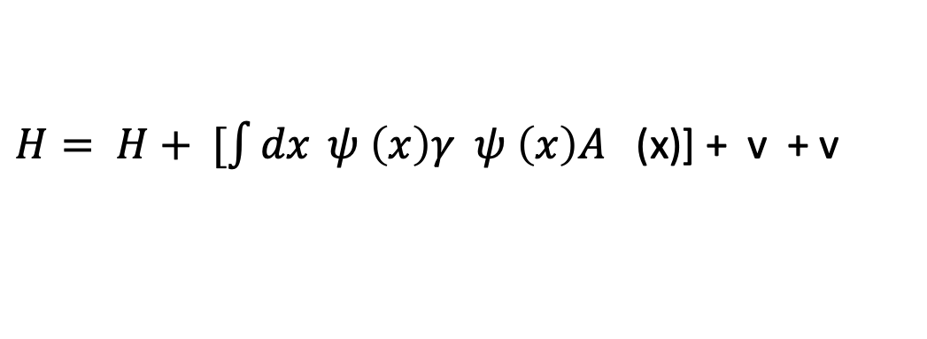
Possibilities for loop-integration :
Constituent Quark model (CQM)
Covariant models :
* based on Dyson-Schwinger Equations
* others
This talk
$$Υ→c\overline{c}$$
μ
$H= H+ [\int{dx} ψ \left(x\right)γ ψ \left(x\right)A$ (x)] + v + v
0
c
c
μ
cc
c-N
Quark-quark potential from CQM
Quark-Nucleon Potential

Slide 16
Steps :
1. Determine J/ψ wavefunction by solving
(H + V ) |φ > = m |φ >
[σ r + …] Cornell Potential or others
b. Fit the decay width of J/ψ → e⁺ e⁻
0
cc
J/ψ
J/ψ
J/ψ
This talk
c
e
+
ϒ
2
2
J/ψ
φ (k)=N Exp(- k /b )
c
J/ψ
-
e

Slide 17
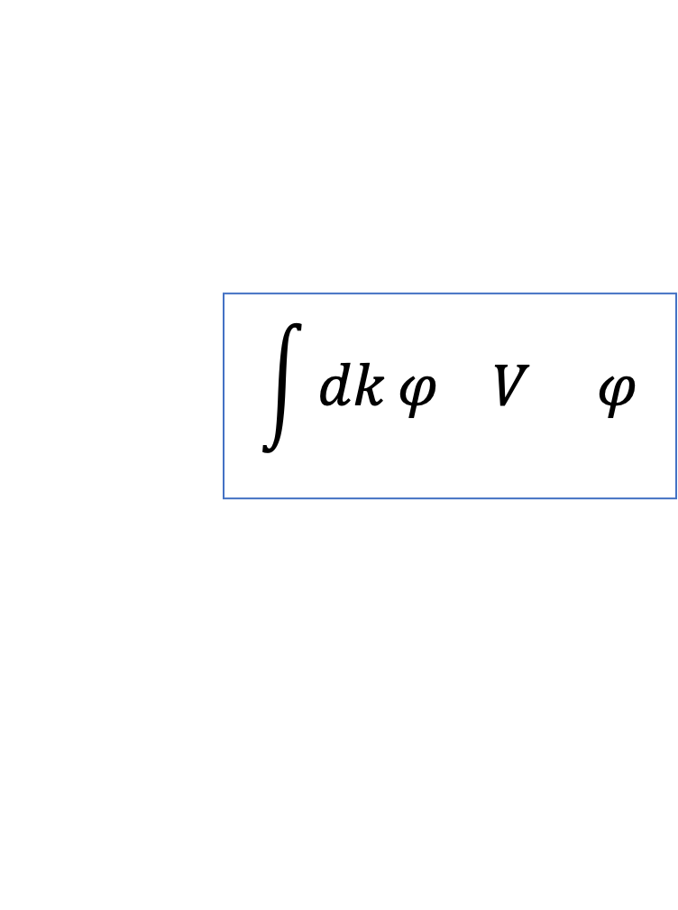
2. Define J/ψ- N potential from c-quark-N interaction
J/ψ
J/ψ
c
LQCD
v
c-N
N
N
$$\int{dk}φ V φ$$
V (Folding model)
J/ψ N, J/ψ NN
J/ψ
c-N
J/ψ

Slide 18
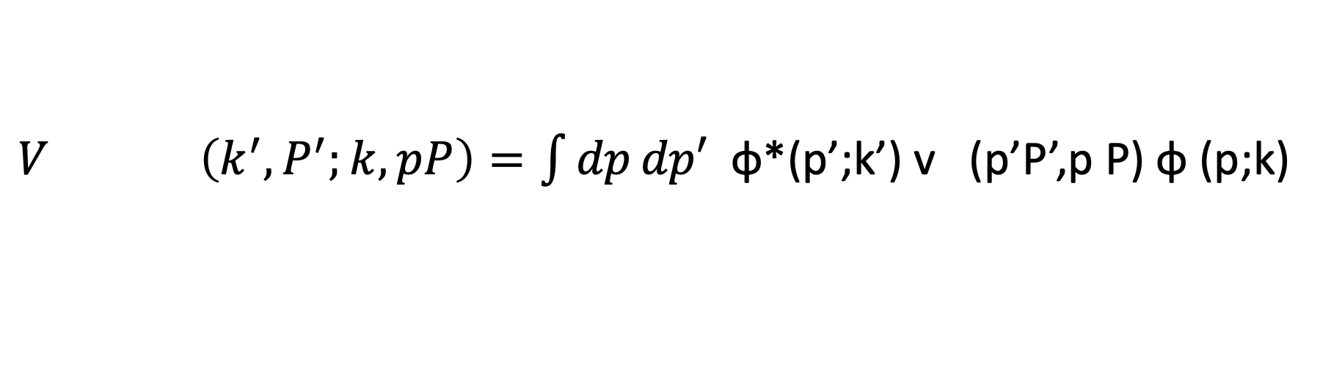
Folding model of J/ψ-N potential
$V \left(k^{′},P^{′};k,pP\right)=\int{dp}dp′$ φ*(p’;k’) v (p’P’,p P) φ (p;k)
J/ψ N, J/ψ N
c
C,N
c
Quark wavefunction in J/ψ

Slide 19
3. Calculation of photo-production by loop-integration
over v and J/ψ wave function
C-N
c
J/ψ
ϒ
c
N
N
v
c-N

Slide 20
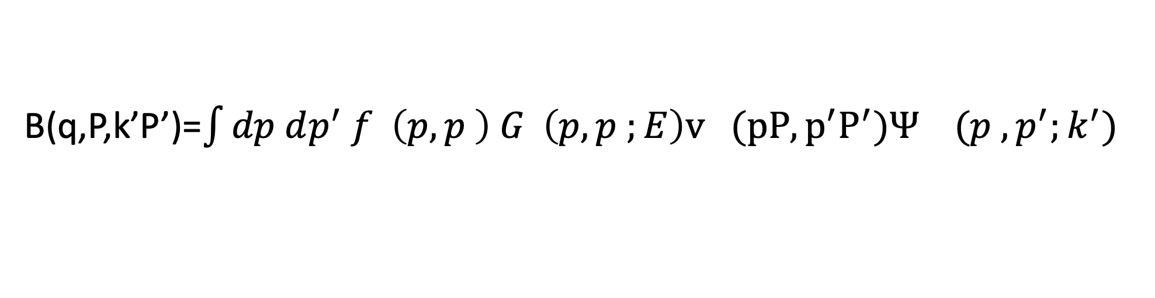
Calculate photo-production by loop-integration :
B(q,P,k’P’)=$\int{dp dp^{′} f \left(p,p \right) G \left(p,p ;E\right)v (pP,p^{′}P^{′})Ψ (p ,p^{′};k^{′}) }$
ϒ,cc
s
cc
s
c-N
J/ψ
s
ϒ-> cc
C-N
Propagator in the cc-loop

Slide 21
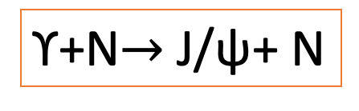
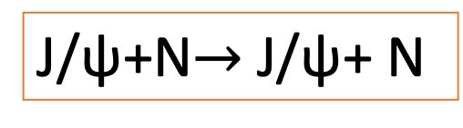
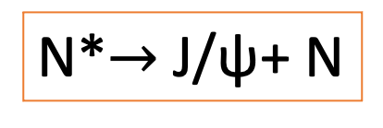
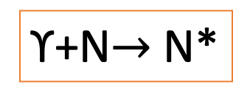
Hamiltonian for reaction calculation including N*
Follow ANL-Osaka approach
H = H + B + V + Γ + Γ
0
ϒ N, J/ψN
J/ψ N, J/ψ N
N*, ϒ N
N*, J/ψ N
ϒ+N$→$J/ψ+ N
ϒ+N$→$N*
N*$→$J/ψ+ N
J/ψ+N$→$J/ψ+ N

Slide 22
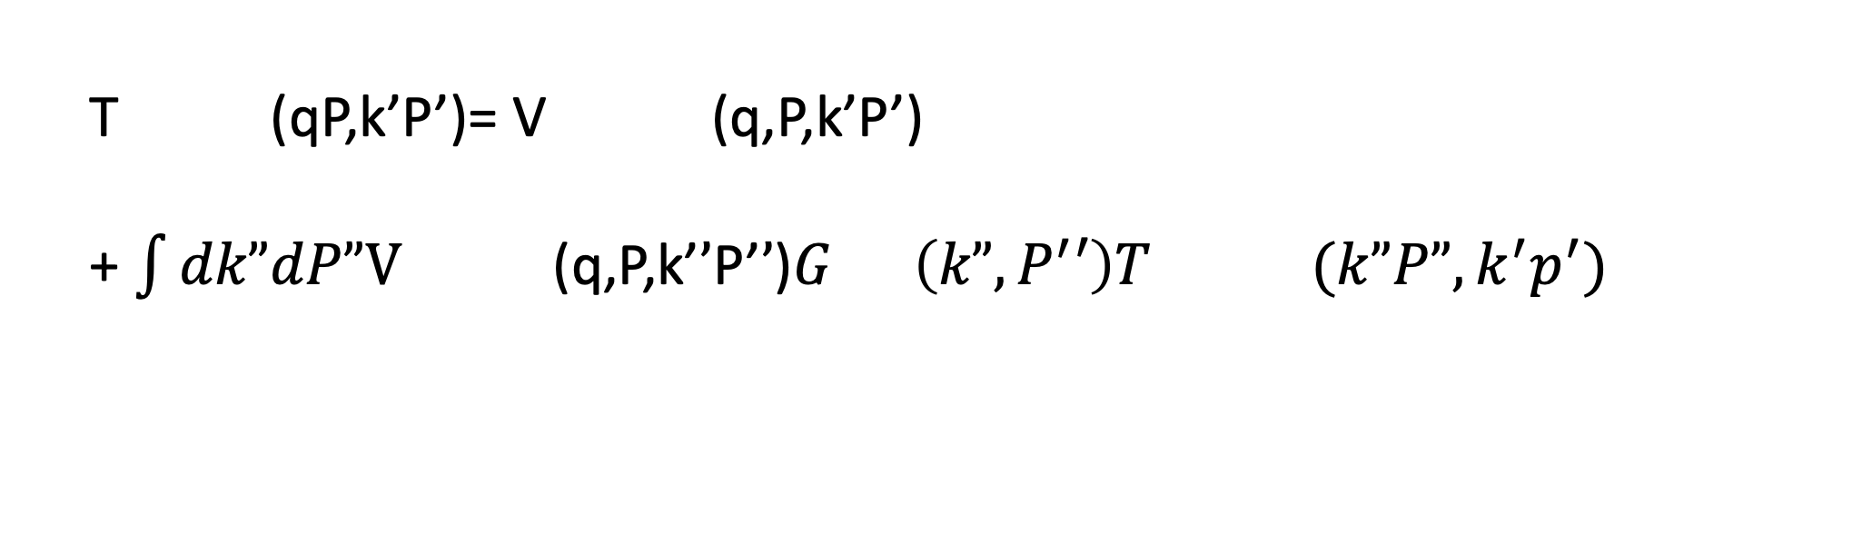
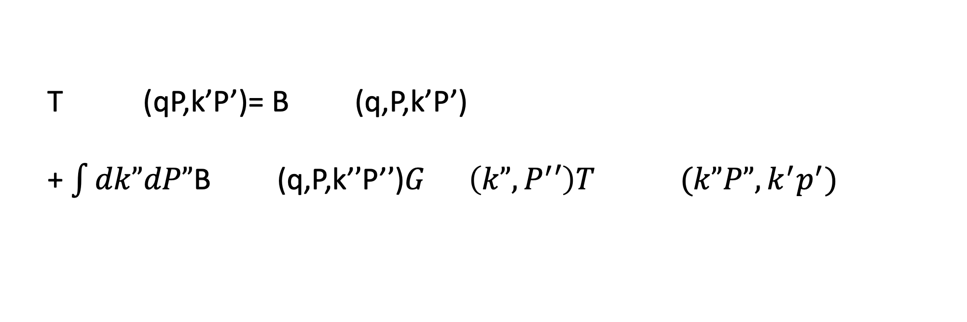
T (qP,k’P’)= T (q,P,k’P’) +T (q,P,k’P’)
Total J/ψ photo-production reaction amplitude
bg
N*
T (qP,k’P’)= B (q,P,k’P’)
+ $\int{dk”dP”\text{B} \text{(}\text{q}\text{,}\text{P}\text{,}\text{k}\text{’}’\text{P}\text{’}’\text{)}G \left(k”,P^{′}′\right)T (k”P”,k^{′}p^{′}) }$
ϒ N, J/ψ N
ϒ N, J/ψ N
ϒ N, J/ψ N
bg
ϒN,J/ψ N
ϒN,J/ψ N
ϒN,J/ψ N
J/ψ N
J/ψN,J/ψ N
T (qP,k’P’)= V (q,P,k’P’)
+ $\int{dk”dP”\text{V} \text{(}\text{q}\text{,}\text{P}\text{,}\text{k}\text{’}’\text{P}\text{’}’\text{)}G \left(k”,P^{′}′\right)T (k”P”,k^{′}p^{′}) }$
Final state interaction
J/ψN,J/ψ N
J/ψN,J/ψ N
J/ψN,J/ψ N
J/ψ N
J/ψN,J/ψ N

Slide 23
Final state interaction (FSI)
c
c
J/ψ
ϒ
c
c
N
N
v
C-N

Slide 24
Best fit to Jlab data:
α= -0.25, β=0.3 GeV
V(c-N) = α exp(- βr)/r
Pomeron+CQM

Slide 25
Pomeron+CQM

Slide 26
Next steps:
Use realistic J/ψ wavefunction of constituent quark model which fits spectrum and J/ψ → e⁺ e⁻ decay width
Need better LQCD calculations
3. Consider different parametrization of J/ψ-N potential

Slide 27
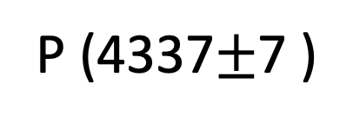


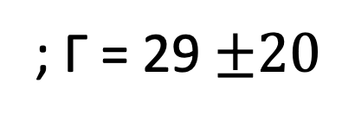
N* excitation in J/ψ photo-production reaction amplitude
T (qP,k’P’)= T (q,P,k’P’) +T (q,P,k’P’)
bg
N*
ϒ N, J/ψ N
ϒ N, J/ψ N
ϒ N, J/ψ N
Pomeron-exchange + V(LQCD)
or
Dynamical model
ϒ
J/ψ
N
N
LHCb (Aug, 2021) :
P (4337$±$7 )
; Γ = 29 $±20$
c
Not determined
π
$$±$$
$$±$$
J = 1/2, , 3/2

Slide 28
1
N*
F
T (q,P,k’P’) =
F
ϓ N , J/ψ N
ϒ N, N*
W - M* -Σ (W)
N*,J/ψ N
0
J
Helicity amplitude A
λ
Determined by Γ
N*→J/ψ N
1
Narrow width
W - M* + iΓ (W) /2
tot
Assume : M*=4337 MeV,
Γ = 29 MeV
Γ = Γ
ANL-Osaka’s parametrizations
of the W-dependence
including J/ψ- N FSI
tot
N*→J/ψ N
tot

Slide 29
Effect of N*: P (1/2+, 4.337 GeV) of LHCb
c
J
ϒ+N ->N* helicity amplitude A is the only parameter
λ

Slide 30
T(b.g.):2g+3g
T(b.g.): Pomeron+ V(LQCD)

Slide 31
Pc(1/2+,4.337 GeV)
Pc(3/2+, 4.337 GeV)

Slide 32
Necessary Improvements:
coupled-channel effects
include πN, ρN, X(multi-π )N (Wu, Lee, 2011)
2. Consider the structure of P_{c}(4338)
a. Pentaquark states
b. Meson-baryon molecular states
c. Hybrid states (like Δ(1232))

Slide 33
B. Other approaches
Based on PQCD
Two-gluon exchange and n=0 term of moment expansion of GPD of the nucleon
(Guo, Ji, and Liu, 2021)
Two-gluon and three-gluon exchange and parton distribution f(x) (Brodsky et al 2001)
2. Holographic model
(Mamo and Zahed, 2021)

Slide 34
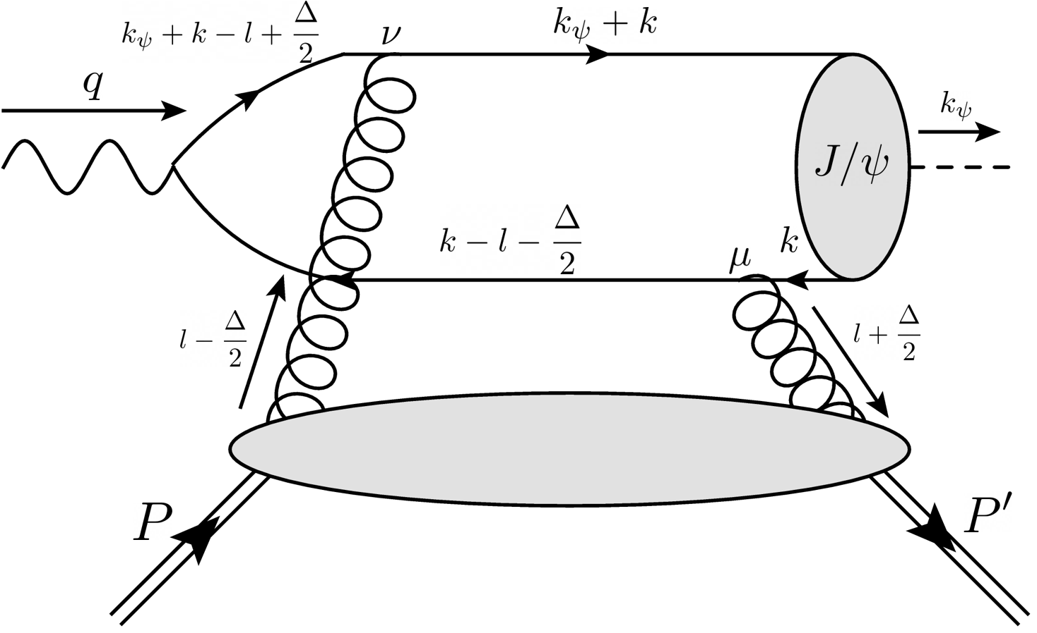

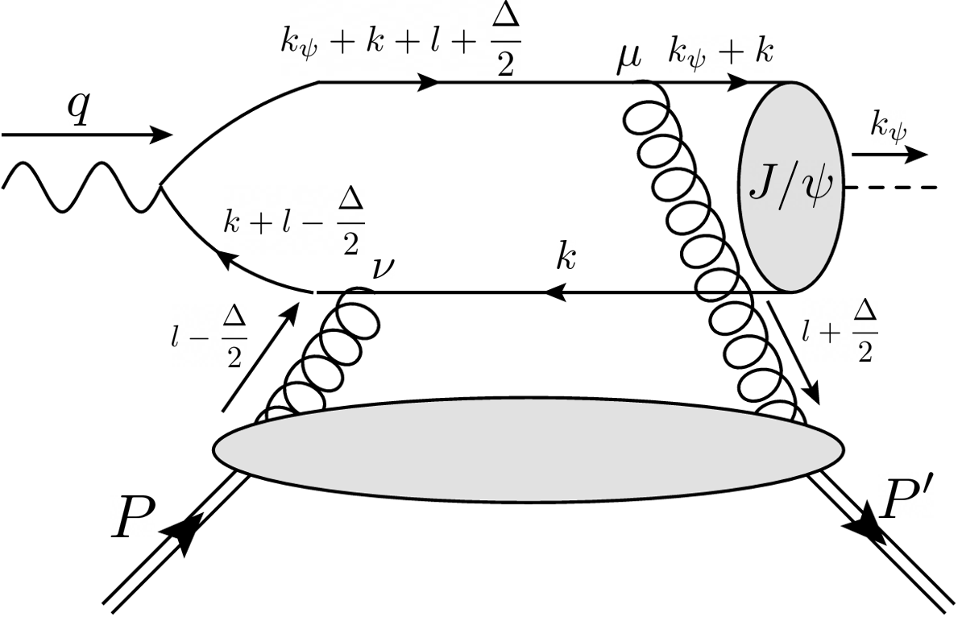
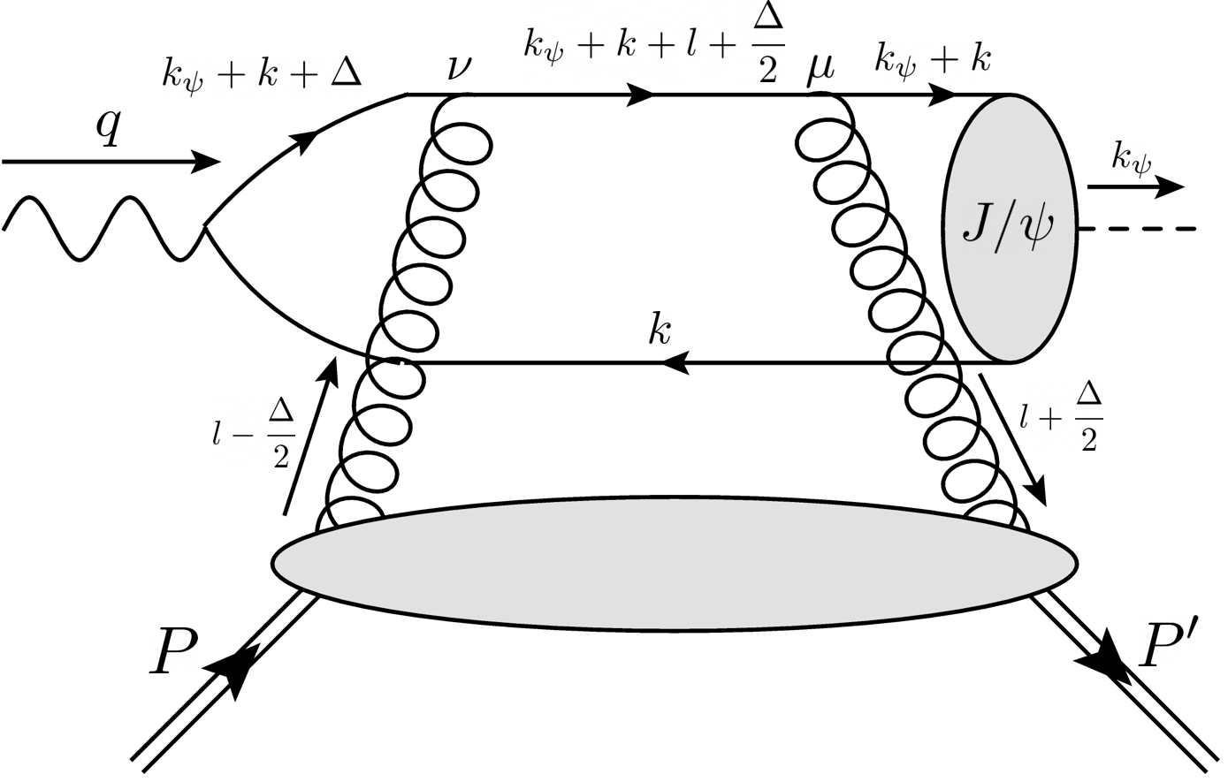
Two-Gluon Exchange Model with GPD
( Y. Guo, X. Ji, Y. Liu, Phys. Rev. D 103 (2021))
ϒ
J/ψ
μ
ν
GPD: < P’ |A (-L-Δ/2) A (L-Δ/2)| P>

Slide 35
Amplitudes
GPD
Momentum-transfer:
BS wavefunction
Quark propagator

Slide 36
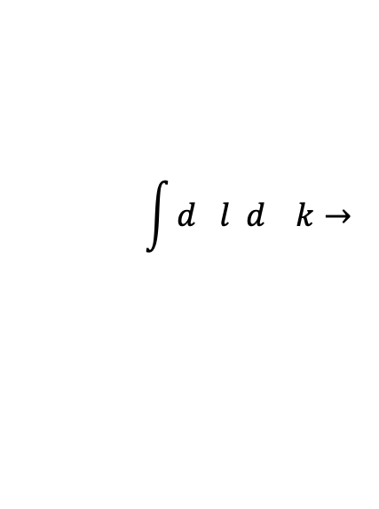
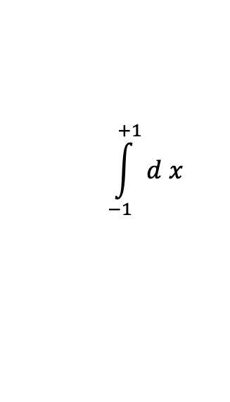
Approximations (valid near threshold for heavy quark systems):
Non-relativistic wavefunction at r=0
+
Keep only transverse part of gluon gauge potential in light-cone gauge A = 0
Simplify loop-integration
+
Factorization of k-integral
set
$$\int{d l d k→ }$$
$$\int_{−1}^{+1}{d x}$$
4
4
only n=0 term of moment expansion of GPD

Slide 37
Non-relativistic wavefunction at r=0
GPD

Slide 38


LQCD :
m = 1.13 GeV, m =0.48 GeV, A (0)=0.58. C (0)=-1.0
A
c
g
g
Best fit:
1.64$±0.11$
$−0.84±$0.82

Slide 39
PQCD: two-gluon-exchange
keep n=0 of Moment Expansion of GPD

Slide 40
2g+3g Model
(S.J. Brodsky et al., Phys. Lett B498, 23 (2001))
ϒ -> cc
cc scattered from N by gluon-exchange with
valence quarks in N
Near threshold , probe x →1 quark configurations
σ = N (1-x) , n = number of spectator quarks
n
s
g
s

Slide 41
ϒ
n
= number of spectator
s
=1
2n
2
σ = N (1-x) = N (1-x)
s
2g
2g
2g

Slide 42
ϒ
n
= number of spectator
s
=0
2n
0
σ = N (1-x) = N (1-x)
s
3g
3g
3g

Slide 43
2g+3g exchange model
N and N are adjusted to fit
Jlab data
2g
3g
Determined by fitting old data

Slide 44
PQCD: 2g+3g exchange
Parton distributions

Slide 45
Holographic Model
(Mamo and Zahed, 2021 )
++
++
Exchanges of scalar (0 ) and tensor (2 ) Glueballs

Slide 46
Holographic Model

Slide 47
Conclusions
In the near threshold region, all models for J/ψ photo-production can describe the available Jlab data equally well, but give rather large differences at large momentum-transfer and in the very near threshold region.
1. Each model needs improvements for determining N*.
2. Need high precision data at large momentum-transfer and very close to threshold .

Slide 48
All are comparable to
the available JLab data
Prediction at W=4.056 MeV
(Near threshold)

