Slide 1
Polarized vector meson production in semi-inclusive DIS
APCTP Focus Program in Nuclear Physics 2022, Pohang, Korea
Kai-bao Chen
Shandong Jianzhu University, Jinan, China
July 21, 2022
Based on: X.S. Jiao and KBC, Phys. Rev. D105, 054010 (2022)

Slide 2
Contents
主要内容
Introduction
Kinematics and structure functions for $eN→eVX$
Parton model results and the spin alignment
Summary
APCTP Focus Program Pohang, Korea, July 2022

Slide 3
Contents
主要内容
Introduction
Kinematics and structure functions for $eN→eVX$
Parton model results and the spin alignment
Summary
APCTP Focus Program Pohang, Korea, July 2022

Slide 4
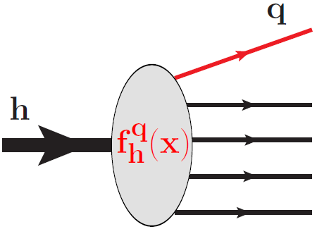
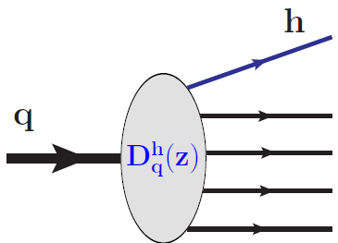
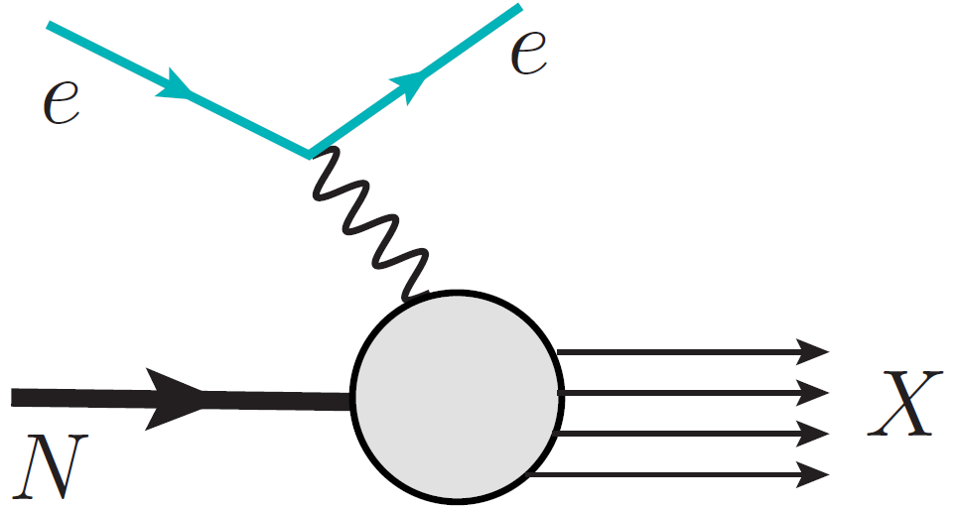
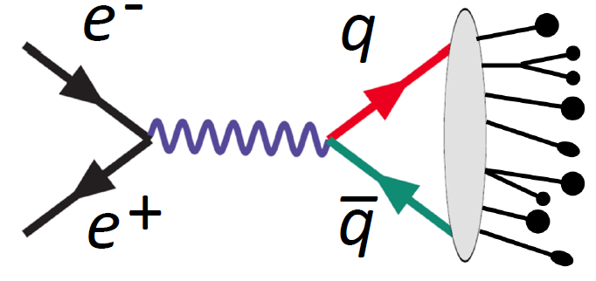
Introduction
主要内容
PDFs and FFs
Parton distribution functions (PDFs)
Hadron structure
Parton momentum distribution
inside a hadron
Fragmentation functions (FFs)
Hadronization mechanism
Hadron momentum distribution
inside a parton jet
Lepton-nucleon deep inelastic scattering (DIS)
$e^{+}e^{−}$ annihilation to hadrons
APCTP Focus Program Pohang, Korea, July 2022

Slide 5
Introduction
主要内容
PDFs and FFs
Parton distribution functions (PDFs)
Hadron structure
Parton momentum distribution
inside a hadron
Fragmentation functions (FFs)
Hadronization mechanism
Hadron momentum distribution
inside a parton jet
Insights into the properties of strong interaction
Inputs for describing high energy reactions
Prerequisite for doing new physics researches
$⋯⋯$
Why PDFs and FFs are important?
APCTP Focus Program Pohang, Korea, July 2022

Slide 6
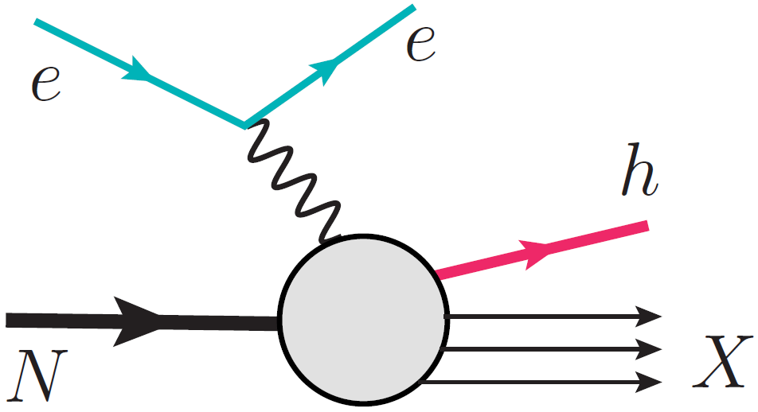
Introduction
主要内容
Semi-inclusive DIS (SIDIS)
Inclusive DIS
SIDIS
One dimensional imaging of the nucleon
Without fragmentation functions
Target spin asymmetries
Three dimensional imaging of the nucleon
Accessing fragmentation functions
Azimuthal and/or spin asymmetries
More abundant physical contents!
APCTP Focus Program Pohang, Korea, July 2022

Slide 7
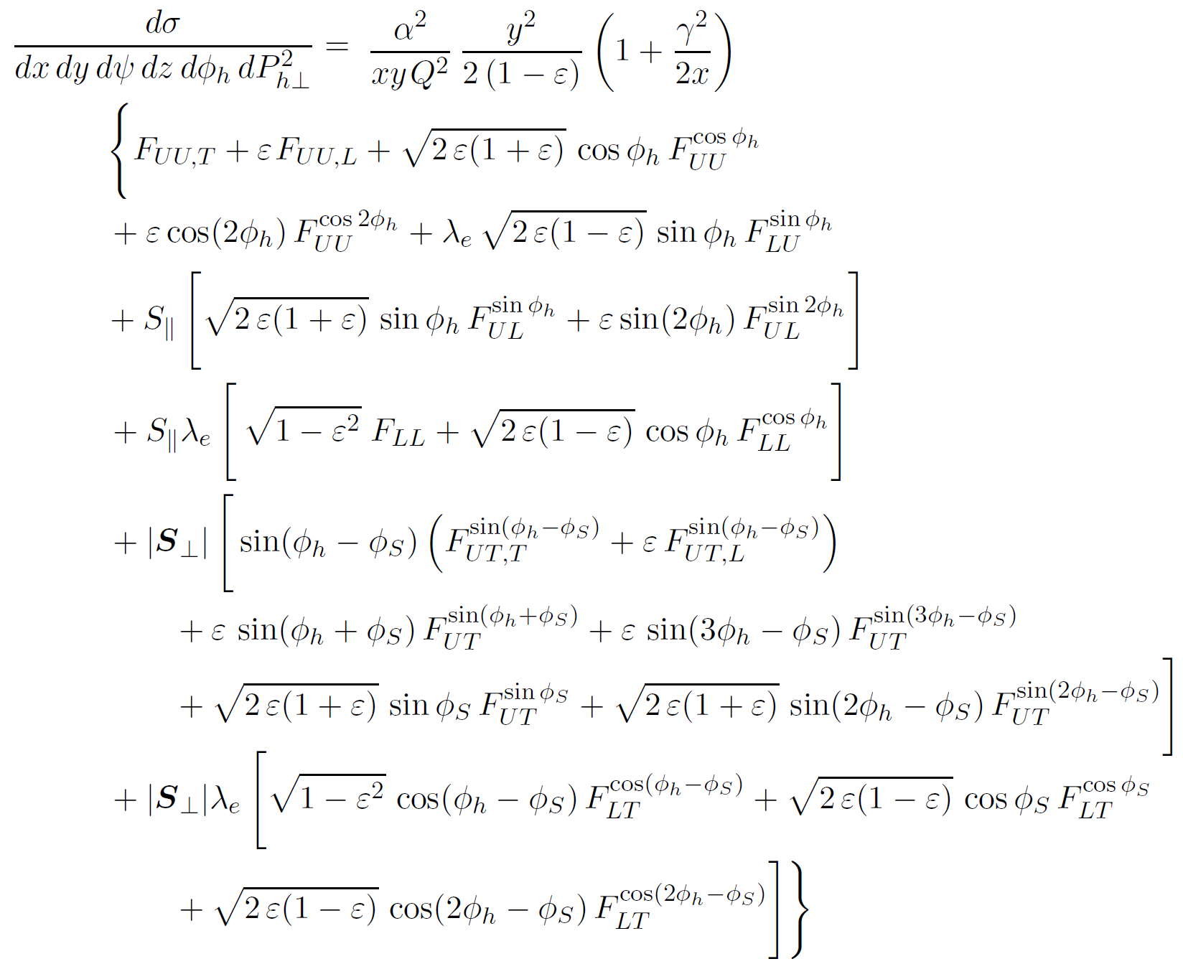
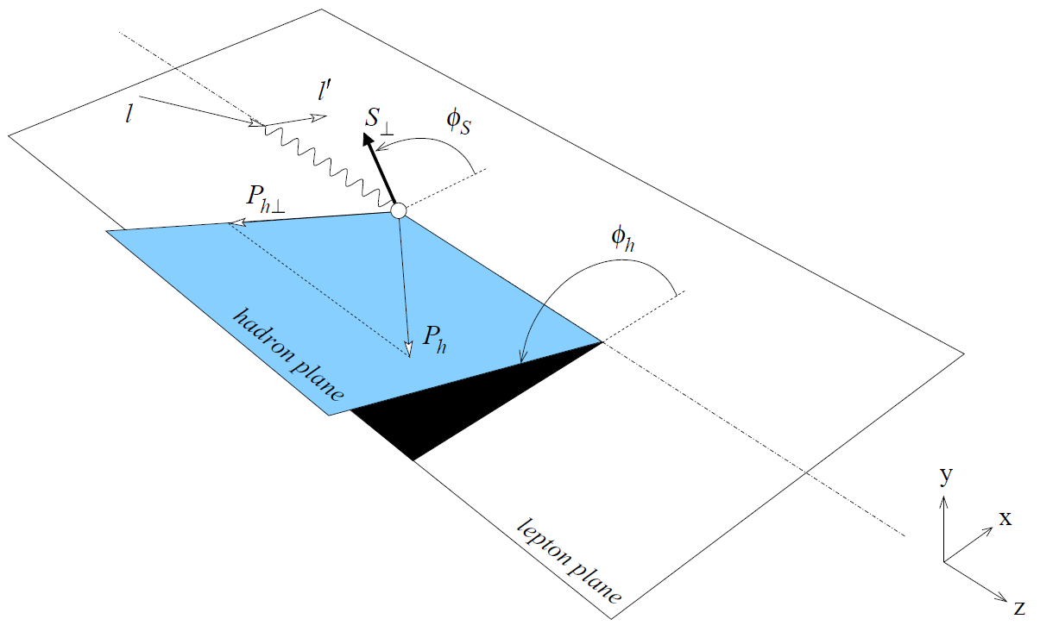
Introduction
主要内容
Semi-inclusive DIS (SIDIS)
A. Bacchetta et al., JHEP 02, 093 (2007)
APCTP Focus Program Pohang, Korea, July 2022

Slide 8
Introduction
主要内容
Semi-inclusive DIS (SIDIS)
$$F_{UU,T} \sim f_{1}⊗D_{1}$$
Number density
$$F_{LL} \sim g_{1L}⊗D_{1}$$
Helicity
$$⊗$$
Unpolarized FF
$$F_{UT,T}^{\sin{(φ_{h}−φ_{S})}} \sim f_{1T}^{⊥}⊗D_{1}$$
Sivers
$$F_{LT}^{{\cos{(φ}}_{h}−φ_{S})} \sim g_{1T}⊗D_{1}$$
Worm-gear
$$F_{UT}^{\sin{(φ_{h}+φ_{S})}} \sim h_{1}⊗H_{1}^{⊥}$$
Transversity
A. Bacchetta et al., JHEP 02, 093 (2007)
$$F_{UU}^{{\cos{2φ}}_{h}} \sim h_{1}^{⊥}⊗H_{1}^{⊥}$$
Boer-Mulders
$$⊗$$
Collins FF
$P_{h⊥}≪Q$: TMD factorization applies.
$$F_{UL}^{\sin{2φ_{h}}} \sim h_{1L}^{⊥}⊗H_{1}^{⊥}$$
Worm-gear
Structure functions are expressed by the convolution of TMD PDFs and FFs.
$$F_{UT}^{\sin{(3φ_{h}−φ_{S})}} \sim h_{1T}^{⊥}⊗H_{1}^{⊥}$$
Pretzelosity
$$⋮$$
APCTP Focus Program Pohang, Korea, July 2022

Slide 9
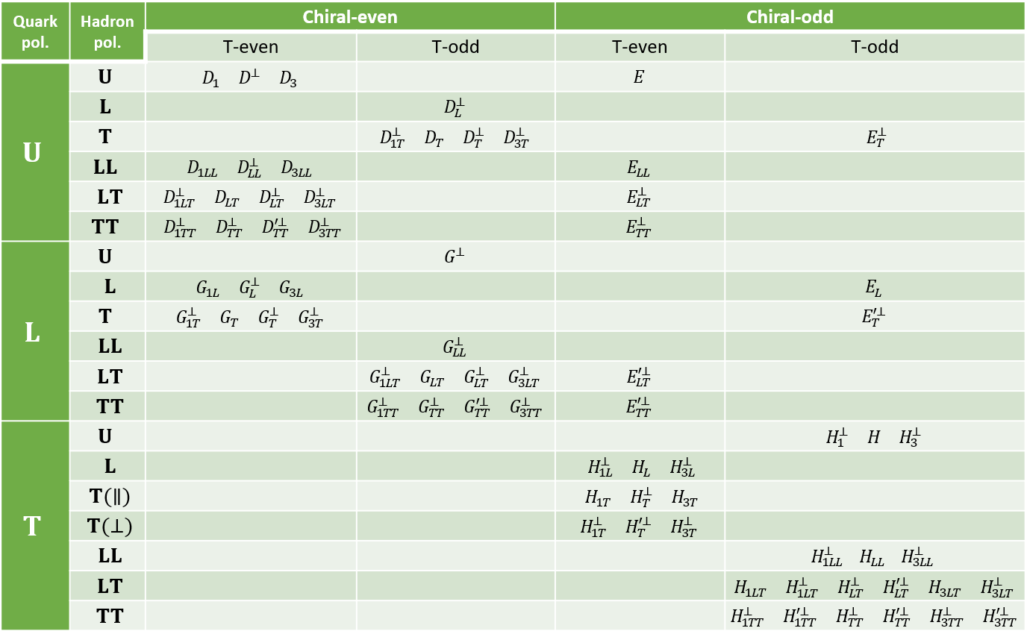
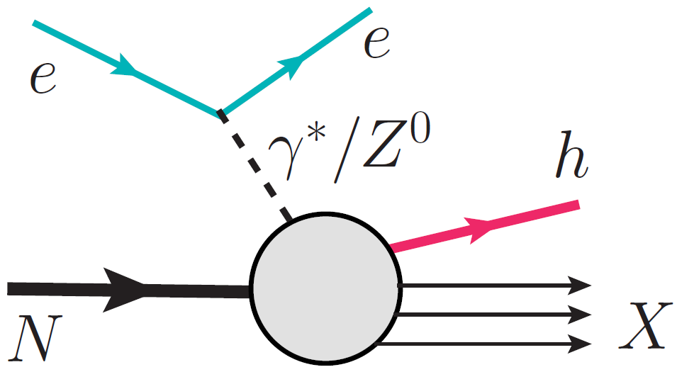
Introduction
主要内容
The polarization of the produced hadron
Vector meson production
$⟹$ New tensor polarization dependent TMD FFs
72 TMD FFs for polarized vector meson production
Chen, Yang, Wei and Liang, PRD94, 034003 (2016)
Electroweak contributions at high energy
Parity violating SIDIS
$⟹$ New structure functions
See e.g.,
Boer, Jakob and Mulders,
NPB 564, 471 (2000)
APCTP Focus Program Pohang, Korea, July 2022

Slide 10
Contents
主要内容
Introduction
Kinematics and structure functions for $eN→eVX$
Parton model results and the spin alignment
Summary
APCTP Focus Program Pohang, Korea, July 2022

Slide 11
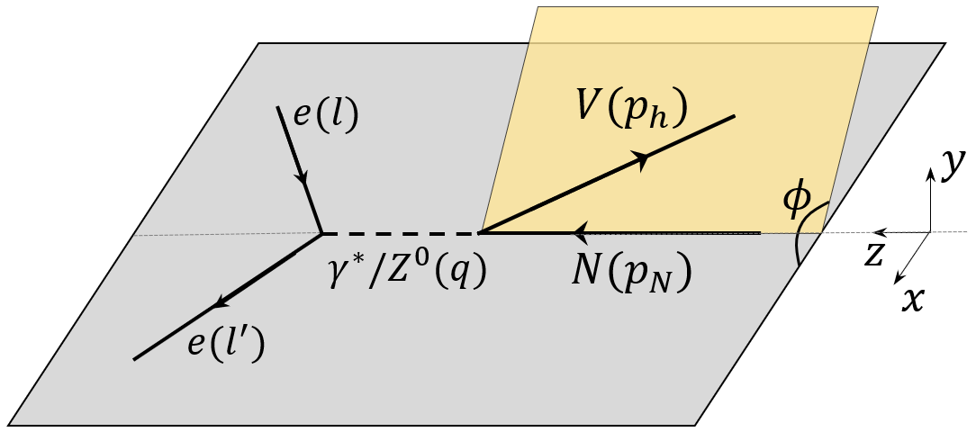
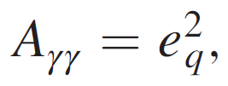
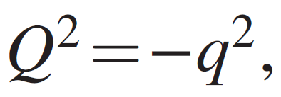
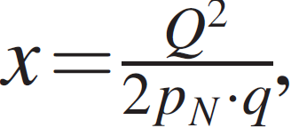
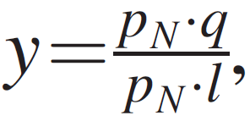
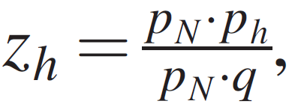
Kinematics and structure functions for $eN→eVX$
主要内容
The process
$$e(l)+N(p_{N})→e(l^{′})+V(p_{h},S)+X$$
$V$: Vector meson (spin 1)
$$dσ=\frac{2α_{em}^{2}}{sQ^{4}}A_{r}L_{r}^{μν}\left(l,l^{′}\right)W_{r,μν}\left(q,p_{N},p_{h},S\right)\frac{d^{3}l^{′}d^{3}p_{h}}{2E_{l^{′}}2E_{h}},$$
$$(r=γγ, ZZ, γZ)$$
APCTP Focus Program Pohang, Korea, July 2022

Slide 12
Kinematics and structure functions for $eN→eVX$
主要内容
Hermiticity:
$$W_{ZZ}^{∗μν}=W_{ZZ}^{νμ}$$
Current conservation:
$q_{μ}W_{ZZ}^{μν}=q_{ν}W_{ZZ}^{μν}=0$
General form of the hadronic tensor
$$W_{ZZ}^{μν}\left(q,p_{N},p_{h},S\right)=W_{ZZ}^{Sμν}(symmetric)+iW_{ZZ}^{Aμν}(antisymmetric)$$
$=\sum_{σ,i}{W_{σi}^{S}}{ h}_{σi}^{Sμν}+i\sum_{σ,j}{W_{σj}^{A}}{ h}_{σj}^{Aμν}$
$+\sum_{σ,k}{{\tilde{W}}_{σk}^{S}}{ \tilde{h}}_{σk}^{Sμν}+i\sum_{σ,l}{{\tilde{W}}_{σl}^{A}}{ \tilde{h}}_{σl}^{Aμν}$
$h$: Parity even, $\hat{𝒫}h^{μν}=h^{μν}$
$\tilde{h}$: Parity odd, $\hat{𝒫}{\tilde{h}}^{μν}={−\tilde{h}}^{μν}$
Scalar coefficients
Basic Lorentz tensors (BLTs)
$σ$: polarizations, $U, V, LL, LT, TT$
Unpolarized BLTs
$$h_{Ui}^{Sμν}=\{\begin{matrix}g^{μν}−\frac{q^{μ}q^{ν}}{q^{2}}, & p_{Nq}^{μ}p_{Nq}^{ν}, & p_{Nq}^{\{μ}p_{hq}^{ν\}}, & p_{hq}^{μ}p_{hq}^{ν}\end{matrix}\}$$
$$h_{U}^{Aμν}=p_{Nq}^{[μ}p_{hq}^{ν]}$$
$$p_{q}^{μ}≡p^{μ}−\frac{p⋅q}{q^{2}}q^{μ}$$
$$q⋅p_{q}=0$$
$${\tilde{h}}_{Ui}^{Sμν}=\{\begin{matrix}ε^{\{μqp_{N}p_{h}}p_{Nq}^{ν\}}, & ε^{\{μqp_{N}p_{h}}p_{hq}^{ν\}}\end{matrix}\}$$
$${\tilde{h}}_{Ui}^{Aμν}=\left\{\begin{matrix}ε^{μνqp_{N}}, & ε^{μνqp_{h}}\end{matrix}\right\}$$
APCTP Focus Program Pohang, Korea, July 2022

Slide 13
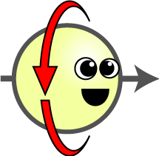
Kinematics and structure functions for $eN→eVX$
主要内容
Spin dependence
$$ρ=\frac{1}{2}\left(1+\vec{S}⋅\vec{σ}\right)$$
$$S=1/2$$
$2×2$ spin density matrix:
Polarization vector: $S^{μ}=(0,{\overset{⃑}{S}}_{T},λ)$, ${\vec{S}}_{T}=(S_{T}^{x},{ S}_{T}^{y})$
$$S=1$$
$3×3$ spin density matrix:
$ρ=\frac{1}{3}\left(1+\frac{3}{2}\vec{S}⋅\vec{Σ}+3T^{ij}Σ^{ij}\right)$,
$Σ^{ij}=\frac{1}{2}\left(Σ^{i}Σ^{j}+Σ^{j}Σ^{i}\right)−\frac{2}{3}δ^{ij}I$.
Polarization vector: $S^{μ}=(0,{\overset{⃑}{S}}_{T},λ)$
$T=\frac{1}{2}\left(\begin{matrix}−\frac{2}{3}S_{LL}+S_{TT}^{xx} & S_{TT}^{xy} & S_{LT}^{x} \\ S_{TT}^{xy} & −\frac{2}{3}S_{LL}−S_{TT}^{xx} & S_{LT}^{y} \\ S_{LT}^{x} & S_{LT}^{y} & \frac{4}{3}S_{LL}\end{matrix}\right)$.
$$S_{LL}$$
Polarization tensor:
$$S_{LT}^{μ}=(0,S_{LT}^{x},S_{LT}^{y},0)$$
$S_{TT}^{xμ}=(0,S_{TT}^{xx},S_{TT}^{xy},0$)
A. Bacchetta and P.J. Mulders, PRD62, 114004 (2000)
APCTP Focus Program Pohang, Korea, July 2022

Slide 14
Kinematics and structure functions for $eN→eVX$
主要内容
Polarized BLTs
$$\left\{\begin{matrix}h_{LLi}^{Sμν} \\ {\tilde{h}}_{LLi}^{Sμν} \\ h_{LL}^{Aμν} \\ {\tilde{h}}_{LLi}^{Aμν}\end{matrix}\right\}=S_{LL}\left\{\begin{matrix}h_{Ui}^{Sμν} \\ {\tilde{h}}_{Ui}^{Sμν} \\ h_{U}^{Aμν} \\ {\tilde{h}}_{Ui}^{Aμν}\end{matrix}\right\}$$
The polarized BLTs can be constructed from the unpolarized ones by multiplying with the polarization dependent scalars.
$$h_{Vi}^{Sμν}=\left\{\begin{matrix}\left[λ, (p_{h⊥}⋅S_{T})\right]{\tilde{h}}_{Ui}^{Sμν}, & ε_{⊥}^{p_{h}S_{T}}h_{Uj}^{Sμν}\end{matrix}\right\}$$
$$h_{LTi}^{Sμν}=\left\{\begin{matrix}(p_{h⊥}⋅S_{LT})h_{Ui}^{Sμν}, & ε_{⊥}^{p_{h}S_{LT}}{\tilde{h}}_{Uj}^{Sμν}\end{matrix}\right\}$$
$${\tilde{h}}_{Vi}^{Sμν}=\left\{\begin{matrix}\left[λ, (p_{h⊥}⋅S_{T})\right]h_{Ui}^{Sμν}, & ε_{⊥}^{p_{h}S_{T}}{\tilde{h}}_{Uj}^{Sμν}\end{matrix}\right\}$$
$${\tilde{h}}_{LTi}^{Sμν}=\left\{\begin{matrix}(p_{h⊥}⋅S_{LT}){\tilde{h}}_{Ui}^{Sμν}, & ε_{⊥}^{p_{h}S_{LT}}h_{Uj}^{Sμν}\end{matrix}\right\}$$
$$h_{Vi}^{Aμν}=\left\{\begin{matrix}\left[λ, (p_{h⊥}⋅S_{T})\right]{\tilde{h}}_{Ui}^{Aμν}, & ε_{⊥}^{p_{h}S_{T}}h_{U}^{Aμν}\end{matrix}\right\}$$
$$h_{LTi}^{Aμν}=\left\{\begin{matrix}(p_{h⊥}⋅S_{LT})h_{U}^{Aμν}, & ε_{⊥}^{p_{h}S_{LT}}{\tilde{h}}_{Uj}^{Aμν}\end{matrix}\right\}$$
$${\tilde{h}}_{Vi}^{Aμν}=\left\{\begin{matrix}\left[λ, (p_{h⊥}⋅S_{T})\right]h_{U}^{Aμν}, & ε_{⊥}^{p_{h}S_{T}}{\tilde{h}}_{Uj}^{Aμν}\end{matrix}\right\}$$
$${\tilde{h}}_{LTi}^{Aμν}=\left\{\begin{matrix}(p_{h⊥}⋅S_{LT}){\tilde{h}}_{Ui}^{Aμν}, & ε_{⊥}^{p_{h}S_{LT}}h_{U}^{Aμν}\end{matrix}\right\}$$
$$h_{TTi}^{Sμν}=\left\{\begin{matrix}S_{TT}^{p_{h}p_{h}}h_{Ui}^{Sμν}, & {\tilde{S}}_{TT}^{p_{h}p_{h}}{\tilde{h}}_{Uj}^{Sμν}\end{matrix}\right\}$$
$$\left(\begin{aligned}\text{Polarization} \\ \text{dependent} \text{BLTs} \end{aligned}\right)=\left(\begin{aligned}\text{Polarization} \\ \text{dependent} \text{scalars} \end{aligned}\right)×\left(\begin{aligned}Unpolarized \\ BLTs\end{aligned}\right)$$
$${\tilde{h}}_{TTi}^{Sμν}=\left\{\begin{matrix}S_{TT}^{p_{h}p_{h}}{\tilde{h}}_{Ui}^{Sμν}, & {\tilde{S}}_{TT}^{p_{h}p_{h}}h_{Uj}^{Sμν}\end{matrix}\right\}$$
$$h_{TTi}^{Aμν}=\left\{\begin{matrix}S_{TT}^{p_{h}p_{h}}h_{U}^{Aμν}, & {\tilde{S}}_{TT}^{p_{h}p_{h}}{\tilde{h}}_{Uj}^{Aμν}\end{matrix}\right\}$$
81 independent BLTs in total
K.B. Chen, W.H. Yang, S.Y. Wei and Z.T. Liang, Phys. Rev. D94, 034003 (2016)
$${\tilde{h}}_{TTi}^{Aμν}=\left\{\begin{matrix}S_{TT}^{p_{h}p_{h}}{\tilde{h}}_{Ui}^{Aμν}, & {\tilde{S}}_{TT}^{p_{h}p_{h}}h_{U}^{Aμν}\end{matrix}\right\}$$
APCTP Focus Program Pohang, Korea, July 2022

Slide 15
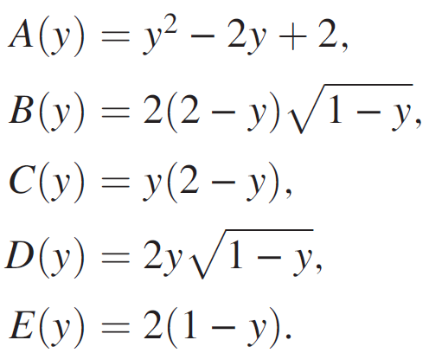
Kinematics and structure functions for $eN→eVX$
主要内容
The cross section in terms of structure functions
APCTP Focus Program Pohang, Korea, July 2022

Slide 16
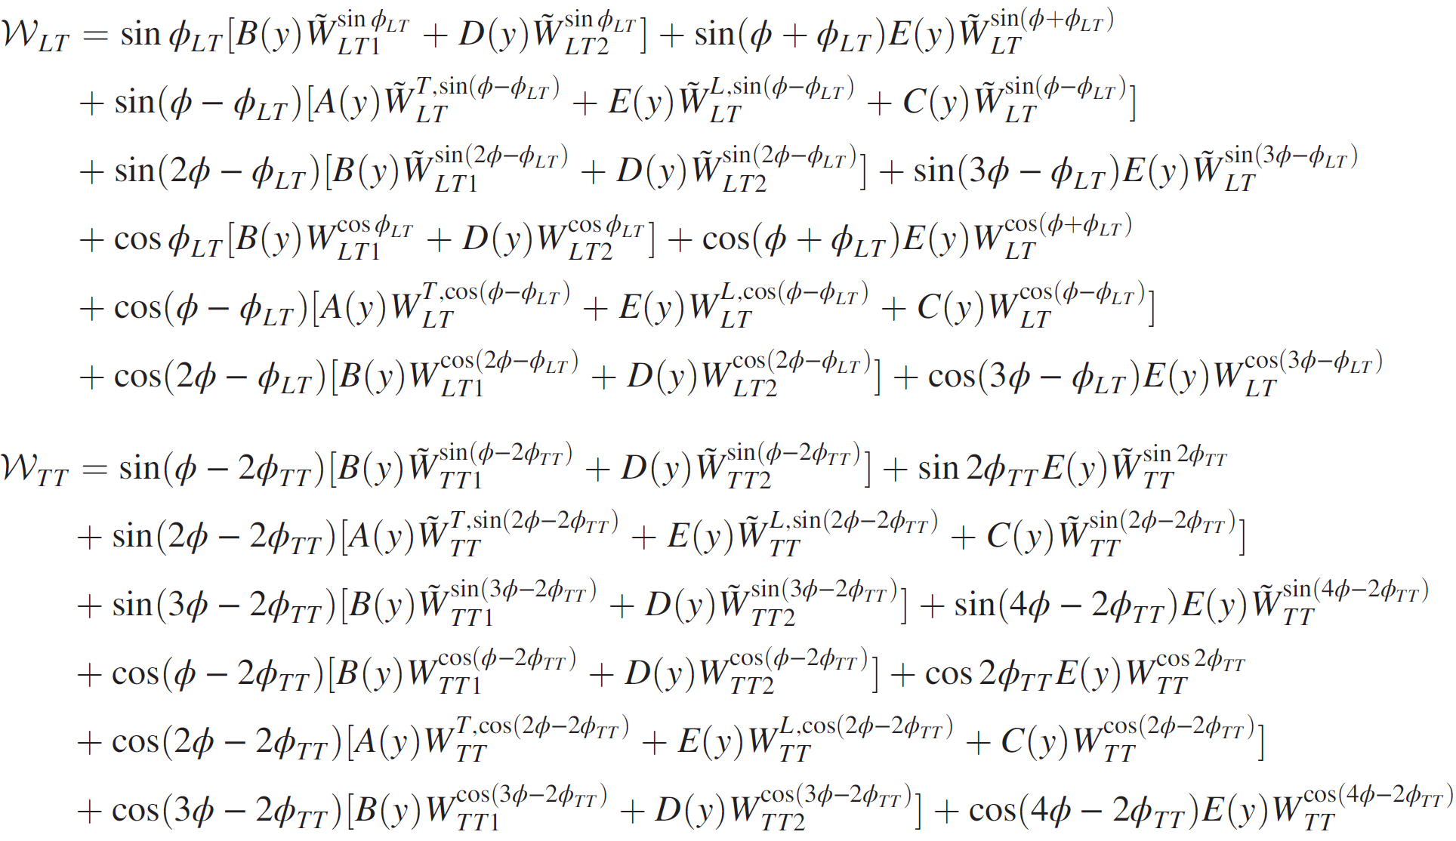
Kinematics and structure functions for $eN→eVX$
主要内容
81 structure functions (SFs) in total
39 SFs are space reflection odd
45 tensor polarization dependent SFs
APCTP Focus Program Pohang, Korea, July 2022

Slide 17
Contents
主要内容
Introduction
Kinematics and structure functions for $eN→eVX$
Parton model results and the spin alignment
Summary
APCTP Focus Program Pohang, Korea, July 2022

Slide 18
Parton model results and the spin alignment
主要内容
The hadronic tensor in terms of TMD PDFs and FFs
TMD factorization applies at $P_{h⊥}≪Q$:
The TMD parton correlators:
For unpolarized nucleon:
APCTP Focus Program Pohang, Korea, July 2022

Slide 19
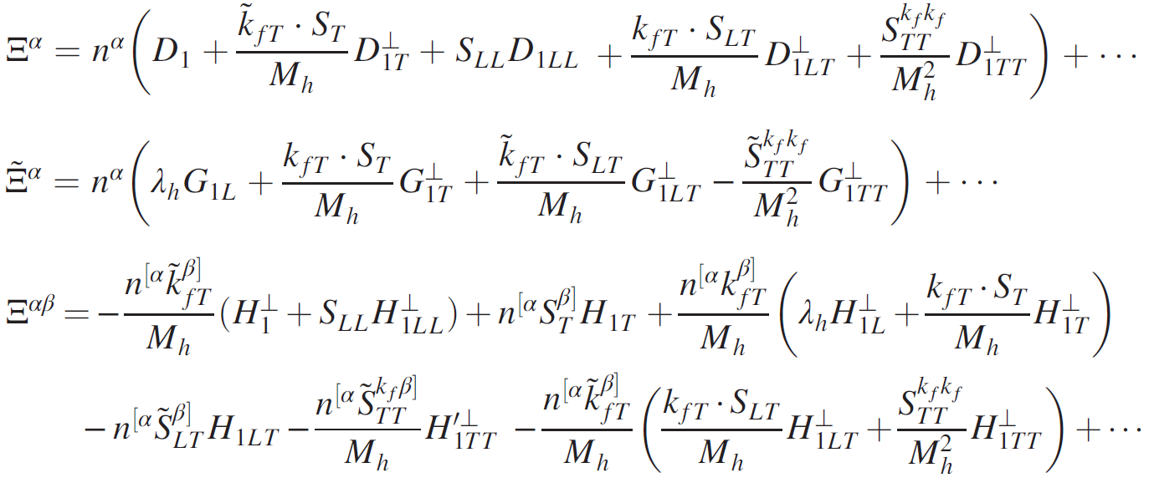
Parton model results and the spin alignment
主要内容
For polarized vector meson production:
Ten tensor polarization dependent TMD FFs at twist-2.
APCTP Focus Program Pohang, Korea, July 2022

Slide 20
Parton model results and the spin alignment
主要内容
The hadronic tensor results:
Parameters for weak, electromagnetic and interference contributions
 | $$A_{r}$$ | $$L_{r}^{μν}$$ | $$W_{r}^{μν}$$
$$ZZ$$ | $$χ$$ | $c_{1}^{e}$, $c_{3}^{e}$ | $c_{1}^{q}$, $c_{2}^{q}$, $c_{3}^{q}$
$$γZ$$ | $$χ_{int}$$ | $c_{V}^{e}$, $c_{A}^{e}$ | $c_{V}^{q}$, $c_{V}^{q}$, $c_{A}^{q}$
$$γγ$$ | $$e_{q}^{2}$$ | $1$, $0$ | $1$, $1$, $0$
APCTP Focus Program Pohang, Korea, July 2022

Slide 21
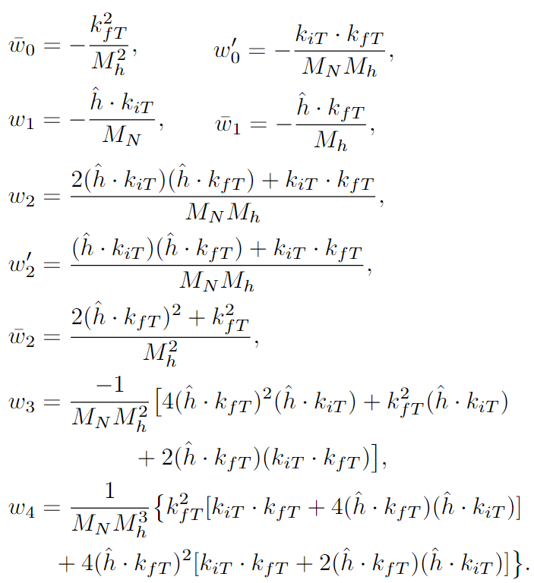
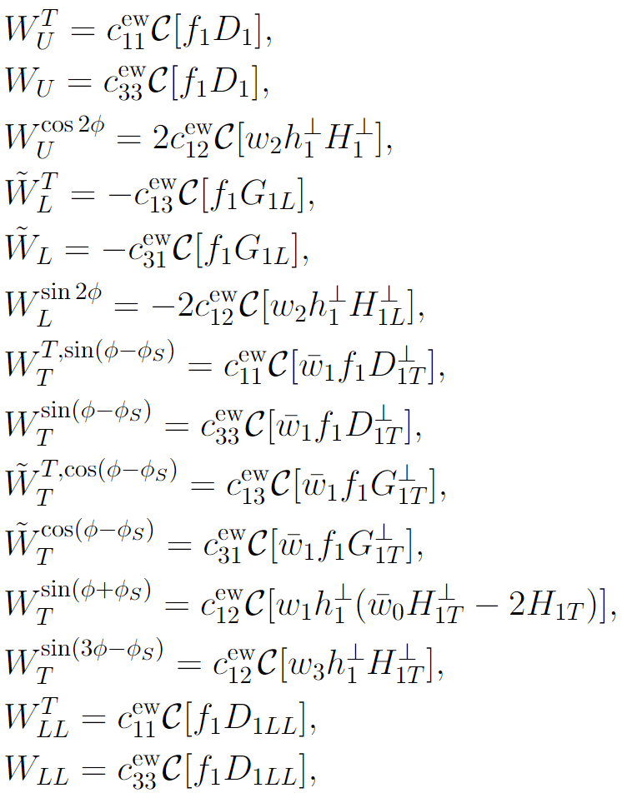
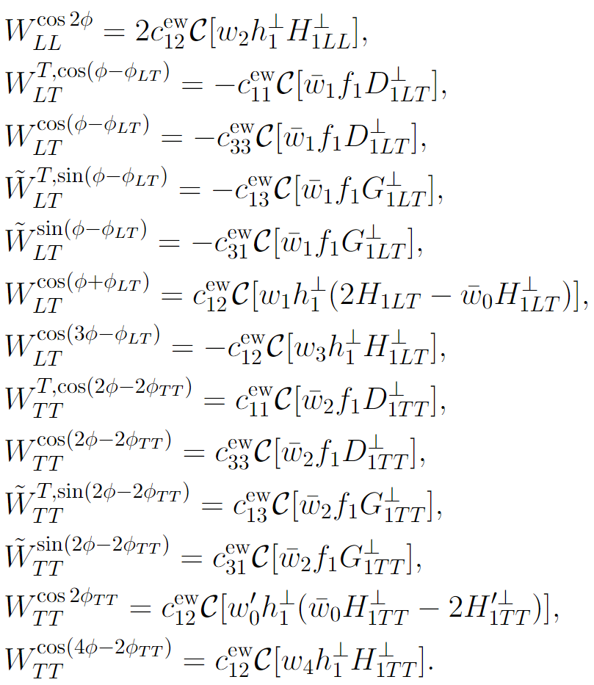
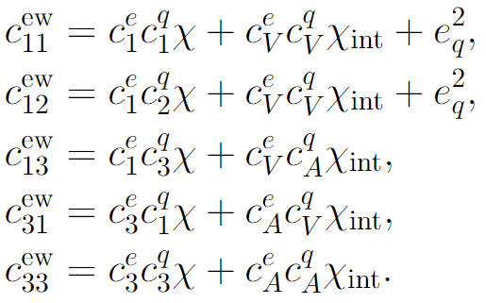
Parton model results and the spin alignment
主要内容
The structure functions
APCTP Focus Program Pohang, Korea, July 2022

Slide 22
Parton model results and the spin alignment
主要内容
The structure functions
27 nonzero SFs at the leading twist
15 tensor polarization dependent SFs
13 new SFs exist only when considering weak interaction
APCTP Focus Program Pohang, Korea, July 2022

Slide 23
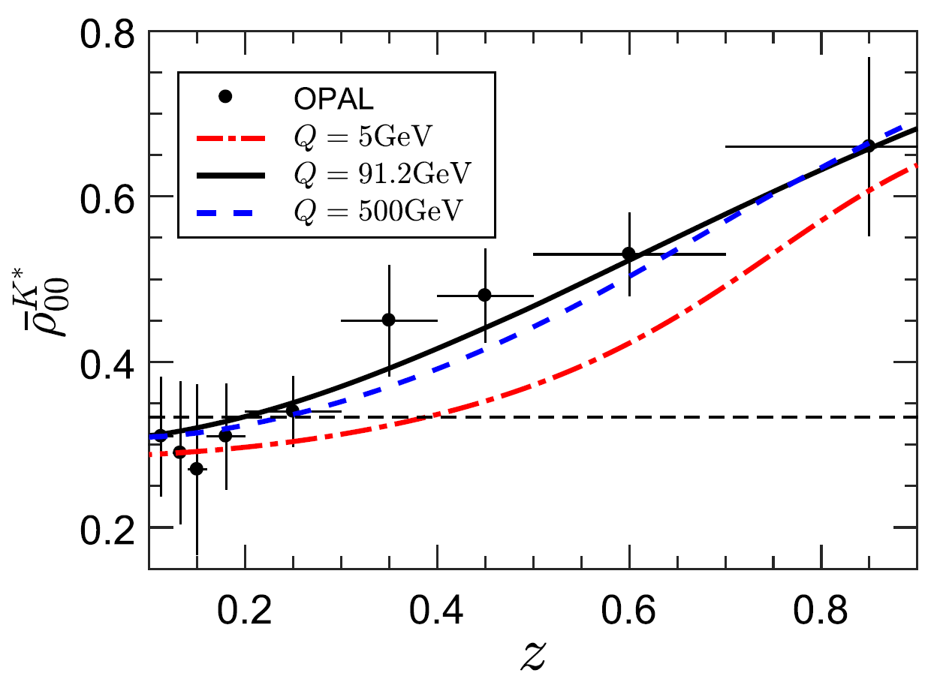
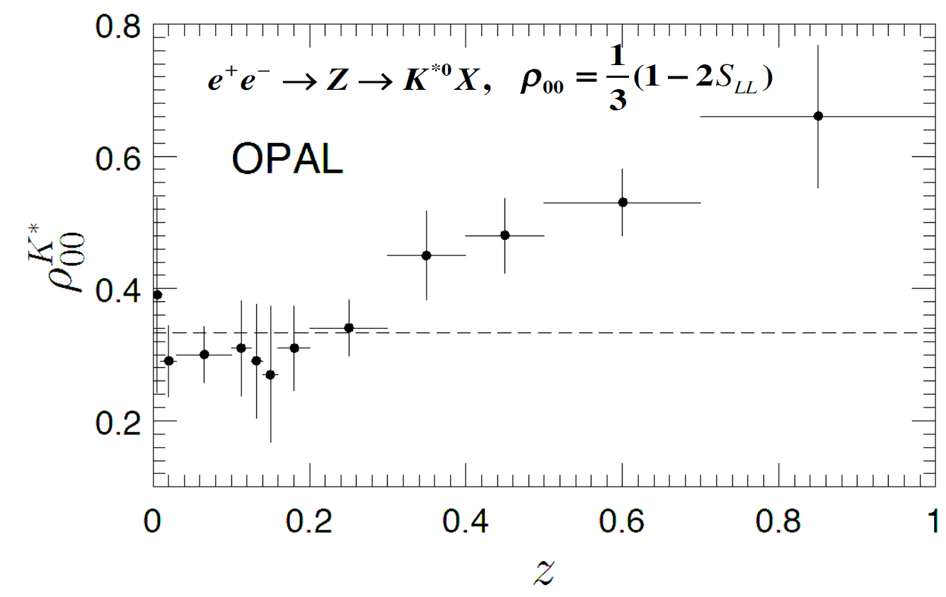
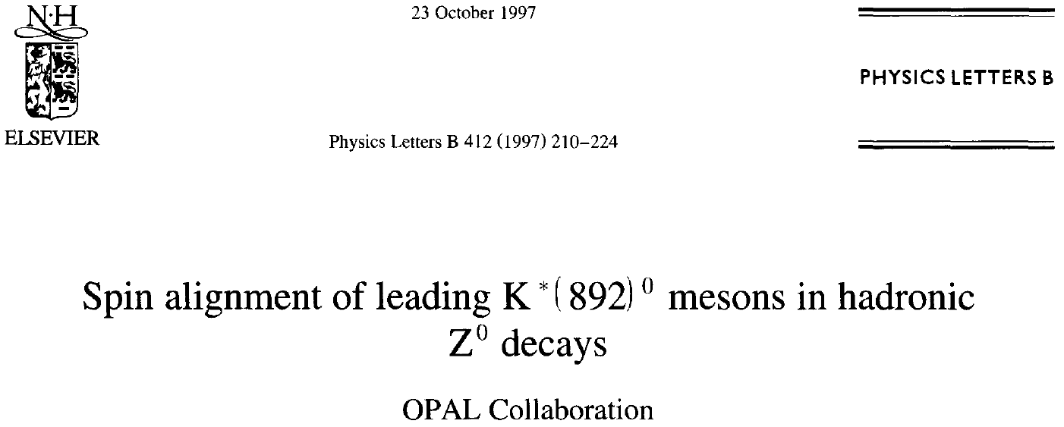
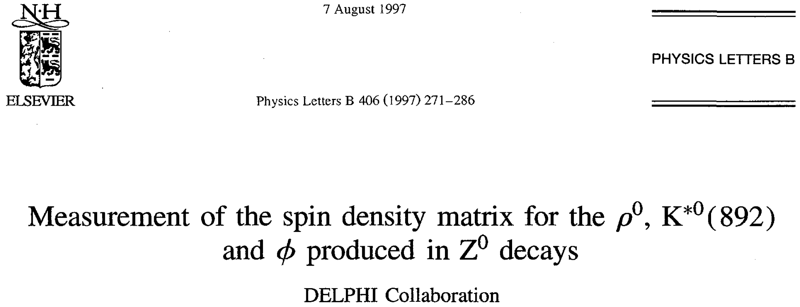
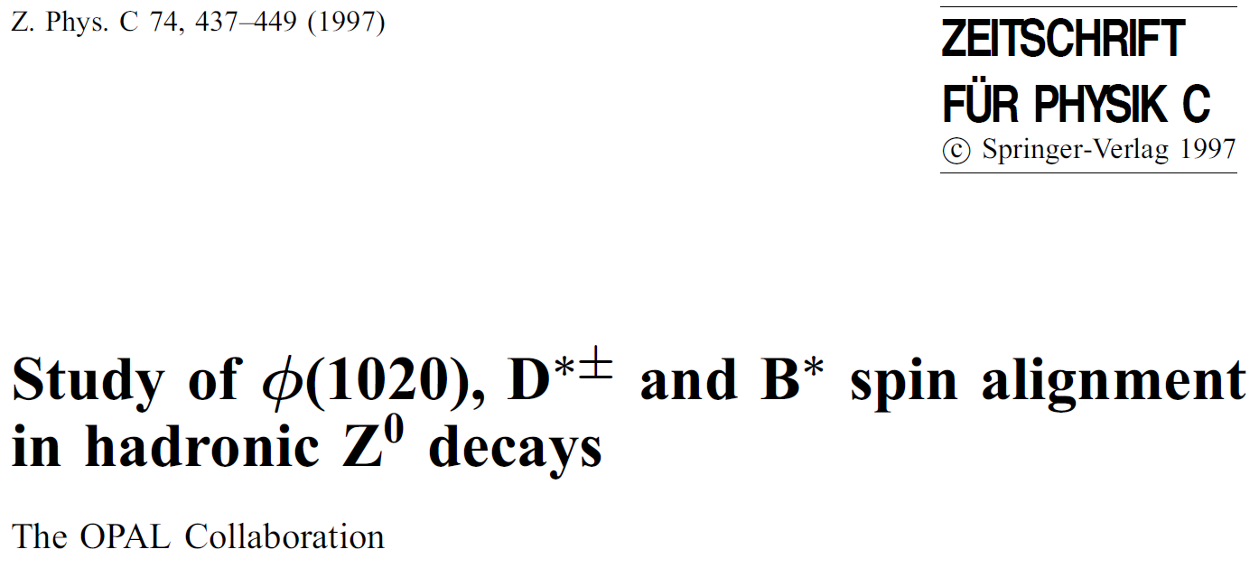
Parton model results and the spin alignment
主要内容
The spin alignment of the vector meson
$ρ_{00}$ gives the relative intensity of mesons in helicity 0 state
In $e^{+}e^{−}$ annihilation:
General features:
Independent of the polarization of the fragmenting quark
Weak energy dependence
K.B. Chen, W.H. Yang, Y.J. Zhou and Z.T. Liang, Phys. Rev. D95, 034009 (2017)
APCTP Focus Program Pohang, Korea, July 2022

Slide 24
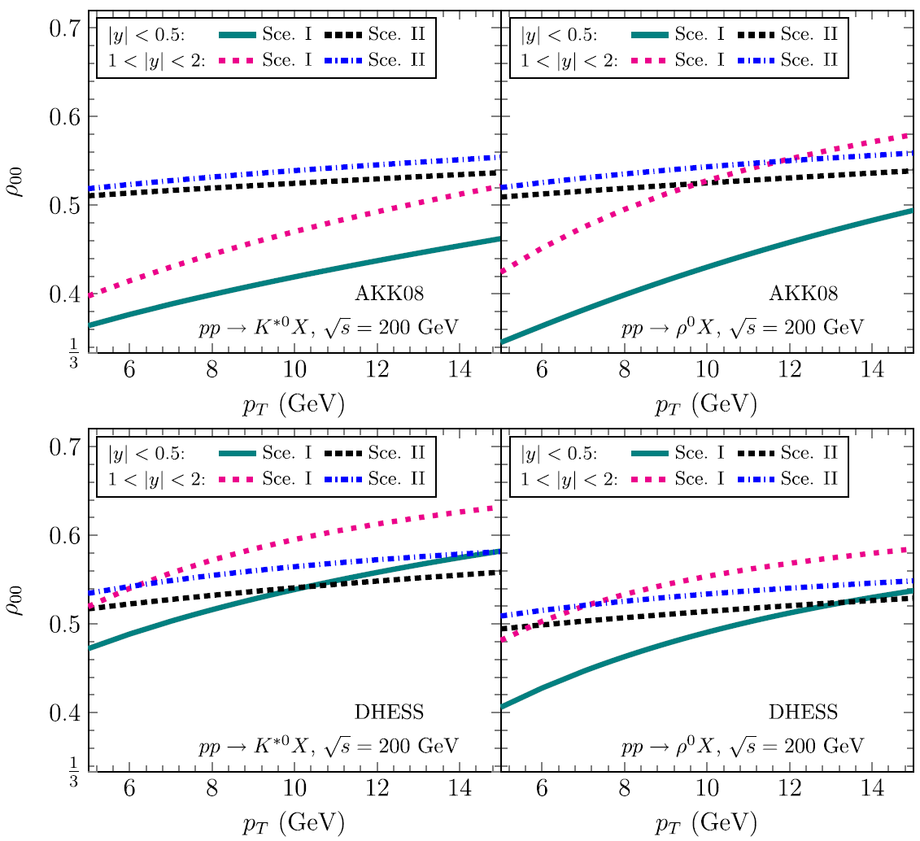
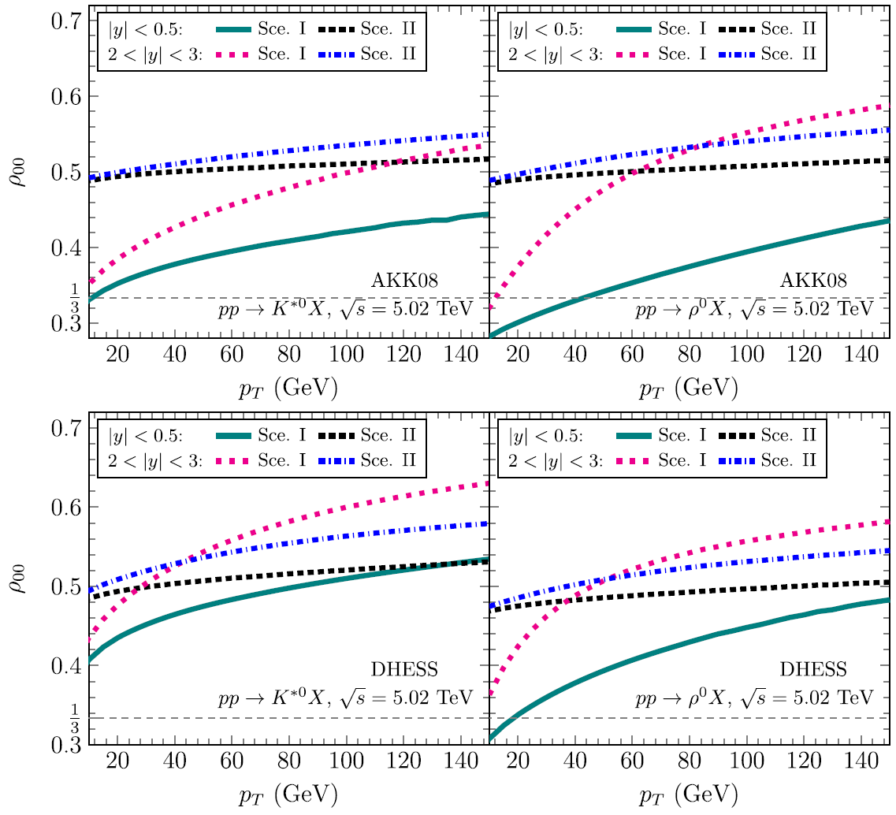
Parton model results and the spin alignment
主要内容
The spin alignment of the vector meson
In $pp$ collision:
K.B. Chen, Z.T. Liang, Y.K. Song, S.Y. Wei, Phys. Rev. D102, 034001 (2020)
APCTP Focus Program Pohang, Korea, July 2022

Slide 25
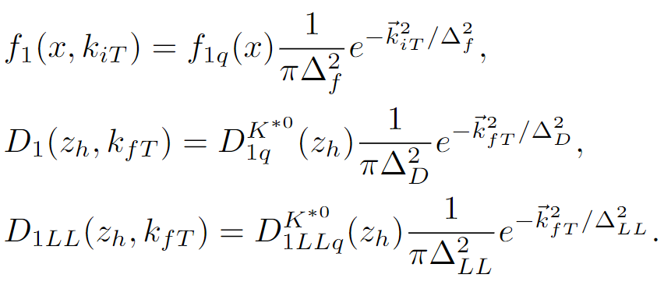
Parton model results and the spin alignment
主要内容
The spin alignment of the vector meson
In SIDIS:
$φ$ integrated
Take Gaussian form for TMDs:
$p_{h⊥}$ integrated
Only depends on the collinear part of the TMDs
$f_{1q}(x)$: CTEQ14 NLO
$D_{1q}^{K^{∗0}}(z_{h})$, $D_{1LLq}^{K^{∗0}}(z_{h})$: K.B. Chen et al., PRD102, 034001 (2020)
APCTP Focus Program Pohang, Korea, July 2022

Slide 26
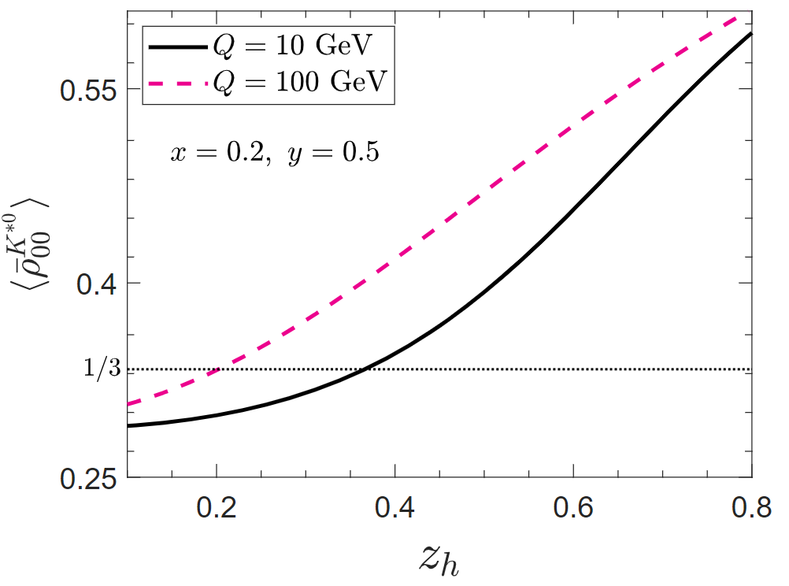
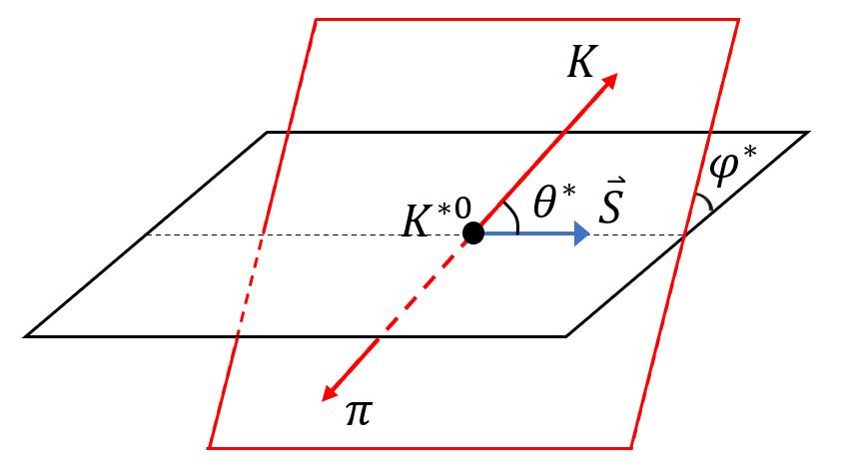
Parton model results and the spin alignment
主要内容
The spin alignment of the vector meson
In SIDIS:
$⟨{\overline{ρ}}_{00}^{K^{∗0}}⟩$ deviates from 1/3 at both low and high $Q$
$⟨{\overline{ρ}}_{00}^{K^{∗0}}⟩$ increases monotonically with $z_{h}$
Scale dependence is relatively small
$$μ_{f}=Q$$
$$W(\cos{θ^{∗},φ^{∗}})=$$
$$\frac{3}{4π}\left[\frac{1−ρ_{00}}{2}+\frac{3ρ_{00}−1}{2}\cos^{2}{θ^{∗}}−Reρ_{1−1}\sin^{2}{θ^{∗}}\cos{2φ^{∗}}−\frac{1}{\sqrt{2}}Re\left(ρ_{10}−ρ_{0−1}\right)\sin{2θ^{∗}}\cos{φ^{∗}}+Imρ_{1−1}\sin^{2}{θ^{∗}}\sin{2φ^{∗}}+\frac{1}{\sqrt{2}}Im\left(ρ_{10}−ρ_{0−1}\right)\sin{2θ^{∗}}\sin{φ^{∗}}\right]$$
$$W(\cos{θ^{∗}})=$$
$$\frac{3}{4}\left[1−ρ_{00}+(3ρ_{00}−1)\cos^{2}{θ^{∗}}\right]$$
A rough numerical estimate of the spin alignment for $K^{∗0}$ production
OPAL Collaboration, K. Ackerstaff et al., Z. Phys. C 74, 437 (1997)
APCTP Focus Program Pohang, Korea, July 2022

Slide 27
Summary
主要内容
We make a kinematic analysis for polarized vector meson production SIDIS. Considering the parity violating effects, the cross section is expressed by 81 structure functions.
We give a parton model calculation in TMD factorization. There are 27 nonzero SFs at the leading twist; 15 tensor polarization dependent SFs; 13 new SFs generated by weak interaction.
A rough numerical estimate of the spin alignment for $K^{∗0}$ production is given.
Thank you for your attention!
APCTP Focus Program Pohang, Korea, July 2022

