Slide 1

Fracture functions formalism for hadron production from the target remnant in hard processes
Aram Kotzinian
YerPhI, Armenia & INFN, Torino

Slide 2
Outlook
Processes to access the non-perturbative inputs Spin and Transverse Momentum Dependent (STMDs)
  Parton Distribution Functions in nucleon.
    STMD PDF: SIDIS, DY
  Parton Fragmentation Functions STMD FF: Hadron production in e⁺e⁻ annihilation (SIA), SIDIS, high p_{T} hadron production in pp collisions
  STMD Fracture Functions: SIDIS, DY
  String Fragmentation: LEPTO, PYTHIA

Slide 3
Twist-2 TMD PDFs
 |  | Quark polarization
 |  | U | L | T
Nucleon Polarization | U
 | L
 | T
All azimuthal dependences are in prefactors. TMDs do not depend on them

Slide 4
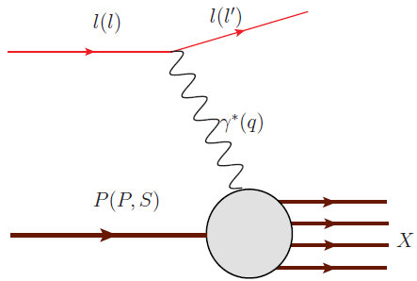
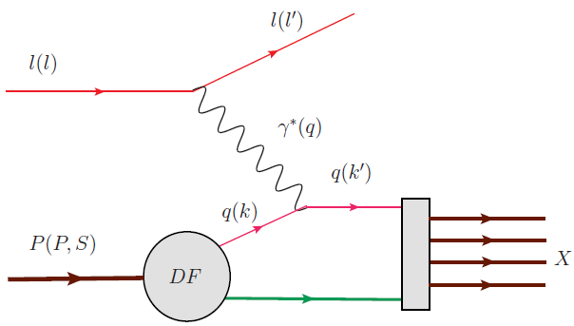
QCD factorization: DIS
≈

Slide 5
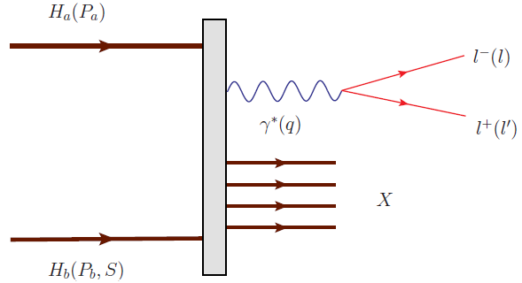
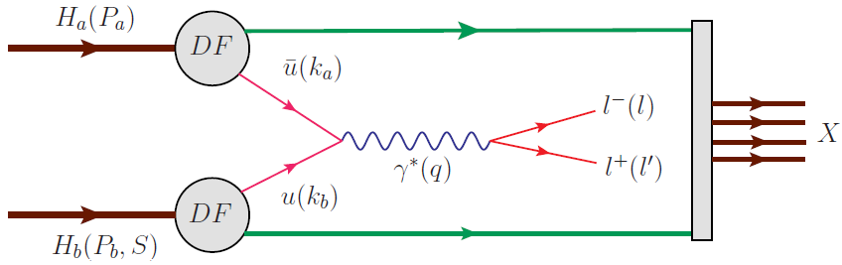
QCD TMD factorization: DY processes
≈

Slide 6
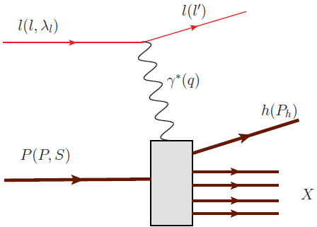
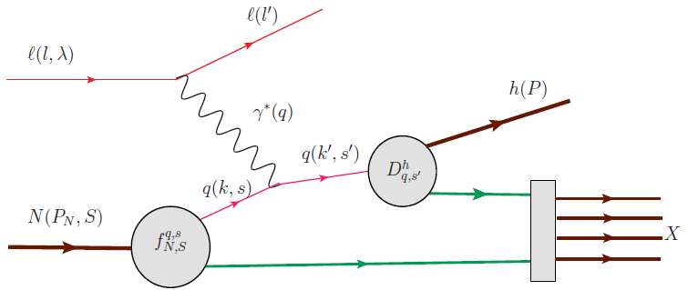
QCD TMD factorization: SIDIS in CFR
≈

Slide 7
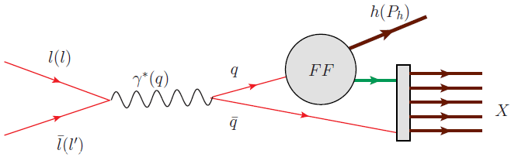
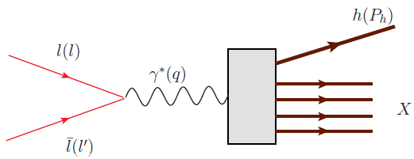
QCD TMD factorization: SIA
≈

Slide 8
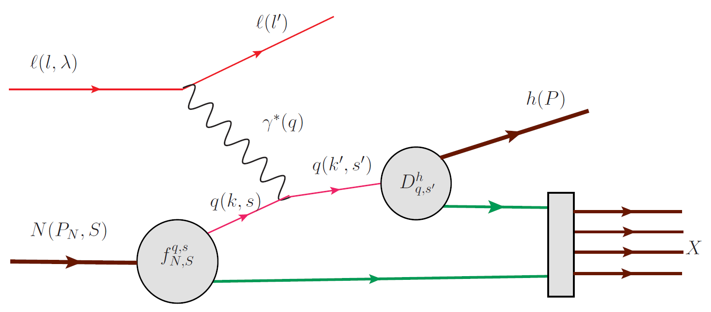
SIDIS: CFR
Measured in e⁺e⁻ semi inclusive
annihilation (SIA)
to 2 back-to-back jets
e⁺e⁻→h₁h₂ + X

Slide 9
LO cross section in SIDIS CFR
At LO only 8 terms out of 18 Structure Functions entering in the general expression of SIDIS cross section
6 azimuthal modulations, 4 terms are generated by Collins effect in fragmentation

Slide 10
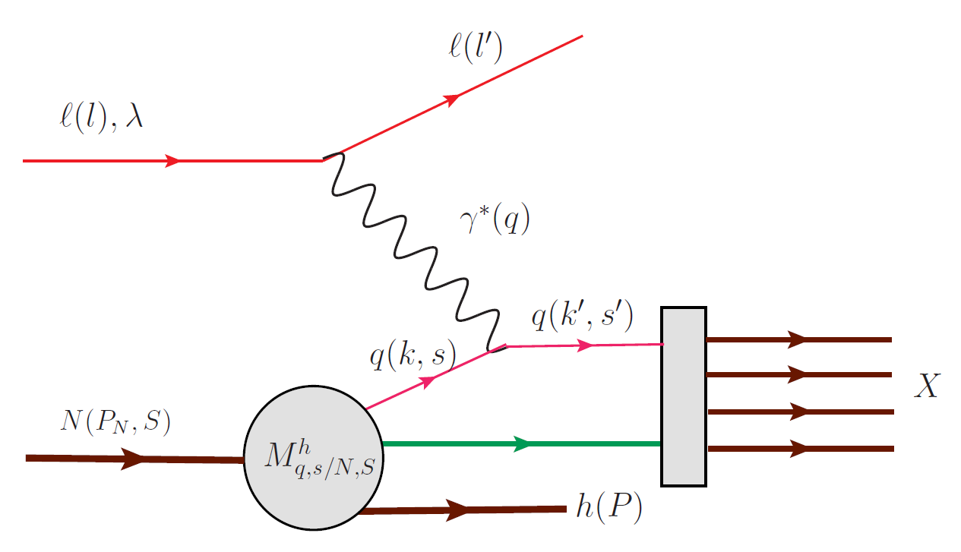
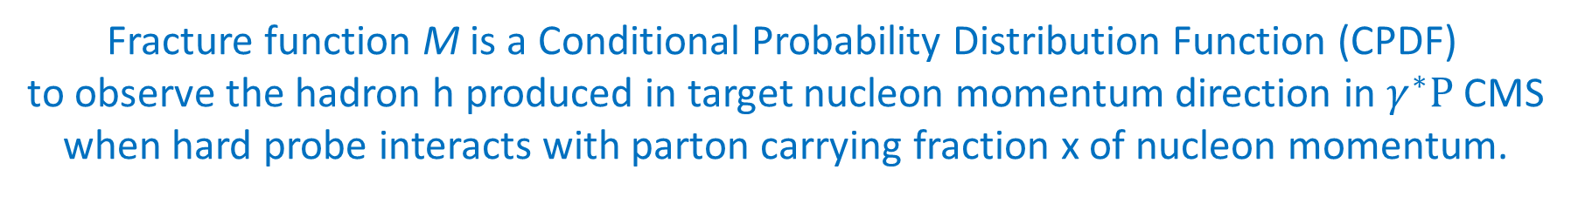
SIDIS: TFR
Trentadue, Veneziano 1994
Graudenz 1994
Collins 1998, 2000, 2002
de Florian, Sassot 1997, 1998
Grazzini, Trentadue, Veneziano 1998
Ceccopieri, Trentadue 2006, 2007, 2008
Sivers 2009
Ceccopieri , Mancusi 2013
Ceccopieri 2013
……..
Fracture function M is a Conditional Probability Distribution Function (CPDF)
to observe the hadron h produced in target nucleon momentum direction in $γ^{∗}P$ CMS
when hard probe interacts with parton carrying fraction x of nucleon momentum.

Slide 11


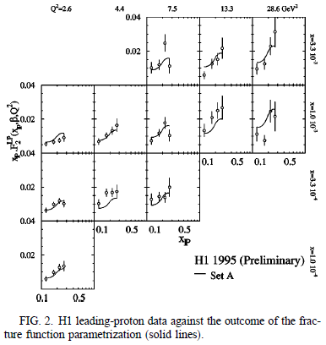
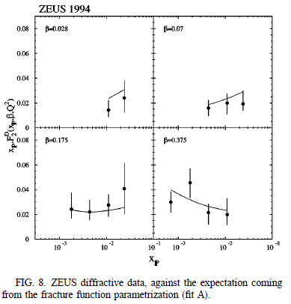
Collinear Frac.Func.: application to HERA data, 1
D. de Florian, R. Sassot, Leading Proton Structure Function. PRD 58, 054003 (1998)

Slide 12
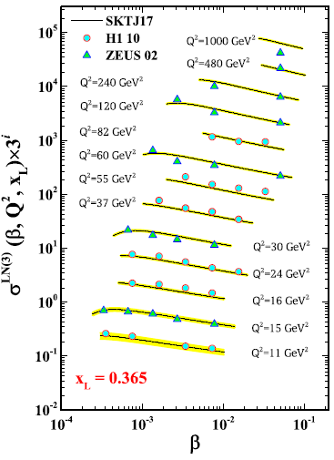
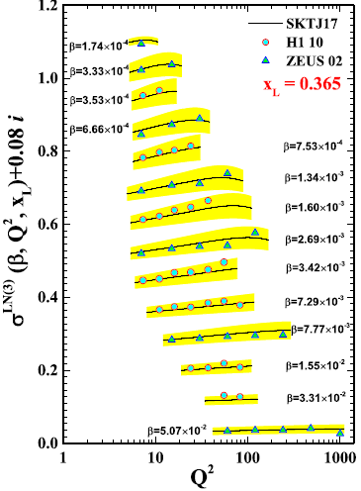
Collinear Frac.Func.: application to HERA data, 2
Shoeibi et al, Neutron fracture functions. PRD 95, 074011 (2017)

Slide 13
SIDIS TFR: Spin & TMD (STMD) Fracture Functions
Anselmino, Barone and AK, PL B 699 (2011)108; 706 (2011)46; 713 (2012)317
Nucleon and quark polarization are included, produced hadron and quark transverse momentum are not integrated over. Classification of twist-two Fracture Functions and cross sections expressions.

Slide 14
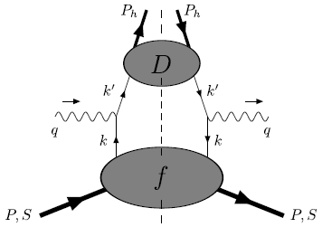
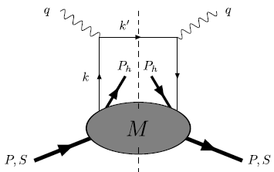
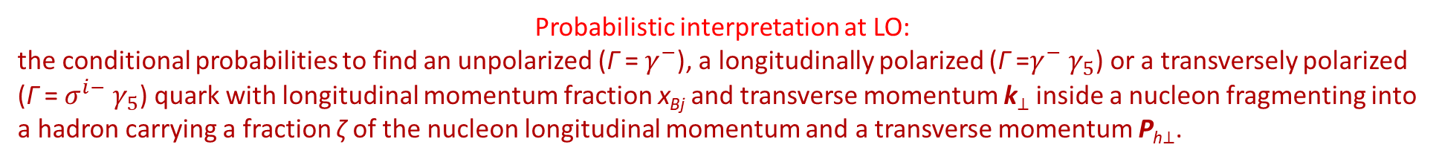
Quark correlator
SIDIS
CFR
TFR
Probabilistic interpretation at LO:
the conditional probabilities to find an unpolarized (Γ = $γ^{−}$), a longitudinally polarized (Γ =$γ^{−}$ $γ_{5}$) or a transversely polarized
(Γ = $σ^{i−}$ $γ_{5}$) quark with longitudinal momentum fraction x_{Bj} and transverse momentum k⊥ inside a nucleon fragmenting into
a hadron carrying a fraction ζ of the nucleon longitudinal momentum and a transverse momentum P_{h⊥}.

Slide 15
STMD Fracture Functions for spinless hadron production
 |  | Quark polarization
 |  | U | L | T
Nucleon Polarization | U
 | L
 | T
For STMD Fracture Functions
I was expecting 32 (Trentadue)
independent structures.
Fortunately, we end up with
only 16 of them at twist-2
STMD fracture functions depend on
Azimuthal dependence
in fracture functions
The contributions in CFR
are marked in red

Slide 16
Sum Rules connecting Fracture Functions to TMD PDFs
Integrating the fracture function over the longitudinal and transverse momentum of hadron in TFR and summing over all possible hadrons recover the corresponding quark TMD DF

Slide 17
Similar TMD Sum Rules for all TMD PDFs

Slide 18
LO cross-section in TFR
At LO (twist 2) only 4 terms out of 18 Structure Functions in SIDIS,
Only 2 azimuthal modulations
In single hadron production in TFR NO access
to final (struck) quark transverse polarization
No Collins-like sin(φ_{h}+φ_{S}) modulation

Slide 19
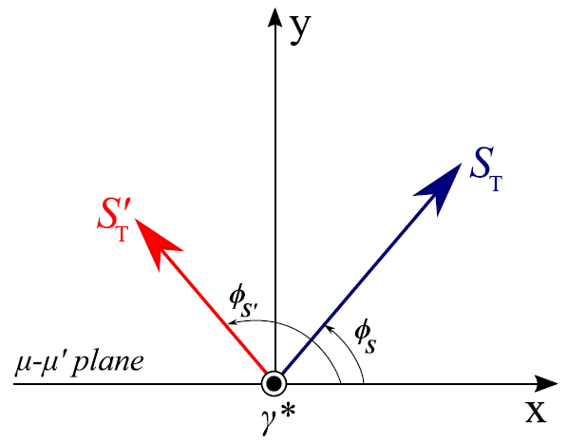
Quark transverse spin in hard l-q scattering
AK, Transversity workshop,
Yerevan, 2009
s_{T}
Nucleon and initial quark spin
Initial quark spin
TFR
Final quark spin
Final quark spin
CFR
If only one hadron in TFR of SIDIS is detected there is no final quark polarimetry.
→ STMD fracture functions depends on initial quark transverse polarization dependent fracture functions.
No Collins like modulation in TFR.

Slide 20
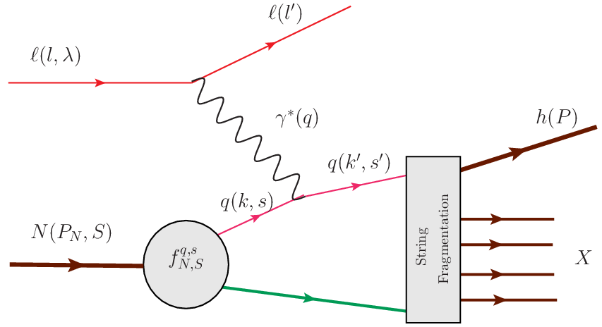
Hadronization Function in MC event generators (LEPTO, PYTHIA)
Hadronization Function modeled
by Lund String Fragmentation
Aram Kotzinian

Slide 21
Quark dynamics in MC even generators
- Before
- After hard scattering
(ud)₀
- Include k_{T} with isotropic azimuth
Modified, mLEPTO and mPYTHIA
Include k_{T} with anisotropic azimuthal modulation according Sivers function

Slide 22
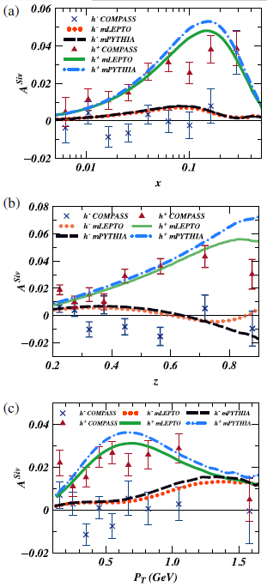
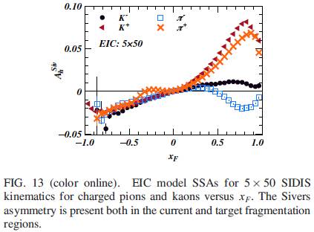
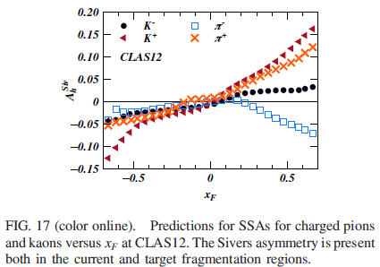
Sivers effect in the event generators
Matevosyan, AK, Aschenauer, Avakian, Thomas, PRD 92, 054028 (2015)
Only correlation of target S_{T} and struck quark k_{T}
is explicitly parametrized using Sivers PDFs.
Then this correlation is transferred
to produced hadrons via
unpolarized string fragmentation .

Slide 23
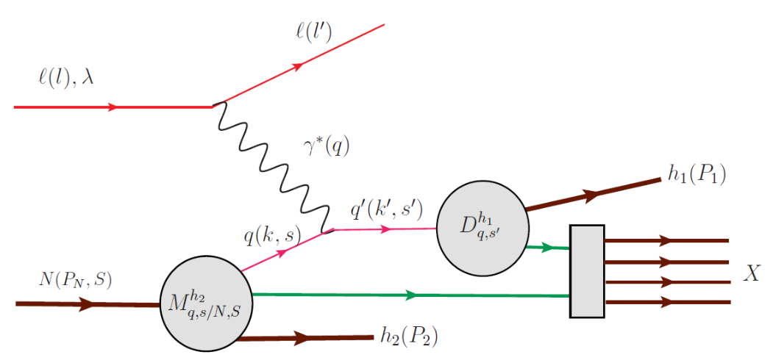
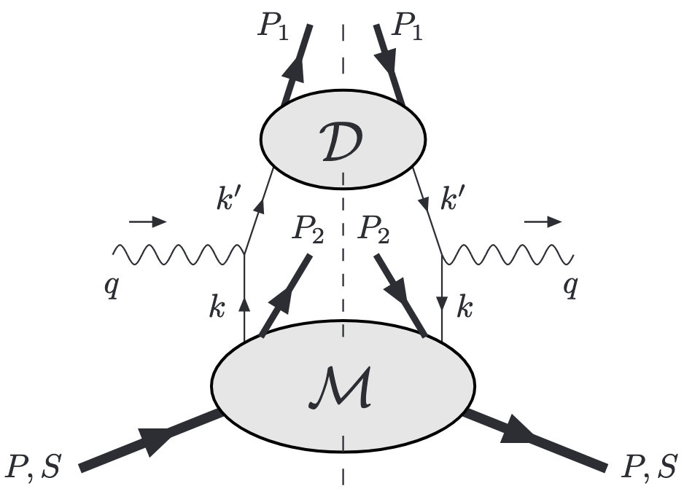
Double hadron production in DIS (DSIDIS): TFR & CFR
Access to final quark transverse momentum and polarization
Handbag diagram for dihadron production; lower blob contains Fracture Functions and upper blob contains the FFs.

Slide 24
Unintegrated DSIDIS LO cross-section: accessing quark polarization
DSIDIS cross section is a sum of
polarization independent, single
and double spin dependent terms
as in 1h SIDIS cross section.

Slide 25
DSIDIS azimuthal modulations
AK @ DIS2011

Slide 26
σ_{UL}

Slide 27
σ_{UT}

Slide 28
σ_{LU}, σ_{LL}, σ_{LT}

Slide 29
A_{LU} asymmetry, 1
Anselmino, Barone and AK, PLB 713 (2012) 317

Slide 30
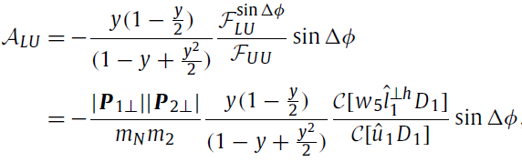
A_{LU} asymmetry, 2
Expected leading-twist asymmetry is proportional to sin($Δ$φ)

Slide 31

A_{LU} @ CLAS12, (1)
Timothy B. Hayward, H. Avakian and A.Kotzinian. (More details in T. Hayward’s talk)
Observed non-zero asymmetries are the first experimental confirmation of possible spin-orbit correlations between hadrons produced simultaneously in the CFR and TFR.
Observed linear dependence on the product of transverse momenta is consistent with expectations.
ep → e’pπ⁺X
Preliminary
ep → e’pπ⁺X
M_{x} > 0.9.5 GeV
x_{Fp} < 0, x_{Fπ} > 0, ΔY > 0
0.2 < z_{π} < 0.70 GeV
M_{h} > 1
M_{x} > 0.90 GeV
M_{h} > 1.5 GeV
x_{Fp} < 0, x_{Fπ} > 0, ΔY > 0
0.2 < z_{π} < 0.7
31

Slide 32
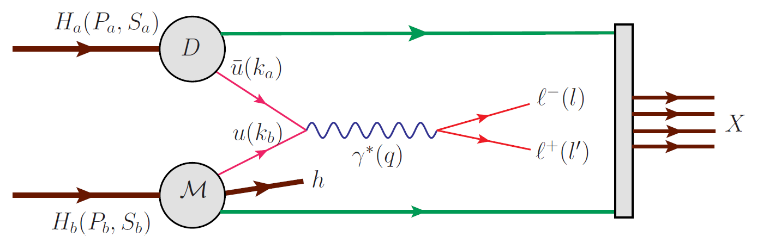
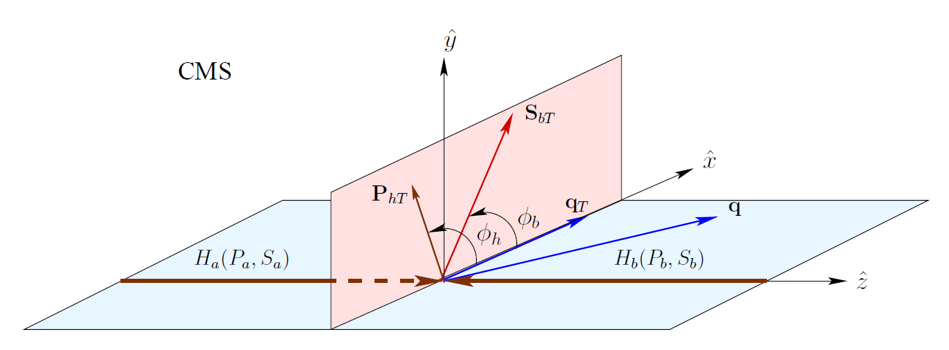
Polarized SIDY
STAR@RHIC?
Kinematics as in Arnold.Metz.Schlegel, PhysRevD.79.034005

Slide 33
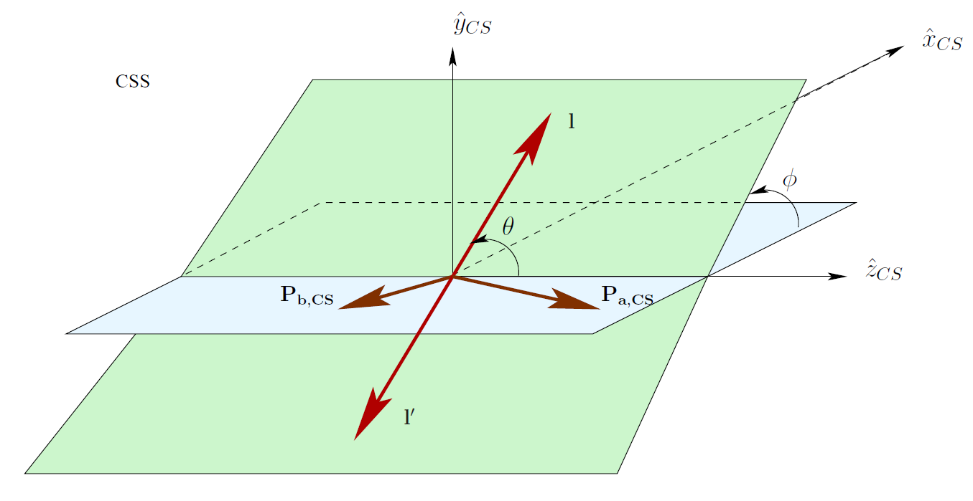
Collins-Soper system

Slide 34
SIDY cross section

Slide 35
σ_{UU}
 |  | Quark polarization
 |  | U | L | T
Nucleon Polarization | U | * |  | *
 | L
 | T

Slide 36
σ_{UL}
Detected hadron originates from longitudinally polarized nucleon remnant (hadron b in reaction diagram).
 |  | Quark polarization
 |  | U | L | T
Nucleon Polarization | U |  | * | *
 | L
 | T

Slide 37

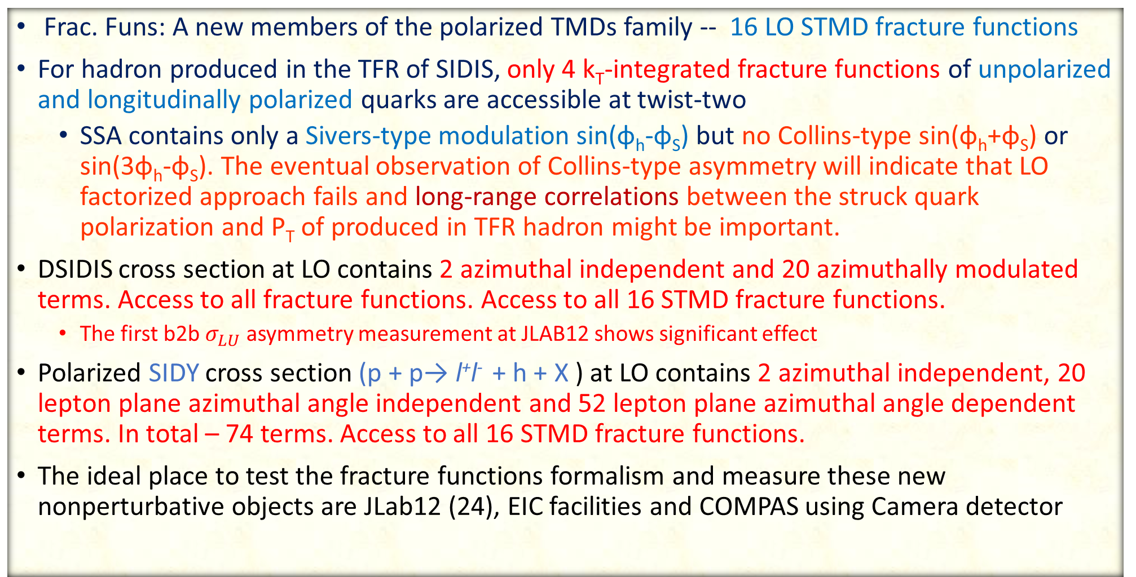
Conclusions
Frac. Funs: A new members of the polarized TMDs family -- 16 LO STMD fracture functions
For hadron produced in the TFR of SIDIS, only 4 k_{T}-integrated fracture functions of unpolarized and longitudinally polarized quarks are accessible at twist-two
  SSA contains only a Sivers-type modulation sin(φ_{h}-φ_{S}) but no Collins-type sin(φ_{h}+φ_{S}) or sin(3φ_{h}-φ_{S}). The eventual observation of Collins-type asymmetry will indicate that LO factorized approach fails and long-range correlations between the struck quark polarization and P_{T} of produced in TFR hadron might be important.
DSIDIS cross section at LO contains 2 azimuthal independent and 20 azimuthally modulated terms. Access to all fracture functions. Access to all 16 STMD fracture functions.
  The first b2b $σ_{LU}$ asymmetry measurement at JLAB12 shows significant effect
Polarized SIDY cross section (p + p→ l⁺l⁻ + h + X ) at LO contains 2 azimuthal independent, 20 lepton plane azimuthal angle independent and 52 lepton plane azimuthal angle dependent terms. In total – 74 terms. Access to all 16 STMD fracture functions.
The ideal place to test the fracture functions formalism and measure these new nonperturbative objects are JLab12 (24), EIC facilities and COMPAS using Camera detector

Slide 38
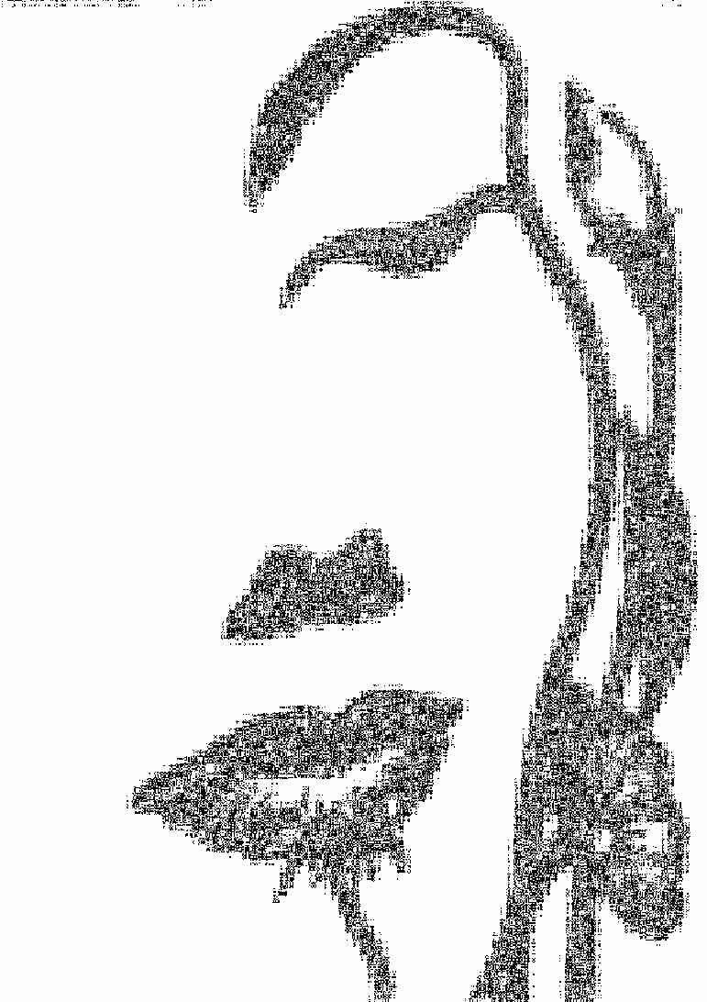
x_{F}
1
CFR
0
-1

Slide 39
x_{F}
1
Larger phase space
0
-1

Slide 40

x_{F}
1
Better statistics
0
-1

Slide 41
x_{F}
1
TFR with good
statistics
0
-1

Slide 42
x_{F}
1
Full picture
0
-1

Slide 43
Additional slides : LO SIDY cross section

Slide 44
Convolutions & tensorial decomposition

Slide 45
Structure functions

Slide 46
σ_{UU}
 |  | Quark polarization
 |  | U | L | T
Nucleon Polarization | U | * |  | *
 | L
 | T

Slide 47
σ_{UL}
 |  | Quark polarization
 |  | U | L | T
Nucleon Polarization | U
 | L | * |  | *
 | T

Slide 48
σ_{UT}
 |  | Quark polarization
 |  | U | L | T
Nucleon Polarization | U
 | L
 | T | * |  | *

Slide 49
σ_{LU}
 |  | Quark polarization
 |  | U | L | T
Nucleon Polarization | U |  | * | *
 | L
 | T

Slide 50
σ_{LL}
 |  | Quark polarization
 |  | U | L | T
Nucleon Polarization | U
 | L |  | * | *
 | T

Slide 51
σ_{LT}
 |  | Quark polarization
 |  | U | L | T
Nucleon Polarization | U
 | L
 | T |  | * | *

Slide 52
σ_{TU}
 |  | Quark polarization
 |  | U | L | T
Nucleon Polarization | U | * | * | *
 | L
 | T

Slide 53
σ_{TL}
 |  | Quark polarization
 |  | U | L | T
Nucleon Polarization | U
 | L |  | * | *
 | T

Slide 54
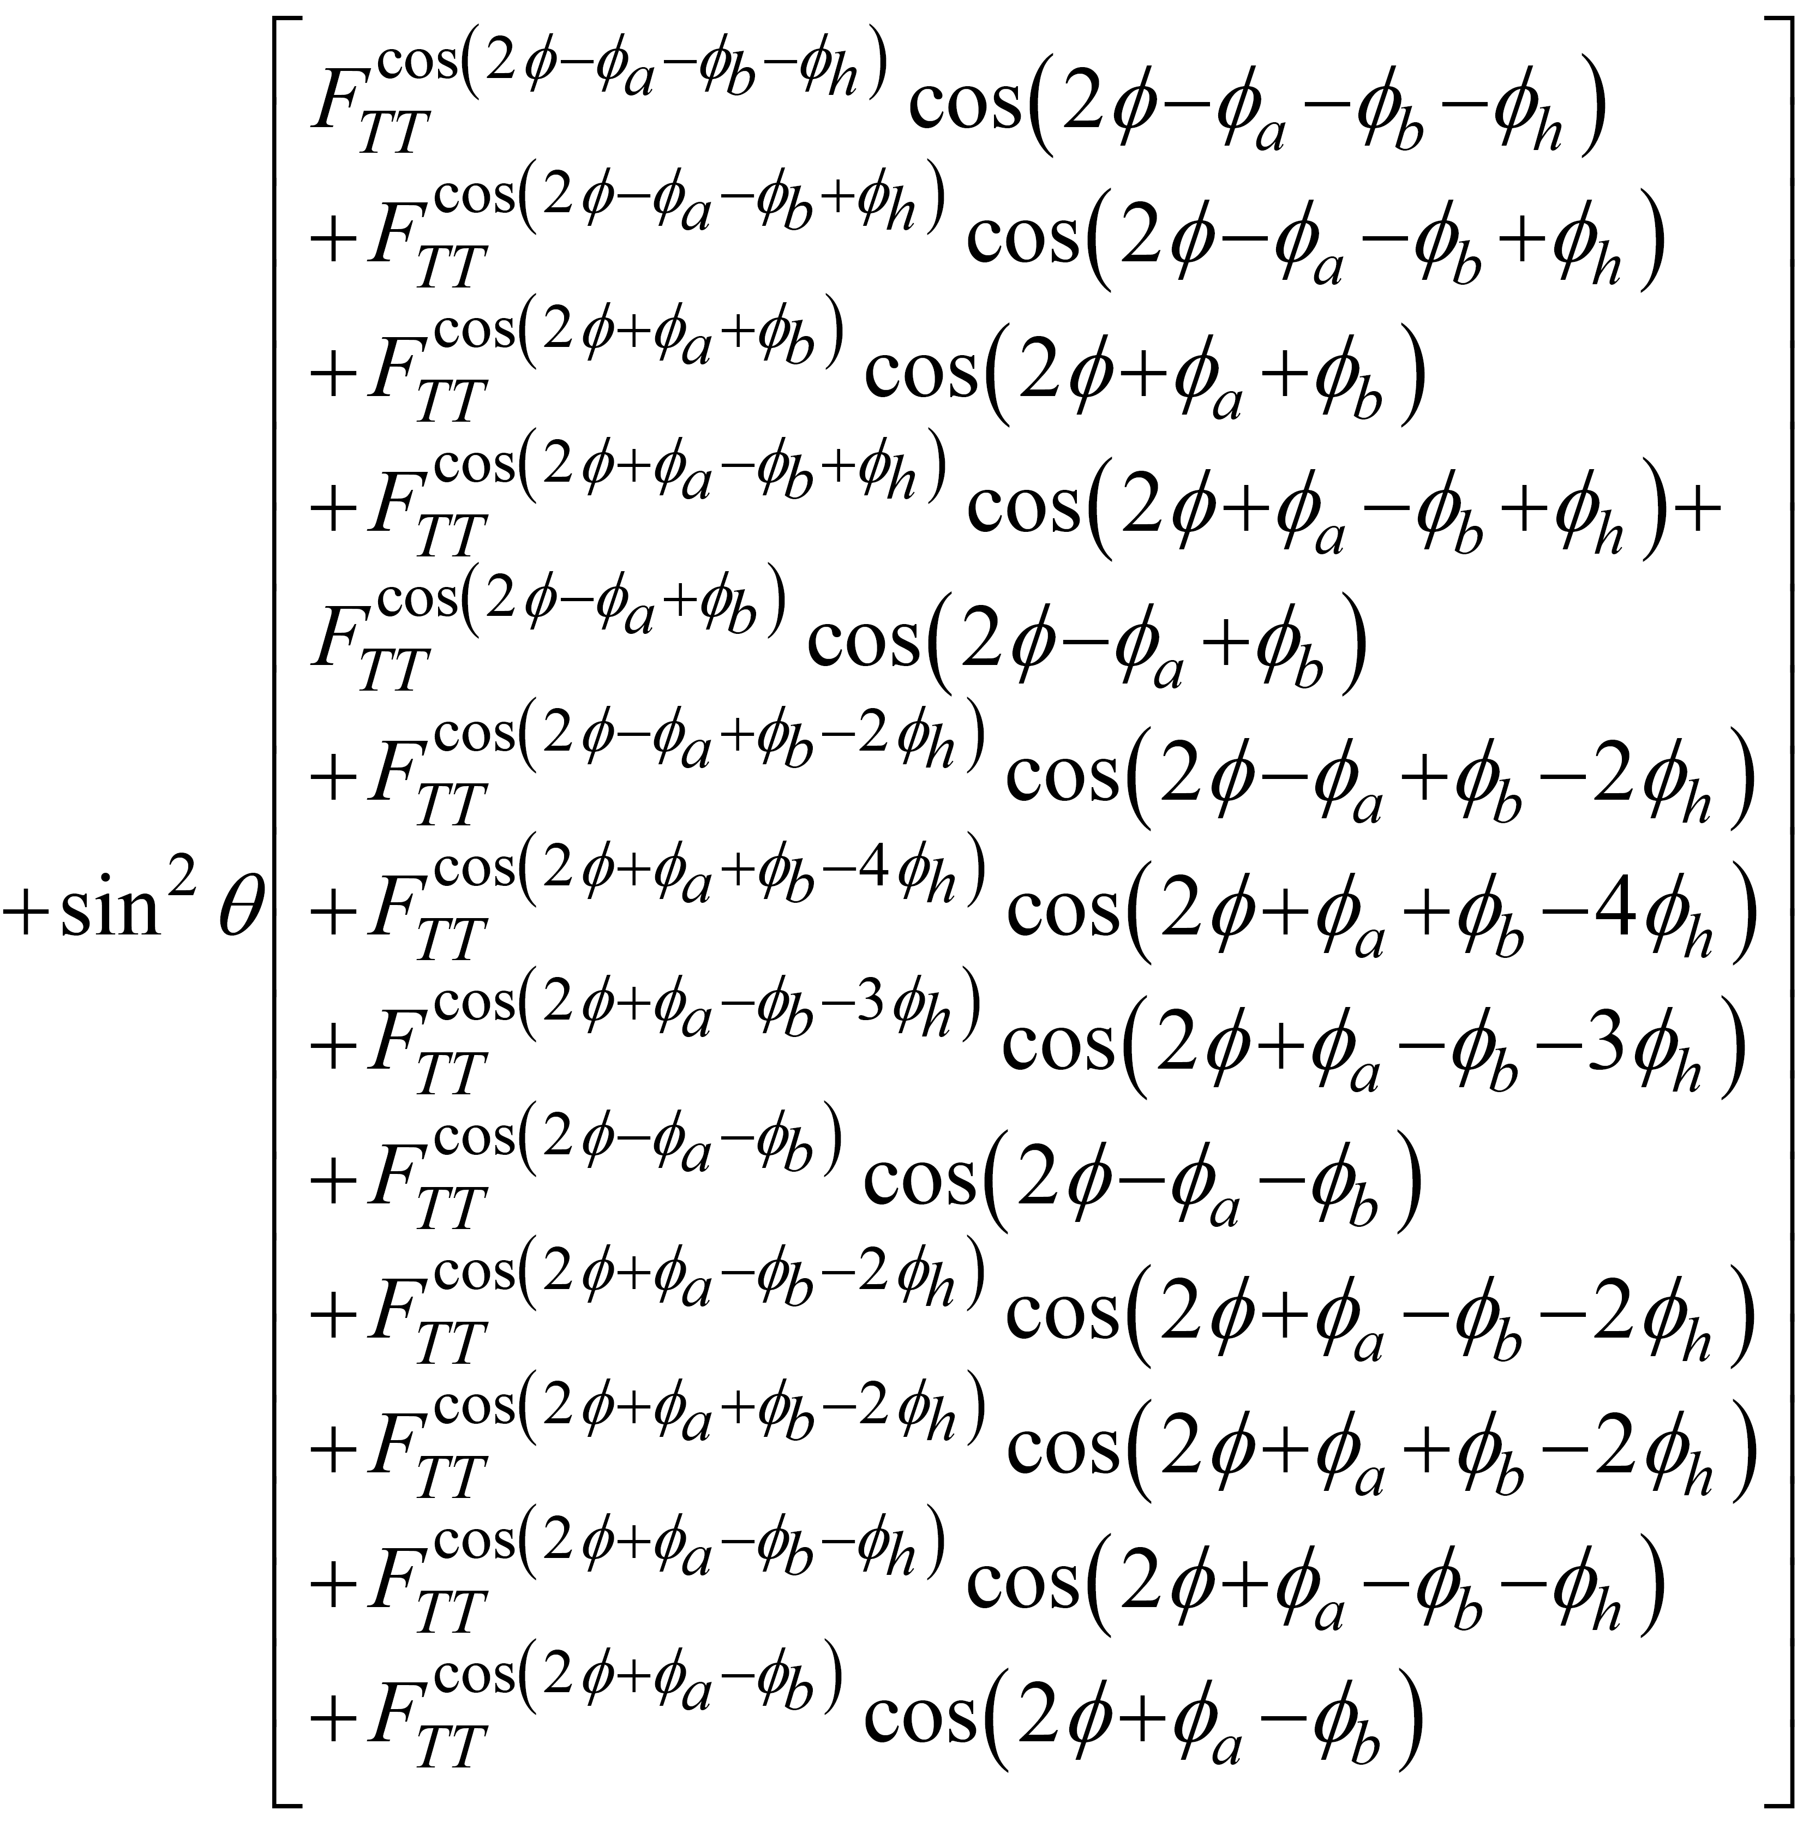
σ_{TT}
 |  | Quark polarization
 |  | U | L | T
Nucleon Polarization | U
 | L
 | T | * | * | *

Slide 55
Structure functions of σ_{UU}, σ_{UL}, σ_{UT}

Slide 56
Structure functions of σ_{LU}, σ_{LL}

Slide 57
Structure functions of σ_{LT}

Slide 58
Structure functions of σ_{TU}

Slide 59
Structure functions of σ_{TL}

Slide 60
Structure functions σ_{TT}

