Slide 1
Feasibility study of X(3872) and Tcc in LHC Run3 and 4
$$\overline{u}$$
c
$$\overline{u}$$
c
Beomkyu Kim
Sungkyunkwan University
ExHIC
$$\overline{d}$$
u
$$\overline{c}$$
c

Slide 2
Physics motivation – Tcc
LHCb measured ‘double charmed $Ξ_{cc}$ (ucc) baryon (arXiv:1806.02744) which could imply a stable doubly-charmed tetraquark
Tcc: The lightest doubly charmed tetraquark
Spin: $I\left(J^{P}\right)=0(1^{+})$
$$D^{0}$$
$$D^{∗+}$$
$$\overline{u}$$
+
c
$$\overline{u}$$
c
c
$$\overline{d}$$
$$\overline{d}$$
c

Slide 3
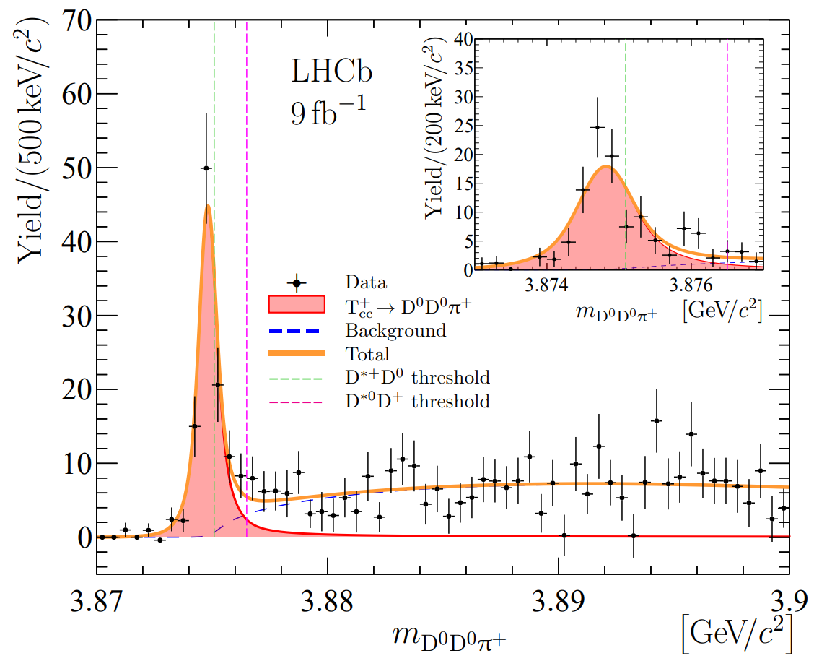
Physics motivation – Tcc
Finally, LHCb reported the discovery of Tcc in 2021 (arXiv:2109.01038)
$$2<η<5$$
Parameter | Value
N $$σ_{T_{cc}}→D^{0}D^{∗+}$$ | $$117±16$$ $\sim 13±2$ fb
$δm_{BW}$ ($m_{BW}−m_{D^{0}D^{∗+}}$) | $−273±61$ keV
$$Γ_{BW}$$ | $410±165$ keV

Slide 4
Physics motivation – X (3872)
First seen by the Belle in 2003 and confirmed by BaBar, CDF, and D0 quickly
Controversial for a new excited charmonium state, molecular states, or tetra-quark
Spin measured by LHCb: $1^{++}$→ charmonium unlikely
$$D^{0}$$
$$\overline{D^{∗0}}$$
$$\overline{u}$$
+
c
$$\overline{u}$$
$$\overline{c}$$
c
u
u
$$\overline{c}$$

Slide 5
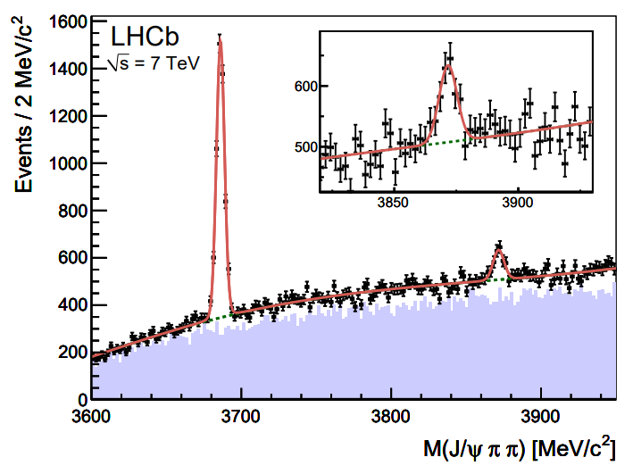
Physics motivation – X (3872)
LHCb first reported X (3872) in pp collisions among the LHC Experiments
$$2.5<η<4.5$$
$5<p_{T}<20$ GeV/c
$34.7$ $pb^{−1}$
Parameter | Value
N | $$565±62$$
$$σ_{X}→π^{+}π^{−}J/ψ$$ | $\sim 5.4$ nb
$δm_{BW}$ ($m_{BW}−m_{D^{0}D^{∗+}}$) | $−273±61$ keV
$$Γ_{BW}$$ | $410±165$ keV
$$ψ(2S)$$
$$X(3872)$$
Eur.Phys.J.C 72 (2012) 1972
$X\left(3872\right)→π^{+}π^{−}J/ψ$ (4.1%), $D^{∗0}{\overline{D}}^{0}$ (52.4%*1.6%)
Phys.Rev.D 100 (2019) 9, 094003

Slide 6
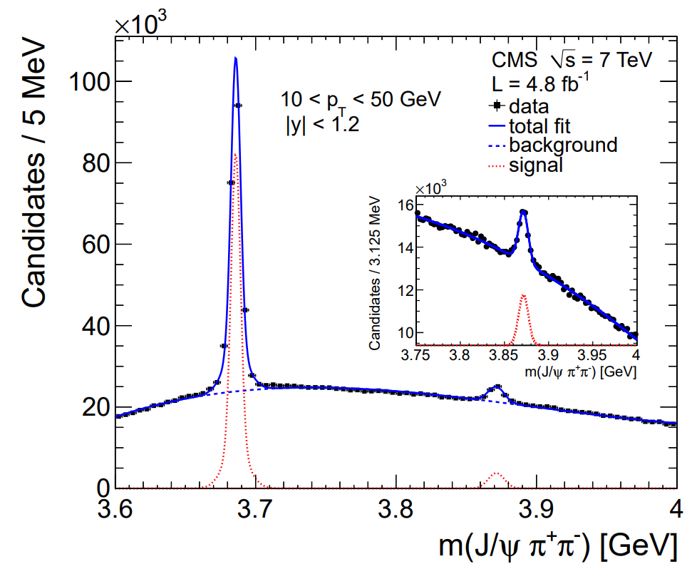
Physics motivation – X (3872)
LHCb first reported X (3872) in pp collisions among the LHC Experiments
 | Value
$$σ_{X}→π^{+}π^{−}J/ψ$$ | $\sim 1$ nb
$$σ_{X, NRQCD}→ π^{+}π^{−}J/ψ$$ Phys. Rev. D 81 (2010) 114018 | $\sim 4$ nb
$$ψ(2S)$$
$$X(3872)$$
JHEP 04 (2013) 154
$X\left(3872\right)→π^{+}π^{−}J/ψ$ (4.1%), $D^{∗0}{\overline{D}}^{0}$ (52.4%)
Phys.Rev.D 100 (2019) 9, 094003

Slide 7
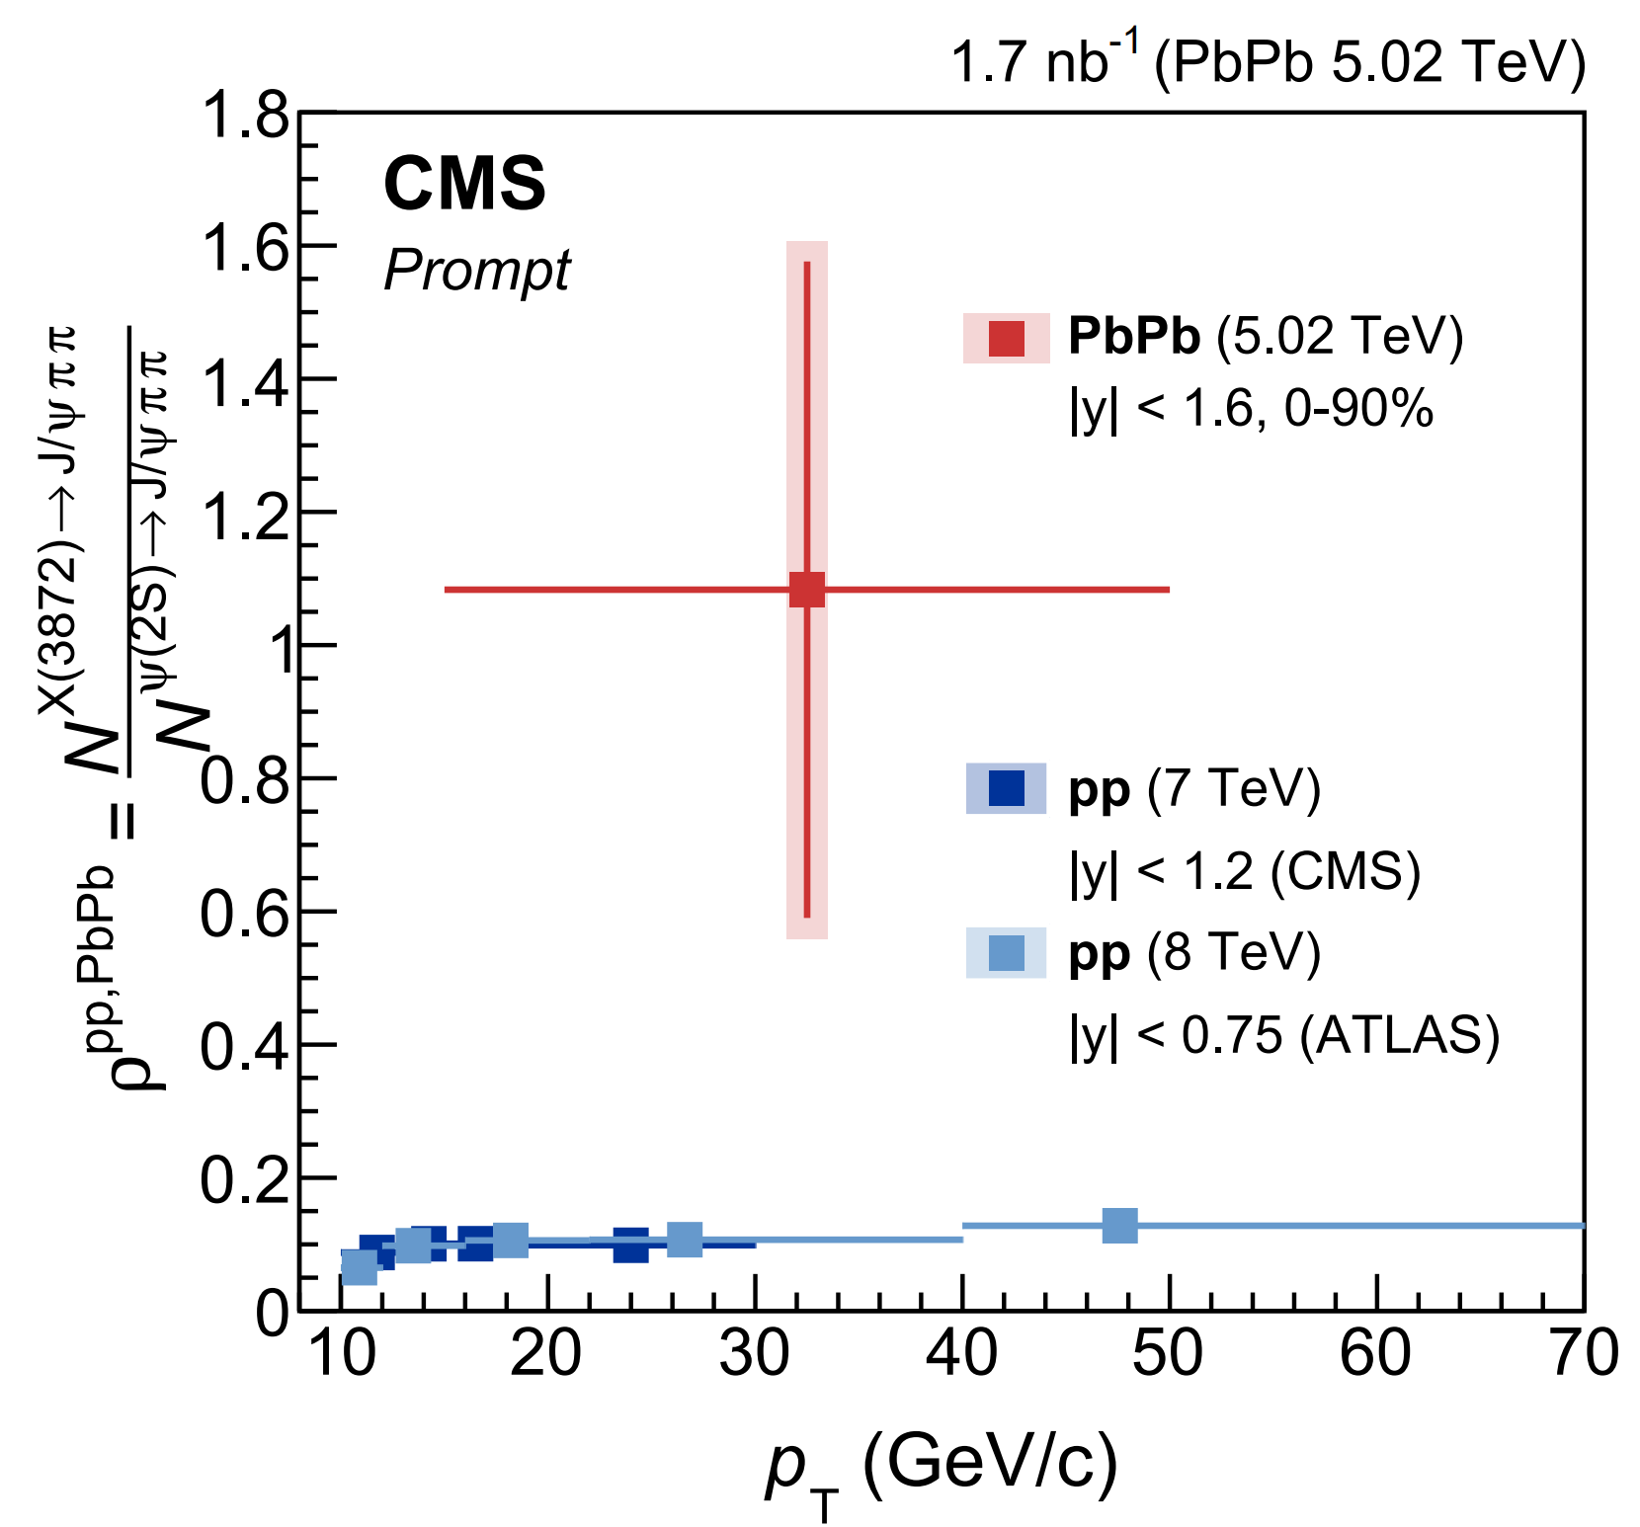
Physics motivation – X (3872)
QGP modifying the production rate depending on its physical size: First measurement by CMS via $X→J/ψππ$
PRL 128 (2022) 3, 032001
(ALICE-PUBLIC-2021-001)
6.8 billion events
Still the large statistical error
Either no suppression or suppression as $ψ(2S)$ with respect to pp collisions is sill open question
Run 3 can help to answer on it
Medium effect essential to study the internal structure of exotic particles -> Statistical improvement demanded
Notes:
If the resonance is large, it is easier to get destroyed by the surrounding activity, and CMS physicists plan to use this interaction with the medium to provide valuable input into understanding the composition of the X(3872) resonance. link

Slide 8
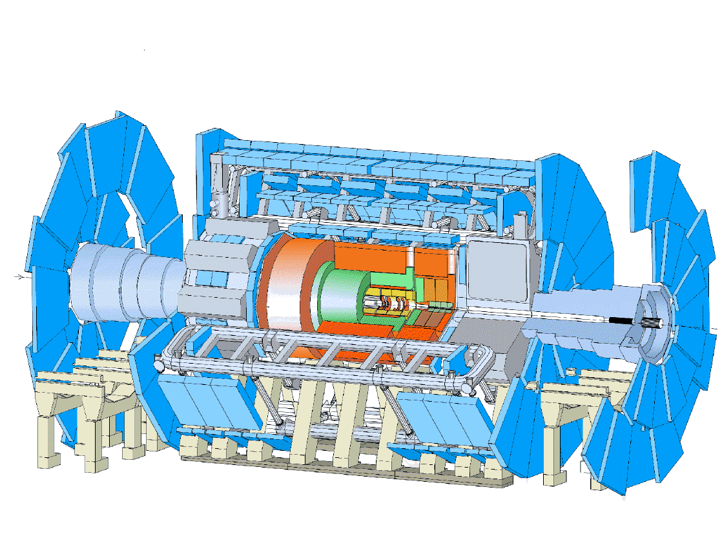
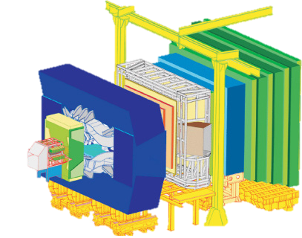
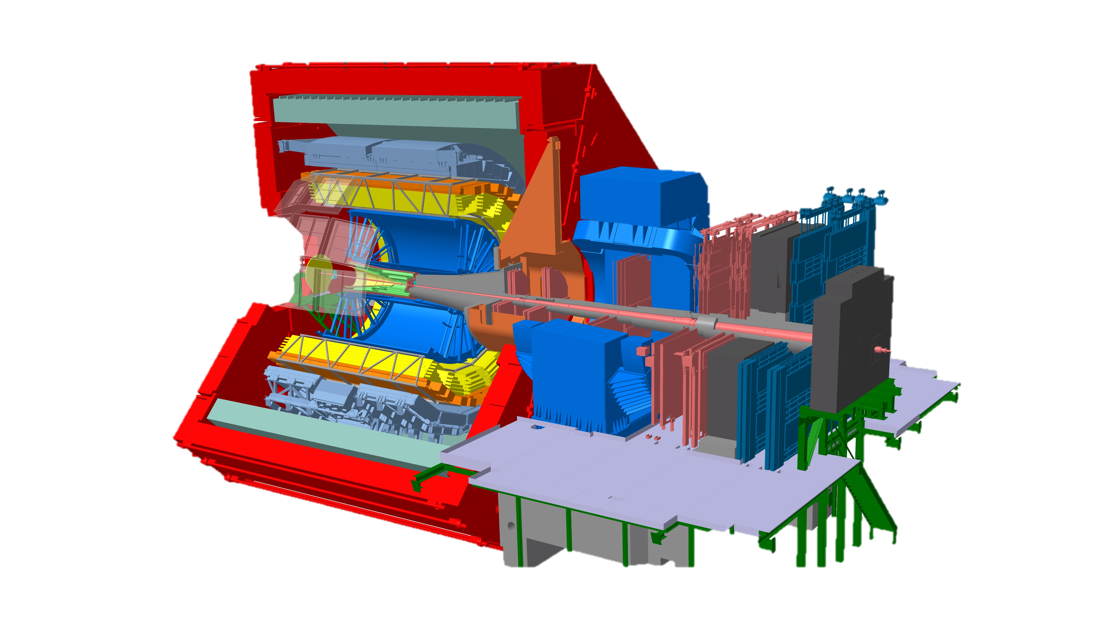
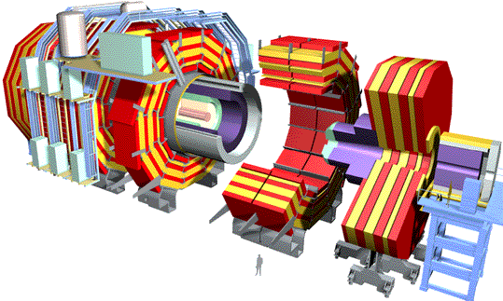
ALICE (A Large Ion Collider Experiment)
$${Pb}^{82+}$$
27 km
LHCb
ATLAS
CMS
ALICE
$\sqrt{s}=13.6, \sqrt{s_{NN}}=$5.36 TeV
8
Notes:
LHC setting for proton beam energy of 6.8 TeV, Pb-Pb $\sqrt{s}$ = 5.36 TeV achieved

Slide 9
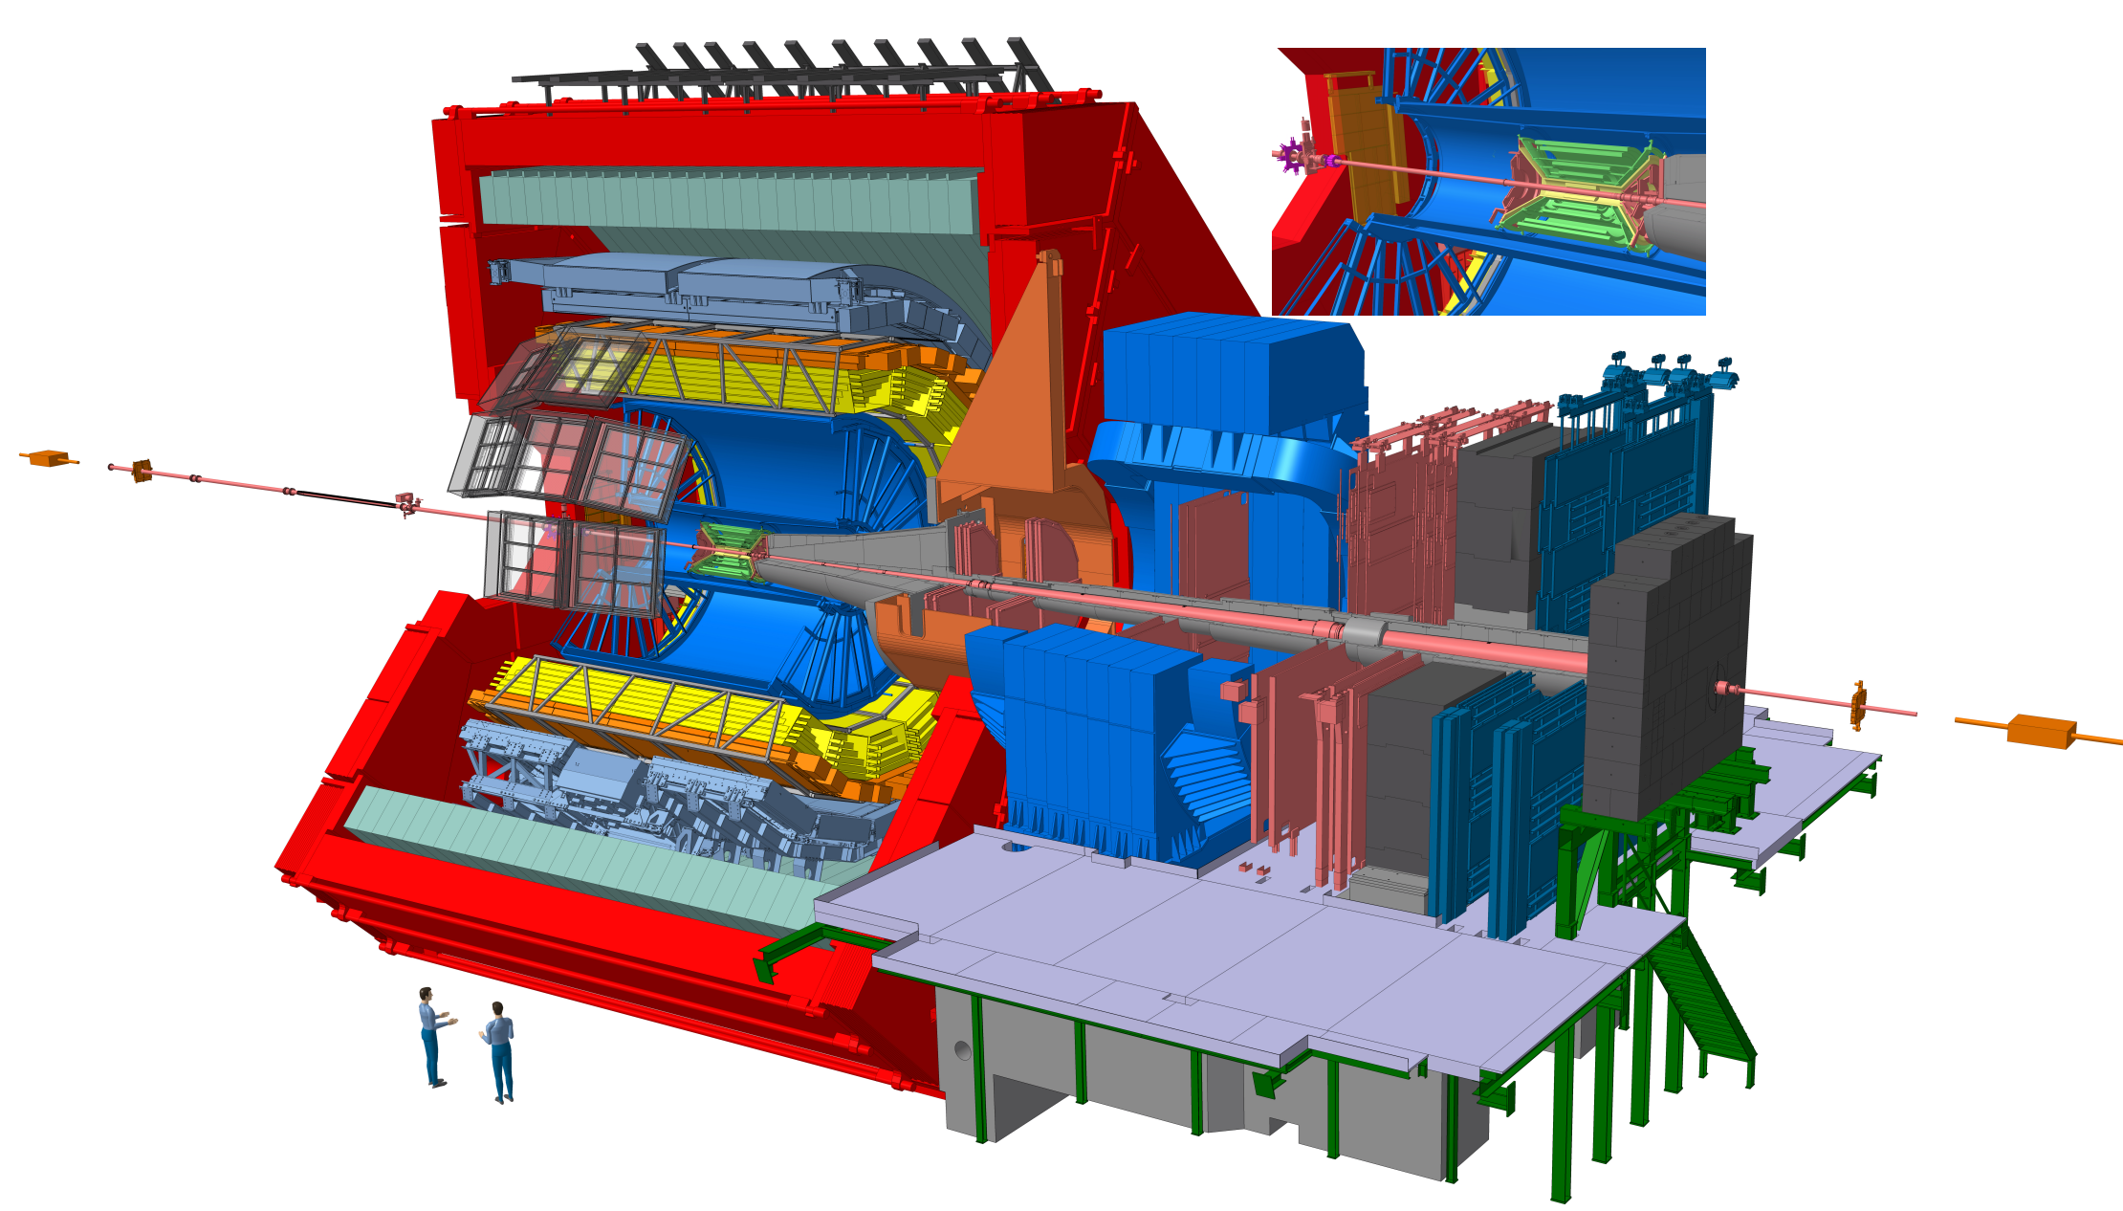
ALICE 1 (2009-2018)
Time Projection Chamber
Track reconstruction
Particle ID
Inner Tracking System
Track reconstruction
Primary and second vertices reconstruction
V0 detectors
Trigger
Multiplicity estimation
ALICE Schematics - CERN Document Server

Slide 10
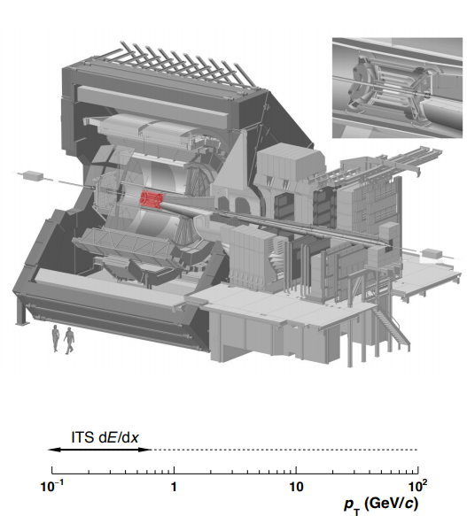
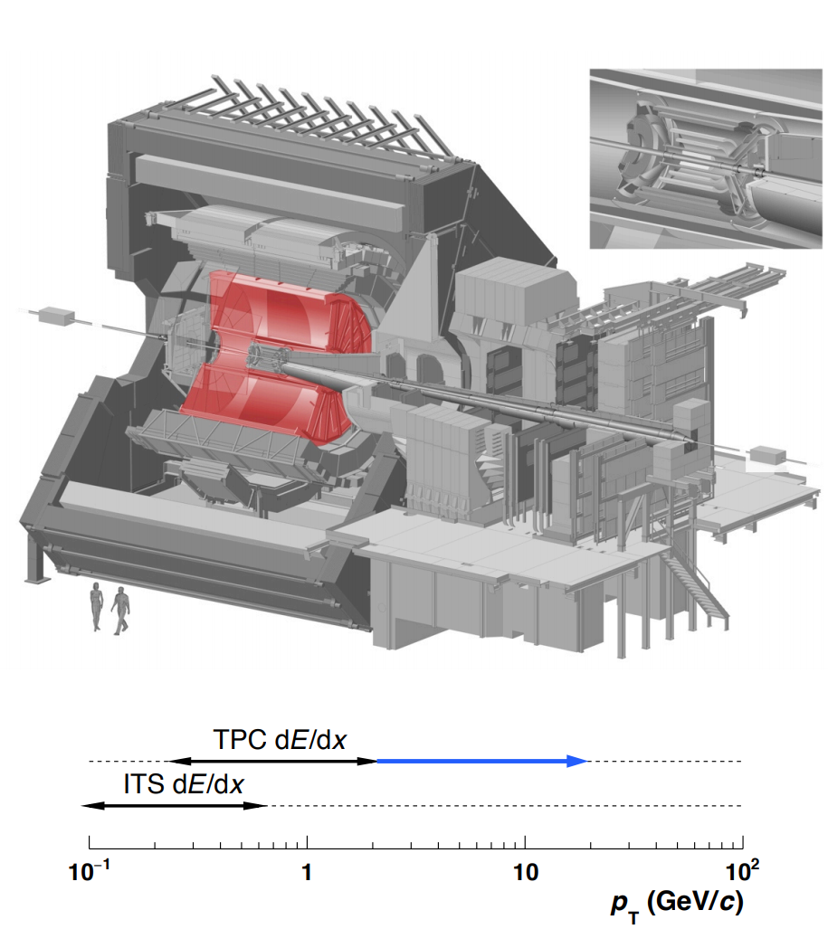
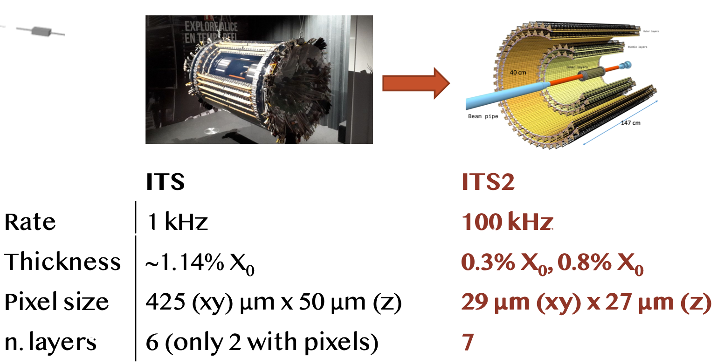
ALICE 1 (2009-2018)
I kHz
ITS ($\left|η\right|<0.9$)
6 layers of Si detector
Trigger, tracking, vertex, PID
TPC ($\left|η\right|<0.9$)
Gas detector
Tracking, vertex, PID
ALICE Schematics - CERN Document Server
Data taking speed limited by the slow reaction of ITS and TPC by maximum operation at 1 kHz

Slide 11
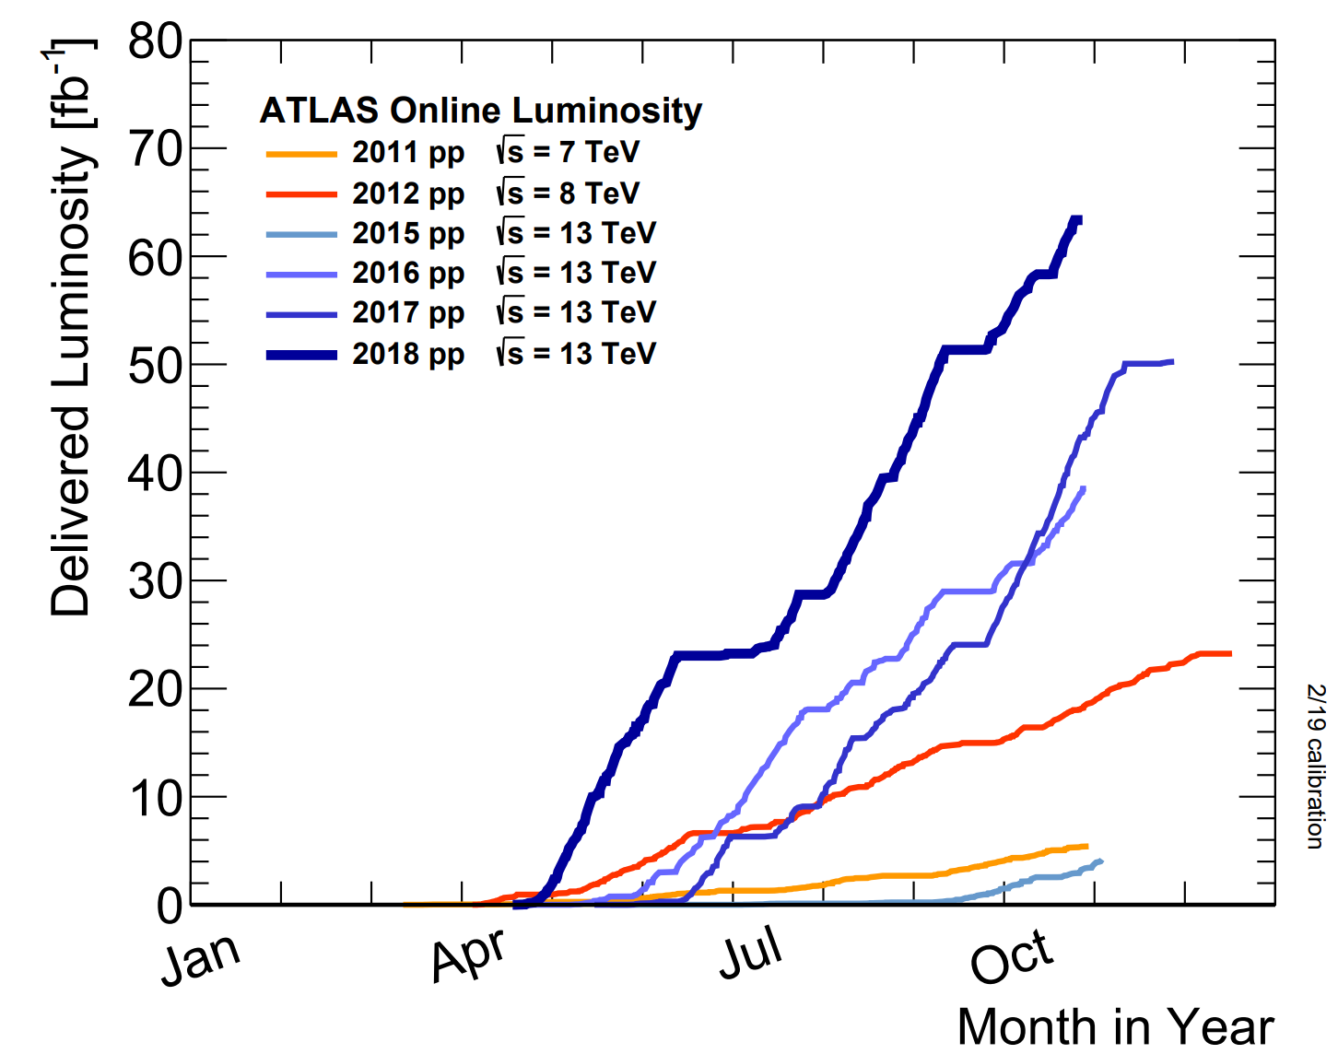
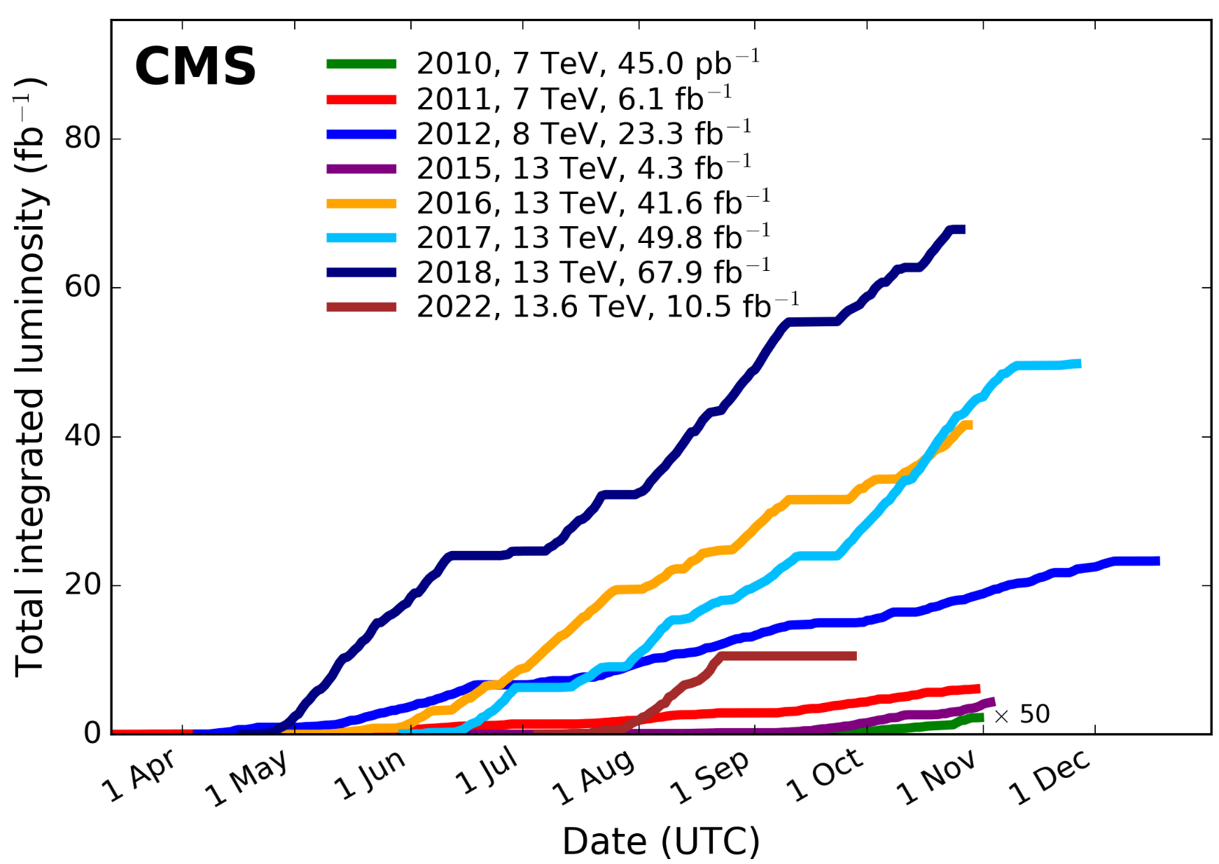
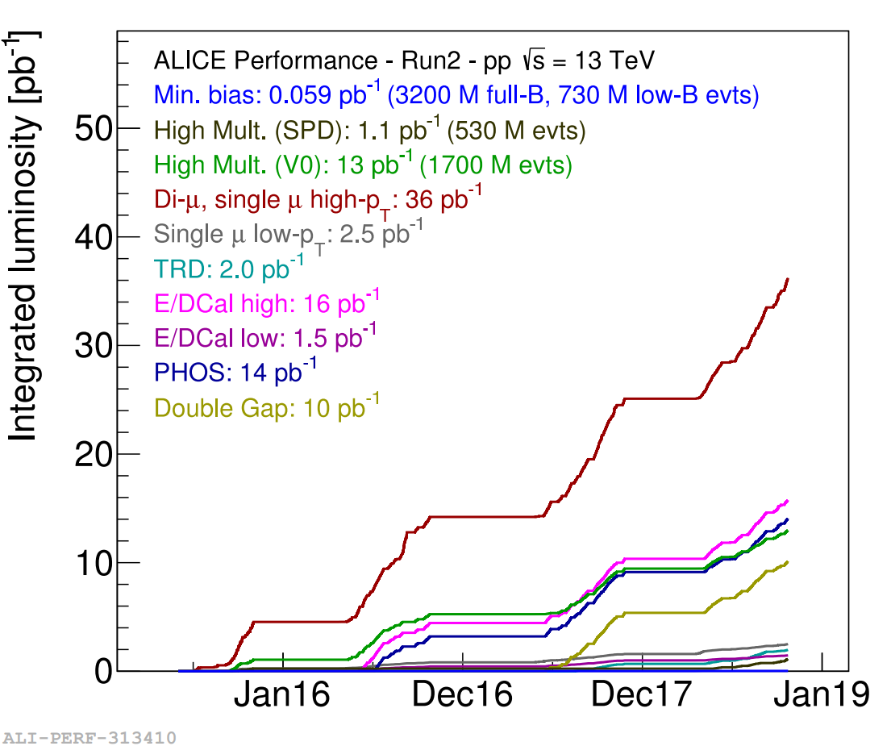
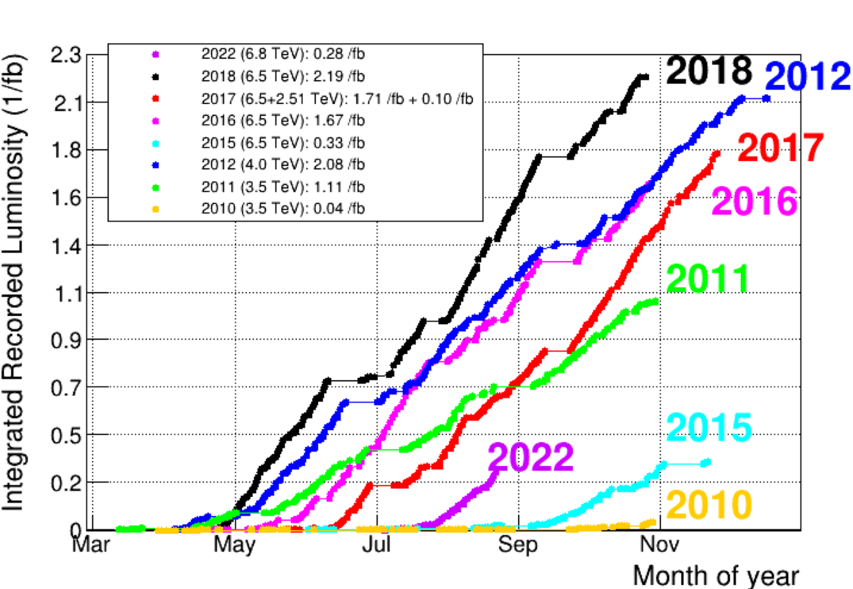
pp data collection (2009-2018, Run1 & 2)
pp INEL cross-section ~ $σ_{INEL}^{pp}\sim 60 mb$
RUN1
(2009-2013)
LS1
2014
RUN2
2015-2018
~6 quadrillion pp events
~6 quadrillion pp events
CMS
~4 billion MB pp events
~0.5 quadrillion pp events
ATLAS
ALICE
LHCb
Notes:
Pp data taking is not of great interest for ALICE.
But the reference pp data taking is lower than CMS ATLAS

Slide 12
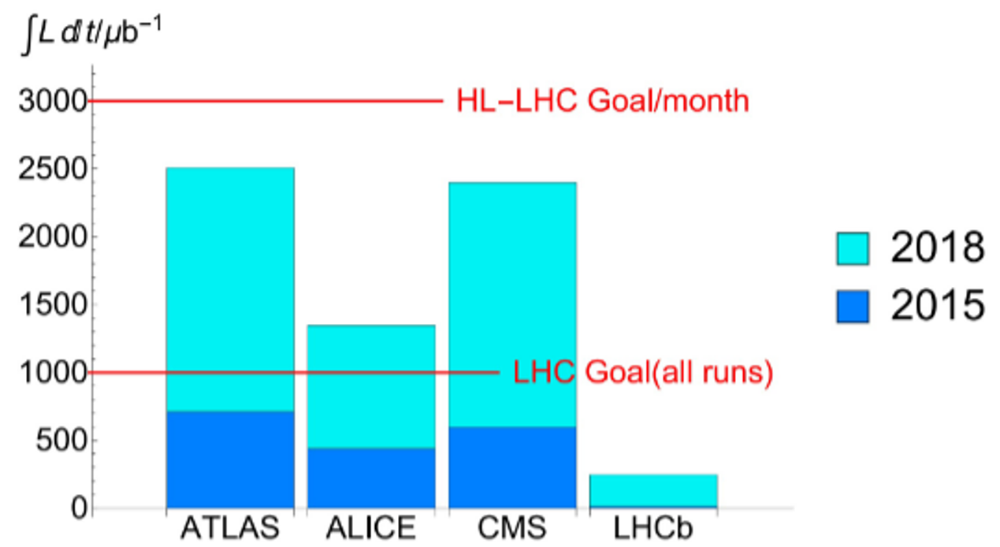
Pb-Pb data collection (2009-2018, Run1 & 2)
Hadronic cross-section ~ $σ_{hadronic}^{Pb−Pb}\sim 4 b$
RUN1
(2009-2013)
LS1
2014
RUN2
2015-2018
Experiment | $N_{evt}$ (roughly)
ALICE | 5 billions
ATLAS | 12 billions
CMS | 12 billions
LHCb | 0.8 billion

Slide 13
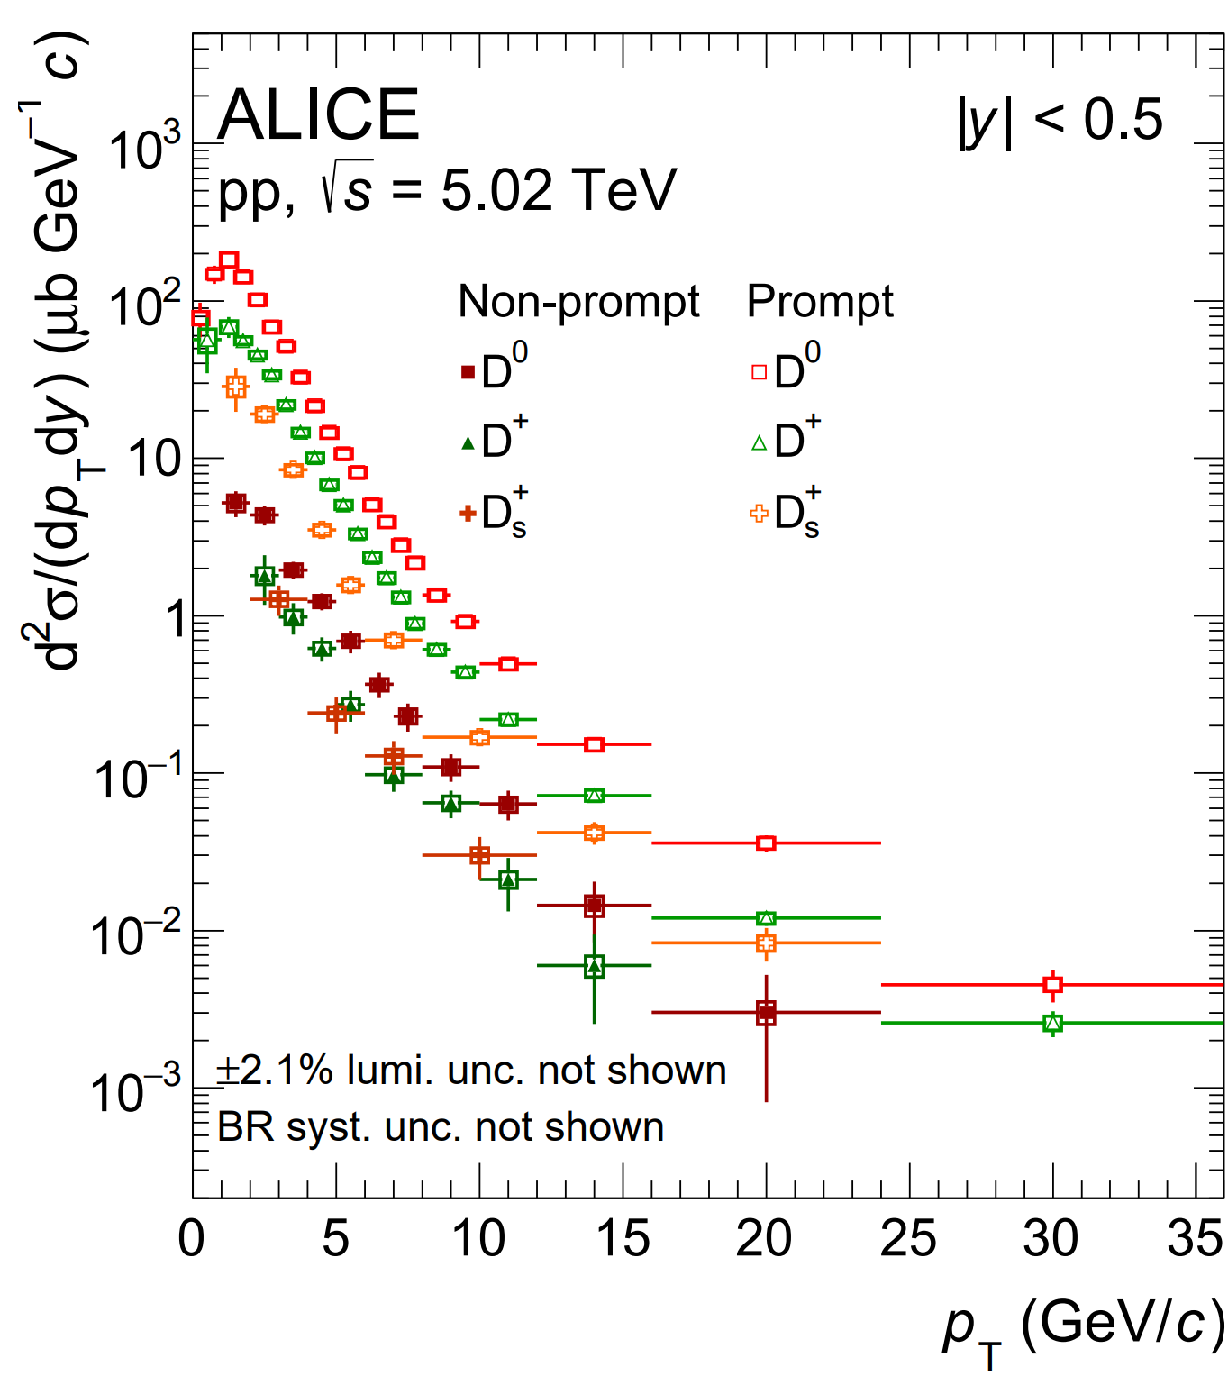
pp data $D^{0}, D^{+},$ and $D^{∗+}$ yield
pp INEL cross-section ~ $σ_{INEL}^{pp}\sim 60 mb$
 | $dσ/dy$ ($μb$)
$$D^{0}$$ | $$447±20±30$$
$$D^{+}$$ | $$184±13±13$$
$$D^{∗+}$$ | $$178±15±14$$
$$D_{s}^{+}$$ | $$95±9±10$$
Production cross sections of prompt D mesons in $\left|y\right|<0.5$ in pp collisions at $\sqrt{s}$ = 5.02 TeV
JHEP 05 (2021) 220
EPJC volume 79, Article number: 388 (2019)

Slide 14
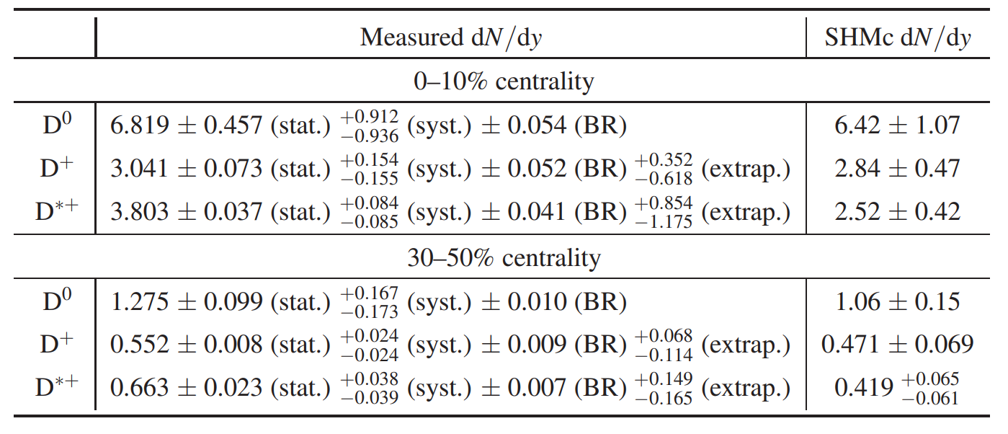
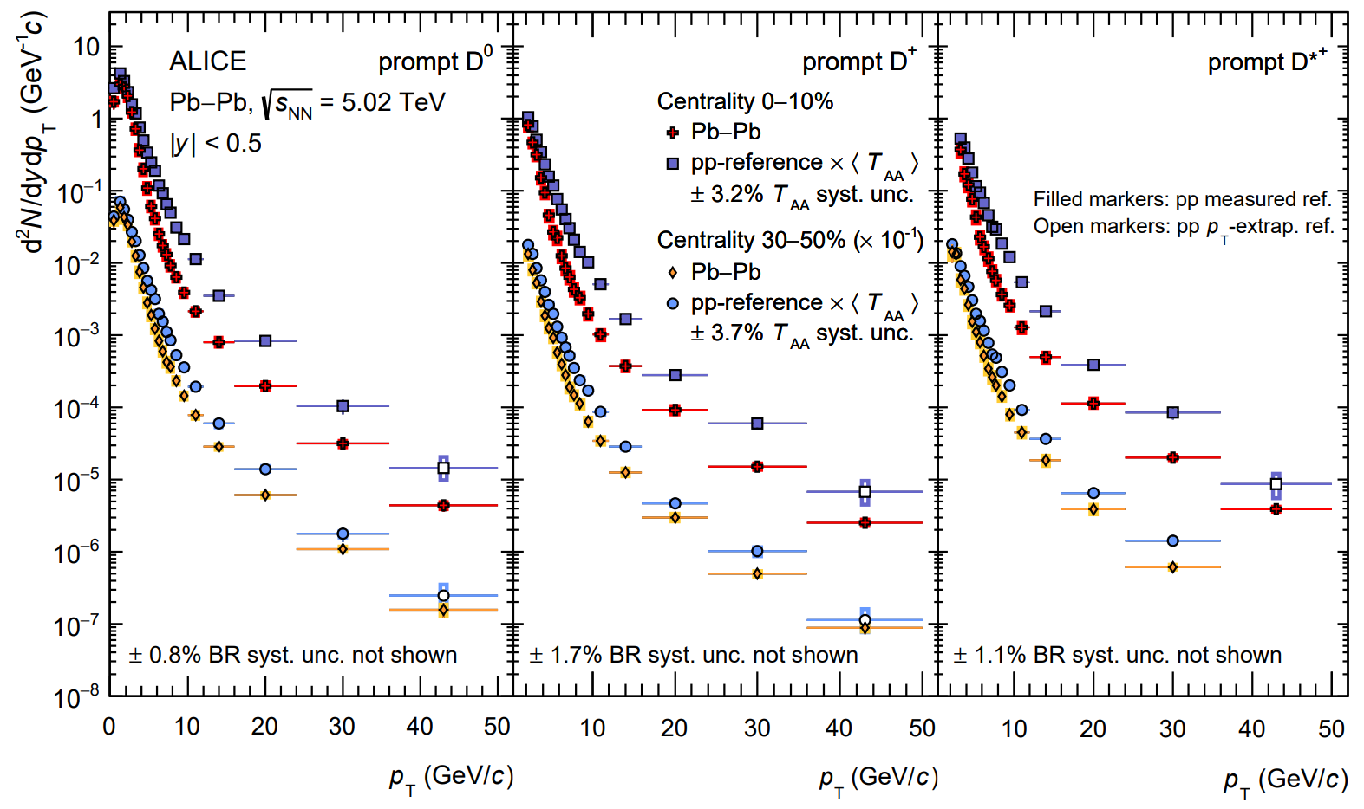
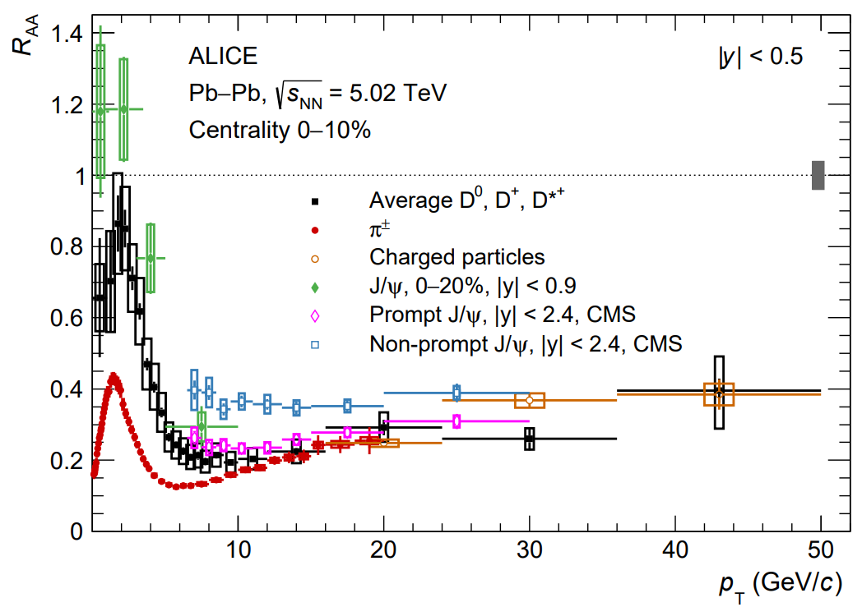
Pb-Pb data $D^{0}, D^{+}, and D^{∗+}$ production
JHEP 01 (2022) 174

Slide 15
Expected # of X in Run 1 and Run 2 (pp)
$$σ\left(X→π^{+}π^{−}J/ψ\right)\sim 5.4 nb$$
$$σ\left(X→D^{∗0}{\overline{D}}^{0} →γ\left(π^{0}\right)KπKπ\right)\sim 1nb$$
Experiment | pp $ℒ_{int}$ | $$X→π^{+}π^{−}J/ψ$$ # of X | $$X→γ\left(π^{0}\right)KπKπ$$ # of X
ALICE | 0.059 ${pb}^{−1}$ (MB) | ~300 | ~60
 | 13 ${pb}^{−1}$ (HM) | ~$7×{10}^{4}$ | ~$1.3×{10}^{4}$
ATLAS | >100 ${fb}^{−1}$ | $$5.4×{10}^{8}$$ | ~$1×{10}^{8}$
CMS | >100 ${fb}^{−1}$ | $$5.4×{10}^{8}$$ | ~$1×{10}^{8}$
LHCb | ~ 9 ${fb}^{−1}$ | $$5.4×{10}^{7}$$ | ~$9×{10}^{6}$

Slide 16
Expected # of Tcc in Run 1 and Run 2 (pp)
$σ(T_{cc}→D^{0}D^{∗+}→3π2K)$ ~ 13 fb
Experiment | pp $ℒ_{int}$ | # of Tcc
ALICE | 0.059 ${pb}^{−1}$ (MB) | ~$7×{10}^{−4}$
 | 13 ${pb}^{−1}$ (HM) | ~$0.2$
ATLAS | >100 ${fb}^{−1}$ | $$\sim 1300$$
CMS | >100 ${fb}^{−1}$ | $$\sim 5×{10}^{8}$$
LHCb | ~ 9 ${fb}^{−1}$ | $$\sim 5×{10}^{7}$$

Slide 17
Expected # of X in Run 1 and Run 2 (Pb-Pb)
$$σ_{PbPb}\left(0−10\%\right)\sim R_{AA}(1)×0.1×66 (σ_{PbPb}/σ_{pp})×N_{coll}(1572)$$
$$σ_{PbPb} \left(X→π^{+}π^{−}J/ψ\right)\sim 56 μb$$
$$σ\left(X→D^{∗0}{\overline{D}}^{0} →γ\left(π^{0}\right)KπKπ\right)\sim 10 μb$$
Experiment | Pb-Pb $ℒ_{int}$ | $$X→π^{+}π^{−}J/ψ$$ # of X | $X→D^{∗0}{\overline{D}}^{0}$($γ\left(π^{0}\right)KπKπ$) # of X
ALICE | ~1.5${ nb}^{−1}$ | ~84000 | ~15000
ATLAS | ~3 ${nb}^{−1}$ | $$\sim 170000$$ | ~$30000$
CMS | ~3 ${nb}^{−1}$ | $$\sim 170000$$ | ~$30000$
LHCb | ~ 0.2 ${nb}^{−1}$ | $$\sim 11000$$ | ~$2000$

Slide 18
Expected # of Tcc in Run 1 and Run 2 (Pb-Pb)
$$σ_{PbPb}\left(0−10\%\right)\sim R_{AA}(1)×0.1×66 (σ_{PbPb}/σ_{pp})×N_{coll}(1572)$$
$σ_{PbPb}(T_{cc}→D^{0}D^{∗+}→3π2K)$ ~ 0.14 nb ($R_{AA}$=1)
Experiment | Pb-Pb $ℒ_{int}$ | # of Tcc ($R_{AA}$=1)
ALICE | ~1.5${ nb}^{−1}$ | ~0.2
ATLAS | ~3 ${nb}^{−1}$ | $$\sim 0.4$$
CMS | ~3 ${nb}^{−1}$ | $$\sim 0.4$$
LHCb | ~ 0.2 ${nb}^{−1}$ | $$\sim 0.03$$

Slide 19
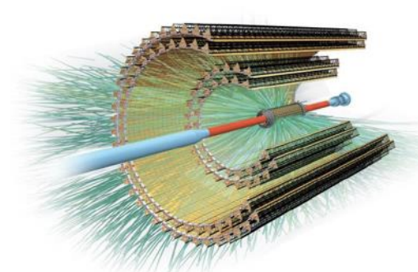
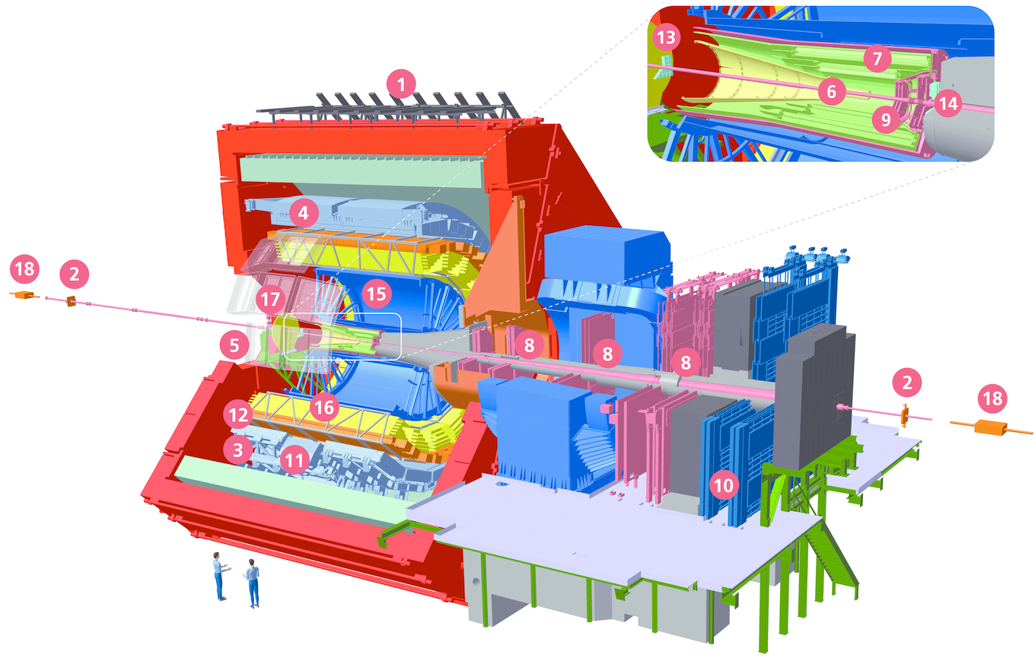
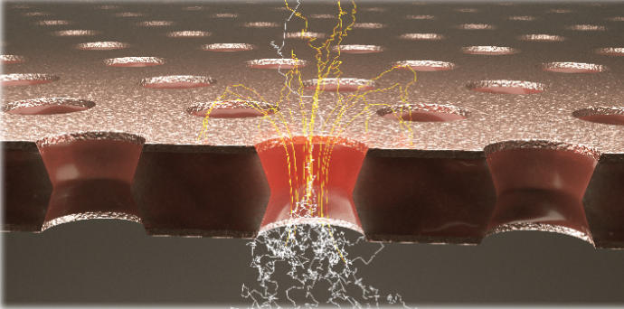
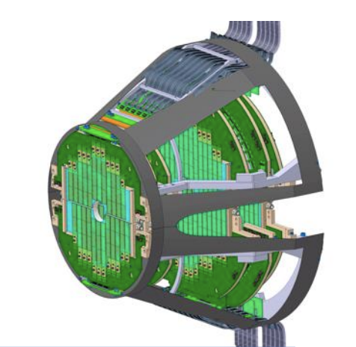
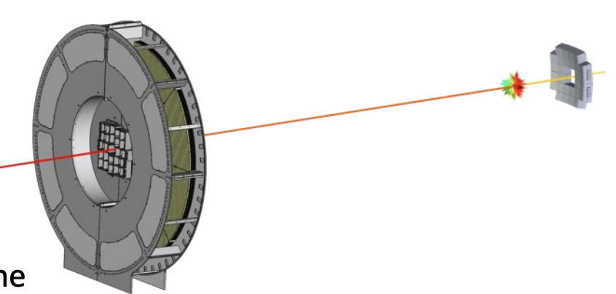
ALICE 2 – LHC Run3 (2022-2024)
ITS2
CMOS Pixel, MAPS
Improved resolution
Less materail, fast readout
New TPC readout
Gas Electron Multiplier
Faster and Continuous readout
New Fast Interaction Trigger
MFT
CMOS Pixel, MAPS
Vertexer, trarcker at forward
Centrality, event plane, luminosity, and interaction time
19

Slide 20
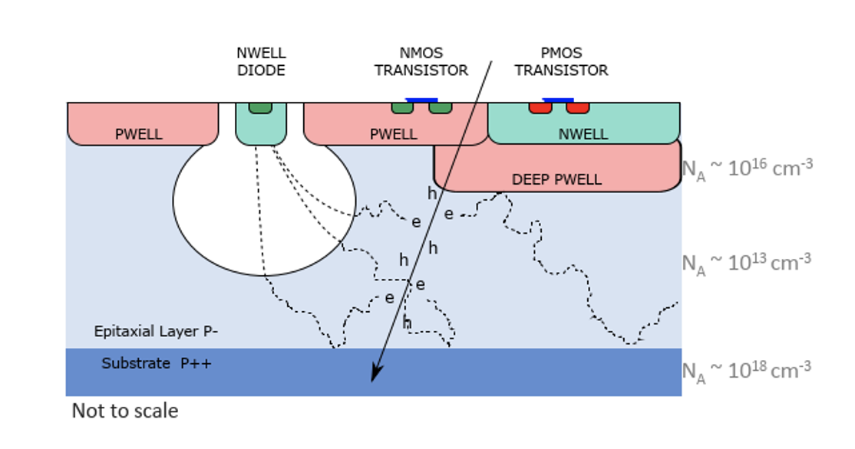
ALICE 2 (ITS) – LHC Run3 (2022-2024)

Slide 21
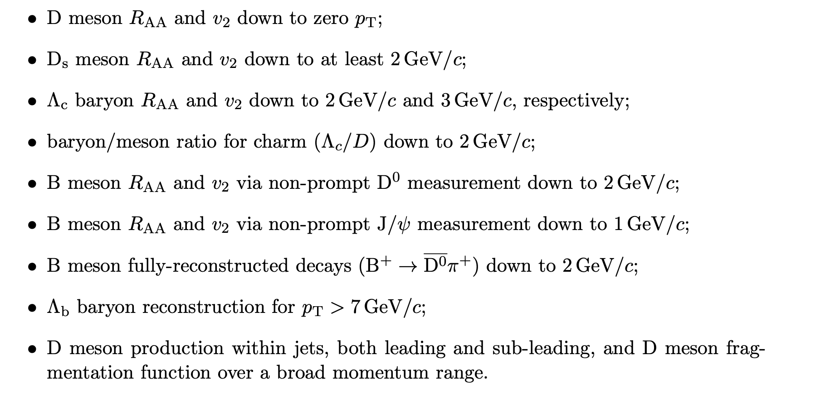
ALICE 2 (ITS) – LHC Run3 (2022-2024)

Slide 22
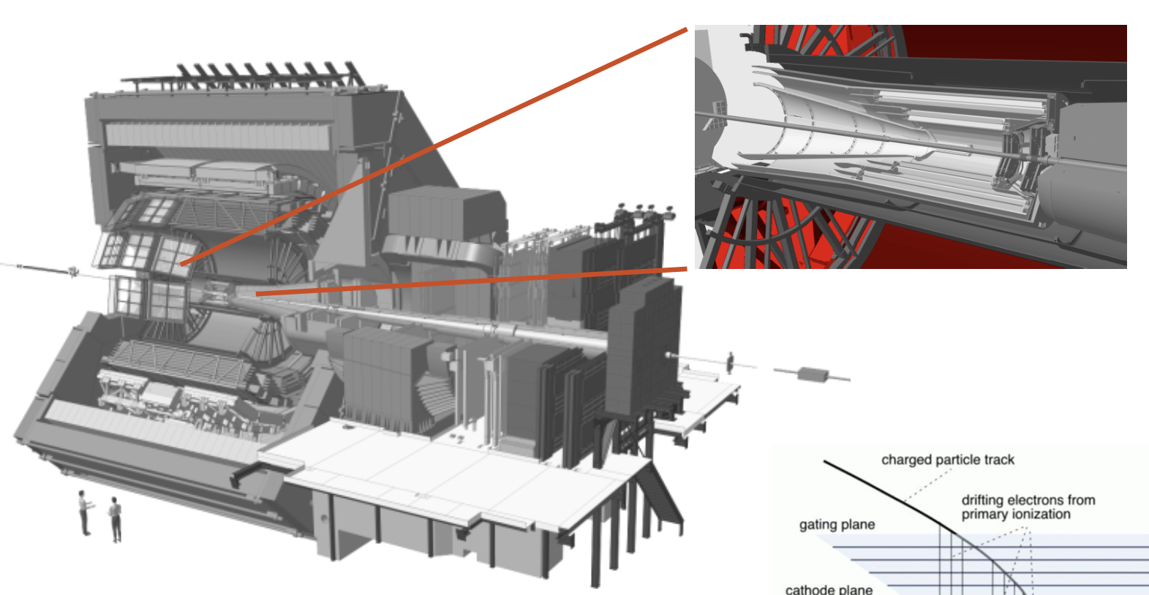
ALICE 2 (TPC) – LHC Run3 (2022-2024)
MPWC (Run 2) | GEM (Run 3 )
I kHz | 50 kHz
GEM stacks with 4 layers
Highly optimized HV configuration
Main reason
for the slow response

Slide 23
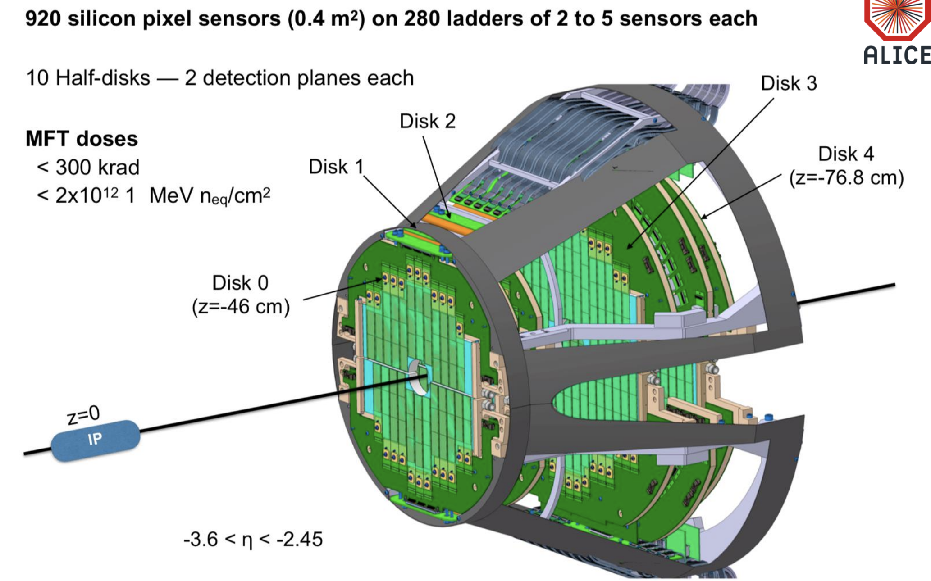
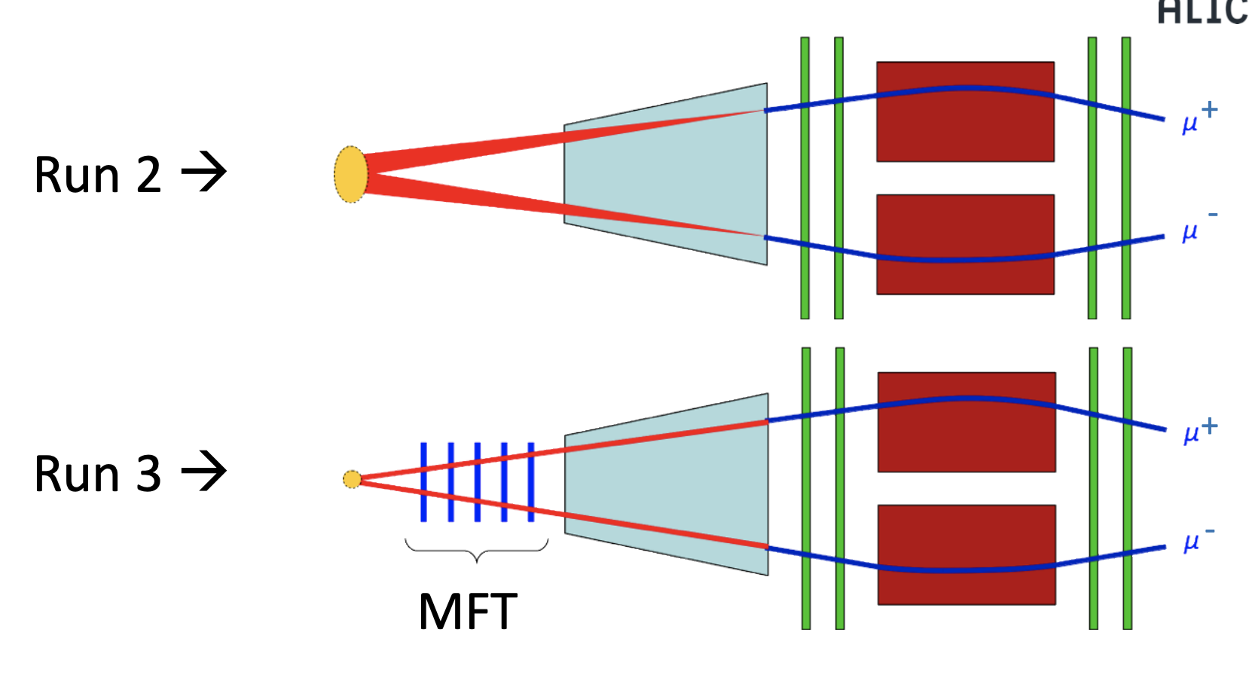
ALICE 2 (MFT) – LHC Run3 (2022-2024)
High pointing accuracy achieved by matching muon tracks with MFT tracks in the pseudorapidity window of $2.5<η<3.6$
23

Slide 24
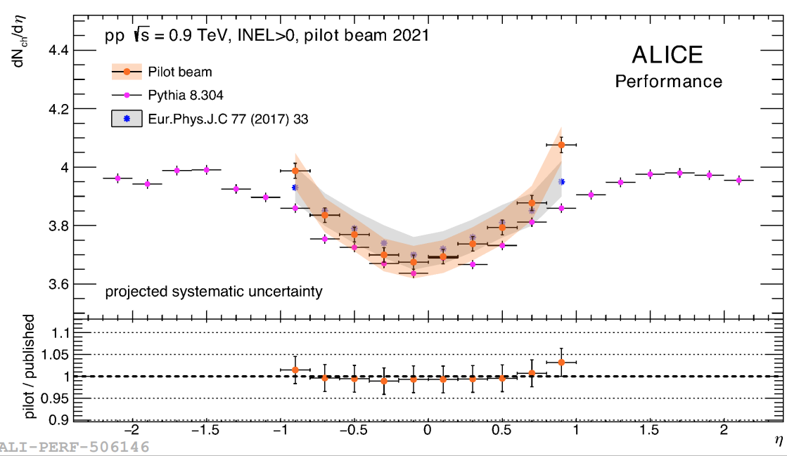
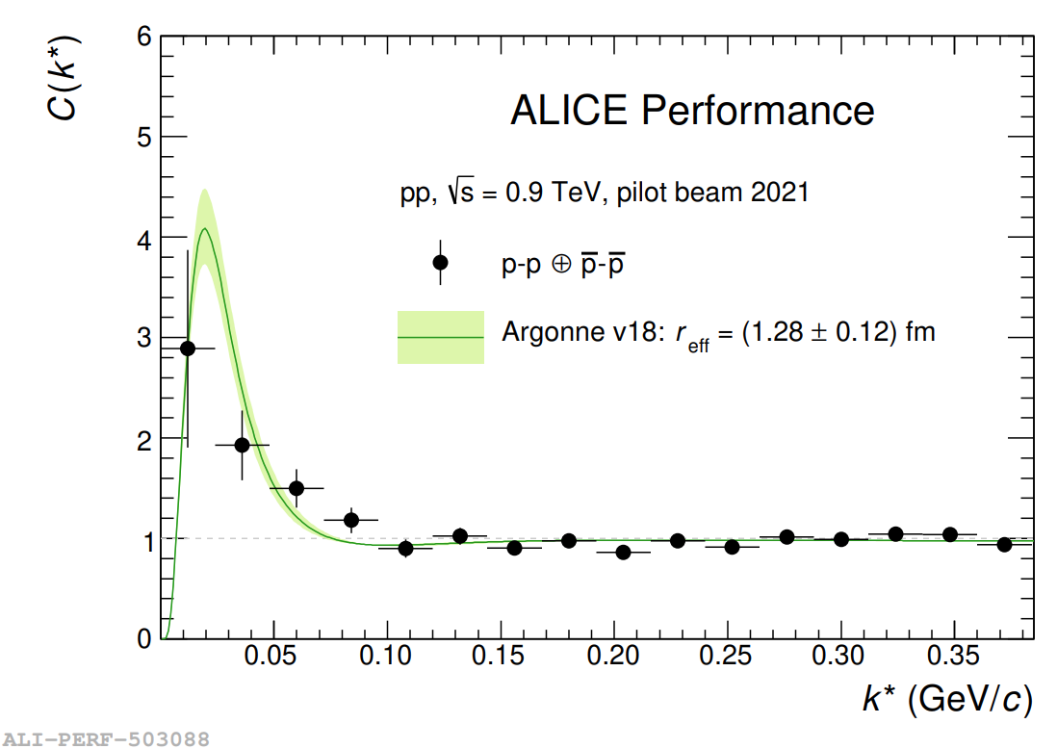
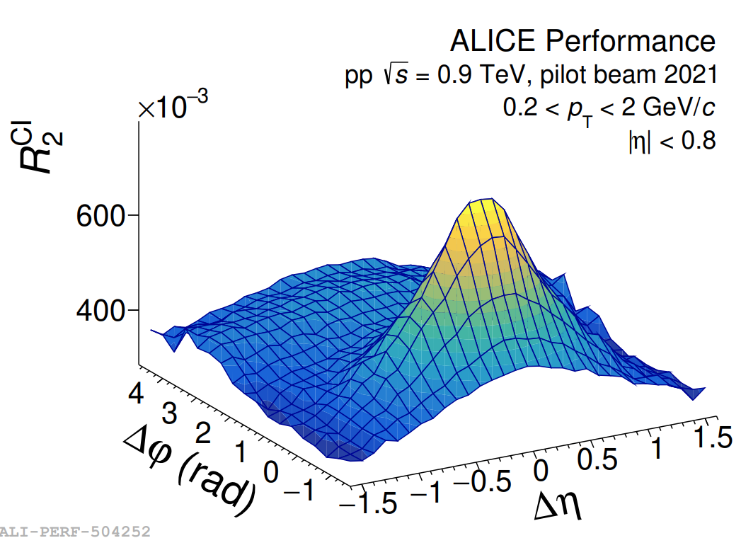
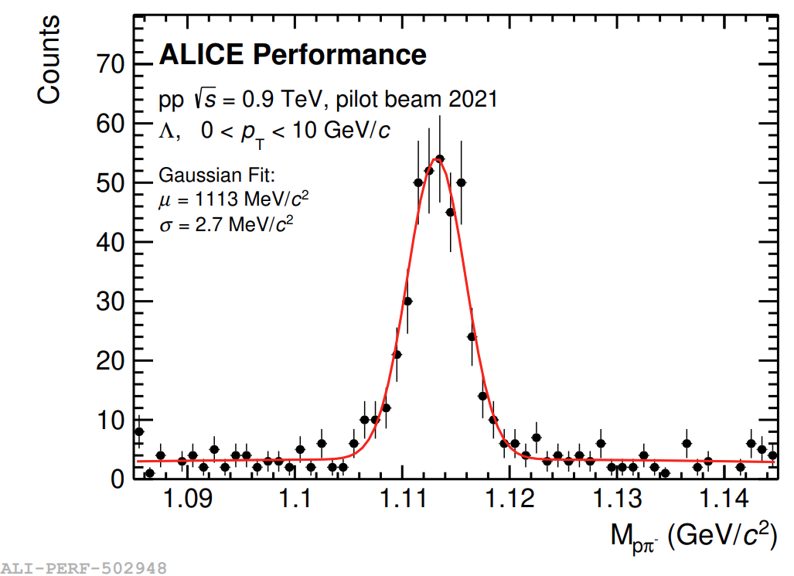
ALICE 2 – Pilot run results
24
Notes:
New strong and useful tool for exotic particles

Slide 25
Data collection plan (2022-2024, Run3)
RUN2
(2015-2018)
LS2
2019-2021
RUN3
2022-2025
Mode | ALICE | ATLAS, CMS
pp | 200 $pb^{−1}$ | 250 $fb^{−1}$
Pb-Pb | 7 $nb^{−1}$ | 7 $nb^{−1}$
p-Pb | 0.25 $pb^{−1}$ | 0.5 $pb^{−1}$
O-O | 0.5 $nb^{−1}$ | 0.5 $nb^{−1}$
p-O | Not fixed | 2$nb^{−1}$
20% reduction of $ℒ_{int}$ expected because of the energy crisis in Europe

Slide 26
Expected # of X in Run 3 in pp and AA
$$σ\left(X→π^{+}π^{−}J/ψ\right)\sim 5.4 nb$$
$$σ_{PbPb} \left(X→π^{+}π^{−}J/ψ\right)\sim 56 μb$$
$$σ\left(X→D^{∗0}{\overline{D}}^{0} →γ\left(π^{0}\right)KπKπ\right)\sim 1nb$$
$$σ_{PbPb}\left(X→D^{∗0}{\overline{D}}^{0} →γ\left(π^{0}\right)KπKπ\right)\sim 10 μb$$
$$σ_{p−Pb}\left(0−10\%\right)\sim R_{AA}(1)×0.1×33 (σ_{p−Pb}/σ_{pp})×N_{coll}(14)$$
$$σ_{p−Pb}\left(X→π^{+}π^{−}J/ψ\right)\sim 0.25 μb$$
$$σ_{p−Pb}\left(X →γ\left(π^{0}\right)KπKπ\right)\sim 0.05 μb$$
Mode | ALICE |  | ATLAS, CMS
 | $$ℒ_{int}$$ | # of X X->$γ\left(π^{0}\right)KπKπ$ | $$ℒ_{int}$$ | # of X $$X→π^{+}π^{−}J/ψ$$
pp | 200 $pb^{−1}$ | $$2×{10}^{5}$$ | 250 $fb^{−1}$ | $${10}^{9}$$
Pb-Pb | 7 $nb^{−1}$ | $$7×{10}^{4}$$ | 7 $nb^{−1}$ | $$4×{10}^{5}$$
p-Pb | 0.25 $pb^{−1}$ | $$1×{10}^{4}$$ | 0.5 $pb^{−1}$ | $${10}^{5}$$
O-O | 0.5 $nb^{−1}$ |  | 0.5 $nb^{−1}$
p-O | Not fixed |  | 2$nb^{−1}$
LHC Run 4 (2029--2032) doubled the statistics

Slide 27
Expected # of Tcc in Run 3 in pp and AA
$$σ\left(T_{cc}→D^{0}D^{∗+}→3π2K\right)\sim \text{13 }\text{fb}$$
$σ(T_{cc}→D^{0}D^{∗+}→3π2K)$ ~ 0.14 nb ($R_{AA}$=1)
$$σ_{p−Pb}\left(0−10\%\right)\sim R_{AA}(1)×0.1×33 (σ_{p−Pb}/σ_{pp})×N_{coll}(14)$$
$$σ_{p−Pb}\left(T_{cc}→D^{0}D^{∗+}→3π2K\right)\sim 0.6 pb$$
Mode | ALICE |  | ATLAS, CMS
 | $$ℒ_{int}$$ | # of Tcc | $$ℒ_{int}$$ | # of Tcc
pp | 200 $pb^{−1}$ | $$2.6$$ | 250 $fb^{−1}$ | $$30,000$$
Pb-Pb | 7 $nb^{−1}$ | 9.8 | 7 $nb^{−1}$ | $$1$$
p-Pb | 0.25 $pb^{−1}$ | $$1.5$$ | 0.5 $pb^{−1}$ | $$0.3$$
O-O | 0.5 $nb^{−1}$ |  | 0.5 $nb^{−1}$
p-O | Not fixed |  | 2$nb^{−1}$
LHC Run 4 (2029--2032) doubled the statistics

Slide 28
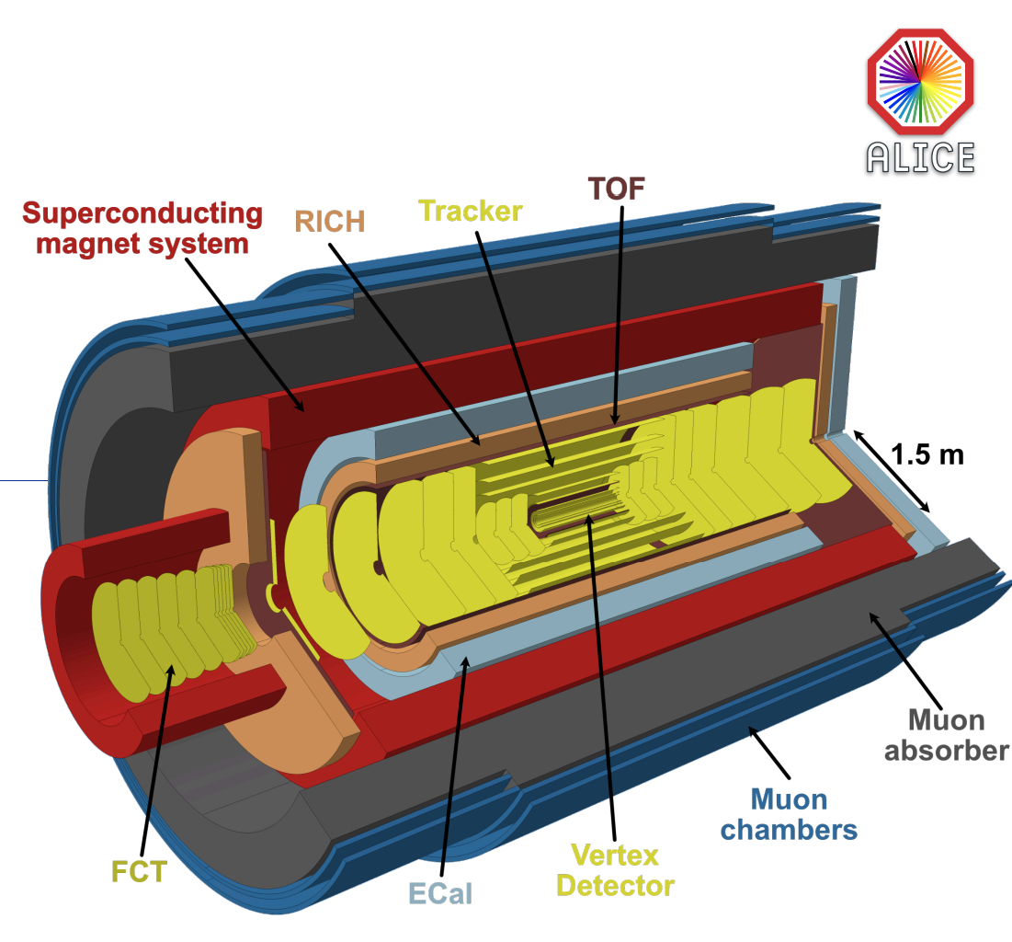
Data collection plan (2035--, Run5)
RUN4
(2029-2032)
LS4
2033-2034
RUN5
2035
CERN-LHCC-2022-009

Slide 29
Summary
Mode | ALICE |  | ATLAS, CMS
 | $$ℒ_{int}$$ | # of X X->$γ\left(π^{0}\right)KπKπ$ | $$ℒ_{int}$$ | # of X $$X→π^{+}π^{−}J/ψ$$
pp | 200 $pb^{−1}$ | $$2×{10}^{5}$$ | 250 $fb^{−1}$ | $${10}^{9}$$
Pb-Pb | 7 $nb^{−1}$ | $$7×{10}^{4}$$ | 7 $nb^{−1}$ | $$4×{10}^{5}$$
p-Pb | 0.25 $pb^{−1}$ | $$1×{10}^{4}$$ | 0.5 $pb^{−1}$ | $${10}^{5}$$
O-O | 0.5 $nb^{−1}$ |  | 0.5 $nb^{−1}$
p-O | Not fixed |  | 2$nb^{−1}$
Mode | ALICE |  | ATLAS, CMS
 | $$ℒ_{int}$$ | # of Tcc | $$ℒ_{int}$$ | # of Tcc
pp | 200 $pb^{−1}$ | $$2.6$$ | 250 $fb^{−1}$ | $$30,000$$
Pb-Pb | 7 $nb^{−1}$ | 9.8 | 7 $nb^{−1}$ | $$1$$
p-Pb | 0.25 $pb^{−1}$ | $$1.5$$ | 0.5 $pb^{−1}$ | $$0.3$$
O-O | 0.5 $nb^{−1}$ |  | 0.5 $nb^{−1}$
p-O | Not fixed |  | 2$nb^{−1}$
X (3872) study in pp, p-Pb Pb—Pb quite optimistic for ALICE, ATLAS, and CMS (even the system-size dependence)
Tcc cannot be accessible by ALICE in both pp and Pb-Pb when $R_{AA}=1$
ATLAS and CMS can measure Tcc only in pp, but with a good PID that can be achieved in the near future in both ATLAS, CMS
Few Tcc obtaining per year in Pb-Pb until LHC Run 5 and 6
If there is a huge enhancement (R>>1) from the medium, Tcc study in Pb-Pb would be possible for the 3 experiments
Realistic MC study planned for a better calculation of the efficiency

