Slide 1
KNU 검출기학교 2022 Fast electronics and DAQ
김상열
노티스

Slide 2
Why Electronics?
Detector + Electronics + Analysis = Experiment
Detector + Electronics + X = Development
X + Electronics + Analysis = Not Bad?
Detector + X + Analysis = ????

Slide 3
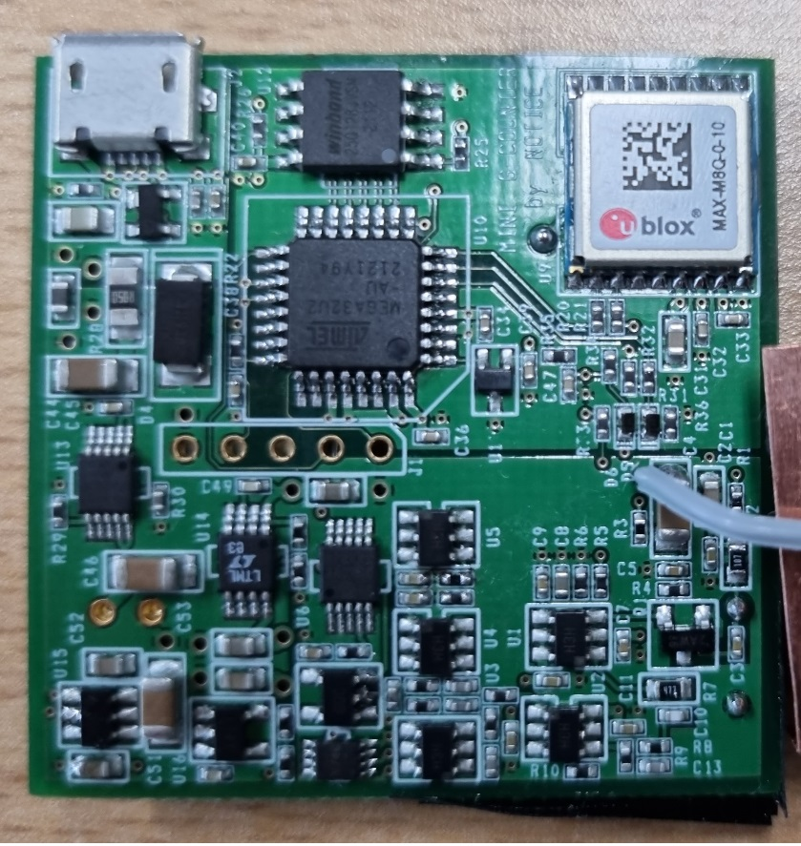
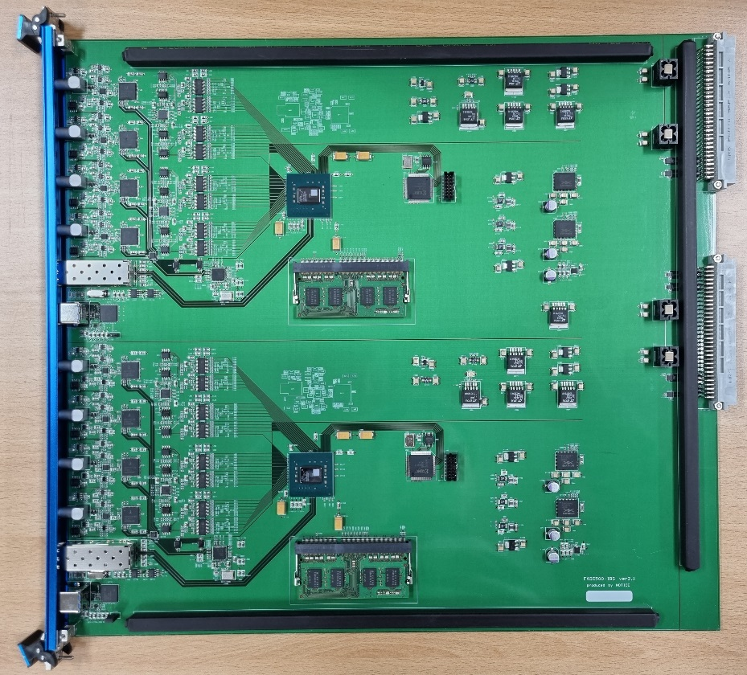
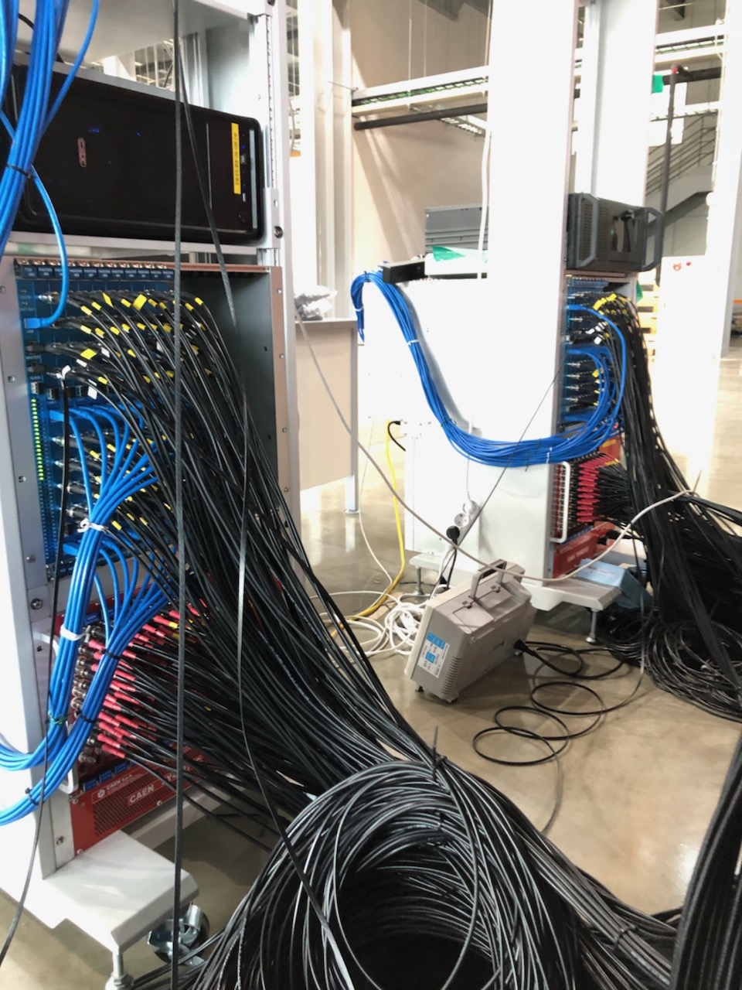
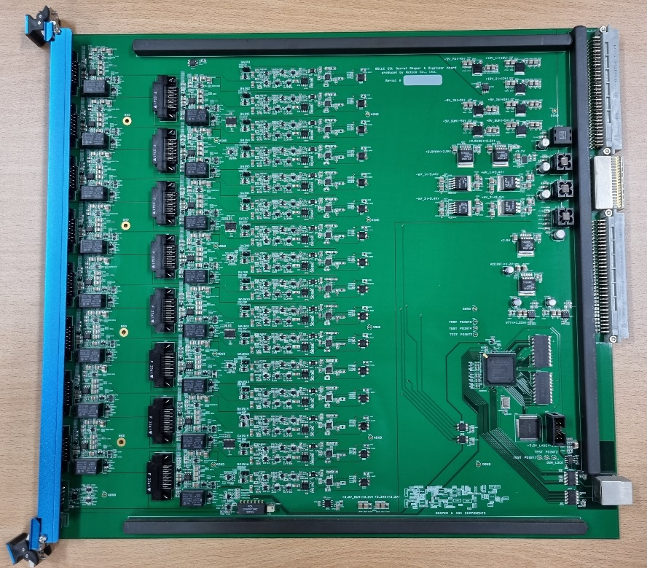
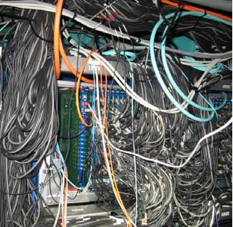

Slide 4
We will see :
1. What electronics are used?
2. How they work?
3. How to make them?
4. Where to sell?

Slide 5
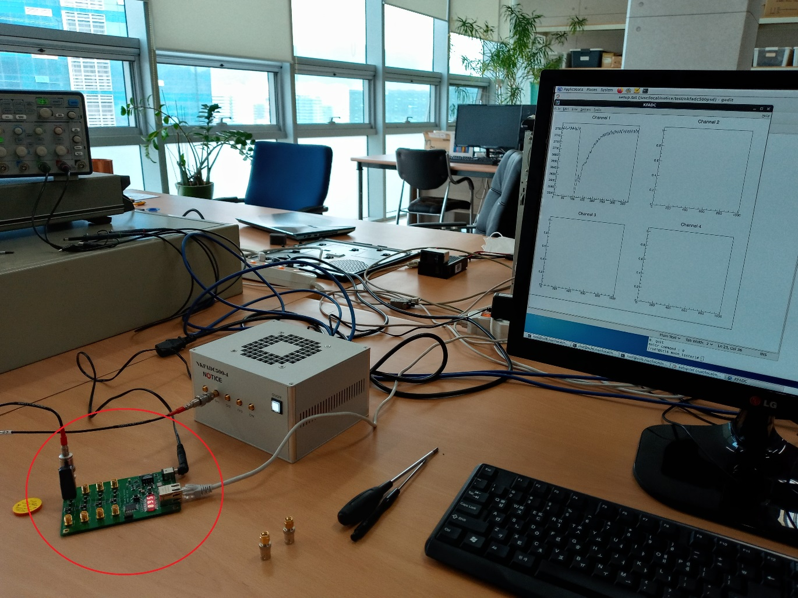
Goal :

Slide 6
Electronics for High energy or Nuclear physics experiment
Detector
Preamp
+ other
Analog circuits
Digitizer
Data Acquisition
Bias Voltage
Trigger
+ DSP
Power Supply

Slide 7
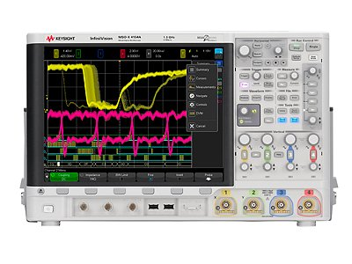
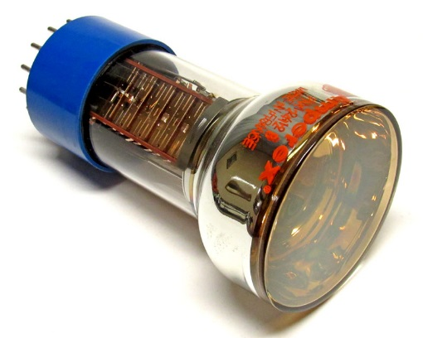
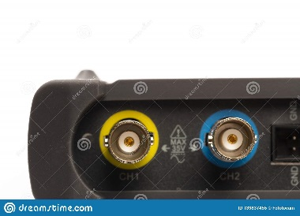
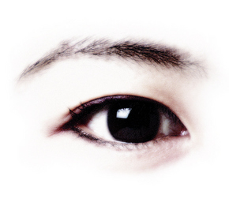
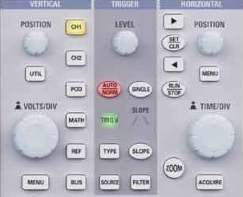
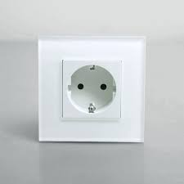
Frequently used example
50 ohm input impedance
Oscilloscope level trigger

Slide 8
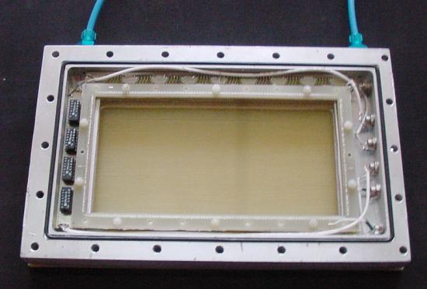
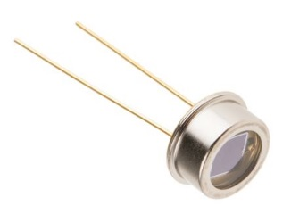
Signal from some detectors
PMT, SiPM… : gain ~ 10^6
-> ~ 10^10 electrons/MeV
= ~ nC/MeV
Wire chamber, GEM… : gain ~ 10^2~3
-> ~ 10^6~7 electrons/MeV
= ~ pC/MeV
Photodiode, Ion chamber… : gain ~ 1
-> ~ 10^3~5 electrons/MeV
= ~ fC/MeV

Slide 9
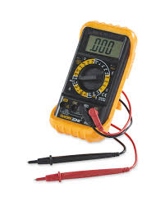
How to measure signal
Typical detector’s capacitance
= 10 ~ 1000 pF
and V = Q/C
~ nC/100 pF/MeV = ~ V/MeV (OK)
~ pC/100 pF/MeV = ~ mV/MeV (?)
~ fC/100 pF/MeV = ~ uV/MeV (X)

Slide 10
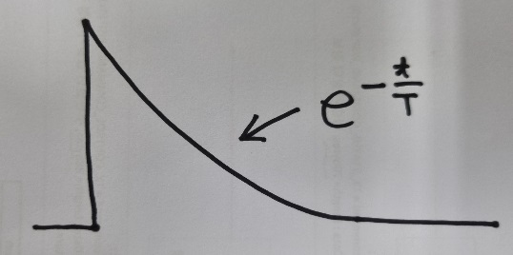
What we measure actually? Charge? Current?
When Idet(detector current) is very fast,
Isig = Qdet x exp(-t/T) where T = Cd x Rm = 100 pF x 10 Mohm
= ~ ms -> very long!

Slide 11
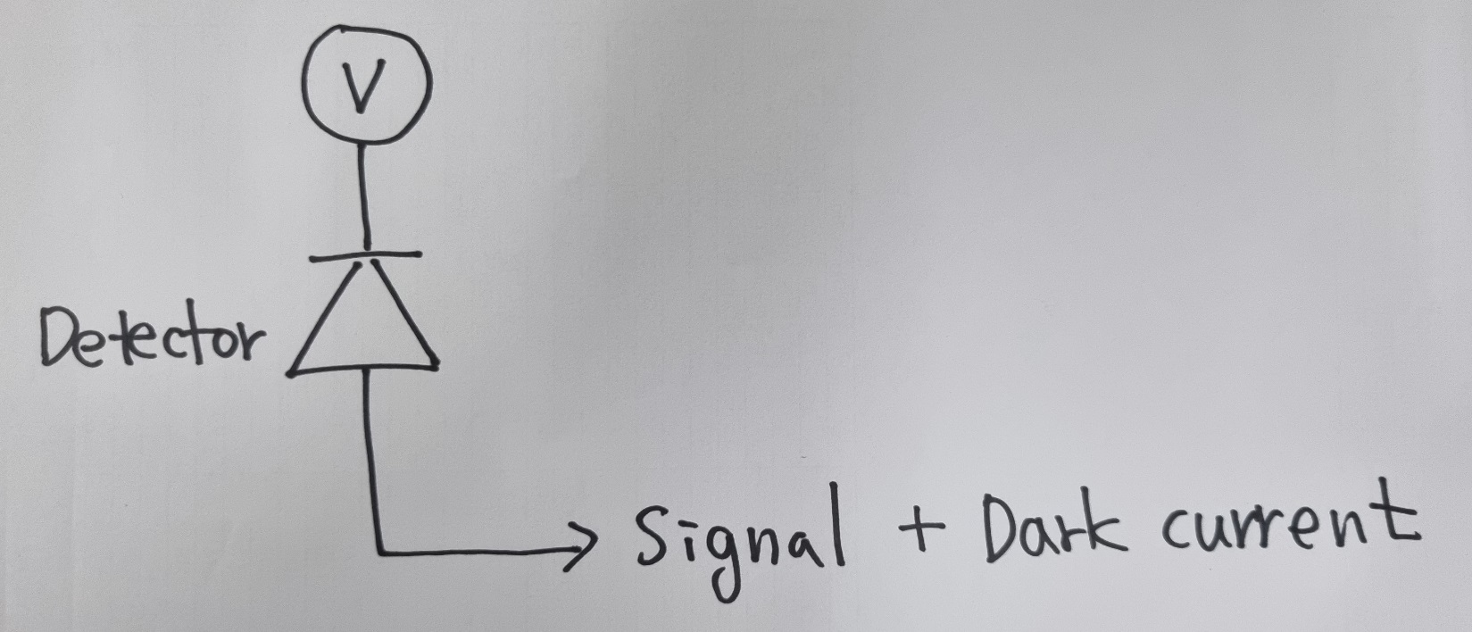
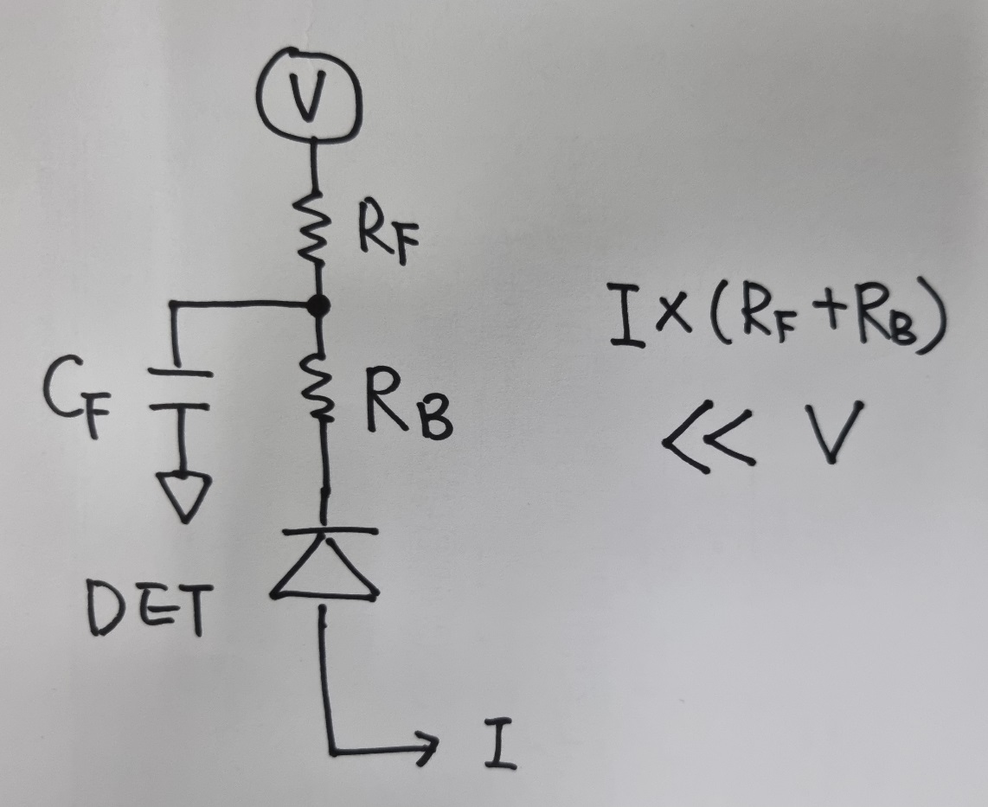
Detector signal :
Where it comes from? = Bias Voltage Source (few ~ 10,000 V)
Ibias(max) > Isig + Idark
Isig = Signal x Count rate
Bias Filter

Slide 12
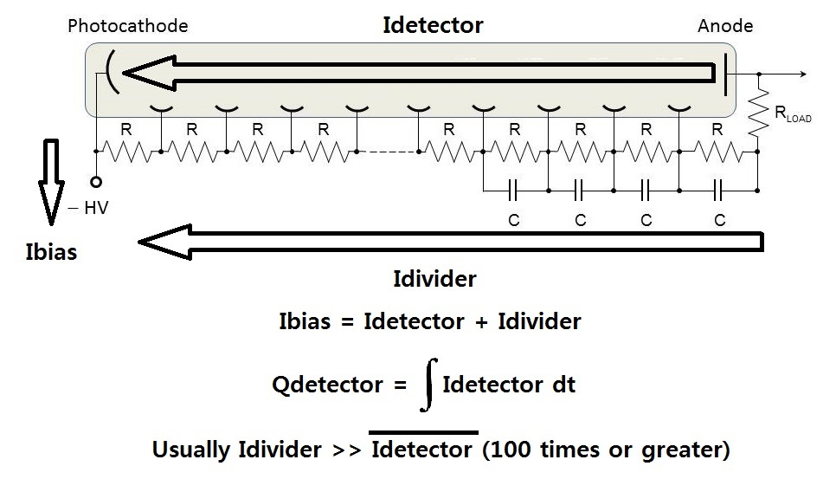
PMT example

Slide 13
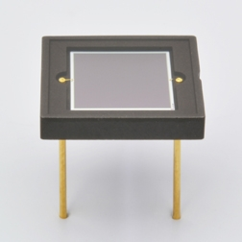
Bias voltage supplier should supply
If count rate = ~ 100 kcps (when no Dark current)
PMT : nC x 100 kcps x (10 ~ 100 : Divider)
= 10 uA -> 1 mA @ a few kV -> W
SiPM : nC x 100 kcps
= 10 uA @ 20 ~ 60 V -> mW
Wire chamber, GEM… : pC x 100 kcps
= 0.1 uA @ kV -> mW
Photodiode, Ion chamber… : fC x 100 kcps
= ~1 nA @ a few ~ kV -> uW

Slide 14
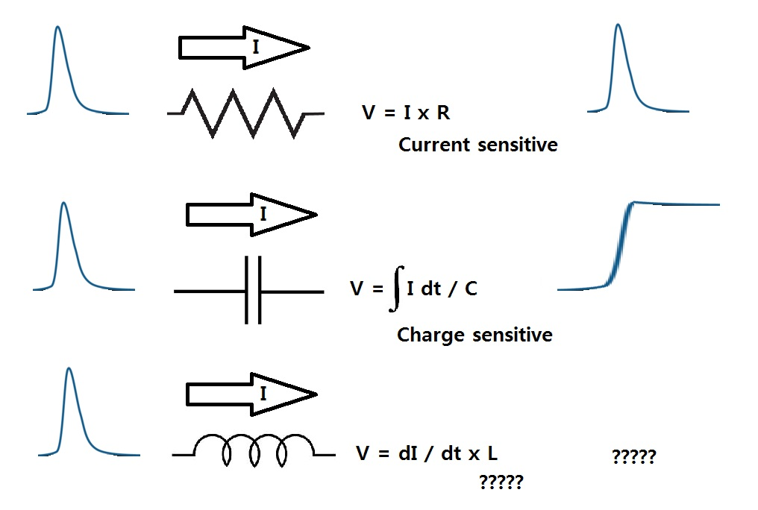
First thing to do :
Preamplifier converts Idet to Voltage signal.

Slide 15
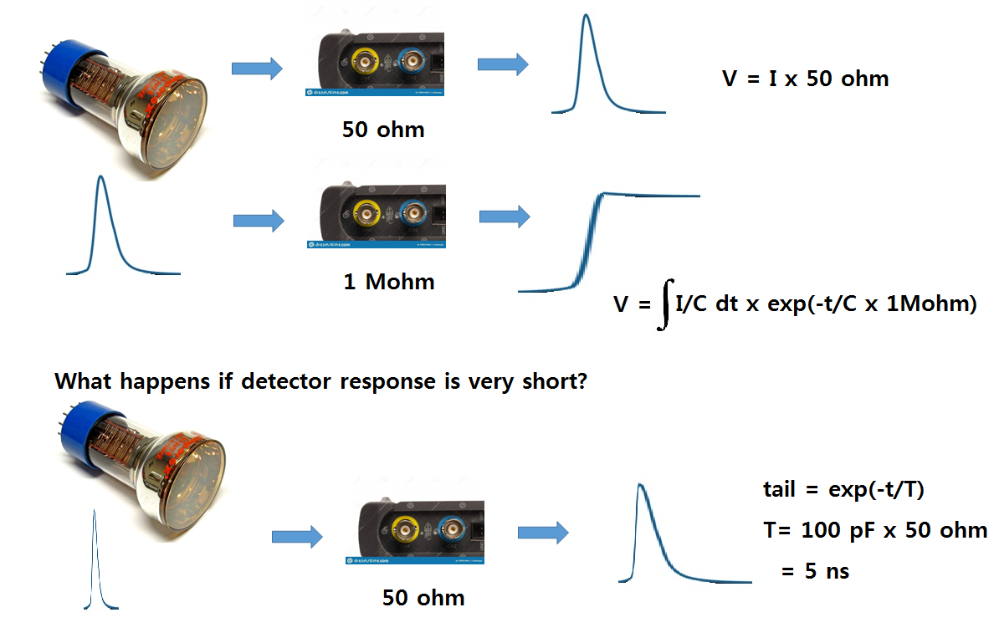
Take a look at PMT oscilloscope shot again

Slide 16
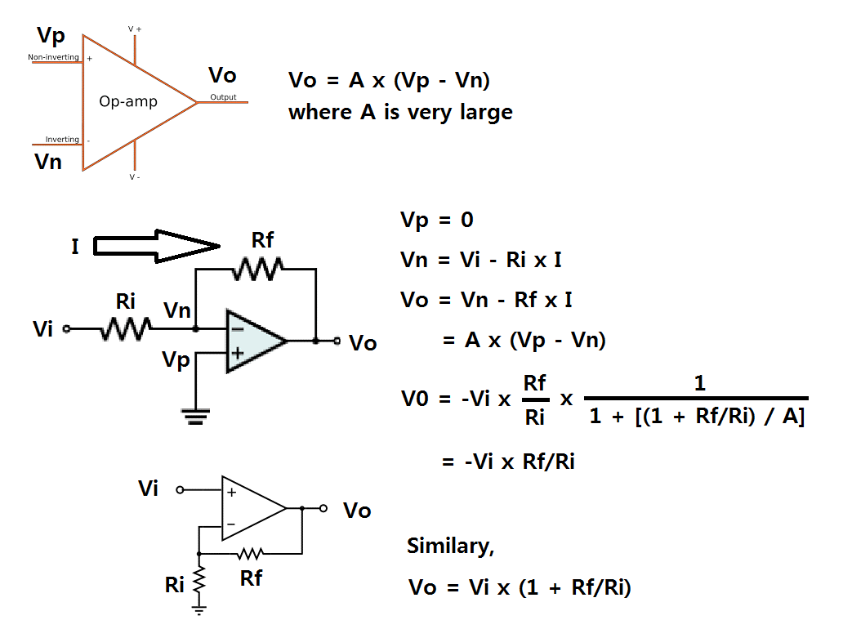
OpAmp basics

Slide 17
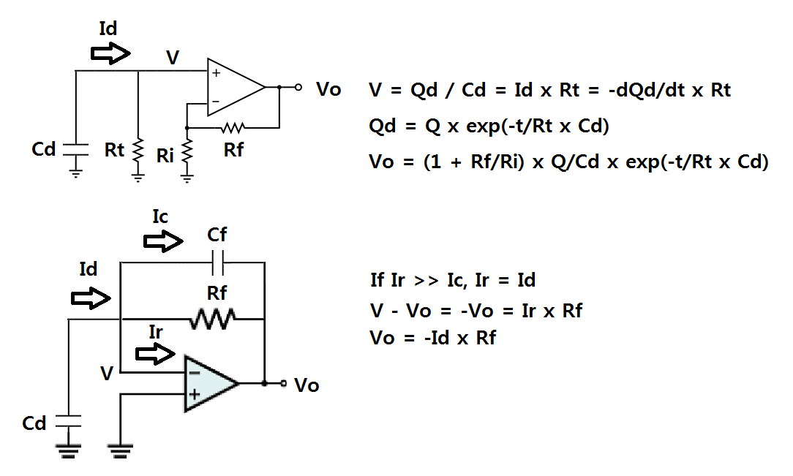
Current Sensitive Preamp

Slide 18
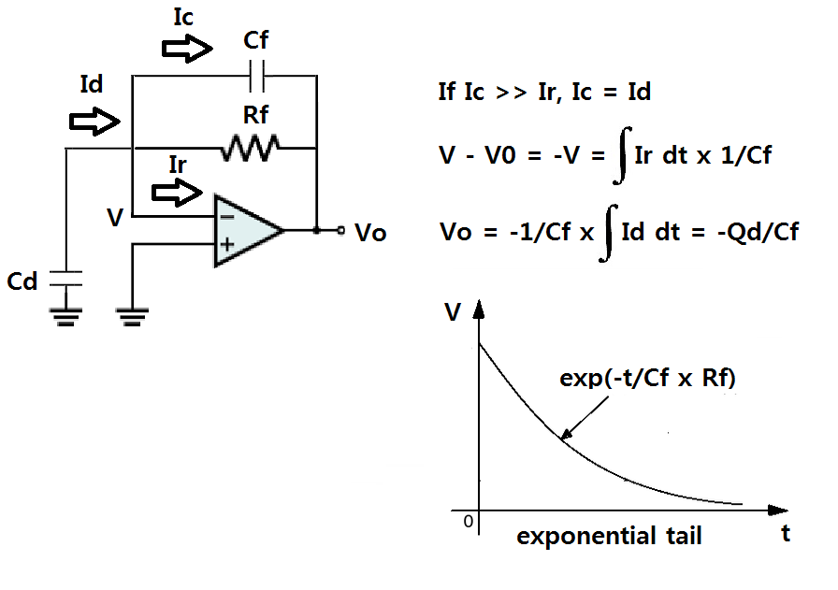
Charge Sensitive Preamp

Slide 19
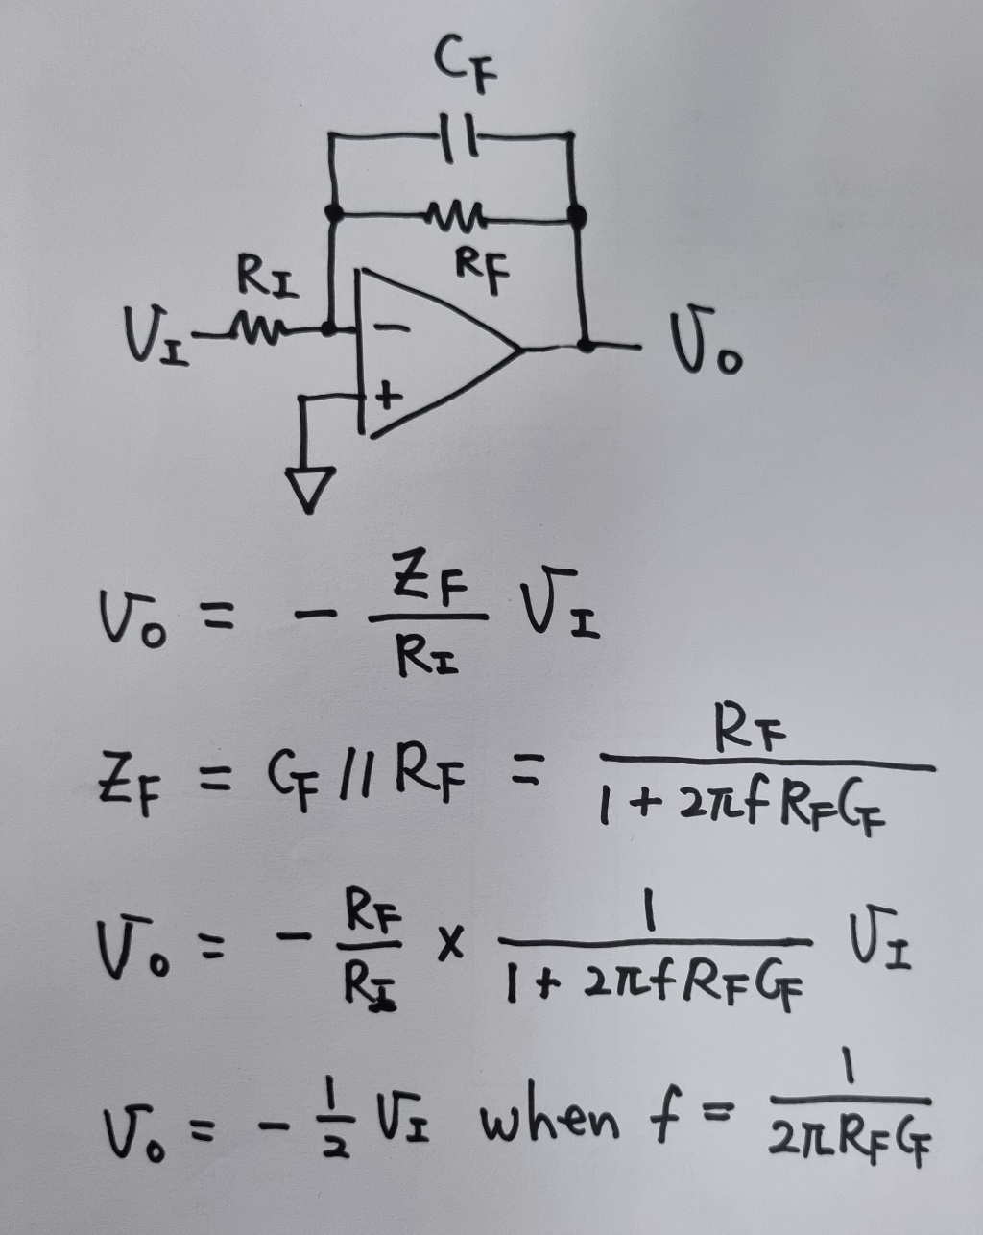
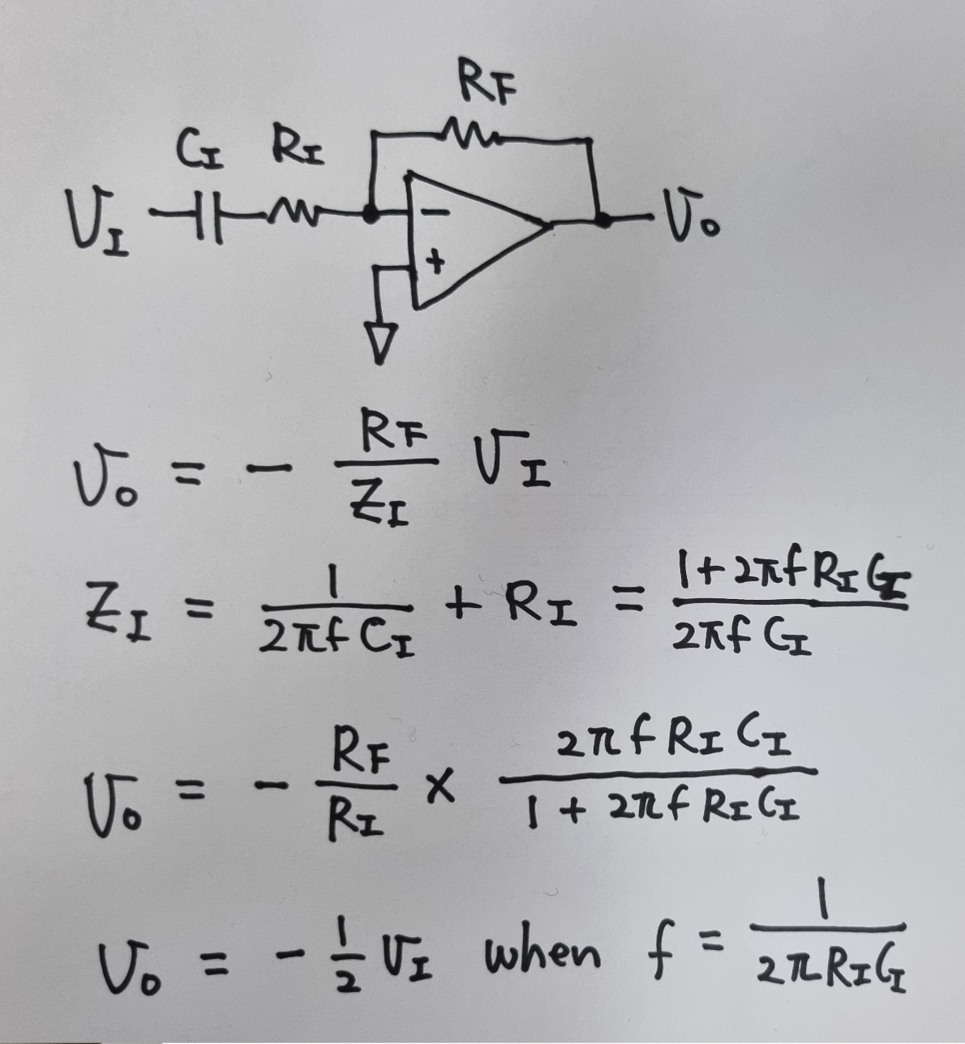
Filter : Modify preamplifier pulse to better shape for later stage
Low Pass Filter High Pass Filter

Slide 20
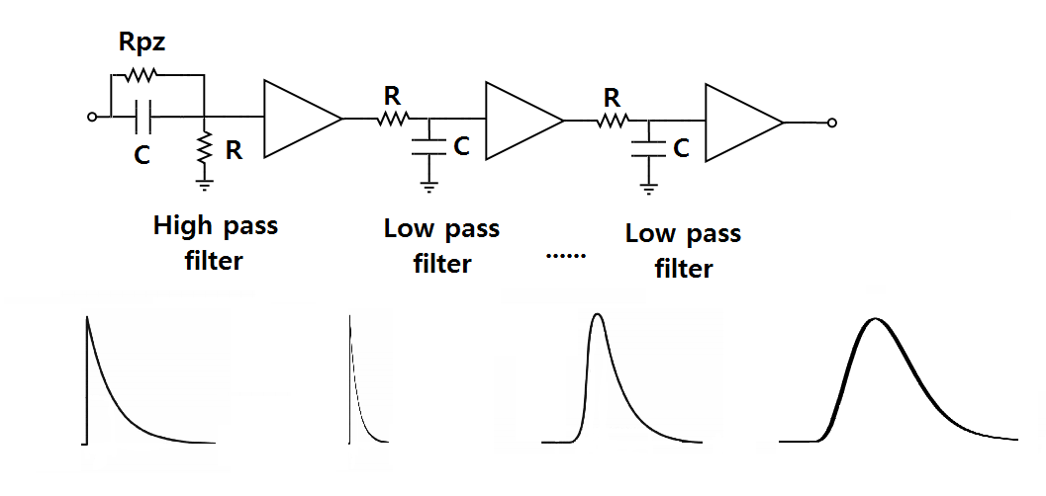
Example of Shaping Amplifier : next to Charge sensitive preamplifier

Slide 21
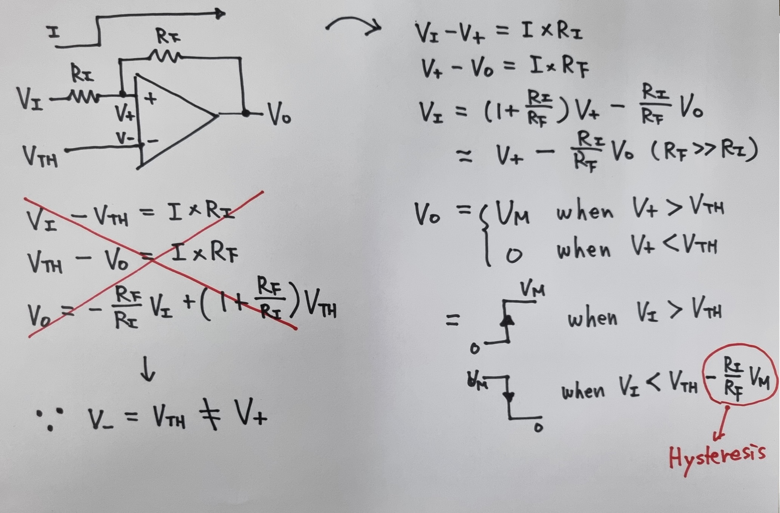
Voltage Comparator

Slide 22
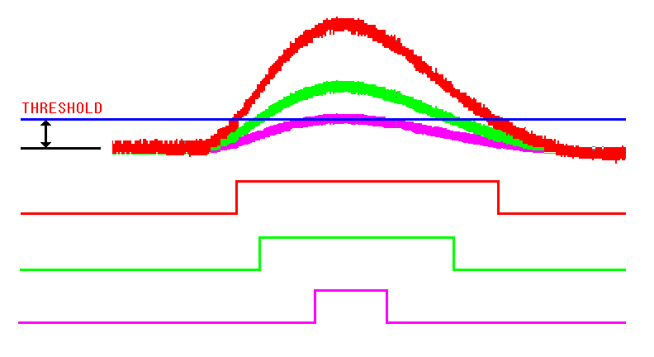
Discriminator
To discriminate noise
To get pulse timing
Leading edge discriminator
Simple
Large time walk

Slide 23
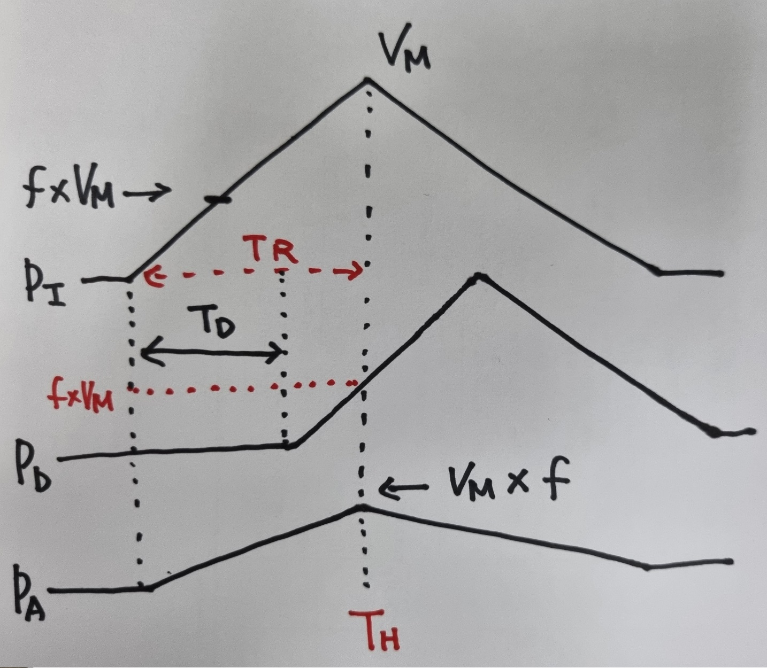
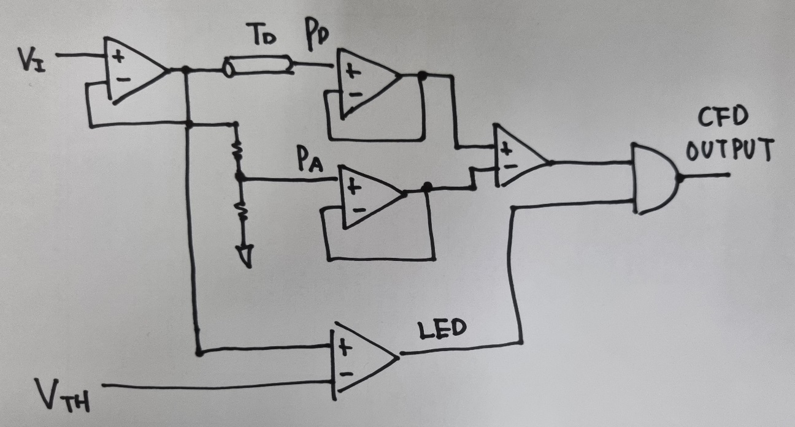
Constant Fraction Discriminator
Input pulse is fan out to
Pd : Delayed (by 1 – f x Tr)
Pa : Attenuated (by f)
Then Pd and Pa have same
Voltage @ Th
Pd has voltage f x Vm @ Th

Slide 24
Logic(or Digital) Signal
 | Type | Low (0) | High (1)
TTL/LVTTL | Single ended | < 0.8 V | > 2.0 V
NIM(slow) | Single ended | < 1.5 V | > 3.0 V
NIM(fast) | Single ended | > -200 mV(-4 mA) | < -600 mV(-12 mA)
ECL | Differential | < -1.48 V | > -0.81 V
LVDS | Differential | < 1.0 V | > 1.4 V

Slide 25
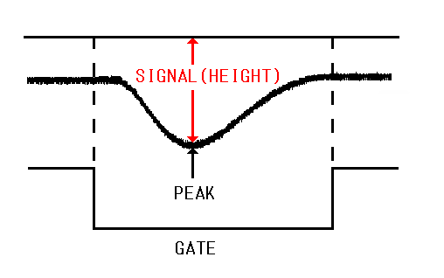
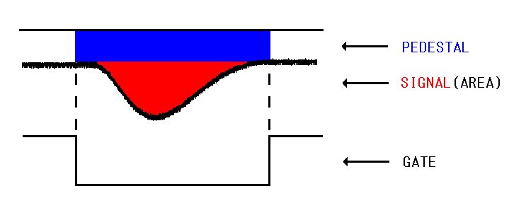
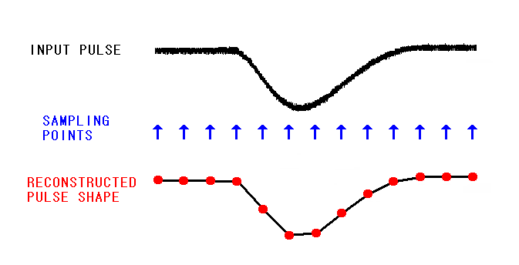
Analog to Digital Converter(ADC)
Peak sensing ADC Charge sensing ADC
Flash ADC

Slide 26
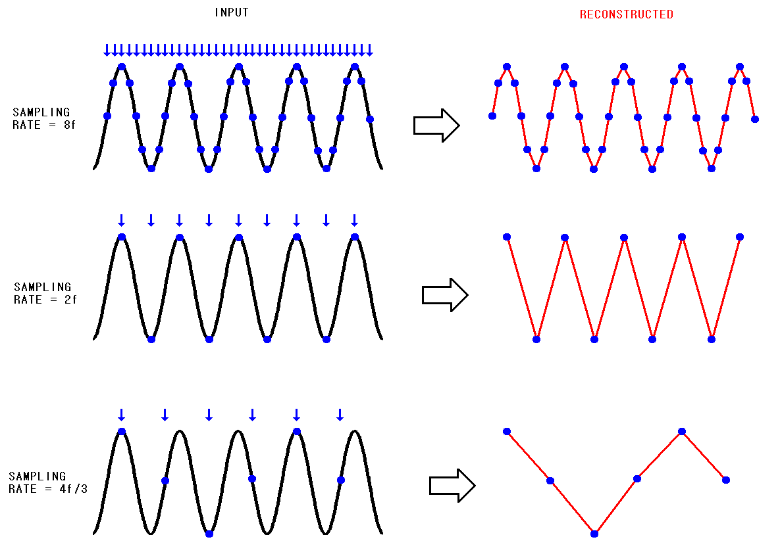
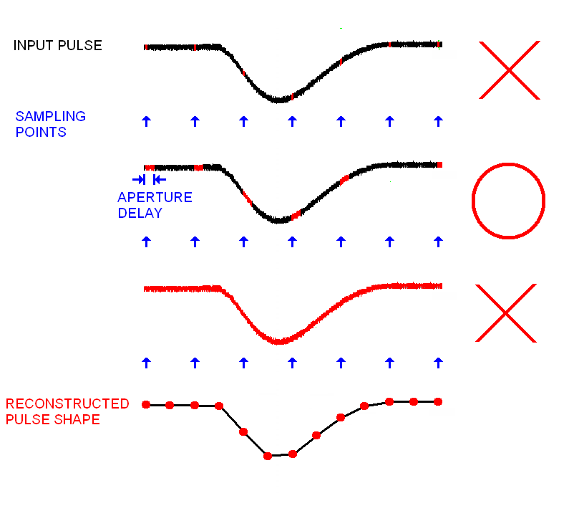
ADC sampling

Slide 27
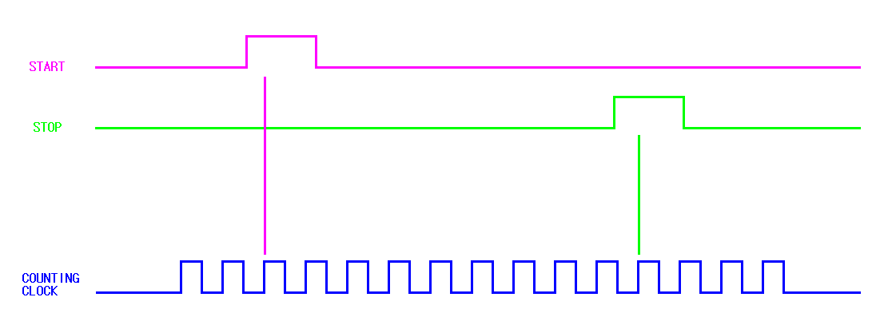
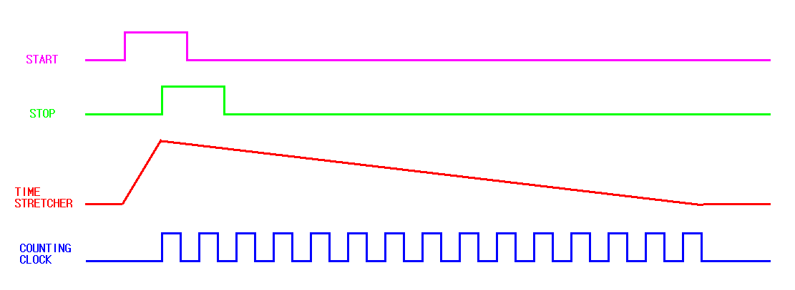
Time to Digital Converter(TDC)
Direct counting
Resolution ~ 1 ns
Time stretching
Resolution ~ 10 ps

Slide 28
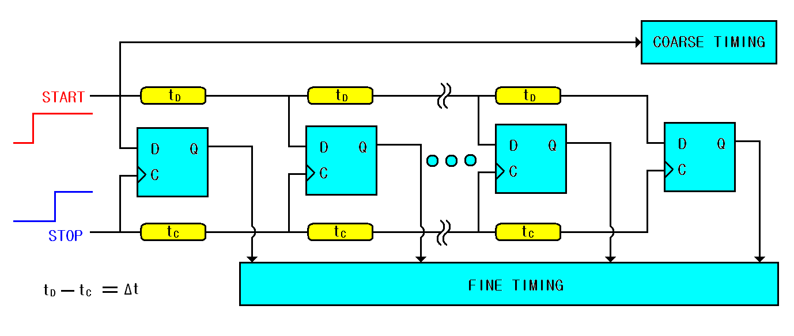
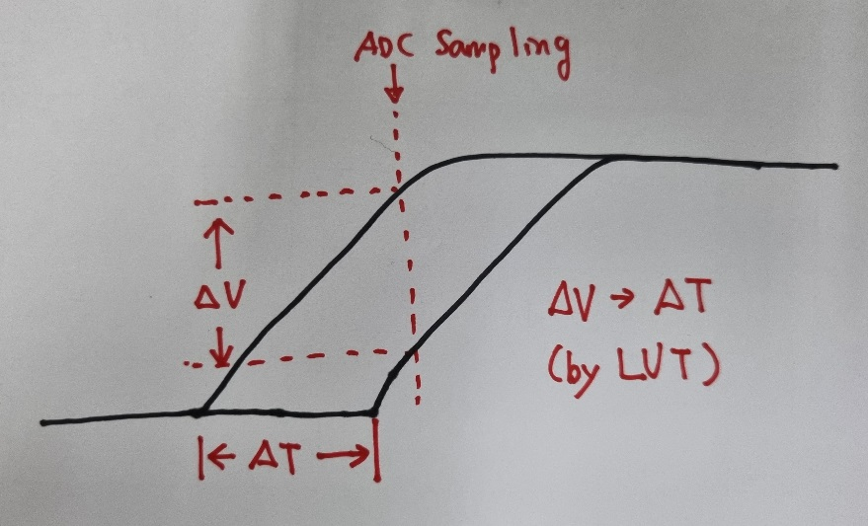
Time to Digital Converter
Time interpolation
Resolution ~ 10 ps
Multi-hit TDC
Pulse shaping TDC : resolution ~ 10 ps, multi-hit

Slide 29
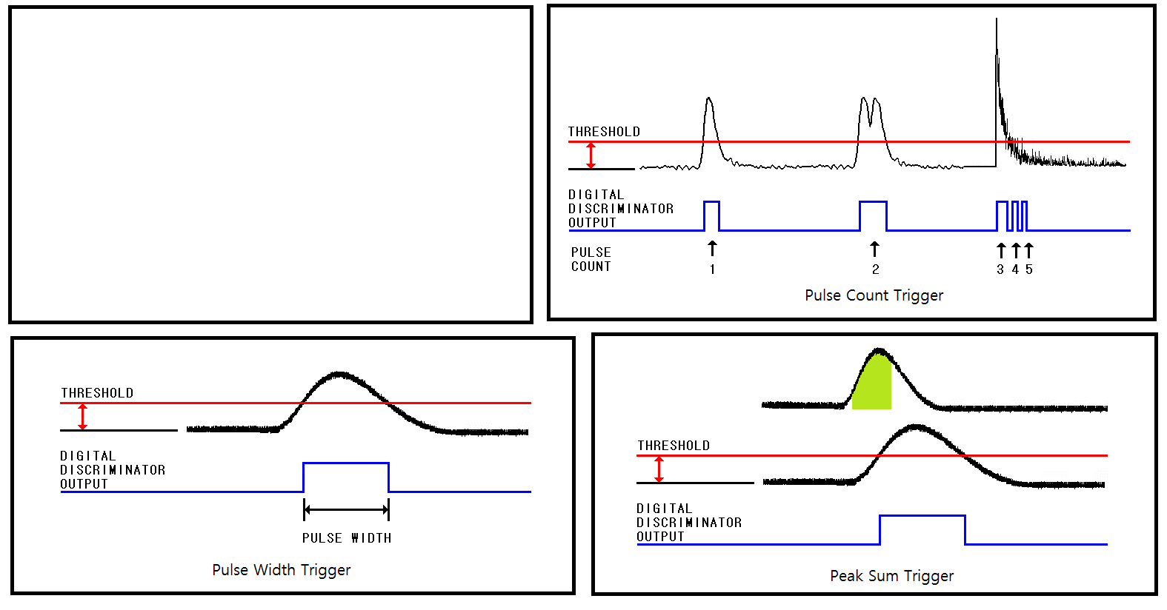
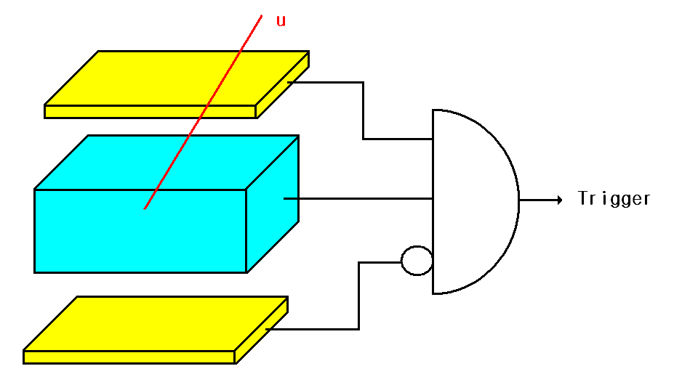
Trigger

Slide 30
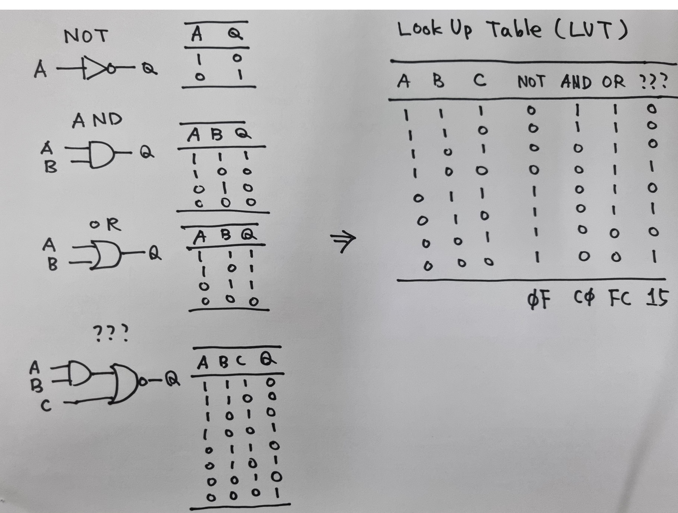
Combinational Logic

Slide 31
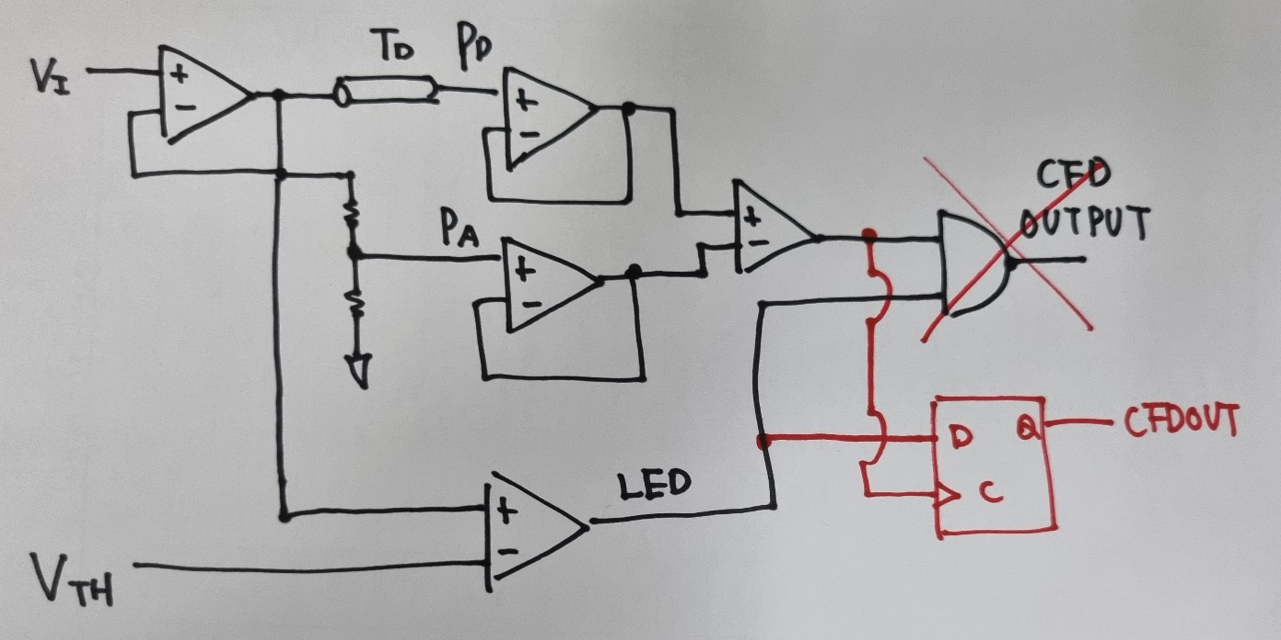
Sequential Logic

Slide 32
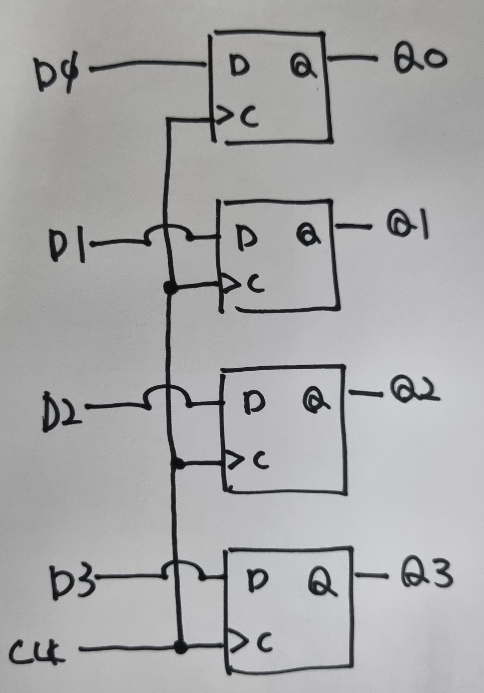
Examples of Sequential Logic
Q0 | Q1 | Q2 | Q3 | D3 | D2 | D1 | D0
1 | 1 | 1 | 1 | 0 | 0 | 0 | 0
1 | 1 | 1 | 0 | 1 | 1 | 1 | 1
1 | 1 | 0 | 1 | 1 | 1 | 1 | 0
1 | 1 | 0 | 0 | 1 | 1 | 0 | 1
1 | 0 | 1 | 1 | 1 | 1 | 0 | 0
1 | 0 | 1 | 0 | 1 | 0 | 1 | 1
1 | 0 | 0 | 1 | 1 | 0 | 1 | 0
1 | 0 | 0 | 0 | 1 | 0 | 0 | 1
0 | 1 | 1 | 1 | 1 | 0 | 0 | 0
0 | 1 | 1 | 0 | 0 | 1 | 1 | 1
0 | 1 | 0 | 1 | 0 | 1 | 1 | 0
0 | 1 | 0 | 0 | 0 | 1 | 0 | 1
0 | 0 | 1 | 1 | 0 | 1 | 0 | 0
0 | 0 | 1 | 0 | 0 | 0 | 1 | 1
0 | 0 | 0 | 1 | 0 | 0 | 1 | 0
0 | 0 | 0 | 0 | 0 | 0 | 0 | 1
Q0 | Q1 | Q2 | Q3 | D3 | D2 | D1 | D0
1 | 1 | 1 | 1 | 0 | 0 | 0 | 0
1 | 1 | 1 | 0 | 0 | 0 | 0 | 0
1 | 1 | 0 | 1 | 0 | 0 | 0 | 0
1 | 1 | 0 | 0 | 0 | 0 | 0 | 0
1 | 0 | 1 | 1 | 0 | 0 | 0 | 0
1 | 0 | 1 | 0 | 0 | 0 | 0 | 0
1 | 0 | 0 | 1 | 0 | 0 | 0 | 0
1 | 0 | 0 | 0 | 1 | 0 | 0 | 1
0 | 1 | 1 | 1 | 1 | 0 | 0 | 0
0 | 1 | 1 | 0 | 0 | 1 | 1 | 1
0 | 1 | 0 | 1 | 0 | 1 | 1 | 0
0 | 1 | 0 | 0 | 0 | 1 | 0 | 1
0 | 0 | 1 | 1 | 0 | 1 | 0 | 0
0 | 0 | 1 | 0 | 0 | 0 | 1 | 1
0 | 0 | 0 | 1 | 0 | 0 | 1 | 0
0 | 0 | 0 | 0 | 0 | 0 | 0 | 1

Slide 33
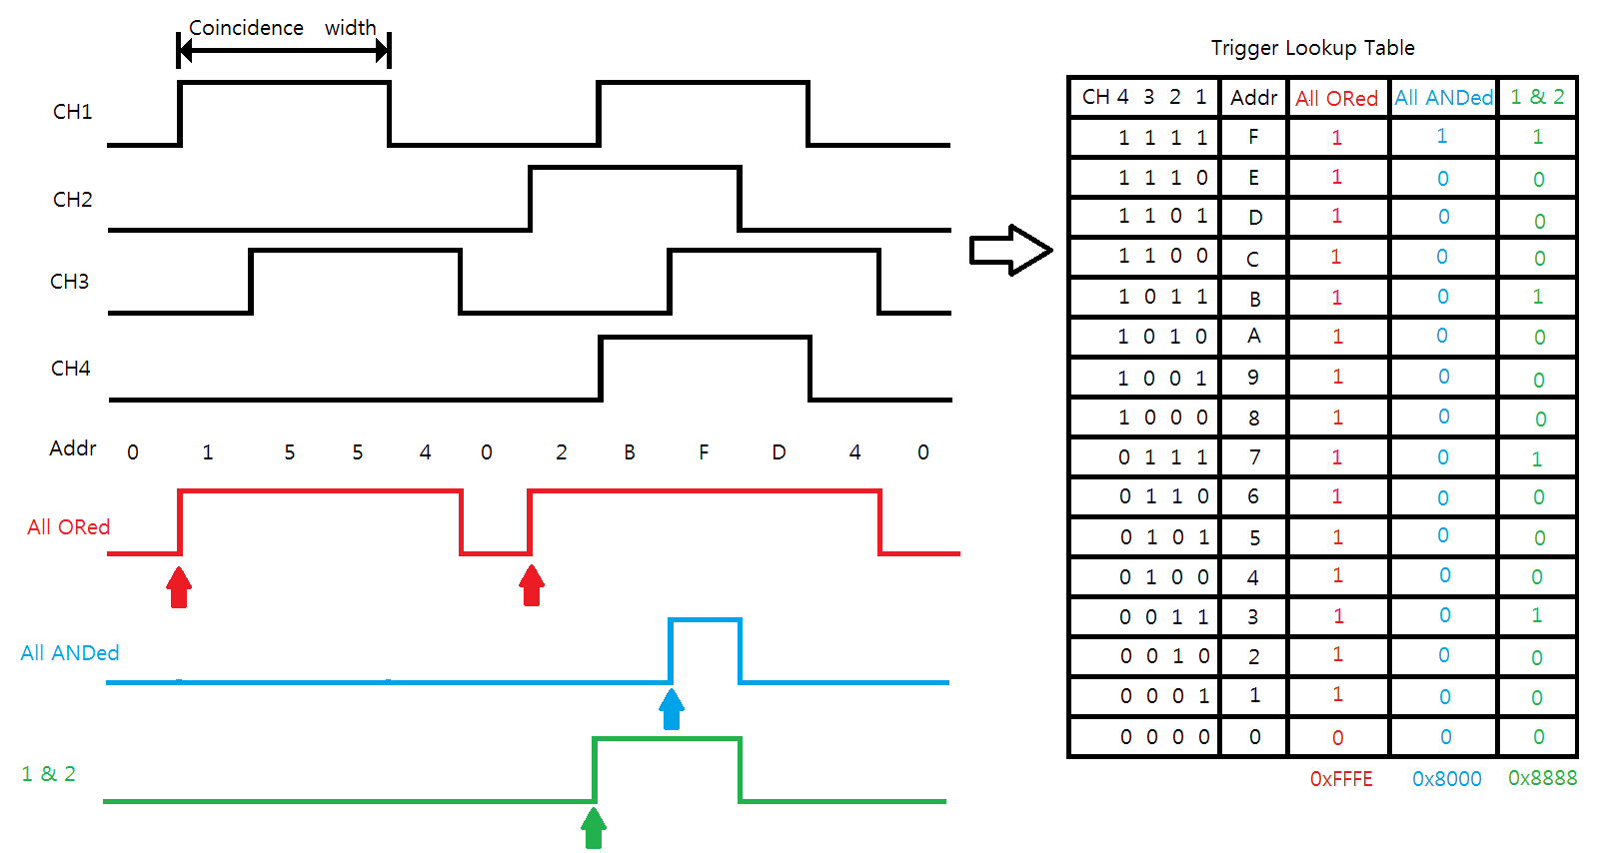
Trigger by combination

Slide 34
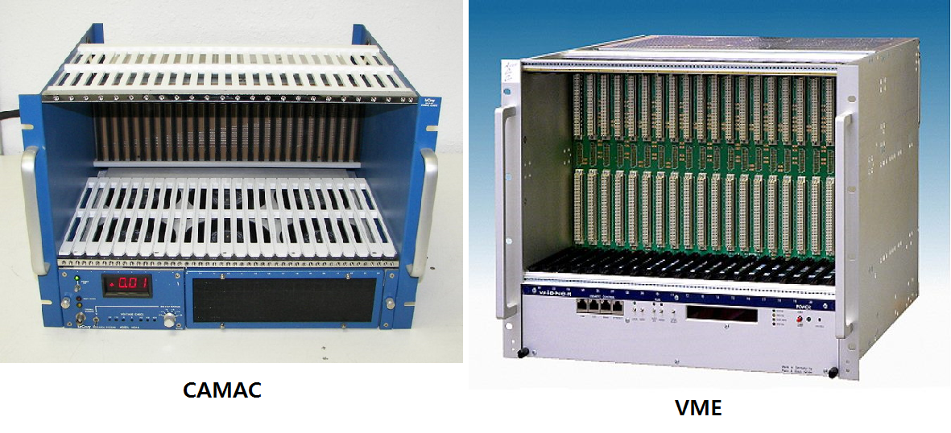
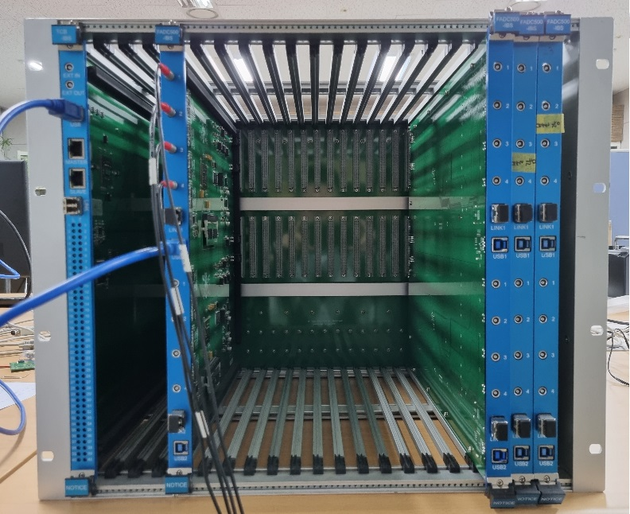
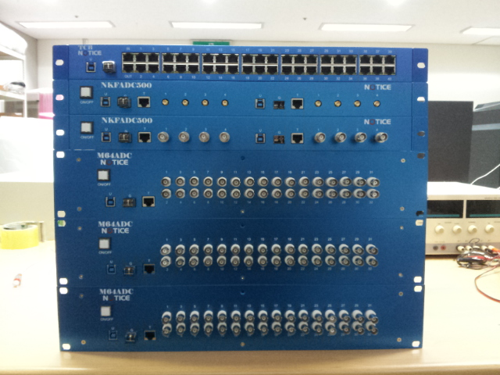
Data Acquisition
Standard
Custom

Slide 35
Data Acquisition
Ethernet : 125 MB/s max, ~30 MB/s typically
USB : 500 MB/s max, ~100 MB/s typically
PCI : 63 GB/s max, ~??? typically

Slide 36
Power Supply

Slide 37
Power Supply Example
1. L, N to
2. FG to GND
3. Check FG & V-
are not shorted
4. Variation :
V- to GND
GND to V1
V+ to V1 + V2
even if V1 is HV!

Slide 38
Example of electronics board : Gamma ray counter board
Pin PD to detect Gamma ray directly
Charge sensitive preamplifier
CR-RC2 shaping amplifier
Leading edge discriminator
MCU for counting logic
USB2 interface
GPS

Slide 39
Electronics board manufacturing process
Conceptual design and colleting parts
Draw schematics
Draw Printed Circuit Board(PCB) layout
Solder and assemble parts on PCB
Write Firmware(MCU, FPGA …)
Write Software
Test and Debug

