Slide 1
The basics of silicon detectors for radiation detection
J. Lee
Center for High Energy Physics
Kyungpook National University
3rd School for Particle Detectors and Applications
at KNU (SPDAK2022)
January 17, 2022
Notes:
경북대학교 고에너지 물리연구소 이직입니다. 실리콘검출기를 소개해드리겠습니다.

Slide 2
Outline
Introduction
Examples of silicon detectors
Interaction of particles with silicon
Properties of silicon
Silicon detectors for charged particle detection
Silicon detectors for photon detection
Radiation damages in silicon detectors
Backgrounds in silicon detectors
Summary
They won’t be covered
due to the time constraint.
Notes:
제 발표 순서는 실리콘 검출기 종류, 하전입자 및 광자의 실리콘물질과의 상호작용으로 구성된 소개부분, 둘째 실리콘의 성질, 셋째 실리콘 하전입자 검출기, 넷째 실리콘 광센서, 마지막 Summary의 순서입니다.

Slide 3
1. Introduction

Slide 4
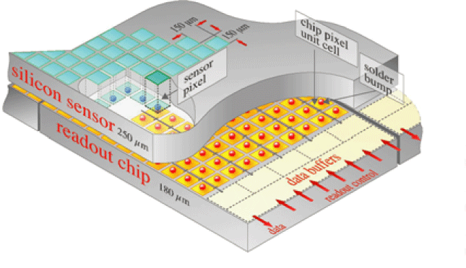
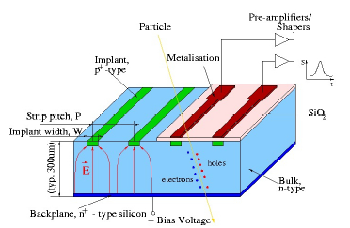
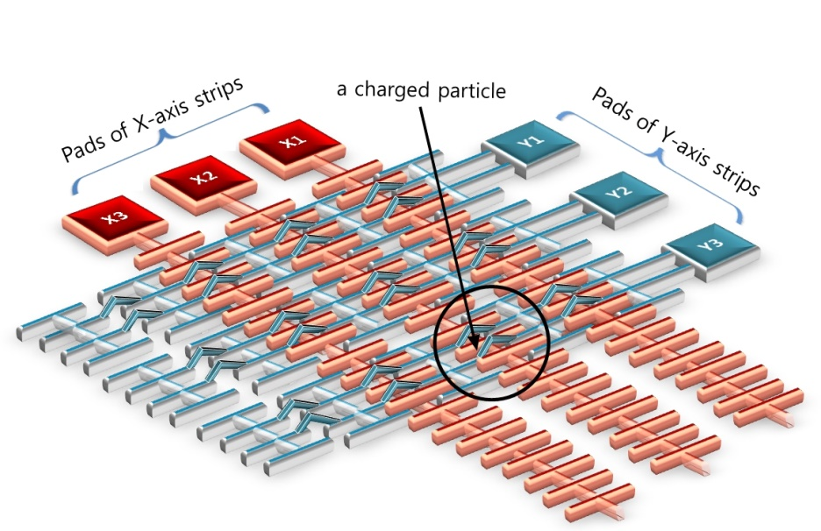
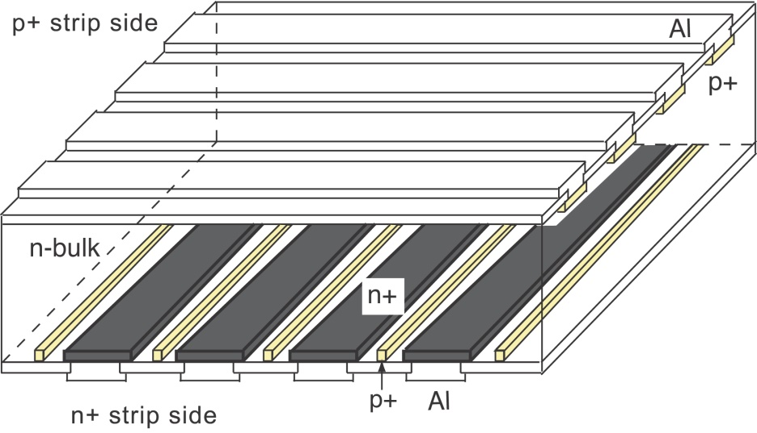
Examples of Silicon Detectors for Charged Particle Detection
http://hep.fi.infn.it/CMS/sensors/Silicon_Detector.gif
Pixel sensor for CMS
Single-side strip sensor
Double-side strip sensor
Strip-pixel sensor

Slide 5
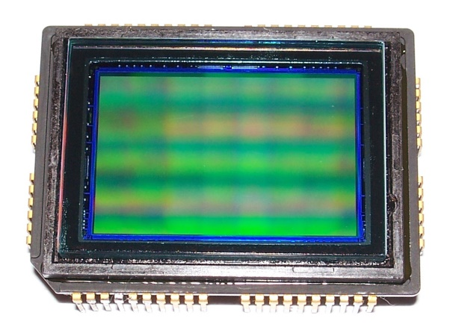
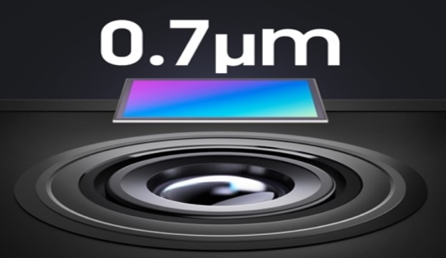
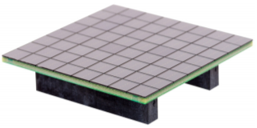
Examples of Silicon Detectors for photon detections
Sony ICX493AQA APS-C, 6.05 μm pixel size, 10.14 M pixels, 23.4 mm × 15.6 mm, CCD from digital camera Sony α DSLR-A200 or DSLR-A300, sensor side
CCD
Samsung ISOCELL HM2 sensor, 0.7 μm pixel size, 12,000 × 9,000 (108 M) pixels, used in Xiaomi Redmi Note 9 Pro 5G and Xiaomi Mi 10i
CMOS
6.3 mm
8.4 mm
SiPM
Sensl SiPM pixel array, 8 × 8 pixels, 6 mm pixel size, 22,292 micro-pixels , 40 μm micro-pixel size

Slide 6
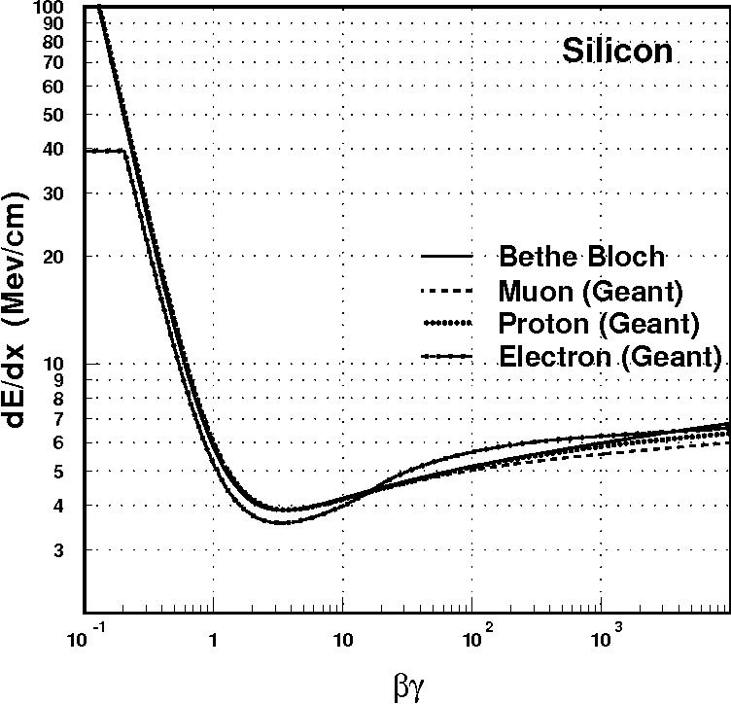
Interaction of charged particles with silicon
Energy loss by ionization
Mean dE/dx:
<dE/dx>
By S. Banerjee
& A. Caner
Relativistic rise
Minimum Ionizing (Particles)
E_{electron} ~ 0.7 MeV
when βγ=1
We will not discuss about energy loss by radiation.
Note that $\frac{dE}{dx}\text{(}\text{ionization}\text{)}≫$ $\frac{ dE}{dx}\text{(}\text{radiation}\text{)}$ for heavy particles.

Slide 7
Energy loss by ionization
z: charge of incident particle
Bethe equation
<$\frac{dE}{dx}$> $∝$ z²
<$\frac{dE}{dx}$> ≈ 40 keV / 100 μm in Si for minimum ionizing particles
3.6 eV required for producing a pair of e-h in Si
≈ 10,000 e-h pairs / 100 μm expected in Si

Slide 8
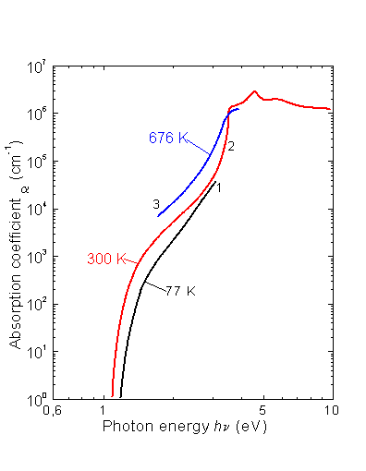
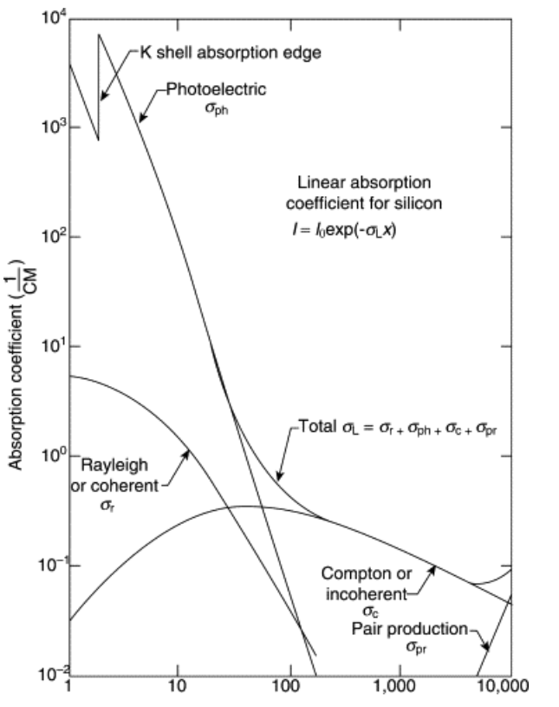
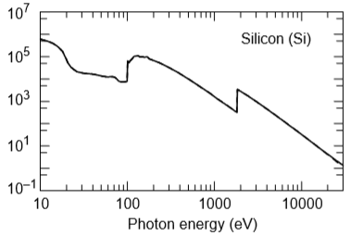
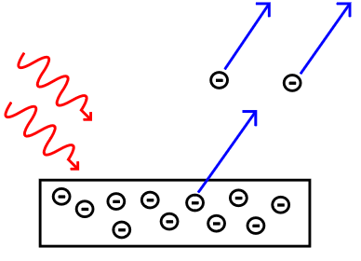
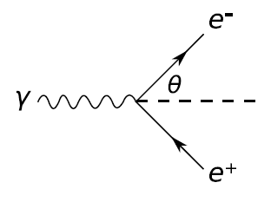
Interaction of photons with silicon
(C)
(A)
(B)
Photon energy (eV)
Photon energy (eV)
Photon energy (keV)
Photoelectric
effect
Compton
scattering
Pair production

Slide 9
References for the plots in Page 8
Sze, S. M., Physics of Semiconductor Devices, John Wiley and Sons, N.Y., 1981; Jellison, Jr., G. E. and F. A. Modine, Appl. Phys. Lett- 41, 2 (1982) 180-182.
X-RAY DATA BOOKLET, Lawrence Berkeley National Laboratory
Durini (Editor), “High Performance Silicon Imaging: Fundamentals and Applications of CMOS and CCD Sensors”, Woodhead Publishing, 2014 Particularly: Chapter 10 (p286) by R. Turchetta, STFC, UK

Slide 10
2. Properties of silicon

Slide 11
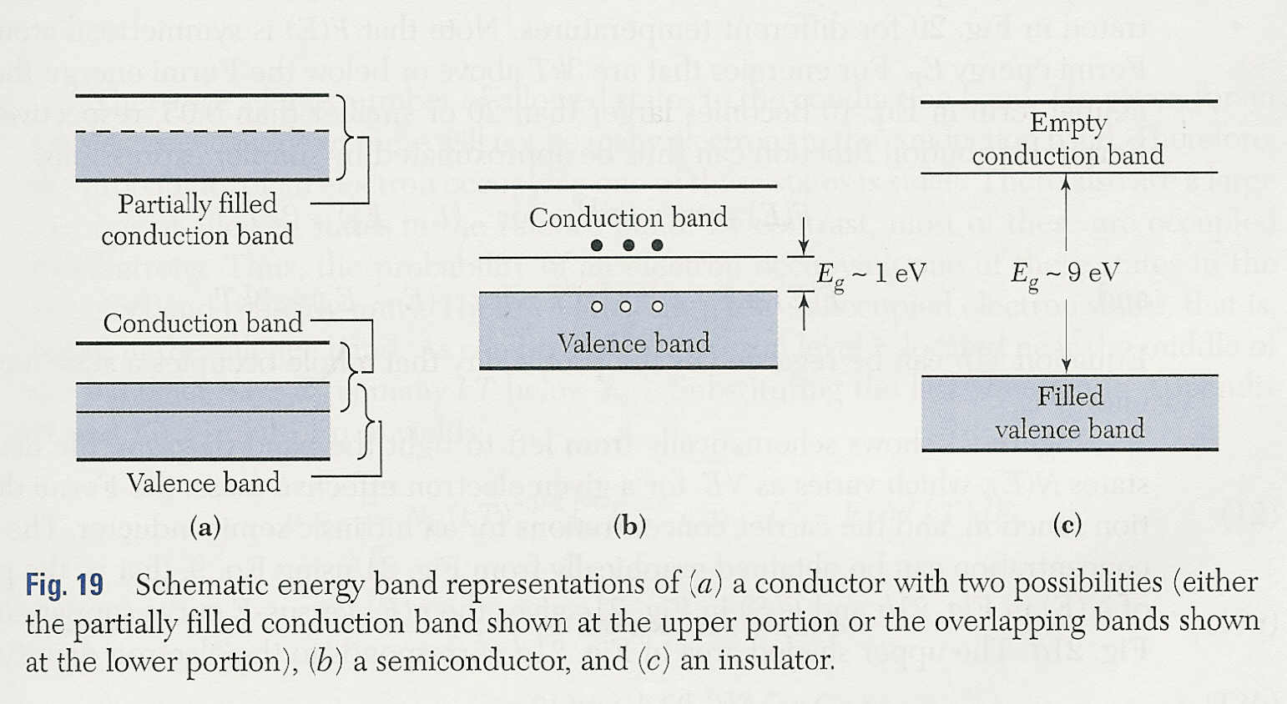
Band & bandgap
From ‘Semiconductor Devices
Physics and Technology Second Edition’
by S.M. Sze

Slide 12
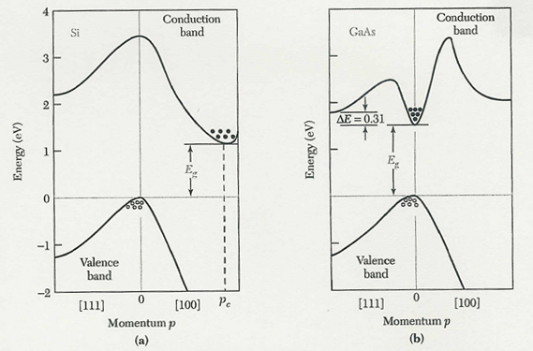
Indirect vs Direct Bandgap Semiconductors
From ‘Semiconductor Devices
Physics and Technology
Second Edition’
by S.M. Sze
Indirect bandgap
Direct bandgap
Si
GaAs
phonon
Excitation/De-excitation = E_{g} + E_{phonon}
Excitation/De-excitation = E_{g}

Slide 13
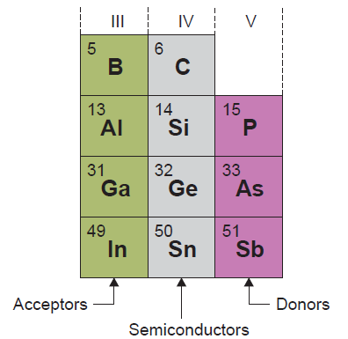
Why Silicon?
abundant --> cheap
Lighter
SiO₂ layer
Naturally or inexpensively formed
chemically and mechanically very stable
effectively passivates the surface states of the underlying silicon
forms an effective diffusion barrier for the commonly used dopant species
easily preferentially etched from the silicon, and vice versa, with high selectivity
By contrast, GeO₂ is a chemically unstable, poor electrical insulator that is 33 times more soluble in water than SiO₂, making it less suited to the photolithographic and wet chemical processes used to fabricate integrated circuits.

Slide 14
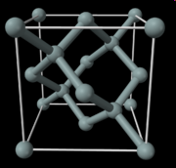
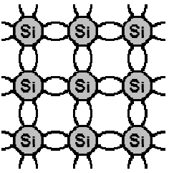
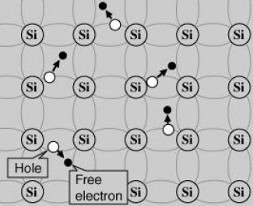
Intrinsic Si semiconductor
The crystalline structure is Diamond Cubic (FCC).
Bare wafers of <100> or <111> crystals are popular ones used for silicon detector fabrications.
low T : electrons bound in lattice
higher T : free electrons & holes

Slide 15
Impurities
Jargons

Slide 16
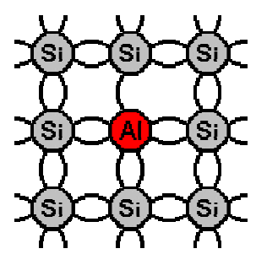
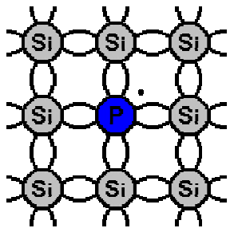
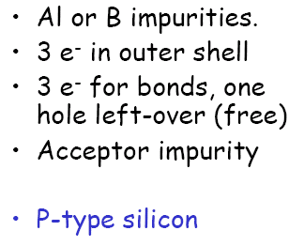
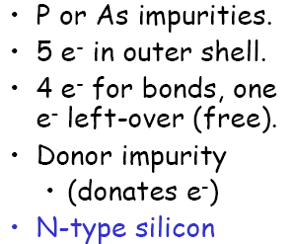
Doping: acceptors & donors

Slide 17
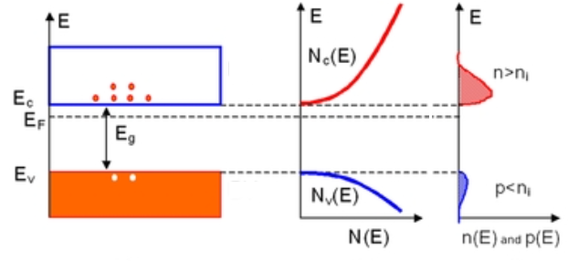
Effect of doping
Phosphorus-doped silicon

Slide 18
3. Silicon detectors for charged particle detection

Slide 19
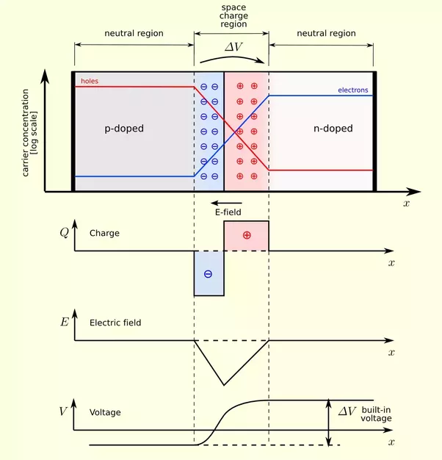
p-n junction (fundamental structure)
The depletion region d is a region
with no charge carriers (with no
free charges).
d
depletion depth

Slide 20
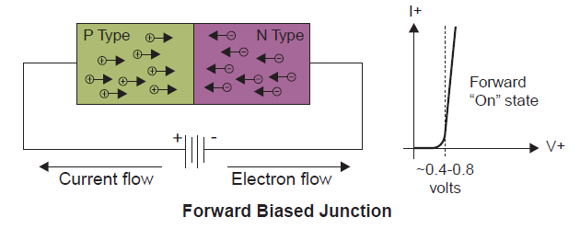
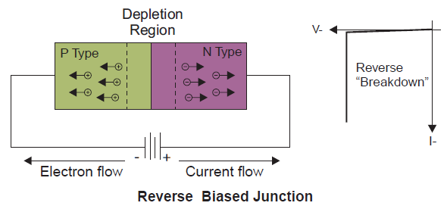
p-n junction
depletion depth

Slide 21
Depletion depth
d=
d=
d=
An exercise :
p-type Si
ρ ~ 10 kΩ cm
d ~ 300 μm
→ V ~ 110 V
d=
d=
(V in Volts & ρ in Ω cm) for Si

Slide 22
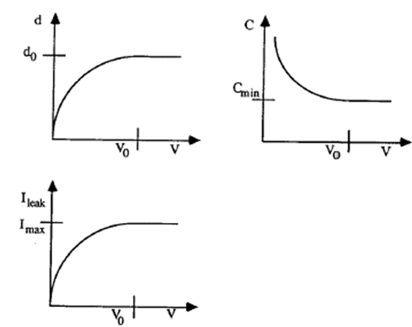
p-n junction reverse bias characteristics
C ∝Area/d
d = depletion depth
I
I

Slide 23
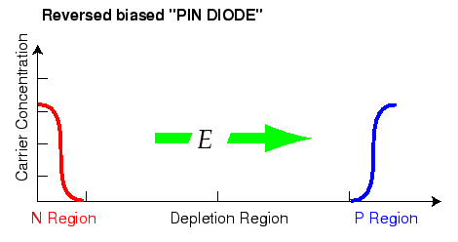
PIN Diode
In practice
p-n junction
n
p
n+ n p+
Intrinsic or
lightly doped
Ohmic contact
or
n
p
n+ p p+
Ohmic contact
p-n junction

Slide 24
When a charged particle traverses the depletion zone
Simple detector
~ 10,000 e-h pairs / 100 μm
n
p
Intrinsic or
lightly doped

Slide 25
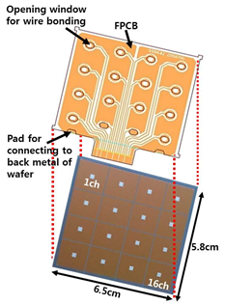
Silicon pixel sensor
PIN diode, DC type
Wafer: 5 inch, 525 μm in thickness, double polished side,
N-type high resistivity (>5 kΩ-cm), (111) orientation
pixel size = 1.55 cm x 1.38 cm
variable
4x4 pixels

Slide 26
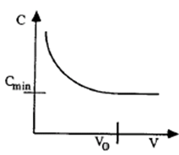
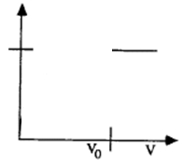
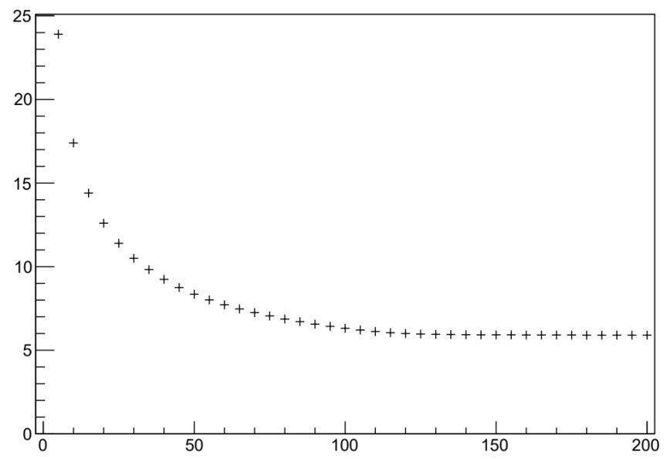
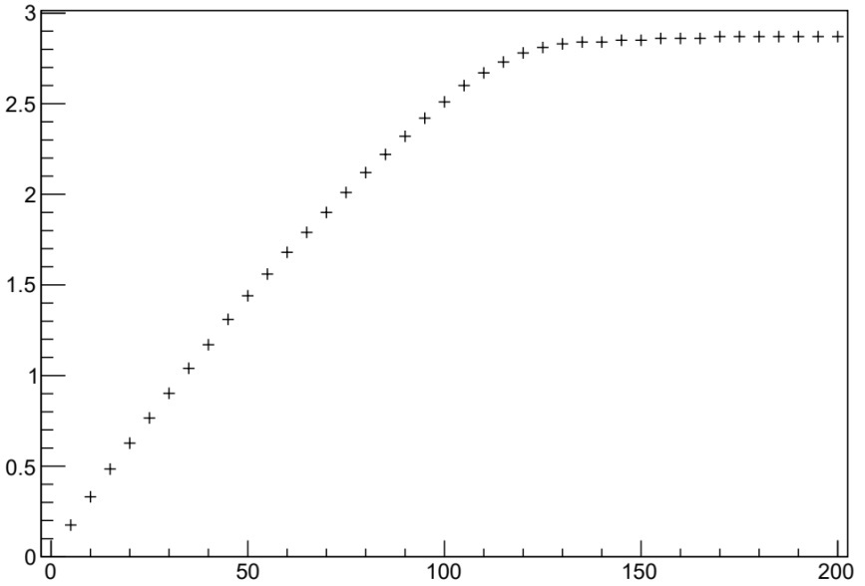
C-V measurement for a single pixel
1/C²$∝V for V<V0$
1/C²
1/C²$=const. for V>V0$
C ∝Area/d
C
1/C²
C in 10⁻¹¹ F
1/C² in 10²⁰ F⁻²
V
V

Slide 27
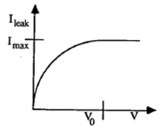
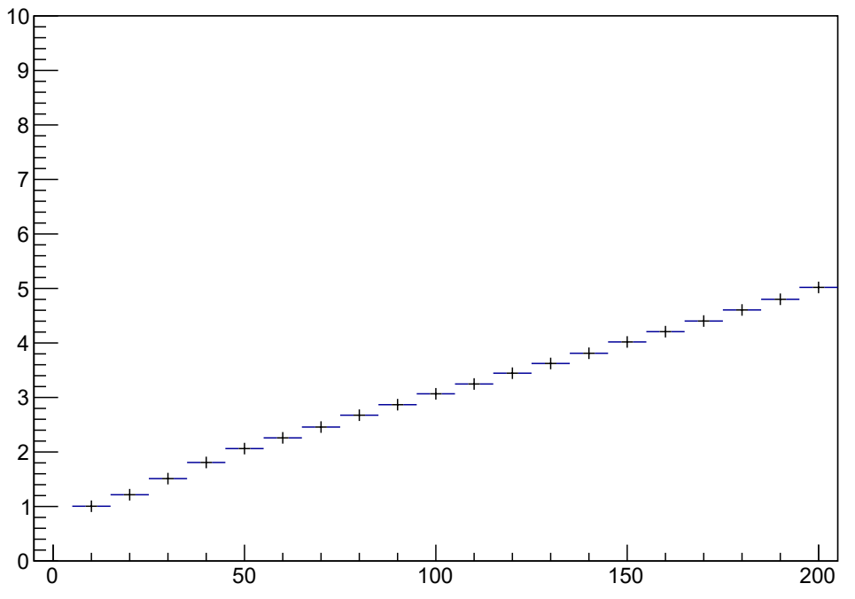
I-V measurement for a single pixel
I
I
I(nA)
The deviation from the expected is
due to the surface current.
Still 5nA @ 200V is excellent.
?
V

Slide 28
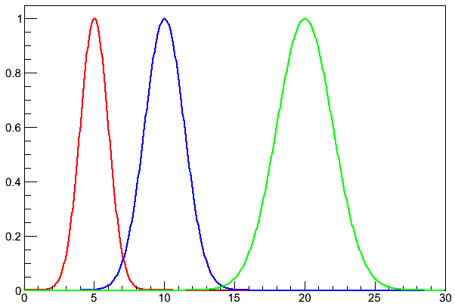
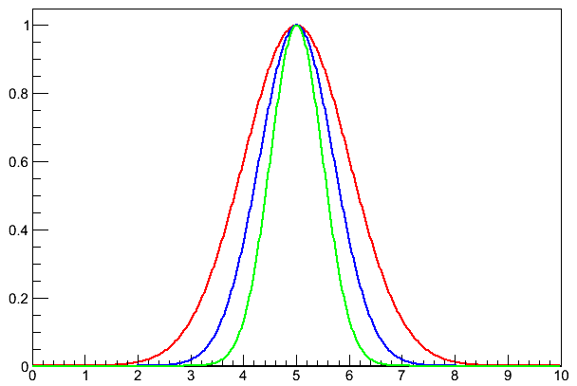
dE/dx is of random nature: if Gaussian distribution
thickness: x 2x 4x
mean dE/dx
most probable dE = dE_{p}
dE_{p}/dx = <dE/dx>
5 $10$ $20$
5 $5$ $5$
σ $\frac{\text{σ}}{\sqrt{2}}$ $\frac{\text{σ}}{\sqrt{4}}$
σ $\sqrt{2}$σ $\sqrt{4}$σ
dE
dE/dx

Slide 29
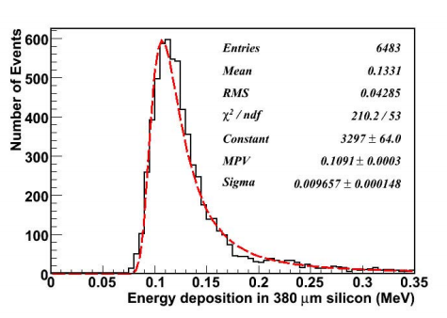
dE/dx is of random nature: Landau Distribution
Simulation of Energy loss in silicon: 100 GeV Proton, 380 μm thickness
dE_{p}
<dE>
w_{FWHM} = 4.02 $ξ$
λ = $\frac{\text{∆}−<\text{∆}>}{\text{ξ}}$ - $β^{2}$-1+$C_{E}−ln(\frac{\text{ξ}}{E_{max}}$)
=$ξ$
Due to δ rays:
Knock-on electrons

Slide 30
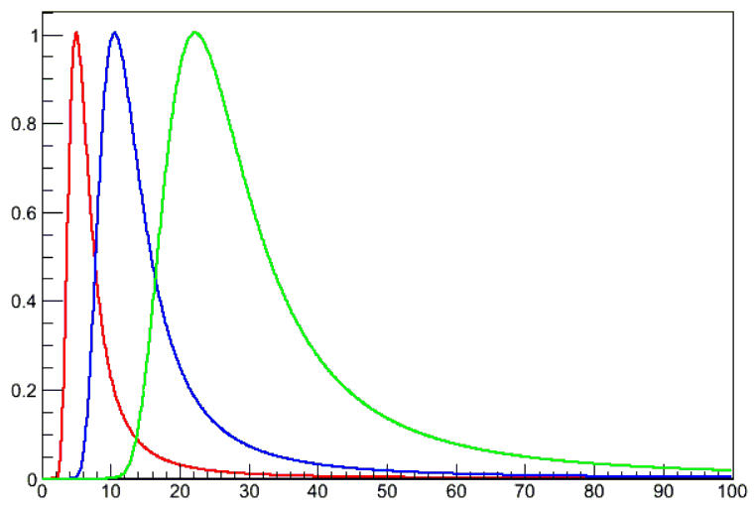
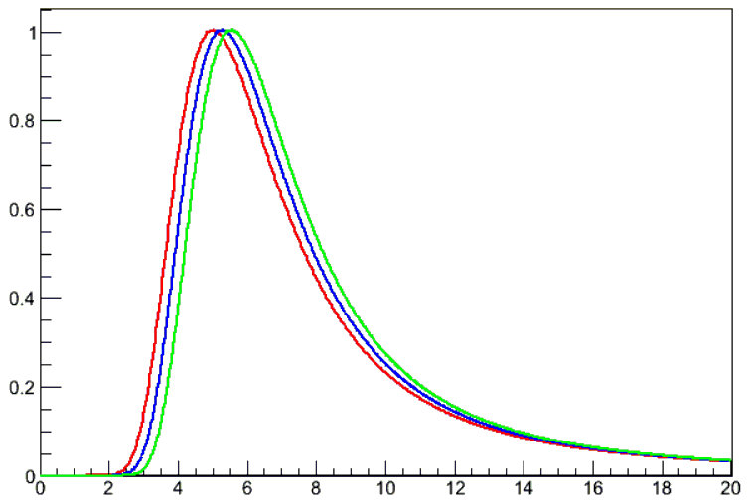
dE/dx is of random nature: if Landau distribution
thickness: x 2x 4x
What will happen as x gets large?
dE_{p} ∝ x[a+ln(x)]
dE_{p} /dx
5 >$10$>$20$
5 >5 >5
σ 2σ 4σ
σ σ σ
<dE/dx>
11.7 12.0 12.3
dE
dE/dx

Slide 31
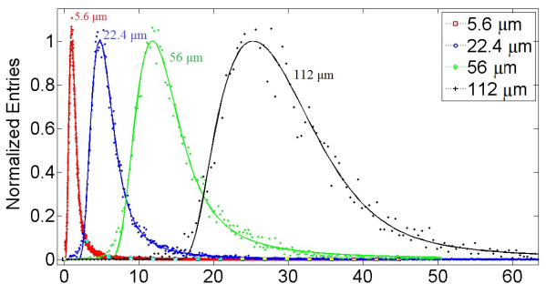
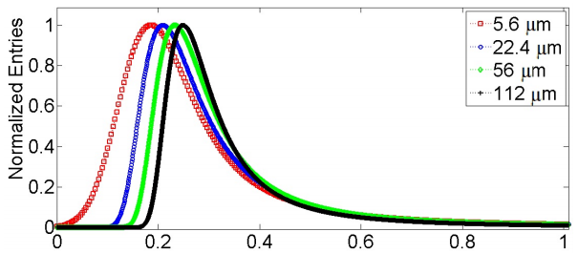
dE/dx is of random nature: if Gaussian convoluted Landau distribution
dE (keV)
S. Meroli, 2011 JINST 6 P06013
dE/dx (keV/μm)

Slide 32
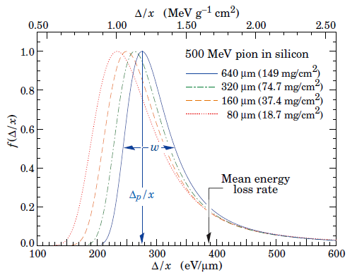
dE/dx is of random nature: if Hans Bichsel’s Straggling function
From Review of Particle Physics

Slide 33
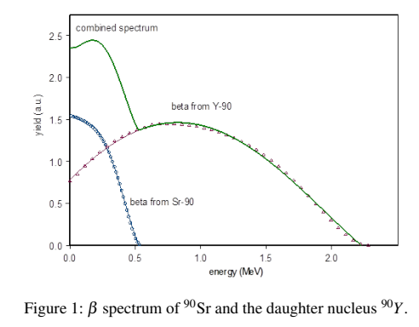
⁹⁰Sr source test for a single pixel
trigger
pixel
the pixel
of interest
electrons
Change the bias voltage of the pixel
CERN Note
PH-EP-Tech-Note-2015-003
Electron Energy is NOT mono-energetic !

Slide 34
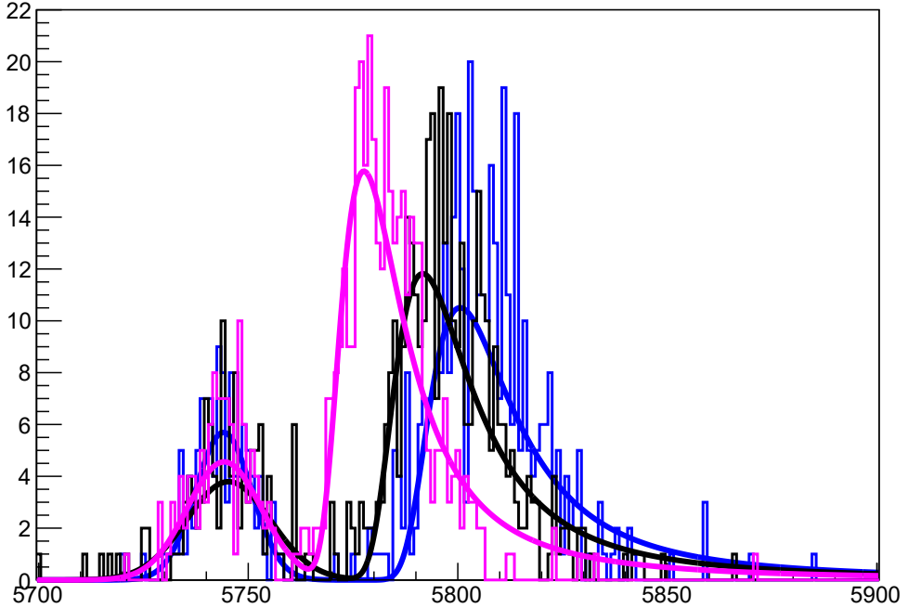
Signal as a function of bias voltage
V_{bias} = 21V, V_{bias} = 60V, V_{bias} = 167V
Signals fitted with Landau functions.
Not very good fits!
Signals fitted with Gaussians.
Use these fit results !
pedestal
pedestal
ADC
ADC

Slide 35
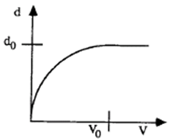
Depletion depth vs. bias voltage
d ∝ Peak_{signal} – Peak_{ped} (ADC)
120 V
V

Slide 36
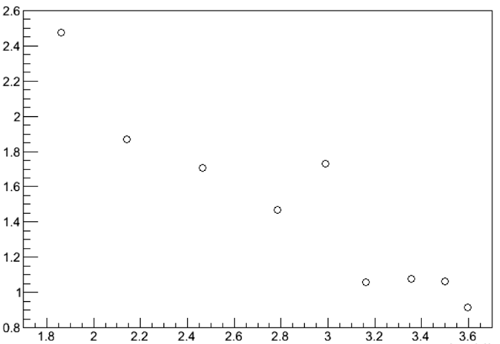
w_{dE/dx} $= \frac{σ_{G}}{\sqrt{V}}$ vs. $\sqrt[4]{V}$
1/x form expected !
$\frac{σ_{G}}{\sqrt{V}}∝ \frac{σ_{G}}{d}∝ \frac{σ_{G}@12V}{\sqrt{d}}$
120 V
$$\sqrt[4]{V}∝\sqrt{d}$$

Slide 37
Pedestal width vs. bias voltage
Why σ_{ped} @ OV >> σ_{ped} @ 167V?
Practically Useful! How?
V_{bias} = 0V
V_{bias} = 167V
ADC

Slide 38
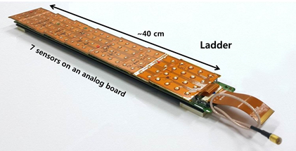
Silicon Pixel Sensor & Ladder for SCD
Built by SKKU group
One sensor
4x4 pixels
pixel size = 1.55 x 1.38 cm²

Slide 39
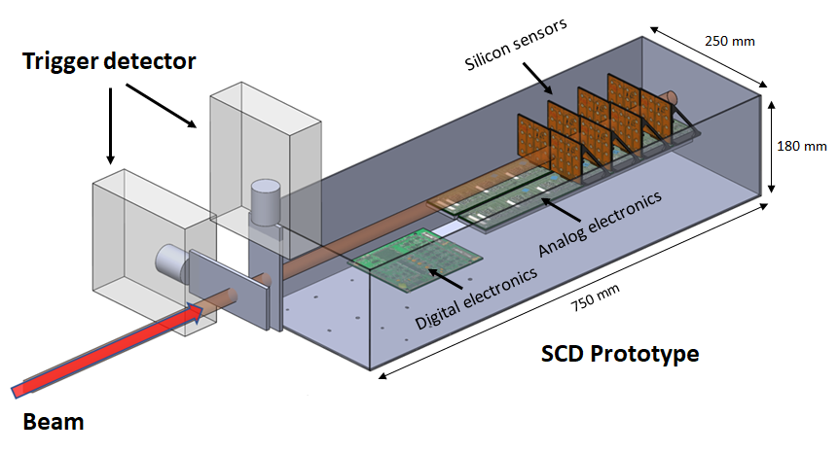
Heavy Ion Beam Test of 4-layer prototype @ CERN

Slide 40
Prototype Performance: Response to Heavy Ions
Histogram = SCD response = ADC = dE/dx ∝ Z²
Curve = Best Fit to Histogram
δ(dE/dx) ↓
as # of layer ↑
A_{i} =ADC(i^{th} layer)
single-layer A₁
2-layer
(A₁+A₂)/2
3-layer average
(A₁+A₂+A₃)/3
4-layer average
(A₁+A₂+A₃+A₄)/4

Slide 41
Prototype Performance: Charge Resolution of Fe as a func. of layer
δZ ↓ as # of layer ↑
δZ_{2L} = (1.65 $±$ 0.10) $×$ 10⁻¹
δZ_{4L} = δZ_{2L} /$\sqrt{2}$
δZ_{3L} = δZ_{2L} $×\sqrt{2}/\sqrt{3}$
δZ_{3L} = (1.39 $±$ 0.10) $×$ 10⁻¹
0.116 ≈ 0.117
0.139 ≈ 0.135
δZ_{4L} = (1.16 $±$ 0.07) $×$ 10⁻¹
2-layer
(Z₁+Z₂)/2
3-layer average
(Z₁+Z₂+Z₃)/3
4-layer average
(Z₁+Z₂+Z₃+Z₄)/4
Z

Slide 42
Silicon Charge Detector (design, fabrication & assembly
Built by SKKU group

Slide 43
Silicon Charge Detector (specification)

Slide 44
ISS-CREAM payload
Mass ~ 1258 kg
Power ~ 415 W
Length ~ 185 cm
4-layer SCD
(built by SKKU group)
ATCS
Grapple Fixture
(1 of 2)
Electronics
Rack (1 of 3)
Targets
PIU
TCD
Instrument
Calorimeter
Calorimeter
Composite Base
Plate
BSD
Electronics
Readout Box
Vents
(1 of 2)
BCD
Instrument
BSD
Instrument
Power
Distribution
Boxes
Fluid Loop
Accumulators
Not Shown (Located behind Power Distribution Boxes
Housekeeping Box
Science Flight Computers
HPDs
(2 of 4)

Slide 45
ISS-CREAM @ GSFC before TVAC test (July 22-25, 2015)

Slide 46
ISS-CREAM in space operation

Slide 47
SCD performance: standalone tracking
A 4-layer track!
layer1
layer2
layer3
θ = 34.19 +1.91 -0.59°
φ = 105.5 +5.9 -2.9°
layer4

Slide 48
SCD performance: charge measurement
Very early data!
C
O
Mg
Si
Fe
N
Ne
S
z

Slide 49
4. Silicon detectors for photon detection

Slide 50
CCD (Charge Coupled Device) sensor
Charge Coupled Device
Photoelectrons produced by photoelectric effect

Slide 51
CCD analogy
output = charge

Slide 52
CCD inventors (winners of Nobel prize in physics in 2010)
G. E. Smith & W.S. Boyle : invented CCD in 1970
Having Fun @ Bell Lab in 1974 !

Slide 53
CCD application in Astronomy/Astrophysics

Slide 54
CMOS sensor
CMOS : Complementary Metal Oxide Semiconductor
output = voltage
PD = Photo Diode
Notes:
PD는 수광부인 photodiode이고, TG는 전하를 전달하는 Transmission Gate입니다, 전달된 전하는 FD 즉 Floating Diffusion에서 전압으로 변환됩니다.
SF =source follower = Buffer, SEL = line selection, RS= Reset

Slide 55
A pixel in CMOS sensor
Amplifier converts charge signal to voltage signal !

Slide 56
Layout of typical CMOS sensor

Slide 57
CCD & CMOS summary
원칙적으로는 동일, 즉 포토다이오드 구조로, 광의 세기가 전하량으로 변환되고, 전하를 전압으로 변환 출력
변환기가 어디에 위치하는가가 두 센서의 근본적인 차이
픽셀의 정보 이동 방법의 차이, 즉 CCD는 전하로 픽셀간 이동 최종 전압으로 변환, CMOS는 픽셀 단위에서 전압으로 변환하여 이동
잡음이 크고, 동적폭 (dynamic range) 및 속도에서 뛰어나지 않음
동적폭 = Full Well Capacity / 잡음
Kodak Mega 픽셀 CCD: 200,000 전자 / 20전자 = 100,000
광량이 적은 환경에서는 고민감도의 센서가 필요하나, CCD와 CMOS는 증폭형 센서가 아니므로 어두운 상황에서 그 성능에 한계
우리의 눈의 민감도는 CCD 보다 우수함
CCD 민감도 ~ 0.03 Lux (냉각 시 0.002 Lux)

Slide 58
Photomultiplier
정확히 말하면 광전자를 다수의 전자로 증폭
광음극(photocathode)과 함께 사용하는 PMT(Photomultiplier Tube) 와 MCP(Microchannel Plate)가 대표적으로 단일 광자 계수 가능
반도체 소자에서는 센서 내부에서 광전자(photoelectron)를 증폭: ICCD(Intensified CCD), EB(Electron Bombardment)CCD, EM(Electron Multiplier)CCD, APD(Avalanche Photodiode), SiPM(Silicon Photomultiplier)

Slide 59
Photomultiplier Tubes (PMTs)
초민감 초고속 특성을 갖는 광센서로 과거 수십년간 특수목적에 사용
그러나 진공관식으로 부피가 매우 크고, 충격에 취약하며 고전압을 필요로 하므로, 내구성, 휴대성 및 실용성이 크게 떨어지며, 광량이 많아지면 소자가 파괴되는 문제
PMT의 원리와 Hamamatsu사 제품

Slide 60
20 inch World largest PMT
For Super-K

Slide 61
SiPM
Micro-pixel: Avalanche Photo Diode (APD) in Geiger mode
Size of micro-pixel = tens of μm
Gain ≥ 10⁶
Distinctive binary single photo-electron signal
Micro-pixels in a SiPM are connected through quenching resistors (R_{Q}) to a common output.
SiPM: 1000 – 10000 micro-pixels / 1 mm²
SiPM output: Sum of binary signals (Analog)
--> counts the incident photons
Single micro-pixel
From Hamamatsu SiPM handbook

Slide 62
Geiger Mode

Slide 63
SiPM
PN 접합면에 매우 높은 전기장 형성
한 개의 광자 입사 -> 100만 배의 전자증폭 발생 -> 초 민 감 도 !!
광이 입사되었을 때 센서의 반응 속도 -> 1ns 초 고 속 도 !!
E (V/cm)
Electric field
10⁶
3
10⁴
4
5
10²
6
N+
P+
0
1
2
X (um)
SiPM의 Micropixel

Slide 64
Analog Signal
single
micro-pixel
e
e
Q = nQ₁ ?
ne

Slide 65
Photon Counting Capability
Waveform
Charge distribution

Slide 66
다화소용 8 x 8 픽셀 어레이 소자
SiPM 픽셀
: 1 x 1 mm² 크기
(30x30μm²크기, 10³개의 마이크로 픽셀)
64ch SiPM 소자 : 1 x 1 cm²
1cm
1
2
3
4
5
6
7
8
2
64ch 설계도
3
1cm
4
5
1cm
6
7
8
1cm
64ch SiPM 센서(1cm²)의 현미경 사진
1
1

Slide 67
1024 화소 배열
1024 화소 구성
a micro-pixel
30μm
32x32 = 1024
mircro-pixels
in parallel
1mm x 1mm
30μm
화소
8mm x 8mm
단위소자
= 8x8 화소
32mm x 32mm
1024 화소
= 4x4 단위소자

Slide 68
16개의 8 x 8 SiPM 픽셀 어레이로 구성된 다화소 (1024-ch)
1단계 SiPM 픽셀 1024ch 제작
: 1 x 1 mm² 크기
(30x30μm²크기, 10³개의 마이크로 픽셀)
64ch SiPM 소자 : 1 x 1 cm²
1024-ch
항복전압 균일
->
Multi channel test
4cm
4cm
Voltage(V)

Slide 69
1024-ch SiPM + 신호처리장치 + Pinhole
Pinhole
Electronics

Slide 70
Image Test
Pinhole Camera
SiPM
Pinhole
A
A
10 cm
10 cm

Slide 71
Image Test
Pinhole Camera
Absolutely Dark!
CCD or CMOS cameras
can NOT get this image!
200 cm

Slide 72
5. Radiation Damages in silicon detectors

Slide 73
Bulk damage
Displacement of lattice atoms
Defects can be active with levels in the band gap
capture and release electrons and holes from conduction and valence bands
trapping centers, generation/recombination centers,
Particles
Distributions
of vacancies in μm³
after 10¹⁴ particles/cm²
NIMA 491 (2002) 194
Mainly clusters

Slide 74
Surface damage
Microelectronic Technology Thermal Oxidation (III)
by Bhargav Veepuri
Si-SiO₂ interface
Radiation produces e-h pairs in SiO₂.
Some of these charge carriers recombine.
Some carriers move to the electrodes.
Some holes (with lower mobility) drift to be fixed oxide charges near the Si-SiO₂ interface.
Some holes drift to the Si-SiO₂ interface to be interface traps.
Q_{it}: holes trapped in the interface

Slide 75
Radiation damages: two types
Bulk (Crystal) damage due to Non Ionizing Energy Loss (NIEL): Displacement Damage
Increase of leakage current (increase of noise)
Change of depletion voltage (higher operation voltage, under-depletion)
Decrease of charge collection efficiency due to under-depletion and increased trapping
Surface damage due to Ionizing Energy Loss (IEL): Accumulation of positive in the oxide (SiO ) and the Si/SiO2 interface
Increase of leakage current with breakdown behavior
Change of depletion voltage (higher operation voltage, under-depletion)
Increase of inter-pixel capacitance (noise factor) & decrease of inter-pixel resistance
Formation of an electron accumulation layer, which may cause charge losses at the interface.

Slide 76
6. Backgrounds in silicon detectors

Slide 77
Leakage current or Dark current in silicon
Free charge carriers can also be generated in absence of signal(charged particles or photons) by thermal excitation or tunneling and produce an avalanche breakdown:
Direct thermal transition
Trap-assisted thermal transition
Direct tunneling effect
Trap-assisted tunneling effect
M. Nitschke-michael Master’s degree, Universität Hamburg, 2016

Slide 78
Optical Cross-Talks Background in SiPM
From Hamamatsu SiPM handbook
Manifestation of Optical Cross-Talks

Slide 79
Manifestation of After-Pulses in SiPM
From Hamamatsu SiPM handbook
During an avalanche process (whether triggered by a photoelectron or a thermal carrier), a small portion of avalanching carriers get trapped in impurity energy levels but are released after short delays (typically on the order of few 10 ns) upon receiving the required energy (albeit small) to reenter the conduction or valence band.
Upon their release, these carriers initiate new avalanche pulses, which appear with delays after the genuine parent pulse and are hence referred to as after-pulses.

Slide 80
Manifestation of After-Pulses in SiPM
From Hamamatsu SiPM handbook
During an avalanche process (whether triggered by a photoelectron or a thermal carrier), a small portion of avalanching carriers get trapped in impurity energy levels but are released after short delays (typically on the order of few 10 ns) upon receiving the required energy (albeit small) to reenter the conduction or valence band.
Upon their release, these carriers initiate new avalanche pulses, which appear with delays after the genuine parent pulse and are hence referred to as after-pulses.

Slide 81
5. Summary

Slide 82
Summary
Silicon is one of most popular material for radiation detection in the fields of Particle physics/Astro-particle physics
Charged particle detection, Photon detection, etc.
Examples are given to help the audience understand
C-V & I-V characteristics of silicon detectors
Responses (signals) of silicon detector to charged particles
dE/dx as a func. of V_{bias}
dE/dx as a func. of the number of measurements (layers)

Slide 83
Back-up slides

Slide 84
Sand to silicon wafer

Slide 85
Recipe for fabrication process
Clean wafer
Oxidation
N⁺Diffusion
Cover with photoresist
Expose through mask
Develop
Etch SiO₂
P⁺ Implantation Anneal
Metallization

Slide 86
Example of CMOS fabrication process
From
https://en.wikipedia.org/wiki/CMOS

Slide 87
Absorption Coefficient
From ‘Semiconductor Devices
Physics and Technology Second Edition’
by S.M. Sze

