Slide 1
Characterization of 20-Inch Micro Channel Plate Photomultiplier Tube (MCP-PMT)
$Kim GeonWoo$¹, Kim HongJoo¹*, Lee Jik¹*
¹Department of Physics, Kyungpook National University, Daegu 41566, Korea

Slide 2
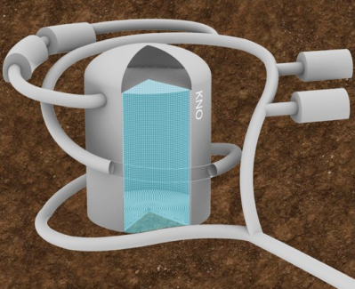
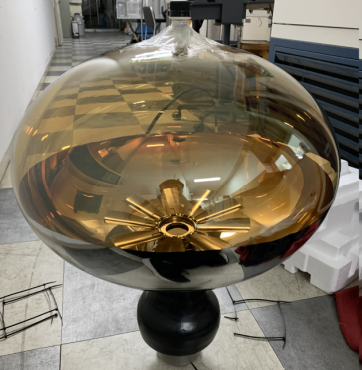
Introduction
There is a proposal to construct a large Korea Neutrino Observatory (KNO) in Korea.
It consists of a large water tank and several tens of thousands of photosensors to detect neutrinos.
The characterization and testing techniques of this PMT as a candidate to be used in this experiment are required.
Among the important characteristics of PMT, test results are provided for gain, rising and falling time, energy resolution, dark count rate, after pulse ratio, signal to noise ratio, and peak to valley ratio.
γ
Glass and photocathode
inner surface
detectors
$$e^{−}$$
20inch MCP PMT
Dual MCP
Underground Water Tank
Anode
MCP-PMT structure

Slide 3
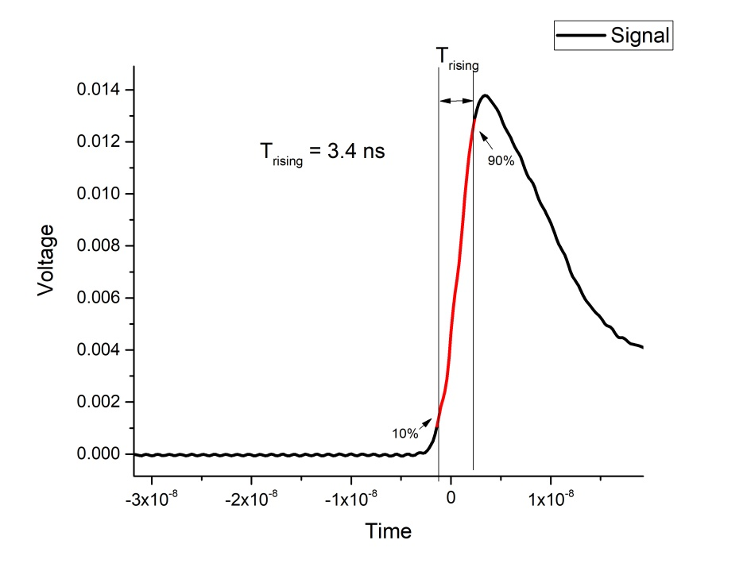
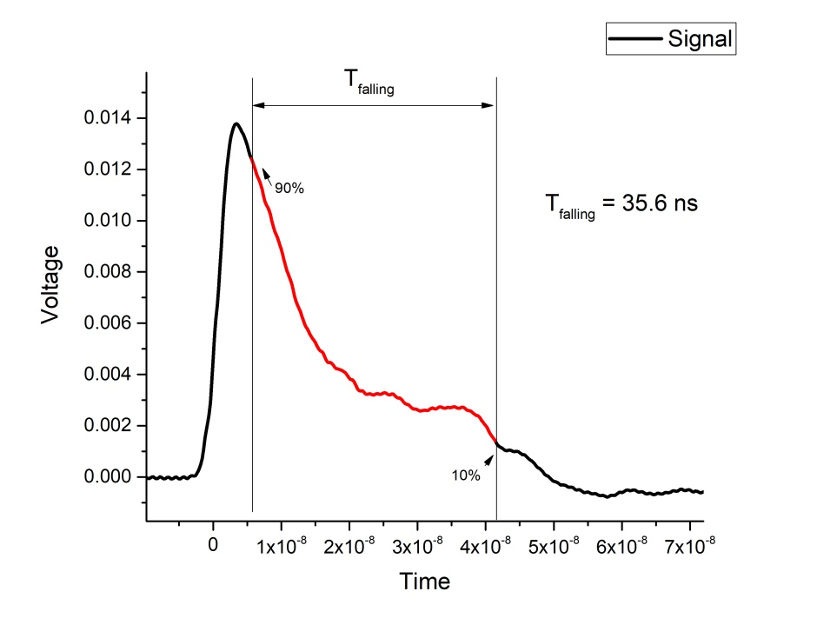
Single photo-electron signal’s Rising time, Falling time
Rising time is from 10% of peak’s timing to 90% of peak’s timing
Falling time is from 90% of peak’s timing to 10% of peak’s timing
Condition : Digital Oscilloscope, Average of 1000 signals, $\frac{1}{4}spe threshold, 1800 voltage,$, temperature : 20℃
 | MCP PMT
Rising time(ns) | 3.4
Falling time(ns) | 35.6

Slide 4
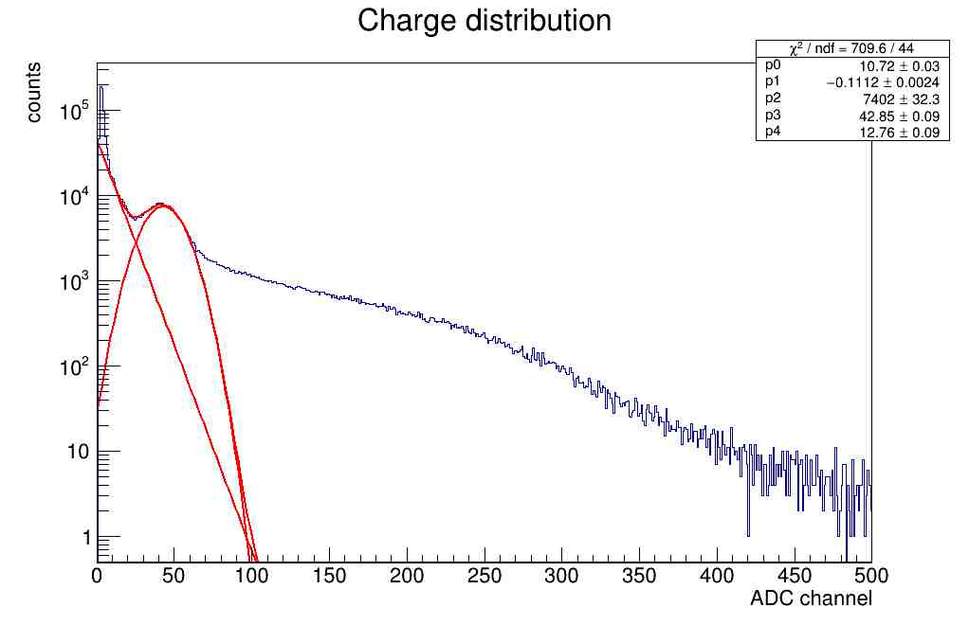
Gain
Counts
$$Gain= \frac{\left(SPE mean−PED mean\right)×\frac{V_{gain}}{50}×time step}{Amp gain ×1.6×{10}^{−19}(e)}$$
$v_{gain}$ : ADC scale : $\frac{(1 volt)}{(ADC channel)}$ = $\frac{1}{1024}$v
50$Ω$ : ADC load resistor
Time step : 2.5 ns
Amp gain : 1.2
ADC Channel
$$Gain= \frac{(42.85−0)×\frac{1}{1024×50}×2.5×{10}^{−9}}{1.2×1.6×{10}^{−19}}=1.0897×{10}^{7}$$
The gain is the value of how many electrons are amplified after one electrons are generated in the photocathode.
We used single photo-electron charge distribution of the PMT at 1800 voltage.
Weak LED source and 400Mhz of FADC were used

Slide 5
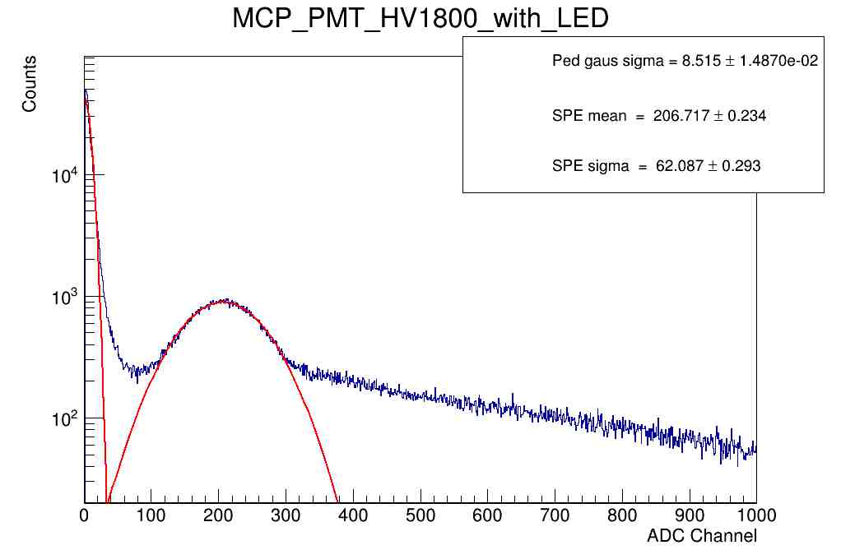
Energy resolution, Signal to noise ratio, Peak to valley ratio
Signal to noise ratio = $\frac{Q_{1 p.e.}−Q_{0 p.e.}}{σ_{0 p.e.}}$ = $\frac{206.717}{8.515}$ = 24.28
Ped sigma = 8.515
SPE sigma = 62.087
Peak to valley ratio = $\frac{937}{188}=4.98$
Charge resolution = $\frac{62.087}{206.717}×100$= 30.0 %
Energy resolution, Signal to noise ratio, Peak to valley ratio also can measure in the Single Photo-electron charge distribution.
We used Neutron tagging module called NGT400, pre Amplifier and LED source for measure charge distribution graph.
S/N value was obtained by divide SPE charge value by Pedestal’s sigma, P/V value was obtained by divide peak value of the SPE by valley value of SPE, Energy resolution was obtained by divide SPE sigma value by SPE mean value.
It can be said that the higher the signal-to-noise ratio and the higher the peak-to-valley ratio, and the lower the energy resolution, the better the performance of the PMT.

Slide 6
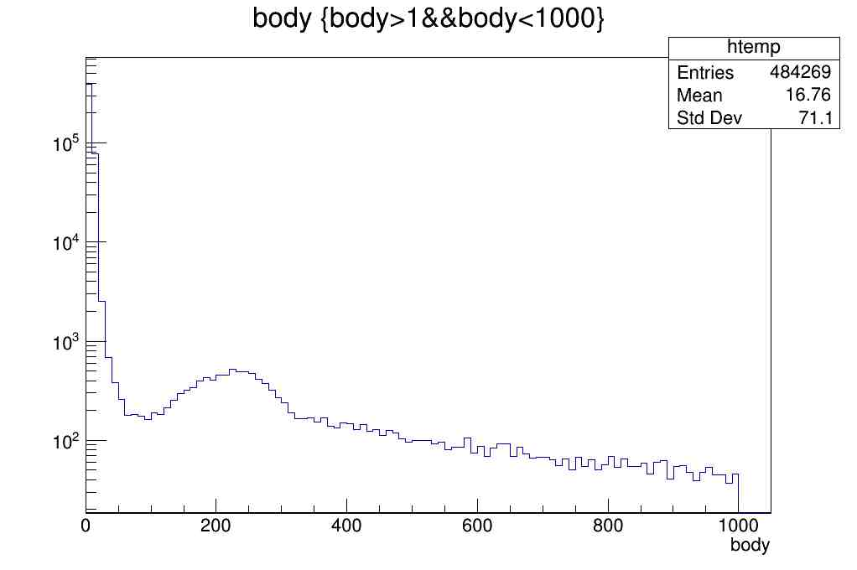
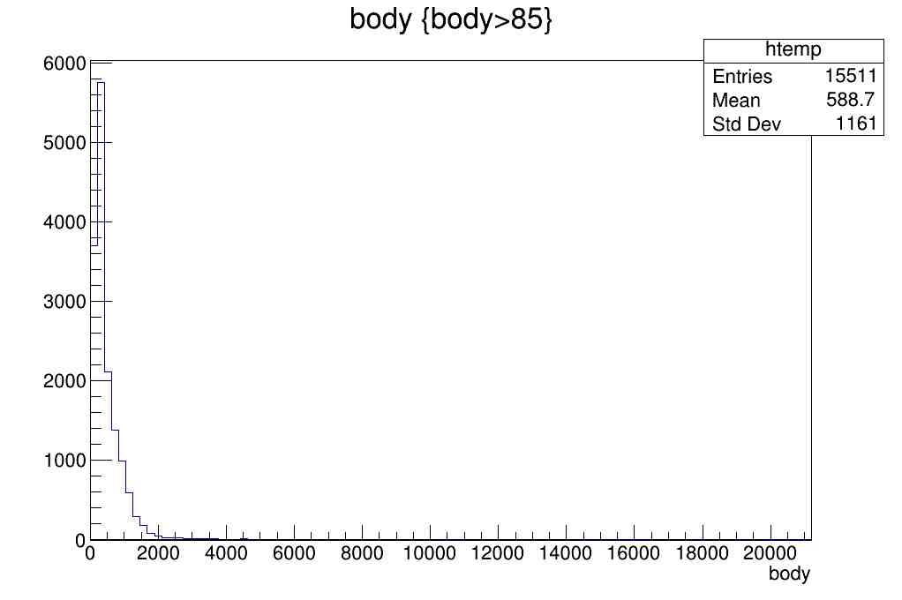
Dark count rate
Counts
Counts
85
ADC Channel
ADC Channel
The dark count rate is a value of how often one photoelectron is generated in the PMT when there is no light.
The lower the dark count rate, the better the performance of the PMT.
Neutron tagging module called NGT400, pre amplifier was used.
Dark count rate = Total Signal x ratio of SPE $÷$ total time
In this case : $64387790×\frac{15511}{1000000}÷71=14066 hz$
Dark count rate = 14.06 Khz (ref. 12.15 Khz)

Slide 7
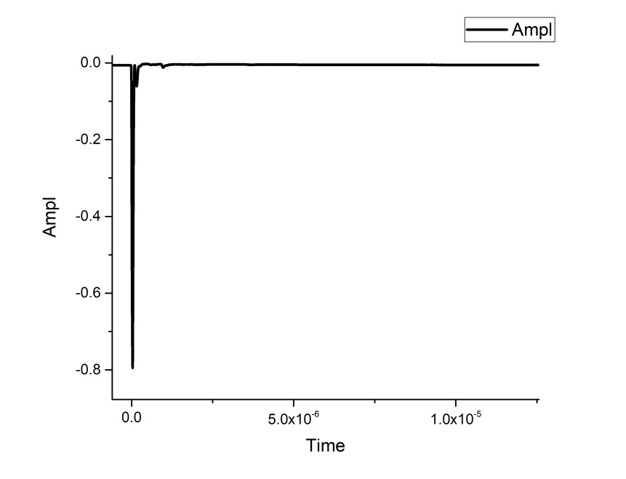
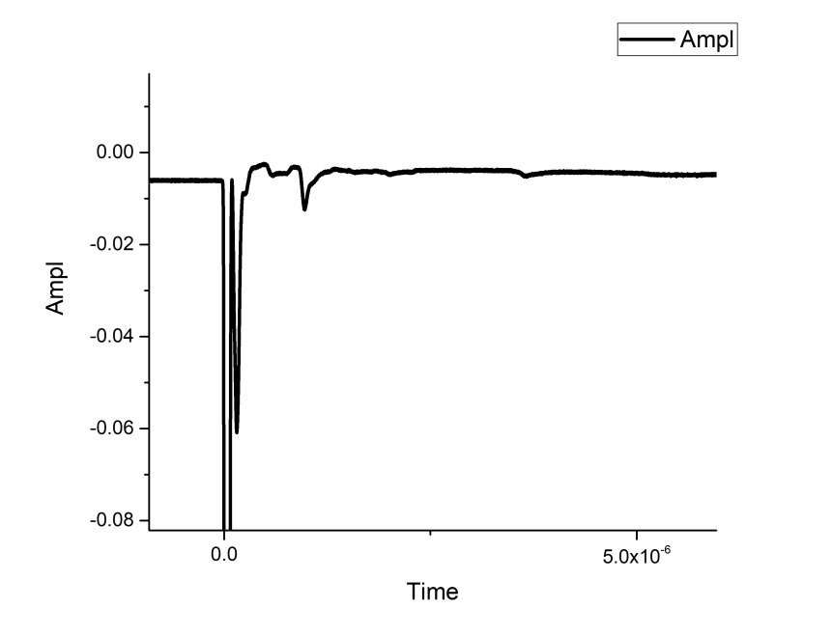
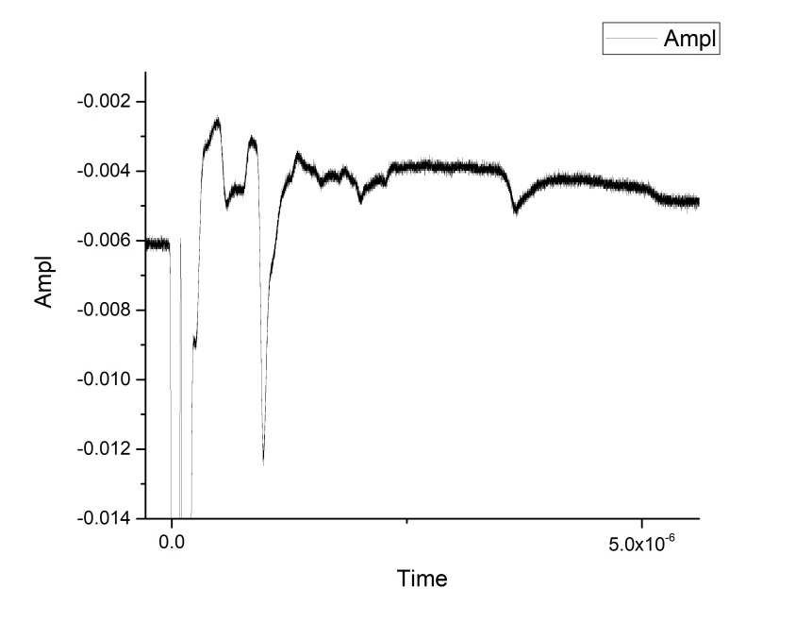
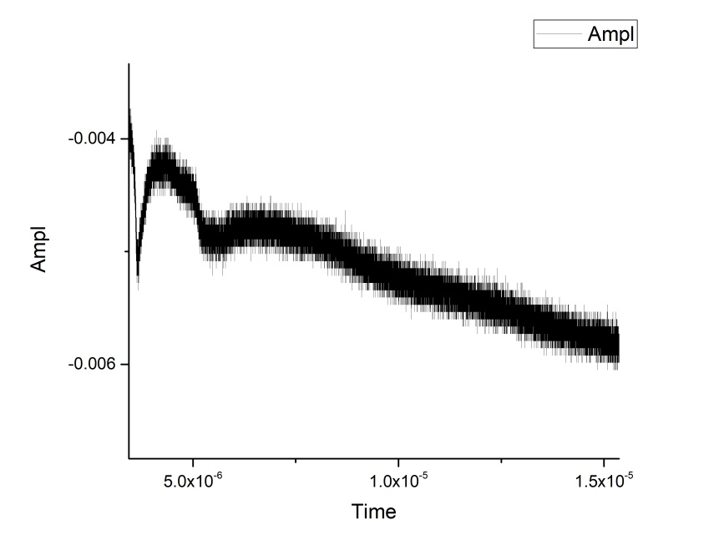
After pulse ratio
3rd after pulse
2nd after pulse
2nd after pulse
Main pulse
1st after pulse
Main pulse
3rd after pulse
4th after pulse
2nd after pulse
Light Source : LED, pulse, Rate 50khz(period 20us). Width 40ns, 2v
10000 Wave averaging with LED source

Slide 8
After pulse Timing and Area
 | Main pulse | 1st After pulse | 2nd After pulse | 3rd After pulse | 4th After pulse
Timing | 0.0312us (peak) | 0.154us (peak) | 0.969us (peak) | 3.664us (peak) | 5.266us (peak)
Area | 3.715E-8 | 3.344E-9 | 1.124E-9 | 2.708E-10 | 1.787E-10
The after-pulses are signals that appears when the residual gases inside the PMT are ionized by the internal voltage.
We used digital oscilloscope and relatively strong LED source.
We averaged 10000 wave forms.
Light Source : LED, pulse, Rate 50khz(period 20us). Width 40ns, 2v
$\frac{3.344×{10}^{−9}+1.124×{10}^{−9}+2.708×{10}^{−10}+1.787×{10}^{−10}}{3.715×{10}^{−8}}×100$ = 13.24 %
After pulse ratio : 13.24 %

Slide 9
Conclusion and Prospect
 | Measurement
Voltage | 1800V
Gain | 1.09E+7
Charge resolution | 30.00 %
Dark count rate | 14.069 kHz
Peak to valley ratio | 4.98
Rise time | 3.4ns
Fall time | 35.6ns
After pulse ratio | 13.24%
Gain, energy resolution, dark count rate, S/N, and P/V are shown to be sufficient for use in KNO experiment.

Slide 10
Experimental setup
DAQ system
Electronics
Function generator
LED
Refrigerator
Optical fiber
PMT
HV
supplier

