Slide 1
Production of XYZ
Alessandro Pilloni
APCTP Focus Progam, July 23rd, 2021

Slide 2
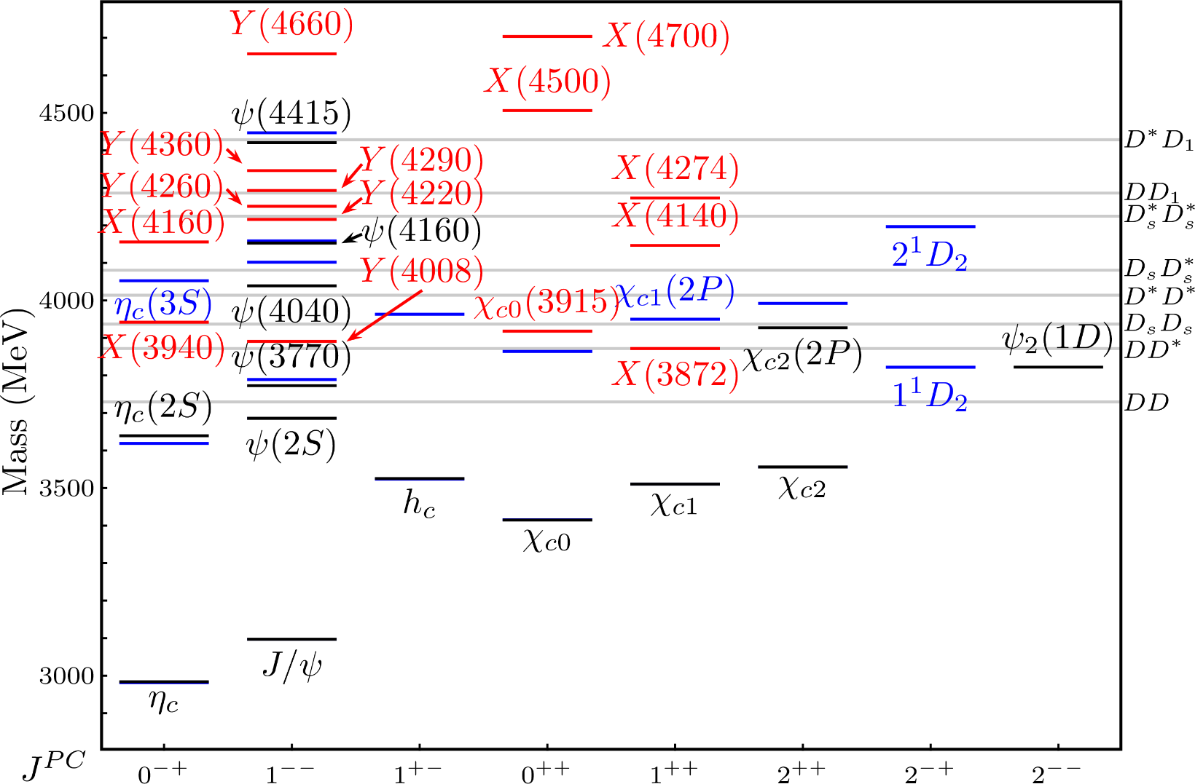
Exotic landscape
Esposito, AP, Polosa, Phys.Rept. 668
A host of unexpected resonances have appeared
decaying mostly into charmonium + light
Hardly reconciled with usual charmonium interpretation
A. Pilloni – Production of XYZ
Notes:
2 slides su Zc, a Bes e a Belle
2 slide su tetraquark model: dall’hamiltoniana di Jaffe al calcolo delle masse
1 slide su molecular models, dove sono i carichi? (non in Tornqvist, si in Hanhart, vedere Braaten, citare Nefediev)
2 slides su decay channels, dove si dovrebbe vedere, e a seconda del modello, vedere qualche plot
1 slide su Y(4260), tetraquark? C’è lo strano (si vede la f0)
1 slide su Zc a cleo (anche il neutro)

Slide 3
Models
Compact
Hybrids
Containing gluonic degrees of freedom
Multiquark
Several (cluster) of valence quarks
Hadroquarkonium
Heavy core interacting with a light cloud via Van der Waals forces
$$π$$
$$π$$
$$J/ψ$$
$$π$$
Rescattering effects
Structures generated by cross-channel rescattering, very process-dependent
Molecule
Bound or virtual state generated by long-range exchange forces
Extended
A. Pilloni – Production of XYZ

Slide 4
Exotic landscape
Broad mesons seen in $b$ decay:
$X(4140)$, $Z(4430)$, $Z_{cs}(4000)$...
Narrow structures seen in $b$ decay:
$X\left(3872\right), P_{c}$, $(P_{cs})$
Scarce consistency between various production mechanisms
Narrow structures seen in $e^{+}e^{−}$:
$X(3872)$, $Y(4260)$, $Z_{c,b}^{(′)}$
A. Pilloni – Production of XYZ

Slide 5
Why photoproduction?
It’s new: no XYZ state has been uncontroversially seen so far
It is free from rescattering mechanisms that could mimic resonances in multibody decays
The framework is (relatively) clean from a theory point of view
Radiative decays offer another way of discerning the nature of the states
A. Pilloni – Production of XYZ

Slide 6
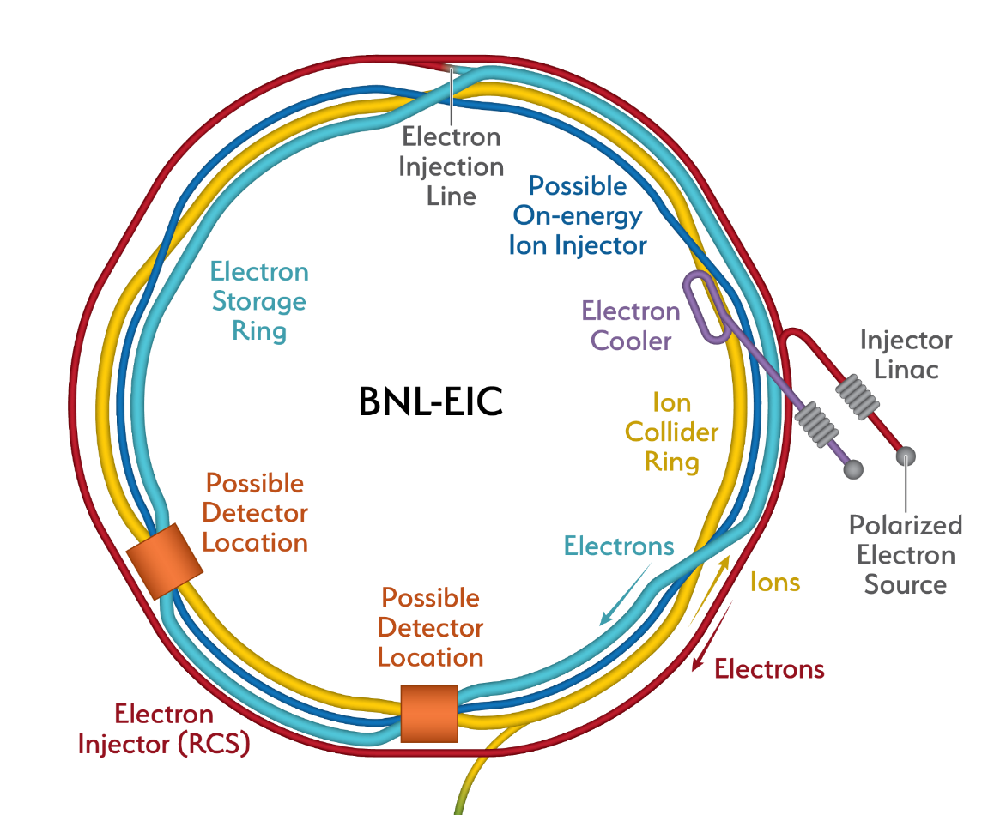
Future Facilities
arXiv:2103.05419
Snowmass LoI RF7_RF0_120
A. Pilloni – Production of XYZ

Slide 7
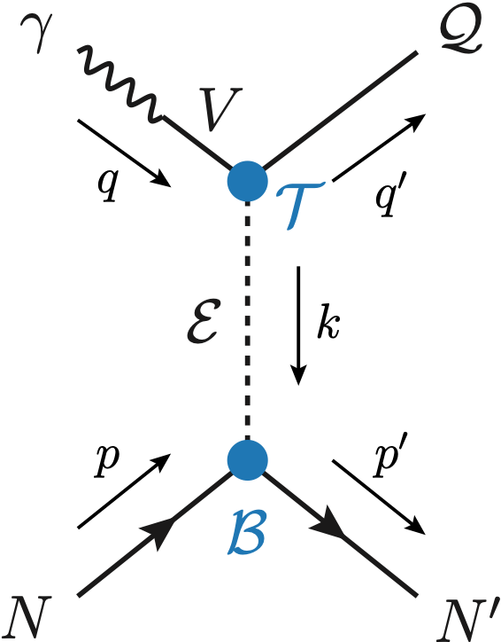
Exclusive (quasi-real) photoproduction
XYZ have not been seen in photoproduction so far : independent confirmation
Not affected by 3-body dynamics: determination of resonant nature
Experiments in the appropriate energy range are promising
We study near-threshold (LE) and high energies (HE)
Couplings from data as much as possible, not relying on the nature of XYZ
M. Albaladejo et al. [JPAC], PRD
$$<λ_{𝒬}λ_{N}^{′}|T|λ_{γ}λ_{N}>=\underset{V,ℰ}{∑}\frac{ef_{V}}{m_{V}}𝒯_{λ_{V}=λ_{γ},λ_{𝒬}}^{α_{1}⋯α_{j}}𝒫_{α_{1}⋯α_{j};β_{1}⋯β_{j}}ℬ_{λ_{N}λ_{N}^{′}}^{β_{1}⋯β_{j}}$$
Bottom vertex from standard photoproduction pheno, exponential form factors to further suppress large t
VMD is used to couple the incoming photon to a vector quarkonium V
Top vertex from measured $𝒬→Vℰ$ decay width
A. Pilloni – Production of XYZ

Slide 8
Threshold vs. high energy
Fixed-spin exchanges expected to hold in the low energy region
$t$ channel grows as $s j$, exceeding unitarity bound, Regge physics kicks in: Reggeized tower of particles with arbitrary spin at HE
$$s^{j}⟶s^{α_{0}+α^{′}t }$$
Holds at low energy, fixed spin
Holds at high energy, resummation of leading $s$ power
If $ε≠$IP, $α_{0}<1$, $dσ/dt$ decreases with energy
Exchange of heavy particles further suppressed
A. Pilloni – Production of XYZ

Slide 9
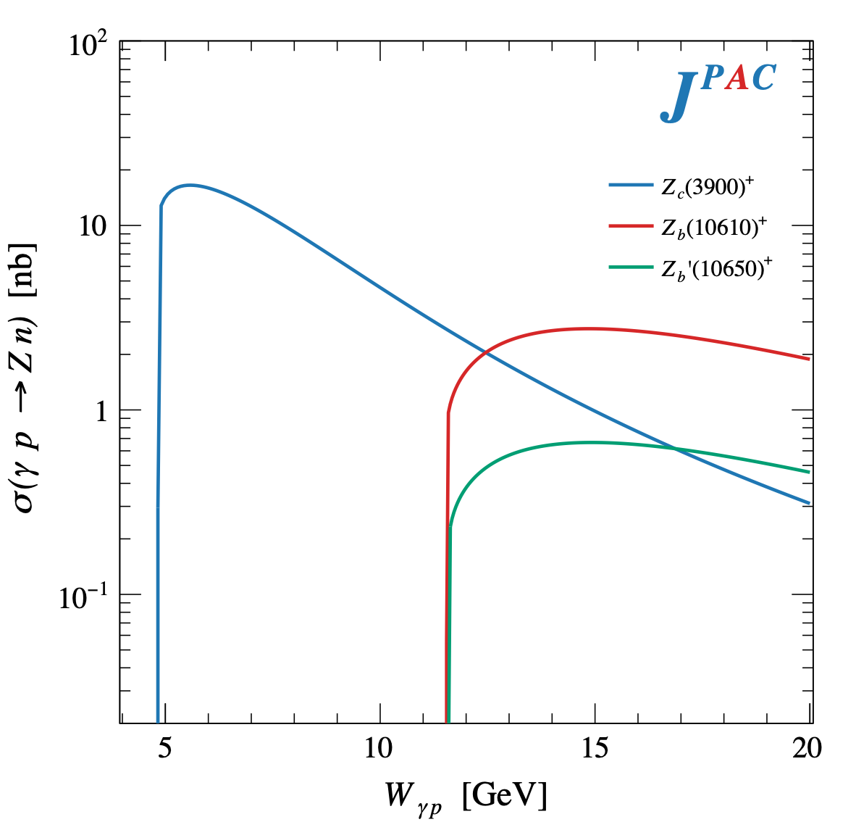
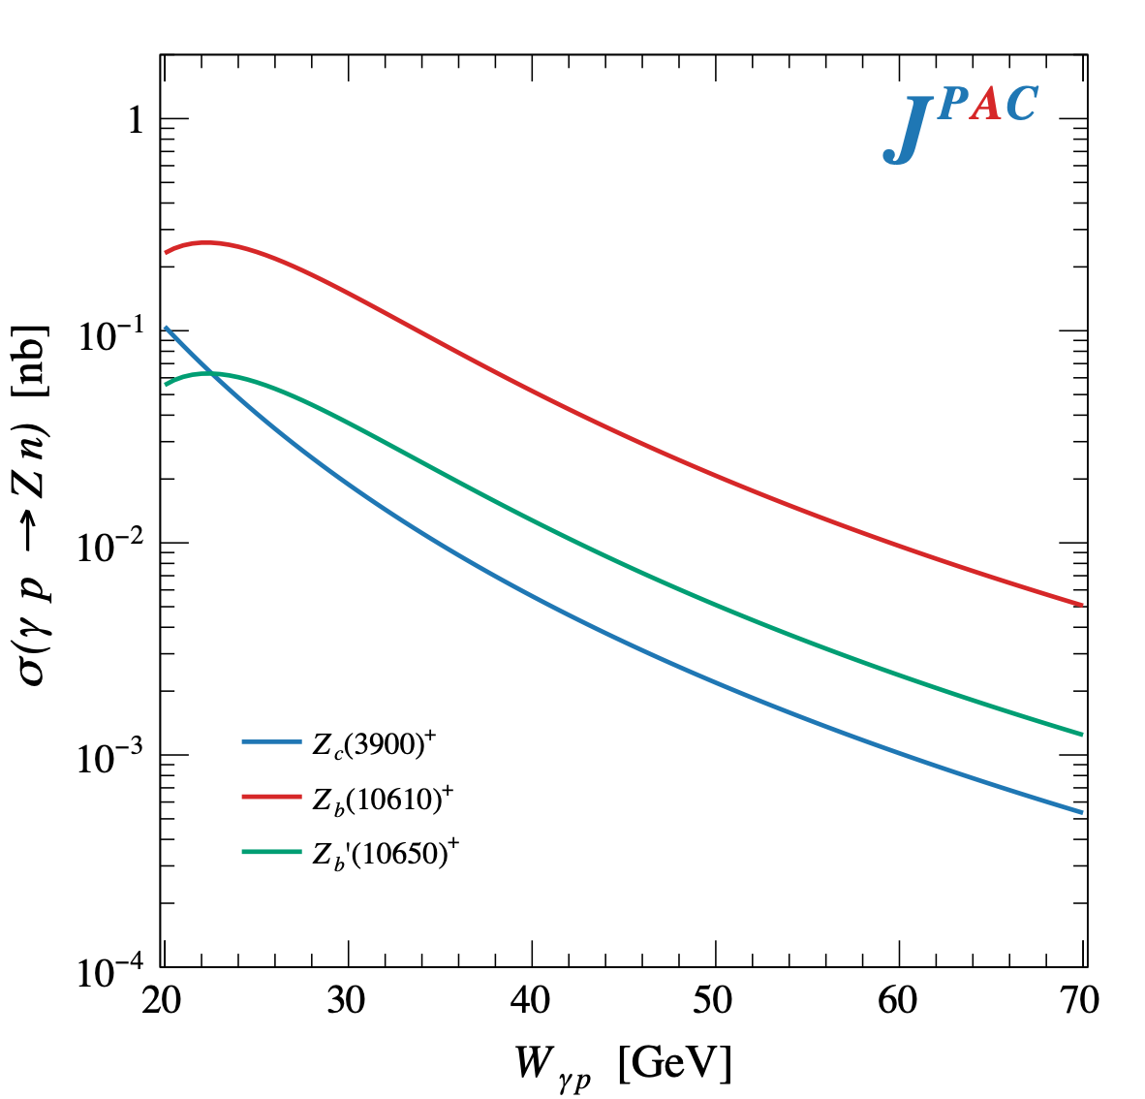
$Z$ photoproduction
The $Zs$ are charged charmoniumlike $1^{+−}$ states close to open flavor thresholds
Focus on $Z_{c}{\left(3900\right)}^{+}→J/ψ π^{+}$, $Z_{b}{\left(10610\right)}^{+},Z_{b}^{′}{\left(10650\right)}^{+}→Υ(nS) π^{+}$
The pion is exchanged in the $t$-channel
A. Pilloni – Production of XYZ

Slide 10
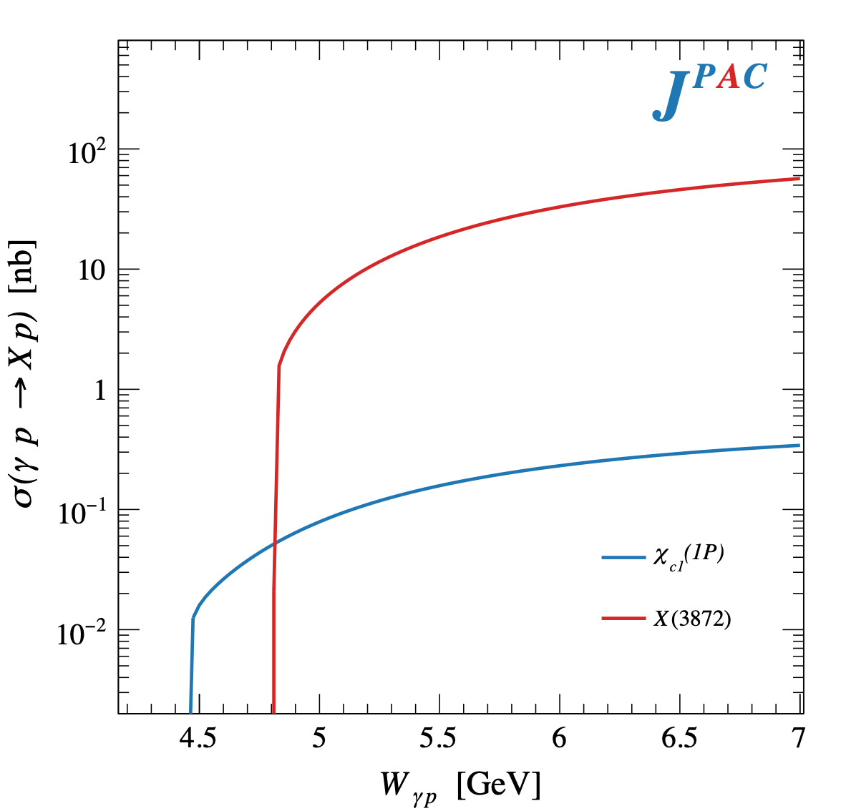
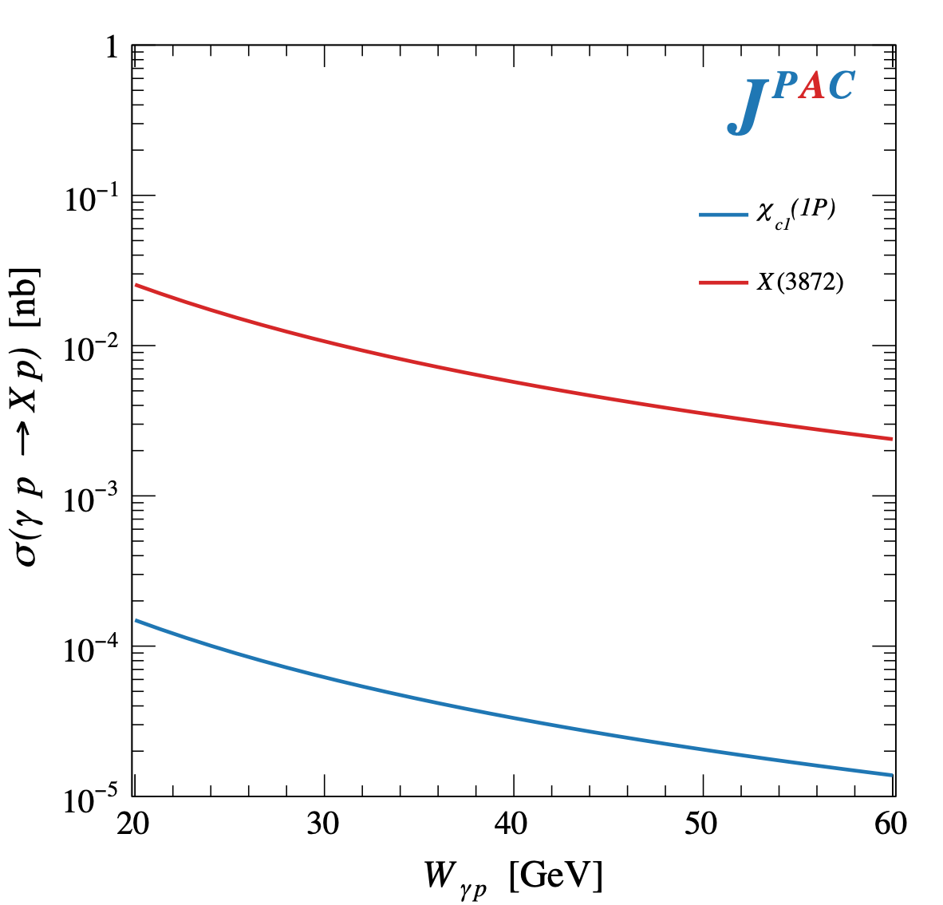
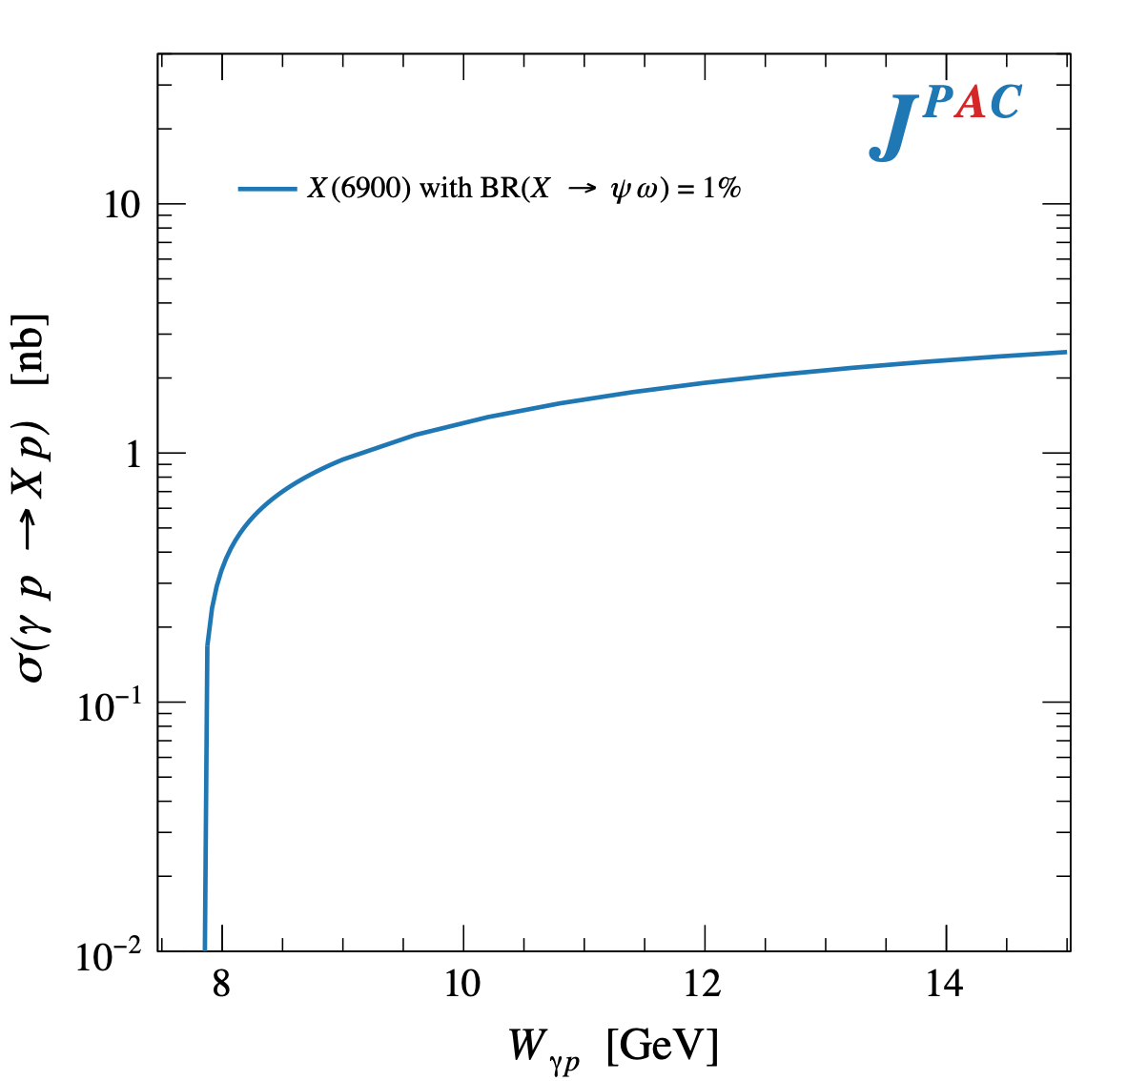
$X$ photoproduction
Focus on the famous $1^{++} X\left(3872\right)→J/ψ ρ,ω$
Studying also $X\left(6900\right)→J/ψ J/ψ$ (assumed $0^{++}$)
𝛚 and 𝛒 exchanges give main contributions: need to assume the existence of a OZI-suppressed $X\left(6900\right)→J/ψ ω$
A. Pilloni – Production of XYZ

Slide 11
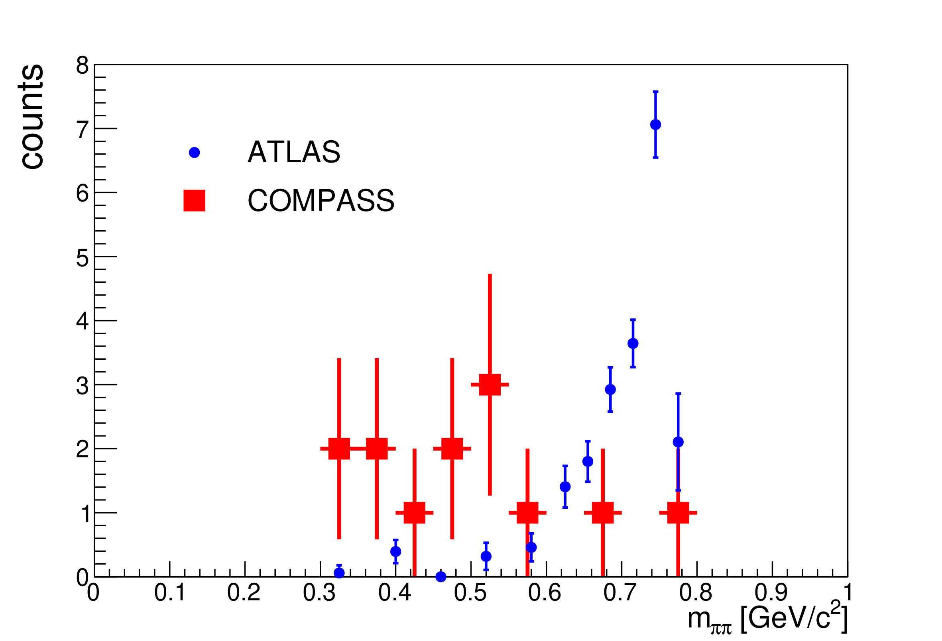
Another $\tilde{X}$?
A. Guskov
COMPASS claimed the existence of a state degenerate with the $X(3872)$, but with $C=1$
Large photoproduction cross section
A. Guskov
A. Pilloni – Production of XYZ
Notes:
2 slides su Zc, a Bes e a Belle
2 slide su tetraquark model: dall’hamiltoniana di Jaffe al calcolo delle masse
1 slide su molecular models, dove sono i carichi? (non in Tornqvist, si in Hanhart, vedere Braaten, citare Nefediev)
2 slides su decay channels, dove si dovrebbe vedere, e a seconda del modello, vedere qualche plot
1 slide su Y(4260), tetraquark? C’è lo strano (si vede la f0)
1 slide su Zc a cleo (anche il neutro)

Slide 12
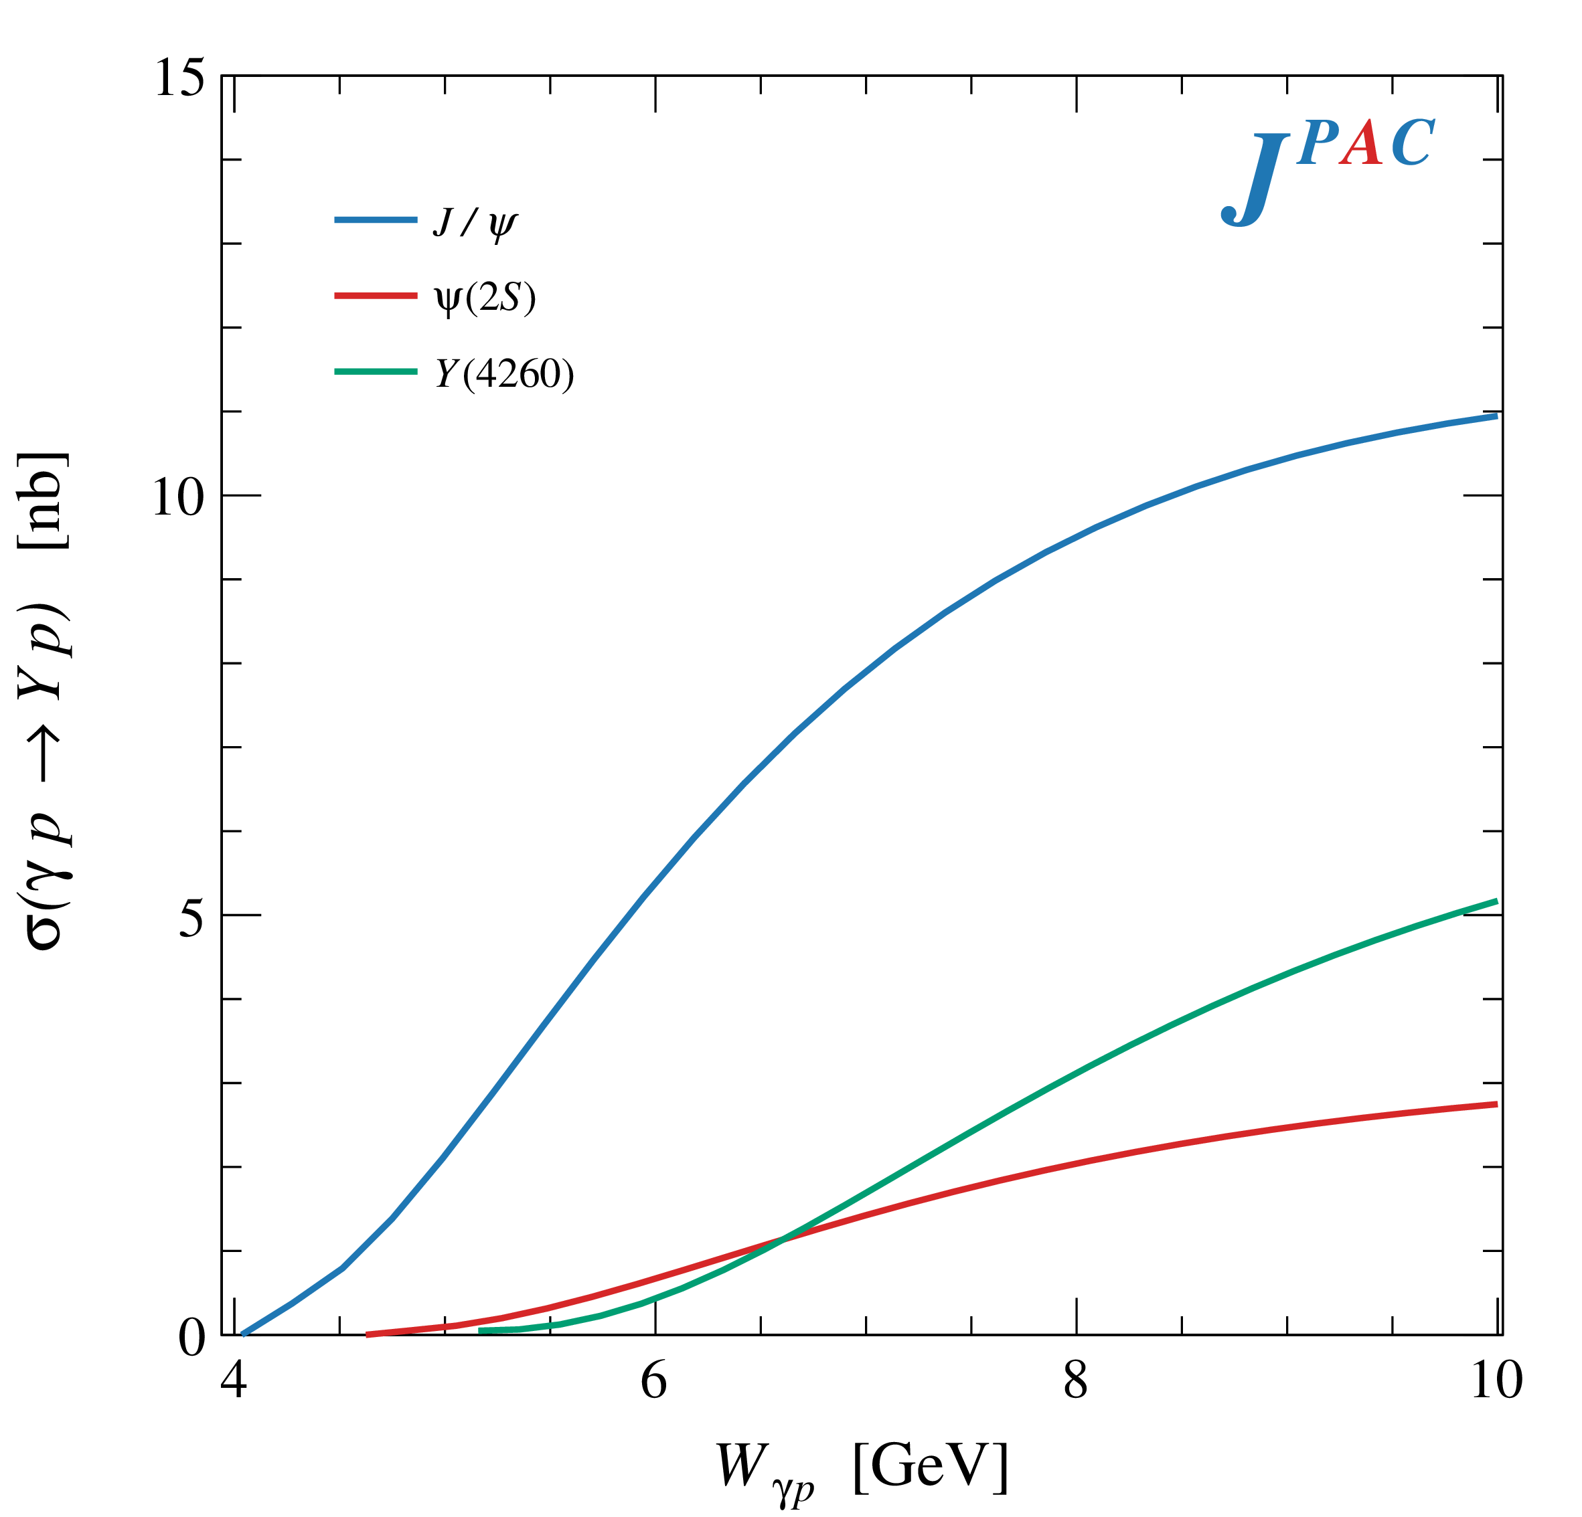
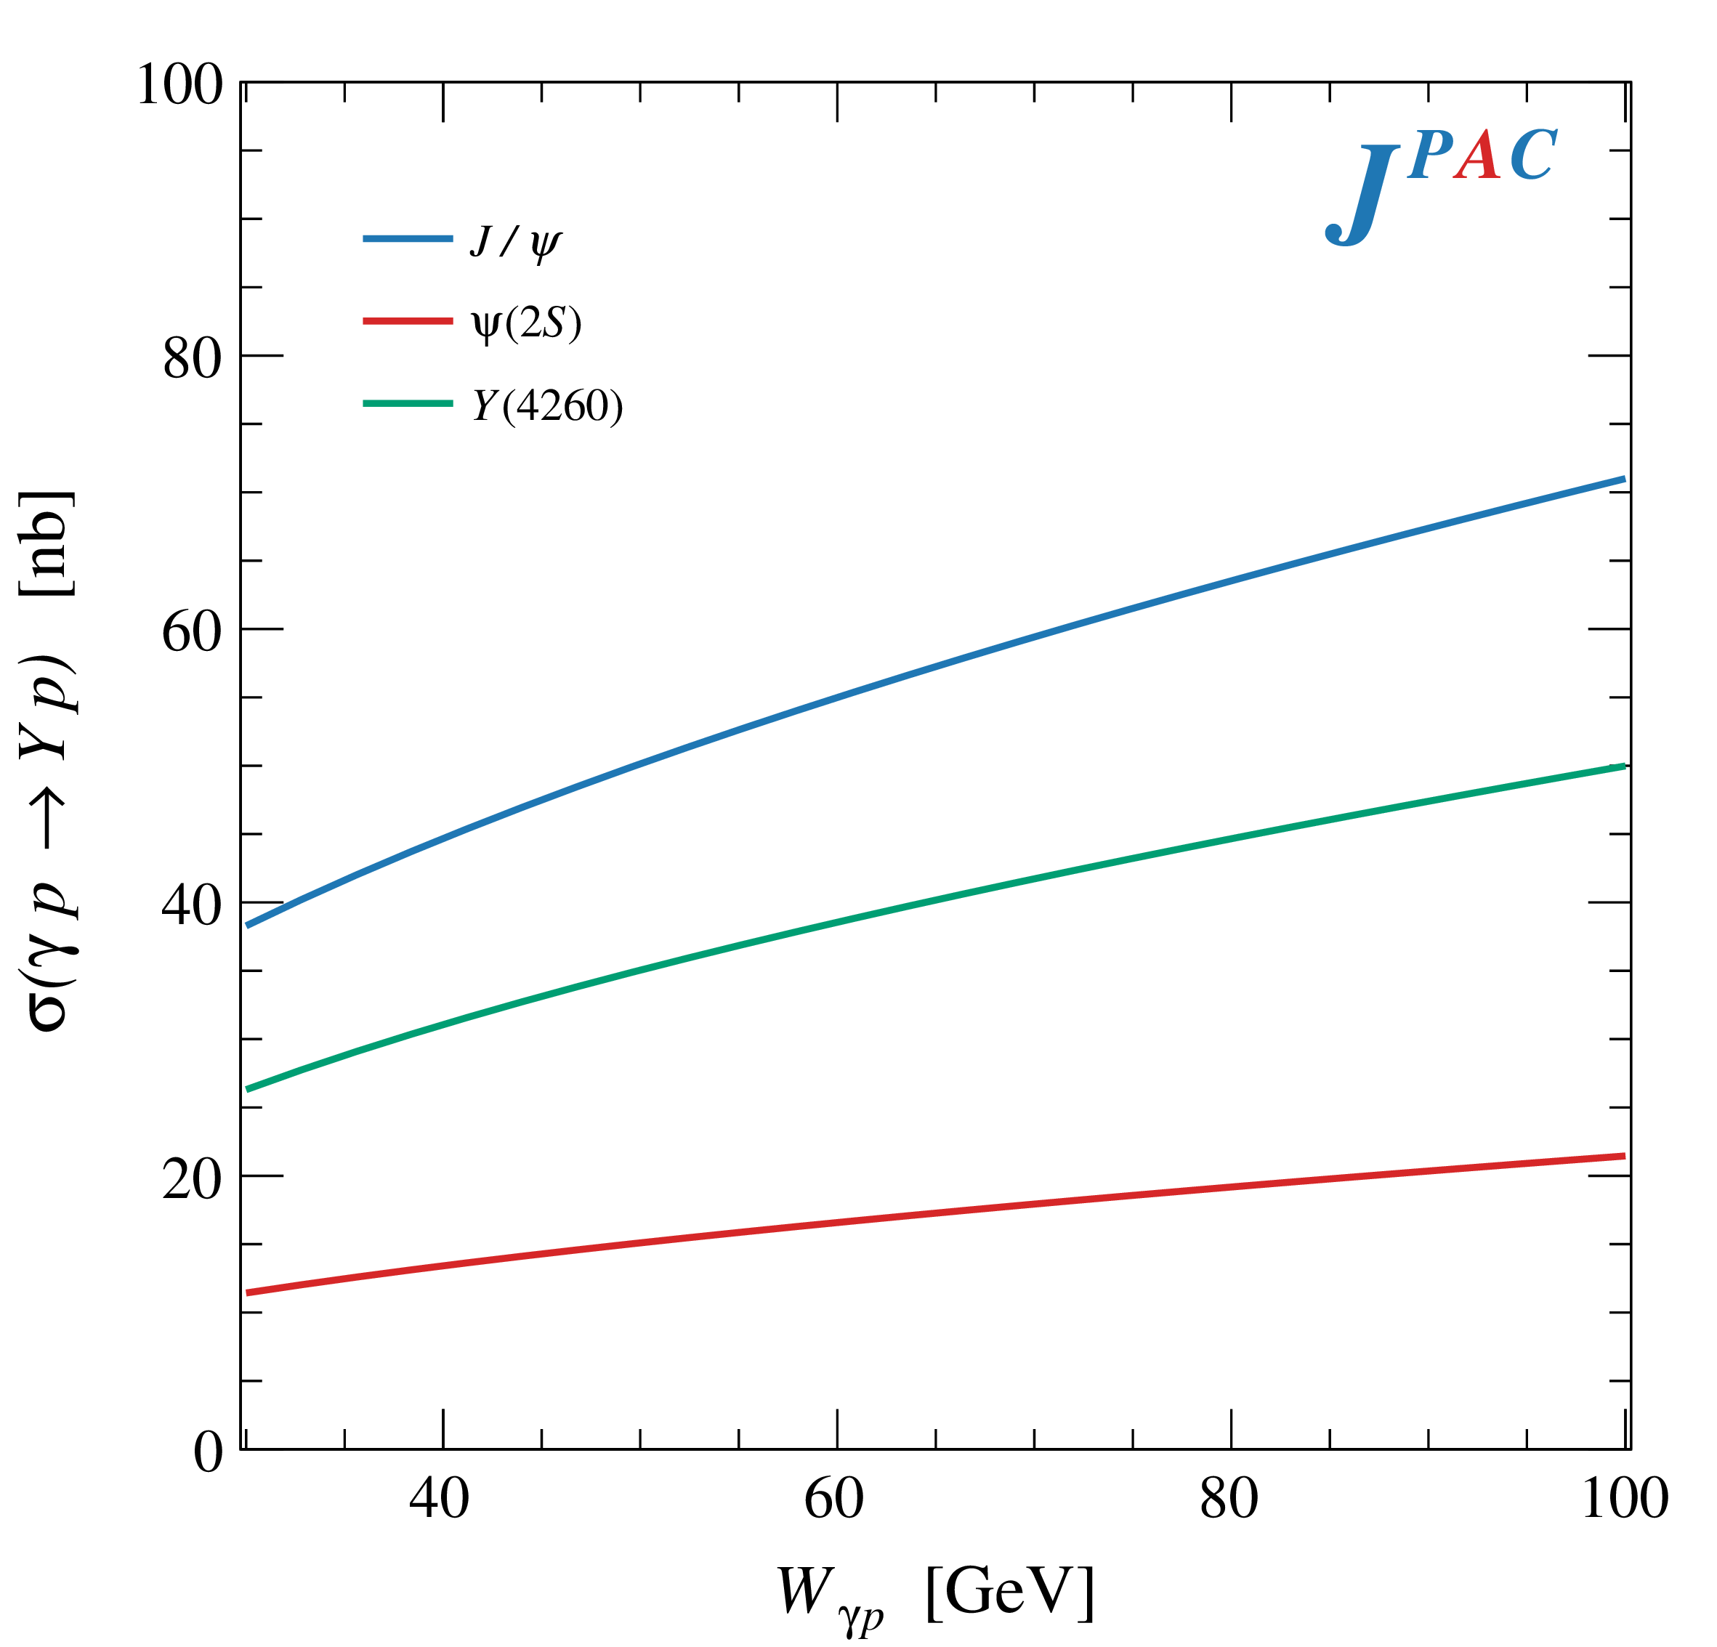
$Y$ (vector) photoproduction
Diffractive production, dominated by Pomeron (2-gluon) exchange
Existing data allow to put a 95% upper limit on the ratio of $ψ′/Y(4260)$ yields
Assuming previous formula, one gets: $Γ_{ee}^{Y}=930 eV$
(cfr. hep-ex/0603024, 2002.05641)
$BR\left(Y→J/ψππ\right)=0.96\%$
$R_{Y}=0.84$
$$R_{Y}=\frac{ef_{ψ}}{m_{ψ}}\sqrt{\frac{g^{2}(Y→ψππ)}{g^{2}(ψ→γgg)}\frac{g^{2}(ψ^{′}→ψgg)}{g^{2}(ψ^{′}→ψππ)}}$$
A. Pilloni – Production of hybrids and exotics

Slide 13
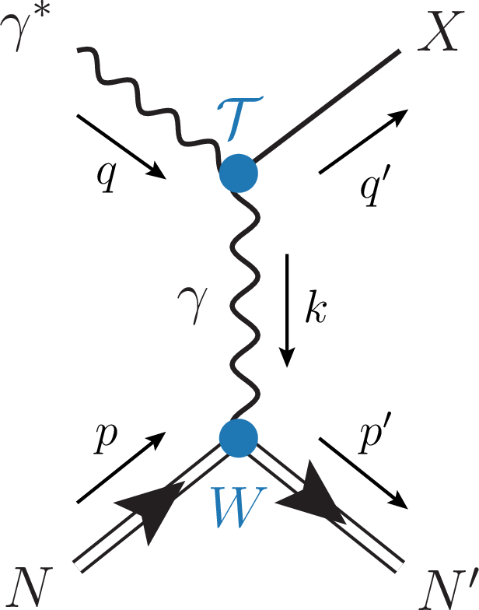
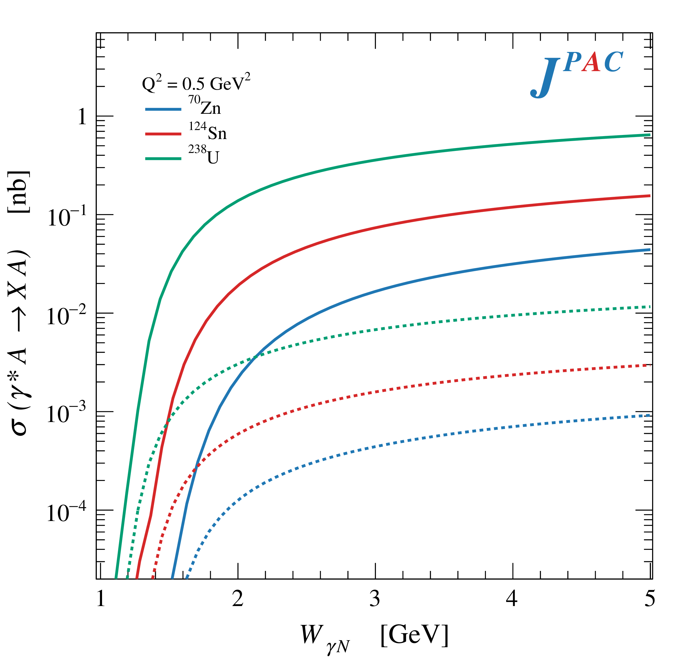
Primakoff X photoproduction
Using measurement of $Γ(X→γγ^{∗})$ from Belle, one can get predictions for Primakoff
Makes use of ion targets, enhancement of cross sections as $Z^{2}$
A. Pilloni – Production of XYZ

Slide 14
Diffractive semi-inclusive $Z_{c}$ ph.
Large rapidity gap
If the target fragments are separated from the beam ones, one can invoke Regge factorization
A. Pilloni – Production of XYZ

Slide 15
Diffractive semi-inclusive $Z_{c}$ ph.
$$= \text{Im}$$
If the target fragments are separated from the beam ones, one can invoke Regge factorization
Quark-Regge duality allows to replace the intermediate hadrons with a Pomeron exchange Pion Pomeron vertex well known
A. Pilloni – Production of XYZ

Slide 16
Diffractive semi-inclusive $Z_{c}$ ph.
Benchmark on (scarce) b₁ data
Application to XYZ ongoing
Omega Photon coll., PLB138, 5-6
A. Pilloni – Spectroscopy: overview and theory

Slide 17
Semi-inclusive $X$ production
For large $Q^{2}$ one can invoke NRQCD factorization to describe quarkonium(-like) production
Perturbative partonic matrix element, calculable
Nonperturbative transition matrix element $Q\overline{Q}→H$ fitted from data
A. Pilloni – Production of XYZ

Slide 18
Semi-inclusive $X$ production
One can assume the same NRQCD factorization for exotics, independent of their internal structure
Artoisenet and Braaten, PRD81, 114018 from Tevatron data
If one consider the first term only, it leads to
X. Yao
A. Pilloni – Production of XYZ

Slide 19
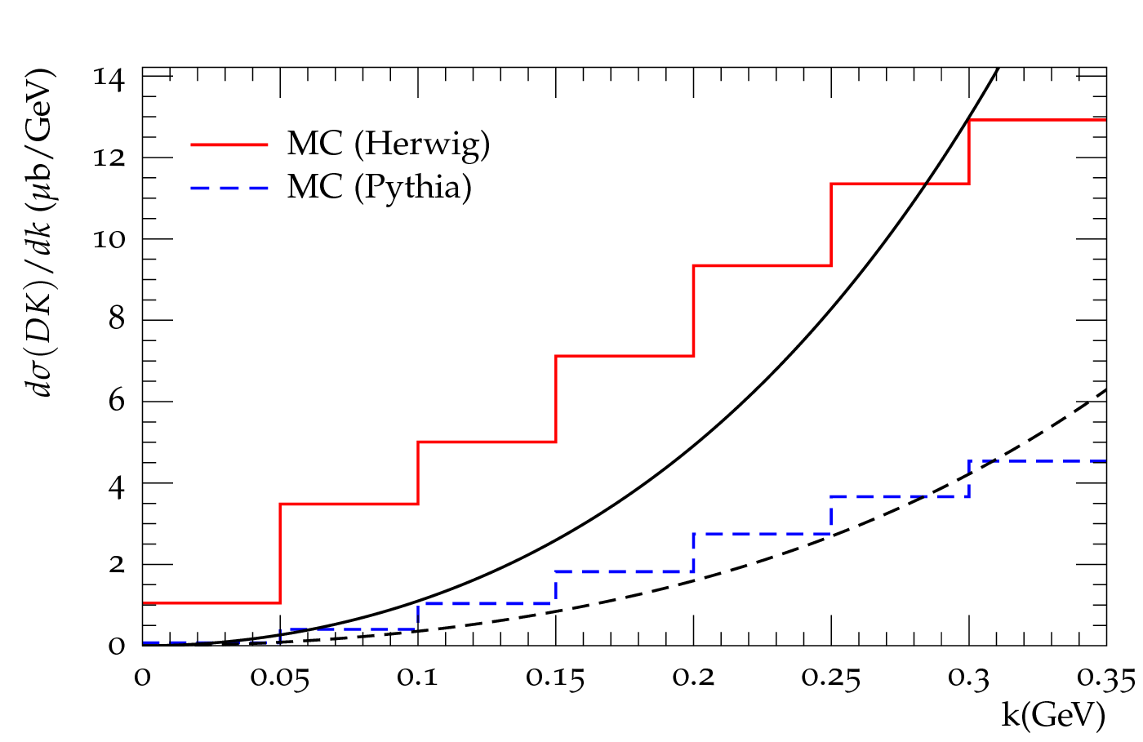
Production of other exotics
Guo et al. EPJC74, 9, 3063
Guo et al. CTP, 61, 354
Other cross sections have been estimated, generally quite large
Estimates can be given using MC generators, using coalescence model and assuming a molecular nature for the exotics
A. Pilloni – Production of XYZ
Notes:
2 slides su Zc, a Bes e a Belle
2 slide su tetraquark model: dall’hamiltoniana di Jaffe al calcolo delle masse
1 slide su molecular models, dove sono i carichi? (non in Tornqvist, si in Hanhart, vedere Braaten, citare Nefediev)
2 slides su decay channels, dove si dovrebbe vedere, e a seconda del modello, vedere qualche plot
1 slide su Y(4260), tetraquark? C’è lo strano (si vede la f0)
1 slide su Zc a cleo (anche il neutro)

Slide 20
New pentaquarks discovered
The lowest $P_{c}(4312)$ appears as an isolated peak at the $Σ_{c}^{+}{\overline{D}}^{0}$ threshold
A detailed study of the lineshape provides insight on its nature
Can we study these in photoproduction?
A. Pilloni – Production of XYZ
Notes:
Controlla la parte su Regge

Slide 21
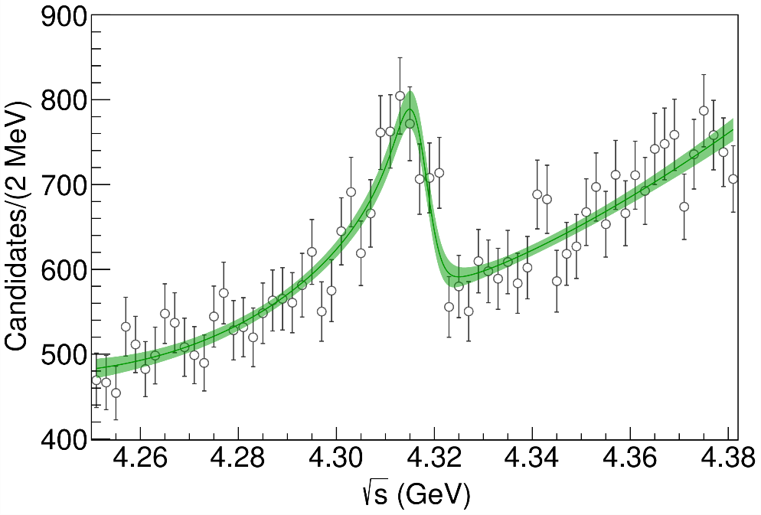
Minimal(istic) model
Fernandez-Ramirez, AP et al. (JPAC), PRL 123, 092001
Effective range expansion We can set $c_{ii}=0$ to reduce to the scattering length approximation
$$c_{ii}=0$$
( data)
Points to a virtual state
A. Pilloni – Production of XYZ
Notes:
2 slides su Zc, a Bes e a Belle
2 slide su tetraquark model: dall’hamiltoniana di Jaffe al calcolo delle masse
1 slide su molecular models, dove sono i carichi? (non in Tornqvist, si in Hanhart, vedere Braaten, citare Nefediev)
2 slides su decay channels, dove si dovrebbe vedere, e a seconda del modello, vedere qualche plot
1 slide su Y(4260), tetraquark? C’è lo strano (si vede la f0)
1 slide su Zc a cleo (anche il neutro)

Slide 22
$P_{c}$ photoproduction
To exclude any rescattering mechanism, we propose to search the $P_{c}(4450)$ state in photoproduction.
Hadronic vertex
EM vertex
Hadronic part
3 independent helicity couplings, → approx. equal, $g_{λ_{ψ},λ_{p}′}∼g$
$g$ extracted from total width and (unknown) branching ratio
Vector meson dominance relates the radiative width to the hadronic width
Hiller Blin, AP et al. (JPAC), PRD94, 034002
Karliner & Rosner, PLB752, 329
A. Pilloni – Production of XYZ
Notes:
Controlla la parte su Regge

Slide 23
$P_{c}$ photoproduction
To exclude any rescattering mechanism, we propose to search the $P_{c}$s in photoproduction.
Karliner & Rosner, PLB752, 329
Hiller Blin, AP et al. (JPAC), PRD94, 034002
D. Winney, C. Fanelli, AP et al. (JPAC) PRD100, 034019
We assume equal hadronic helicity couplings, extracted from the unknown partial width
Vector meson dominance relates the radiative width to the hadronic width
A. Pilloni – Production of XYZ
Notes:
Controlla la parte su Regge

Slide 24
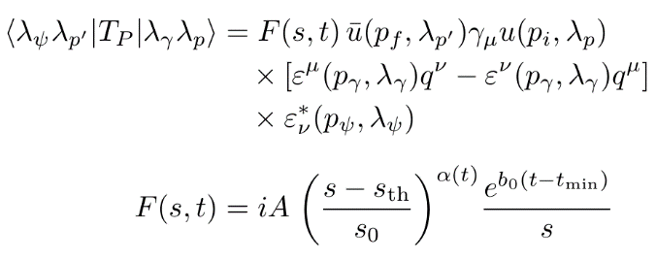
Background parameterization
The background is described via an Effective Vector Pomeron
A. Pilloni – Production of XYZ
Notes:
Controlla la parte su Regge

Slide 25
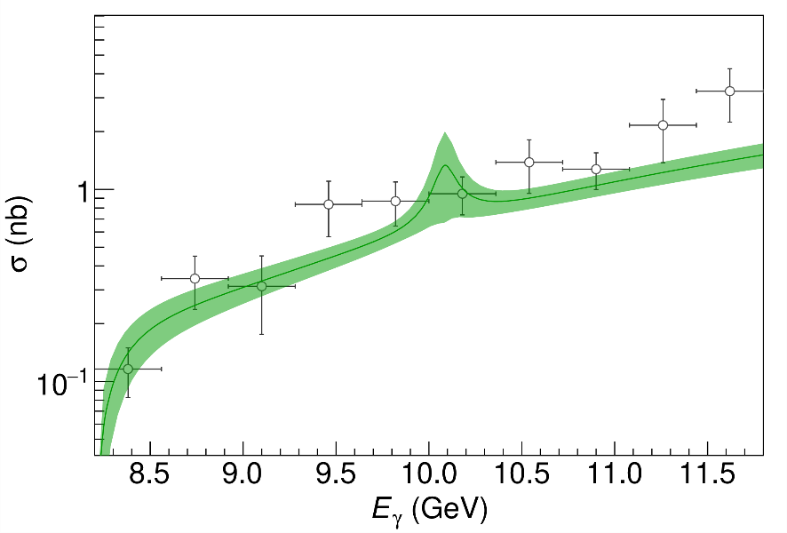
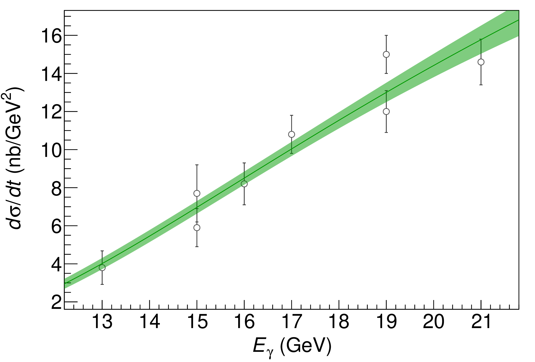
$P_{c}$ photoproduction
( data)
A. Pilloni – Production of XYZ
Notes:
Controlla la parte su Regge

Slide 26
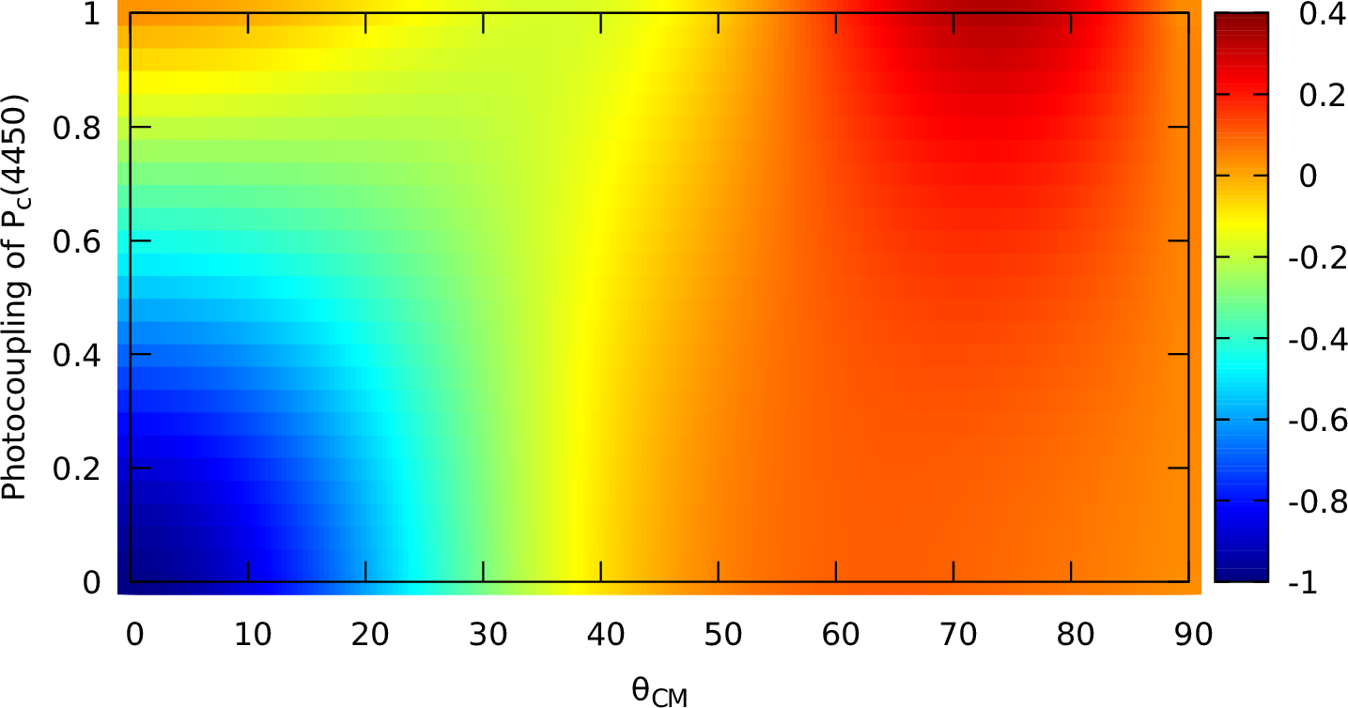
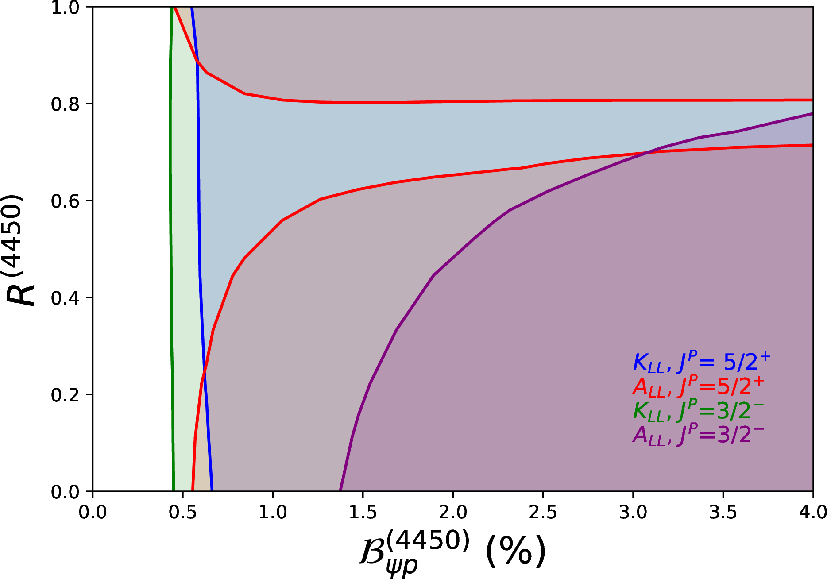
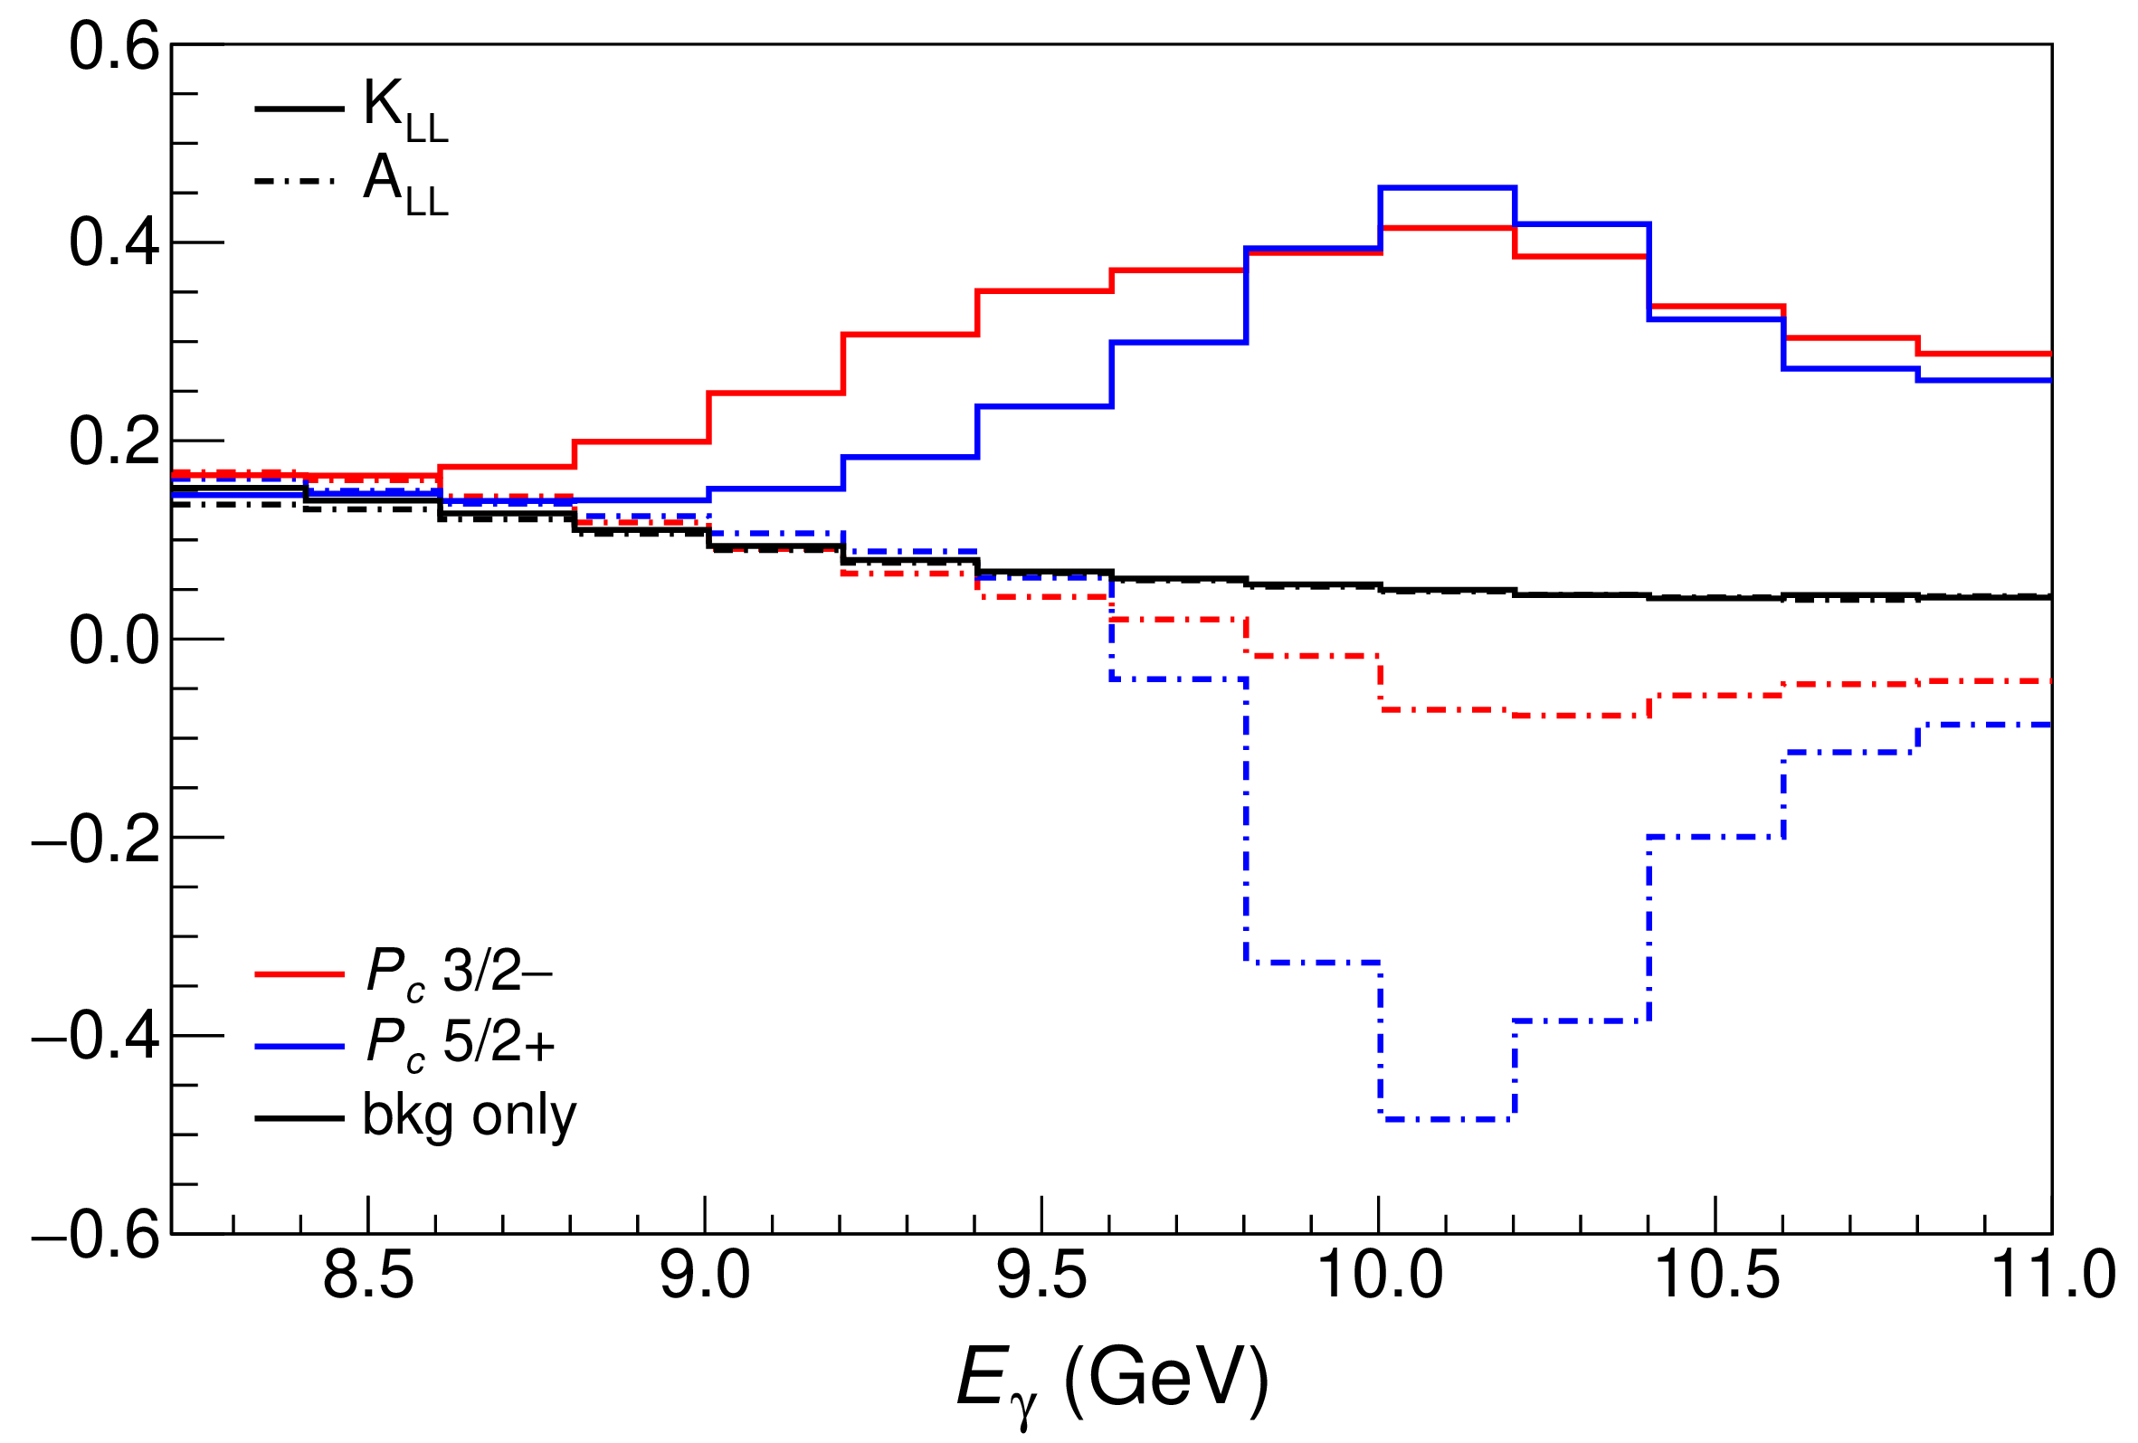
Polarization observables
One can take advantage of the polarized beam at Jlab Need polarized target ($A_{LL}$) or polarization of recoiling proton ($K_{LL}$)
$$K_{LL}$$
(in SBS acceptance)
Ni – Production of XYZ
Notes:
Controlla la parte su Regge

Slide 27
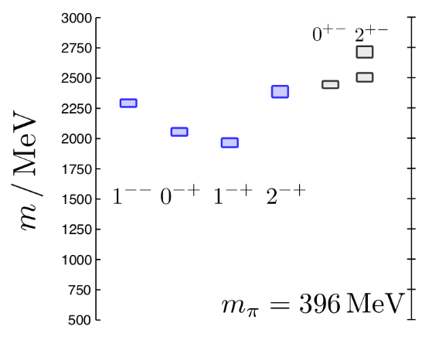
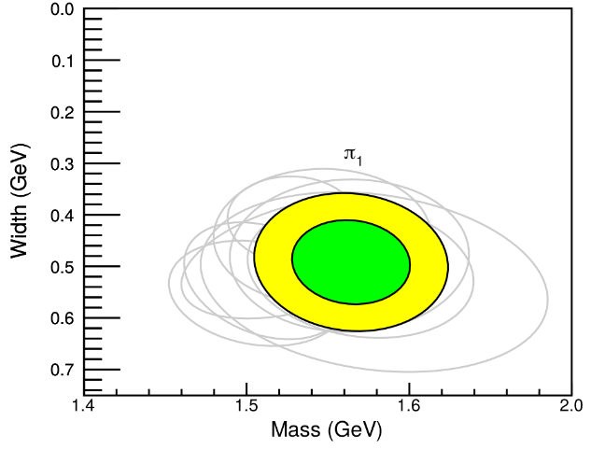
Hybrid hunting
J. Dudek
$$\overline{r}$$
$$\overline{g}$$
$$r$$
Searches at COMPASS (pion beam) and GlueX (photon beam),
EIC = same + quarkonium hybrids
$$g$$
A. Rodas, AP et al. (JPAC), PRL122, 042002
$$M=1564±24±86 \text{MeV}$$
$$Γ=492±54±102 \text{MeV}$$
( data)
A. Pilloni – Production of XYZ
Notes:
2 slides su Zc, a Bes e a Belle
2 slide su tetraquark model: dall’hamiltoniana di Jaffe al calcolo delle masse
1 slide su molecular models, dove sono i carichi? (non in Tornqvist, si in Hanhart, vedere Braaten, citare Nefediev)
2 slides su decay channels, dove si dovrebbe vedere, e a seconda del modello, vedere qualche plot
1 slide su Y(4260), tetraquark? C’è lo strano (si vede la f0)
1 slide su Zc a cleo (anche il neutro)

Slide 28
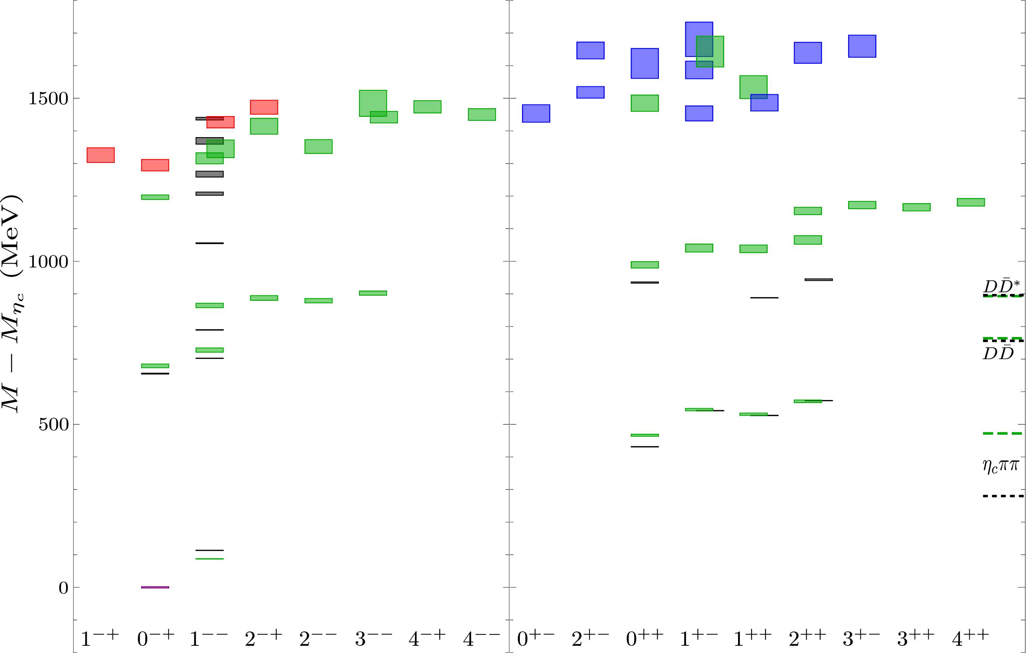
Heavy hybrids
HadSpec, JHEP 1612 (2016), 089; JHEP 02 (2021), 214
P. Guo et al., PRD78 (2008), 056003
M. Berwein et al., PRD92 (2015), 114019
A. Pilloni – Production of XYZ
Notes:
Controlla la parte su Regge

Slide 29
Conclusions
Photoproduction is a valuable tool to study exotic states
Complementary infomation to other mechanisms
Facilities to study photoproduction at low energies are very welcome to pursue this program
Thank you!
A. Pilloni – Production of XYZ
Notes:
2 slides su Zc, a Bes e a Belle
2 slide su tetraquark model: dall’hamiltoniana di Jaffe al calcolo delle masse
1 slide su molecular models, dove sono i carichi? (non in Tornqvist, si in Hanhart, vedere Braaten, citare Nefediev)
2 slides su decay channels, dove si dovrebbe vedere, e a seconda del modello, vedere qualche plot
1 slide su Y(4260), tetraquark? C’è lo strano (si vede la f0)
1 slide su Zc a cleo (anche il neutro)

Slide 30
Backup

Slide 31
JPAC 2021
Jefferson Lab
Victor Mokeev
Miguel Albaladejo
Astrid Hiller Blin
Pedagogical U. Kraków
Lukasz Bibrzycki
INP Kraków
Robert Kaminski
Chiao-Tung University
Robert Perry
INFN Roma
Alessandro Pilloni
Indiana U.
Emilie Passemar
Adam Szczepaniak (also JLab)
Sergi Gonzàles-Solís
Nathan Sherrill
Daniel Winney
Sebastian Dawid
TUM
Misha Mikhasenko
W&M
Arkaitz Rodas
Barcelona U.
Vincent Mathieu
ODU
Andrew Jackura
UNAM
César Fernández-Ramírez
Jorge Silva-Castro
INFN Genova
Andrea Celentano
JGU-Mainz U.
Igor Danilkin
Faculty/Staff
Postdoc
Students
Members affiliated with CLAS, GlueX, LHCb, BESIII, BaBar, COMPASS
A. Pilloni – Production of hybrids and exotics

Slide 32
Another $\tilde{X}$?
A. Guskov
COMPASS claimed the existence of a state degenerate with the $X(3872)$, but with $C=1$
Large photoproduction cross section
A. Pilloni – Spectroscopy: overview and theory
Notes:
2 slides su Zc, a Bes e a Belle
2 slide su tetraquark model: dall’hamiltoniana di Jaffe al calcolo delle masse
1 slide su molecular models, dove sono i carichi? (non in Tornqvist, si in Hanhart, vedere Braaten, citare Nefediev)
2 slides su decay channels, dove si dovrebbe vedere, e a seconda del modello, vedere qualche plot
1 slide su Y(4260), tetraquark? C’è lo strano (si vede la f0)
1 slide su Zc a cleo (anche il neutro)

Slide 33
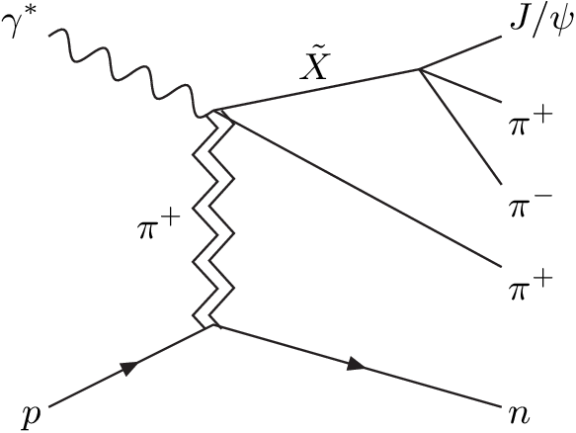
Another $\tilde{X}$?
A. Guskov
COMPASS claimed the existence of a state degenerate with the $X(3872)$, but with $C=1$
Large photoproduction cross section
A. Pilloni – Spectroscopy: overview and theory
Notes:
2 slides su Zc, a Bes e a Belle
2 slide su tetraquark model: dall’hamiltoniana di Jaffe al calcolo delle masse
1 slide su molecular models, dove sono i carichi? (non in Tornqvist, si in Hanhart, vedere Braaten, citare Nefediev)
2 slides su decay channels, dove si dovrebbe vedere, e a seconda del modello, vedere qualche plot
1 slide su Y(4260), tetraquark? C’è lo strano (si vede la f0)
1 slide su Zc a cleo (anche il neutro)

Slide 34
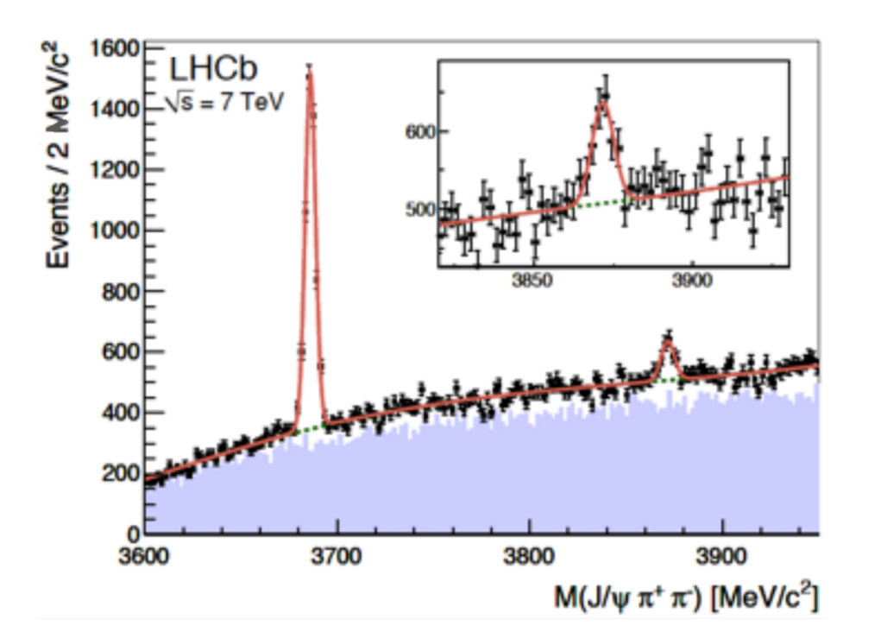
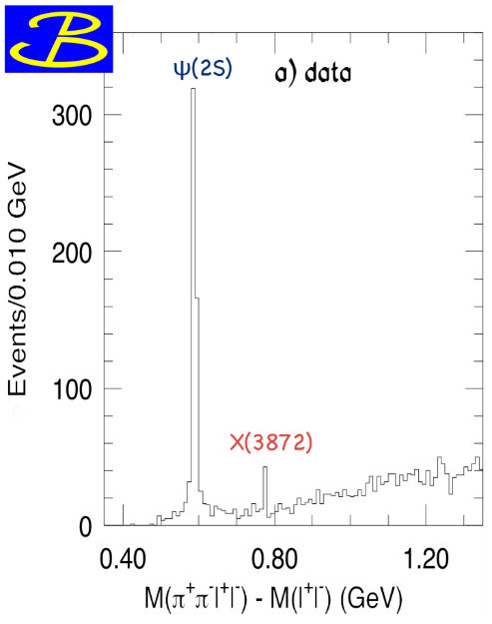
$X(3872)$
Discovered in $B→K X→K J/ψ ππ$
Quantum numbers $1^{++}$
Very close to $DD^{∗}$ threshold
Too narrow for an above-treshold charmonium
Isospin violation too big $\frac{Γ\left(X→J/ψ ω\right)}{Γ\left(X→J/ψ ρ\right)}\sim 0.8±0.3$
Mass prediction not compatible with $χ_{c1}(2P)$
Sizeable prompt production at hadron colliders, $∼5\%$ of $ψ(2S)$
$σ_{PR}×B(X→J/ψππ)=\left(1.06±0.11±0.15\right) \text{nb}$ @CMS
$M=3871.68±0.17$MeV
$$M_{X}−M_{DD^{∗}}=−3±192 \text{keV}$$
$$Γ=1.19±0.19 \text{MeV}$$
A. Pilloni – Production of hybrids and exotics

Slide 35
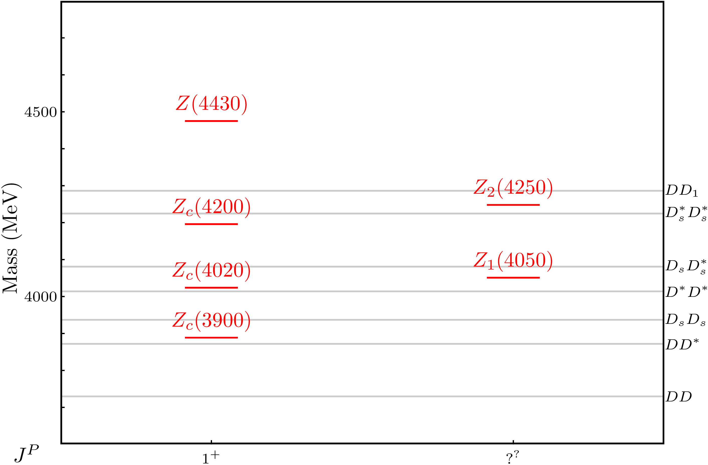
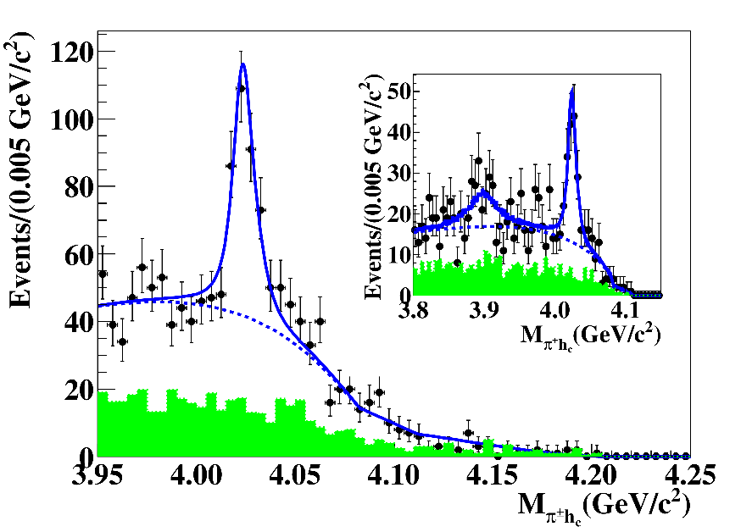
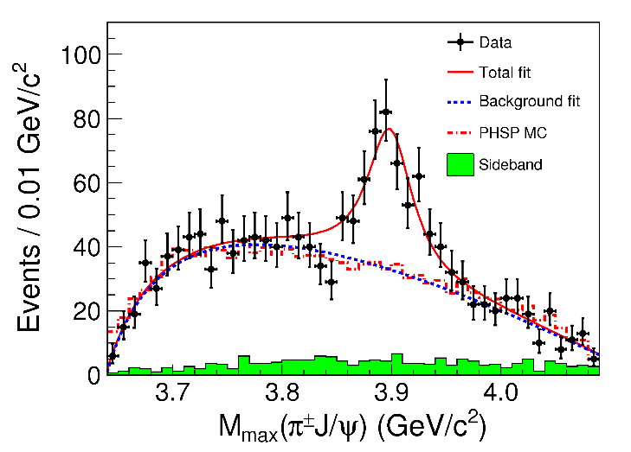
Charged $Z$ states: $Z_{c}\left(3900\right), Z_{c}^{′}(4020)$
Charged quarkonium-like resonances have been found, 4q needed
Two states $J^{PC}=1^{+−}$ appear slightly above $D^{(∗)}D^{∗}$ thresholds
$e^{+}e^{−}→Z_{c}{\left(3900\right)}^{+}π^{−}→J/ψ{ π}^{+}π^{−}$ and $→{\left(DD^{∗}\right)}^{+}π^{−}$ $M=3888.7±3.4$MeV, $Γ=35±7$ MeV
$e^{+}e^{−}→Z_{c}^{′}{\left(4020\right)}^{+}π^{−}→h_{c}{ π}^{+}π^{−}$ and $→{\overline{D}}^{∗0}D^{∗+}π^{−}$
$M=4023.9±2.4$MeV, $Γ=10±6$ MeV
A. Pilloni – Production of hybrids and exotics
Notes:
Y(4260), M=4263 +- 5, Gamma = 95+-14
D_1(2420)^0, M=2421.3 ±0.6, Gamma =27.1 ±2.7
D_1(2420)^+-, M=2423.4 ±3.1, Gamma =25 ±6
I D_1 hanno J^P = 1^+
La molecola D_1 D sta 22 MeV sotto
Se la Y è D_1 D, il pione lega fortemente, come fa la Y a essere così larga?
Come funziona lo scambio del pione???

Slide 36
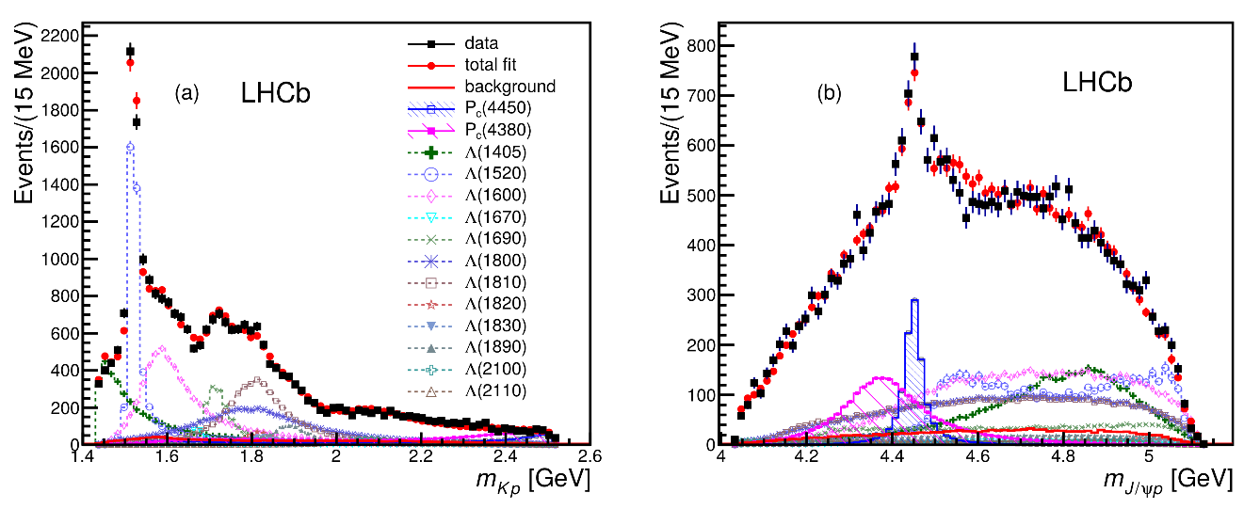
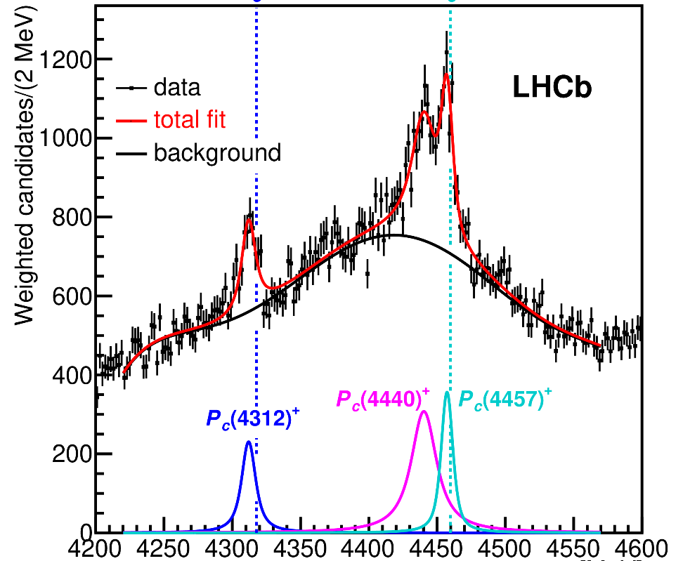
Pentaquarks!
LHCb, PRL 115, 072001
LHCb, PRL 117, 082003
Two states seen in $Λ_{b}→\left(J/ψ p\right) K^{−}$,
evidence in $Λ_{b}→\left(J/ψ p\right) π^{−}$
$$M_{1}=4380±8±29 \text{MeV} \\ Γ_{1}=205±18±86 \text{MeV}$$
$$M_{2}=4449.8±1.7±2.5 \text{MeV} \\ Γ_{2}=39±5±19 \text{MeV}$$
Quantum numbers $$J^{P}=\left({\frac{3}{2}}^{−},{\frac{5}{2}}^{+}\right) \text{or}\left({\frac{3}{2}}^{+},{\frac{5}{2}}^{−}\right)\text{or}\left({\frac{5}{2}}^{+},{\frac{3}{2}}^{−}\right)$$
LHCb, PRL 122, 222001
Higher statistics analysis revealed a two-peak structure of the narrow state, plus a new lighter one Quantum numbers still unknown
A. Pilloni – Production of hybrids and exotics
Notes:
Y(4260), M=4263 +- 5, Gamma = 95+-14
D_1(2420)^0, M=2421.3 ±0.6, Gamma =27.1 ±2.7
D_1(2420)^+-, M=2423.4 ±3.1, Gamma =25 ±6
I D_1 hanno J^P = 1^+
La molecola D_1 D sta 22 MeV sotto
Se la Y è D_1 D, il pione lega fortemente, come fa la Y a essere così larga?
Come funziona lo scambio del pione???

Slide 37
$Y$ (vector) photoproduction
Focus on the $1^{−−} Y\left(4260\right)→J/ψ π^{+}π^{−}$, check with $ψ′→J/ψ π^{+}π^{−}$
Diffractive production, dominated by Pomeron (2-gluon) exchange
Good candidates for EIC: diffractive production increases with energy!
We have $γψ$-pomeron coupling from our analyses 1606.08912, 1907.09393
How to rescale from $J/ψ$ to $ψ′$ ?
How to rescale from $J/ψ$ to $Y(4260)$ ?
We assume VMD and $g^{2}\left(Y→ψππ\right)=g^{2}\left(Y→ψgg\right)×g^{2}(gg→ππ)$ (Novikov & Shifman)
$$R_{ψ^{′}}=\sqrt{\frac{g^{2}(ψ^{′}→γgg)}{g^{2}(ψ→γgg)}}∼0.55$$
$$g^{2}(ψ→γgg)=\frac{6m_{ψ}ℬ(ψ→γgg)Γ_{ψ}}{PS(ψ→γgg)}$$
$$R_{Y}=\frac{ef_{ψ}}{m_{ψ}}\sqrt{\frac{g^{2}(Y→ψππ)}{g^{2}(ψ→γgg)}\frac{g^{2}(ψ^{′}→ψgg)}{g^{2}(ψ^{′}→ψππ)}}$$
Caveat : $BR(Y→ψππ)$ only known times the leptonic width $Γ_{ee}^{Y}$
A. Pilloni – Production of hybrids and exotics

Slide 38
From threshold to high energy
Fixed-spin exchanges expected to hold from threshold to moderate energies (LE): Contain full $s$ dependence
$t$ channel grows as $s j$, exceeding unitarity bound: Reggeized tower of particles with arbitrary spin at HE
$${\left(\frac{4p(t)q(t)}{s_{0}}\right)}^{j−M}𝒩_{μμ^{′}}^{j}\frac{d_{μμ^{′}}^{j}(θ_{t})}{ξ_{μμ}^{(t)}(s,t)}\frac{1}{t−m_{ℰ}^{2}}⟶−α^{′}Γ(j−α(t))[\frac{1+τe^{−iπα(t)}}{2}]{\left(\frac{s}{s_{0}}\right)}^{α(t)−M}$$
Holds at LE, fixed spin
Holds at HE, resummation of leading $s$ power
A. Pilloni – Production of hybrids and exotics

Slide 39
Same model as before
Two/three channels, $i,k=ππ, KK,(ρρ)$ Two waves, $J=S,D$
3 K-matrix pole for the S-wave
3 K-matrix poles for the D-wave
A. Pilloni – Production of hybrids and exotics
Notes:
Controlla la parte su Regge

Slide 40
Minimal(istic) model
Effective range expansion We can set $c_{ii}=0$ to reduce to the scattering length approximation
Points to a virtual state
$$c_{ii}=0$$
Finite $c_{ii}$
A. Pilloni – Production of hybrids and exotics
Notes:
2 slides su Zc, a Bes e a Belle
2 slide su tetraquark model: dall’hamiltoniana di Jaffe al calcolo delle masse
1 slide su molecular models, dove sono i carichi? (non in Tornqvist, si in Hanhart, vedere Braaten, citare Nefediev)
2 slides su decay channels, dove si dovrebbe vedere, e a seconda del modello, vedere qualche plot
1 slide su Y(4260), tetraquark? C’è lo strano (si vede la f0)
1 slide su Zc a cleo (anche il neutro)

Slide 41
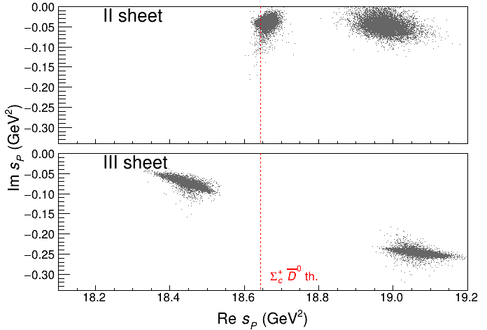
Minimal(istic) model
Effective range expansion We can set $c_{ii}=0$ to reduce to the scattering length approximation
Points to a virtual state
Doesn’t point to a resonance
$$c_{ii}=0$$
Finite $c_{ii}$
A. Pilloni – Production of hybrids and exotics
Notes:
2 slides su Zc, a Bes e a Belle
2 slide su tetraquark model: dall’hamiltoniana di Jaffe al calcolo delle masse
1 slide su molecular models, dove sono i carichi? (non in Tornqvist, si in Hanhart, vedere Braaten, citare Nefediev)
2 slides su decay channels, dove si dovrebbe vedere, e a seconda del modello, vedere qualche plot
1 slide su Y(4260), tetraquark? C’è lo strano (si vede la f0)
1 slide su Zc a cleo (anche il neutro)

Slide 42
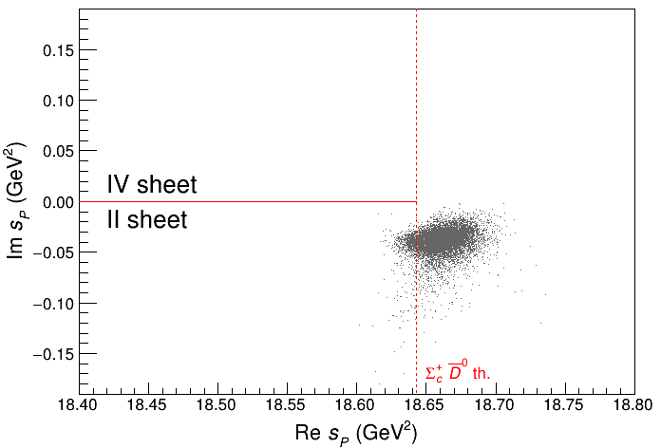
Minimal(istic) model
Effective range expansion We can set $c_{ii}=0$ to reduce to the scattering length approximation
Points to a virtual state
Doesn’t point to a resonance
$$c_{ii}=0$$
Finite $c_{ii}$
A. Pilloni – Production of hybrids and exotics
Notes:
2 slides su Zc, a Bes e a Belle
2 slide su tetraquark model: dall’hamiltoniana di Jaffe al calcolo delle masse
1 slide su molecular models, dove sono i carichi? (non in Tornqvist, si in Hanhart, vedere Braaten, citare Nefediev)
2 slides su decay channels, dove si dovrebbe vedere, e a seconda del modello, vedere qualche plot
1 slide su Y(4260), tetraquark? C’è lo strano (si vede la f0)
1 slide su Zc a cleo (anche il neutro)

Slide 43
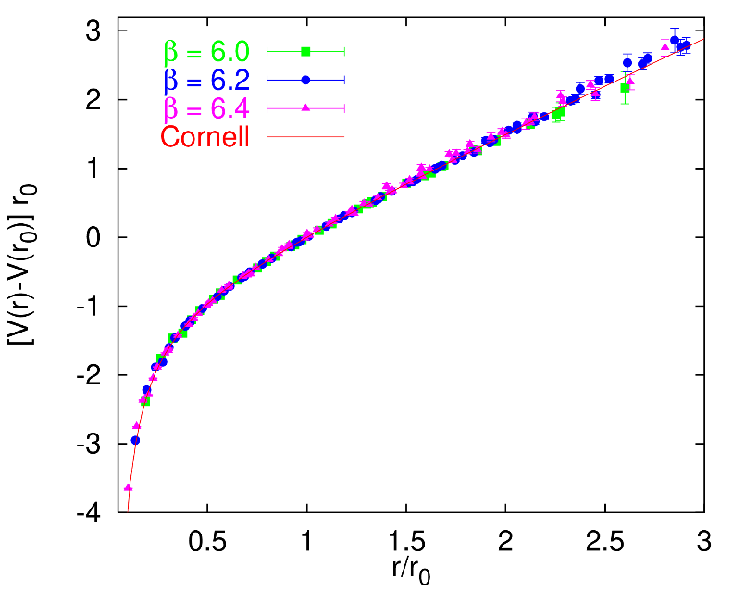
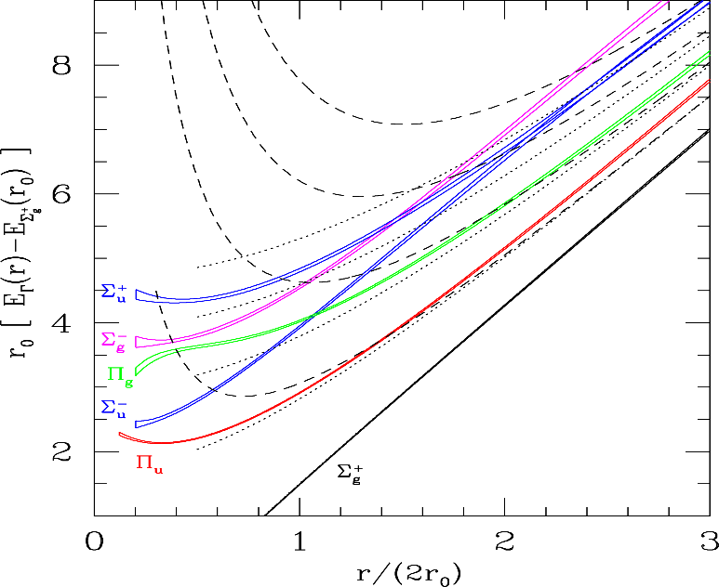
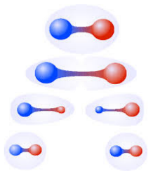
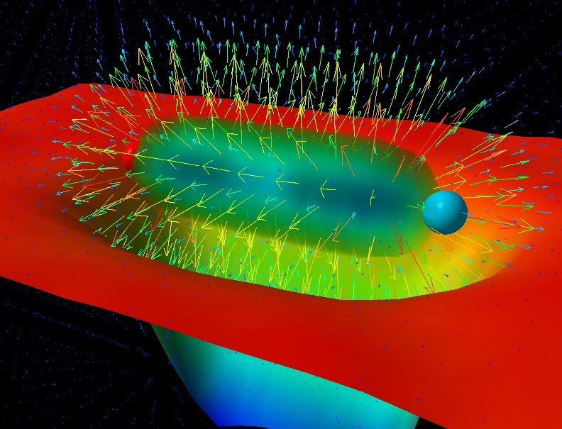
Learning about confinement
If quarks were infinitely heavy, gluonic field is confined in a string
Linear rising potential
What is a constituent gluon?
vibration of the string? → degenerate $J^{PC}={\left(0,1,2\right)}^{−+},{\left(0,1,2\right)}^{+−}$
excitation of a quasiparticle? → degenerate $J^{PC}={\left(0,1,2\right)}^{−+},1^{−−}$
G. Bali
C. Morningstar
J. Dudek
excitation of a quasiparticle! → degenerate $J^{PC}={\left(0,1,2\right)}^{−+},1^{−−}$ says Lattice QCD...
What about real data?
D. Leinweber
A. Pilloni – Production of hybrids and exotics
Notes:
Controlla la parte su Regge

Slide 44
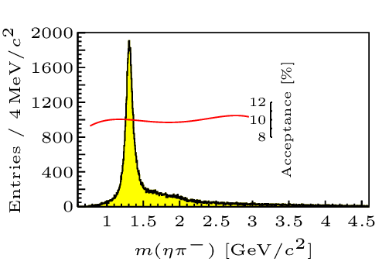
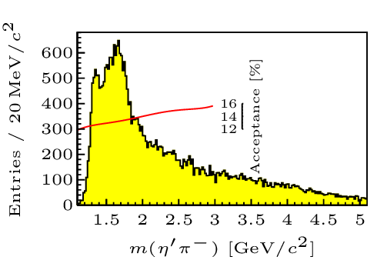
Hybrid hunting
Excited gluon, $$J^{PC}=1^{+−}$$ mass $∼1.0\text{−}1.5 \text{GeV}$
$$\overline{r}$$
$$\overline{g}$$
$$r$$
$$g$$
Look for a $π_{1}$ state with $J^{PC}=1^{−+}$
decaying into $\left\{\begin{matrix}η π \text{and} η^{′}π \\ ρ π→3π \\ b_{1}π→5π\end{matrix}\right.$
Small signal in data
A. Pilloni – Production of hybrids and exotics
Notes:
2 slides su Zc, a Bes e a Belle
2 slide su tetraquark model: dall’hamiltoniana di Jaffe al calcolo delle masse
1 slide su molecular models, dove sono i carichi? (non in Tornqvist, si in Hanhart, vedere Braaten, citare Nefediev)
2 slides su decay channels, dove si dovrebbe vedere, e a seconda del modello, vedere qualche plot
1 slide su Y(4260), tetraquark? C’è lo strano (si vede la f0)
1 slide su Zc a cleo (anche il neutro)

Slide 45
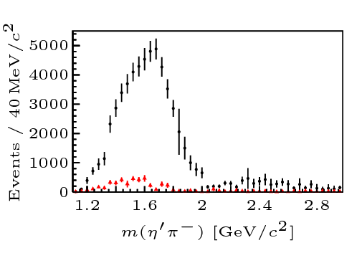
Two hybrid states???
Neither lattice nor models predict two $1^{−+}$ states in this region!
A. Pilloni – Production of hybrids and exotics
Notes:
2 slides su Zc, a Bes e a Belle
2 slide su tetraquark model: dall’hamiltoniana di Jaffe al calcolo delle masse
1 slide su molecular models, dove sono i carichi? (non in Tornqvist, si in Hanhart, vedere Braaten, citare Nefediev)
2 slides su decay channels, dove si dovrebbe vedere, e a seconda del modello, vedere qualche plot
1 slide su Y(4260), tetraquark? C’è lo strano (si vede la f0)
1 slide su Zc a cleo (anche il neutro)

Slide 46
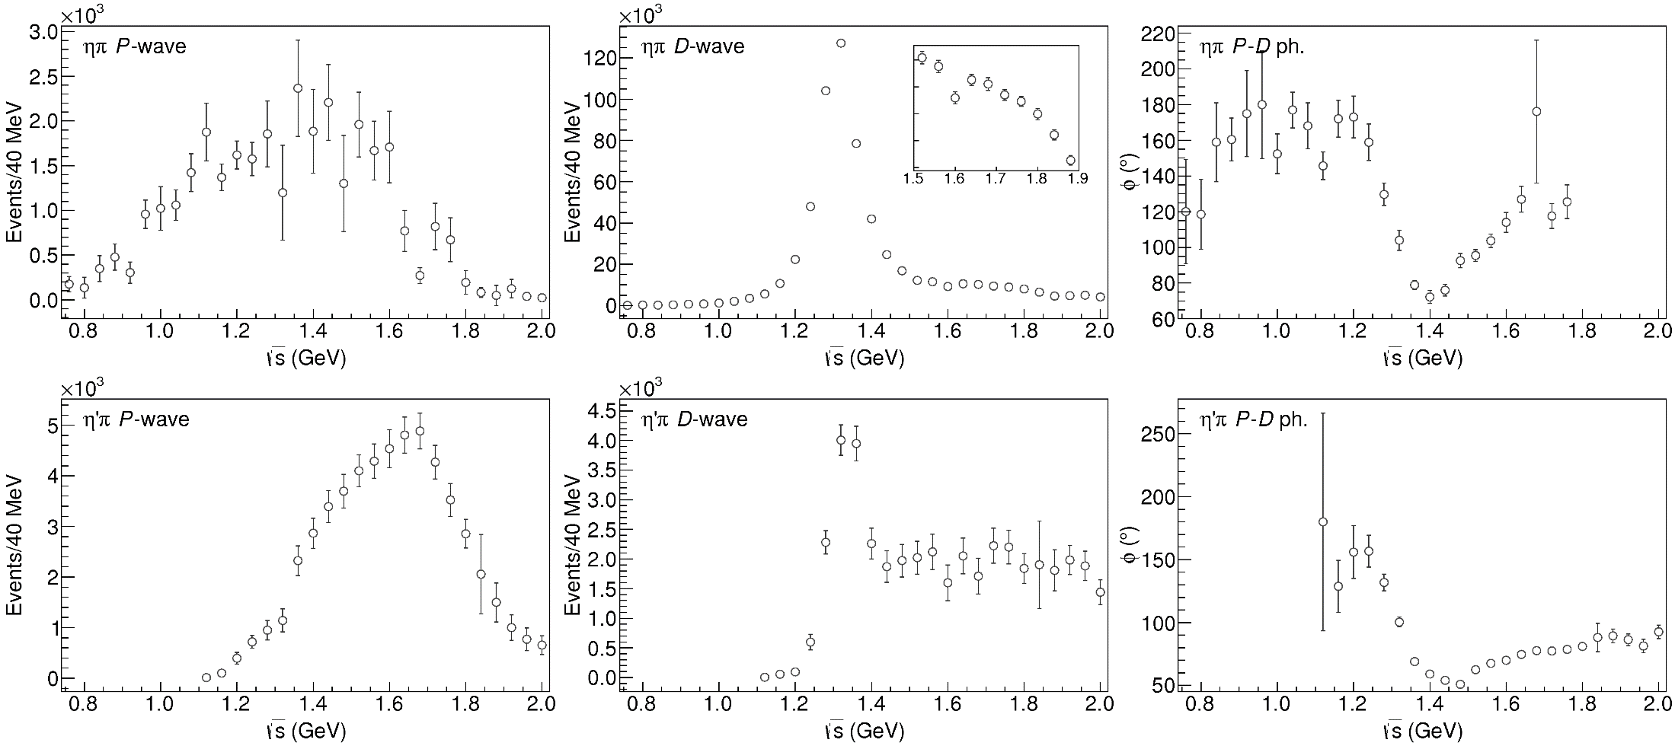
Data in $η^{(′)}π$
( data)
$$π_{1}\left(1400\right)?$$
$$a_{2}\left(1320\right)$$
$$a_{2}^{′}\left(1700\right)$$
$$π_{1}\left(1600\right)?$$
$$a_{2}\left(1320\right)$$
$$a_{2}^{′}\left(1700\right)$$
$$J^{PC}=1^{−+}$$
$$J^{PC}=2^{++}$$
A. Pilloni – Production of hybrids and exotics
Notes:
Controlla la parte su Regge

Slide 47
Amplitudes for $η^{(′)}π$
We build the partial wave amplitudes according to the $N/D$ method
Jackura, Mikhasenko, AP et al. (JPAC & COMPASS), PLB
Rodas, AP et al. (JPAC), PRL
$$a\left(s\right)=\frac{n\left(s\right)}{D\left(s\right)}$$
$$D(s)$$
$$n(s)$$
The $n\left(s\right)$ → background physics, process-dependent, smooth
The $D(s)$ contains all the Final State Interactions constrained by unitarity → universal
A. Pilloni – Production of hybrids and exotics at JLab
Notes:
Controlla la parte su Regge

Slide 48
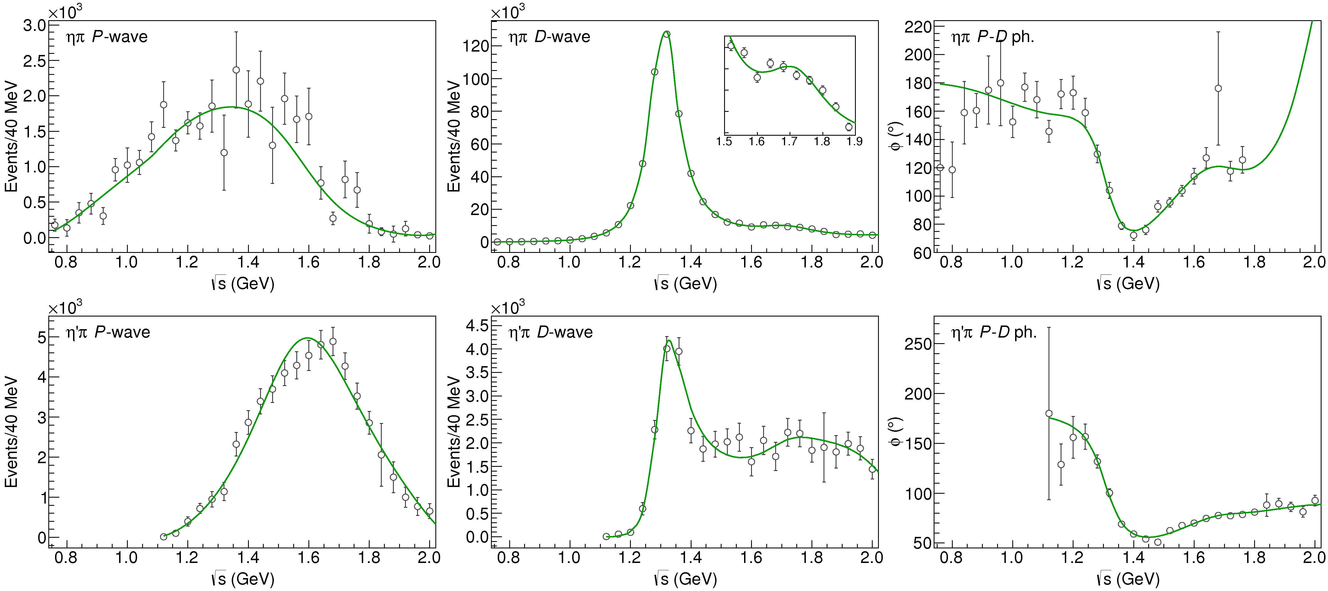
Fit to $η^{(′)}π$
( data)
$$π_{1}\left(1400\right)?$$
$$a_{2}\left(1320\right)$$
$$a_{2}^{′}\left(1700\right)$$
$$π_{1}\left(1600\right)?$$
$$a_{2}\left(1320\right)$$
$$a_{2}^{′}\left(1700\right)$$
$$J^{PC}=1^{−+}$$
$$J^{PC}=2^{++}$$
A. Pilloni – Production of hybrids and exotics
Notes:
Controlla la parte su Regge

Slide 49
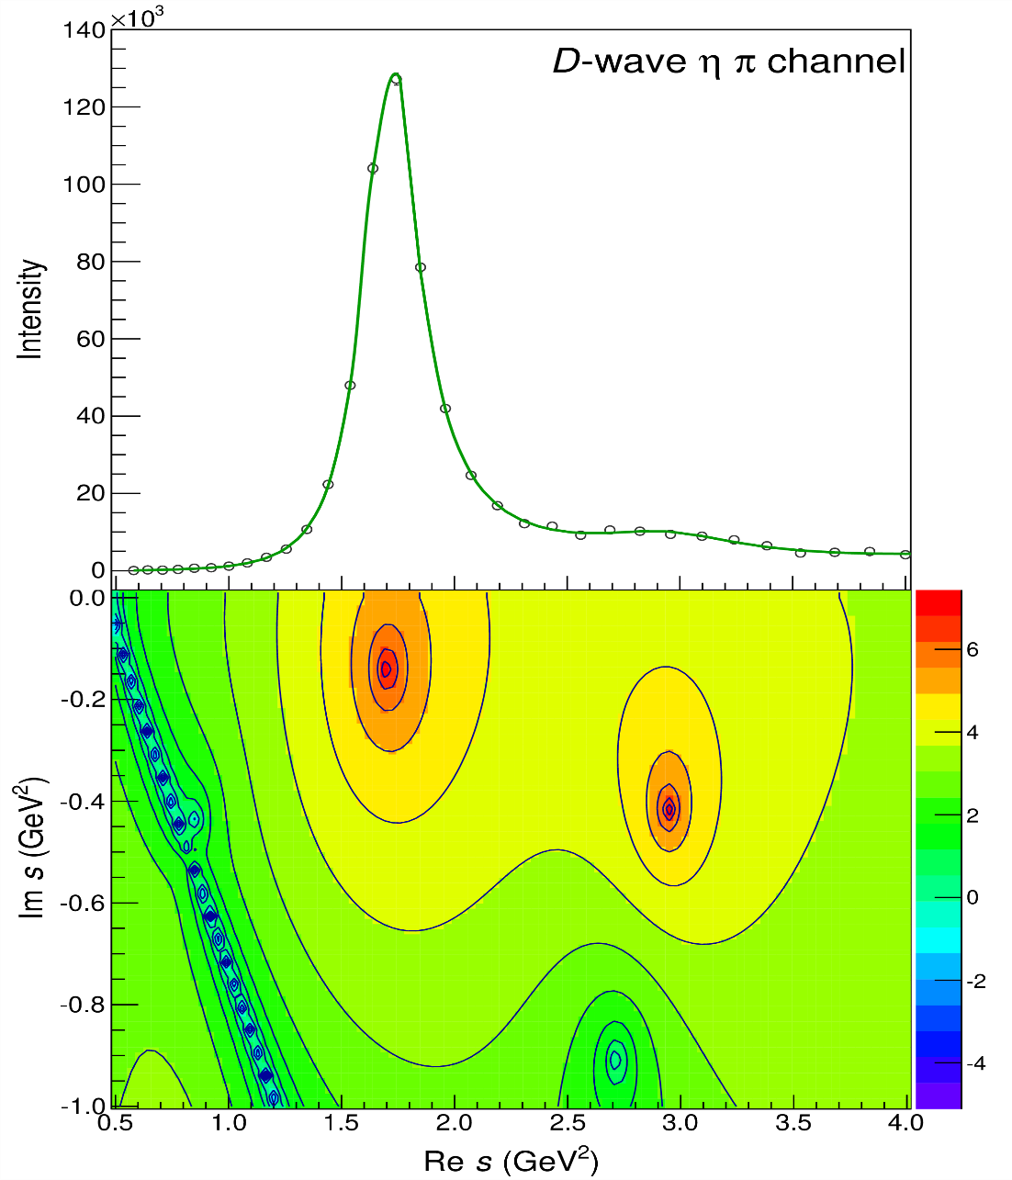
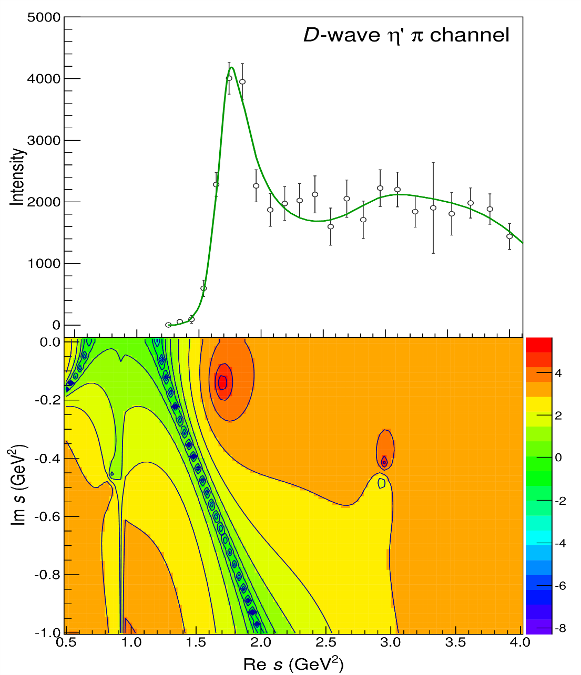
Pole hunting
$$a_{2}^{′}\left(1700\right)$$
$$a_{2}^{′}\left(1700\right)$$
$$a_{2}\left(1320\right)$$
$$a_{2}\left(1320\right)$$
A. Pilloni – Production of hybrids and exotics
Notes:
Controlla la parte su Regge

Slide 50
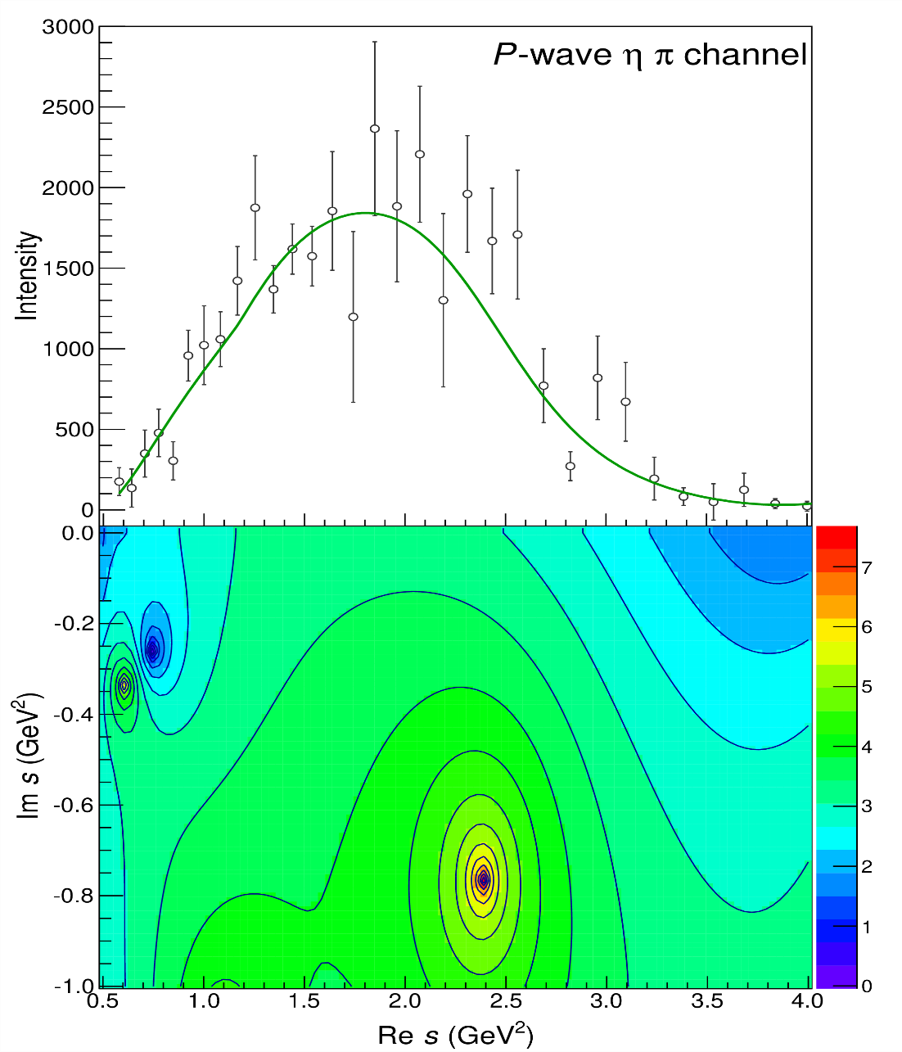
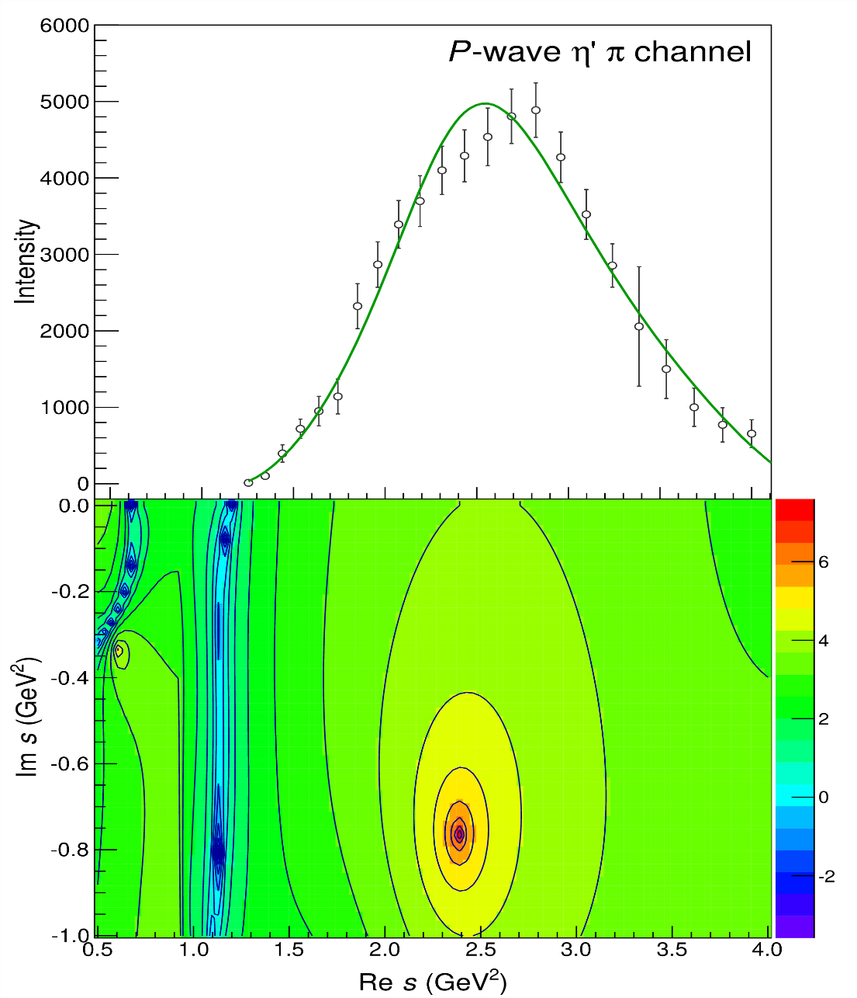
Pole hunting
$$π_{1}$$
$$π_{1}$$
A. Pilloni – Production of hybrids and exotics
Notes:
Controlla la parte su Regge

Slide 51
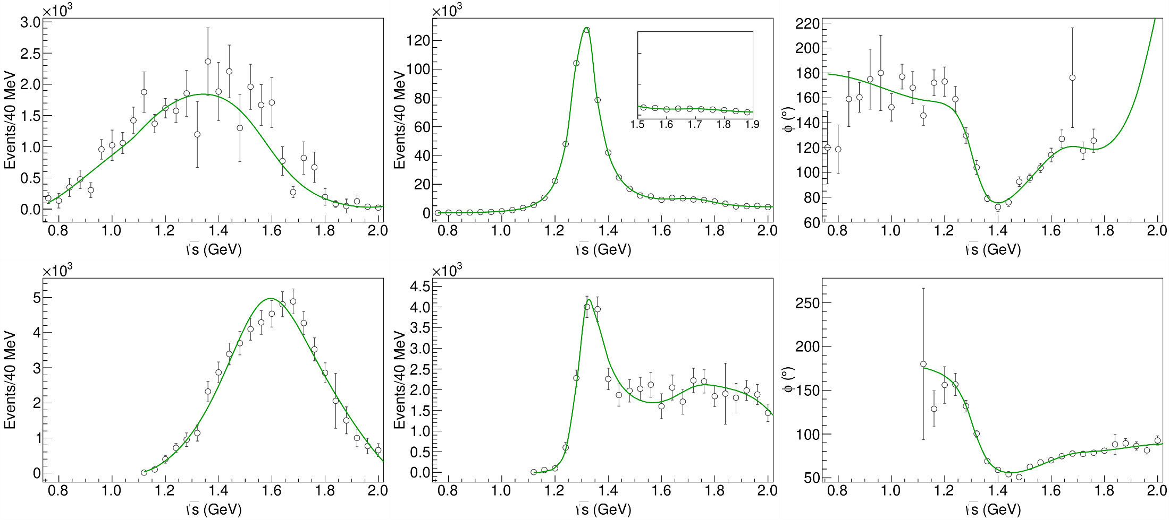
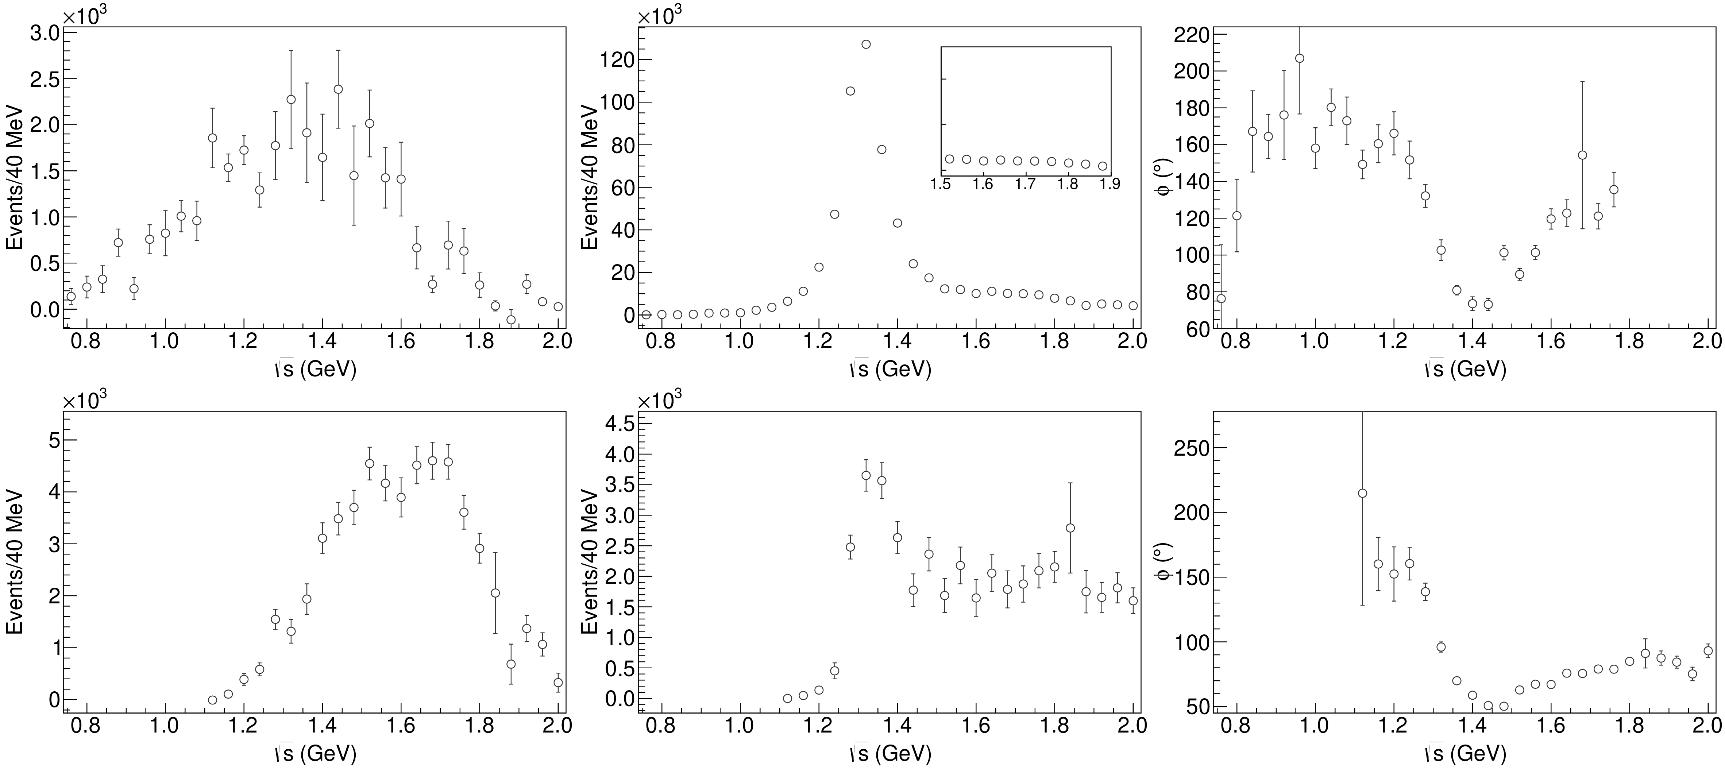
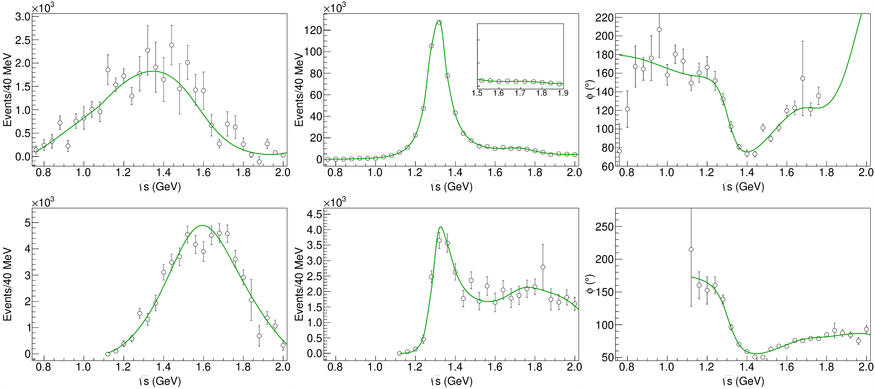
Statistical Bootstrap
A. Pilloni – Production of hybrids and exotics
Notes:
Controlla la parte su Regge

Slide 52
Statistical Bootstrap
For each fit, we search poles: two clusters in D-wave: $a_{2}\left(1320\right)$ and $a_{2}^{′}\left(1700\right)$
A. Pilloni – Production of hybrids and exotics
Notes:
Controlla la parte su Regge

Slide 53
Statistical Bootstrap
Only one stable cluster in $P$-wave: a single $π_{1}$
A. Pilloni – Production of hybrids and exotics
Notes:
Controlla la parte su Regge

Slide 54
Final results
Agreement with Lattice is restored
That’s the most rigorous extraction of an exotic meson available so far!
A. Pilloni – Production of hybrids and exotics
Notes:
Controlla la parte su Regge

