Slide 1
Dark matter in neutron stars
Wasif Husain
The university of Adelaide

Slide 2
Abundance of DM
DM constitutes the approximately 25% of the total matter present in the universe.
DM does not interact with ordinary matter except through gravity
Neutron stars and other compact objects can accrete DM.
In a cold neutron star DM must settle inside it.

Slide 3
DM assumptions
DM has a particle nature.
DM is self-interacting.

Slide 4
Does DM always sit inside the core?
Depends on the nature of the DM.
If DM is fermionic then it cannot condense and might spread all over the neutron star?
If DM is bosonic it must condense in the core.

Slide 5
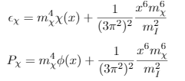
Fermionic DM
Construct a self-interacting fermionic DM Equation of state (EoS) using similar approach to a vector meson exchange in the hadronic matter

Slide 6
Bosonic DM
Below a critical temperature all particle must condensate.
For a dilute gas of bosonic particles at such low temperature, only binary collisions at low energy are relevant, which are characterized by scattering length (la) parameter.
Construct an EoS for self-interacting bosonic DM

Slide 7
Neutron stars
- Astrophysical laboratories
- Physics at extreme conditions
- Select model for ordinary matter at extreme conditions.
- Have some observational constraint.

Slide 8
Selected models for neutron star for ordinary matter
Neutron star contains nucleons only matter (N-QMC700)
Neutron star contains nucleons and hyperons (F-QMC700)
Neutron star contains nucleons and strange matter (Deconfined quark matter)

Slide 9
Constraints
Neutron star must have a maximum mass of at lease 2 solar masses
Radius should be 9-13 kms for neutron stars.
Tidal deformability must follow gravitational wave observational constraint (ꓥ = 400-800) for neutron star of 1.4 solar masses.

Slide 10
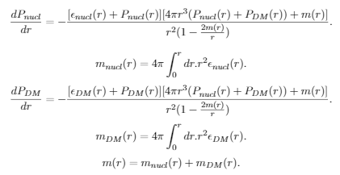
Two fluid structural equation
Construct a TOV equation for two fluids.

Slide 11
Solve
Fermionic DM EoS + ordinary matter EoS + Structural equation
Bosonic DM EoS + ordinary matter EoS + Structural equation

Slide 12
Constraint on DM
Select properties for DM particles.
mx = 1 GeV
la = 1 fm (Bosonic DM)
mI = 100 MeV (Fermionic DM)
Select how much DM mass a neutron star contains.
Does the selected properties of the DM particles follow the constraints on the neutron star?

Slide 13
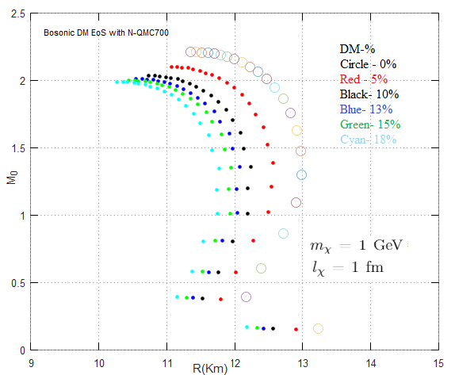
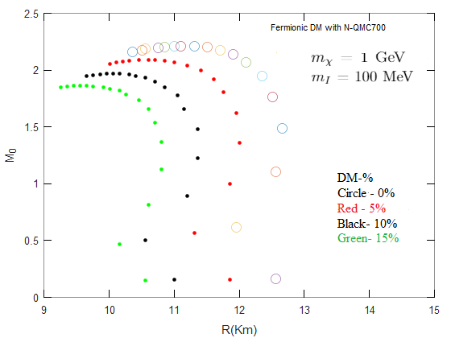
Nucleons only EoS with DM– Mass vs Radius

Slide 14
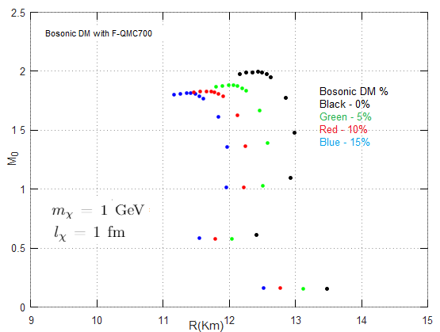
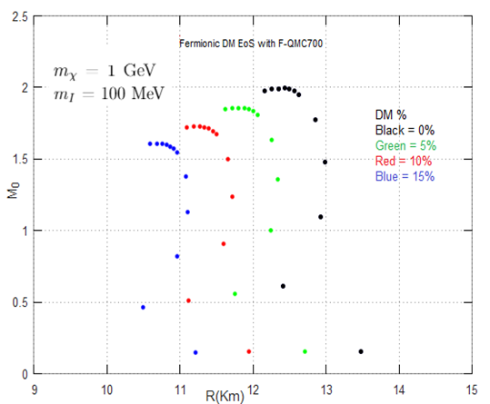
Hyperons included EoS with DM– Mass vs Radius

Slide 15
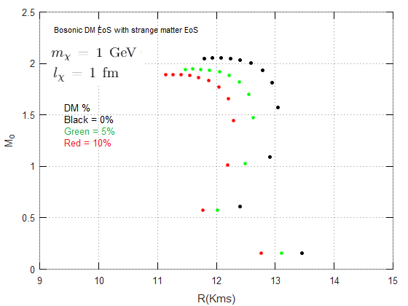
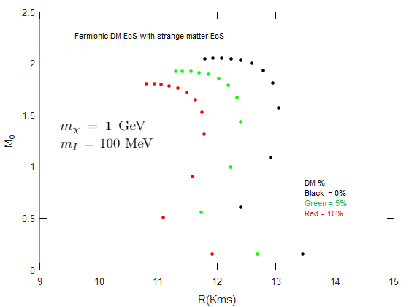
Strange matter EoS with DM– Mass vs Radius

Slide 16
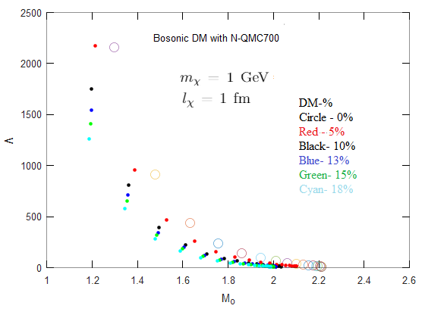
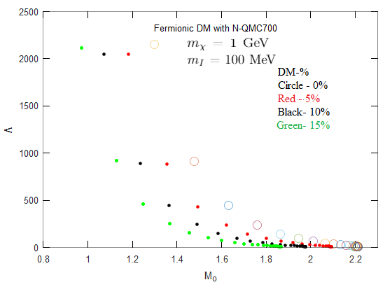
Nucleons only EoS with DM– Mass vs Tidal deformability

Slide 17
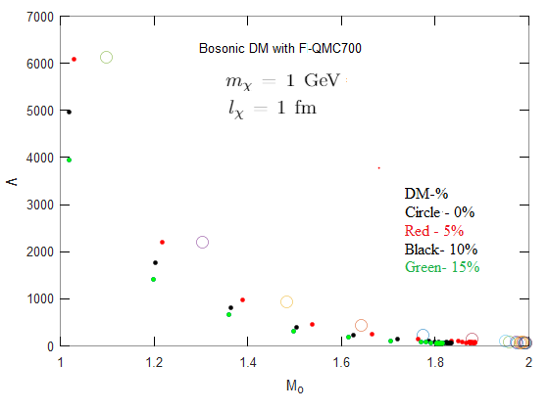
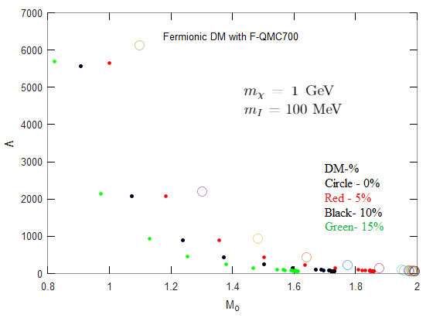
Hyperons included EoS with DM– Mass vs Tidal deformability

Slide 18
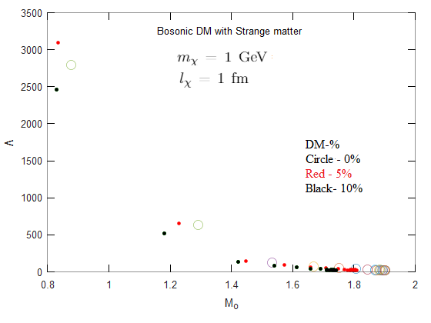
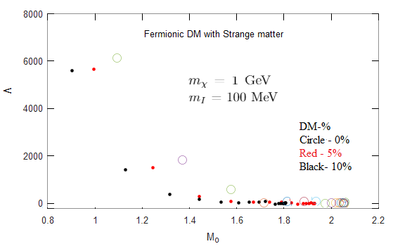
Strange matter EoS with DM– Mass vs Tidal deformability

Slide 19
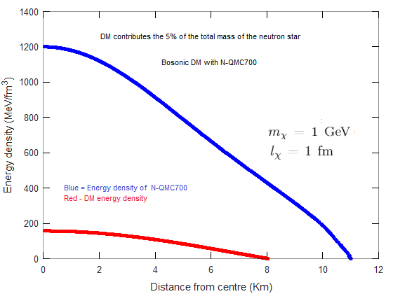
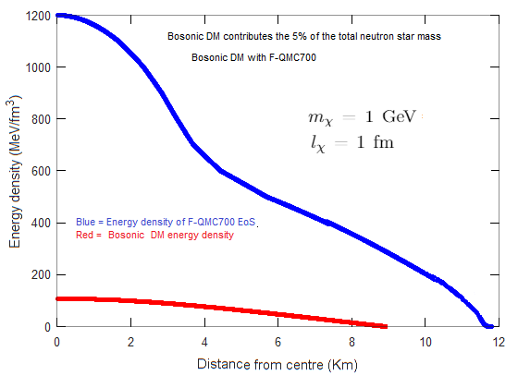
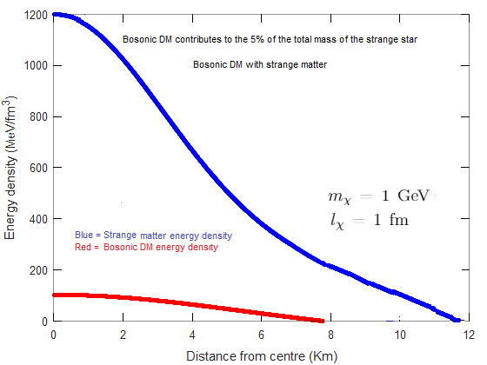
Distribution of DM inside neutron stars
Energy density distribution of bosonic DM when DM contributes to the 5% of the total neutron star mass.

Slide 20
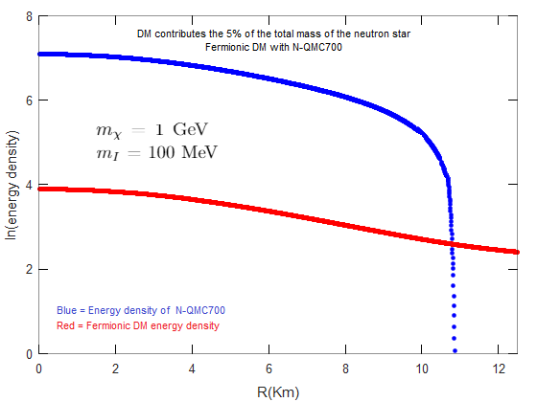
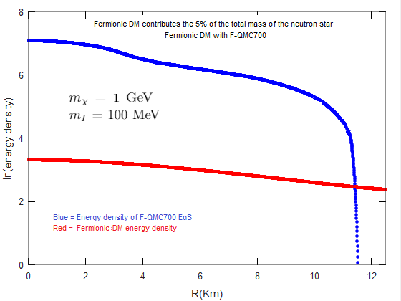
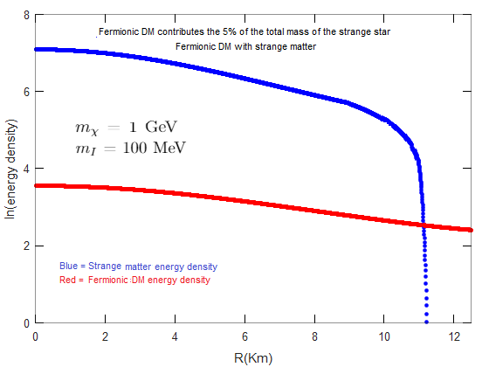
Distribution of DM inside neutron stars
Energy density distribution of bosonic DM when DM contributes to the 5% of the total neutron star mass.
220.3 km 223.47 km 225.9 km

Slide 21
Future work
- It may be interesting to see the gravitational lensing of neutron star: might an insight of DM distribution inside neutron star and we could have a signal regarding the DM nature.
- Make DM mass contribution to neutron star more realistic by constructing a Neutron star DM accretion model, get the age a neutron star and test how much DM it may has accreted.

Slide 22
Thank You
Any Questions?

