Slide 1
나노응용물리연구실 소개
(NAPL)
2020. 11. 18
발표자 : 정진주
지도교수 : 김 도 형

Slide 2
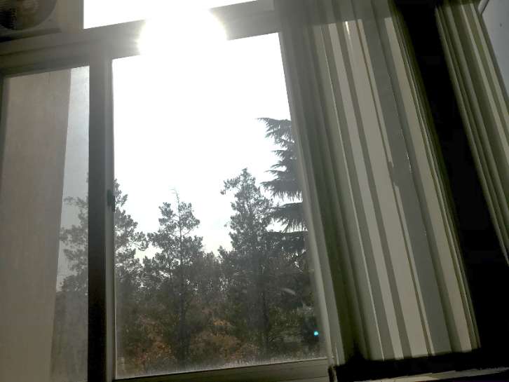
학위 연구주제
The flexible all-solid-state electrochromic devices using core-shell nanowire networks for smart window applications.
Exploring individual and collective electrochromic dynamics and degradation behaviors of nanostructured metal oxides for smart window applications
Model for charging dynamics of nanoporous electrodes for electrochromic devices and supercapacitors
Energy Saving
- Optimal heating/cooling
NIR
Visible
Energy Harvesting
- Electricity
Energy Storage
- Supercapacitor
Demonstration of EC devices for
smart window applications (NAPL)
Nanotechnology and nanomaterials for Bio- and dental applications

Slide 3
연구실에서 내가 해야 하는 일
• Synthesis
: 1D, 2D, 3D
• Tuning the properties
: doping, surface
& morphologies control
• Characterization
:SEM, TEM, XRD,
Raman, XPS, PL, etc
• Device fabrication technologies
for flexible and all-solid-state
devices
: Deposition, printing
: Interface modification
: CV, EC, IV measurements
Device
Fabrication
Nanomaterials
In-situ
measurements
Simulation
Mechanism
• Circuit modeling
• Slow charging and
coloration mechanism
• Degradation and
Enhancement mechanism
• Scale laws
• Individual nanomaterials
characrterization
• In-situ measurement methods
: design, fabrication, upgrade

