Slide 1
RADIATION DETECTOR R&D, HIGH ENERGY PHYSICS LAB
김홍주 교수님 연구실
석사과정 박세동

Slide 2
Index
1. Development of Crystal Scintillator
2. ISS-CREAM
3. AMoRE
4. COSINE
5. KAPAE
6. Radio-Photoluminescence

Slide 3
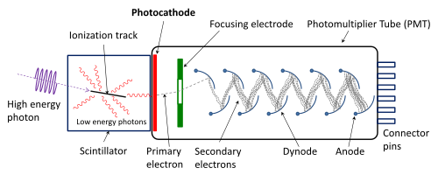
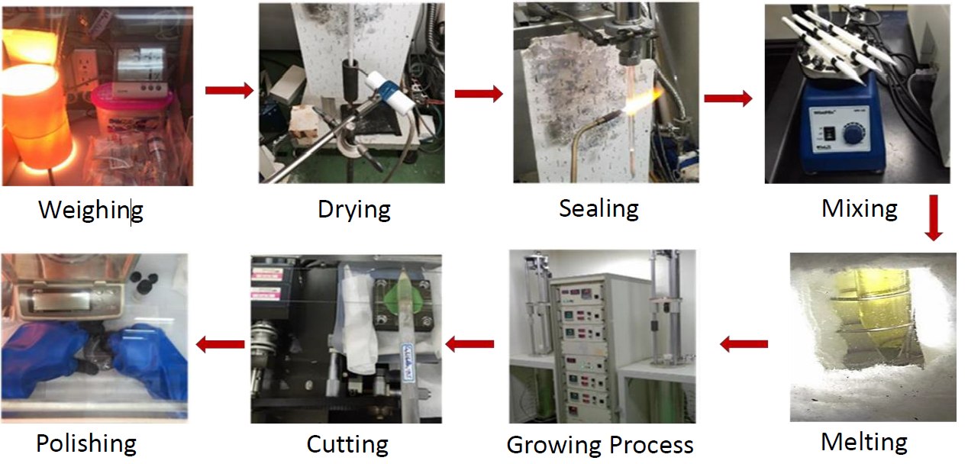
1. Development of Crystal Scintillator
• Scintillator
• Crystal Growing
A scintillator is a material that exhibits scintillation, the property of luminescence, when excited by ionizing radiation. Luminescent materials, when struck by an incoming particle, absorb its energy and scintillate.

Slide 4
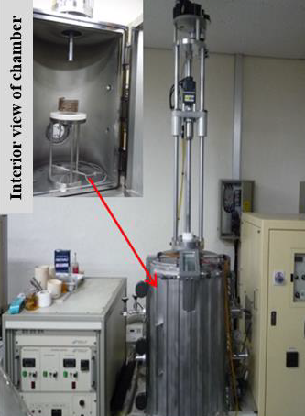
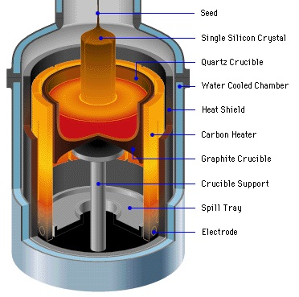
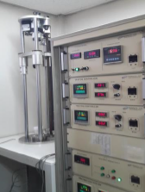
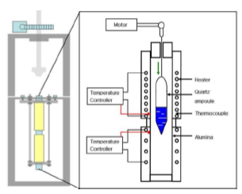
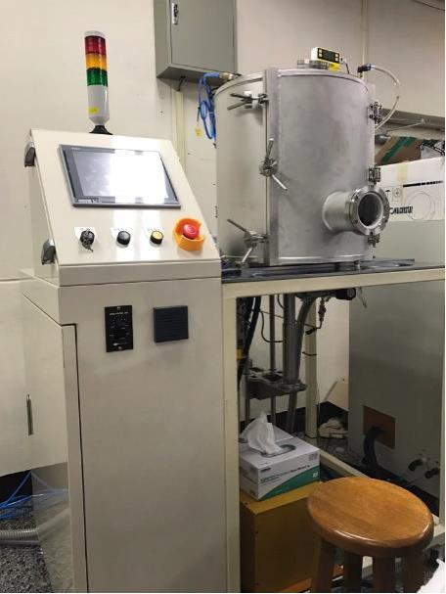
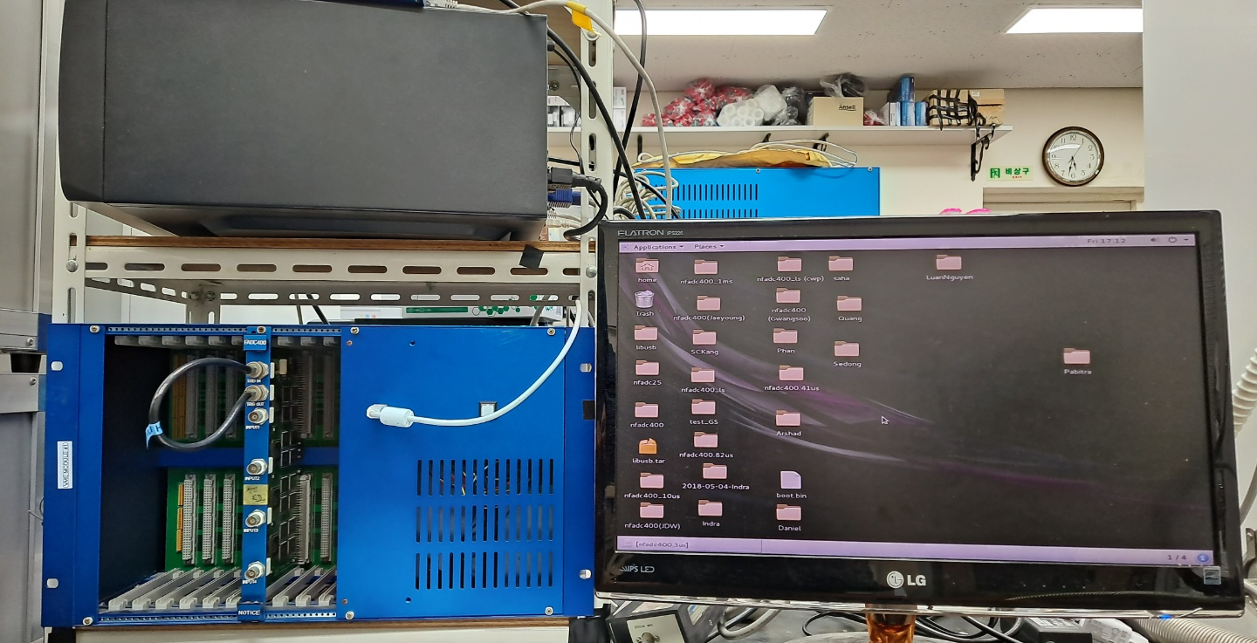
1. Development of Crystal Scintillator
• Czochralski Technique
• Bridgman Technique
• MPD Technique
• Crystal Property Characterization
- Energy spectrum & Decay time
- Relative light yield
- X-ray luminescence
- Thermoluminescence

Slide 5
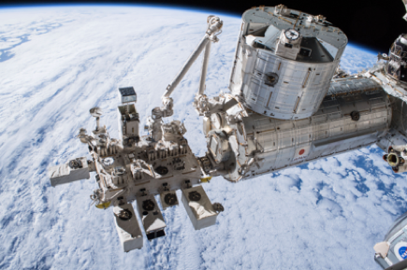
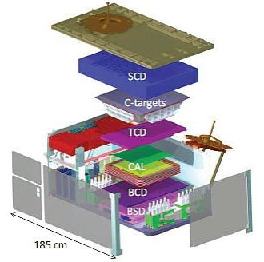
2. ISS-CREAM
ISS-CREAM Collaboration list
ISS-CREAM (Cosmic Ray Energetic And Mass on the International Space Station)
- Five institutes are participated in this collaboration led by University of Maryland
in the United States.
- The ISS-CREAM instrument is designed to investigate the origin, acceleration
and propagation of high energy cosmic rays up to 1000 TeV.
• Structure of the TCD/BCD
- TCD/BCD consist of plastic scintillator coupled with 2-dimensional
photodiode arrays.
Top/Bottom Counting Detector (TCD/BCD)
Structure of ISS-CREAM Instrument
The process of making a Top/Bottom Counting Detector.

Slide 6
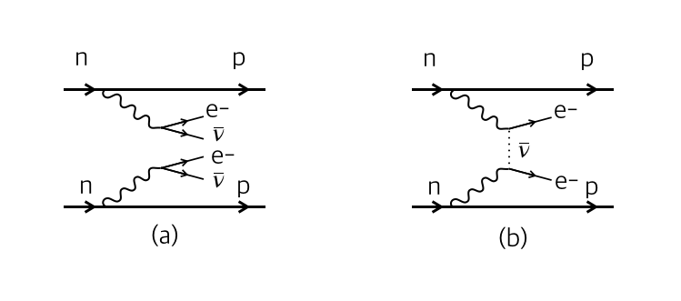
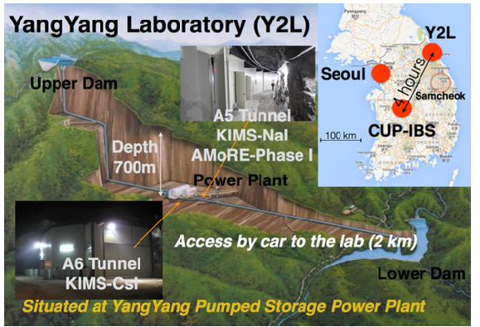
3. AMoRE
• AMoRE (Advanced Mo-based Rare process Experiment) is an international project to search for 0𝝂𝝱𝝱 from 100Mo (Qββ = 3.034MeV) in CMO (CaMoO4) crystals.
• This project uses the Metallic Magnetic Calorimeters (MMCs) for high level sensitivity.
• The AMoRE will operating at underground laboratory and having the many shield for zerobackground level.
Feynman diagram of 2𝝂𝝱𝝱 & 0𝝂𝝱𝝱
0𝝂𝝱𝝱 is very rare process. So 0𝝂𝝱𝝱 experiments need to very low background state, and high level sensitivity.
AMoRE-Pilot
CaMoO4 Crystals : 1.5 kg
Background level :
10-2 counts/keV/kg/year
AMoRE Phase I
CaMoO4 Crystals : 10 kg
Background level :
10-3 counts/keV/kg/year
AMoRE Phase I I
CaMoO4 Crystals : 200 kg
Background level :
10-4 counts/keV/kg/year

Slide 7
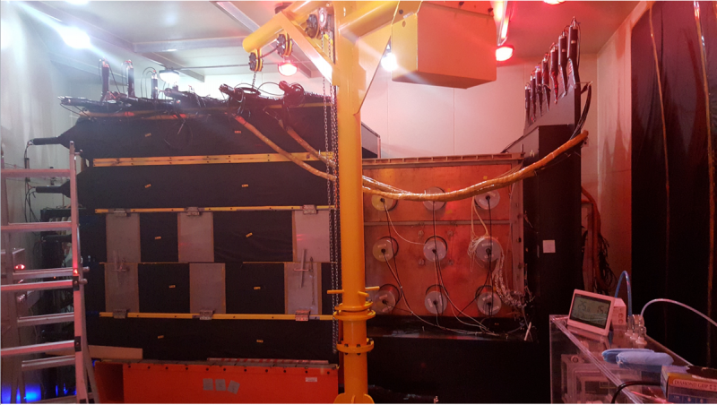
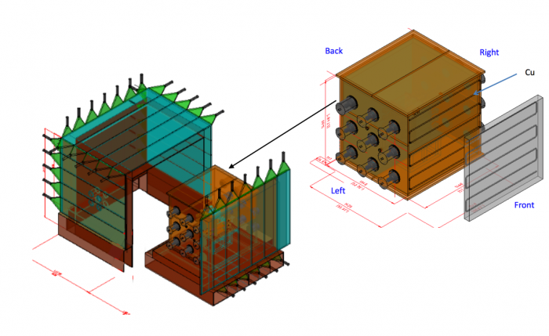
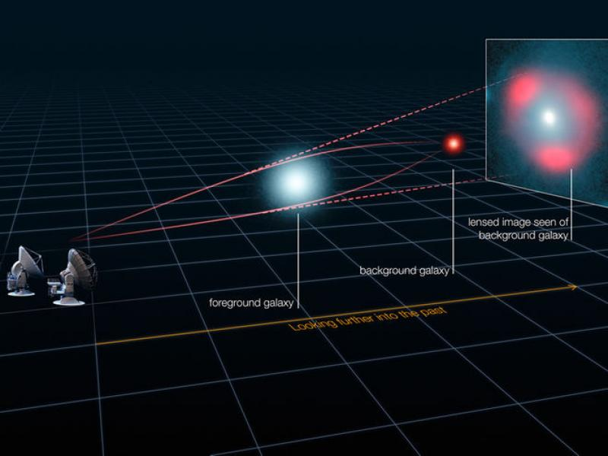
4. COSINE
Dark matter was first proposed by Fritz Zwicky in 1930s to explain the discrepancy between predicted and observed rotation speeds of stars in the galaxy. Observed cluster of galaxies, the Coma cluster, needed at least 400 times the mass he had calculated to hold itself together. Since then, many experiments were performed to search dark matter.
• COSINE-100 is a joint effort between the DM-Ice and KIMS collaborations to search for dark matter interactions in NaI(Tl) scintillating crystals. The experimental site is located at Yangyang underground laboratory (Y2L) with ~700 m of rock overburden.

Slide 8
5. KAPAE
KAPAE (KNU Advanced Positronium Annihilation Experiment) is experiment to research annihilation of positronium composed of electron and anti-electron.
Annihilation of positronium
• Experiment design & concept
- Actual experiments consist of SiPM, ²²Na radiation
isotopes, plastic scintillators, reflectors, aerogels,
BGO scintillator.
- About 200 BGO crystals and 400 SiPMs were used
in this detector.
- Machine learning is applied to analysis data from
this experiment.

Slide 9
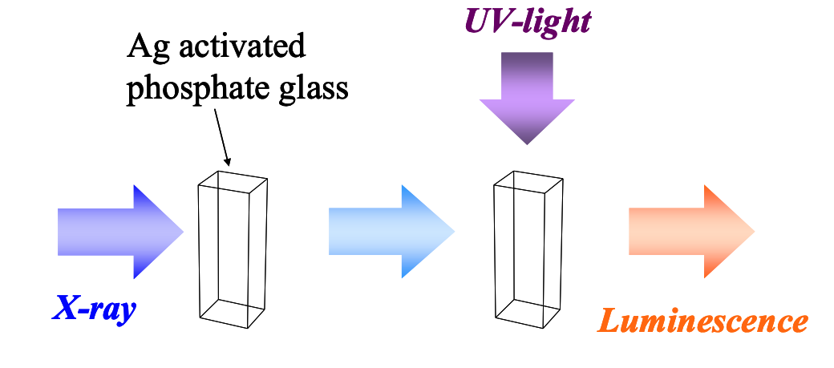
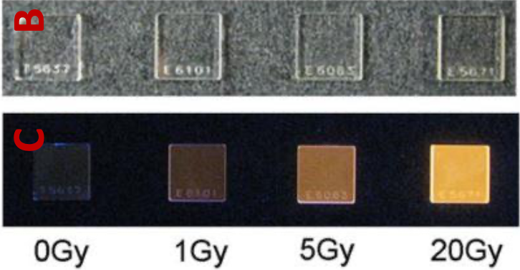
6. Radio- Photoluminescence
Radio-photoluminescence(RPL) is phenomenon that glass irradiated with ionizing radiations emits luminescence when expose to UV light.
Concept of radio-photoluminescence and result of RPL. 2 of right side was irradiated with X-ray and left 1 was irradiated with beta.
Light yield of radio-photoluminescence is proportional to the absorbed dose.
This phenomenon is applied to glass dosimeter which can be a promising tool to be used as personal, environmental, and clinical dosimeters as well.
Glass sample grown in the lab.

Slide 10
Thank You!

